Slide 1
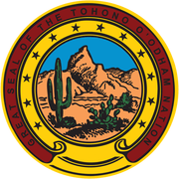
Tohono O’odham Nation
Indian Child Welfare Act

Slide 2
Child Welfare Division
ICWA Program

Slide 3

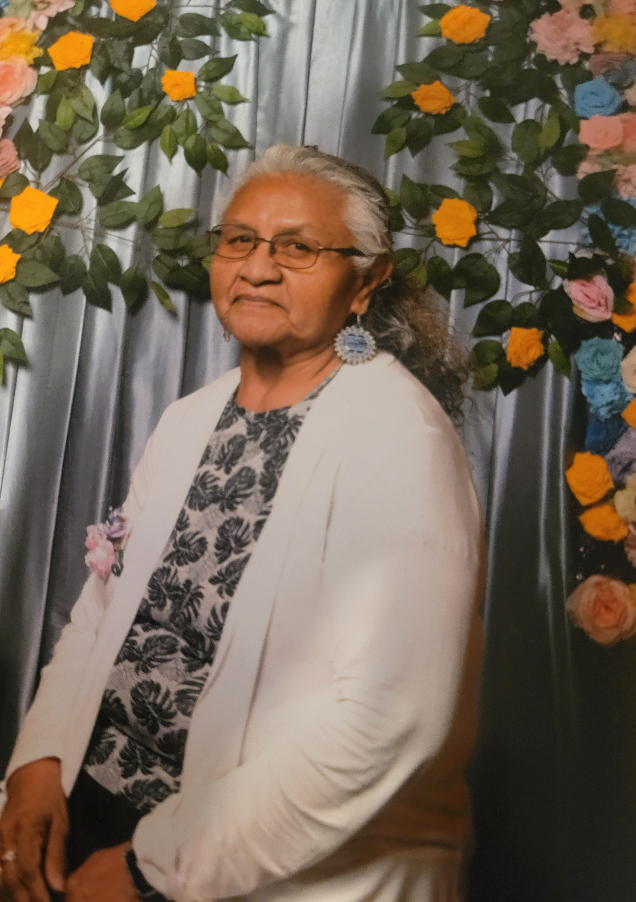
Sylvia Lopez
Child Welfare
Program Manager, Sr.

Slide 4
ICWA Staff Introduction
Please welcome!

Slide 5
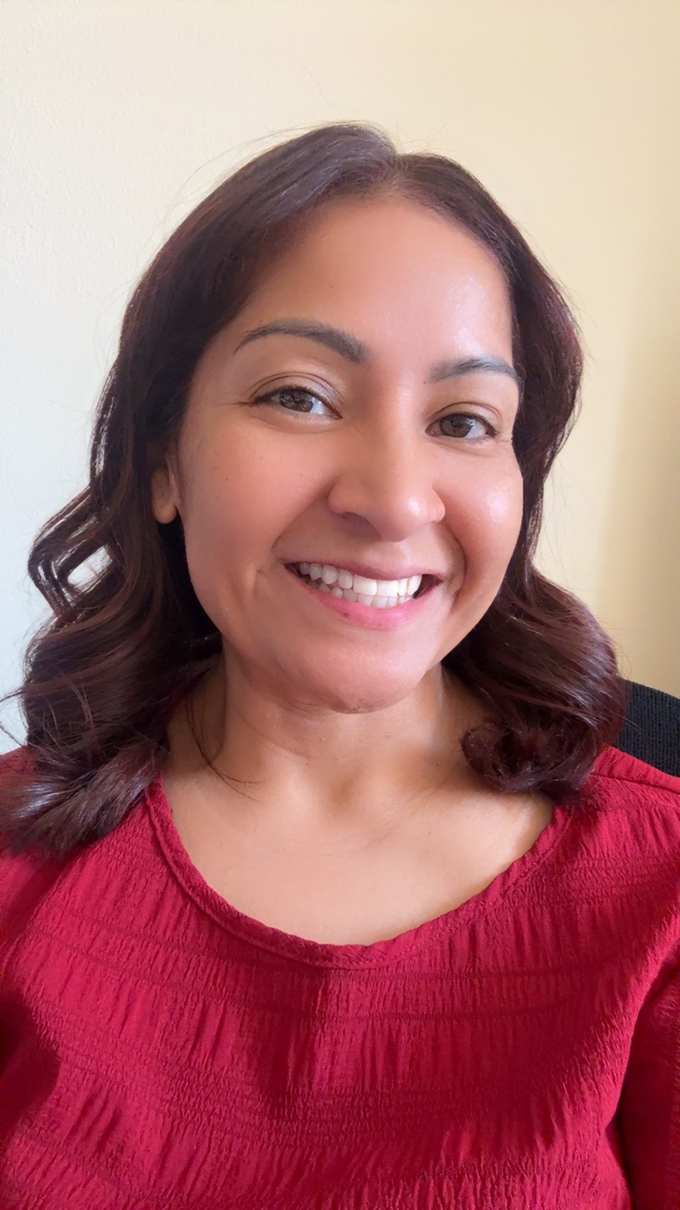
Monica Laborin
ICWA Program Supervisor

Slide 6
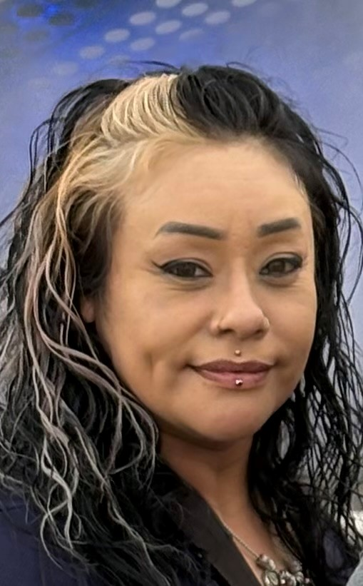
Carmen Soto
ICWA Case Manager
Pima County

Slide 7
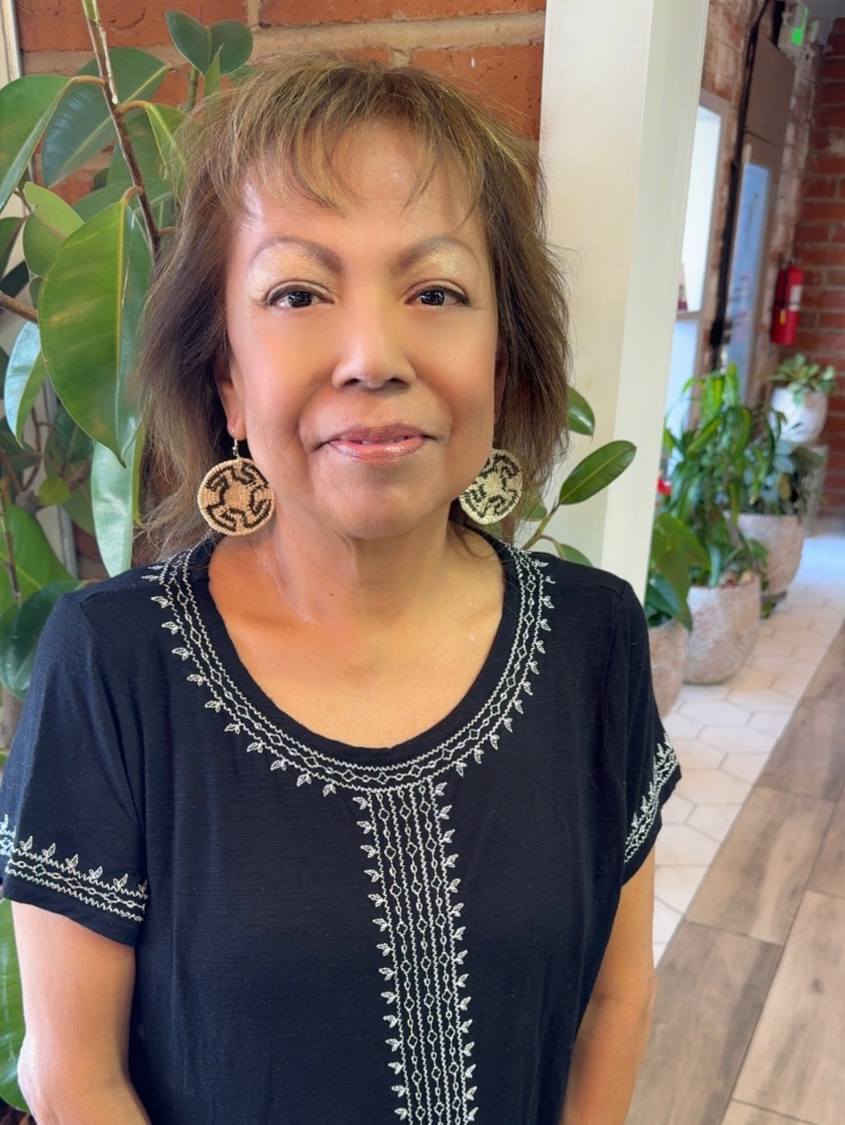
Dorcas Segundo
ICWA Case Manager
Maricopa County

Slide 8
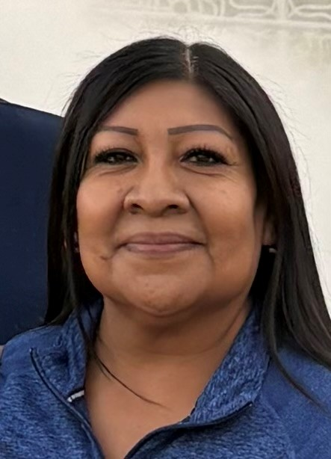
Grace Lopez
ICWA Case manager
Maricopa County

Slide 9
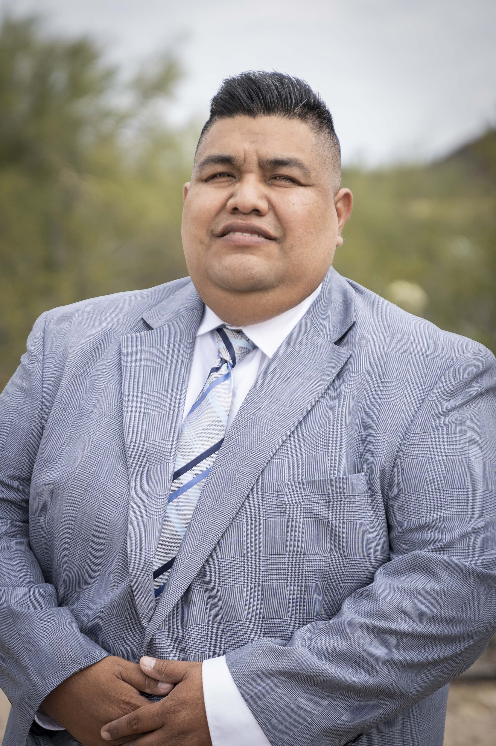
Juan Urbalejo
ICWA Case Manager
Pinal and Maricopa County

Slide 10
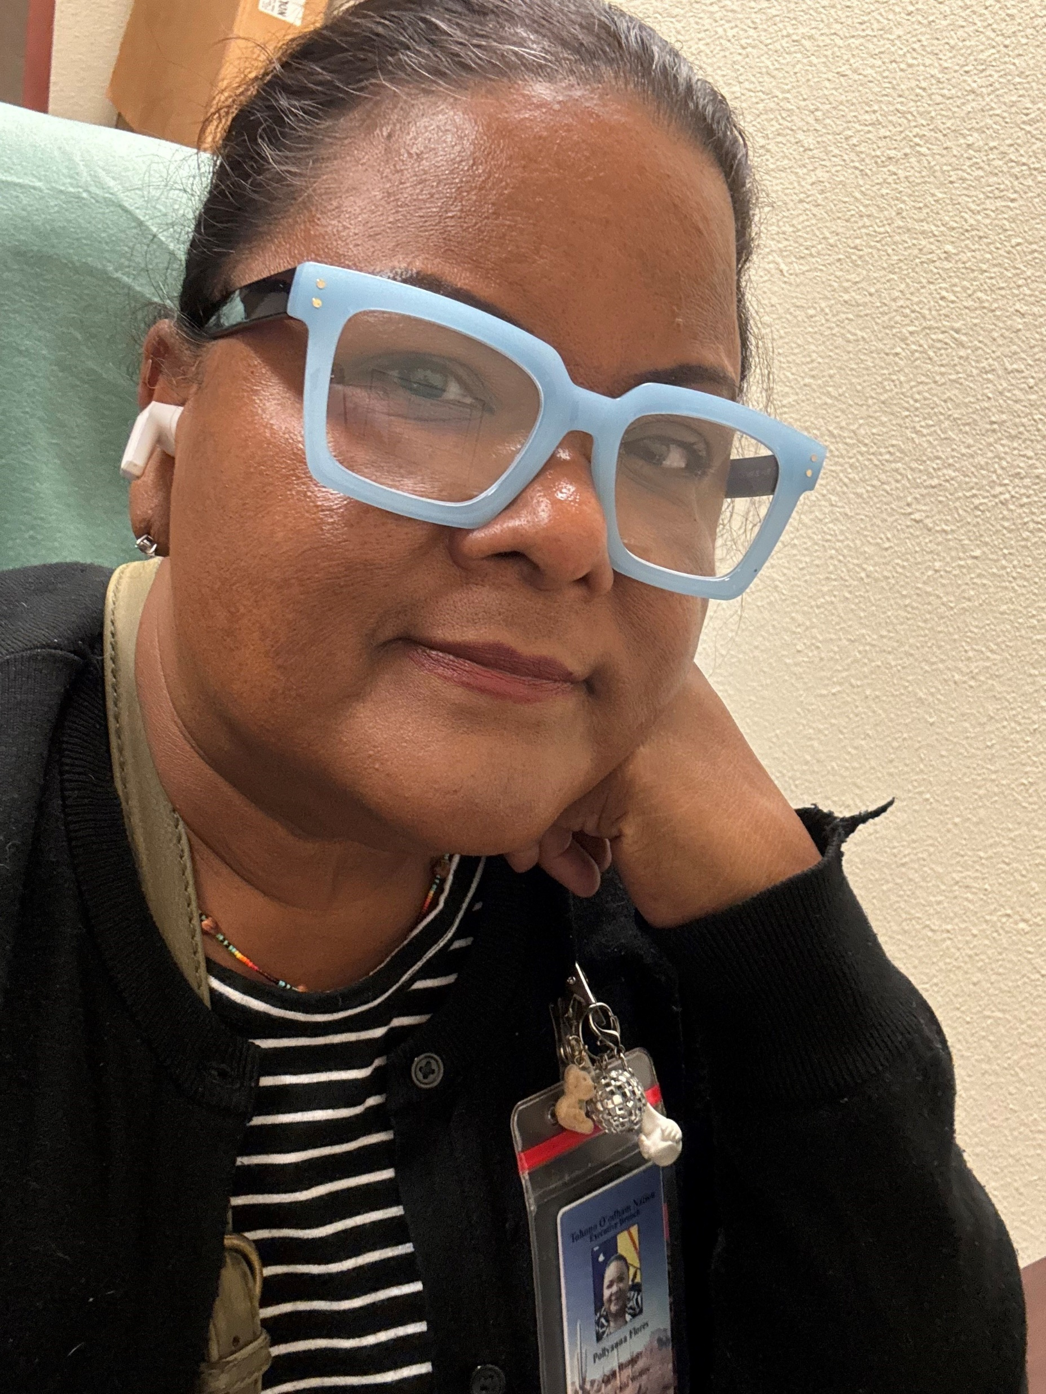
Pollyanna Flores
ICWA Case Manager
Maricopa County

Slide 11
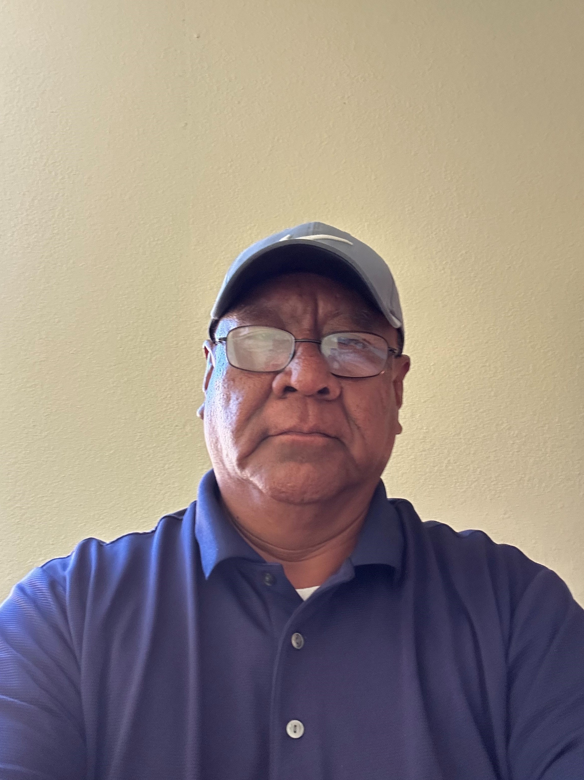
Richard Johnson
ICWA Case Manager
Pima County

Slide 12

Rodrigo Lopez
ICWA Case Manager
Pima County

Slide 13
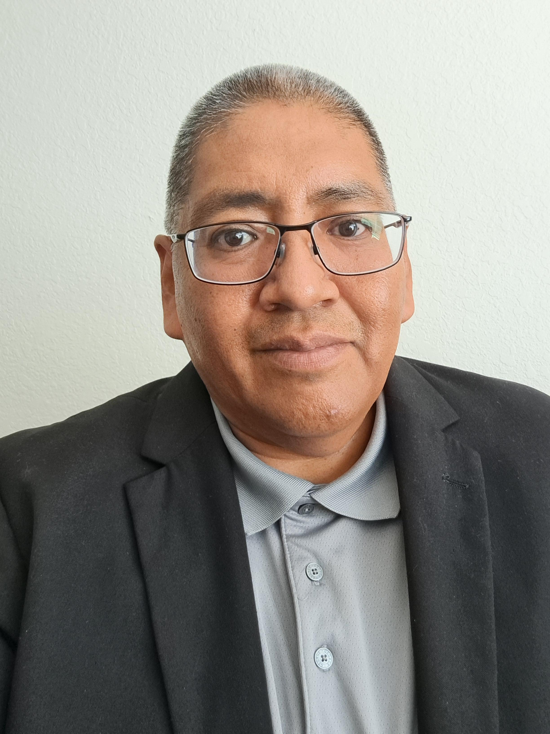
Silas Garcia
ICWA Case Manager
Pima County

Slide 14
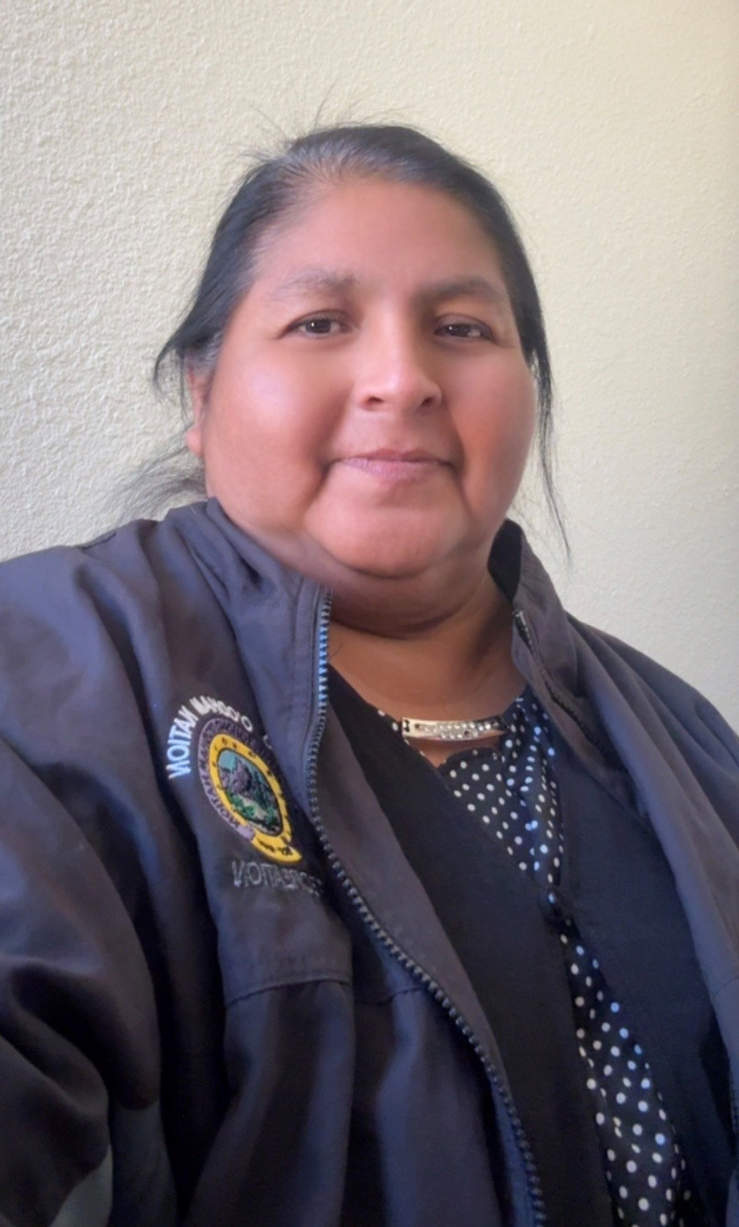
Dayle Jose
ICWA Case Aide

Slide 15
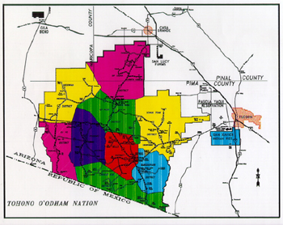
The Tohono O’odham Nation
Historically, the Nation inhabited an enormous area of land in the southwest
The Nation extends to the south of Sonora, Mexico, north, to Central Arizona (just north of Phoenix, Arizona), west to the Gulf of California, and east to the San Pedro River
The land base was known as the Papagueria. It has been the home to the O’odham for thousands of years
The Tohono O’odham Nation is the size of Connecticut

Slide 16
The Nation is broken down into districts
Baboquivari
Chukut Kuk
Gu Achi
Gu Vo
Hickiwan
Pisinemo
San Lucy
San Xavier
Shuk Toak
Sells
Sif Oidak
No District

Slide 17
How many Tohono O’odham Members:
There are approximately 45,000 enrolled members.
This number is increasing due to:
Children being born
Members who are now finding they have ancestral blood
Members are finding family they didn’t know existed because some were sent away to boarding schools and lost the connection with the tribe.
Children who have been adopted or taken from their families and are now finding that they have family on the Nation.
Currently through ICWA we are finding many children who are not enrolled with the Nation for various reasons

Slide 18
Enrollment Process
To be eligible for enrollment…
The Nation goes by descendent not blood quantum
A person interested in enrolling will need the following:
Tohono O’odham Nation’s enrollment application
Birth certificate of person applying
At least one parent of the applicant needs to be enrolled for eligibility
Social security card of person applying
It Takes approximately 4 months for processing and approval

Slide 19
Traditions
Bi:T (Clay Ceremony)
Bahidag fruit/wine ceremony
Toka (played by women)
Gins (gambling game played by men)
Adopted some catholic religion
St. francis feast day
All soul’s day
Rodeo and Fair
Young women and Men Gathering
Story telling (done only in winter months)
Waila dancing/music

Slide 20
The number of families and children under ICWA
In and out of state

Slide 21
Number of cases/children that are currently in care, under ICWA with Tohono O’odham Nation
There are :
  106 in-state Dependency cases
  190 children in-state
There are:
  17 out of state Dependency cases
  25 children out of state
A Total of 123 dependency cases
  215 total children in care

Slide 22
Adoptions and Family
Re-unification
From August 2024 – August 2025
There has been 28 families Re-unified
There has been 26 children adopted by either family or non-relative.

Slide 23
ICWA Case Manager’s Role:
Assist state case workers in developing case plans and tasks.
Help identify cultural and traditional sensitive services that can assist the family.
Ensure the family has resources for transportation to attend services and Court hearings.
Ensure the family has resources for the facilitation for visits.
Monitor case progress
Attend Court and provide expert witness testimony.
Identify ICWA compliant placement options.
Facilitate the transfer of cases to tribal Court when appropriate.
Give our families a voice when they feel they don’t have one.

Slide 24
Tohono O’odham Nation’s Resources
Medical
Dental
Vision
Behavioral health
Education
Housing
Burial Assistance
Family assistance
Family preservation

Slide 25
Questions?

Slide 26
THANK YOU!
Tohono O’odham Nations ICWA Program

