Slide 1

Vis pwezidan rejyonal

Slide 2
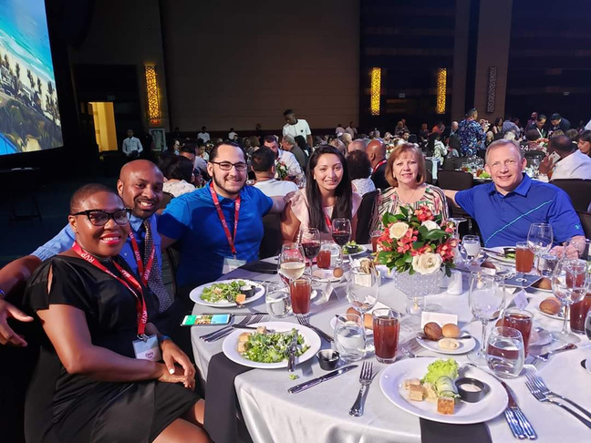
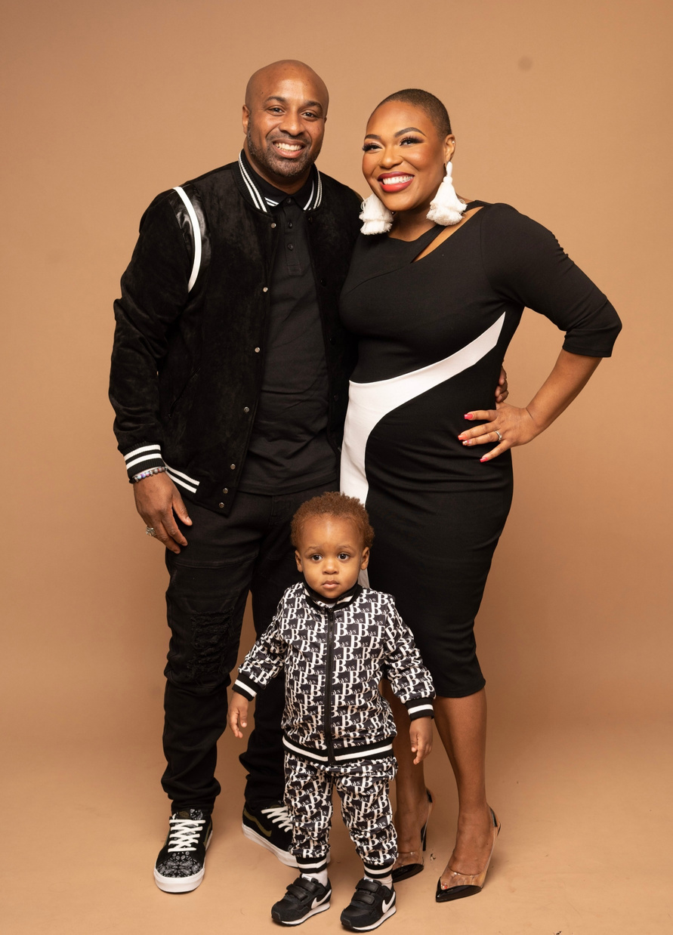



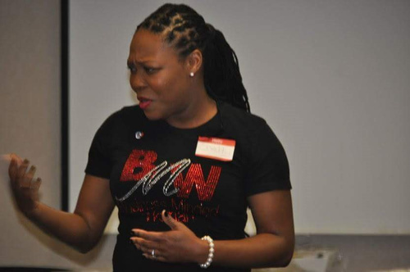

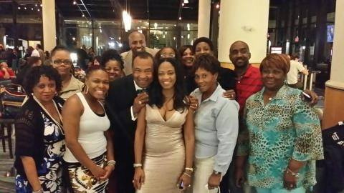
DE WALMART À WALLSTREET

Slide 3





Enfants, pour la plupart d’entre nous, l’argent était toujours une « conversation d’adulte ». On nous a tous appris...
1. Faites du bon à l’école.
2. Aller à l’université.
3. Prends un Bon travail.
4. Se marier.
5. Acheter une maison.
Qu’est-ce que ces étapes nous ont appris sur l’argent ?
3
Notes:
3

Slide 4

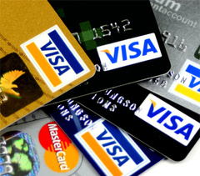



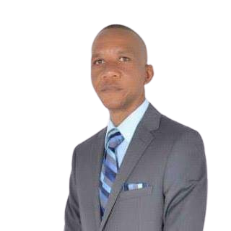

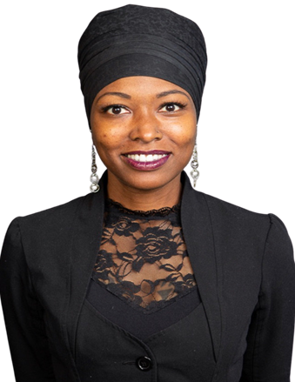
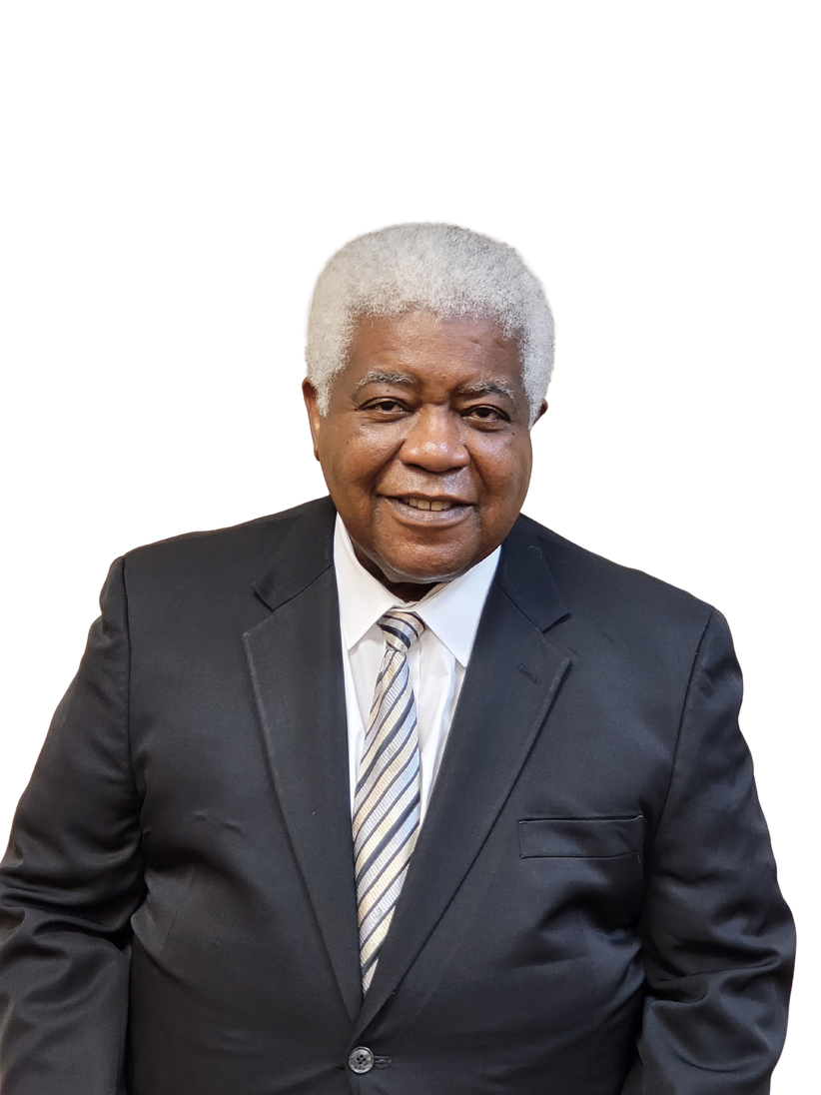

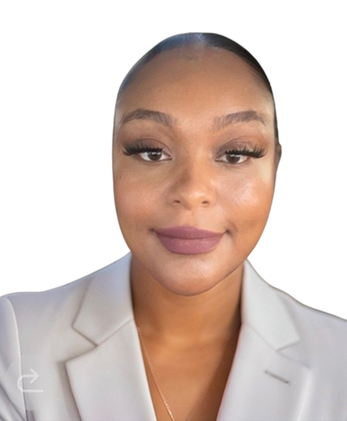
The Challenge…… 95%
Don’t Have A Financial Education.
Don’t Have A Financial Game Plan.
Don’t Have A Financial Coach.
Our Mission is to help the 95%
Anissa D.
Noah F.
Calisha W.
Jean E.
James H.
Jesse S.
Andrea S.
This Photo by Unknown Author is licensed under CC BY-SA
Notes:
1.7.2013
4
‹#›

Slide 5
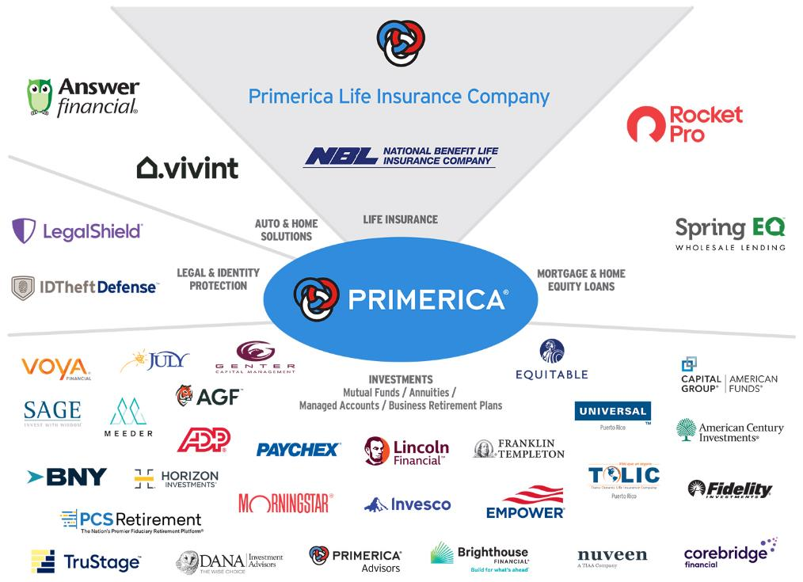
PASSION & ACCÈS
PASSION & ACCESS!!
Franchise Companies
McDonalds & Chic-Fil-a
Distribution Companies
Walmart & Amazon
Not all products and services are available in all states, territories, or the District of Columbia. A representative’s ability to offer products from the companies listed is subject to state and federal licensing and certification requirements. Please refer to the Important Endnotes for additional details about the contractual arrangements and company affiliations detailed above.

Slide 6









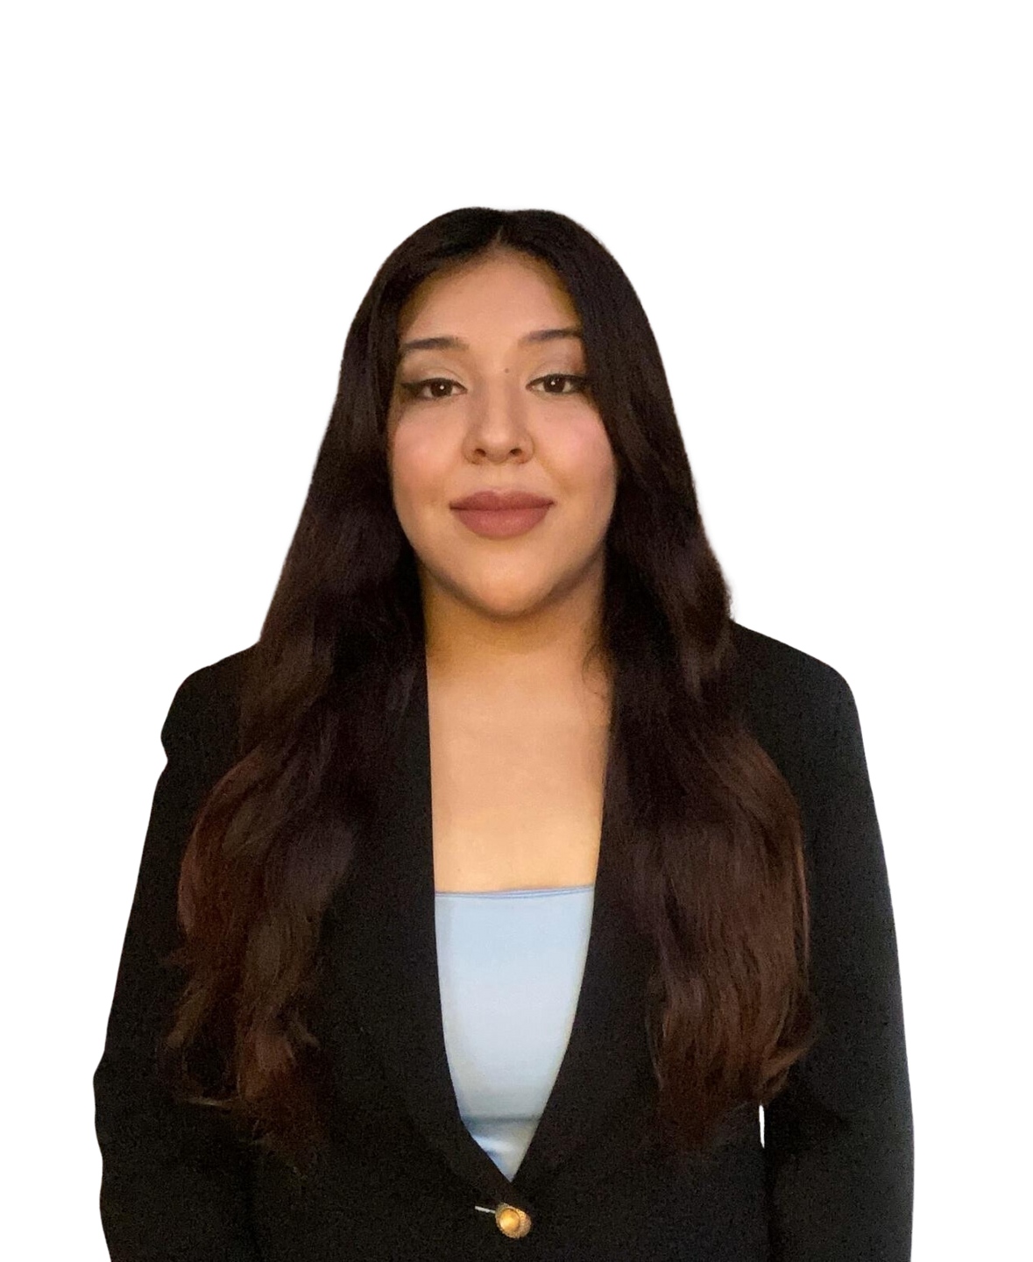

Nou edike sou 5 konsèp senp
Konnen F.I.N &a p.I.N ou Diminye responsablite Règ 72 Pwoteksyon revni Plizyè sous dlo revni
1. From Fortune. © 2023 Fortune Media IP Limited All rights reserved. Used under license. Fortune 1000® is a registered trademark of Fortune Media IP Limited and is used under license. Fortune and Fortune Media IP Limited are not affiliated with, and do not endorse products or services of, Primerica, Inc, as of June 6, 2023. 2. Dalbar.com, 2023 Service Award History, January 10, 2024. 3. The following Primerica life insurance companies have been rated A+ (Superior) by AM Best, as of November 15, 2023: Primerica Life Insurance Company, Primerica Life Insurance Company of Canada, and National Benefit Life Insurance Company. AM Best ratings range in order from the highest ratings as follows: A++, A+, A, A-, B++, B+, B, B-, C++, C+, C, C-, D, E, F. For the latest Best’s Credit Rating, access www.ambest.com. 4. From Bloomberg Finance L.P, "2023 Bloomberg Gender–Equality Index," January 31, 2023. The 2023 Bloomberg Gender-Equality Index logo mark is associated with the Bloomberg Gender Equality data for the 2021 fiscal year. 5. Survey results are presented solely with respect to Primerica’s U.S. term life insurance business. Forbes.com, “Forbes 2022 America’s Best Insurance Companies,” October 25, 2023. 6. Forbes.com, “Forbes 2022 The Best Employers for Diversity,” April 25, 2023. 7. Forbes.com, “Forbes 2023 The Best Employers for Women,” July 18, 2023. 8. Survey results are presented solely with respect to Primerica’s U.S. term life insurance business. Term life insurance underwritten by National Benefit Life Insurance Company, Home Office: Long Island City, NY in New York State; Primerica Life Insurance Company, Executive Offices: Duluth, GA in all other U.S. jurisdictions; and Primerica Life Insurance Company of Canada (Head Office: 6985 Financial Drive, Suite 400, Mississauga, ON, L5N 0G3, Phone: 905-812-2900) in Canada. From Investor’s Business Daily, “#1 Most Trusted Life Insurance Company and #3 Most Trusted Financial Company in 2022,” as of September 29, 2023.

Slide 7

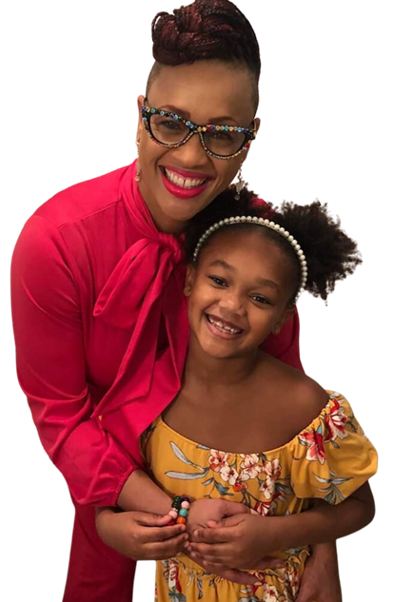

de nimewo ENPÒTAN
F.I.N
NIMEWO ENDEPANDANS FINANSYE
P.I.N
NIMEWO REVNI PWOTEKSYON
KONBYEN LAJAN OU BEZWEN KENBE FÒM OU POU OU PA BEZWEN TRAVAY?
KONBYEN ASIRANS LAVI OU BEZWEN KENBE FÒM FANMI OU LÈ W ALE?
Èske ou gen ase asirans pèsonèlman (deyò nan travay ou) pou peye..... DÈT/LANMÒ REVNI IPOTÈK EDIKASYON
PA KOURI SOTI NAN LAJAN!!!

Slide 8
Teyori responsablite diminye
Gen de garanti nan LAVI ....Nou bezwen $ $ $ $ 1$ pou Tou de
P.I.N
LAGONI TWÒ BONÈ
VIV Twò LONTAN
F.I.N
Today
Jenn timoun/Depandan dèt segondè Peman ipotèk Pèt revni ta dwe devaste
At Retirement
Grandi timoun yo Dèt anba Ipotèk Peye Retrèt ki nesesè
Ki konpayi ou konnen nan asirans lavi ofri, men tou, anseye moun yo ki jan yo elimine nesesite pou asirans lavi?

Slide 9
Règ 72
Règ 72 se yon lòt prensip enpòtan ki dwe konprann sou majik enterè konpoze a. Kalkil senp sa a (72÷ to enterè a) ba ou kantite ane apwoksimatif nan ane pou double ekonomi ou (72÷3 = 24 an / 72÷6 = 12 ane / 72÷12 = 6 ane).
72 ÷ 3 % 24 ane fin vye granmoun
72 ÷ 6 % 12 ane
72 ÷ 12 % 6 ane
Le tableau sert à illustrer le fonctionnement du concept de la Règle de 72 d’un point de vue mathématique. Il n’a pas pour objet de représenter un placement en particulier. Le tableau se fonde sur
des taux de rendement constants, contrairement aux placements réels, dont la valeur fluctue. Il ne tient pas compte des frais et des impôts qui entraîneraient une diminution du rendement. Il est
peu probable qu’un placement croisse d’au moins 10 % sur une base régulière.
Notes:
The Rule of 72
Objective: To show the effect that compound interest has over time at three different rates of returns
Points to Cover:
“The Rule of 72 shows that, the higher the rate of return, the faster you can grow your savings. It would take you 24 years to double your savings if it only grows at a 3% annual rate of return. Could you wait that long?”
“It would take you 12 years to double your money at a 6% annual rate of return. But it would only take 6 years to double your savings if you can achieve a 12% rate of return.”
“Now, let’s apply some dollar amounts to this principle so you can see how savings could grow over time.”
Go to next slide.

Slide 10



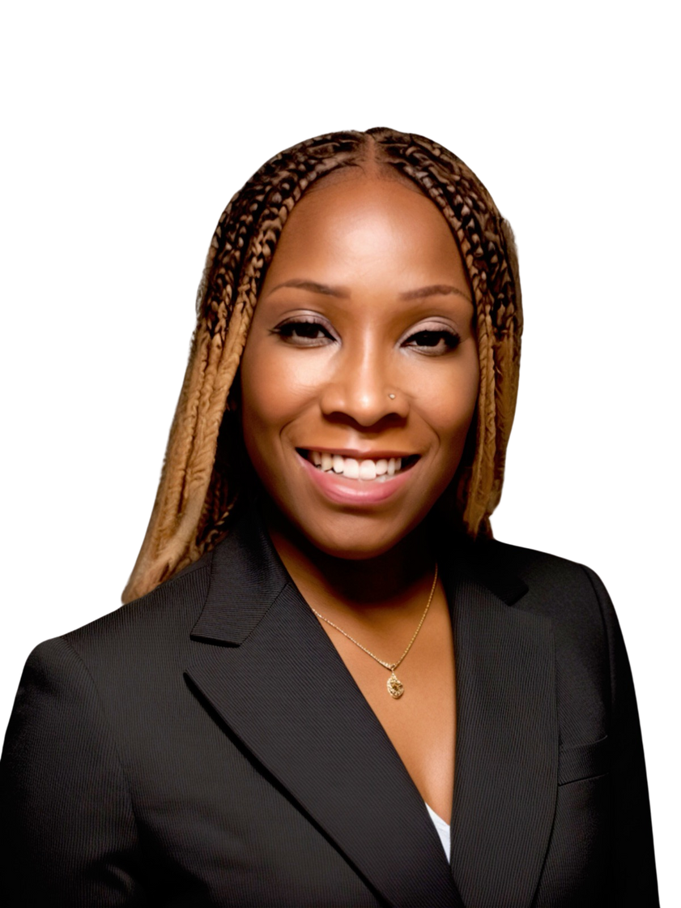


KONSÈP BANKÈ KOMIN
KI PLAN RICHÈS FÈ PLIS SANS?
ASIRANS LAVI INIVÈSÈL (IUL)
ASIRANS LAVI TÈM
0 BALANS (pou premye 1-3yrs yo nan kont yo te louvri)
2. 1% A 4% enterè touche apre sa
3. CHAJE OU 5% A 10% (prete pwòp lajan ou)
4. 6 MWA (konpayi ka kenbe lajan ou)
5. KENBE LAJAN OU (pa pral ale nan fanmi oswa benefisyè)
Kòmanse nan Laj 35
$250,000 Montan fas a fas
$250,000 Montan fas a fas
$250,000 Montan fas a fas
$250,000 Montan fas a fas
Achte Tèm Asirans
$251 yon mwa
$88 yon mwa
Envesti $163 ekonoloji nan yon Wout IRA
Same $251
Chris
Sarah
Chris
Sarah
_
X____________________
Valè lajan kach nan 65 = $ 127,051
Roth IRA %9 retounen nan 65 = $ 300,649
SIYEN LA A
Figi Montan
Valè lajan kach /Ekonoloji
Figi Montan
Envesti nan Wout IRA
swa oswa ou pa tou de
Zak separe
Èske ou ta siyen kontra sa a?
Prete $ (6 mwa kenbe)
Retire $ (7 jou)
Lajan kach nan Règleman lajan kach
Montan lajan peye
A
or
B
Notes:
13

Slide 11







“Ne te limite jamais ! » « Ça semble toujours impossible tant que ce n’est pas fait. » -Nelson Mandela
« Le pouvoir de s’aider soi-même et d’aider les autres est une grande récompense ! » C’est la différence entre succès et importance ! » – Coach Chelly

Slide 12




Ede 1 Fanmi
Sesyon Avg se 30 èdtan min
Solisyon
Pwoteksyon lavi
Asirans oto
Lakay
PLPP
ID vòt defans
Vivint
Investments (100k)
Total
Repwezantan ajan
$180
$100
$95
$50
$39
$200
$1,725
Distri
$360
$105
$99
$80
$62
$200
$2,012
Vis pwezidan rejyonal
$798
$135
$112.50
$125
$98
$300
$3,565
Ou prale reponn apèl la ?
$2,389
$2,918
$5,133.50

Slide 13


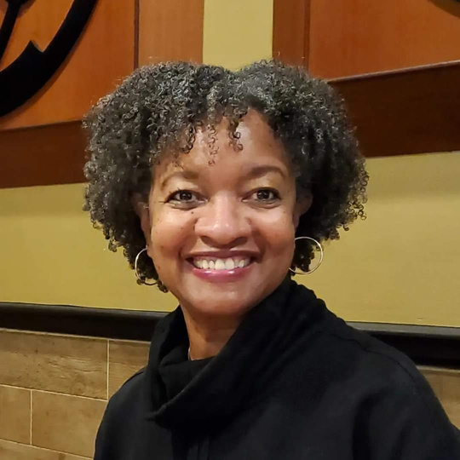
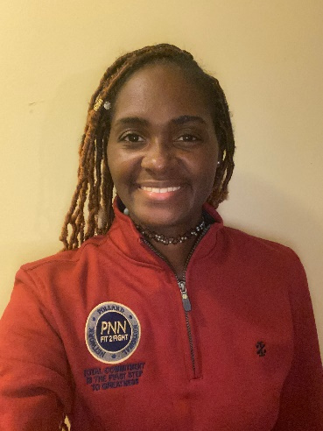
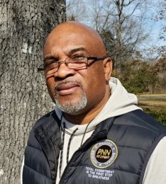
Histoires de réussite à revenu à temps partiel
Keisha High
Leader régional
Marcia High
Chef de division
Marquita Kennedy
Leader régional
Freddie Byrd
Chef de division
One Month Cash Flow
One Month Cash Flow
One Month Cash Flow
One Month Cash Flow
$8,000
$10,600
$5,500
$2,600
Profession :
Profession :
Profession :
Profession :
Employé du gouvernement
Employé gouvernemental à la retraite
Ancien directeur adjoint
Armée à la retraite Vétéran

Slide 14






Propriétaires d’agences
Columbus & Alison Pollard
Chelly & Jaye Toler
Jan & Mark Biggs
Calandra Jones
Dennis Love
King and Queen County, VA
E6 Army
Richmond,VA
Cellphone Specialist
King and Queen County,VA
Finance Manger
Cape Girardeau, MO
Customer Service/Retail Manager
Saint Louis, MO
Vice Principal
Revenu annuel moyen
Revenu annuel moyen
Revenu annuel moyen
Revenu annuel moyen
Revenu annuel moyen
$800,000
$100,000+
$100,000+
$100,000+
$200,000
Un bilan de succès avec un élan énorme
Monthly average is based on twelve-month total cash as of September 2024. From January 1 through September 31, 2024, Primerica paid cash flow to its
North American sales force at an average of $8,410, which includes commissions paid on all lines of business to life licensed representatives. Figures include U.S. and Canadian dollars remaining in the local currency earned by the representative, not adjusted for exchange rates.

Slide 15


KI JAN OU TA RENMEN AVANSE POU PI DEVAN?
FÈ PLIS LAJAN
VIN YON KLIYAN
Kreye revni adisyonèl Tan rezèv a tan pasyèl Brokerage Opòtinite
Aplike konsèp ak sèvis yo vin endepandan
oswa toude
Shelita S.
Antonio T.

