Slide 1

AGENCY OVERVIEW

Slide 2








FROM WALMART TO WALLSTREET

Slide 3

PROFESSIONAL TRADES LICENSES
REFERRAL REP
  WORK IN PARTNERSHIP WITH AGENT ON REFERRAL BASIS ONLY
  PROFESSIONAL LICENSE $124
  REFERRAL INCENTIVES
  LIMITED BACK OFFICE ACCESS
AGENT
  FULL – ALL ACCESS TRAINING
  PROFESSIONAL LICENSES $124
  UNLIMITED INCOME POTENTIAL
  BUSINESS EXPENSES ONLY $25
BROKER
  DISTRIBUTION OUTLET-OPERATE AN AGENCY
  PROFESSIONAL LICENSES $124
  TRAIN/MENTOR/
  DEVELOP AGENTS
  UNLIMITED
INCOME POTENTIAL
*BUSINESS EXPENSE $75-$150
YOU DECIDE WHAT PATH IS RIGHT FOR YOU

Slide 4

Four Ways to Earn Income
MOVE THROUGH THE CASH FLOW QUADRANT*
EMPLOYEE
Has a job.
Income based on position, not the person.
BUSINESS (BROKER)
Owns a system. Has others working for him/her.
Unlimited income potential via manufacturing, marketing, etc.
SELF-EMPLOYED
(AMBASSADOR/AGENT)
Owns a job.
Dentist, doctor, lawyer, hair stylist,
real estate agent, salesperson.
INVESTOR (SERIAL BROKER)
Has money working for him/her.
Enjoys freedom and has the opportunity to achieve their dreams.
Which two ways to earn income appeal to you the most?
*The Cash Flow Quadrant, CASH FLOW Technologies, Inc.; used with permission.
The Cash Flow Quadrant is a trademark of CASH FLOW Technologies, Inc. For informational purposes only.
4

Slide 5

What You’ll Get
An Opportunity to:
Receive an education and mentorship on How Money Works
Have flexibility to earn additional part-time income
Become a Broker and Build an Agency
3

Slide 6











The Challenge…… 95%
Don’t Have A Financial Education.
Don’t Have A Financial Game Plan.
Don’t Have A Financial Coach.
Our Mission is to help the 95%
Anissa D.
Noah F.
Calisha W.
Jean E.
James H.
Jesse S.
Andrea S.
This Photo by Unknown Author is licensed under CC BY-SA
Notes:
1.7.2013
4
‹#›

Slide 7
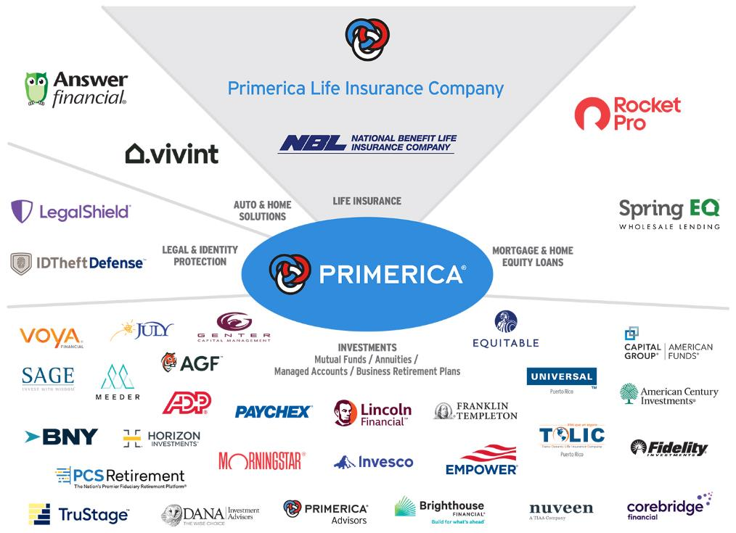
PASSION & ACCESS
PASSION & ACCESS!!
Franchise Companies
McDonalds & Chic-Fil-a
Distribution Companies
Walmart & Amazon
Not all products and services are available in all states, territories, or the District of Columbia. A representative’s ability to offer products from the companies listed is subject to state and federal licensing and certification requirements. Please refer to the Important Endnotes for additional details about the contractual arrangements and company affiliations detailed above.

Slide 8











We educate on 5 simple concepts
Know your F.I.N & P.I.N
Decreasing Responsibility
The Rule of 72
Funny Banking
Financial Independence
1. From Fortune. © 2023 Fortune Media IP Limited All rights reserved. Used under license. Fortune 1000® is a registered trademark of Fortune Media IP Limited and is used under license. Fortune and Fortune Media IP Limited are not affiliated with, and do not endorse products or services of, Primerica, Inc, as of June 6, 2023. 2. Dalbar.com, 2023 Service Award History, January 10, 2024. 3. The following Primerica life insurance companies have been rated A+ (Superior) by AM Best, as of November 15, 2023: Primerica Life Insurance Company, Primerica Life Insurance Company of Canada, and National Benefit Life Insurance Company. AM Best ratings range in order from the highest ratings as follows: A++, A+, A, A-, B++, B+, B, B-, C++, C+, C, C-, D, E, F. For the latest Best’s Credit Rating, access www.ambest.com. 4. From Bloomberg Finance L.P, "2023 Bloomberg Gender–Equality Index," January 31, 2023. The 2023 Bloomberg Gender-Equality Index logo mark is associated with the Bloomberg Gender Equality data for the 2021 fiscal year. 5. Survey results are presented solely with respect to Primerica’s U.S. term life insurance business. Forbes.com, “Forbes 2022 America’s Best Insurance Companies,” October 25, 2023. 6. Forbes.com, “Forbes 2022 The Best Employers for Diversity,” April 25, 2023. 7. Forbes.com, “Forbes 2023 The Best Employers for Women,” July 18, 2023. 8. Survey results are presented solely with respect to Primerica’s U.S. term life insurance business. Term life insurance underwritten by National Benefit Life Insurance Company, Home Office: Long Island City, NY in New York State; Primerica Life Insurance Company, Executive Offices: Duluth, GA in all other U.S. jurisdictions; and Primerica Life Insurance Company of Canada (Head Office: 6985 Financial Drive, Suite 400, Mississauga, ON, L5N 0G3, Phone: 905-812-2900) in Canada. From Investor’s Business Daily, “#1 Most Trusted Life Insurance Company and #3 Most Trusted Financial Company in 2022,” as of September 29, 2023.

Slide 9



TWO IMPORTANT NUMBERS
F.I.N
FINANCIAL INDEPENDENCE NUMBER
PROTECTION INCOME NUMBER
P.I.N
HOW MUCH MONEY DO YOU NEED TO MAINTAIN YOUR LIFESTYLE SO YOU DON’T HAVE TO WORK?
HOW MUCH LIFE INSURANCE DO YOU NEED TO MAINTAIN YOUR FAMILY’S LIFESTYLE WHEN YOU’RE GONE?
Do you have enough personally owned insurance (outside of your job) to payoff…..
  DEBT/DEATH
  INCOME
  MORTGAGE
  EDUCATION
DON’T RUN OUT OF MONEY!!!!

Slide 10

We Teach on The Rule of 72?
GOOGLE IT
Years | Emergencies 3% | Short Goals 6% | F.I.N 12%
0 | $10,000 | $10,000 | $10,000
6 | — | — | $20,000
12 | — | $20,000 | $40,000
18 | — | — | $80,000
24 | $20,000 | $40,000 | $160,000
30 | — | — | $320,000
36 | — | $80,000 | $640,000
42 | — | — | $1,280,000
48 | $40,000 | $160,000 | $2,560,000
Divide 72 by Interest Rate % to determine how many years to double your MONEY.
This table serves as a demonstration of how The Rule of 72 concept works from a mathematical standpoint. It is not intended to represent an investment. The chart uses constant rates of return, unlike most investments which will fluctuate in value. It does not include fees or taxes, which would lower performance. It is unlikely that an investment would grow 10% or more on a consistent basis.

Slide 11
How We Helps Families: Chris and Sarah, Each Age 35
A - Before FNA
Life Insurance
$250,000 coverage on Chris $100,000 coverage on Sarah Cash Value Policy: $251/mo.* $127,051 cash value at age 65
B - After FNA
Life Insurance/Income Protection²
$250,000 coverage on Chris $250,000 coverage on Sarah 30-year level term life insurance: $88/mo. $251 - $88 = $163/month savings to INVEST
A - Before FNA
Retirement Plan
Chris & Sarah had $20,000 in an IRA at their bank earning 1.5% with $105 per month contributions. Accumulated savings at age 65 = $79,118
B - After FNA
Retirement Plan³
Rolled over $20,000 IRA into a mutual fund. Monthly contributions increased to $268 ($105 + $163 savings from cash value life insurance) 6% rate of return: $380,912 at age 65 9% rate of return: $770,486 at age 65
If you showed the A and B example to 10 families, how many of the 10 would switch from A to B?
1. This is a hypothetical family that is used to illustrate our products and is not intended to reflect any real family. 2. Primerica PrecisionTerm policy 1, Class 6, husband, form ICC21PA0 or PLF22PA0 in the U.S., and Primerica PrecisionTerm policy 2, Class 4, wife, form ICC21PA0 or PLF22PA0 in the U.S. 3. This illustration is a hypothetical and does not represent an actual investment. The illustration uses constant rates of return compounded on a monthly basis, unlike actual investments which will fluctuate in value and could be significantly impacted by periods of negative returns.
It does not include fees, taxes, expenses, or withdrawals, which if included, would lower results. There is no guarantee you will achieve these results.
*Monthly premium and accumulated cash value for cash value policies is an average of whole life policies from three major North American life insurance companies for male and female, both age 35 and standard risk. Cash value life insurance can be universal life, whole life, etc., and may contain features in addition to death protection, such as dividends, interest, or cash value available for a loan or upon surrender of the policy. Cash value insurance usually has a level premium for the life of the policy. Term insurance provides a death benefit and its premiums increase after initial premium periods and at certain ages.
Not to be used in New York

Slide 12



Helping 1 Family
Avg session is 30 mins-1 hour
Solution
Life Protection
Auto
Home
PLPP
ID Theft Defense
Vivint
Investments (100k)
Total
Agent-Rep
$180
$100
$95
$50
$39
$200
$1,725
District
$360
$105
$99
$80
$62
$200
$2,012
RVP
$798
$135
$112.50
$125
$98
$300
$3,565
Will you
answer the call?
$2,389
$2,918
$5,133.50

Slide 13

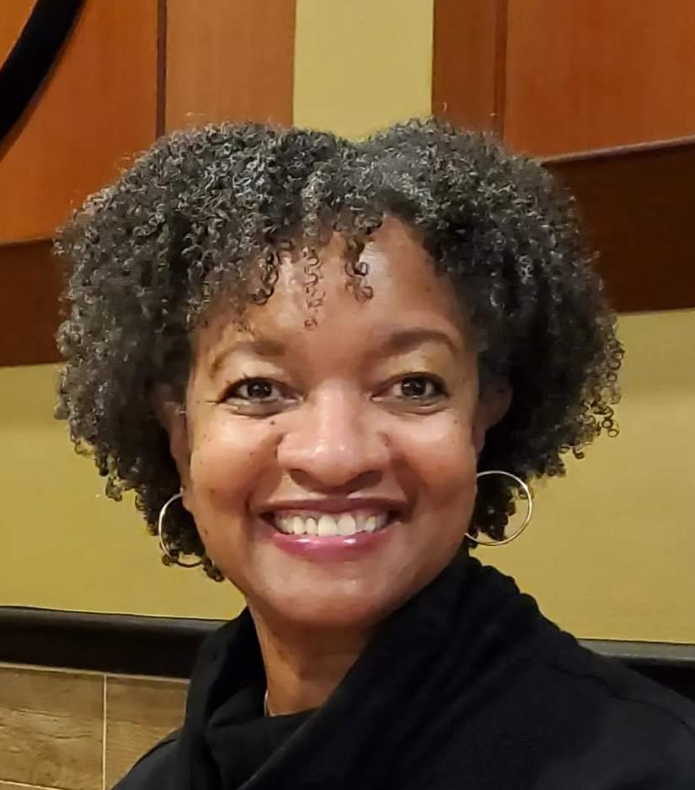
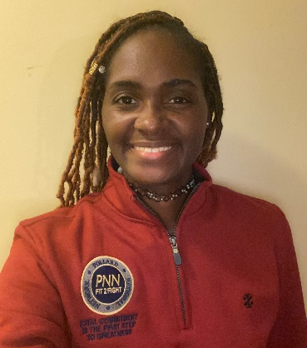

Part-Time Income Success Stories
Keisha High
Regional Leader
Marcia High
Division Leader
Marquita Kennedy
Regional Leader
Freddie Byrd
Division Leader
One Month Cash Flow
One Month Cash Flow
One Month Cash Flow
One Month Cash Flow
$8,000
$10,600
$5,500
$2,600
Occupation:
Occupation:
Occupation:
Occupation:
Government Employee
Retired Government Employee
Former Assistant Principal
Retired Army
Veteran

Slide 14






Agency Owners
Columbus & Alison Pollard
Chelly & Jaye Toler
Jan & Mark Biggs
Calandra Jones
Dennis Love
King and Queen County, VA
E6 Army
Richmond,VA
Cellphone Specialist
King and Queen County,VA
Finance Manger
Cape Girardeau, MO
Customer Service/Retail Manager
Saint Louis, MO
Vice Principal
Average Yearly Income
Average Yearly Income
Average Yearly Income
Average Yearly Income
Average Yearly Income
$800,000
$100,000+
$100,000+
$100,000+
$200,000
A Track Record of Success with Tremendous Momentum
Monthly average is based on twelve-month total cash as of December 2025. From January 1 through December 2025, Primerica paid cash flow to its
North American sales force at an average of $8,410, which includes commissions paid on all lines of business to life licensed representatives. Figures include U.S. and Canadian dollars remaining in the local currency earned by the representative, not adjusted for exchange rates.

Slide 15



HOW WOULD YOU LIKE TO MOVE FORWARD?
MAKE MORE MONEY
BECOME A CLIENT
Create additional income
Referral Rep
Part-time Agent
Brokerage Opportunity
Apply the concepts and services
to become Financially Independent.
or BOTH
Shelita S.
Antonio T.

