Slide 1


Slide 2
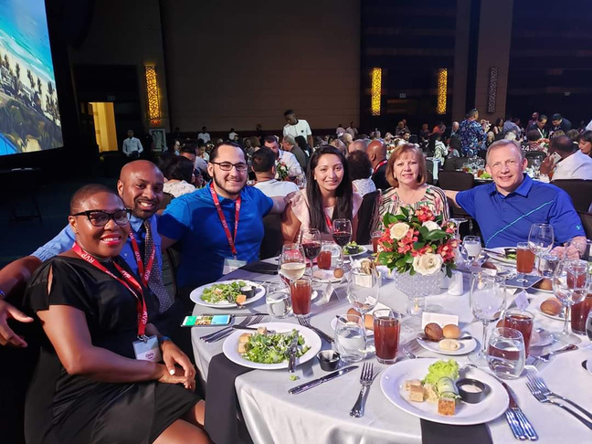




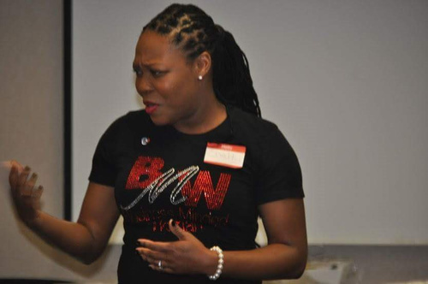
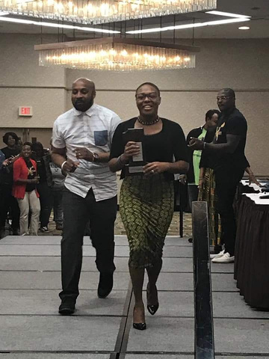

FROM WALMART TO WALLSTREET

Slide 3





As children, for most of us, money was always an “Adult Conversation.” We Were All Taught…
1. Do well
in school.
2. Go to
college.
3. Get a
good job.
4. Get Married.
5. Buy A Home.
What have these steps taught us about Money?
3
Notes:
3

Slide 4








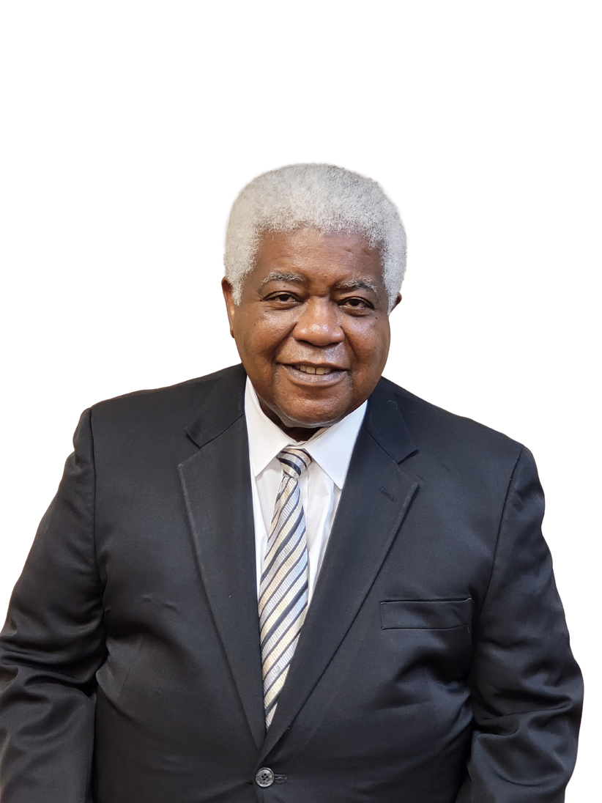

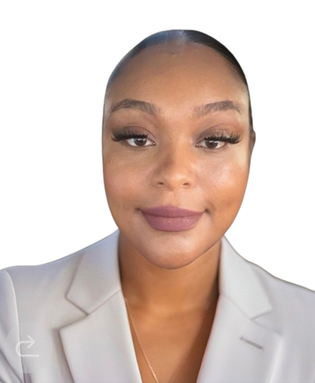
The Challenge…… 95%
Don’t Have A Financial Education.
Don’t Have A Financial Game Plan.
Don’t Have A Financial Coach.
Our Mission is to help the 95%
Anissa D.
Noah F.
Calisha W.
Jean E.
James H.
Jesse S.
Andrea S.
This Photo by Unknown Author is licensed under CC BY-SA
Notes:
1.7.2013
4
‹#›

Slide 5
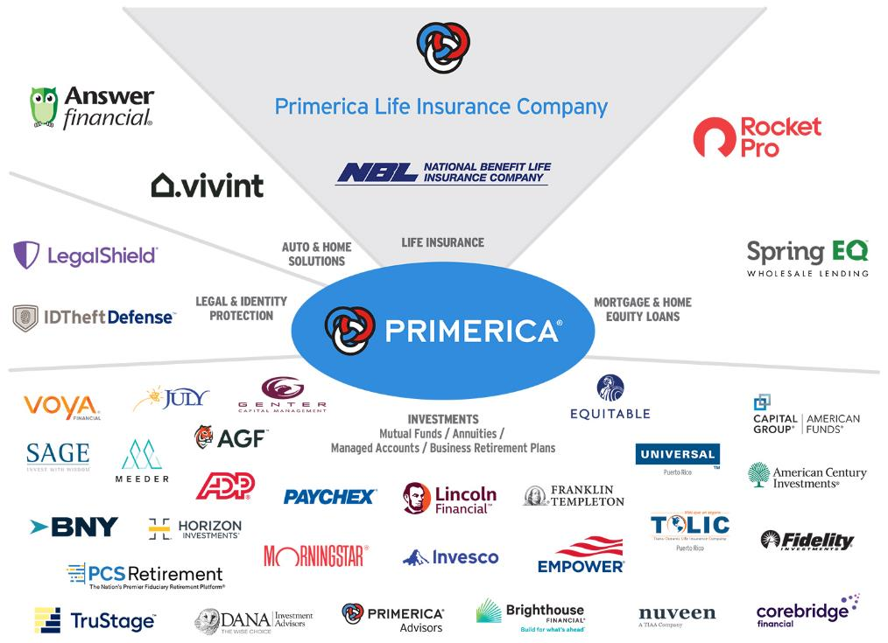
PASSION & ACCESS
PASSION & ACCESS!!
Franchise Companies
McDonalds & Chic-Fil-a
Distribution Companies
Walmart & Amazon
Not all products and services are available in all states, territories, or the District of Columbia. A representative’s ability to offer products from the companies listed is subject to state and federal licensing and certification requirements. Please refer to the Important Endnotes for additional details about the contractual arrangements and company affiliations detailed above.

Slide 6









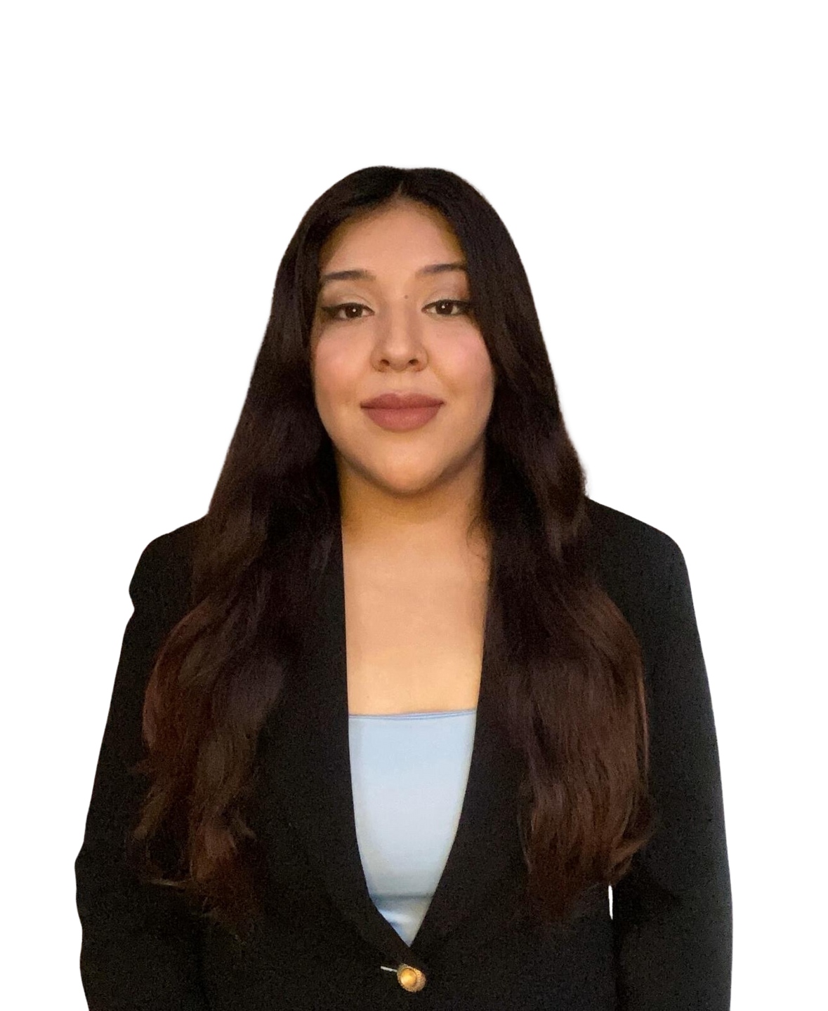

We educate on 5 simple concepts
Know your F.I.N & P.I.N
Decreasing Responsibility
The Rule of 72
Funny Banking
Multiple Streams of Income
1. From Fortune. © 2023 Fortune Media IP Limited All rights reserved. Used under license. Fortune 1000® is a registered trademark of Fortune Media IP Limited and is used under license. Fortune and Fortune Media IP Limited are not affiliated with, and do not endorse products or services of, Primerica, Inc, as of June 6, 2023. 2. Dalbar.com, 2023 Service Award History, January 10, 2024. 3. The following Primerica life insurance companies have been rated A+ (Superior) by AM Best, as of November 15, 2023: Primerica Life Insurance Company, Primerica Life Insurance Company of Canada, and National Benefit Life Insurance Company. AM Best ratings range in order from the highest ratings as follows: A++, A+, A, A-, B++, B+, B, B-, C++, C+, C, C-, D, E, F. For the latest Best’s Credit Rating, access www.ambest.com. 4. From Bloomberg Finance L.P, "2023 Bloomberg Gender–Equality Index," January 31, 2023. The 2023 Bloomberg Gender-Equality Index logo mark is associated with the Bloomberg Gender Equality data for the 2021 fiscal year. 5. Survey results are presented solely with respect to Primerica’s U.S. term life insurance business. Forbes.com, “Forbes 2022 America’s Best Insurance Companies,” October 25, 2023. 6. Forbes.com, “Forbes 2022 The Best Employers for Diversity,” April 25, 2023. 7. Forbes.com, “Forbes 2023 The Best Employers for Women,” July 18, 2023. 8. Survey results are presented solely with respect to Primerica’s U.S. term life insurance business. Term life insurance underwritten by National Benefit Life Insurance Company, Home Office: Long Island City, NY in New York State; Primerica Life Insurance Company, Executive Offices: Duluth, GA in all other U.S. jurisdictions; and Primerica Life Insurance Company of Canada (Head Office: 6985 Financial Drive, Suite 400, Mississauga, ON, L5N 0G3, Phone: 905-812-2900) in Canada. From Investor’s Business Daily, “#1 Most Trusted Life Insurance Company and #3 Most Trusted Financial Company in 2022,” as of September 29, 2023.

Slide 7



TWO IMPORTANT NUMBERS
F.I.N
FINANCIAL INDEPENDENCE NUMBER
PROTECTION INCOME NUMBER
P.I.N
HOW MUCH MONEY DO YOU NEED TO MAINTAIN YOUR LIFESTYLE SO YOU DON’T HAVE TO WORK?
HOW MUCH LIFE INSURANCE DO YOU NEED TO MAINTAIN YOUR FAMILY’S LIFESTYLE WHEN YOU’RE GONE?
Do you have enough personally owned insurance (outside of your job) to payoff…..
  DEBT/DEATH
  INCOME
  MORTGAGE
  EDUCATION
DON’T RUN OUT OF MONEY!!!!

Slide 8
The Theory of Decreasing Responsibility
There are TWO Guarantees in LIFE….We NEED $$$$ for Both
P.I.N
DYING
TOO SOON
LIVING TOO LONG
F.I.N
Today
Young children/Dependents
High debt
Mortgage Payments
Loss of income would be devastating
At Retirement
Grown children
Lower debt
Mortgage Paid
Retirement income needed
What company do you know of that OFFERS life insurance, but also
teaches people how to eliminate the need for life insurance?

Slide 9

Do You Know The Rule of 72?
GOOGLE IT
Divide 72 by Interest Rate % to determine doubling periods.
Years | Emergencies 3% | Short Goals 6% | F.I.N 12%
0 | $10,000 | $10,000 | $10,000
6 | — | — | $20,000
12 | — | $20,000 | $40,000
18 | — | — | $80,000
24 | $20,000 | $40,000 | $160,000
30 | — | — | $320,000
36 | — | $80,000 | $640,000
42 | — | — | $1,280,000
48 | $40,000 | $160,000 | $2,560,000
This table serves as a demonstration of how The Rule of 72 concept works from a mathematical standpoint. It is not intended to represent an investment. The chart uses constant rates of return, unlike most investments which will fluctuate in value. It does not include fees or taxes, which would lower performance. It is unlikely that an investment would grow 10% or more on a consistent basis.
9

Slide 10







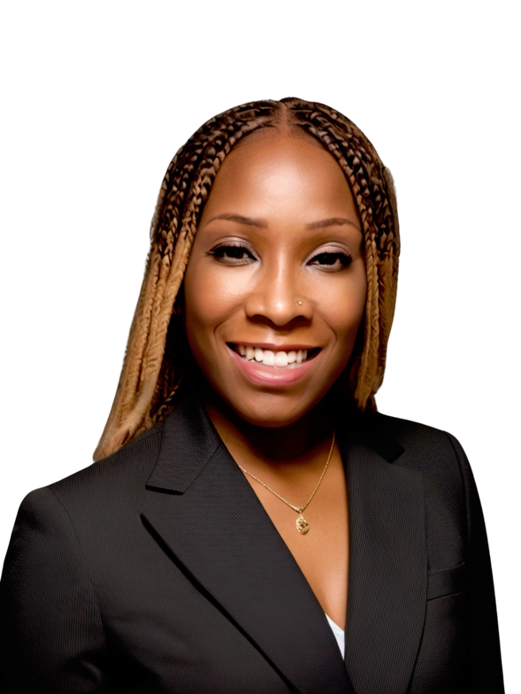





FUNNY BANKING CONCEPT
WHICH WEALTH PLAN MAKES MORE SENSE?
1. 0 BALANCE (for the first 1-3yrs of account being opened)
2. 1% TO 4% interest earned afterwards
3. CHARGE YOU 5% TO 10%
(to borrow your own money)
4. 6 MONTHS
(company can hold your money)
5. KEEP YOUR MONEY
(won’t go to family or beneficiary)
INDEXED UNIVERSAL LIFE INSURANCE (IUL)
TERM LIFE INSURANCE
Start at Ages 35
Start at Ages 35
$250,000
Face Amount
$250,000
Face Amount
$250,000
Face Amount
$250,000
Face Amount
Buy Term Insurance
$251
a month
$88 a month
Invest the
$163 savings
into a
Roth IRA
Same $251
Chris
Sarah
Chris
Sarah
_
X____________________
Cash Value at 65 = $127,051
Roth IRA %9 return at 65 = $300,649
SIGN HERE
Face
Amount
Cash Value
/Savings
Face
Amount
Invest in
Roth IRA
Either or not both
Would you sign this contract?
Separate Accts
Borrow $ (6 months hold)
Withdraw $ (7 days)
Cash In Policy
Face Amount Paid
A
or
B
Notes:
1.7.2013
13
‹#›

Slide 11







“Never limit yourself!”
“It always seems impossible until it’s done.”
-Nelson Mandela
“The power to help ourselves and others is a high reward!” That’s the difference between success and significance!”
– Coach Chelly

Slide 12







Helping 1 Family
Avg session is 30 mins-1 hour
Solution
Life Protection
Auto
Home
PLPP
ID Theft Defense
Vivint
Investments (100k)
Total
Agent-Rep
$180
$100
$95
$50
$39
$200
$1,725
District
$360
$105
$99
$80
$62
$200
$2,012
RVP
$798
$135
$112.50
$125
$98
$300
$3,565
Will you
answer the call?
$2,389
$2,918
$5,133.50
Notes:
13

Slide 13


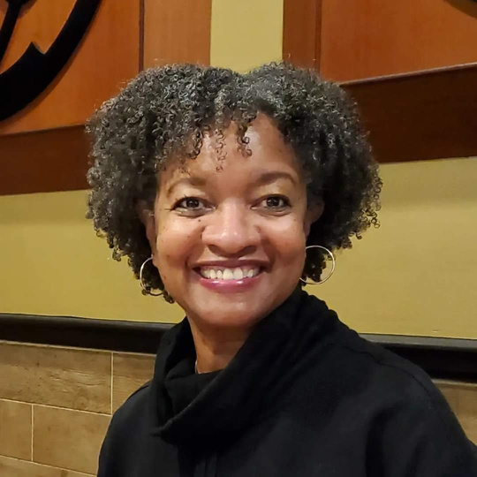
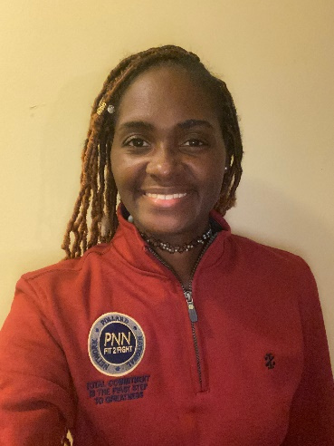
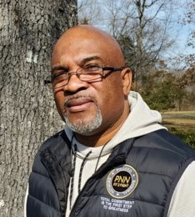
Part-Time Income Success Stories
Keisha High
Regional Leader
Marcia High
Division Leader
Marquita Kennedy
Regional Leader
Freddie Byrd
Division Leader
One Month Cash Flow
One Month Cash Flow
One Month Cash Flow
One Month Cash Flow
$8,000
$10,600
$5,500
$2,600
Occupation:
Occupation:
Occupation:
Occupation:
Government Employee
Retired Government Employee
Former Assistant Principal
Retired Army
Veteran

Slide 14






Agency Owners
Columbus & Alison Pollard
Chelly & Jaye Toler
Jan & Mark Biggs
Calandra Jones
Dennis Love
King and Queen County, VA
E6 Army
Richmond,VA
Cellphone Specialist
King and Queen County,VA
Finance Manger
Cape Girardeau, MO
Customer Service/Retail Manager
Saint Louis, MO
Vice Principal
Average Yearly Income
Average Yearly Income
Average Yearly Income
Average Yearly Income
Average Yearly Income
$800,000
$100,000+
$100,000+
$100,000+
$200,000
A Track Record of Success with Tremendous Momentum
Monthly average is based on twelve-month total cash as of September 2024. From January 1 through September 31, 2024, Primerica paid cash flow to its
North American sales force at an average of $8,410, which includes commissions paid on all lines of business to life licensed representatives. Figures include U.S. and Canadian dollars remaining in the local currency earned by the representative, not adjusted for exchange rates.

Slide 15




HOW WOULD YOU LIKE TO MOVE FORWARD?
MAKE MORE MONEY
BECOME A CLIENT
Create additional income
  Spare-Time
  Part-time
  Brokerage Opportunity
Apply the concepts and services
to become Financially Independent
or Both
Shelita S.
Antonio T.

