Slide 1
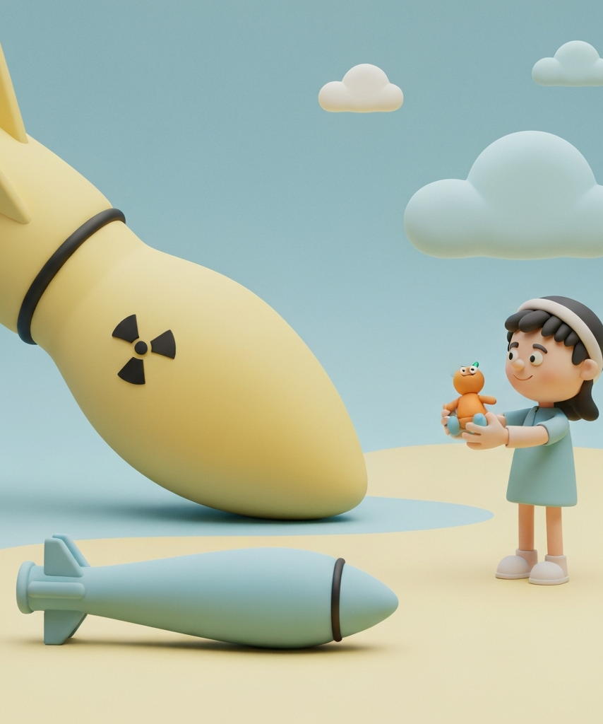
The Impact of Nuclear Weapons on Middle East Peace
Author: Sibel Elif Özdilek
Affiliation: Ufuk University, FEAS, Department of Political Sciences and International Relations, Ankara, Türkiye
Notes:
Good morning/afternoon everyone. My name is Sibel Elif Özdilek from Ufuk University, Ankara. Today I will examine how nuclear weapons – both existing and potential – continue to shape peace and conflict dynamics in the Middle East.

Slide 2
Historical Development of Nuclear Technology
Origins of Nuclear Technology
  Discoveries of atoms and splitting of the atomic nucleus in the early 20th century
Key Scientists
  James Chadwick, Otto Hahn, Lise Meitner, Enrico Fermi, and their groundbreaking research
Nuclear Fission and Fusion
  Advancements in understanding nuclear fission and fusion reactions
Birth of the Nuclear Age
  Fermi and Szilard's design of the first experimental nuclear reactor at the University of Chicago in 1942
Albert Einstein's Involvement
  Einstein's direct involvement in the study of using atomic energy for weapons purposes
Notes:
The nuclear age began with scientific breakthroughs in the 1930s and 1940s. Key figures like Chadwick, Hahn, Meitner, Fermi, and even Einstein laid the foundations. The first controlled chain reaction took place under the stadium at the University of Chicago in 1942, and only three years later the world witnessed the devastating power of nuclear weapons in Hiroshima and Nagasaki.

Slide 3
Proliferation of Nuclear Weapons
1952-1967
1945
Rapid Nuclear Weapons Development by UK, France, China
1998
U.S. Atomic Bomb Attacks on Japan
India and Pakistan Conduct Nuclear Tests
1949
1974
2017
Soviet Union Detonates First Nuclear Weapon
India Conducts First Nuclear Test
North Korea Conducts Series of Nuclear Tests
Notes:
After 1945 the bomb spread rapidly: Soviet Union 1949, UK 1952, France 1960, China 1964, India 1974, Pakistan 1998, and North Korea in the 2000s. Israel is widely believed to have assembled its first device in the late 1960s but maintains a policy of deliberate ambiguity. Today nine states possess nuclear weapons.

Slide 4

The Middle East and Nuclear Weapons
The Middle East has been a hotbed of nuclear ambitions, with several countries in the region pursuing nuclear technology and, in some cases, the development of nuclear weapons. This pursuit has been driven by a variety of factors, including the desire for regional influence, the perceived need for deterrence, and the potential for the peaceful use of nuclear energy.
Notes:
The Middle East is the only region where we have an undeclared nuclear weapon state (Israel), a threshold state that left the NPT (North Korea is outside), a state widely suspected of weaponisation ambitions (Iran), and several others that have considered or abandoned nuclear options (Iraq, Libya, Syria). This makes the region uniquely dangerous.

Slide 5
Impact on Middle East Peace
Percentage increase in regional conflicts due to the presence of nuclear weapons
75%
65%
80%
55%
Arab-Israeli Conflict
Iran-Saudi Rivalry
Israel-Iran Tensions
Turkey-Kurds Conflict
Notes:
The presence or suspicion of nuclear capability has dramatically escalated every major rivalry:
Arab–Israeli wars became existential after Israel went nuclear
Iran–Saudi cold war intensified as Tehran moved closer to breakout capability
Israel–Iran shadow war has already included sabotage, cyberattacks and assassinations Even the Turkey–PKK conflict has seen occasional nuclear rhetoric from non-state actors.

Slide 6





Disarmament Efforts
Acheson-Lilienthal Report and Baruch Plan (1946)
Signing of the Nuclear Weapon Non-Proliferation (NPT) (1968)
START I and START II (1991-1993)
Ireland's Request (1958)
New START Treaty (2010)
This proposed sharing nuclear technology for peaceful purposes, but was vetoed by the Soviets, who feared a US monopoly on nuclear energy.
Ireland was the first country to propose the destruction of all nuclear weapons.
The NPT aims to prevent the proliferation of nuclear weapons and promote the peaceful use of nuclear energy. It prohibits member states from selling or transferring nuclear weapons technology.
These treaties focused on reducing strategic nuclear weapons, ballistic missiles, and intercontinental ballistic missiles (ICBMs). The number of US and Soviet nuclear warheads declined significantly, from around 21,000 and 39,000 at their peak in the 1980s to around 4,000 and 7,000 in 2005.
This treaty included the reduction of strategic nuclear weapons to 1,500 and delivery systems such as ICBMs and SLBMs to 800, to be accomplished within seven years. However, by 2022, the US and Russia had not fully implemented these restrictions.
Notes:
Global efforts began immediately after 1945. The 1946 Baruch Plan failed because of Soviet rejection. The 1968 NPT remains the cornerstone, but four regional states never joined (India, Pakistan, Israel, South Sudan) and North Korea withdrew. The idea of a Weapons of Mass Destruction-Free Zone in the Middle East has been on the UN agenda since 1974 but has never moved forward due to the Israeli–Arab divide.

Slide 7

Despite the significant challenges, ongoing efforts to promote nuclear disarmament and the establishment of a Nuclear Weapon-Free Zone in the Middle East are crucial for fostering lasting peace and stability in the region. Continued dialogue and international cooperation are essential to address the complex geopolitical dynamics and reduce the risk of nuclear conflict.
Thank you very much. I welcome your questions and comments.
Notes:
To conclude: nuclear weapons have not brought stability to the Middle East the way some deterrence theorists predicted. Instead they have created a situation of “existential deterrence” mixed with constant low-level conflict, sabotage, and the ever-present risk of miscalculation. Real peace in the region will remain elusive as long as nuclear asymmetry and suspicions persist. The only long-term solution is a mutually agreed, verifiable WMD-Free Zone – politically difficult, but not impossible.

Slide 8
References
Cirincione, J. (2007). Bomb Scare: The History and Future of Nuclear Weapons. Columbia University Press.
Cohen, A. (2010). The Worst-Kept Secret: Israel’s Bargain with the Bomb. Columbia University Press.
Cordesman, A. H. (2022). Israel and Iran: The Shadow War and Nuclear Risks. CSIS.
Dalton, T., et al. (2024). A WMD-Free Zone in the Middle East: Past Lessons, Future Prospects. Carnegie Endowment for International Peace.
Fitzpatrick, M. (Ed.). (2016). Iran’s Nuclear Program: Tehran’s Compliance with International Obligations. Routledge.
IAEA (2024). Verification and Monitoring in Iran reports. International Atomic Energy Agency.
Kerr, P., & Nikitin, M. B. (2023). Nuclear Weapons in the Middle East: An Overview. Congressional Research Service (CRS) Report.
Perkovich, G., & Acton, J. (2009). Abolishing Nuclear Weapons: A Debate. Carnegie Endowment.
SIPRI Yearbook 2025: Armaments, Disarmament and International Security. Stockholm International Peace Research Institute.
United Nations (1974–2024). Resolutions on the Establishment of a Nuclear-Weapon-Free Zone in the Region of the Middle East (annual).

Slide 9
Thank you very much.
I welcome your questions and comments.

