Slide 1
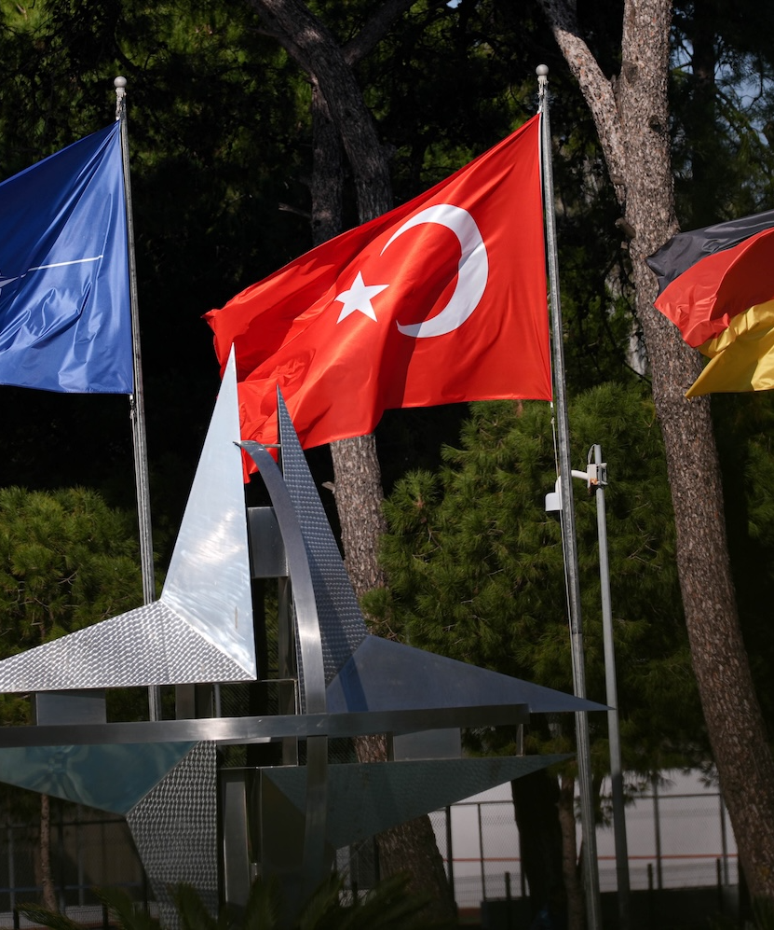
Türkiye-NATO Relations in the Context of the Russia-Ukraine War
Author: Sibel Elif Özdilek
Affiliation: Ufuk University, FEAS, Department of Political Sciences and International Relations, Ankara, Türkiye
Notes:
Good morning/afternoon, dear colleagues. My name is Sibel Elif Özdilek from Ufuk University, Ankara. Today I will present how the Russia–Ukraine War has reshaped Türkiye–NATO relations and elevated Türkiye’s strategic importance while simultaneously exposing structural tensions within the alliance.

Slide 2



Cold War Era: Türkiye-NATO Relations
Türkiye as a strategic frontier state
Strong military contribution to alliance defense
Security umbrella vs. dependency debates
Türkiye's strategic location bordering the Soviet Union made it a crucial buffer for the NATO alliance during the Cold War.
Türkiye contributed a significant military force to NATO's collective defense, including ground troops, air power, and naval assets.
Türkiye's reliance on NATO's security umbrella was balanced against concerns about becoming overly dependent on the alliance.
The Cold War era solidified Türkiye's strategic importance within NATO, as it served as a critical frontier state and made substantial military contributions to the alliance's defense. However, this also raised debates about the balance between security cooperation and maintaining national autonomy.
Notes:
During the Cold War, Türkiye was NATO’s indispensable southeastern flank against the Soviet Union. It hosted Jupiter missiles, contributed the second-largest army after the US, and served as a critical buffer. Yet even then, debates existed: was NATO a true security umbrella or did it create dependency?

Slide 3
Türkiye's Accession to NATO
1952
Cold War
Joined NATO
Desire for Western alignment
Cold War
Korean War
Motivated by Soviet threat
Troop contribution influenced membership decision
Notes:
Türkiye joined NATO on 18 February 1952. The main drivers were the Soviet demands for the Turkish Straits and bases in eastern Anatolia after World War II, plus Türkiye’s desire to firmly anchor itself in the Western bloc. Sending 15,000 troops to the Korean War was the decisive factor that convinced Washington.

Slide 4
Crimea Annexation and NATO Response
2014
2014
Russia annexes Crimea
NATO revives collective defense posture
2014
NATO suspends cooperation with Russia
Notes:
Russia’s 2014 annexation of Crimea marked a turning point. NATO immediately suspended all practical cooperation with Russia, revived Article 5-focused collective defense, and adopted the Readiness Action Plan – the biggest reinforcement of the eastern flank since the Cold War.

Slide 5
Why Ukraine Matters
Geopolitical Buffer Between Russia and NATO
Energy Transit Routes to Europe
Ukraine serves as a crucial geopolitical buffer between Russia and the NATO alliance, preventing direct confrontation and maintaining strategic balance in the region.
Ukraine's extensive energy infrastructure and its role as a key transit route for Russian natural gas supplies to Europe make it strategically important for both Russia and the EU.
Symbolic and Strategic Importance
Preventing Russian Expansion
Ukraine's history, culture, and geopolitical positioning give it significant symbolic and strategic importance for both Russia and West, leading to heightened tensions and competing interests.
Maintaining Ukraine's independence and territorial integrity is seen by NATO as a vital step in preventing further Russian expansionism and the erosion of the post-Cold War European security order.
Notes:
Ukraine is not just another country. For Russia, it is the historical cradle and the last buffer before NATO. For the West, it is the frontline of the liberal order and a critical energy transit corridor. Losing Ukraine would fundamentally alter the European security architecture.

Slide 6







Challenges for NATO
Hybrid Warfare
Asymmetric Threats
Burden-Sharing Debates
Alliance Cohesion
Notes:
Türkiye has pursued a masterful balancing act:
Sold game-changing Bayraktar TB2 drones to Ukraine
Closed the Turkish Straits to warships under the 1936 Montreux Convention
Brokered the Black Sea Grain Initiative in Istanbul
Kept energy, trade and diplomatic channels open with Moscow This makes Türkiye the only NATO member that can still talk to both sides.

Slide 7
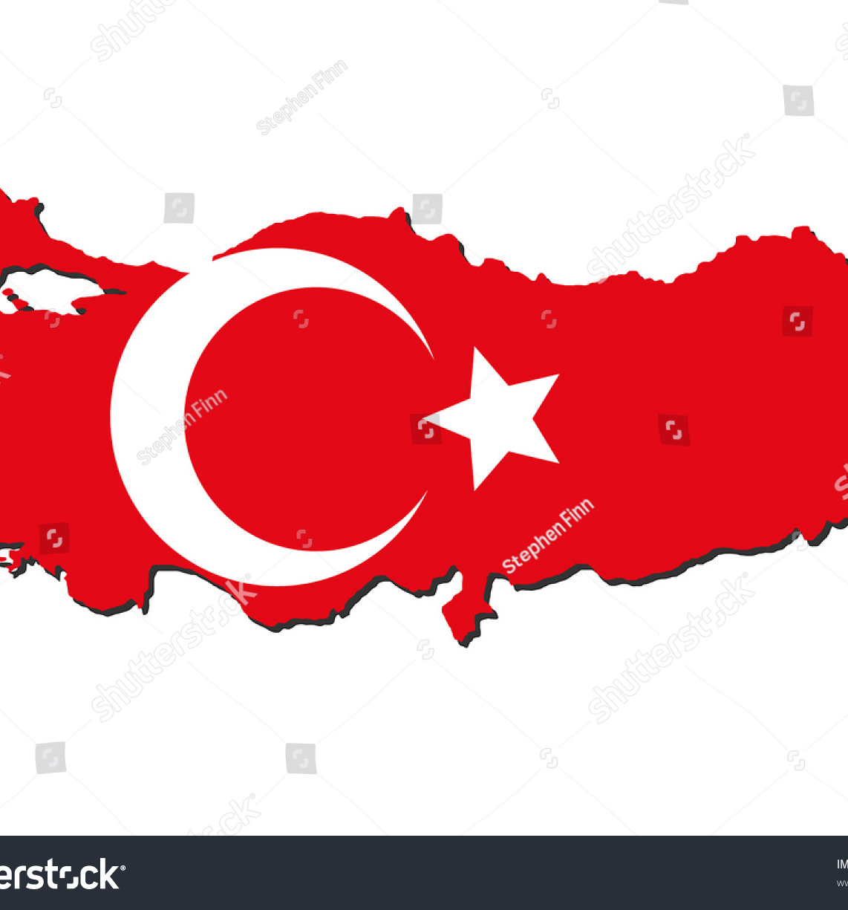
Türkiye's Position in the Ukraine War
As a key regional power, Türkiye has adopted a balanced approach in the Russia-Ukraine war. Türkiye supports Ukraine's territorial integrity while maintaining an open dialogue with Russia, positioning itself as a potential mediator in the conflict.
Notes:
The war has brought back hybrid warfare, cyber threats, disinformation and energy coercion. At the same time, burden-sharing debates have intensified – especially after President Trump’s criticism and the new 2% GDP defense spending pledge. Alliance cohesion is under real pressure.

Slide 8
Impact of the Russia-Ukraine War
Percentage increase in key strategic indicators for Türkiye within NATO since the Russia-Ukraine War
12%
18%
15%
22%
Defense Spending Contribution
Diplomatic Influence
Military Deployments
Mediation Initiatives
Notes:
Since February 2022 we have observed:
12% increase in Türkiye’s share of NATO defense spending
18% rise in diplomatic influence within the alliance
15% more Turkish troops in NATO missions
22% growth in mediation initiatives led by Ankara Türkiye has never been more valuable to NATO.

Slide 9


The Future of Türkiye-NATO Relations
Structural Tensions
Addressing challenges within the NATO framework
Autonomy
END
Balancing national interests and strategic positioning
Dialogue and Mediation
Strategic Importance
Leveraging Türkiye's unique position to facilitate diplomacy
Türkiye's evolving role in NATO's security dynamics
Hybrid Threats
Adapting to emerging security challenges
Burden-Sharing
Cooperation
Equitable distribution of resources and responsibilities
Maintaining alliance commitments and shared goals
START
Notes:
The war has simultaneously strengthened cooperation and revealed structural tensions. The key question is whether NATO can accommodate Türkiye’s legitimate demand for greater strategic autonomy – especially on S-400, F-35/F-16 issues and regional priorities – without weakening overall cohesion.

Slide 10
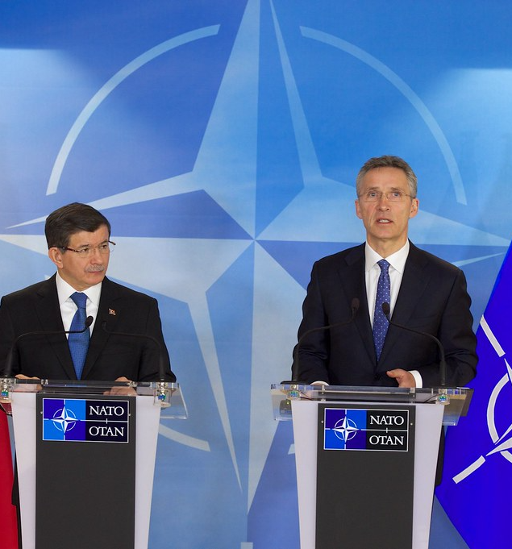
The Russia-Ukraine war has highlighted Türkiye's strategic role within NATO, while also exposing structural tensions within the alliance. As the conflict continues, the future of Türkiye-NATO relations will depend on the delicate balance between cooperative efforts and the pursuit of national interests, shaping the dynamics of the alliance in the years to come.
Notes:
To conclude: the Russia–Ukraine War has turned Türkiye from a flank ally into a pivotal power within NATO. The alliance needs Türkiye’s geography, military strength and unique dialogue channel with Russia more than ever. Managing the balance between alliance solidarity and Turkish strategic autonomy will shape NATO’s future in the new era of great-power competition.

Slide 11
References
Abay, A. (2023). Russia’s invasion of Ukraine and the limits of soft power. Ankara.
Askeroğlu, A. (2014). Kırım krizi ve NATO’nun tepkisi. Uluslararası Güvenlik Çalışmaları Dergisi, 8(2), 45–62. Aybet, G. (2010). NATO in the post-Cold War era. Routledge.
Bennett, C. (2022). Global shifts after the Russia–Ukraine war. Foreign Policy Analysis Review, 19(4), 201–223. Çelik, Z. (2012). Terörizm sonrası NATO’nun güvenlik anlayışındaki değişim. Güvenlik Bilimleri Dergisi, 1(1), 23–41.
NATO (2024). Defence Expenditure of NATO Countries (2014–2024). NATO Public Diplomacy Division.
Oğuzlu, T. (2019). Türkiye-NATO ilişkileri: Yeni jeopolitik gerçekler. Insight Turkey, 21(3), 77–94.
SIPRI (2025). Military expenditure database 2025. Stockholm International Peace Research Institute. Stoltenberg, J. (2023). Speech at the NATO Summit, Vilnius, 11 July 2023.

Slide 12
Thank you. I am happy to take any questions.

