Slide 1
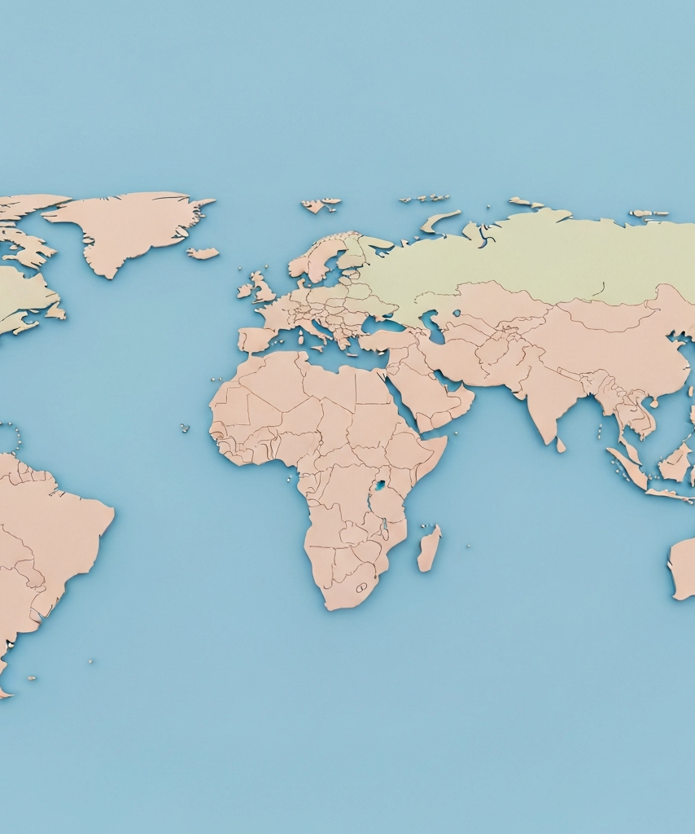
The Impact of EU Sanctions on Russia (2014-2022)
This presentation explores the far-reaching consequences of the European Union's sanctions against Russia, following the annexation of Crimea in 2014 and the ongoing conflict in Ukraine.

Slide 2
Introduction to EU Sanctions against Russia
Crimea Annexation (2014)
Russia's annexation of Crimea from Ukraine, a major geopolitical event that led to increasing tensions between Russia and the West.
Conflict in Eastern Ukraine
The outbreak of pro-Russian separatist conflicts in eastern Ukraine, leading to further escalation of the crisis.
EU's Response: Sanctions
The European Union's decision to impose sanctions on Russia in response to the annexation of Crimea and the conflict in Ukraine.
Targeted Sanctions
The EU's implementation of targeted sanctions, including asset freezes and travel bans on individuals and entities connected to the Russian government.
Economic Sanctions
The EU's imposition of economic sanctions, such as trade restrictions, financial sector measures, and restrictions on access to capital markets.

Slide 3
Timeline of EU Sanctions (2014-2022)
September 2014
March 2014
EU introduces additional sectoral sanctions and asset freezes on individuals and entities
June 2022
EU imposes initial sanctions in response to Russia's annexation of Crimea
EU imposes its sixth package of sanctions, including a ban on Russian oil imports
July 2014
July 2022
EU expands sanctions targeting Russia's financial, energy, and defense sectors
December 2015
EU adopts its seventh package of sanctions, targeting additional Russian individuals and entities
EU extends sanctions in response to the lack of progress in the Minsk agreements

Slide 4

Sanctions Targeting Russia's Economy
The European Union has implemented a comprehensive sanctions regime targeting various sectors of the Russian economy since the annexation of Crimea in 2014. These sanctions include trade restrictions, financial sanctions, and targeted asset freezes aimed at limiting Russia's access to global financial systems and disrupting its ability to conduct international trade.

Slide 5
Sanctions' Impact on International Trade
Percentage change in trade volumes between the EU and Russia (2013-2021)
-55%
-44%
-57%
-39%
EU Exports to Russia
EU Imports from Russia
Russia's Exports to the EU
Russia's Imports from the EU

Slide 6
Responses and Countermeasures
Retaliatory Import Bans
Substitution of Imports
Promotion of Domestic Production
Russia imposed counter-sanctions on various agricultural products from the EU, US, and other countries, effectively banning the import of these goods in retaliation for the EU sanctions.
Russia sought to replace imported goods and services with domestic alternatives or imports from other countries not subject to the sanctions, in an effort to mitigate the economic impact of the EU sanctions.
The Russian government implemented policies to boost domestic production and self-sufficiency in various sectors, including agriculture, manufacturing, and technology, to reduce reliance on imports and sanctions-affected trade.
Sanctions Evasion Tactics
Strengthening Ties with Non-EU Partners
Russia employed various methods to circumvent the sanctions, such as using shell companies, offshore accounts, and alternative payment systems to continue accessing restricted technologies, financing, and trade channels.
Russia sought to strengthen economic and political ties with countries such as China, India, and others, to diversify its trade and financial relationships and reduce its dependence on the EU and Western markets.

Slide 7
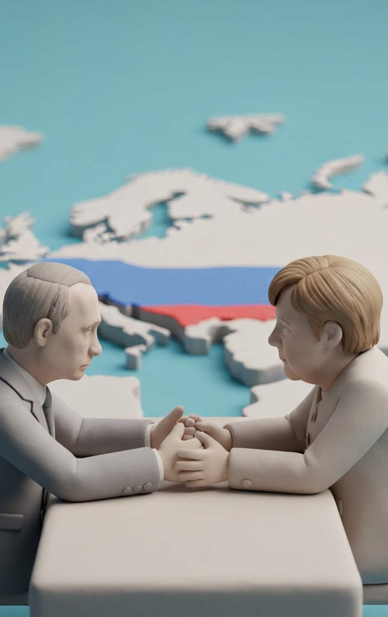
Sanctions and Geopolitical Tensions
The imposition of EU sanctions against Russia in response to the annexation of Crimea in 2014 has had significant geopolitical ramifications. The sanctions have strained EU-Russia relations, leading to a deterioration of diplomatic ties and increased tensions between the two powers. This has shifted the global balance of power, with Russia aligning more closely with China and other non-Western countries, while the EU has strengthened its ties with the United States and other allies in the face of this crisis.

Slide 8
Compliance and Enforcement Challenges
Complex Regulatory Environment
Navigating the intricate web of sanctions regulations and policies across multiple jurisdictions poses a significant challenge for compliance.
Sanctions Evasion Tactics
Russia and its entities have employed sophisticated methods to circumvent sanctions, such as using front companies, alternate payment systems, and illicit trade networks.
Jurisdictional Conflicts
Enforcing sanctions is complicated by the potential for conflicting laws and policies between nations, hindering international cooperation and information sharing.
Monitoring and Enforcement Capacity
Limited resources and capabilities of regulatory bodies make it challenging to effectively monitor and enforce sanctions, especially across global supply chains.
Unintended Consequences
Sanctions can have unforeseen ripple effects, such as disrupting legitimate trade and financial transactions, which can undermine compliance efforts.

Slide 9

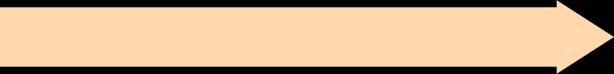





Future Outlook and Considerations
Potential Long-term Consequences of Sanctions
Possible Scenarios for EU-Russia Relations
Broader Implications for Global Economy
Challenges in Maintaining Sanctions Regime

Slide 10

The EU sanctions against Russia have had a significant impact, both on the Russian economy and on the broader geopolitical landscape. While the sanctions have undoubtedly put pressure on Russia, their long-term effectiveness remains to be seen. As the international community navigates this complex situation, it will be crucial to carefully evaluate the impact of the sanctions, explore alternative approaches, and work towards a more stable and peaceful resolution.

Slide 11
Thank you very much.
I welcome your questions and comments.

