Slide 1



NEC UNIVERGE BLUE®
CLOUD SERVICES
Cloud solutions
enable constant
innovation
Notes:
2/5/2021

Slide 2






NEC UNIVERGE BLUE CLOUD SERVICES
  Fully integrated cloud communications, collaboration, and contact center
UCaaS including fully integrated enterprise-grade communications, team collaboration, online meeting, and file sharing. All accessible through NEC desk phones and easy to use mobile and desktop apps.
HD Video Conferencing and Collaboration. Online meeting with screen share, remote control, recording, Outlook, Teams and G Suite integration and Artificial Intelligence integration for meeting transcription, key word detection and search and action item capture.
File Sync, Share, and Backup with Antivirus. Easily save, sync, and share files from any device with built-in file backup to mitigate any data loss situation that may occur.
CCaaS designed to scale from the simple, single channel small business to the most sophisticated, large, omni-channel environment. Offered either integrated with BLUE CONNECT or “over the top” for existing NEC PBX or any other PBX. The CORE version of ENGAGE is included with CONNECT.
Cost savings, scalability and flexibility. Offers superior call quality, optimized bandwidth, unlimited local & long distance, and a quick return on investment.
Notes:
2/5/21
Here are the primary services offered as the basis for NEC’s UNIVERGE BLUE CLOUD SERVICES platform.
CONNECT is the name for NEC’s UCaaS solution but it’s much more than just UCaaS. CONNECT is a full-on telephony solution that can replace your current phone system plus multiple other applications. BLUE includes enterprise-grade calling features and can work across all user devices.
MEET is the collaboration tool. HD video conferencing with up to 200 attendees at once. MEET is unique as it has Artificial Intelligence taking the entire meeting transcript and capturing key words and action items from the meeting.
SHARE is the file sharing and personal backup component. SHARE is built natively into the system’s single pane of glass, where you can co-collaborate on documents in Office365 and much more.
ENGAGE, that is the BLUE contact center. Unique to NEC, the ENGAGE CORE Contact Center is included as part of CONNECT. Need more? ENGAGE is an omni-channel enterprise grade contact center environment that can be added to any phone system. You don’t have to be an NEC customer to use our ENGAGE contact center offering. It can be layered on top of whatever phone system you are using today.
SIP TRUNKING- UNIVERGE BLUE SIP TRUNKING is a Voice over Internet Protocol (VoIP) and streaming media service by which NEC delivers telephone and unified communications features. SIP trunks are part of CONNECT, or they are available as PSTN services for customers who still have premises-based telephone solutions.

Slide 3

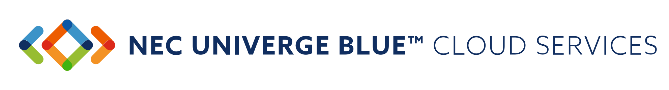
UNIVERGE BLUE
CONNECT
AWARD WINNING UCaaS
Notes:
2/5/21
Let’s look at the CONNECT solution suite.

Slide 4



Combines an enterprise grade
cloud-based PBX phone system,
video conferencing, chat,
file management, and
contact center into a
seamless experience.
Notes:
2/5/21
CONNECT is the name for NEC’s UCaaS solution but it’s so much more than just UCaaS. I mentioned that there are four primary solutions that are part of CONNECT. MEET is the collaboration tool. SHARE is used for file sharing and personal file backup. CONNECT includes a Contact Center called “CORE” that is a strong voice-based contact center. ENGAGE is the advanced contact center that comes in two flavors – ADVANCED and COMPLETE. Both CONNECT UCaaS and ENGAGE ADVANCED Contact Centers offer integrations to 3rd party applications or CRM tools like Outlook and Salesforce.com.
We will dive deeper into integrations in a moment but what I want to highlight here is that every CONNECT user license comes with a desktop and mobile option in addition to a physical phone with the option to add more licenses.

Slide 5
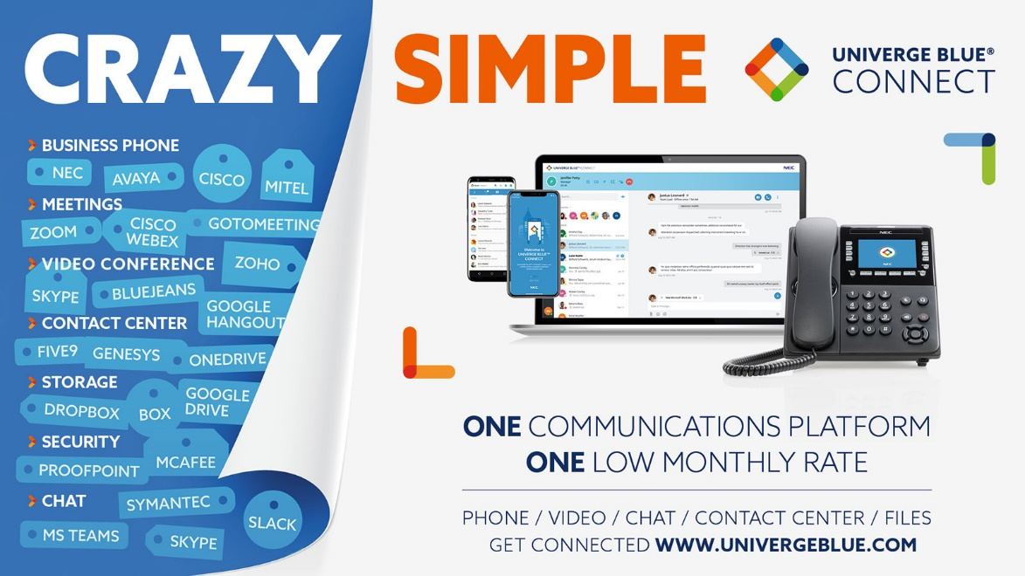
CRAZY SIMPLE
CONFIDENTIAL
Notes:
2/5/21
By now you’ve certainly come to realize that this is a very robust solution. However, UNIVERGE BLUE is also crazy simple! Imagine having all your core collaboration tools all in one place. Your business phone, your HD video and screen share, collaboration for meetings, file share built-in natively to the application, contact center, persistent chat to your peers or SMS chat to a cell phone, all the while adhering to the compliance and security that is required to run your business safely. UNIVERGE BLUE is an all-in-one communications platform with one low monthly rate. We call this “Crazy Simple”, and it is unique in our industry.

Slide 6

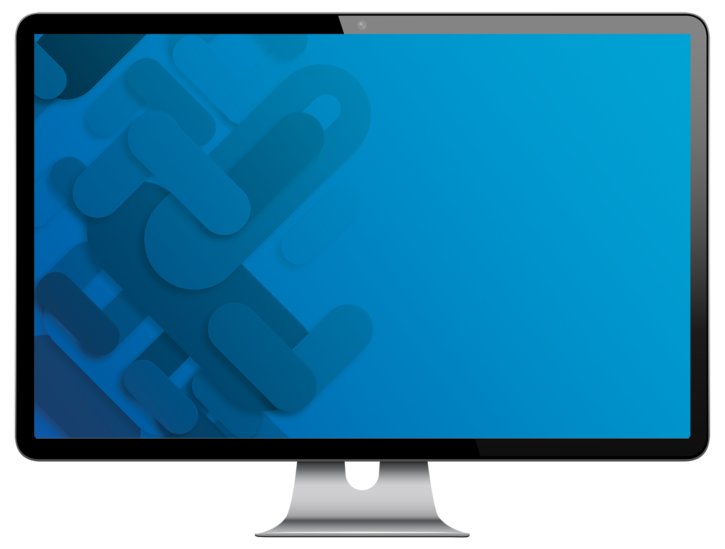

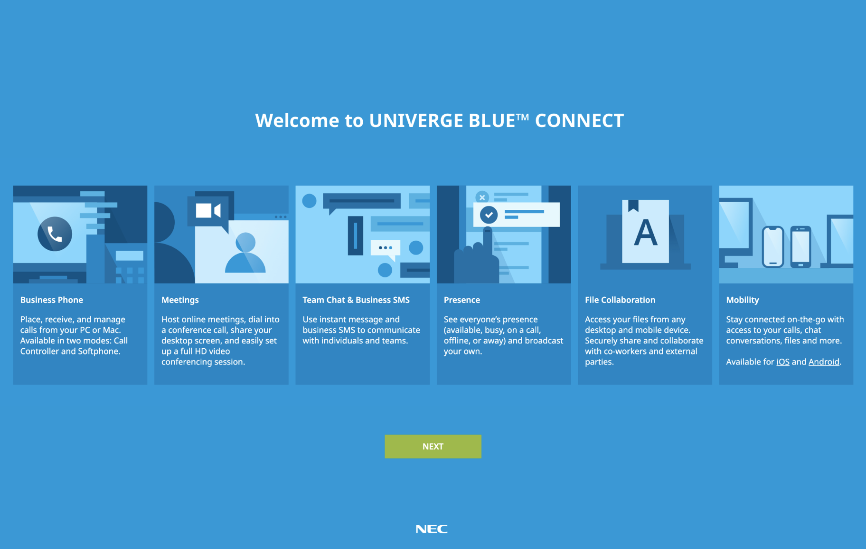

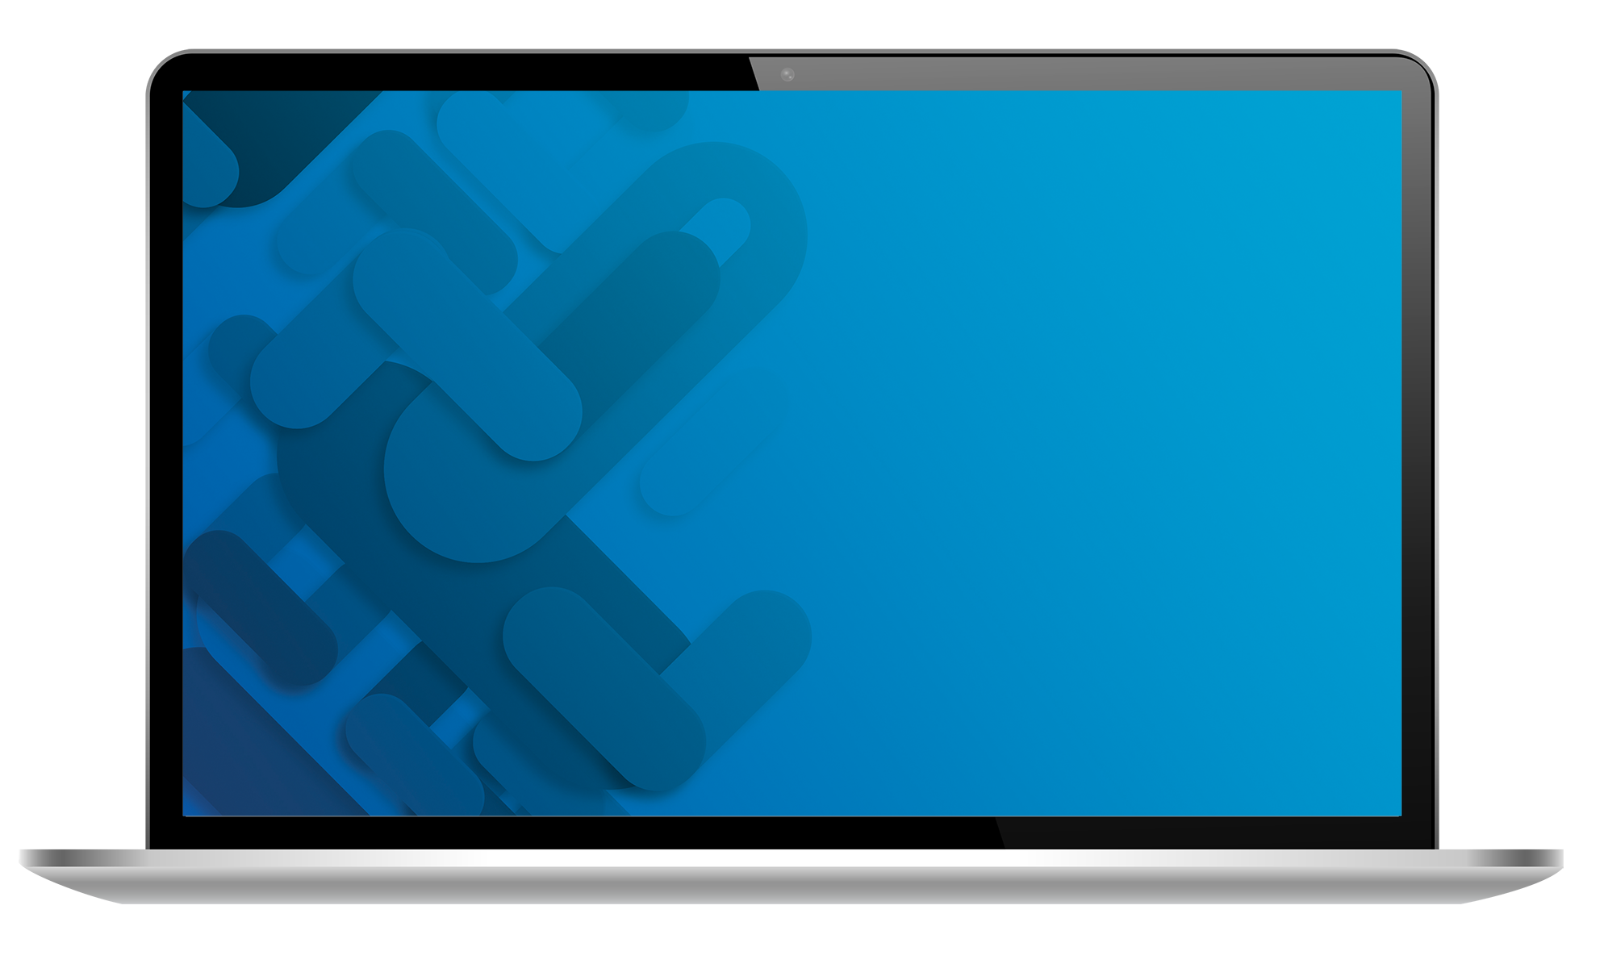
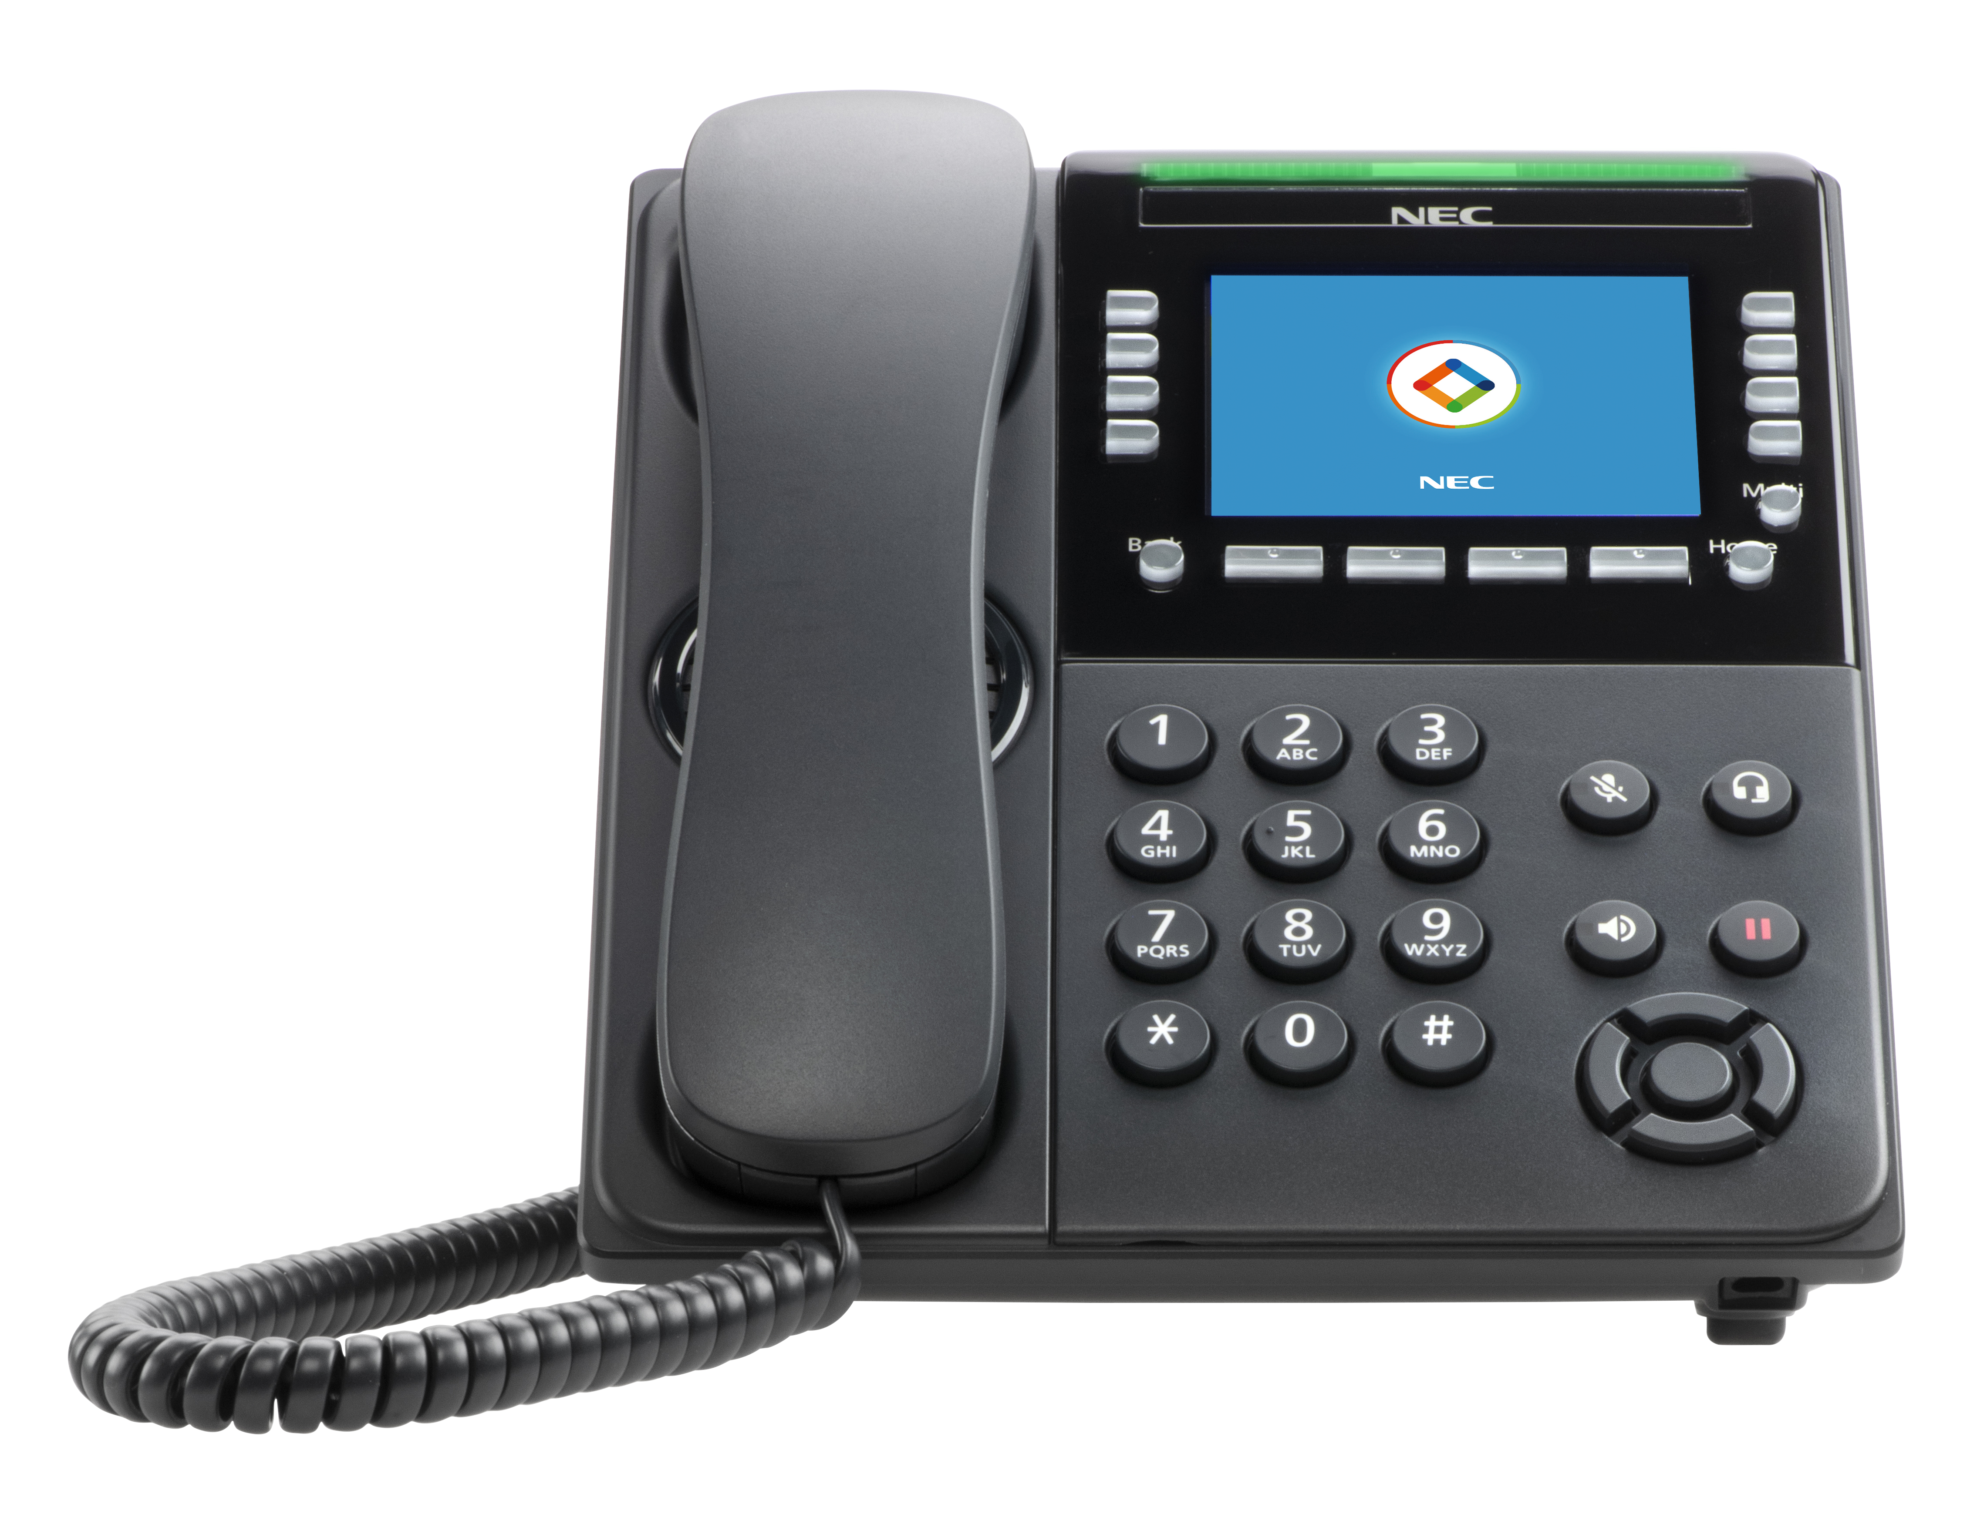
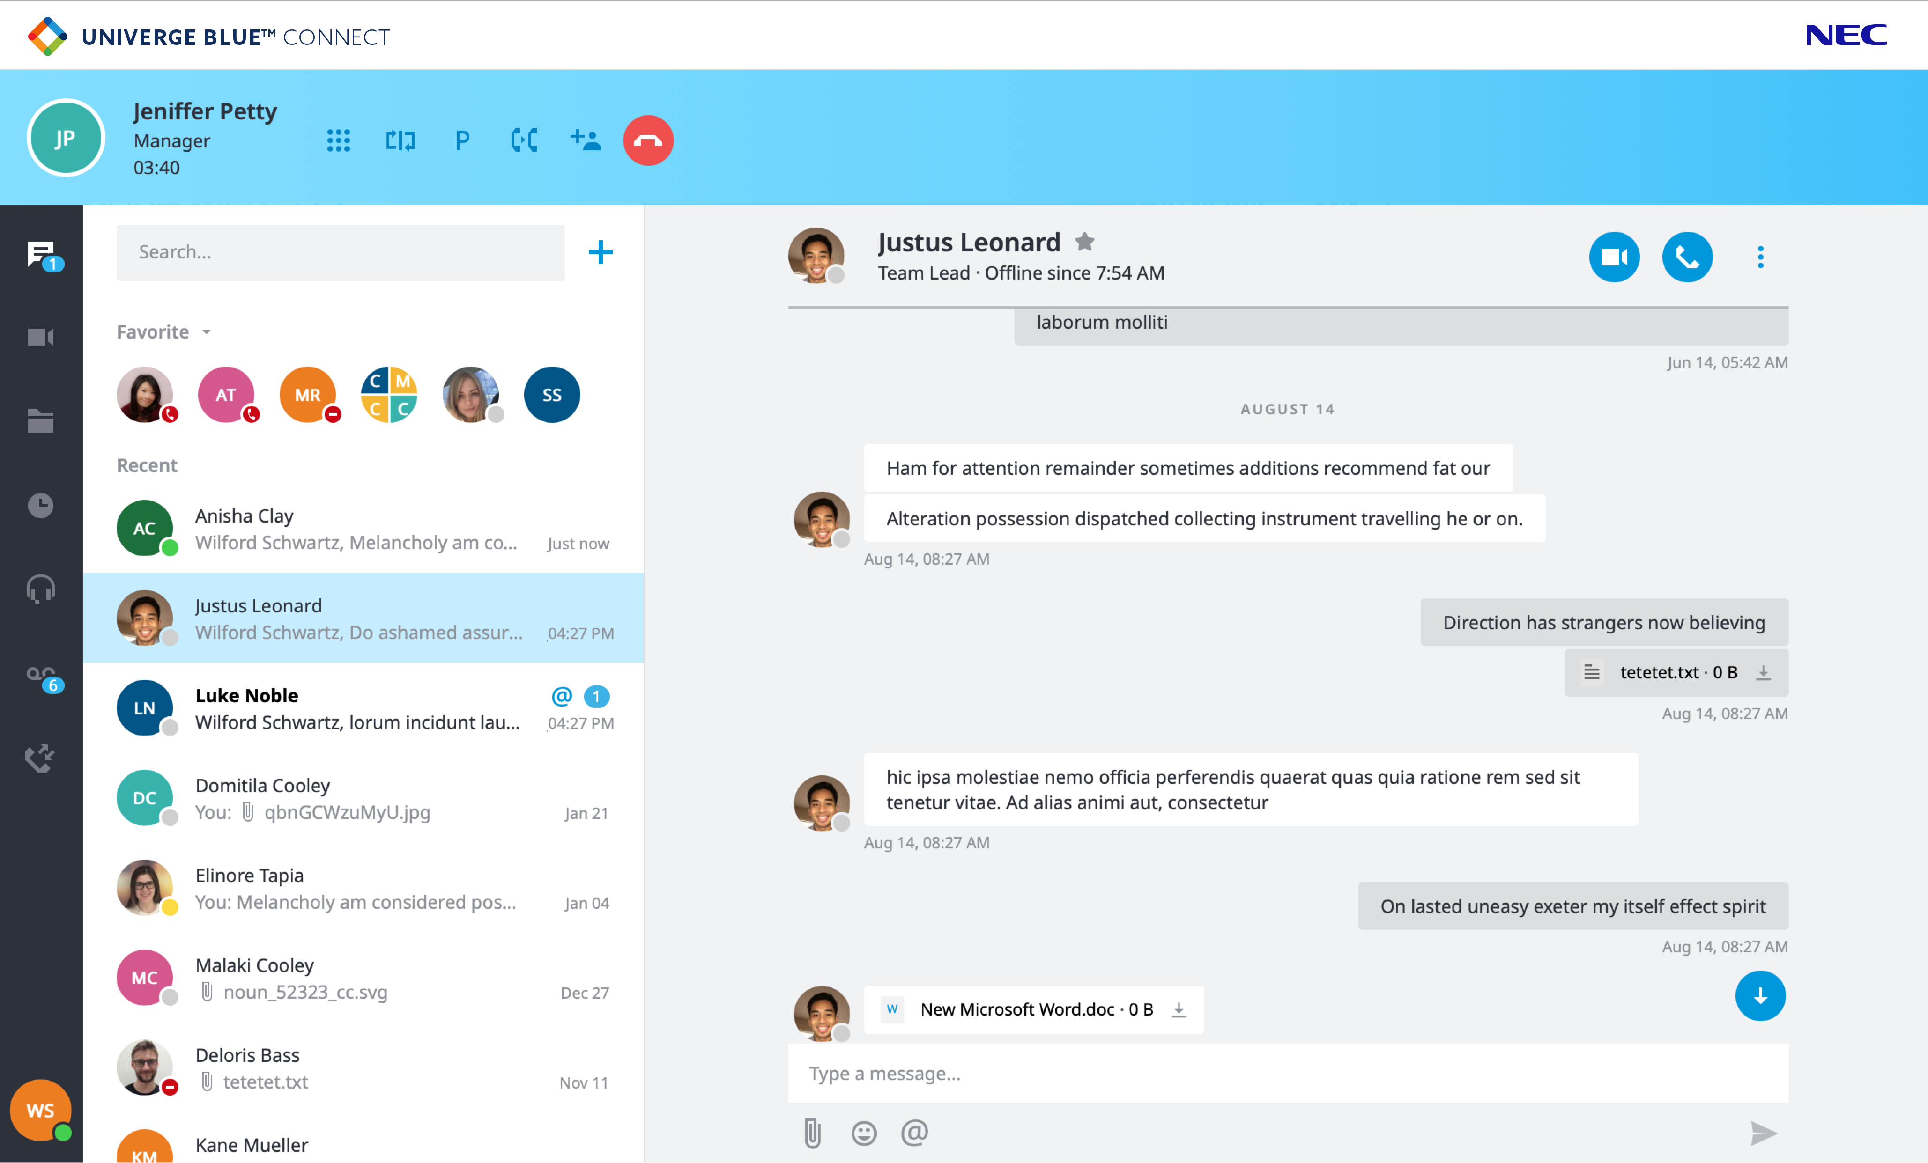
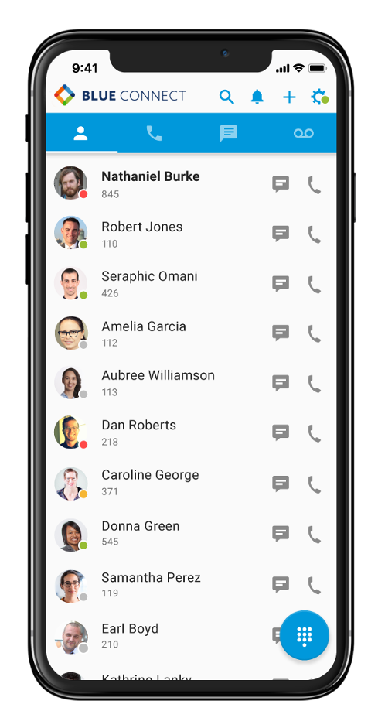
CONNECT - Complete Communications Solution
All User License Roles Include the UCaaS Desktop and Mobile App
Notes:
2/5/21
Here’s a glimpse of NEC’s UNIVERGE BLUE CLOUD SERVICES. You’ll be able to seamlessly communicate across all your devices. Whether you want to take a call on your desk phone or on your desktop, all user licenses for NEC’s UNIVERGE BLUE include a desktop and a mobile app. You’re able to use NEC’s CLOUD SERVICES on up to five devices, all the while being able to flip back-and-forth between devices.

Slide 7







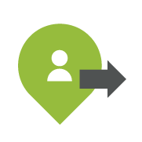















UNIVERGE BLUE New Generation UCaaS and CCaaS
UNIVERGE BLUE CONNECT
UNIVERGE BLUE ENGAGE
Cloud Phone System
Management Applications
Workforce Management | Reporting
Quality Management | Supervisor
Contact Center
Video Conferencing
Email
In-House Agents
Inbound
Customer Service
CUSTOMER
Phone
AGENT
Team Chat and SMS
Outsourced
Agents
Mobile
Web
Work-at-Home
Agents
Desktop
Backup and Collaboration
Outbound
Sales & Marketing
Social Media
Experts
Presence Indicator
Fax
Chat
Integrations
CRM & Other Business Applications
Mobile
Self-Service
Notes:
2/5/21
Let’s take a walk around the wheel of CONNECT. At the top it says Cloud based phone system, that’s kind of a given. Over to the right it shows video conferencing. This solution has built in video and online conferencing and collaboration as part of the tool. Based on the user role associated with their CONNECT licensing, they will have a varying level of video conferencing support. All level user licenses include video collaboration.
CONNECT supports mobility on all 3 levels of user licensing so you never have worry about if mobile is included or not. This mobile app works just like the desktop app and is fully synchronized. There is no delay between what happens on the desktop and the mobile app as I will show in a live demo coming up.
SHARE is used for personal backup and file sharing and is part of the CONNECT app. The mid level and high-level user licenses come with SHARE as part of the solution.
BLUE supports faxing in two ways. We support traditional, physical fax machines via ATI interface with an optional piece of gateway equipment and we also support web faxing as part of the core of CONNECT with the middle and higher-level licenses. With web fax the user will get an interface for sending and receiving fax files, and those files are viewable from the desktop and mobile apps.
Since the service is UC as a service, presence indication is part of the solution and is driven throughout the tool in every location where you are and every app component that you are working with.
The BLUE Desktop is also available for all user license types along with team chat and SMS. Chat supports one-to-one chat, group chat as well as sending a chat message via SMS to a mobile device. SMS chat is great for when you need to send a message to someone who is not on your network where you can simply open your desktop application, choose SMS chat and send texts directly to someone’s mobile device.
On the right, you’ll see the ENGAGE for cloud contact center. CONNECT & ENGAGE are fully integrated with each other. In fact, the CORE version of ENGAGE is INCLUDED with CONNECT mid and high-level user licenses. For more advanced contact center users, ENGAGE contact center is an enterprise grade, omni-channel cloud contact center. A company’s inbound and outbound contact center agents can connect with their customers any way that they’d like, via mail, phone, chat, and even social media or the web. The ADVANCED and COMPLETE Omni-channel solution is available stand alone and does not require CONNECT and can run over the top of any PBX or Cloud phone system. Our ENGAGE product will be a key product for you to take to market and we’ll talk a little more about this product later.

Slide 8


UNIVERGE BLUE CONNECT Suite
UNIVERGE BLUE CONNECT
UNIVERGE BLUE CONNECT
UNIVERGE BLUE SHARE
UNIVERGE BLUE
MEET
UNIVERGE BLUE ENGAGE
Cloud Phone System
Team Chat
and SMS
File
Collaboration
Video Conferencing & Screenshare
Contact
Center
CONNECT is a fully integrated cloud based Unified Communications and Collaboration platform
that combines a cloud-based PBX phone system, video conferencing, chat, screen sharing, and
file management into a seamless experience*
*Feature set depends on user profile
Notes:
2/5/21
I mentioned that CONNECT is a suite of solutions. If you look at this image, everything with a blue background is a standard part of CONNECT. What an individual user gets is dependent upon the user license profile. Every user license has individual chat, group chat, and SMS chat.
The next two, File Collaboration, also known as SHARE, and video conferencing, also known as MEET are integrated in the CONNECT control panel with the PRO and PRO PLUS licenses. In addition, the ENGAGE CORE Contact Center is also part of CONNECT for PRO and PRO PLUS user licenses.
SHARE offers the ability to backup your personal files, quickly share files with file collaboration and you can even let someone co-edit a file along with you in a team environment if they are in the same Microsoft 365 business environment.
UNIVERGE BLUE MEET is the online meeting tool where you can do video conferencing of up to 30 viewable video feeds, file collaboration and sharing among 30 to 200 users depending on user license, as well as supporting up to 200 audio conference attendees.
All solutions of CONNECT, SHARE, and MEET that are highlighted in blue are available for all PRO and PRO PLUS users including ENGAGE CORE contact center. ENGAGE ADVANCED and COMPLETE, in the green area, are optional upgrades for those who need multimedia and omni-channel contact center capabilities. Our experience tells us that some level of contact center is needed by every customer – so we include ENGAGE CORE with CONNECT.
CONNECT is a fully integrated cloud-based platform that includes all these solutions in one easy to use application offering a seamless experience.
Differentiation from our competition are the inclusion of File Share and the ENGAGE CORE contact center.

Slide 9


UNIVERGE BLUE CONNECT Packages – Summarized Differences
USER Types Summarized
ESSENTIALS | PRO | PRO PLUS
Advanced Phone Service with Collaboration/DID | Advanced Phone Service with Collaboration/DID
One Desk Phone, One Mobile App, One Desktop App | 5 Devices, Desk Phones, or Apps
MEET Starter: 4 Collab Online Meeting with Screen Share | MEET 100 Collab Online Meeting with Screen Share, Notes, Recording, Transcription & Remote Control | MEET 200 Collab Online Meeting with Screen Share, Notes, Recording, Transcription & Remote Control
HD Audio Conf Bridge up to 200 Participants | HD Audio Conf Bridge up to 200 Participants | HD Audio Conf Bridge up to 200 Participants
Video Conferencing 720p HD, up to 4 Webcam Panels | Video Conferencing 720p HD, up to 30 Webcam Panels
Free Phone or Rebate 1> Year
ESSENTIALS continued | PRO continued | PRO PLUS continued
 | File Sync, Share, & Backup 10GB/Pooled
G-Suite, Microsoft Active Directory, Outlook,& Teams, & Slack Integrations | ← + Sugar Zoho | ← + Salesforce, Zendesk, ServiceNow, Netsuite, MS Dynamics
Call Recording - 24 Hrs (300MB)/User
10 Hrs Voicemail Storage | 10 Hrs Voicemail Storage with Transcription
1:1 and Group Instant Messaging
 | ENGAGE CORE Contact Center
 | WebFax/DID
 | Receptionist Mode
PROMO
*Feature Set depends on user license profile
Notes:
2/5/21
I mentioned that there are three user levels for CONNECT and ENGAGE and as you can see in the box on the left the CONNECT user seats are ESSENTIALS, PRO, and PRO PLUS. This chart provides a high-level overview of the hundreds of features and capabilities available with CONNECT.
ESSENTIALS is the basic level user license. It includes cloud-based phone service, all the typical phone features and functions that you see, and many more that you might not think are part of a typical UCaaS. It supports three devices. A physical desk phone, a mobile app, and a desktop app. I can run my desktop as a softphone or can use it as a UC app that drives my hard phone and flip between the two and choose anytime. It also supports integration for G-Suite, Microsoft (MS) Active Directory, MS Outlook, MS Teams, and Slack. ESSENTIALS also includes a MEET starter package, and Call Recording.
The PRO user gets everything from ESSENTIALS plus a few more things. Support for up to five endpoints gets added for devices such as a home phone, a tablet, or another device in another location. It adds additional integration to Sugar and Zoho along with what comes with ESSENTIALS. PRO MEET allows up to 100 people sharing a screen, file, or application, and MEET supports up to 200 in an audio conference bridge. That’s 100 people viewing online and up to 200 people just listening in, or a 200-party audio only bridge for every PRO user. The PRO license also supports SHARE -the personal backup, antivirus, and file sync tool that we talked about. PRO also includes support for an ENGAGE CORE Contact Center Agent.
PRO PLUS is the highest-level user license which includes everything in PRO and ESSENTIALS plus additional integration support with Salesforce, Zendesk, ServiceNow, Netsuite, and Microsoft Dynamics. From a MEET standpoint it increases the online attendees that can view the screen to 200 and includes 200 personal audio conference bridge. PRO PLUS also includes the file sync, share, and backup.

Slide 10
UNIVERGE BLUE Additional Device Connections (Resource License)
IP, Fax, or Analog Resource Packages
Resource Per Use | Resource Per Minutes
Resource license used for general purpose device with no UC – IP device or analog*. Pay per use or metered. No free phone or rebate is available with these licenses
Use Cases: Courtesy, Lobby, Conference Room, Paging Device
Billed Per Minute | Includes 500 Minutes
*Analog Requires Adapter (purchased separately)
Includes 1 DID & VM - Max 1 Device per License
Call Recording On Demand and Automatic
Fax Resource Per Use | Fax Resource Per Minutes | Fax Resource Unlimited
License to support physical fax machine (use WebFax for virtual fax app), with no UC included. Pay per use or metered. No free phone or rebate is available with these licenses. Requires adapter*
Used for Fax Machine or Analog Terminal
Billed Per Minute | Includes 500 Minutes | Unlimited Outbound, Local, and LD
*Requires Analog Fax Adapter (purchased separately)
Includes 1 DID - Max 1 Device per License
*Fax adapter included in quote tool on equipment screen
Notes:
2/5/21
In addition to the user seats, we also have low-cost resource licenses. These resource licenses can be used for a low-cost method getting dial tone to a conference room phone, kitchen phone, fax machine, or connecting a door phone or paging system – locations that have no need for the UC capabilities of the user licenses.
The price on the resource license varies based on use. For example, if you want to connect a door phone that won't need to make any outbound calls you can use the pay per use resource license or if you have a conference room phone that has some usage you can use the resource license that comes with 500 minutes of usage.

Slide 11


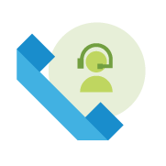



CONNECT - 100+ Enterprise-level Features Included
Full Featured Phone System | Automated Attendant | Hunt Groups (10 included with CONNECT)
Call transfer, hold, park, monitor, conference, contact list, BLF, Line Keys, follow me forwarding, call flip Easily deploy phones at remote and home offices | Multi-menu, multi-level, scheduled routing with easy graphical setup and management | Flexible call delivery - simultaneous, round robin, sequential, longest idle Greetings & recorded messages Graphical Data & Usage Reports
Call Recording | Receptionist Routing | Control Panel (Admin)
Automatic call recording: Records all calls placed to a hunt group On-demand call recording: Decide when to record a call on the fly | Route to one or multiple receptionists Scheduled routing based on time of day | Feature & User Management Add phones, device, and numbers Manage Auto Attendant & Groups View Hunt Group Reports
*Feature Set depends on user profile type
Notes:
2/5/21
NEC works hard to make our feature sets all inclusive. We don’t nickel and dime with add-ons and we go above and beyond with the features included.
I mentioned that the cloud-based phone system is a fully featured enterprise-grade cloud PBX including all the features that we typically expect, plus some that you might not. In addition, CONNECT includes unlimited parking, support for monitoring, and conferencing. If I want to go beyond three party conferencing, I can use my MEET personal audio bridge or video conferencing. CONNECT supports integration to a personal contact list; active directory is part of the integration at the base level for the Global Address List. Busy lamp fields, both physical and soft, follow-me forwarding, and call flip - a feature that lets me take a call and move it to one of my other devices – so I can move my calls from my desktop to my cell with one click – or vice versa.
From an auto attendant standpoint this is one on steroids. Every CONNECT account includes 10 auto attendants with multi-menu, multi-level, schedule routing, and an easy GUI setup for graphical setup and management. You can add any number of auto attendants to the solutions that you may need.
There are 10 hunt groups built-in for basic routing with queuing and some basic call reporting for all users, and the CORE contact center is available for PRO and PRO PLUS users offering priority routing, preferred agent routing, or longest idle. If you can think of a way to route it, you can do it with one of the contact center solutions available. If you need more than phone call routing, the optional ENGAGE ADVANCED or COMPLETE contact centers can route virtually any contact type you can imagine.
CONNECT supports multiple levels of recording, including an override as well as reporting on that recording for what you are looking for.
Call recording is a standard feature of CONNECT for all user license types and you record all calls to a specific pilot or hunt group, or you can do on-demand recording.
Receptionist routing can be combined with auto attendant so calls can be routed directly to a live person or sent to an auto attendant then to reception. It can be changed by time of day.
Multi-site is a typical capability in a cloud environment. It is easily deployed, even for remote workers in a home office environment.

Slide 12


NEC Business Phones
For UNIVERGE BLUE
Built for business needs
and designed for easy deployment
Notes:
2/5/21
CONNECT doesn’t require any hardware or any phones, however NEC has a plethora of phones that seamlessly integrate with UNIVERGE BLUE CONNECT services. And currently we have a promotion where you receive a free phone with PRO and PRO PLUS user licenses.

Slide 13







UNIVERGE BLUE Business Phones – DT900S
BUILT FOR BUSINESS NEEDS AND DESIGNED FOR EASY DEPLOYMENT
MWI LAMP
Message-waiting indicator
SECURITY
TLS and SRTP security encryption technology to protect calls and accounts
HD AUDIO QUALITY
Both speakerphone and handset offer super wideband technology for superior HD audio quality
INTUITIVE AND INTERACTIVE NAVIGATION
All models offer intuitive and interactive navigation of the NEC communication features
ADJUSTABLE STAND
5 adjustments - Built-in wall mount
PoE Powered
PoE powers the device and gives it a network connection
HIGH-QUALITY HANDSET
Slimline handset increases the conversation comfort
MORE FLEXIBILITY WITH ADD-ON MODULES
60 additional line key options turn your phone into a switchboard
Notes:
2/5/21
<read a few of the highlights from the slide directly>

Slide 14
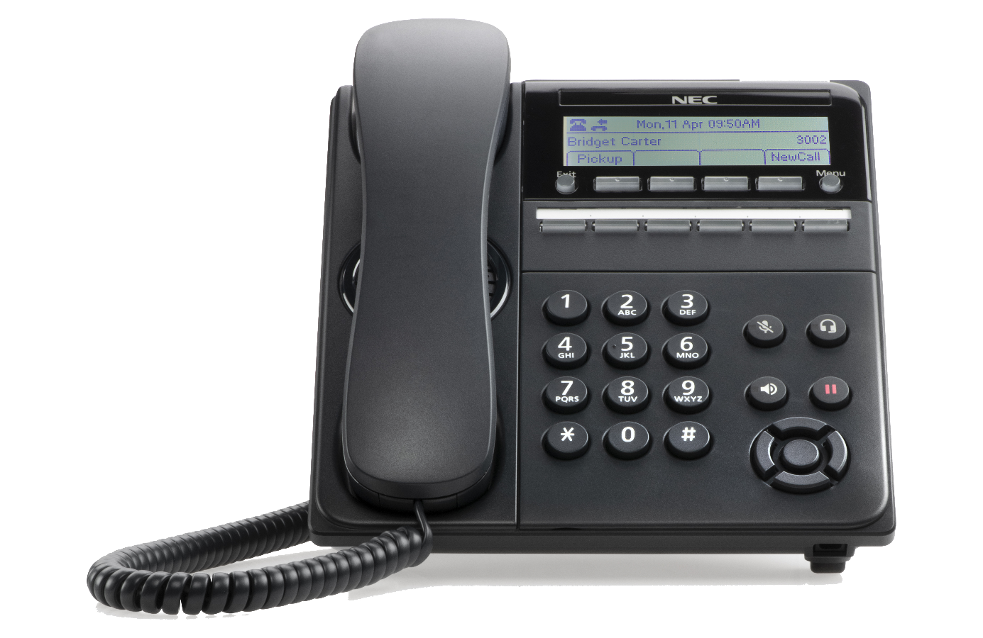

UNIVERGE BLUE Business Phones – DT920S 6-key
Message Waiting Indicator (MWI)
Incoming and MWA indication lamp
168x41 dot monochrome LCD
Multiline support
6 soft keys | Backlit line keys
Handset and speaker
Wideband and narrowband audio
Fixed telephone keys
Microphone Mute Headset |
Speaker and Hold
Adjustable stand
5 adjustments
Headset jack
EHS support
      Menu keys
      Call history | Redial/missed calls Directories | Settings: ring volume
Connectivity
Network support
10/100/1000 Mbps;
PoE Support
Notes:
2/5/21
Basic phones can be used in classrooms, break rooms, lobby areas, etc. This can also be used for a power user that mostly uses the softphone and desktop tools but wants a backup in case they experience PC issues.

Slide 15
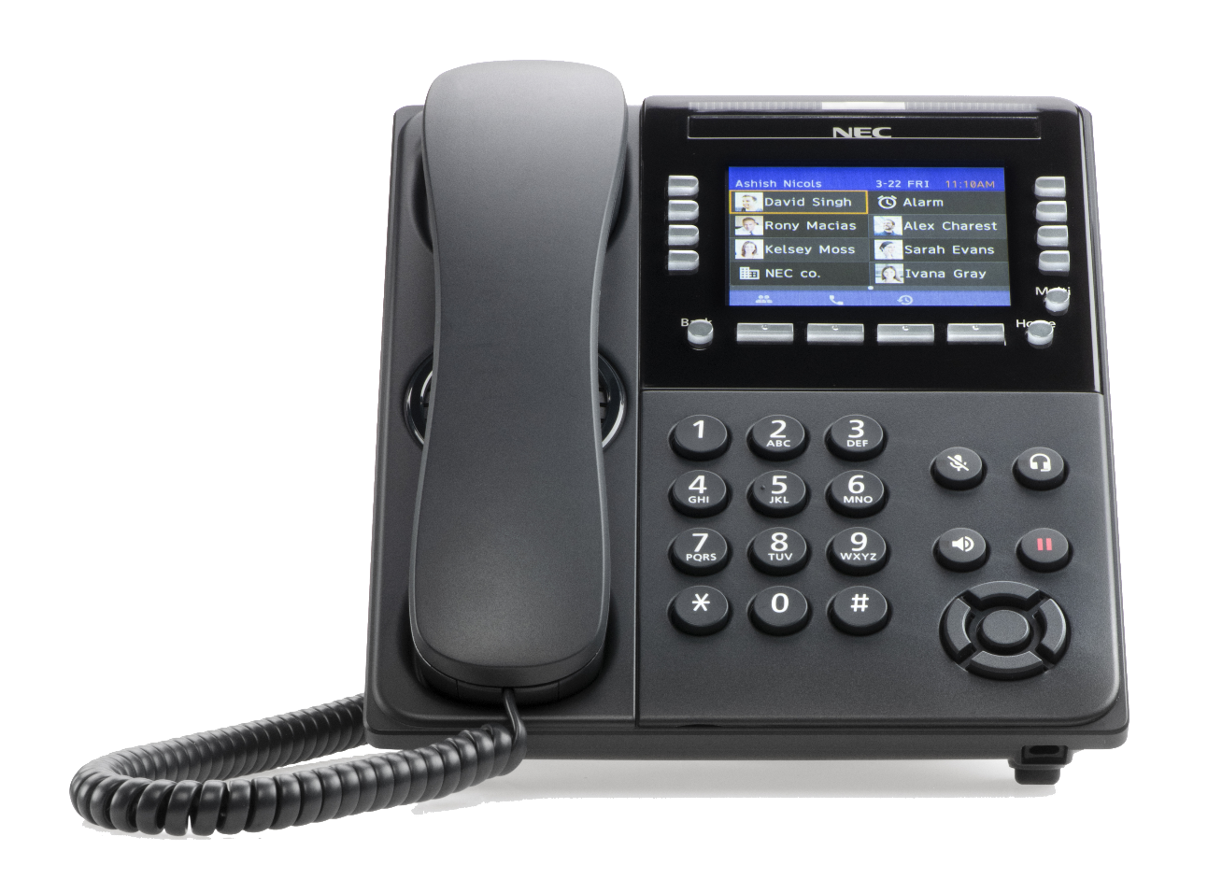
UNIVERGE BLUE Business Phones – DT920S Self-labeling
Message Waiting Indicator (MWI)
Incoming and MWA indication lamp
3.5” full color display
Self-labeling multiline support
8 viewable lines with 32-line support
Handset and speaker
Wideband and narrowband audio
Fixed telephone keys
Microphone Mute Headset |
Speaker and Hold
Adjustable stand
5 adjustments
Headset jack
EHS support
      Menu keys
      Call history | Redial/missed calls Directories | Settings: ring volume
Connectivity
Network support
10/100/1000Mbps
PoE
Notes:
2/5/21
<point out a few features from reading slide directly>

Slide 16
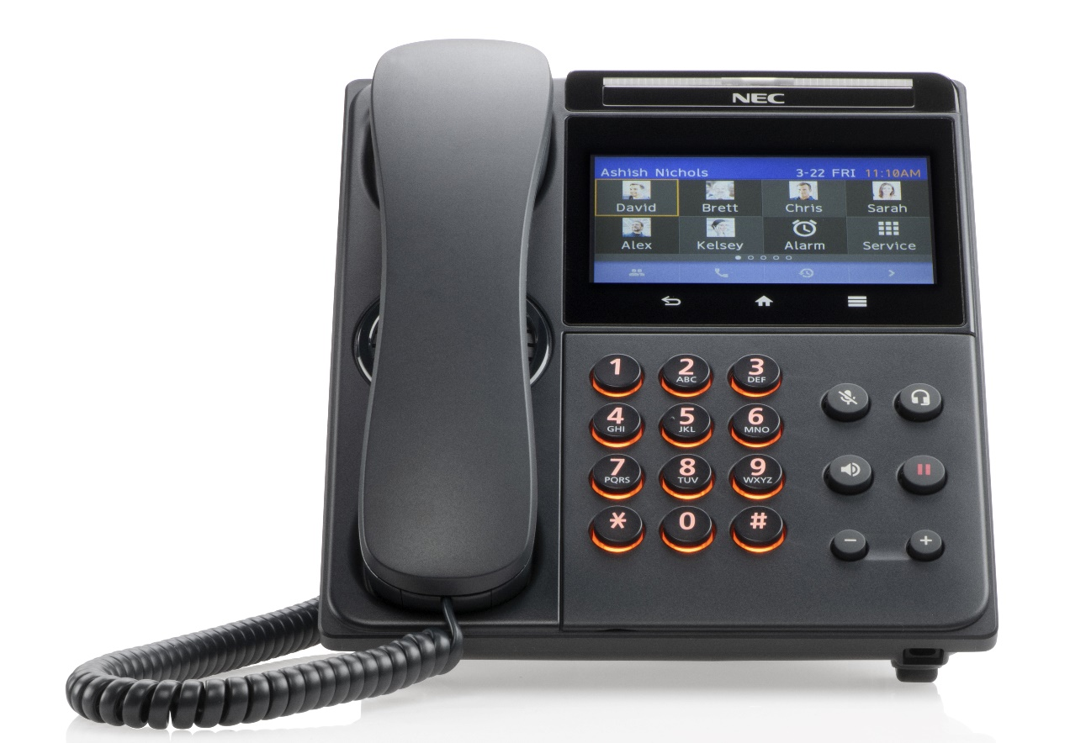
UNIVERGE BLUE Business Phones – DT930S Touch Screen
4.3” full color display
Multi-touch 2-point
Projective capacity sensor
Backlit
Message Waiting Indicator (MWI)
Incoming and MWA indication lamp
Self-labeling
multiline-programmable
touch-key color display
Handset and speaker
Wideband and narrowband audio
Fixed telephone keys
Microphone Mute |
Headset Speaker and Hold
Adjustable stand
5 adjustments
Backlit keypad
Headset jack
EHS support
Built-in Bluetooth
For connecting Bluetooth headsets
Connectivity
Network support 10/100/1000Mbps
PoE or power adapter (optional)
Terminal adapter
Notes:
2/5/21
Color touch screen with Bluetooth support built in for headsets.
<point out a few features from reading slide directly>

Slide 17
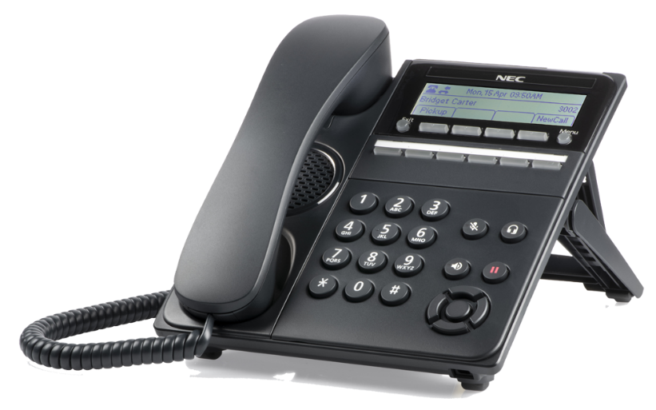
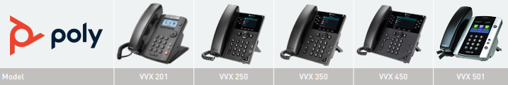
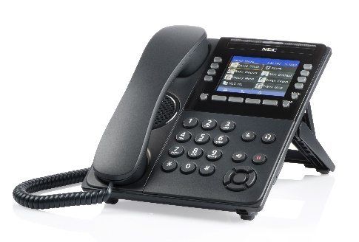
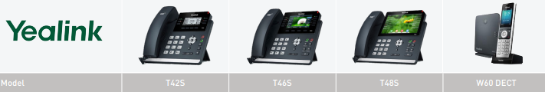
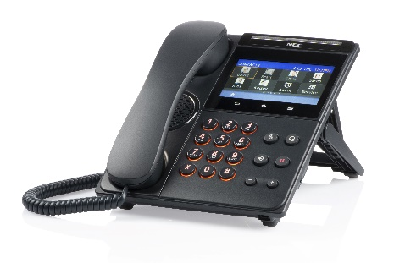
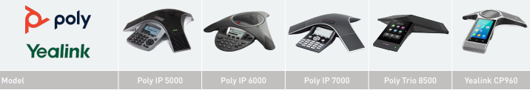
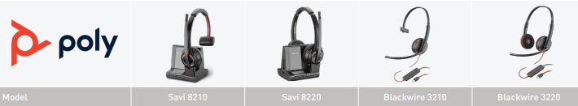

CONNECT Plug and Play Phone – 3rd Party Options
NEC Phones
DT-6DGS
DT-32LCGS
DT-32TCGS
Delivered pre-configured to work seamlessly with UNIVERGE BLUE CONNECT service
No special setup required or special technician/IT resources
Management and configuration of phones from simple web-based management tool
Notes:
2/5/21
In addition to the NEC phone models, Poly and Yealink are available with BLUE CONNECT contracts. Those noted with a green star are offered free with every PRO or PRO PLUS user license. Alternatively, you can elect to use the “free phone” to apply a credit toward a higher-level model as desired.

Slide 18
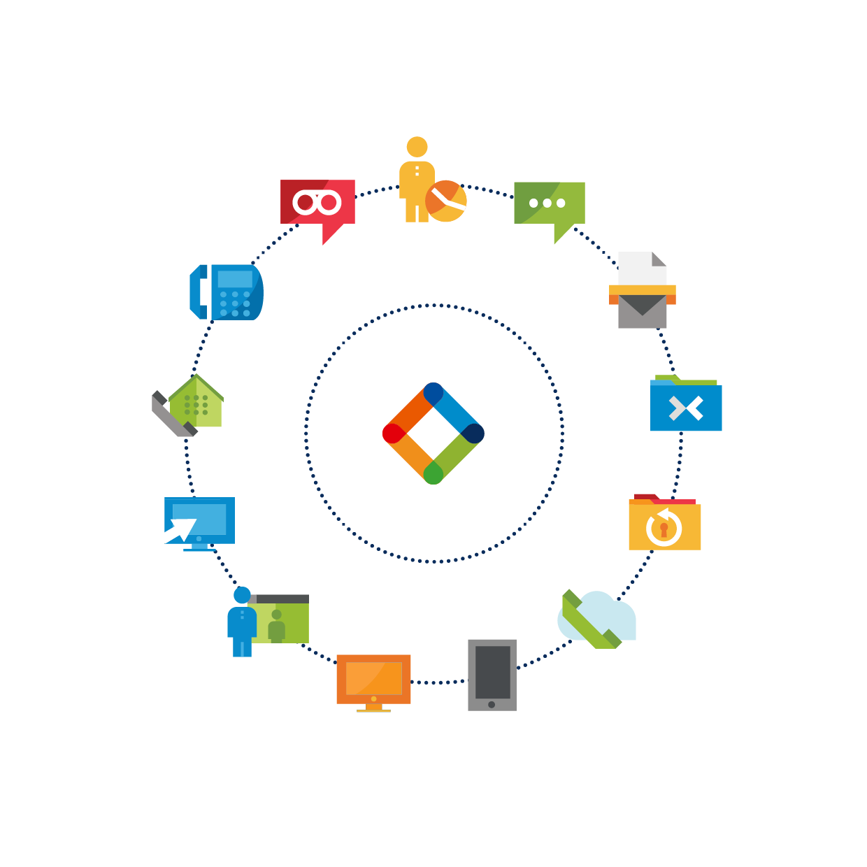
FREE PHONE
WITH UNIVERGE BLUE CONNECT
Expires March 31, 2021
Free Phone (Select Models) with CONNECT PRO or PRO PLUS
Now includes ESSENTIALS!
or – Credit toward upgrade of advanced color phone model.
Minimum One Year Contract Term
NEC reserves the right to end this promotion for any reason and without notice
Notes:
2/5/21
No matter which licensing model you choose for UNIVERGE BLUE, you’ll get a free phone or credit toward an upgrade. The only requirement is a minimum 1yr contract.

Slide 19
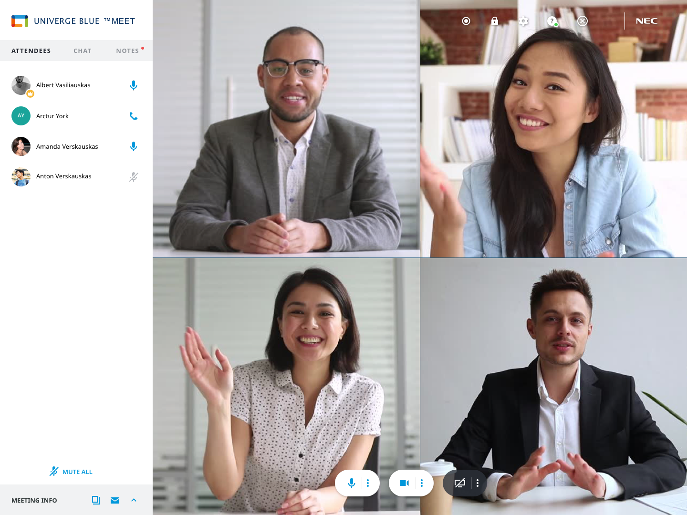
PC and Mac® Platforms – Fully Integrated Experience
Phone with CID, hold, park, flip transfer, conference
Video, screen share, add participants to any chat
Chat & SMS
Web meeting
Integrated company directory
File SHARE
Call history
CCaaS/CORE
Up to 30-way HD video
Voicemail
Dial Pad
Presence
Notes:
2/5/21
Whether you’re taking calls on your cell phone, your desk phone, or on your desktop, we want you to have the same fully integrated experience. The desktop app works on PC or Mac and will bring the full power of collaboration right to your desktop, all in one place. You’ll be able to see someone’s presence, collaborate on files, place calls, chat with your team, and collaborate via video as it’s integrated with your company directory or as you’re reaching out to prospects or customers.

Slide 20
CONNECT Mobile – Fully Integrated Experience
Transcribed voicemail
All company contacts
Team chat
Place and receive business calls
Real-time presence
Siri and Apple watch integration
Phone with hold, park, transfer, conference, and flip
Notes:
2/5/21
The CONNECT mobile app is a fully integrated experience. It will have the same look and feel as your desktop app, you’ll be able to see your contacts, their presence, chat with people, place and receive calls, check your voicemail, flip calls back-and-forth between devices, and it even has Siri and Apple Watch integration. There is no delay in synchronizing between the desktop and mobile apps, which is common with the competition.

Slide 21


Enabling the workforce to provide personalized service…
from anywhere
EXTEND Integrations are included with CONNECT and ENGAGE based upon user license or package
Notes:
2/5/21
Companies are using other applications, whether it be their CRM or their other collaboration tools or ticketing desk. NEC’s UNIVERGE BLUE EXTEND has integrations for everyone!

Slide 22
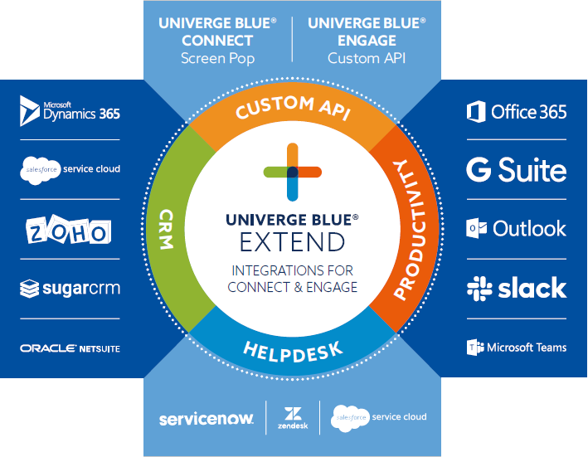
UNIVERGE BLUE EXTEND – Easily Access Pre-built Apps
Screen Pop CONNECT
Custom Integrations ENGAGE
  Enhance existing business systems with click-to-dial, analytics, call logging,
  and fax
  from one UX
  Comprehensive Google integration
  Broad Microsoft support
  APIs for everything –
  voice, SMS, messaging, meetings, and fax
Click to Call
Screen Pops
Advanced Ticketing
Notes:
2/5/21
The UNIVERGE BLUE EXTEND integration platform connects powerful voice, chat, video conferencing, and contact center functionalities into everyday business applications from Google, Microsoft, Salesforce, and more — driving higher productivity and increasing customer retention with no heavy costs.
From click-to-call in Outlook or Google, to contact integration in Salesforce, or screen pops in your ticketing or helpdesk system, to comprehensive integrations within your productivity tools like Microsoft 365 and SLACK, even custom API capabilities, UNIVERGE BLUE EXTEND has integrations that are simple to use and deploy. You’ll notice the different integrations within the varying levels of licensing for CONNECT and ENGAGE.
An important differentiation with EXTEND is that CONNECT includes all integrations, and they become available based upon the user license type. They are not “add on options” as is typical with most competitive providers.

Slide 23
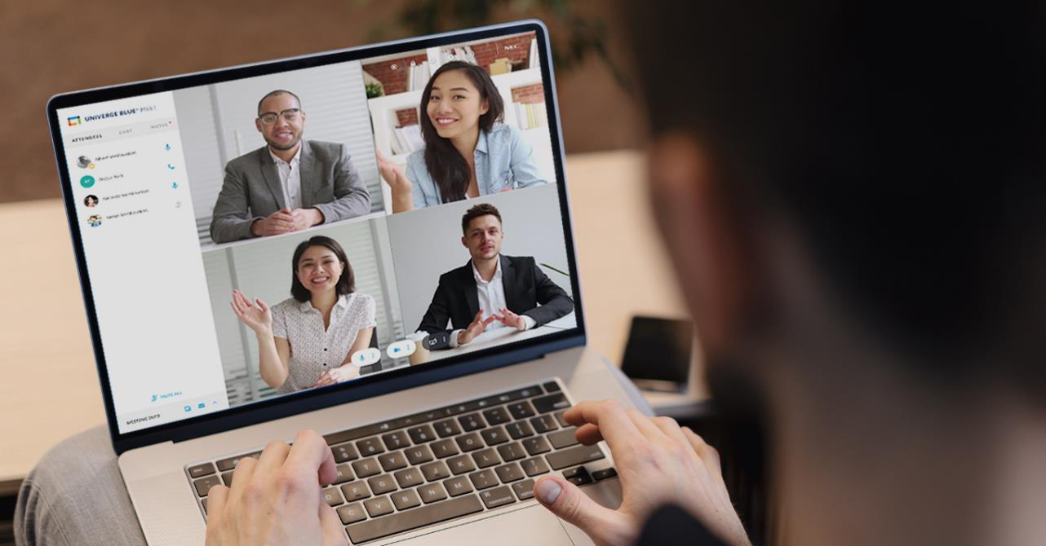

Video Conferencing
With high quality HD audio and video, interactive collaboration tools, and artificial intelligence capabilities, MEET transforms communications with a smarter, faster, engaging,
and actionable meetings experience.
Notes:
2/5/21
UNIVERGE BLUE MEET is a robust, high-quality HD audio and video collaboration platform that will allow you to provide clearer and more interactive communications.

Slide 24
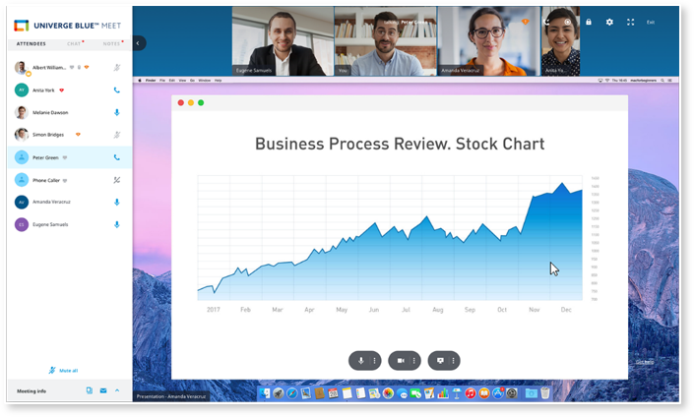
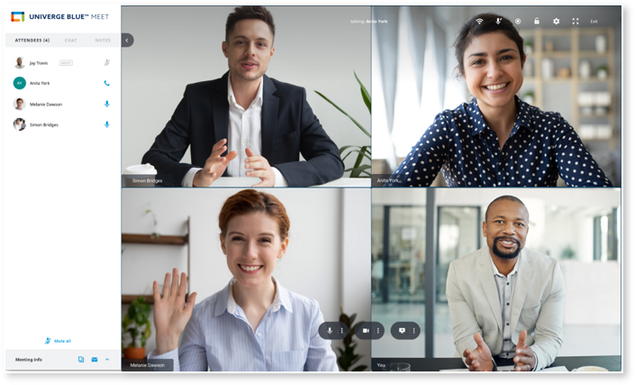
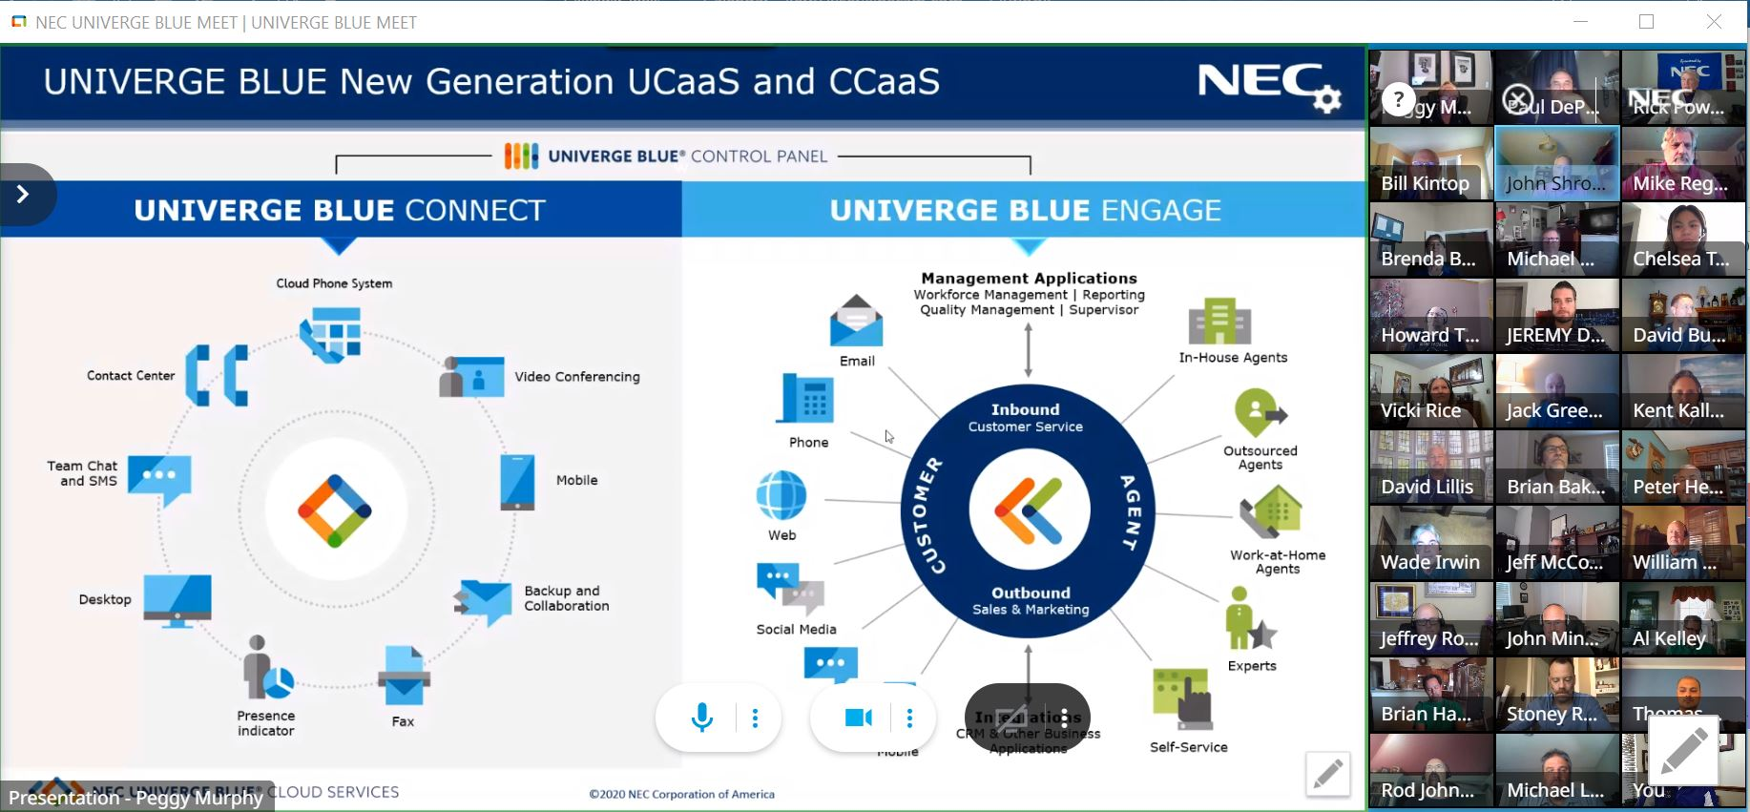
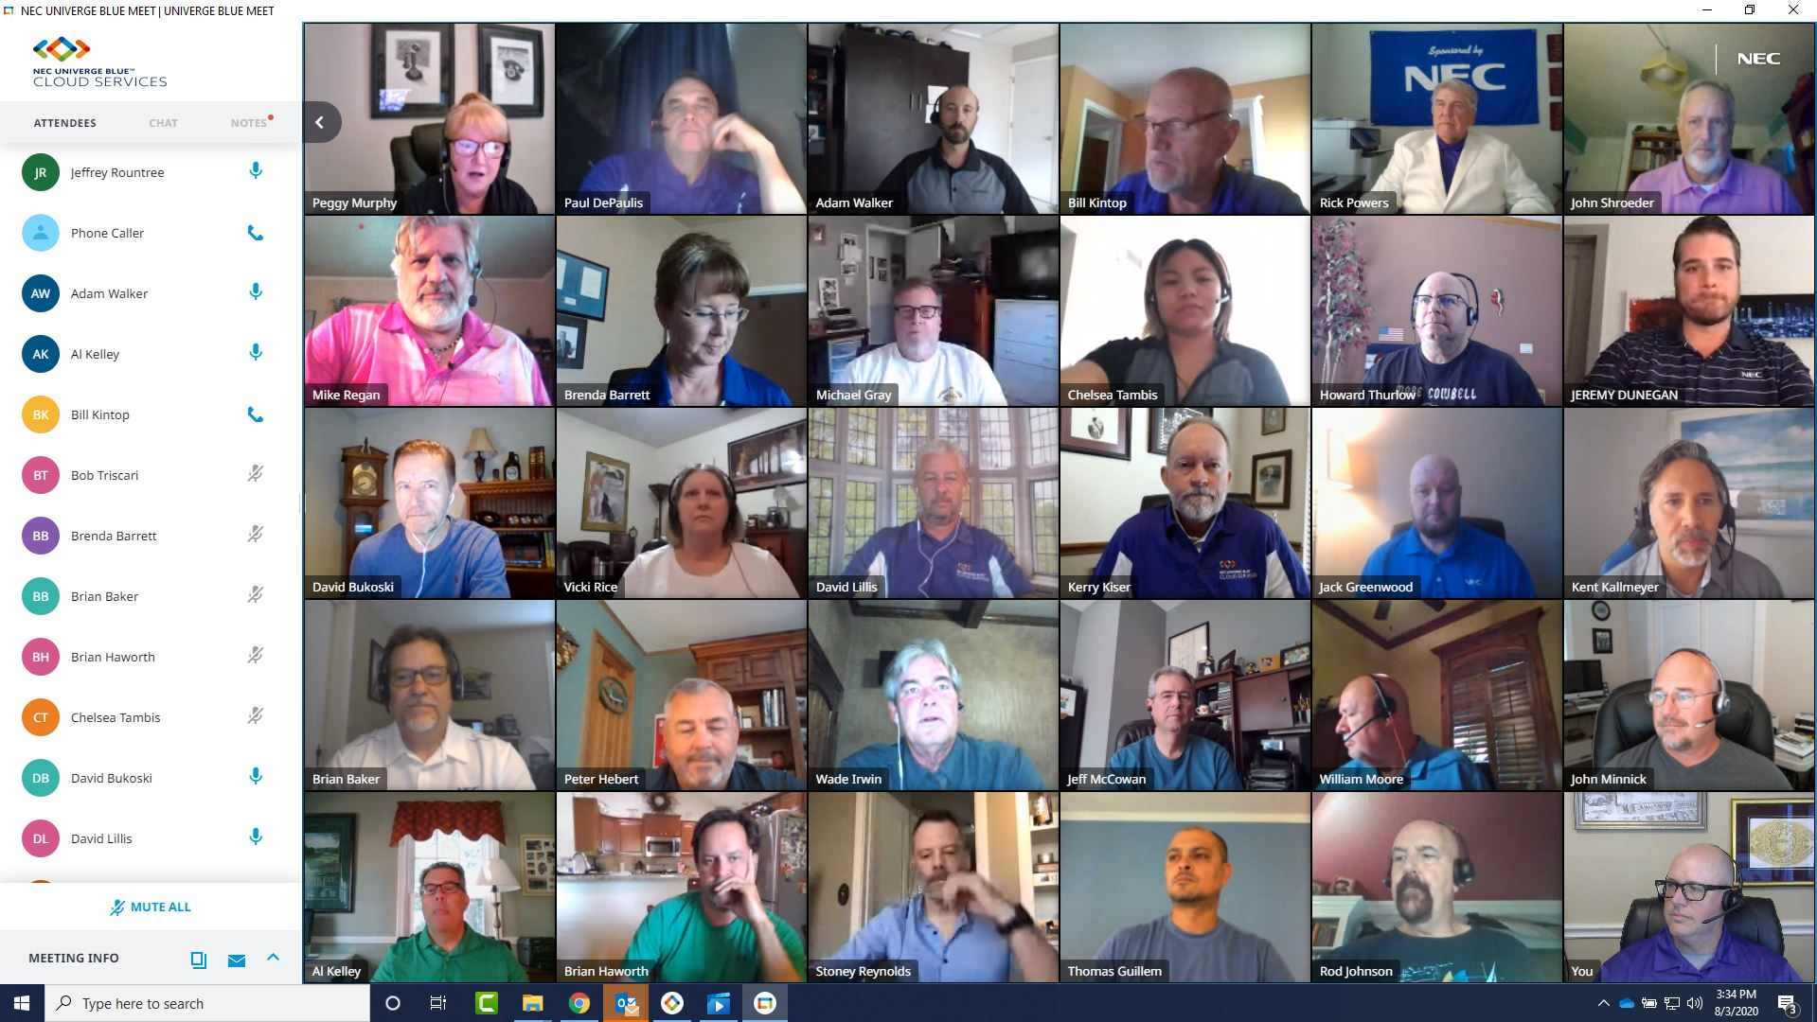
MEET – Easy, Affordable, Reliable Online Meetings
Comprehensive online meeting service
Easy to use – one-click meetings
HD video conferencing – up to 30 panels
Screen sharing
One-click recording
Integrated phone and web audio conferencing
Chat Rooms
In-meeting Notes published to attendees post-meeting
Emoji reactions during MEET, and much more
Part of CONNECT for ESSENTIALS (Starter), PRO, and PRO PLUS Users
*Feature set depends on user profile
Notes:
2/5/21
UNIVERGE BLUE MEET increases workforce productivity with its integrated audio, video, and screen sharing capabilities. It’s simple to use, you can have up to 30 videos visible in the screen (soon to be 200!) as well as up to 200 people on the line doing the screen sharing with audio. There is a built-in chat room and attendees will be able to take notes that will be published post meeting to everyone, there’s even emojis to provide real-time reactions during the meetings. AND the recording available with PRO and PRO plus includes a transcript of the MEET session with insights and assignments called out. MEET is part of CONNECT for ESSENTIALS, PRO, and PRO PLUS license.

Slide 25



Reach, engage, and convert your audience with a turnkey webinar solution
Notes:
2/5/21
UNIVERGE BLUE offers a MEET WEBINAR platform option which allows you to tell your stories easier.
All webinar packages come with UNIVERGE BLUE MEET PRO features! Let’s take a high-level look at the features of MEET WEBINAR.

Slide 26

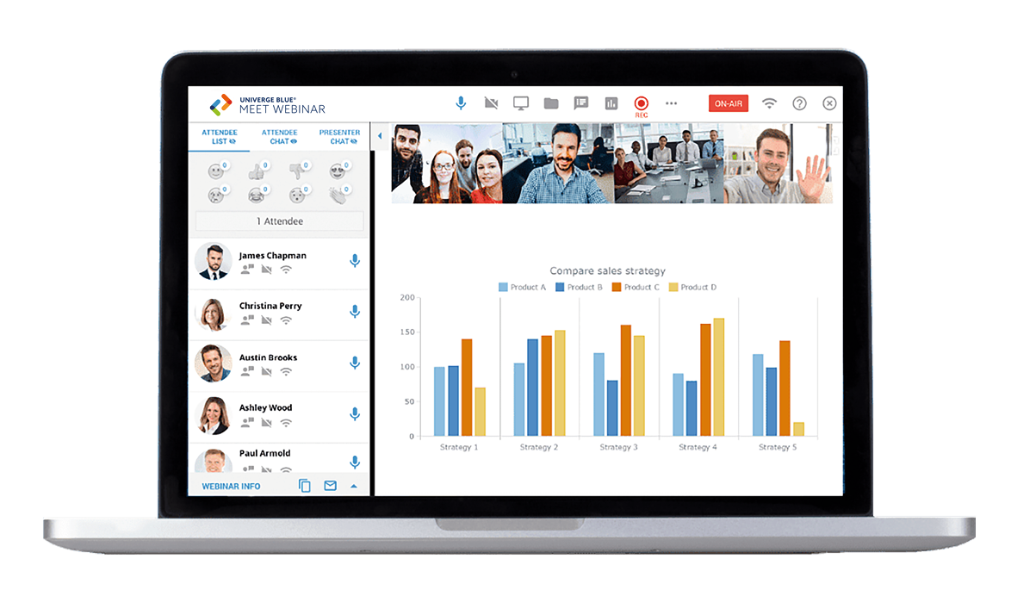

UNIVERGE BLUE MEET WEBINAR
Comprehensive online webinar service
HD video, computer audio, and phone
dial-In audio cues
International dial-in numbers in 40 countries
Host controls: custom email invites, registration forms, and reminder emails
One-click screen sharing, cloud recording,
storage, and playback hosting
Custom branding
Real-time quick polls
Live audience Q&A
Private and public chat
Audience waiting room
Presenter green room
Plus! All webinar packages come with
UNIVERGE BLUE MEET PRO features
Notes:
2/5/21
With UNIVERGE BLUE MEET WEBINAR presenters can use audio, video, and screen sharing for events, training sessions, large meetings, and to market their products and services to audiences anywhere. Attendees can use HD computer audio or phone dial-in. The host can control customizable email invites and registration forms with flexible reminder emails.
MEET WEBINAR is very easy to use with one click screen sharing, cloud recording, storage, and playback. You can custom brand the webinar portal, you can run real-time polls during the webinar, there’s a live audience Q&A, a private and public chat, a waiting room, and even a green room before the webinar kicks off for the presenters to practice. In addition to easily managing the setup of events, MEET WEBINAR offers reports on registration, attendance, polls, responses, recording access, and utilization.
And again, all webinar packages come with UNIVERGE BLUE MEET PRO level features.

Slide 27
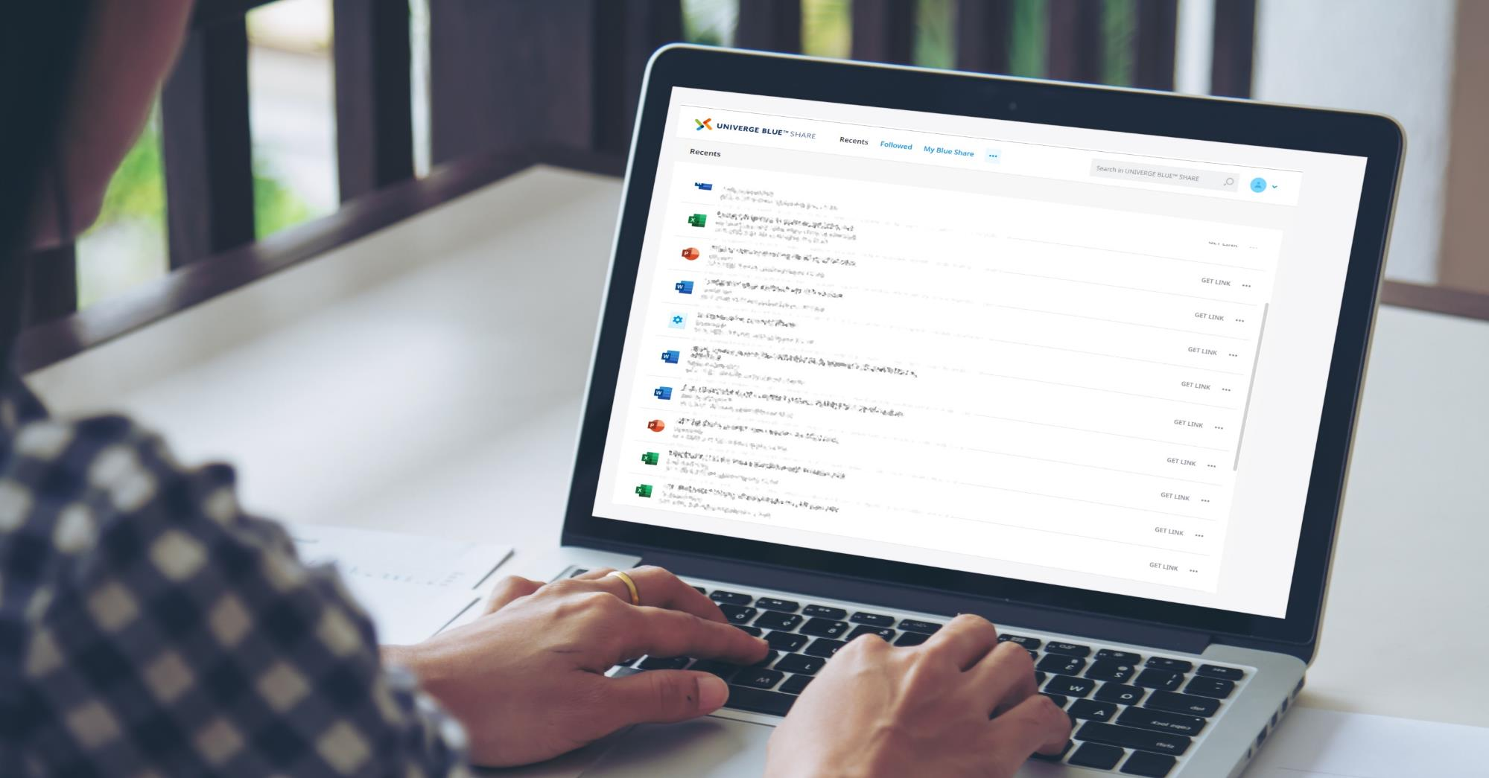

Cloud Storage
Beyond typical cloud file storage
Three functions in one product: file sync & share, real-time backup, and antivirus protection
(including ransomware).
Notes:
2/5/21
UNIVERGE BLUE SHARE is natively built into CONNECT. The SHARE feature is a differentiator, as it is part of our UCaaS – not a separate application like Dropbox. SHARE lives in the CONNECT app, on your phone or wherever you need to access your files.

Slide 28



UNIVERGE BLUE SHARE Key Features
File sync and mobile access
  Access files from desktops, laptops, smartphones, tablets, and the web
  Always up to date
  Unlimited versioning
File sharing and collaboration
  Secure internal & external sharing
  Co-editing in real-time (MS365)
  Flexible sharing permissions
  Powerful administrative controls
  Device access policy
Mobilize file servers
  Windows file server integration
  Access file server content from mobile devices
  Easy, secure sharing of file server files
  Backup & restore file server files
Real-time file backup
  Real-time backup of all PC files, mobile photos,
  and videos
  Restore files to any point in time with one click
  Protects files & enables quick recovery from ransomware attacks
Anti-malware and antivirus protection from Bitdefender
  Files are protected with Bitdefender’s anti-malware and antivirus software at no extra cost
  Two-factor authentication lets administrators add a second layer of protection
Notes:
2/5/21
You’ll be able to access your files from your desktop, your smart phone, tablet, or the web. Your files will always be up-to-date with unlimited versioning. You can control the level of file access with others when sharing files, and you can select which files you want to backup and share.
SHARE integrates with Microsoft 365 allowing you to collaborate on documents. You’ll experience real-time backup of your files, while being protected with ransomware, anti-malware, and anti-virus. You’ll feel secure about storing your files all in one, safe place.

Slide 29
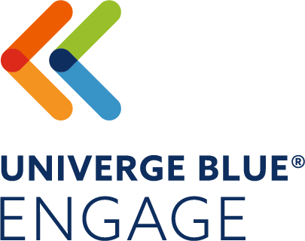
Contact Center
A highly customizable cloud-based customer care contact center – from small call-centric teams to large omni-channel environments
Improve contact handling, customer experience, analytics, and oversight
Notes:
2/5/21
UNIVERGE BLUE’s contact center is called ENGAGE. It’s a highly customizable cloud-based customer care contact center – from small call-centric teams to large omni-channel environments.
Remember that we include the ENGAGE CORE contact center with CONNECT PRO and PRO PLUS users – a key differentiator for NEC.

Slide 30
ENGAGE – Everything A Modern Contact Center Needs
Management Applications
Workforce Management | Reporting
Quality Management | Supervisor
Email
In-House Agents
Inbound
Customer Service
CUSTOMER
Phone
AGENT
Outsourced
Agents
Web
Work-at-Home
Agents
Outbound
Sales & Marketing
Social Media
Experts
Chat
Integrations
CRM & Other Business Applications
Market Watch: Cloud-based Contact Center Market is Expected to Reach USD 33.296 Over the Forecast Period 2019-2024 (May 2019)
Mobile
Self-Service
Notes:
2/5/21
ENGAGE is a very robust cloud contact center offering, with enterprise grade features and omni-channel capabilities. ENGAGE ranges from simple inbound call routing with analytics to outbound, web, chat, email, and social media - you will be able to connect with your customers in a multitude of ways – omni-channel.
The ENGAGE CORE inbound voice with analytics contact center is included with CONNECT. If you have more advanced needs can move to either ADVANCED or COMPLETE depending upon your requirements.
UNIVERGE BLUE ENGAGE can be part of CONNECT or can be sold stand alone operating over the top of any other phone system.

Slide 31
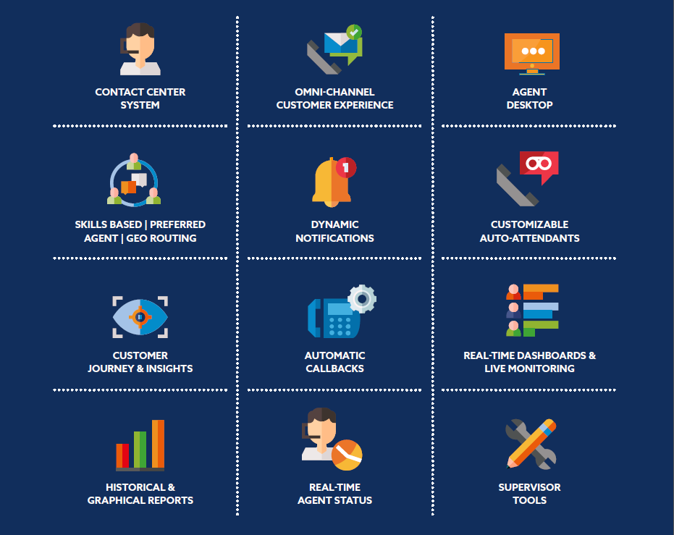
UNIVERGE BLUE ENGAGE
Notes:
The BLUE ENGAGE contact center utilizes the components and elements we just identified to improve the agent’s ability to respond to customer requests the first time through an intuitive agent desktop. When customer contacts beyond voice are included, ENGAGE threads all customer interaction types – including email, chat, sms, web, voice, and social within a single agent interface using advanced skills-based routing rules and methodologies. This improves the customer’s journey experience by getting to the best resource for their specific request.
ENGAGE also manages outbound interactions utilizing dynamic notifications based upon schedules and rules you define. You can communicate with your customers using the same omni-channel engine via SMS, email, text-to-speech, or voice recording. This is useful for such purposes as collecting feedback via surveys, reminding customers of upcoming appointments or meetings, driving awareness of events, promotions, or new products and services.
Easily customizable IVR’s allow for database integration, self service, and effective routing. ENGAGE includes advanced analytics for real time dashboards and monitoring, historical reports, workforce and quality management and scheduling.
You can design ENGAGE to be as simple or as sophisticated as you like. You can even choose to use advanced options like outbound notifications for only those time periods you need them (for example, an education environment might use outbound reminders during the school year but not during the summer months).
To make it easy, we have designed ENGAGE in 3 packages.

Slide 32


UNIVERGE BLUE ENGAGE – 3 Packages
The Contact Center Made Simple! Cost-effective voice-only contact center capabilities, available directly from your UNIVERGE BLUE CONNECT desktop app. | Extend your Contact Center Capabilities A flexible solution providing sophisticated inbound and outbound voice contact center capabilities to increase customer satisfaction for businesses of any size. | Optimize your Customer Experience A full-featured Omni-channel Contact Center solution with powerful integrations capable of delivering the ultimate customer experience.
Simple and robust cloud call center tightly integrated with CONNECT* Inbound Voice Queues Supervisor functions including Monitor, Barge, and Whisper Real-Time & Graphics Reports Scheduled Reporting NEW! Call Recording *Included with every UNIVERGE BLUE CONNECT PRO & PRO PLUS user license | ENGAGE ADVANCED includes All Contact Center CORE functionalities plus: Call Recording Call Scripting Analytic and Historical Reporting IVR Monitor | Whisper| Barge Outbound Scheduled Power Dialing Post Call Survey Queued Callbacks and Voicemails Skills-based Routing Smart Greetings (ETA/Position in Queue) Text-to-Speech | ENGAGE COMPLETE includes All Contact Center CORE & ADVANCED functionalities plus: Chat Channel Queues* Email Channel Queues* Dynamic Notification* Evaluator* Custom Reports* Custom IVR & WFM (DB Dips and Self-service) Schedule Manager* Screen Recording* SMS Channel Queues* Social Media Speech Recognition Integration *Available to add individually ($) to ENGAGE ADVANCED
ENGAGE CORE
ENGAGE ADVANCED
ENGAGE COMPLETE
Included with CONNECT
ADVANCED and COMPLETE are available with a UNIVERGE BLUE CONNECT plan or with your existing phone system
Notes:
2/5/21
For ENGAGE, there are three user levels for contact center. The first contact center agent user type is ENGAGE CORE. CORE is a voice only contact center with flexible routing options, supervisor functionality, reporting, and call recording. CORE is great for SMB or simple contact centers. CORE is part of CONNECT and is included with every CONNECT PRO or PRO PLUS user license.
If you need more than that, especially in terms of contact center analytics and scheduled reporting I would move into the ADVANCED contact center. Again, the biggest difference with CORE, ADVANCED, and COMPLETE is that CORE is part of the CONNECT user license. ADVANCED and COMPLETE are options with CONNECT, or they can be sold as a standalone contact center or over the top of an existing on-prem PBX. Let’s say you have an SL, SV, 3C, or non-NEC on-prem PBX and you need a contact center, you can do that with ADVANCED or COMPLETE licenses. CORE is only available as part of CONNECT.
The ADVANCED license has all the capabilities of CORE with additional contact center analytics as well as call scripting, outbound, post call surveys, callback, skills-based routing, smart greetings, and text to speech. In addition, you also get screen-based recording, scheduler, and evaluator.
ENGAGE COMPLETE takes you all the way up to an omni-channel contact center so that you can route things in addition to voice like email, web chat, and social media. It provides additional analytics to support the multiple channels, very importantly adds custom IVR, integration with database dipping so you can utilize that solution for callers to self-route or callers to be automatically routed based on the status in the database. You can also have other requests and be routed that way to the most effective agent because this is full omni-channel. It includes speech recognition, scheduler, and evaluator.
Those are the three levels for ENGAGE. One basic level (CORE) that is included with CONNECT and two that can be included in addition to CONNECT, next to or on top of a PBX or other cloud-based solutions.

Slide 33


Control & Manage
From the initial network testing, to Quality of Service (QoS) monitoring, we will make sure your BLUE solution is always available, secure and of the highest quality
Protected with an NEC service level guarantee!
Notes:
Most companies, when shopping for cloud services, don't think about the day-to-day management, but nothing is more important to both admin and user productivity than a simple and secure control panel.
Accessible using a web browser, UNIVERGE BLUE CONTROL PANEL is your command post for deploying cloud services to your workforce. You'll use it to manage your user accounts, services, and devices—including mobile device management. It's a "single pane of glass" for your cloud.
It provides simple, powerful and intuitive control over your cloud, integrates your users, services and devices for centralized management, and let’s you easily move, add and change your users. But while it's simple to use, it just got more secure. Now you can enable advanced two-factor authentication to add an extra layer of security when logging into the control panel.
While BLUE CONTROL PANEL makes the admin's job easy, NEC makes it a stress-free cloud experience. That's because we offer 24/7 admin phone support, a 99.999% uptime SLA, integration, and security.

Slide 34
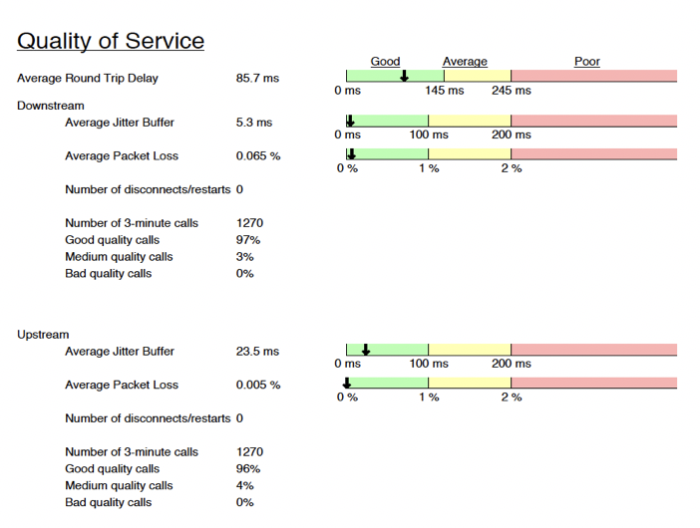
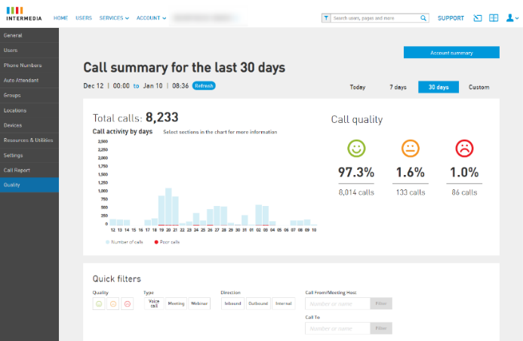

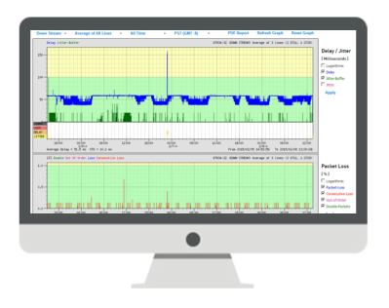
Network Testing | Real Time Analytics | Control Panel Admin
VoIP Scout for Network Testing
Customer QoS Dashboard
Notes:
2/5/21
Most competitors don’t analyze the network (a few have flash / speed tests - ping).
NEC believes testing is important, the call quality and service level are only as good as your network.
For Front End Testing we offer VoIP Scout: A business grade application – and we recommend three days minimum monitoring/testing of entire the network. This app is a soft client that runs on network computers or as a “box” and sends bidirectional VOIP traffic – analyzed for jitter, packet loss, delay, to get a good picture of the network.
Once deployed, we offer the QoS Dashboard: a view into your network allowing you to actively monitor the status of your network. You can set alerts and thresholds with notification of alerts via SMS and email.
We offer troubleshooting, showing what was happening view by time, extension, or on a specific call. This dashboard allows your technicians to spot trends and proactively react to potential or growing network issues.

Slide 35
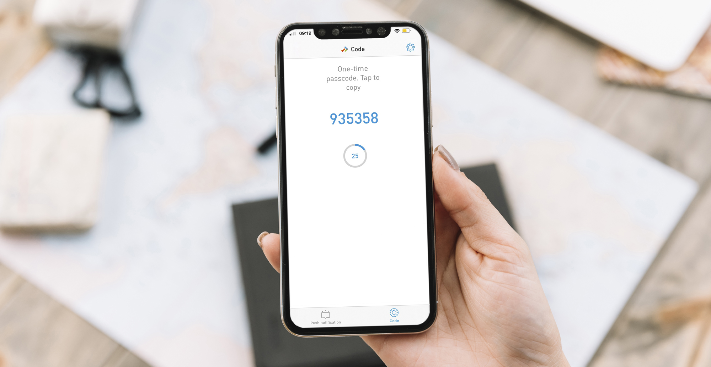

Enhanced Security
Two Factor Authentication (2FA) via Protect App.
Additional extra security layer for using UNIVERGE BLUE Services.
Can be set per user or per account by admin.
Notes:
2/5/21
UNIVERGE BLUE offers enhanced security via PROTECT with two factor authentication. Through the PROTECT app, you can add additional security for your UNIVERGE BLUE CLOUD SERVICES. This can be set per user per account by the admin.

Slide 36
UNIVERGE BLUE CLOUD SERVICES - Layered Security Model
Geographically dispersed, highly secure, monitored data centers by certified tier-three providers
Monitored with pan/tilt closed circuit TVs
Electronic man-trap devices, motion censors, ID key cards
Formal policies and procedures, config standards for firewalls
BLUE employee background checks
Documented privacy policy
Working through the changes required for EU compliance
HIPPA compliant
Data centers located in U.S., Canada, UK, Germany, Australia, and soon Japan
Data encrypted in transit and at rest, including VMS, Chat, SMS, and File Sharing
Handsets: MTLS authentication, HTTPS for provisioning, SRTP for voice
Apps: can enable 2FA
Desktop App: Built using Google Chromium technology and kept current with latest security patches preventing malware, transient key-loggers, and file theft
Automated, 24/7 Toll Fraud and Threat Detection
Toll Fraud Monitoring
International calling threshold notifications
Active monitoring to detect suspicious logins and unrecognized devices
SPAM caller protection
SOC 2 report from independent auditor to ensure CONNECT, ENGAGE, MEET, and SHARE are effective in minimizing risk and data exposure
Support:
  CPNI
  HIPPA
  PCI-DSS
  GDPR compliance
Infrastructure &
Network Security
Data Protection
& Privacy
Phones, Devices, &
App Security
Monitoring &
Detection
Security
Compliance
Notes:
2/5/21
<recommend hiding slide and using only for deeper dive if needed, use text on-slide as needed>

Slide 37
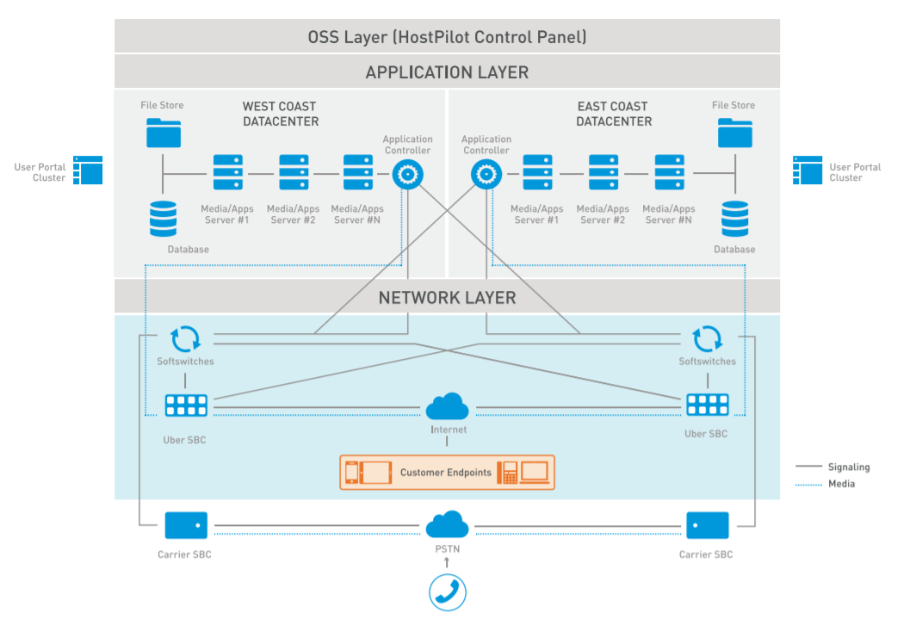


UNIVERGE BLUE Cloud Architecture & Security
World-class Multi-region Data Centers
  North America, EMEA, and Asia Pacific data center deployments
  Multiple full-peer connections to Internet & Tier 1 telecom backbone carriers from each data center with redundant private circuit data paths between centers
  By design prevents multi-component failures from impacting customers ensuring 99.999% SLA backed uptime with constant network resiliency/readiness testing
Voice Cloud Security – 3 levels plus 2-factor authentication
Typical Data Center Deployment
SIP Endpoint Security (phones & devices)
Toll-fraud Monitoring/
Detection
Physical & Network Security
Notes:
2/5/21
NEC takes security and redundancy seriously, and it is our highest priority. There are two data centers in the US, one on the west coast and one on the east, to ensure 99.999% SLA backed uptime. In addition to the US data centers, we are also deploying around the globe with data centers in EMEA, Asia Pacific, & Canada.
In terms of security, we offer three levels plus 2-factor authentication to ensure access is only granted to those authorized.

Slide 38

Competitive Differentiation
Contact Center Included
UNIVERGE BLUE EXTEND
Allows for integration of CONNECT & ENGAGE functionalities into everyday business applications from Google, Microsoft, Salesforce, and more
The CORE Contact Center is INCLUDED with CONNECT PRO and PRO PLUS User Licenses – Not bundled – included!
UNIVERGE BLUE MEET
Custom Branded Online Meetings with Transcriptions, Insights, and WEBINAR
Extreme Security
Two-Factor Authentication (2FA)
Regulatory Compliance (SOC2, GDPR, HIPAA, PCI)
UNIVERGE BLUE SHARE
Integrated Personal Backup,
File Sharing, & Collaboration
Vertical Market Focus
Regulatory Compliance & Solutions
Notes:
2/5/21
NEC offers multiple competitive differentiators.
At NEC, we believe the Contact Center is key to the success and growth of our customers and their businesses. As such we INCLUDE the CORE Contact Center as part of our UCaaS offering. Some of our competition offers contact center as part of a bundle with associated fees, but UNIVERGE BLUE CONNECT includes Contact Center in the base solution. This not only provides savings for our customers but delivers call routing technology and analytics to every CONNECT customer out of the gate.
On the technology side, UNIVERGE BLUE MEET with its artificial intelligence and insights built-in, coupled with the WEBINAR functionality makes it a game changer technology for videoconferencing. This product comes with your different levels of licensing for CONNECT.
UNIVERGE BLUE SHARE, being natively built into the application, is also a differentiator. We’re not integrating with a third-party, it’s an NEC product built into the NEC application.
UNIVERGE BLUE EXTEND, the integrations platform of UNIVERGE BLUE CONNECT and ENGAGE, connects powerful voice, chat, video conferencing, and contact center functionalities into everyday business applications like Google®, Microsoft®, Salesforce®, and more — driving higher productivity and increasing customer retention with no heavy costs.
NEC also specializes in different verticals, whether it be healthcare, state local government, education, hospitality, or finance to name a few.
With our extensive security capabilities, NEC complies and adheres to the security regulations that customers need to protect their data.

Slide 39
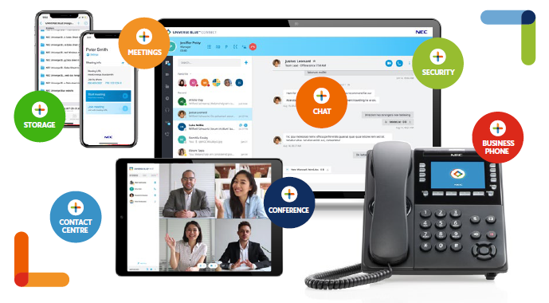
Advance Your Workforce To The Next Level
ONE COMMUNICATIONS PLATFORM
ONE LOW MONTHLY RATE
CONTACT
CENTER
Notes:
2/5/21
NEC offers you ONE communications platform for: meetings, storage, phones, conferencing, collaboration, and contact center, with all the security features that you will need. ALL in one platform ALL at one low monthly rate.

Slide 40

Ready for a Tour?
Notes:
2/5/21
Let me show you what some of the key features and functionalities look like.

Slide 41
Tour of CONNECT UCaaS
UNIVERGE BLUE CONNECT
Unified Messaging
Presence
Team Chat & SMS
Contact Center
Fax
Remote Work
File Share
Desktop
Backup
Video Conf
Cloud Phone
System
Collaboration
Mobile
Notes:
2/5/21
When touring through the UNIVERGE BLUE CONNECT application, you’ll see a multitude of features: you’ll be able to see your colleagues’ presence, chat with SMS text capability, faxing, file share and back up, your actual phone system - across all your devices, video conferencing, contact center built into the application and the list goes on and on.

Slide 42
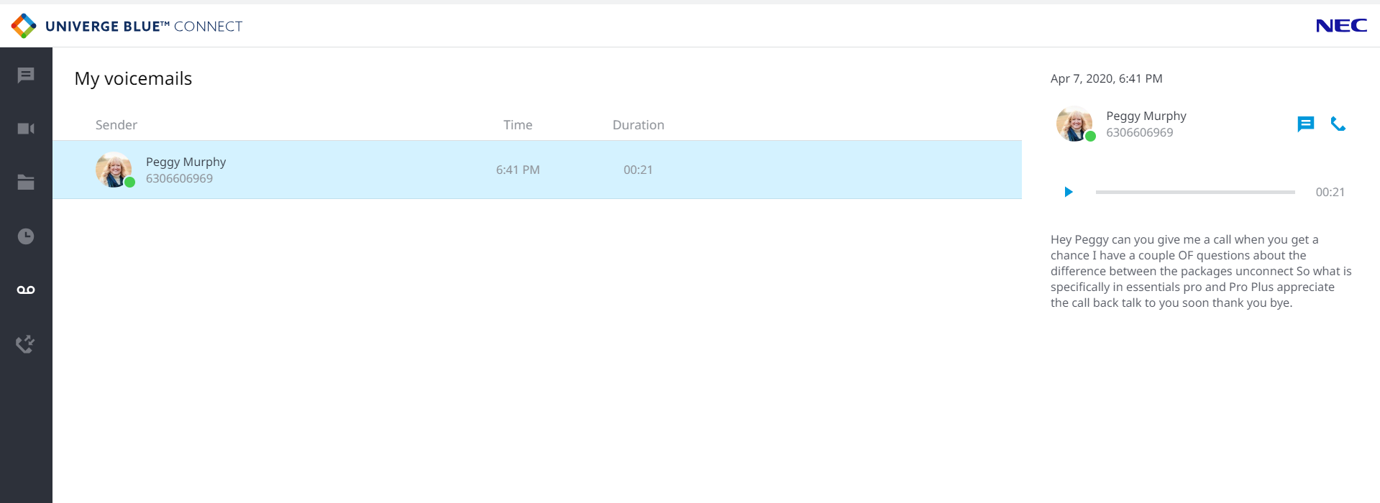

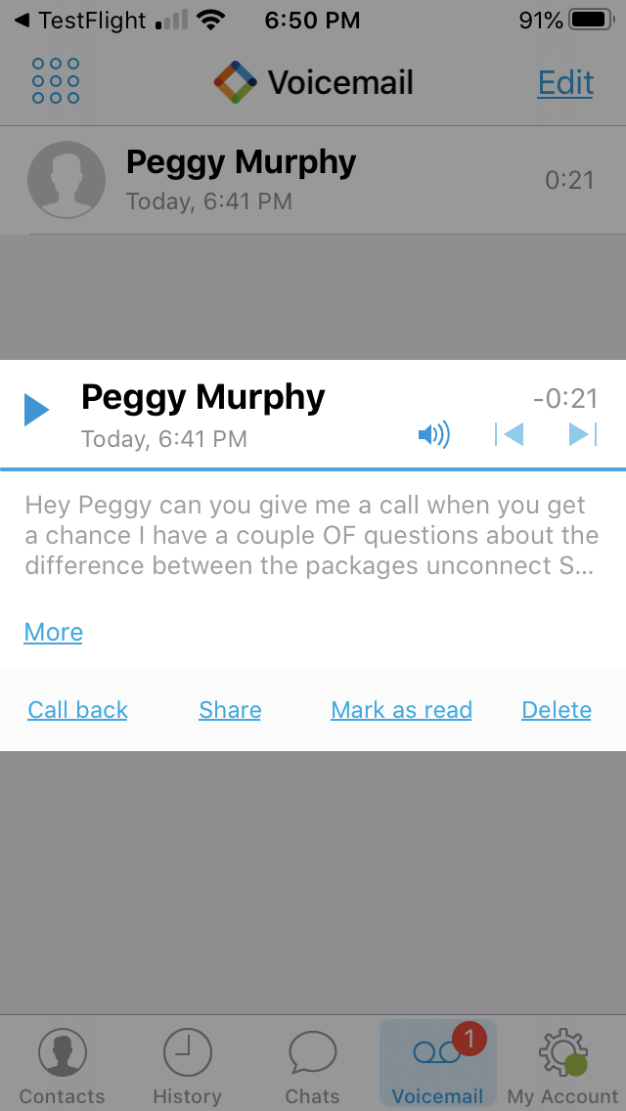
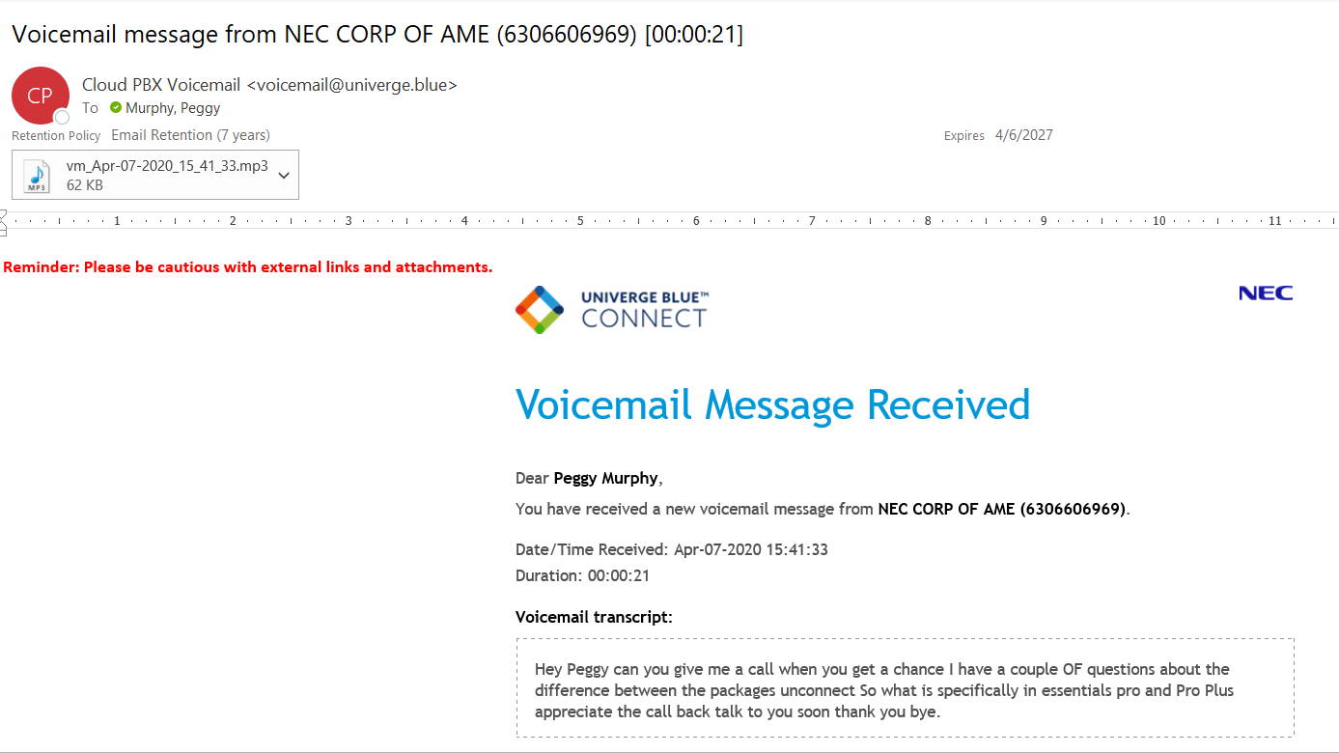
Voicemail Transcription
VM Transcription
On my desktop
In my email
On my mobile
Notes:
2/5/21
When you receive a voicemail, not only does it capture the audio, but it captures the transcript. You can read this transcript from your app on your desktop or from your cell phone, or even in your email.

Slide 43

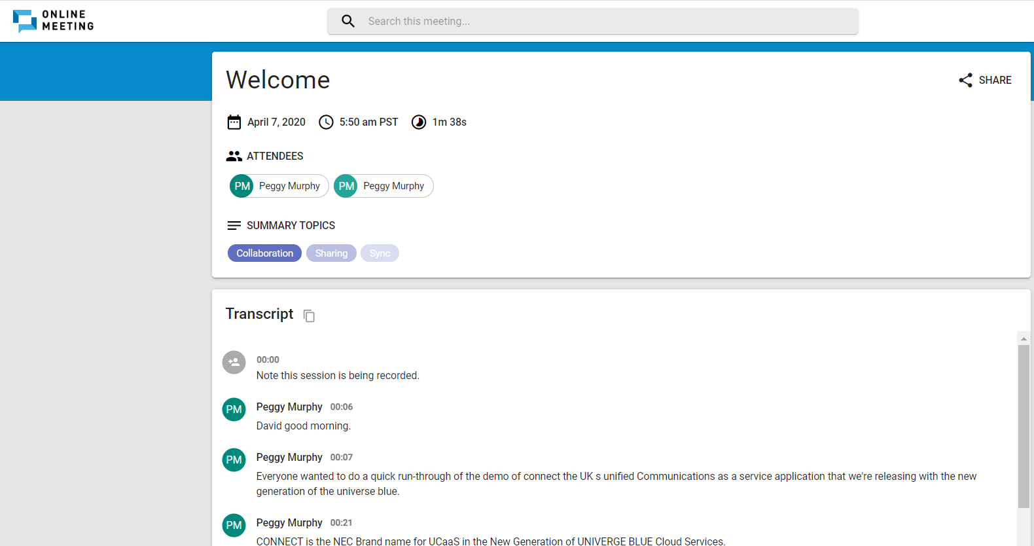
MEET Transcription – Sent to Email
Available for CONNECT Pro and ProPlus MEET Users Only
Notes:
2/5/21
In UNIVERGE BLUE MEET, you’ll be able to capture the transcripts of your calls via the artificial intelligence and send them to your email, by simply turning that feature on in the application.

Slide 44
CONNECT Mobile – Fully Integrated Experience
Transcribed voicemail
All company contacts
Team chat
Place and receive business calls
Real-time presence
Siri and Apple watch integration
Phone with hold, park, transfer, conference, and flip
Notes:
2/5/21
The CONNECT mobile app is a fully integrated experience, replicating what you see on your desktop app. You’ll be able to see your transcribed voicemails, chat with team members, place and receive calls, put calls on hold, transfer or even flip a call back and forth between devices. All your company contacts will be there, with their presence, and it even integrates with Siri and Apple Watch.

Slide 45
Questions & Discussion
Notes:
10/16/2020

