Slide 1

Payne’s landing hoa
Spring Meeting
March 11, 2025
6:30 p.m.

Slide 2
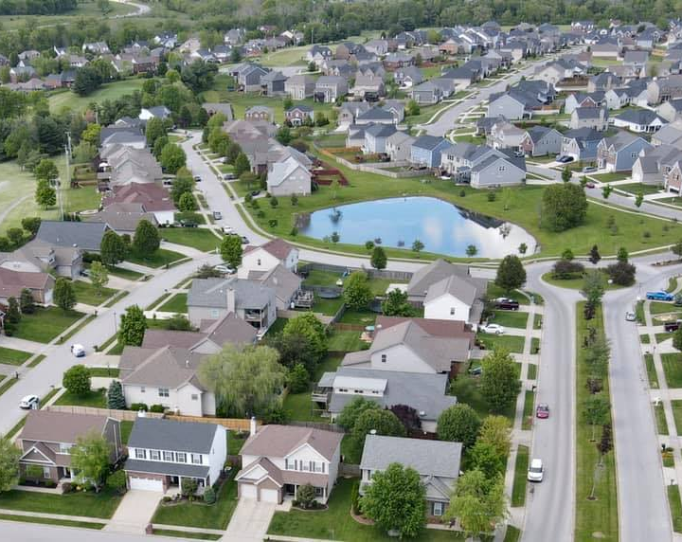
agenda
Introductions
Events
CCR Vote Status
Financials
Elections
General Update
Q&A

Slide 3
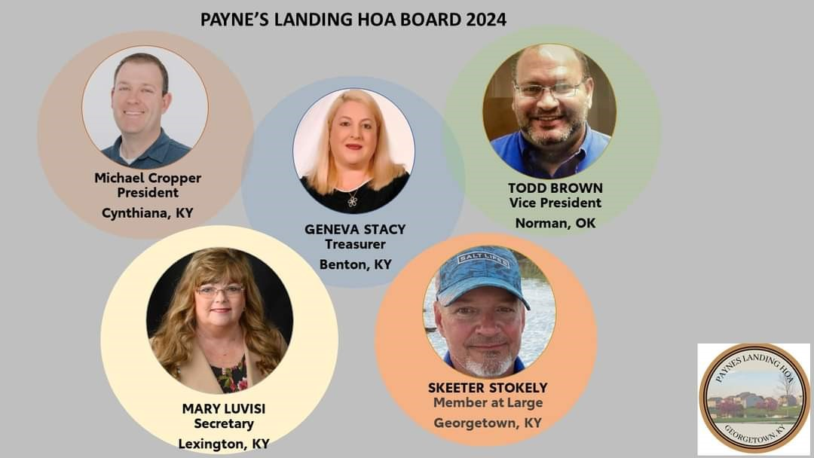
Michael Cropper-President (2024-2026)
Geneva Stacy-Vice President (2024-2026)
Dan Stadnyk-Treasurer (02/2025-03/2025)
Mary Luvisi-Secretary (2024-2025)
Skeeter Stokley-Member at large (2024-2025)

Slide 4
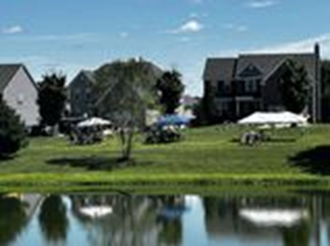
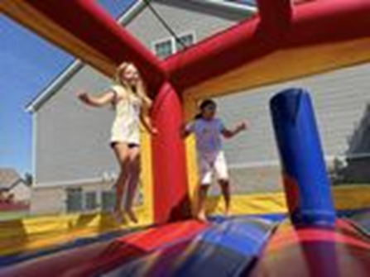
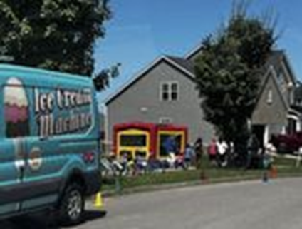
ACTIVITIES COMMITTEE-EVENTS
IN SEARCH Of INDIVIDUALS to SERVE ON THE SOCIAL and WELCOMING COMMITTEES
Yard Sale-May 17 OR 24 (TBD)
We need a Social Committee Lead
Social Committee Volunteers
Welcoming Committee Volunteers
Interested in joining the Social Committee? Please contact Paynes Landing HOA

Slide 5

Financials
Expenses Forecast 2025
Item | Amount
Lawn Care | $17,200.00
Pond Maintenance | $1,575.00
HOA Insurance | $2,831.60
HOA Taxes | $265.00
Tree Replacement/Landscaping | $3,800.00
Office Supplies | $200.00
Mailings | $300.00
PO Box | $183.84
Social Committee | $2,000.00
Attorney Fees | $3,000.00
Website Creation | $2,000.00
Quickbooks | $1,133.35
Total | $34,488.79
CURRENT ACCOUNT BALANCE: $39,376.24

Slide 6
Financials
HOA DUES
Item | Amount | # of Homes
Outstanding Dues Past-2024 | $11,454.00 | 38 homes
*Data as of 3/10/2025
2025 HOA Dues | $34,560.00 | 288 homes
2025 HOA Dues Collected | $21,480.00 | 179 homes
2025 HOA Dues outstanding | $13,080.00 | 109 homes
HOA DUES
SUMMARY
62% 2025 Dues Received

Slide 7

Draft Policy Proposal
Goal – collect past due HOA fees without putting liens on property
Allows home owners with past due fees to catch up monthly on past due fees if they pay current 2025 fee.
See draft on your table for review
Suggestions appreciated

Slide 8
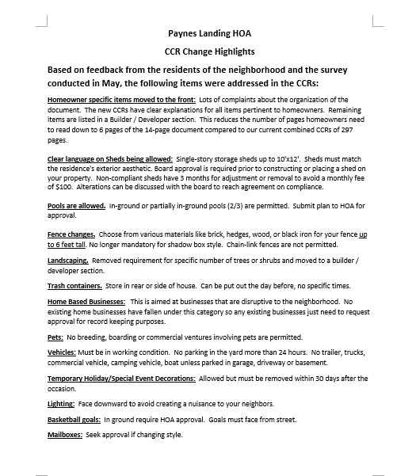

Ccr Vote status/outreach
172 Votes in favor
44 still needed
Outreach-door to door discussions in the next month
Monthly drawings began in February
We need your help in talking to your neighbors

Slide 9
Ccr Vote status by Streets
Street Name | Number of Houses | Number of Houses Not Voted | %
Amen Corner Way | 37 | 18 | 49%
Inverness Drive | 6 | 0 | 0%
Lacosta Drive | 10 | 2 | 20%
Osprey Way | 11 | 3 | 27%
Paynes Landing Blvd | 20 | 6 | 30%
Quail Hollow | 12 | 6 | 50%
Sea Pines Way | 20 | 11 | 55%
Shinnecock Hills Dr. | 78 | 30 | 38%
Swilcan Bridge Way | 74 | 28 | 38%
Turtle Point Drive | 19 | 9 | 47%

Slide 10
General updates
Election Results
Damage to median trees/turf
Replacing trees/adding up front
Roundabout fixup
Web Site
Online fee payments
Coming Soon!
Pet waste stations
Dog Boarding and Grooming Business-LaCosta

Slide 11
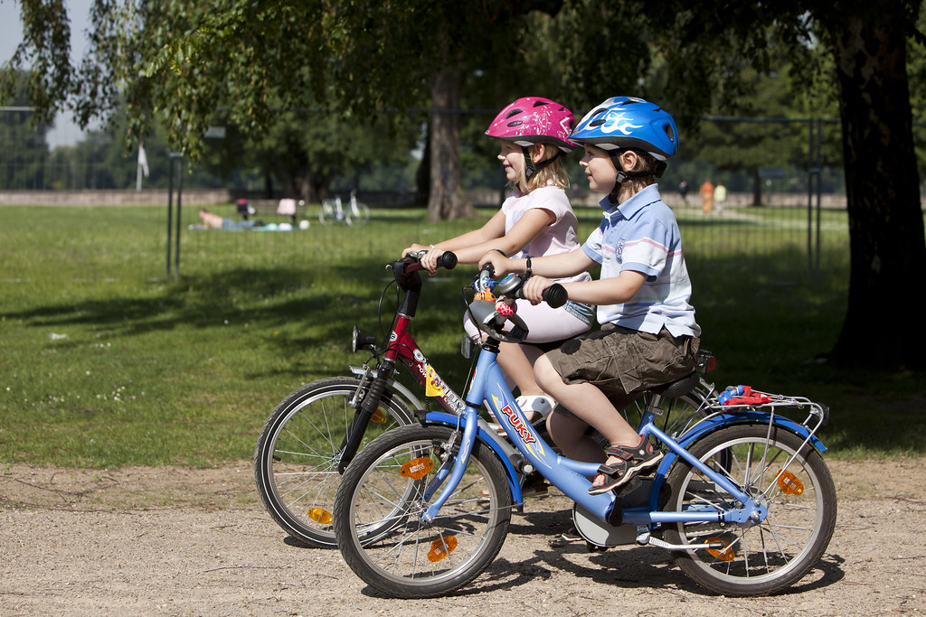
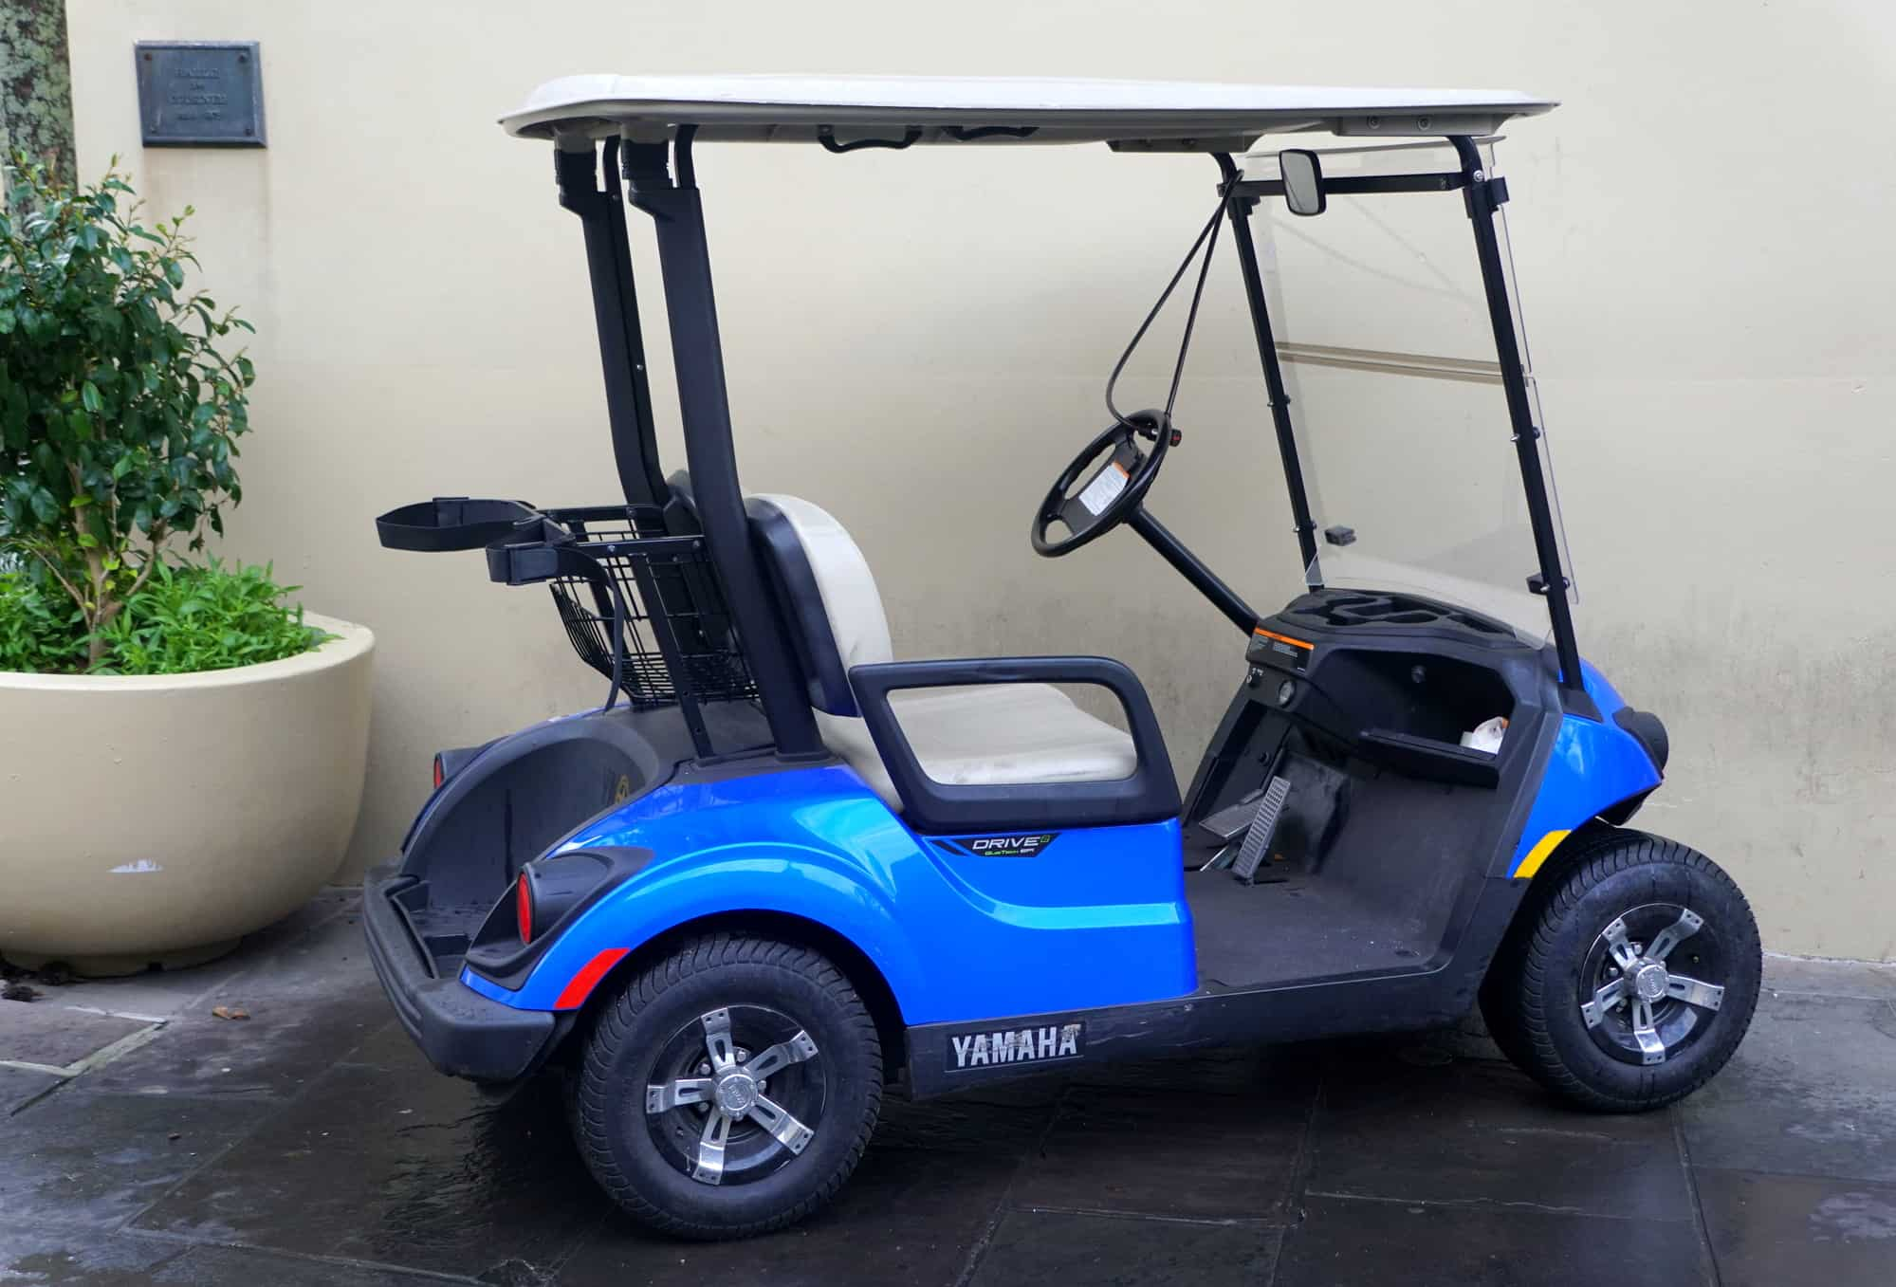
As warmer weather heads out way….
Please remind kids on bikes and golf carts to be courteous and respectful of the neighborhood
  Limit loud music and music with profane language
  Mind traffic rules and signs
  Do not litter throughout the neighborhood
Everyone should monitor their speed in the neighborhood, particularly during the warmer months when we have more children playing outdoors.

Slide 12

GREEN SPACE
By Inverness Dr. and Swilcan Bridge Way
Reminders:
Please be respectful of the neighbors living next to the Green Space by:
  Picking up dog waste and putting it in the dog waste station
  Monitoring noise levels when playing in the Green Space
  Removing toys, sports equipment and other items brought to the space once play time is completed
THANK YOU!

Slide 13
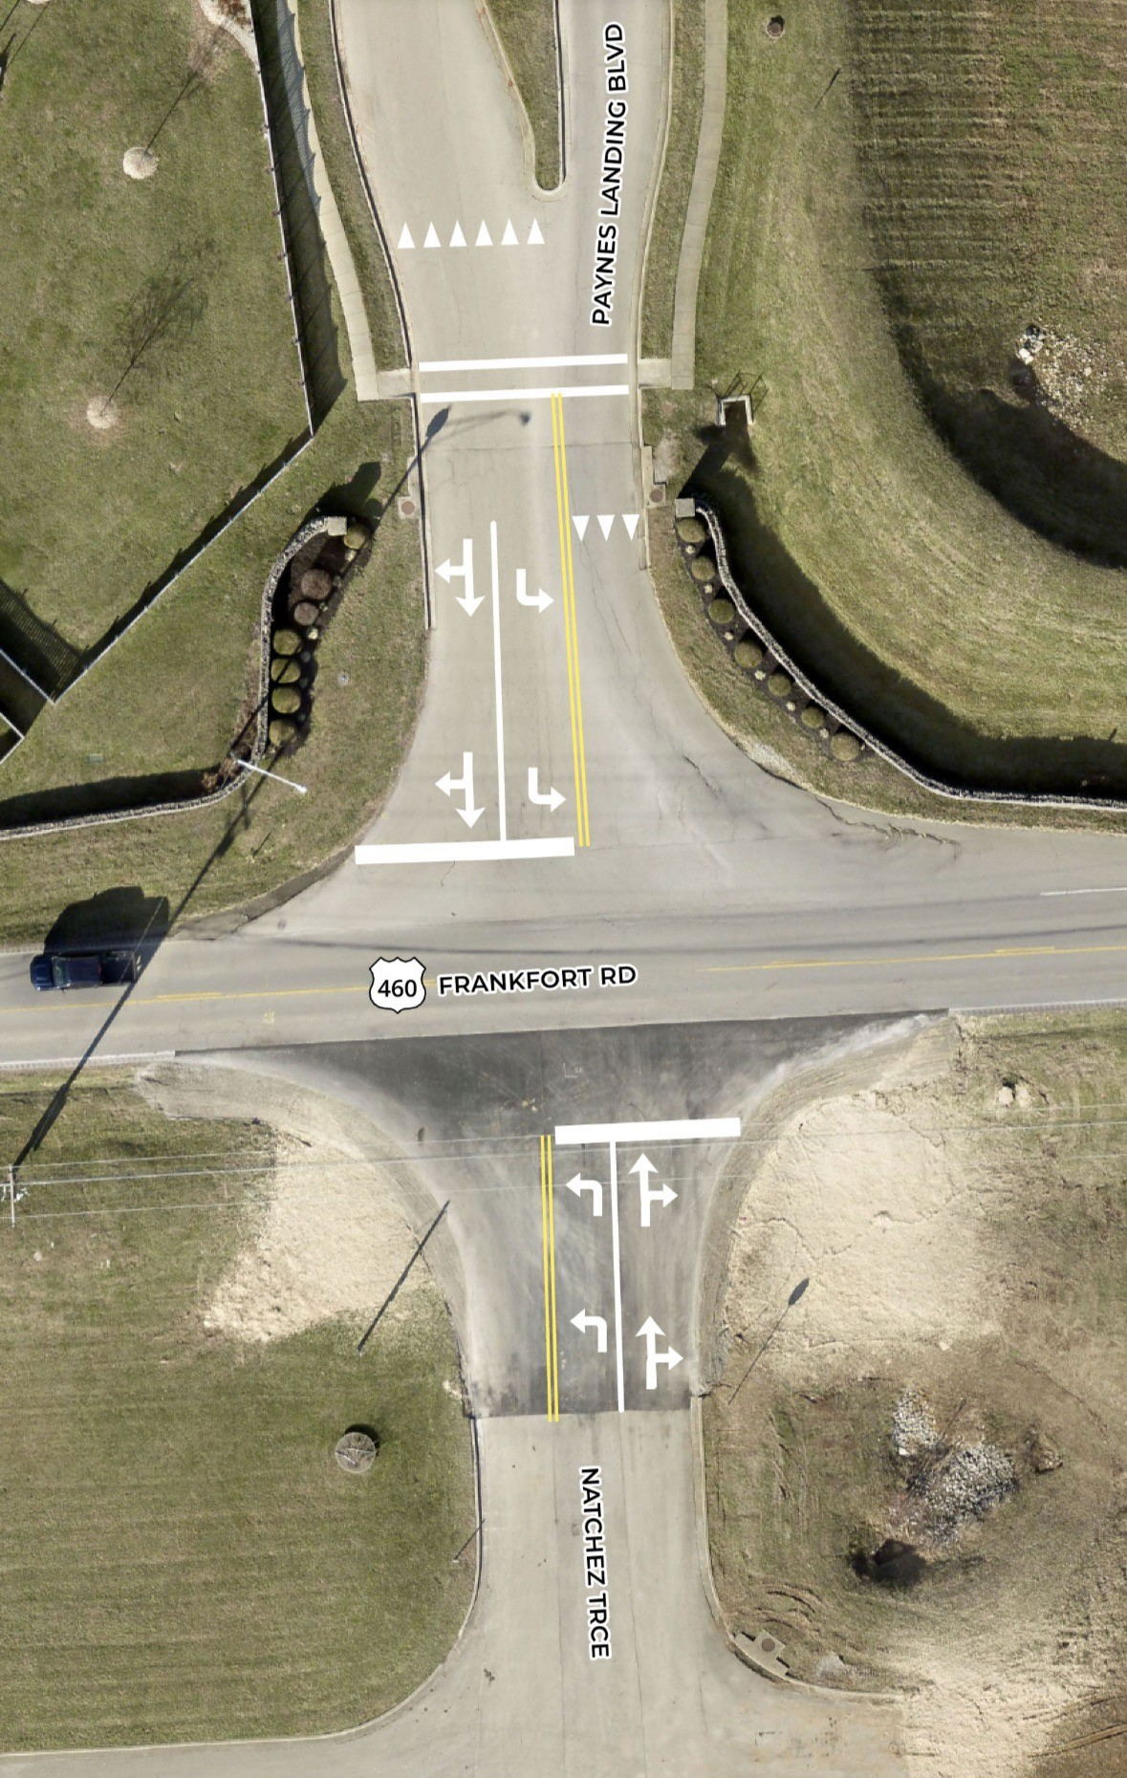
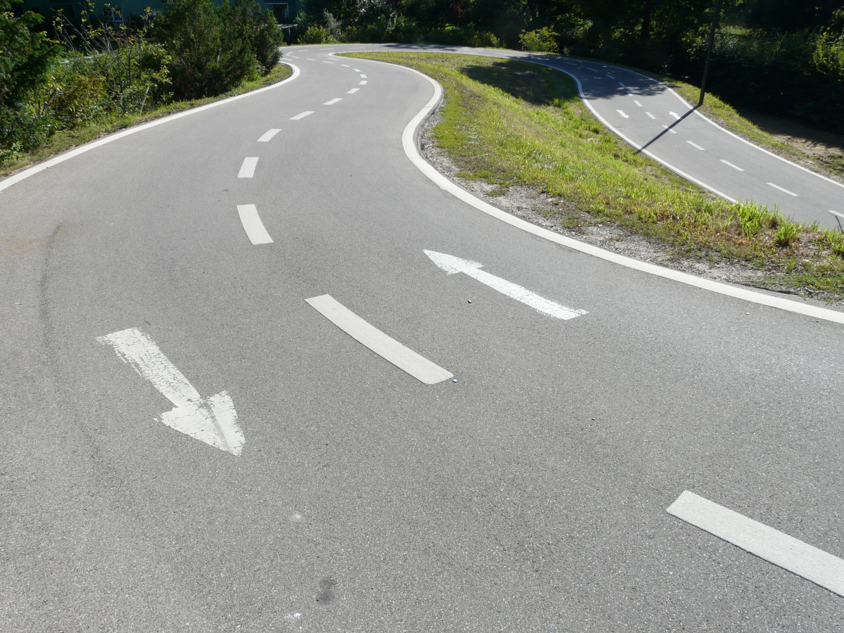
General updates
ENTRANCE
STRIPING MARKERS
COMING THIS SPRING!

Slide 14

Questions / discussion

