Slide 1

Payne’s landing hoa
Fall Meeting
September 9, 2025
6:30 p.m.

Slide 2
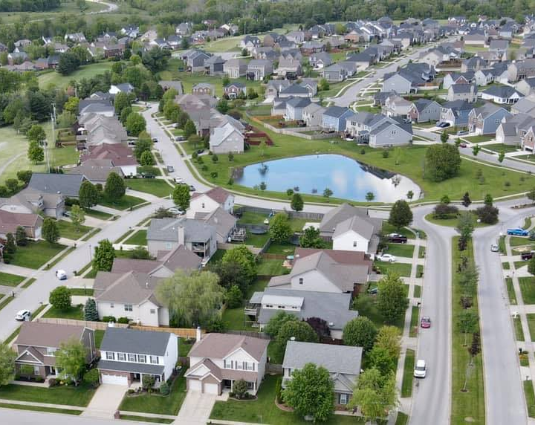
agenda
Introductions
CCR Update
Bylaws
Financials
General Updates
Q&A

Slide 3
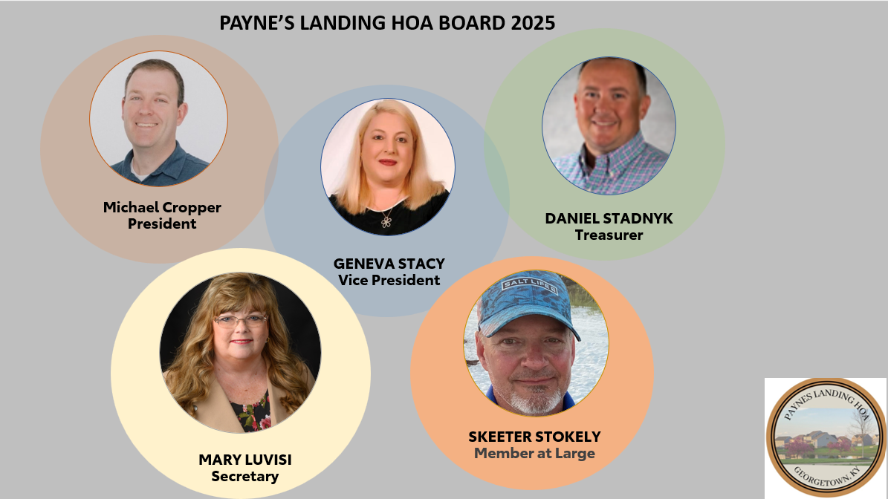
Michael Cropper-President (2024-2026)
Geneva Stacy-Vice President (2024-2026)
Dan Stadnyk-Treasurer (02/2025-03/2027)
Mary Luvisi-Secretary (2024-2027)
Skeeter Stokley-Member at large (2024-2027)

Slide 4
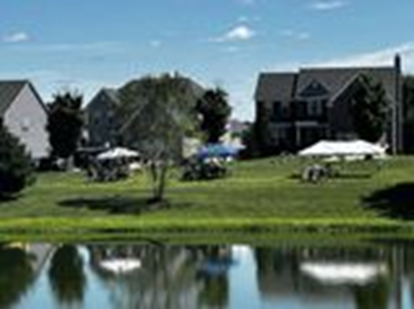
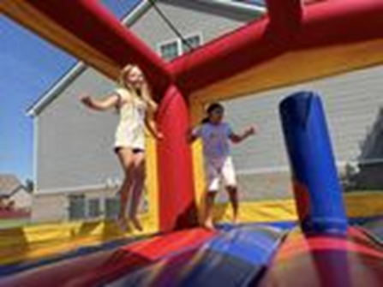
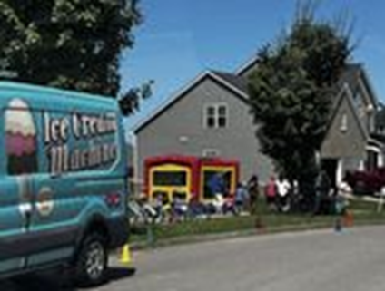
VOLUNTEERS NEEDED!
IN SEARCH Of INDIVIDUALS to SERVE ON THE SOCIAL and WELCOMING COMMITTEES
Social Committee Volunteers
Welcoming Committee Volunteers
Interested in joining the Social Committee? Please contact us payneslandinghoa@gmail.com

Slide 5

Financials
YTD Expenses 8/31/2025
CURRENT ACCOUNT BALANCE: $27,681.56

Slide 6
Financials
HOA DUES
Item | Amount | # of Homes
*Data as of 9/8/2025
Outstanding Dues Past-2024 | $9,683.86 | 28 homes down from 38 in March 2025
2025 HOA Dues | $34,560.00 | 288 homes
2025 HOA Dues Collected | $29,760.00 | 248 homes
2025 HOA Dues outstanding | $4,800.00 | 40 homes
HOA DUES
SUMMARY
86% 2025 Dues Received

Slide 7

WE CAN NOW ACCEPT ONLINE PAYMENTS!
Please make payments for HOA dues at the following address:
https://pay.payneslandinghoa.com/dues

Slide 8
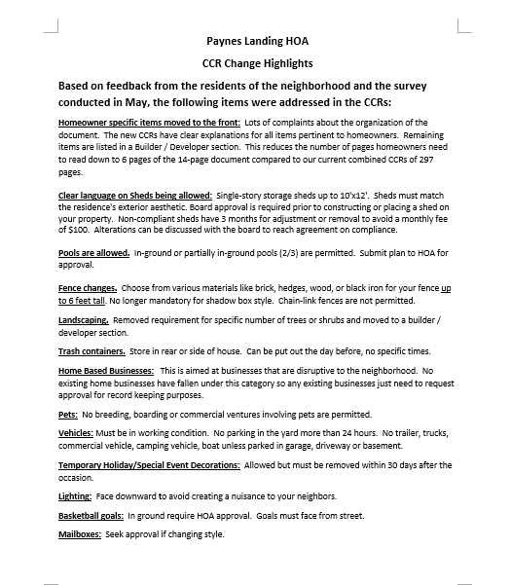
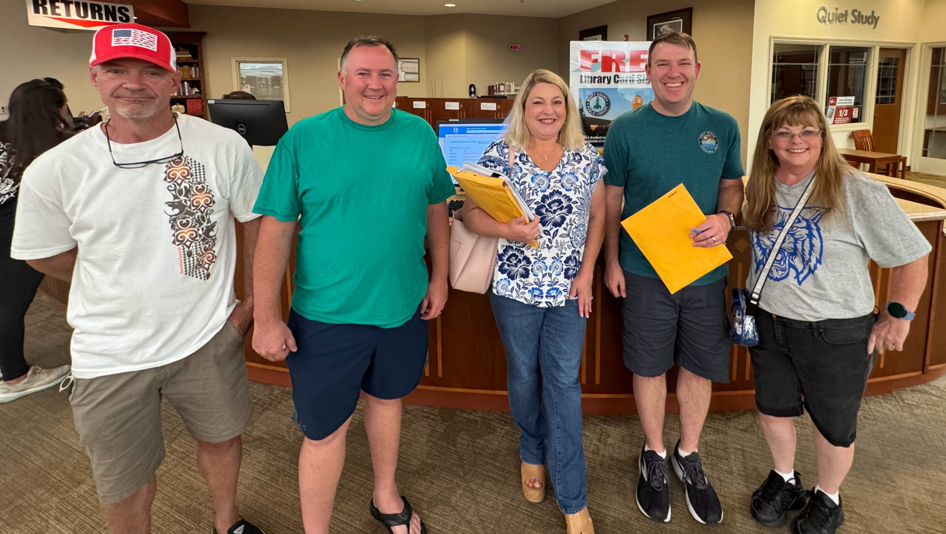
CCRs are now finalized
We did secure favorable signatures of 216 current residents.
Thank you to everyone who submitted signatures and shared feedback during this process!
We need to focus on getting unapproved items that are now outlined in the CCRs, approved. Including:
Fences, Sheds and Home-based businesses.

Slide 9
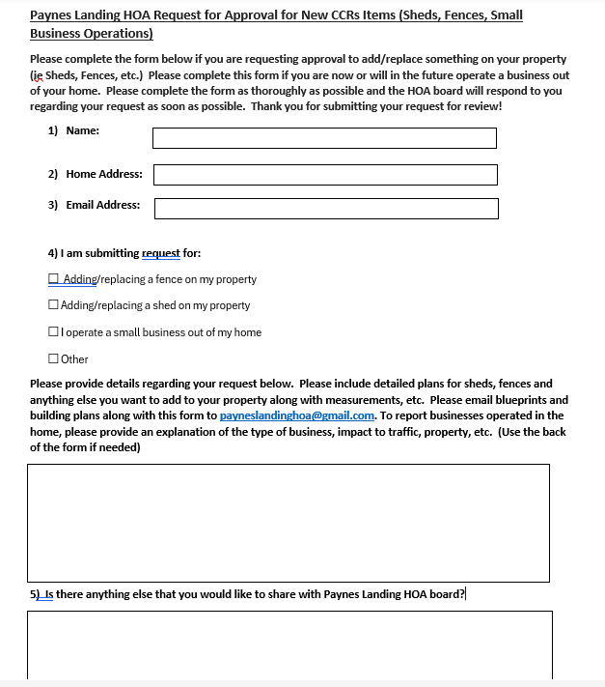

Form to complete to get HOA Board Approval
  Please submit the approval form to the HOA Board to review and approve these items.
  Please email the completed form to: payneslandinghoa@gmail.com
  The approvals will be tracked as we are creating a formalized approval process and tracking system.
  We are asking that everyone participate to avoid notification of not being in compliance with the new CCRs.
Form can be found on our website: payneslandinghoa.com

Slide 10
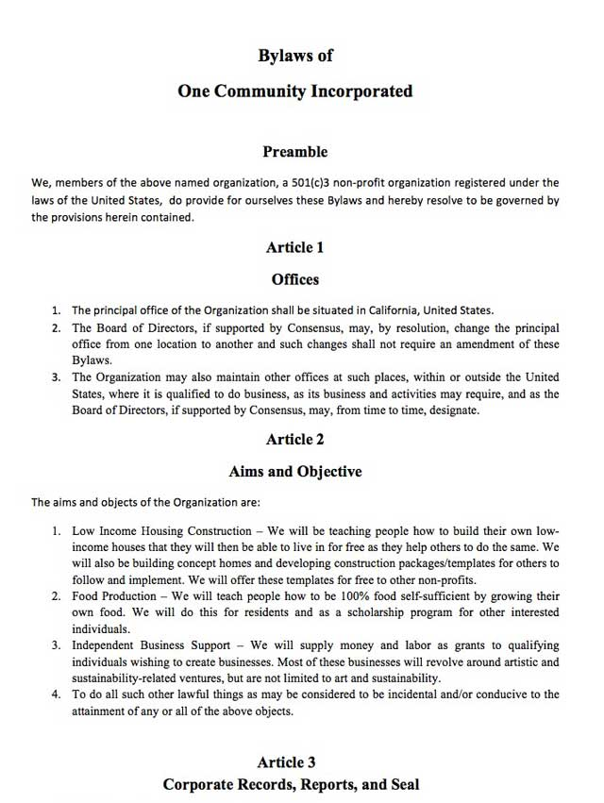

Next order of business…
Update Bylaws
Bylaws were created during the building phase of Paynes Landing
Language needs to be updated to include Board of Directors instead of Builders
Clarify number of board members, add term limits and resignation procedure
Review language to focus on HOA majority vote for high capital purchases, loans, etc. Currently not outlined today

Slide 11
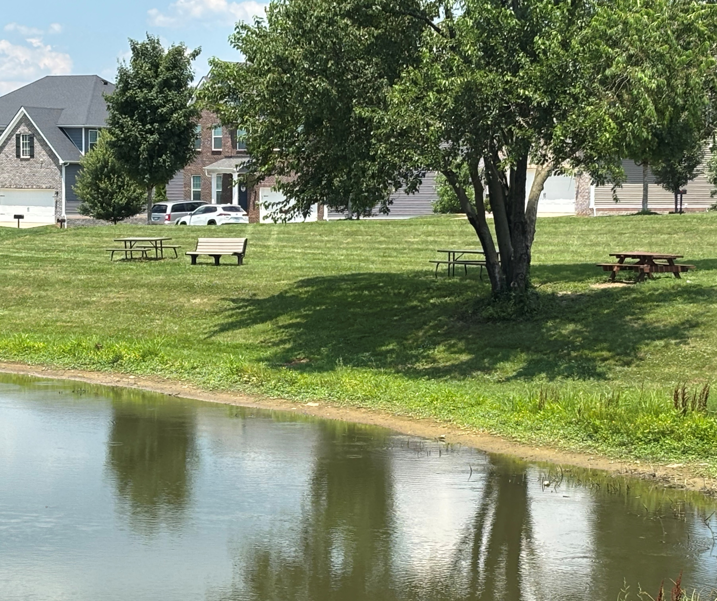
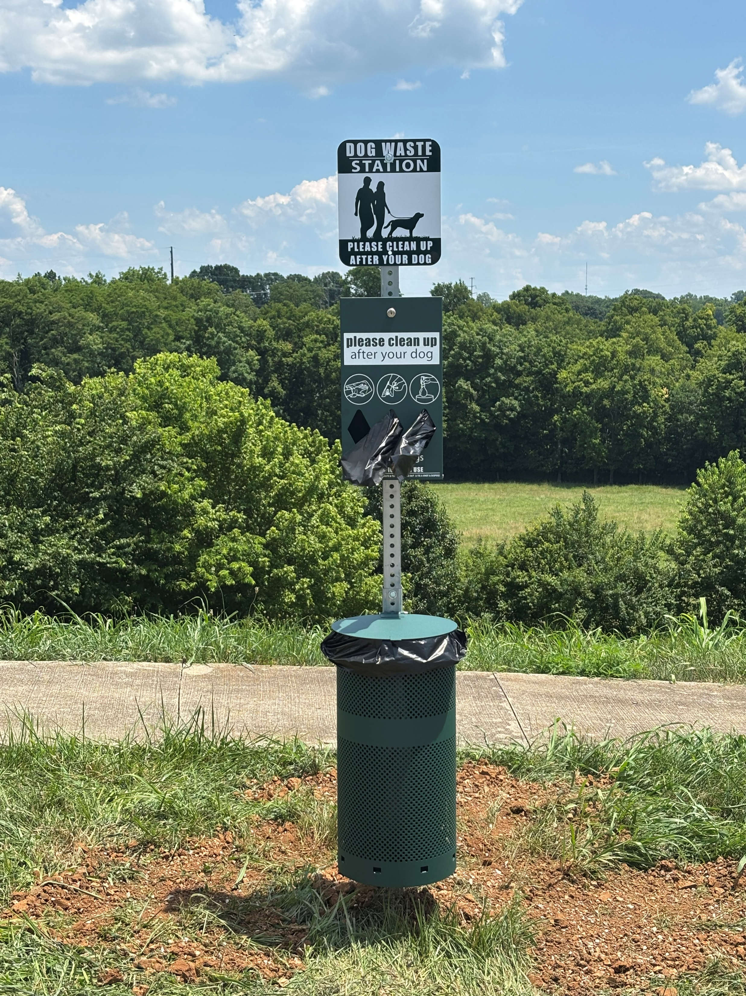
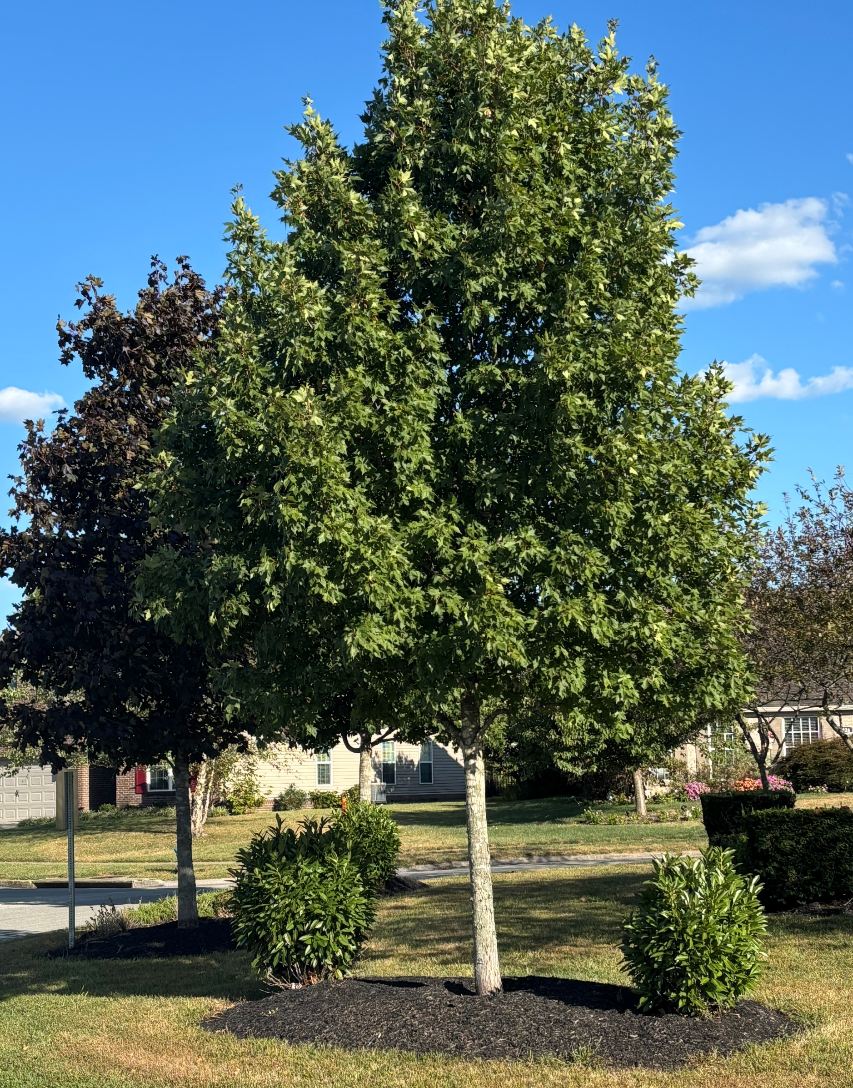
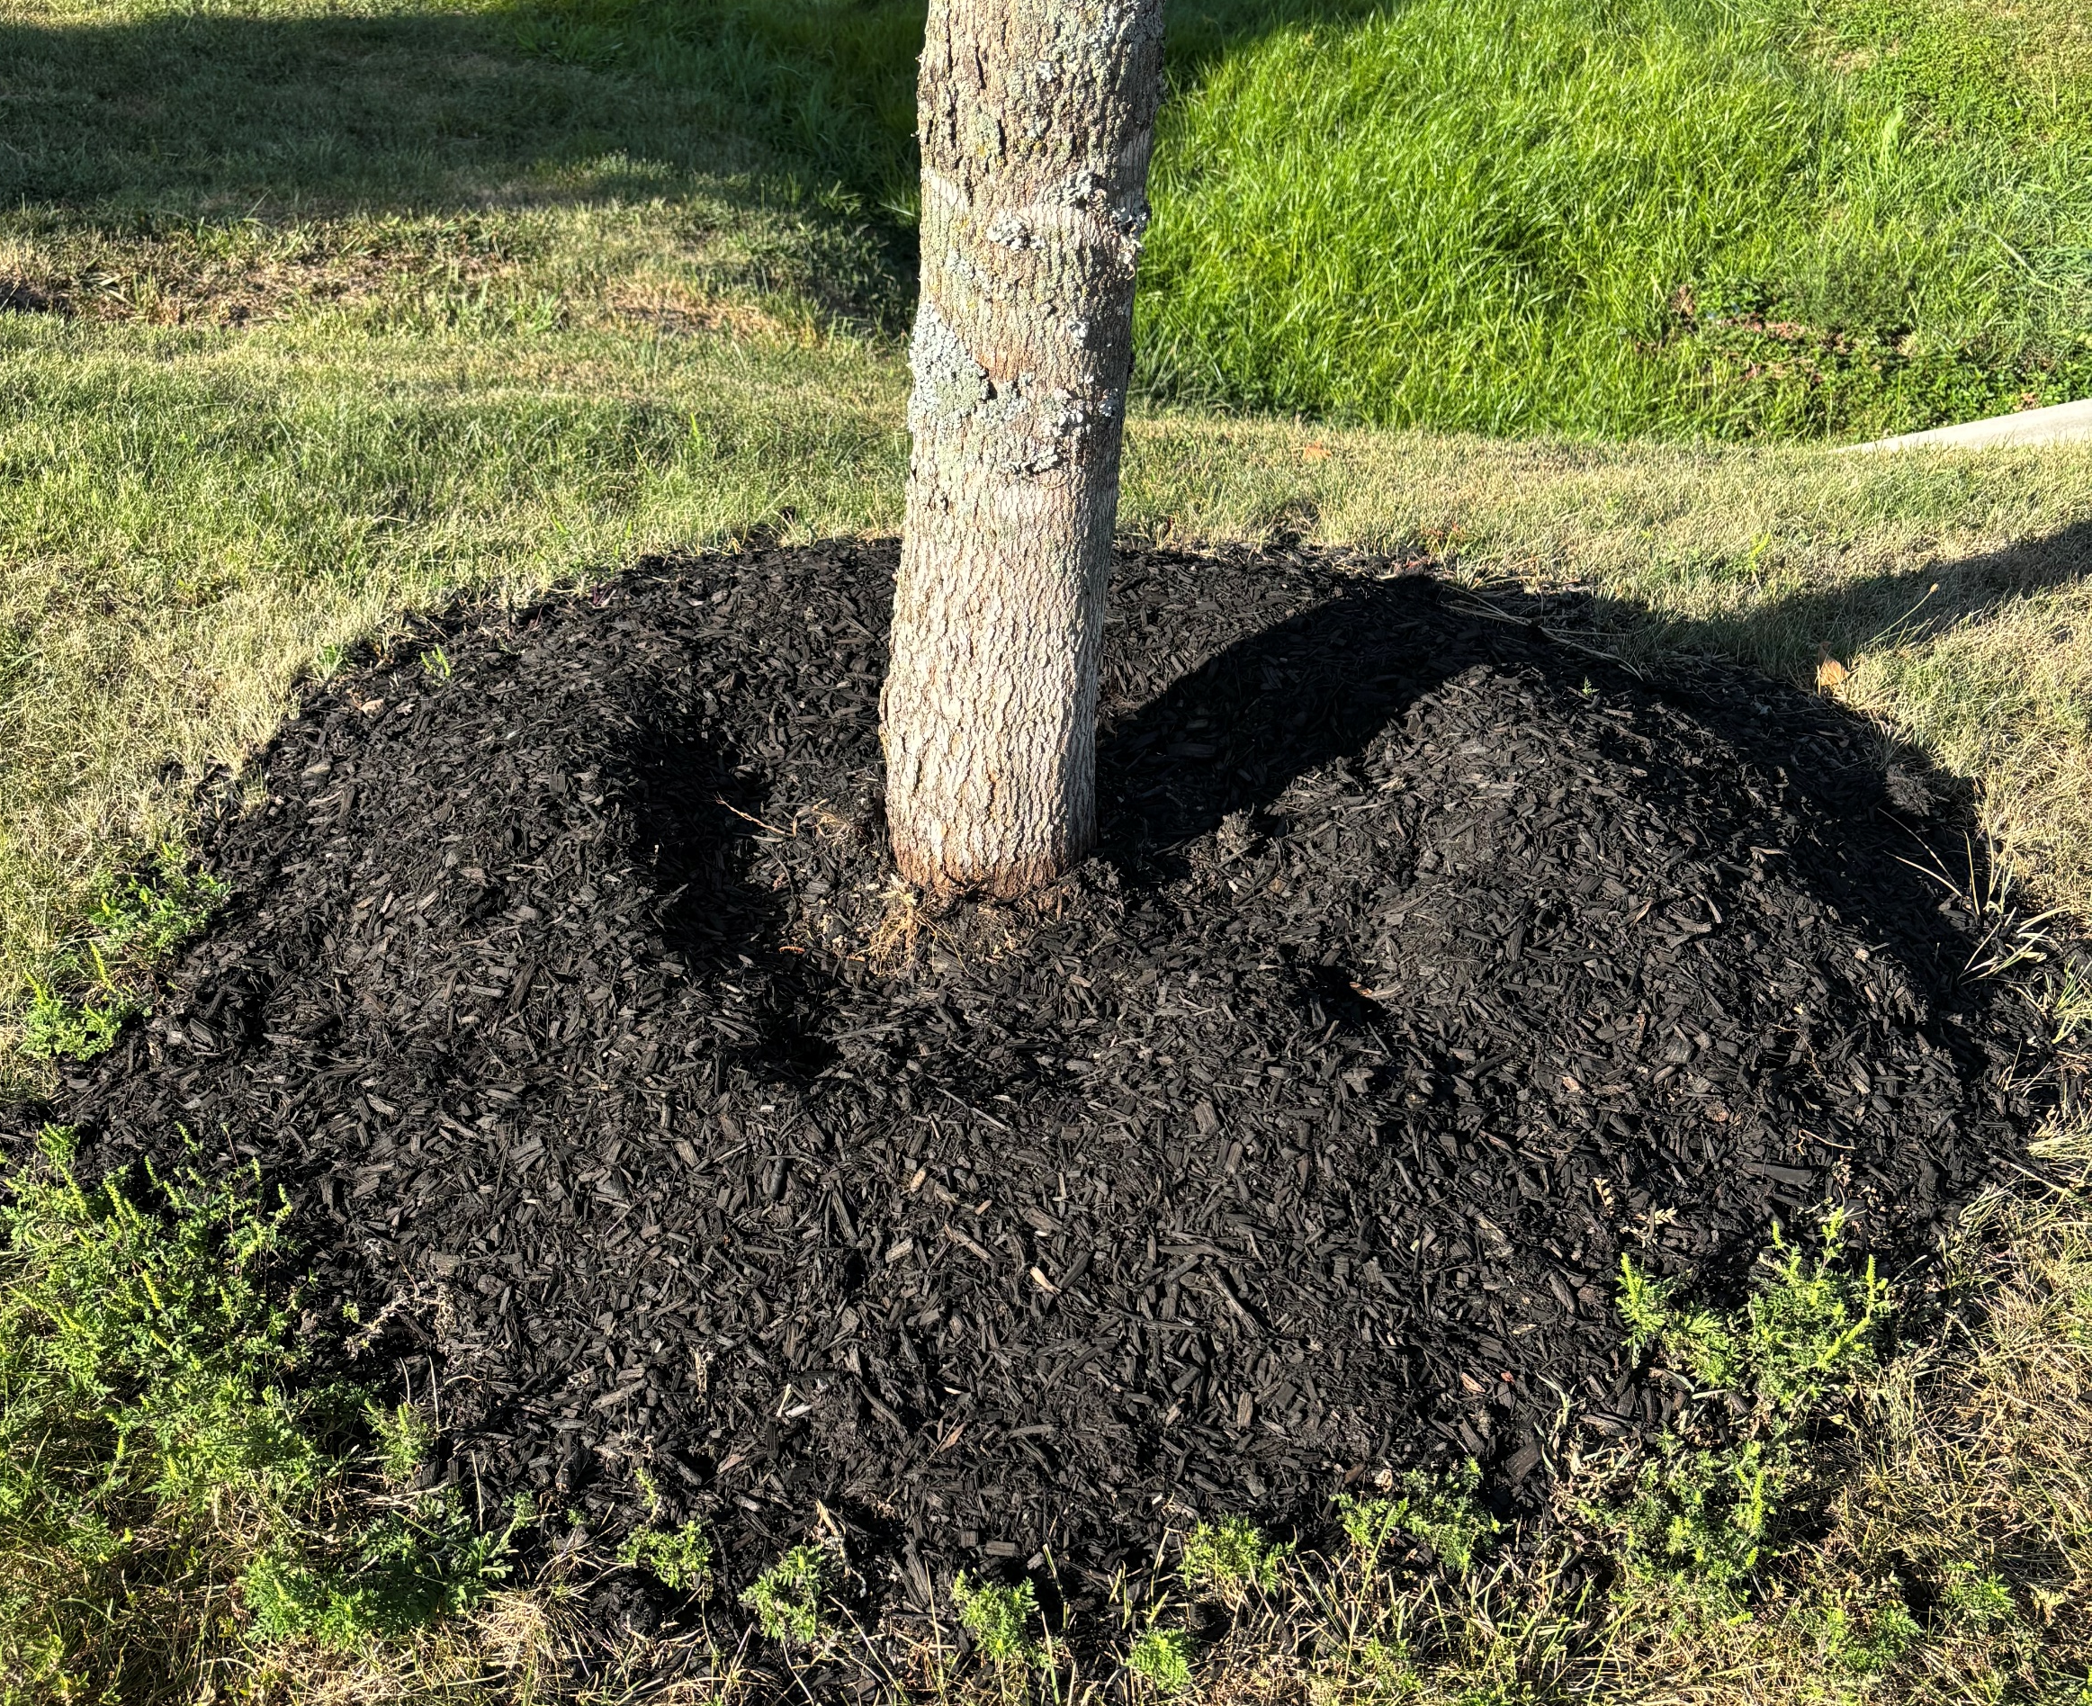



Updates we are making progress!
NEW PICNIC TABLES ADDED BY THE POND
ADDITIONAL WASTE STATION ADDED AT AMEN CORNER WAY
TREES HAVE BEEN TRIMMED AND MULCH HAS BEEN PLACED AROUND THE PUBLIC SPACES AND TREES

Slide 12
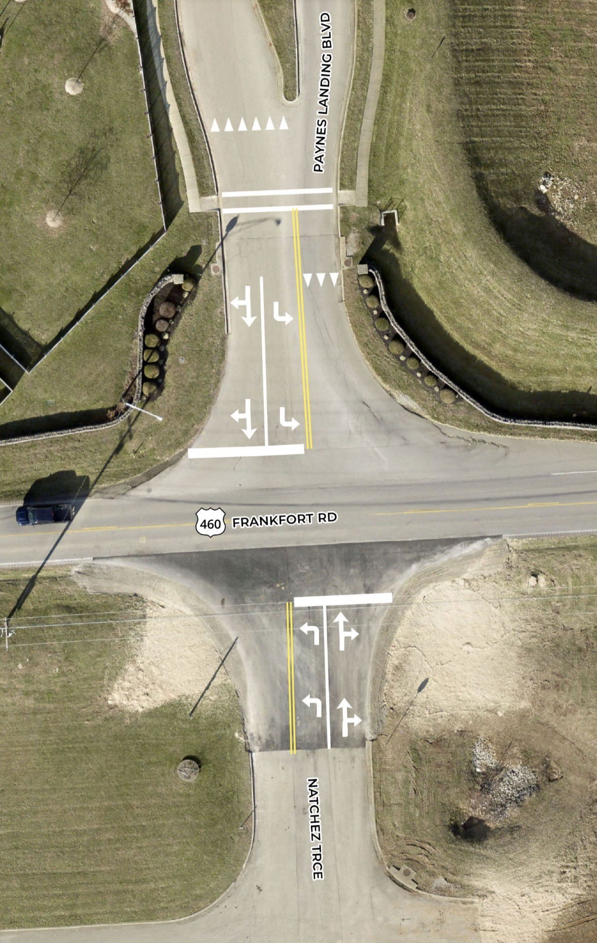
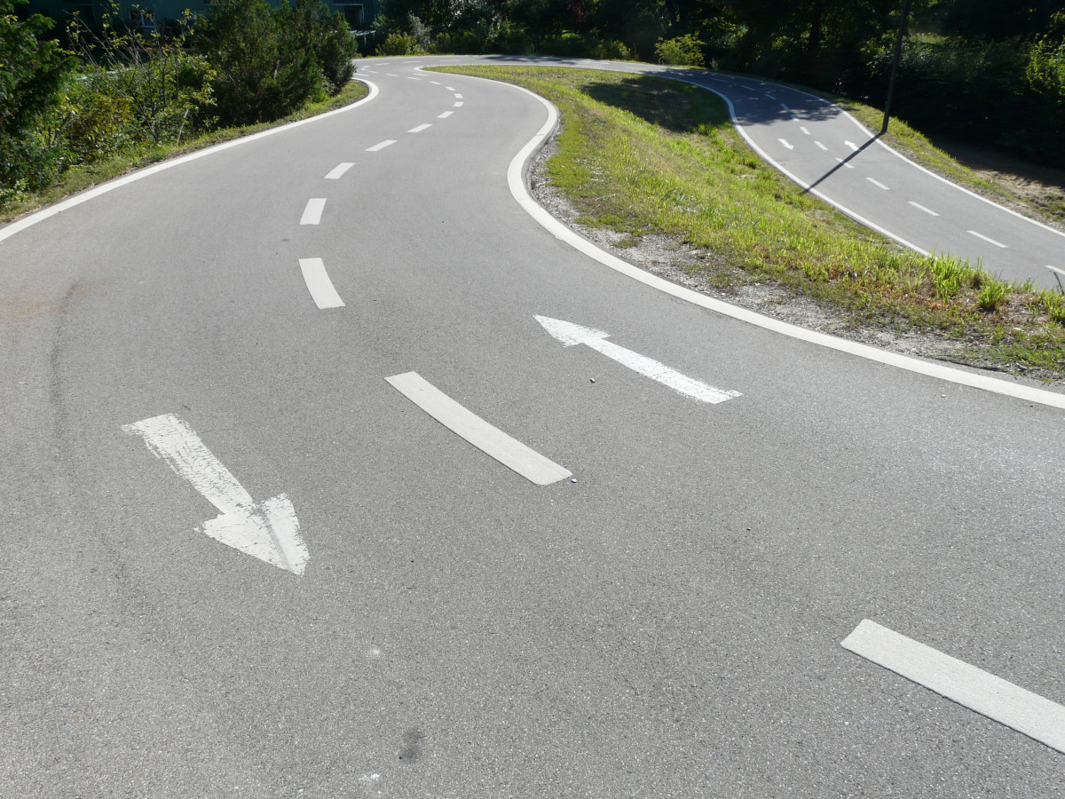
General updates
ENTRANCE
STRIPING MARKERS
COMPLETED!
MID AUGUST 2025

Slide 13


GREEN SPACES
ELECTRICAL PEDESTAL PROPOSAL
We would like to place two electrical pedestals in the green spaces.
One by the pond
One by Inverness Dr. and Swilcan Bridge
This would provide a power source for these areas to assist with social activities and making enhancements possible by the pond (installing a fountain, etc.)
Through KU (Kentucky Utilities) awaiting final costs to share with the HOA.

Slide 14

Questions/ open discussion

