Slide 1

Payne’s landing hoa
Spring Meeting
March 10, 2026
6:30 p.m.
Notes:
Michael called the meeting to order at 6:30 p.m. 8 families attended in person and 3 online. Sign in included: Elena Moore, Wandy Ray, Amy Maynard, Alisa Vance, George Brock, Edie Brock, Jamie and Glenn Hudson, Robin (Online), Patrick Ballard, Cassie Ernest (Online), Luke M (Online). Board members present Michael Cropper, Geneva Stacy and Mary Ballard.

Slide 2
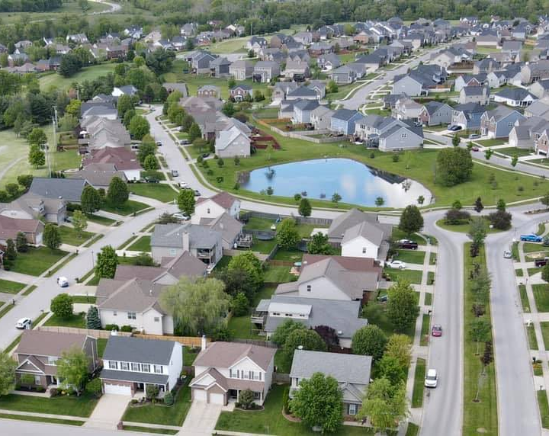
agenda
Introductions
Elections
Social Committee
Financials
CCR Issues
Bylaws
General Updates
Q&A
Notes:
Michael reviewed the agenda.

Slide 3
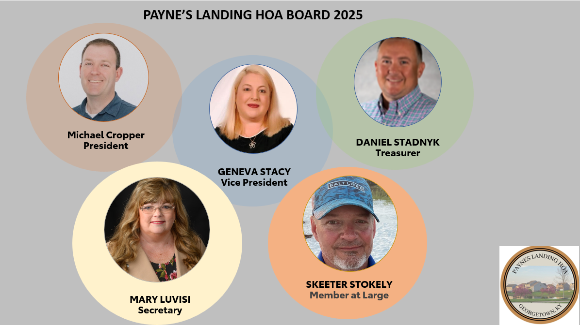
Michael Cropper-President (2024-2026)
Geneva Stacy-Vice President (2024-2026)
Dan Stadnyk-Treasurer (02/2025-2027)
Mary Luvisi-Secretary (2024-2027)
Skeeter Stokley-Member at large (2024-2027)
Notes:
Michael reminded everyone of our current board members and their terms. Up for reelection today are Michael Cropper, President and Geneva Stacy, Vice President. No additional candidates applied via the application form available on our website. Michael and Geneva agreed to continue on for a new term. No one opposed.

Slide 4
Nominations from the floor
Notes:
No nominations from the floor for President or Vice President but Alena Moore self nominated for at large board member. No one opposed.

Slide 5



VOLUNTEERS NEEDED!
IN SEARCH Of INDIVIDUALS to SERVE ON THE SOCIAL and WELCOMING COMMITTEES
Social Committee Volunteers
Welcoming Committee Volunteers
Interested in joining the Social Committee? Please contact us payneslandinghoa@gmail.com
Notes:
Geneva asked for volunteers to assist with social committee and to start a welcoming committee. No volunteers. Robin online offered to help with yearly envelope stuffing for invoice mailing.

Slide 6
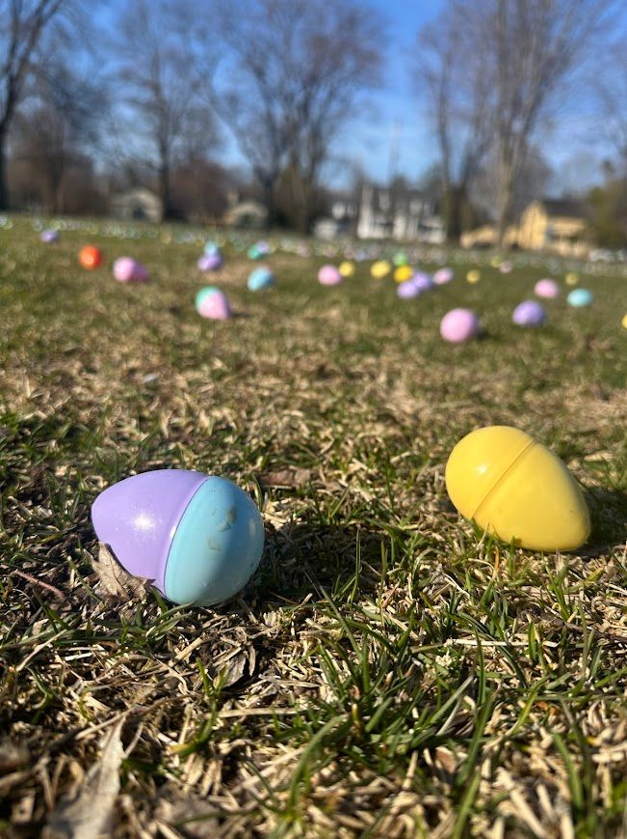
2026 Social Events
Easter Egg Hunt
Back to School Bash
Trunk or Treat
Notes:
Geneva covered planned social activities. Question about yard sale. We do plan on participating again this year. Waiting for Canewood and White Oak to determine their date so we can have a larger event to attract more yard salers. We did attempt a Christmas house decorating contest but no one signed up last year. Question about 4th of July. Michael explained it was a liability issue and insurance was very expensive.

Slide 7

Financials
Fiscal Year 2025 Actual Expenses
CURRENT BANK
ACCOUNT BALANCE: $38,892.48
Notes:
Geneva covered the expenses for 2025 and Alena commented that mowing was a large portion of our budget. She asked about White Oak helping chip in. Michael found out that our contract does not include mowing the front area, our landscape company just does it to keep our neighborhood looking beautiful. We also do not own any of the medians. They are city owned and they rarely address needs. They did agree for us to go ahead and replace the dead trees.

Slide 8
Financials
HOA DUES
Item | Amount | # of Homes
*Data as of 3/9/2026
Outstanding Dues Past-2025 | $12,740.41 | # homes past due 36 homes
2026 HOA Dues | $34,560.00 | 288 homes
2026 HOA Dues Collected | $23,430.00 | 195 homes
2026 HOA Dues outstanding | $11,130.00 | # homes = 93
HOA DUES
SUMMARY
68% 2026 Dues Received
Notes:
Geneva covered status of HOA dues received. We are ahead of last year but still have 93 homes with dues outstanding.

Slide 9

Reminder-WE CAN
NOW ACCEPT ONLINE PAYMENTS!
Please make payments for HOA dues at the following address:
https://pay.payneslandinghoa.com/dues
Notes:
Payments online are easy and have been going well. Led to us being ahead of last years receipts.

Slide 10
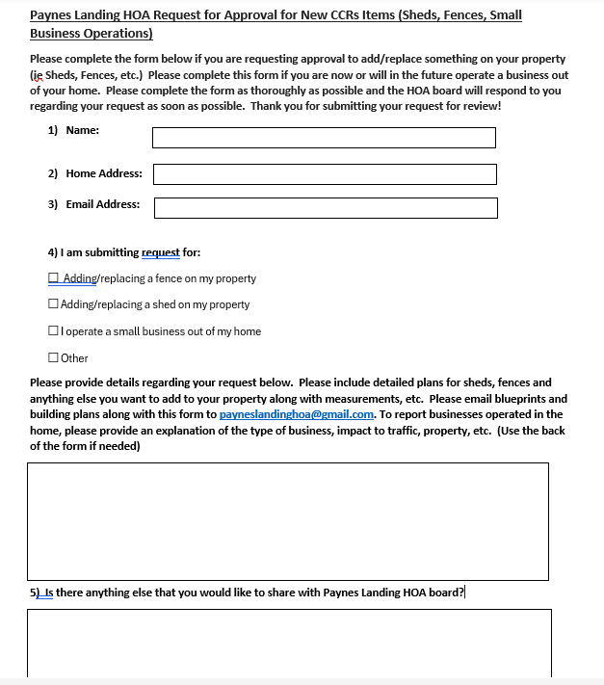

Reminder-Form to complete to get HOA Board Approval
  Please submit the approval form to the HOA Board to review and approve these items.
  Please email the completed form to: payneslandinghoa@gmail.com
  The approvals will be tracked as we are creating a formalized approval process and tracking system.
  We are asking that everyone participate to avoid notification of not being in compliance with the new CCRs.
Form can be found on our website: payneslandinghoa.com
Notes:
Michael reminded everyone that any CCR requests from homeowners require the completion of the online request form and approval from the board.

Slide 11
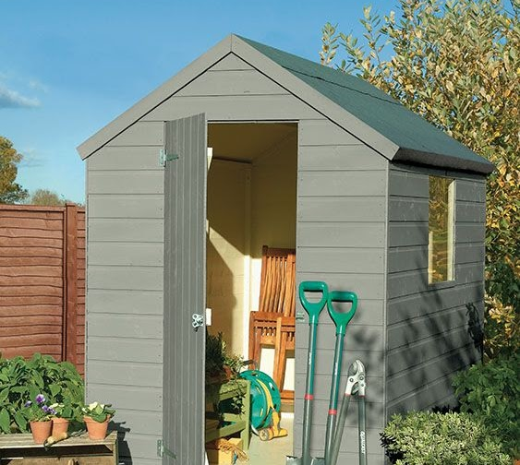
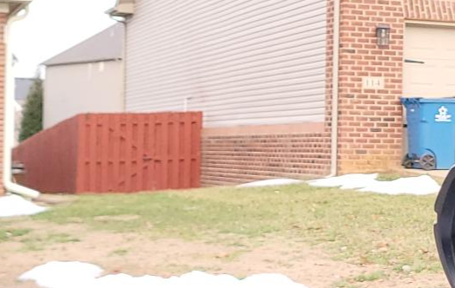
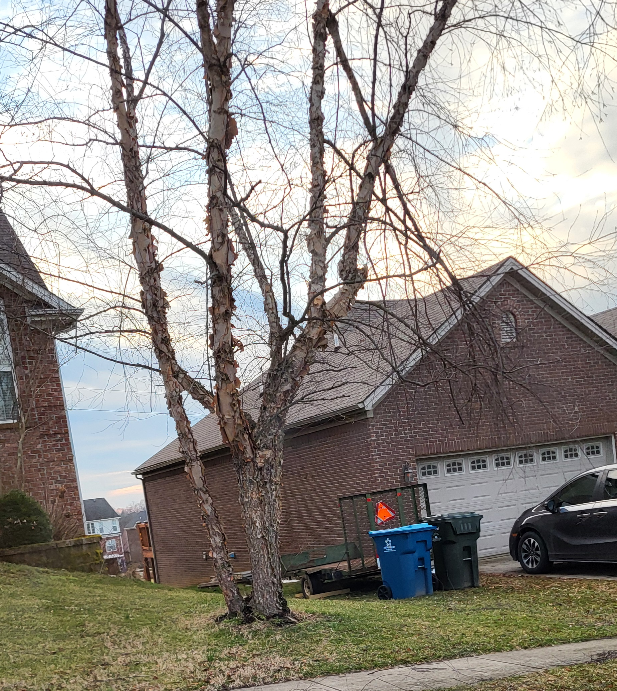
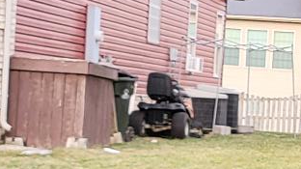
CCR CoMPLIANCE
Fences
Sheds
Clutter
Notes:
We spent a large amount of time discussing the homes out of compliance with CCRs. Several home owners expressed that it is just a fence and why do we care where they come to. Michael reminded everyone that 75% of our home owners approved the CCRs and it is required of the board to enforce them. The CCRs have always said fence must connect at the back of the house. Noone expressed any concerns in meetings, surveys, etc about this requirement and 20% of the homes our out of compliance.

Slide 12

Current CCR Compliance Issues:
Fences – Current and Past CCRS required fences to not come past the rear wall of the house.
The board has not been granting approvals for noncompliant fences.
Some homes have requested approvals of fences past the back wall of the house which approvals have not been granted.
Currently 57 of 288 homes in the neighborhood have fence violations, roughly 20%.
Most of these houses the board can not find past approvals for these fences.
Notes:
57 of 288 homes in the neighborhood have violations or 20%. We are looking for a solution that doesn’t require another 1.5 process to update the CCRs. No past approvals from previous boards to address this with any homes have been found on file or in email.

Slide 13
The board is considering several options and would like homeowners’ input:
Option 1: Grandfather clause + strict forward enforcement
Existing non-compliant fences → grandfathered (only until repaired, replaced or substantially modified, or property is sold then must be brought into compliance)
New fences → strict enforcement
Option 2: Hardship variance policy
Variances may only be granted for:
  Lot shape (including if back of neighbor’s house is farther back/forward than yours).
  Drainage
  Topography
  Easements
Variances must not materially conflict with aesthetics
Homeowners must apply for hardship variance and be approved by the board
  New fences → strict enforcement
Notes:
Background
We have a fence issue never mentioned in prior committee, member meetings, member surveys about updating CCRs.
Took 1.5 years for current board to get 75% vote on new consolidated, simplified CCRs. Michael reviewed the options the board came up with. Even the 5 board members were not in agreement on the solution. We want to be transparent and get input from our members before we act on the CCR violations. Current CCR require homes with be in compliance within 90 days of receiving a violation letter or face $100 month fine. Geneva has created a survey and will send out via Facebook group and on our website for input. She requested everyones help to get the word out. Michael went over the 3 options in detail and asked for any other suggestions. Only other suggestions was to update the CCRs again which the board could do in the future but is not in favor of doing now after just completing 1.5 years of work. IN the mean time we need a solution. Discussion over Option 2 and conditions that would meet a variance. Alenda suggested survey the 57 homes that are out of compliance.
All past CCRs included language on fences constructed in front of rear wall of homeowner’s residence
New CCRs kept that language
Board must enforce language in CCRs
Future CCR modifications could change rear wall language with 50% of homeowner’s approval
All homes received notice of approved CCRs with 75%-member vote and were notified that enforcement would begin. No homes have received noncompliant fence letters yet.
Issue
Two homeowners have submitted fence plans with fence not connecting to rear wall of homeowner’s residence
Board denied both requests. Homeowners pointed out that other homes in the neighborhood are not in compliance with CCRs
Board must enforce current CCRs
Board wants input from homeowners on enforcement actions
Board wants to enforce CCRs, recognize homeowners that followed the rules, punish violators but give reasonable time for compliance
Board is in no win situation
Outreach/Input
Board will reach out to members for input on Facebook page, website and via email if members have provided an email
Board wants transparency and neighborhood input on this issue
Board and members will discuss at March 10, 2026 Annual Member meeting
Board will conduct compliance review of all homes in the HOA to provide data on homes out of compliance
Review of CCR Section 4(d)(i-vii)- Fences:
Constructing, erecting, or planting a new fence, hedge, wall, or barrier requires Board approval in writing before construction, erection, or planting may begin. Homeowners must submit plans for the fence, hedge, wall, or barrier project to the Board in writing before construction, erection, or planting may begin. Fences, hedges, walls, or barriers cannot be constructed, erected, or planted beyond the building set back lines (except for those along the rear property lines) as shown on the recorded subdivision plat without the written permission of the Board; nor shall any fence, hedge, wall, or barrier of any nature be constructed, erected, or planted in front of the rear wall of the Homeowner’s residence building. For corner lots, side fences must be setback 15 ft from street curb. ii. No chain link or vinyl fences are permitted whatsoever. Brick walls, hedge walls, wooden and wood-like composite fences, rod iron, and rod iron-like aluminum fences are permitted. Rod iron, and rod iron-like aluminum fences must be black. iii. Approved fences, hedges, walls, or barriers may only be up to six (6) feet in height. No specific fence style is mandated, other than the requirements stated herein. iv. All fences, hedges, walls, or barrier shall comply with all government regulations and shall be approved by the Board in writing prior to commencement of the construction thereof. v. In the event a Homeowner fails to obtain prior written approval from the Board before constructing, erecting, or planting a fence, hedge, wall, or barrier, then such lot Homeowner shall incur a fine of $100.00 per week from the date of written notice to the Homeowner by the entity seeking to enforce this restriction until such violation ceases. vi. Homeowners with fences, hedges, walls, or barriers erected under the previous Declarations which were not compliant thereunder, and which are not complainant under these Consolidated CCRs, are hereby considered non-compliant fences, hedges, walls, or barriers and must be made to be in accordance with the fence requirements stated herein or be removed within three months of receipt of the notice of non-compliance sent to the Homeowner after the recording of this instrument. Non-compliant fences, hedges, walls, or barriers will be assessed an HOA fine of $100.00 per month until the fence, hedge, wall, or barrier is either made to be in compliance with these rules or removed. vii. The Board’s approval of the proposed fence, hedge, wall, or barrier will be based on Neighborhood safety and cohesive Neighborhood aesthetics. viii. Board approval of construction and design plans for proposed fence, hedge, wall, or barrier will not be unreasonably withheld.

Slide 14
Option 3: Enforce CCRs + adopt a compliance policy
Establish a written compliance/enforcement policy:
  Existing non-compliant fences:
    Grant temporary variance for existing non-compliant fences with compliance timeline increased to 12 months vs 3 months in CCRs
  Variance void before 12 months if fence is repaired, replaced or substantially modified, or property is sold, then fence must be brought into compliance
  New fences:
    Must fully comply, no exceptions.
Option 4: Any other options?
Notes:
Michael discussed option 3 and compliance policy. Would give homeowners 12 months vs. 90 days to comply. No new options suggested other than rewrite the CCRs.

Slide 15
Homeowners with any approved fence plans that do not comply with current CCRs from previous boards or variance approved from previous boards should supply copy to current board. We have reviewed what we have on file.
Enforcement/Penalty (once input received from homeowners and board members vote)-
Non-compliant fences, hedges, walls, or barriers will be assessed an HOA fine of $100.00 per month until the fence, hedge, wall, or barrier is either made to be in compliance with these rules or removed.
Note this issue also applies to out of compliant sheds, clutter.
Notes:
No previous approvals found on file or in emails.

Slide 16
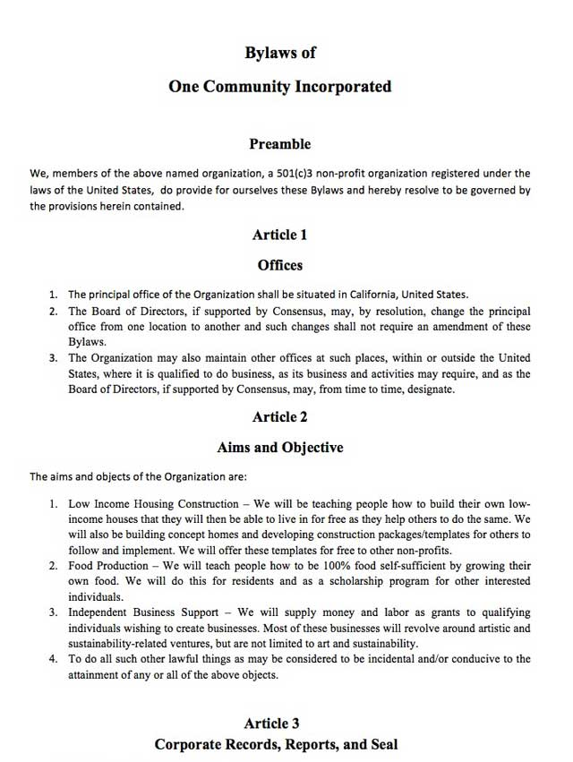

Update Bylaws
Bylaws were created during the building phase of Paynes Landing
Purpose: Present recommended updates to the Bylaws
Goal: Improve clarity, transparency, and operational effectiveness
Language needs to be updated to include Board of Directors instead of Builders
Clarify number of board members, add term limits and resignation procedure
Review language to focus on HOA majority vote for high capital purchases, loans, etc. Currently not outlined today
Notes:
Geneva reviewed current state of bylaws and that board would like to address since they are more builder based. We went over what we would like to change and mentioned that we will have the HOA attorney draft the first updated version and share with homeowners for input. Stressed the need to members voting when high capital purchases are involved. As it is now board could take on huge debt and raise HOA dues or charge assessment to homeowners. This board would like to prevent that by requiring 75% HOA member votes.

Slide 17
Proposed Changes
Organizational Improvements:
Add a Table of Contents for easy navigation
Standardize section numbering, fonts, and formatting
Include a definitions section (e.g., "Member," "Quorum," "Common Elements")
Governance Enhancements:
Define minimum qualifications for Board members
Introduce term limits (e.g., two consecutive terms)
  Cannot hold same position for more than two consecutive terms
Add formal procedure for removal of a Board member
  Member request special meeting by 50% signature
  Board process to remove: 75% vote of board for removal
Require disclosure of conflicts of interest
  At election and anytime during term that conflict arises.
Notes:
Geneva covered additional proposed changes. Attendees agreed changes are needed.

Slide 18
Proposed Changes
Meetings and Voting Enhancements:
Allow electronic voting and virtual meetings
  Board required to offer remote option.
  Two meetings per year
Review and revise quorum requirements for feasibility
Clarify proxy voting procedures. Clarify % voting required.
Financials and Budgeting:
Capital expenditures/loan voting requirement outline
  Set capital expenditure limit based on % of income/budget. Get feedback from owners on amount. Cannot be changed by board without 75% approval of membership.
Include language on late fees, interest, and collections process. Per CCRs unpaid dues or fines accrue 15% late fees and interest, enforceable via lien and foreclosure. Set timeframe.
Mandate reserve fund maintenance and periodic reserve review. % of budget
Require annual budget and audit transparency to members. Budget and expenditure review at least twice annual at member meetings.
Notes:
Addition review and discussion of proposed changes.

Slide 19
Proposed Changes
Maintenance and Property Standards:
Detail the request submission, review process and timelines
Clarify HOA vs. homeowner maintenance responsibilities
Create a maintenance responsibility matrix/chart
Rules Enforcement & Dispute Resolution:
Outline steps for rule enforcement (warnings, hearings, fines) CCRs-Unpaid dues or fines accrue 15% late fees and interest, enforceable via lien and foreclosure.
Add an Alternative Dispute Resolution (ADR) clause (e.g., mediation before litigation)
Emergency Provisions:
Define Board powers during emergencies (e.g., natural disasters, pandemics, temporary relief of CCR requirements)
Provide a contingency plan for Board vacancy or inactivity. If board member becomes incapacitated, temporarily unavailable. Limit 6-month appointment of new member without member vote.
Notes:
Additional review and discussion on proposed changes.

Slide 20

NEXT STEPS
Board review and feedback
Legal review and creation of proposed updates
Share Draft with Homeowners and get feedback through survey
Vote on Adoption (Tentative June 2026)
Notes:
Discussed next steps. Question about who is creating. Michael confirmed attorney will be drafting revised bylaws based on that was covered today.

Slide 21
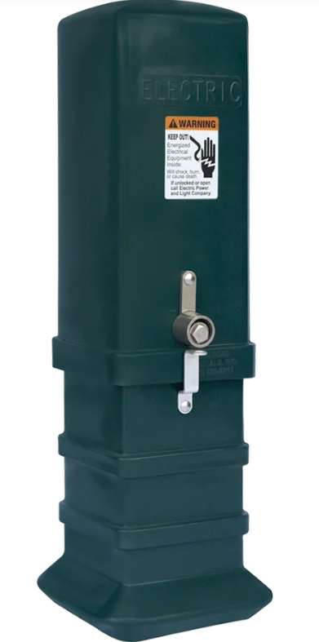

GREEN SPACES
ELECTRICAL PEDESTAL PROPOSAL
We would like to place two electrical pedestals in the green spaces.
One by the pond
One by Inverness Dr. and Swilcan Bridge
This would provide a power source for these areas to assist with social activities and making enhancements possible by the pond (installing a fountain, etc.)
Through KU (Kentucky Utilities) awaiting final costs to share with the HOA.
Notes:
Still working on getting electrical pedestals for the green space. They would power events like our back to school bash and if we add a fountain to the pond. Question about cost when not in use. Michael indicated there is a set up cost then based on usage. Most usage would be if we get a pond fountain.

Slide 22


Door prize
AND THE WINNER IS…….
Notes:
Door prize winners were selected based on random numbers and winners are Wanda Ray in person and Robin online. Geneva have Wanda her gift card and will get Robins to her. No further discussion meeting adjourned at 7:45 p.m.

Slide 23

Questions/ open discussion

