Slide 1

Welcome to Heavy Duty Towing & Recovery Class
All the information in this workbook is for the use of The American Towing & Recovery Institute only. All rights of this manual are reserved for their use only. No part of this manual shall be copied or used without the written permission of Wes Wilburn & The American Towing & Recovery Institute.
2025

Slide 2
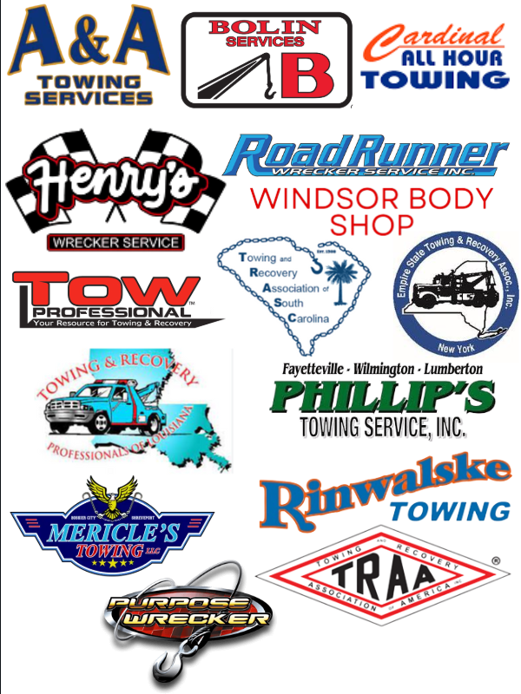
Special Thanks to our Sponsors!

Slide 3
Attitude
“The longer I live, the more I realize the impact of attitude on life. Attitude, to me, is more important than facts. It is more important than the past, than education, than money, than circumstances, than failures, than successes, than what other people think or say or do.
It is more important than appearance, giftedness, or skill. It will make or break a company, a church, a home. The remarkable thing is we have a choice everyday regarding which attitude we will embrace for that day.
We cannot change our past…we cannot change the fact that people will act in a certain way. We cannot change the inevitable. The only thing we can do is play on the one thing we have, and that’s our attitude.
I am convinced that life is 10% what happens to me and 90% how I react to it.
And so it is with you, we are in charge of our attitudes.”
CHARLES SWINDOLL
There is Never any reason for a towing & recovery instructor to say
“THIS is the ONLY WAY to handle a towing-recovery job.”
However, there are several ways to do the same job; if the casualty is taken out in a timely manner, with little to no further damage being done.
So, lets learn from each other and have fun in doing so.
THANK YOU FOR ATTENDING

Slide 4

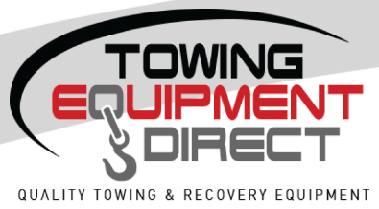



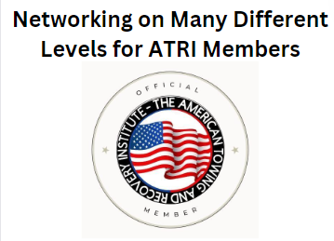
10 years passes quickly…

Slide 5


Slide 6
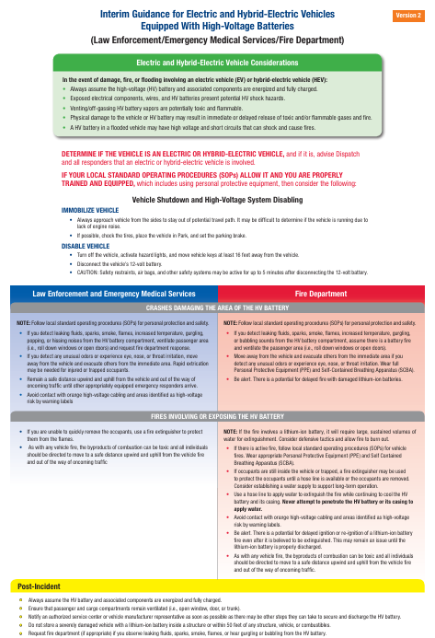

Slide 7
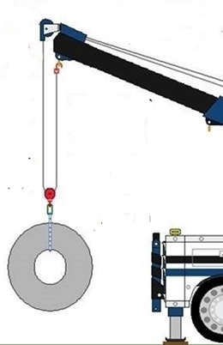
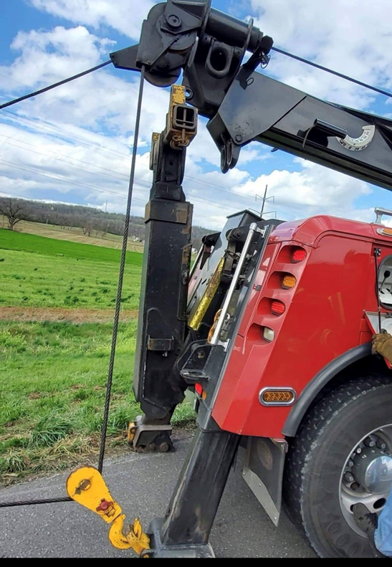
Winching & Rigging
Snatch blocks serve two different purposes when rigging one is to;
To change direction

Slide 8
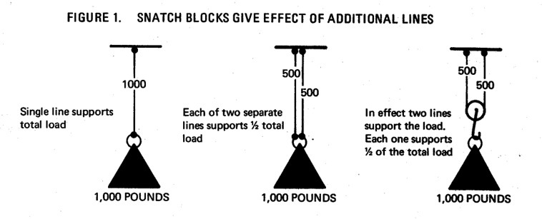
Why Use Snatch Blocks – You can significantly increase the capacity of your wrecker by using snatch blocks. You should always use them for loads that would exceed the recommended working limits of your wrecker cables.
How a Snatch Block Reduces Line Tension – A single snatch block used to its best advantage would give the effect of connecting two lines to the load. Hence, we say the line has two parts or is a two-part line. Each of those two parts would share the load equally. Hence, tension on each part would be reduced to ½ the tension of a single line. The use of additional snatch blocks would further divide and reduce the tensions when properly used.

Slide 9
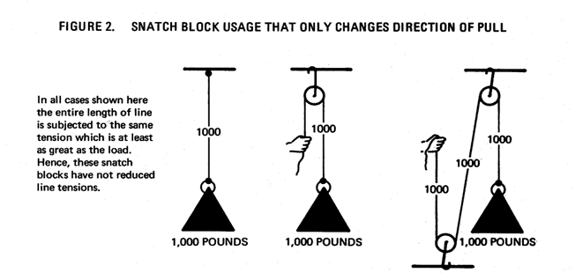
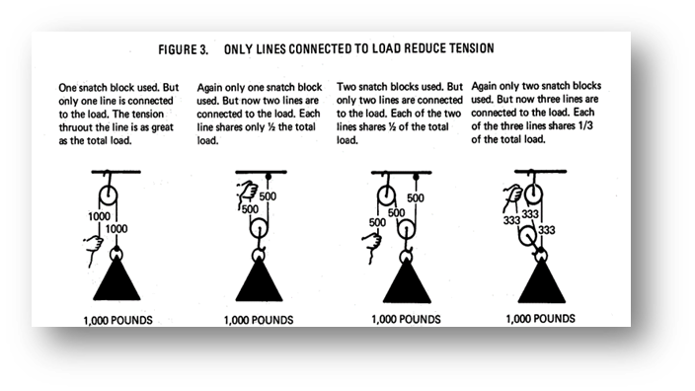
Using Snatch Blocks with Wreckers: Theory & Practice

Slide 10
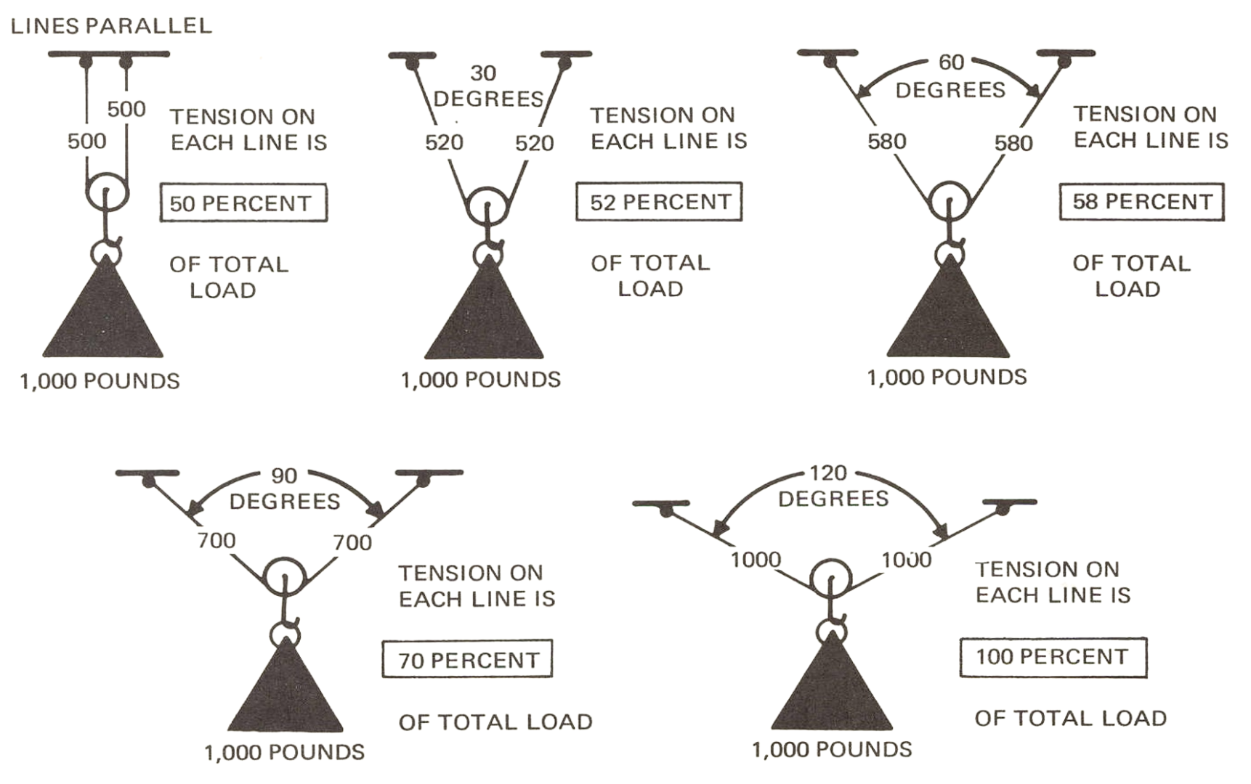
How line angles affect tensions

Slide 11
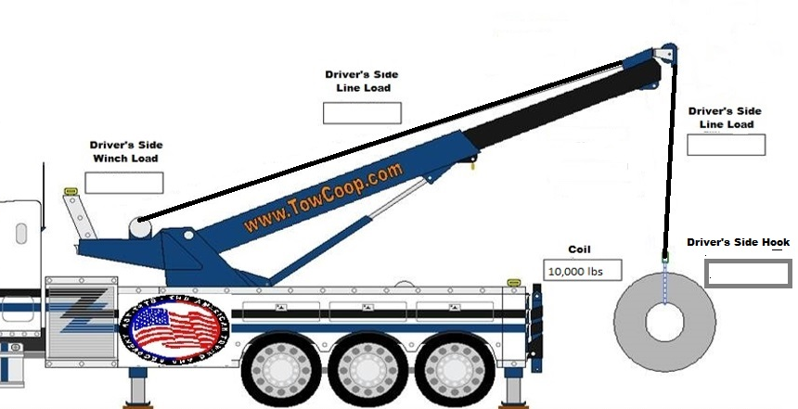
10,000 lb Coil, Single Line to Load
Now, test your understanding of the winching information. Try to find the tensions on the cables on the following problems. Then determine the minimum size cable for the problem, disregard friction when calculating.
Notes:
Print out

Slide 12
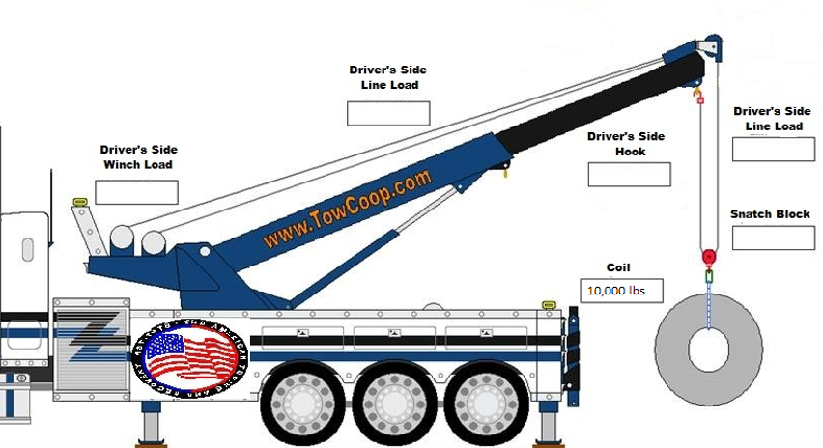
10,000 lb Coil, Two Lines to Load
Now, test your understanding of the winching information. Try to find the tensions on the cables on the following problems. Then determine the minimum size cable for the problem, disregard friction when calculating.
Notes:
Print out

Slide 13
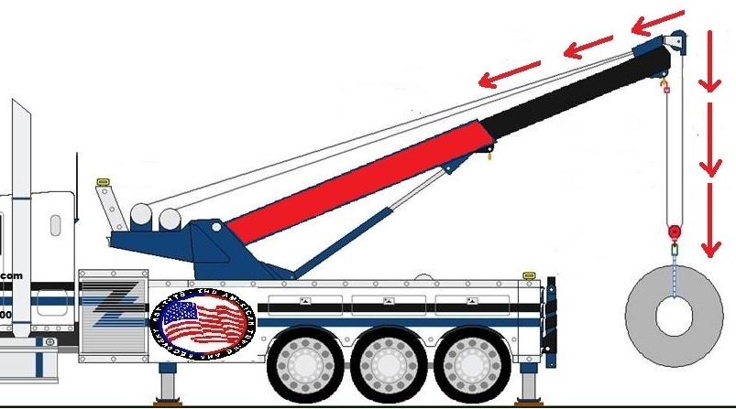
Opposing forces create more stress at the boom pulley.

Slide 14
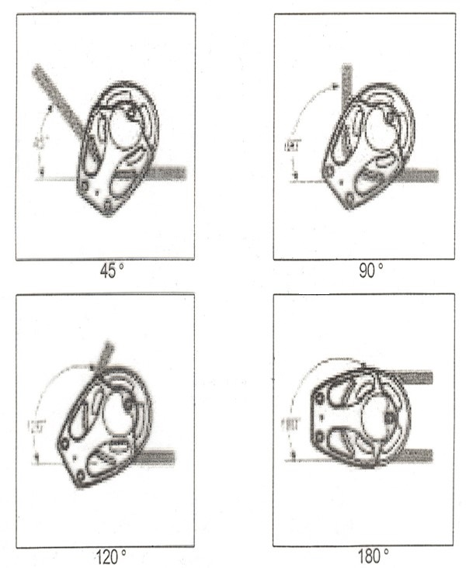
Loads on Snatch Blocks & Other Sheaves
Loading Formulas
Block Loading vs. Angle of Deflection
Load on a block is a combination of the load on the line passing through the block, plus a block loading factor, which is determined by the angle of which the block supports the line.
Angle of Deflection | Load Factor
30° | 52%
45° | 76%
60° | 100%
75° | 122%
90° | 141%
105° | 159%
120° | 173%
135° | 185%
150° | 193%
160° | 197%
180° | 200%
Boom Load vs Angle of Deflection
If Boom Angle is Angle Multiplier
60º 1.93
50º 1.87
45º 1.85
30º 1.73
Notes:
Print out

Slide 15
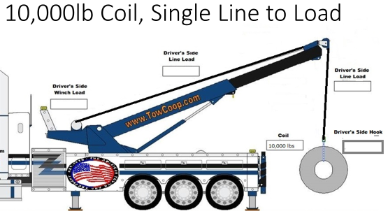
Calculating Boom Load – Single Line
Boom angle is 45 degrees, so use line load x 1.85 = load on pulley
X
1.85
=
Line Load
Total Boom Load
Notes:
Print out

Slide 16

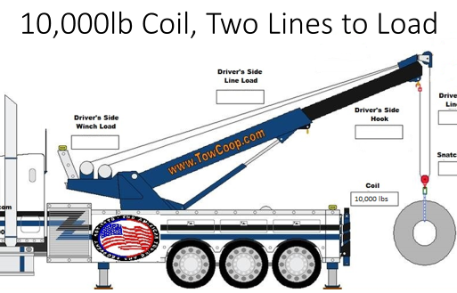
Calculating Boom Load – Two Lines
Boom angle is 45 degrees, so use line load x 1.85 = load on pulley
x
1.85
=
Line Load
Load on Pulley
+
=
Load on pulley
Drivers Side Hook
Total Boom Load
Notes:
Print out

Slide 17
Working Load Limits
What they are, how they are determined, and why they are important
Working Load Limit (WLL) is the maximum load a product should ever see.
WLL is a ratio of the minimum breaking strength (MBS)
MBS is determined by testing, then a ratio or design factor is applied
All chains, straps, shackles, and other rigging items have at least one WLL
Items can have two or more WLLs depending on how they are rigged and what angles are present

Slide 18
Design Factors & WLL Applied to Products
Synthetic Web, Winchlines, Round Slings, etc. – 5 to 1
Chain, Hooks, Connectors, Oblongs, & most Shackles – 4 to 1
Wire Rope (normally in Towing) – 3.55 to 1
For overhead lifting 5:1
Tie-Down Straps & Ratchets – 3 to 1
*AMSE/ANSI B30.5, formerly SAE J-959
Basic recovery strap suggestions…
Always use at least two ply for heavy recovery work.
Always use wear pads at all corners to give the recovery strap a better surface to touch as it stretches.
Cordura wrapped is always a good idea. It does NOT make the strap bullet-proof but it does help!
Always load fiber evenly

Slide 19
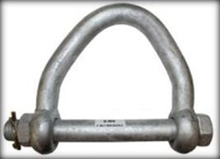
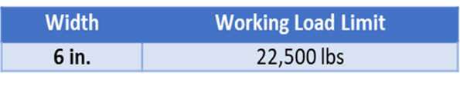
These web shackles will help to extend the life of your recovery straps by evenly distributing the load of the fibers of the strap. All ratings on these straps are obtained using a straight pin style shackle. The load rating info is forged into the body of the shackle and manufacturer info on the pin as well.
Alloy Web Shackle Info
6 inch is the largest size & WLL available. Something to consider when you are choosing recovery straps.

Slide 20
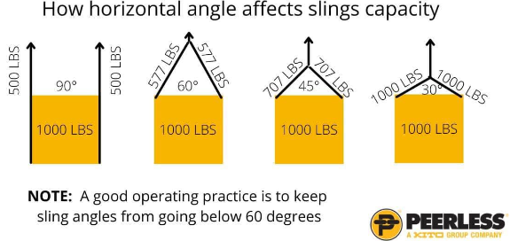
Angles matter, BIG TIME!
Sling angle should not be less than 30°

Slide 21
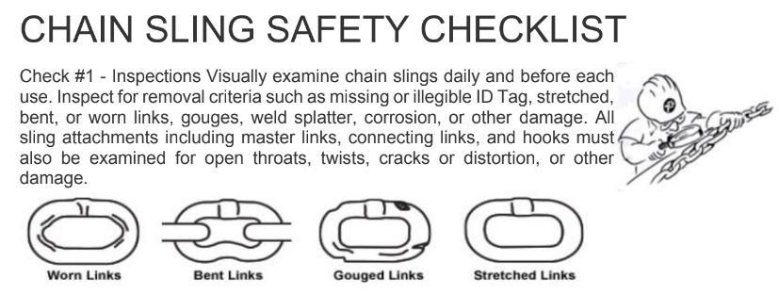
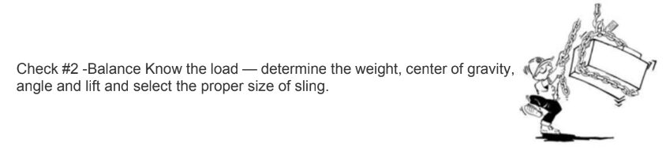
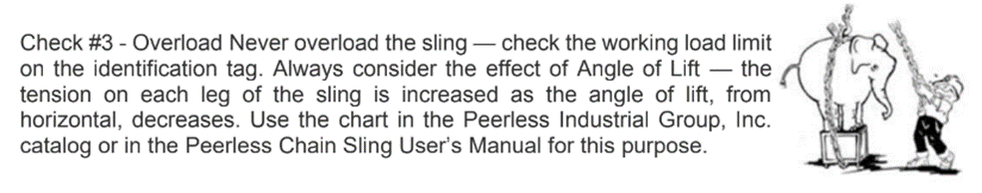
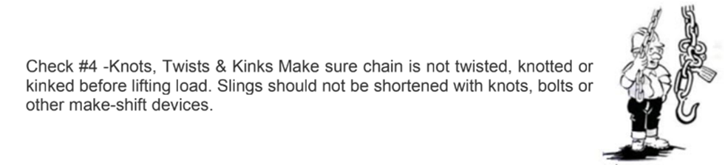

Slide 22
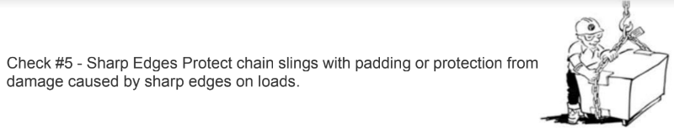
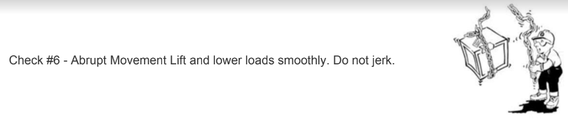
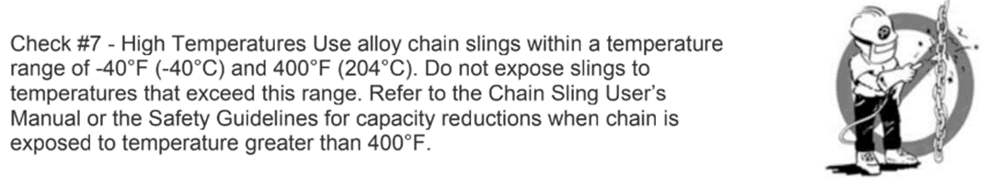
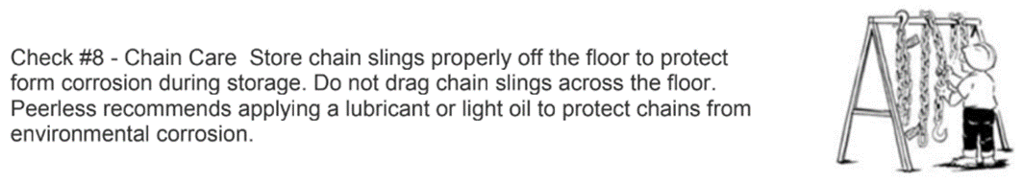

Slide 23
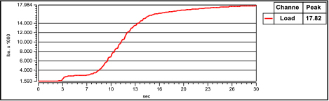
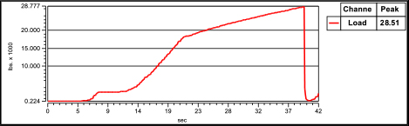
CHAIN MEMORY
How much does a one-time overload affect the overall strength of a chain?
Grade 100 3/8”
WLL 8800lbs
MBS 35,200lbs
1st pull 17,820 lbs
Lost about 25 percent in ONE overload.
2nd Pull 28,510 lbs

Slide 24
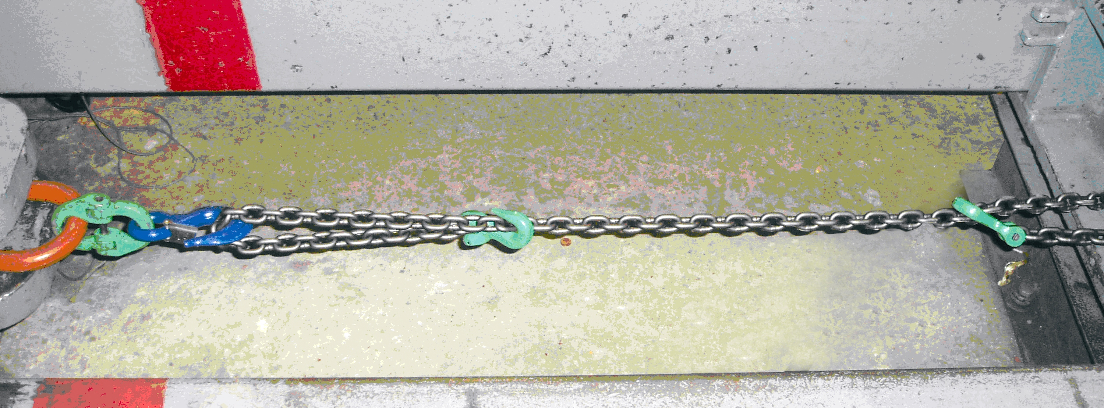
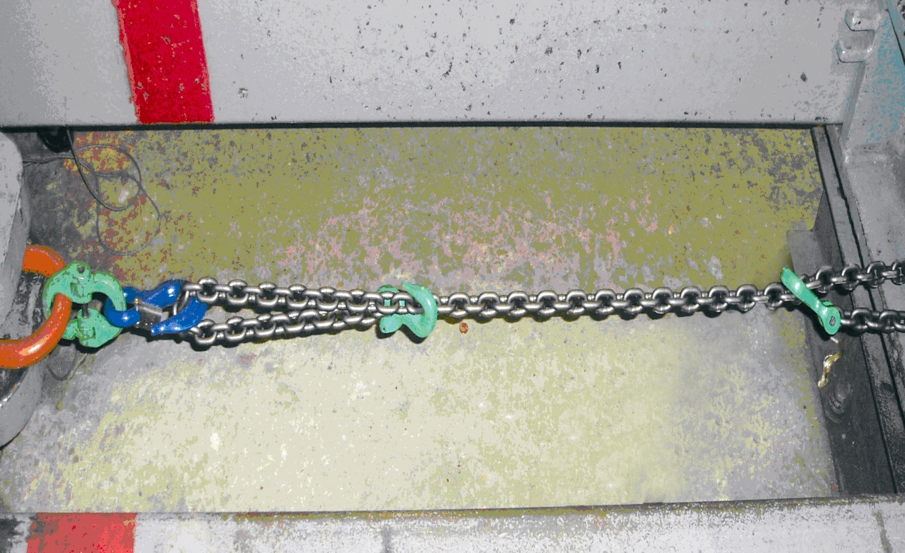
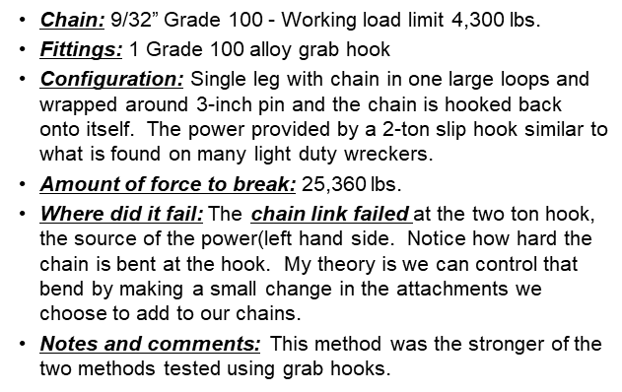
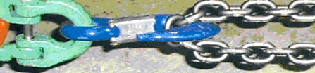
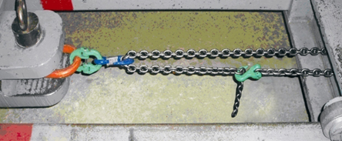
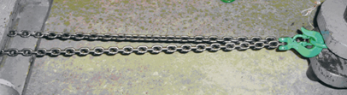
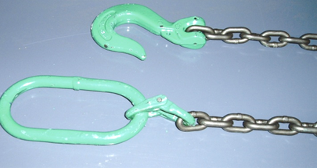
Break Test #1
Chain: 9/32” Grade 100 - Working load limit 4,300 lbs.
Fittings: 2 Grade 100 alloy grab hooks
Configuration: Single leg with one end of chain choked around 3-inch pin and the chain hooked back onto itself. The other end of the chain hooked back onto itself with the power coming from a 2-ton slip hook similar to what is found on many light duty wreckers.
Amount of force to break: 16,140 lbs.
Where did it fail: A chain link failed where a grab hook was connected to the chain on the right hand side.
Notes and comments: While this method allows the chain to be as long as possible the two small loops proves to be weaker than one larger loop.
Break Test #2
Break Test #3
Chain: 9/32” Grade 100 - Working load limit 7,400 lbs
Fittings: 1 Oblong ring (rated for a two leg bridle), 1 Grade 100 alloy chain coupler - hammer lock, 1 Grade 100 sling hook.
Configuration: Created almost a two legged bridle with chain legs encompassed around 3-inch pin.
Amount of force to break: 37,840 lbs
Where did it fail: The chain link failed in the bend at the connection at the load, i.e. the 3-inch pin. The alloy chain coupler - hammer lock was stretching significantly as well. All of the assembly was warm to the touch.
Notes and comments: This method was the strongest of the all of the methods tested and is the best method for achieving the best strength expectations when rigging a chain for a serious heavy pull or lift.

Slide 25
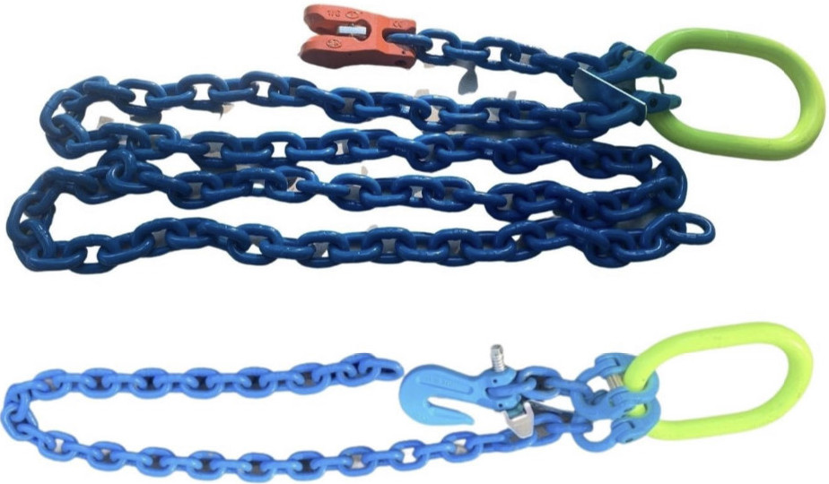
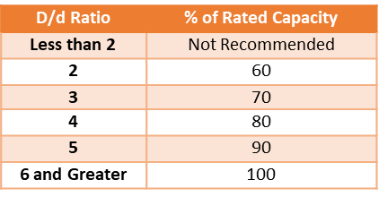
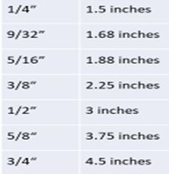
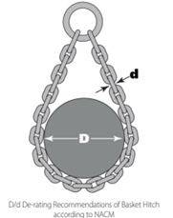
An example of a two-leg chain bridle
Winching Chains
Slings & D/D Ratio – Alloy Chain Slings
D/d ratio is the diameter of curvature around which a sling is bent affecting its capacity. The upper case “D” refers to the diameter of the object to which the sling hitch is applied, and the lower case “d” represents the diameter of the chain link of the sling
Chain Conversion Table

Slide 26
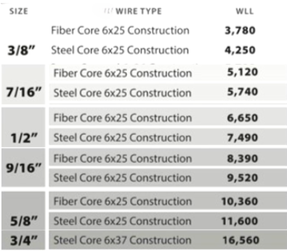
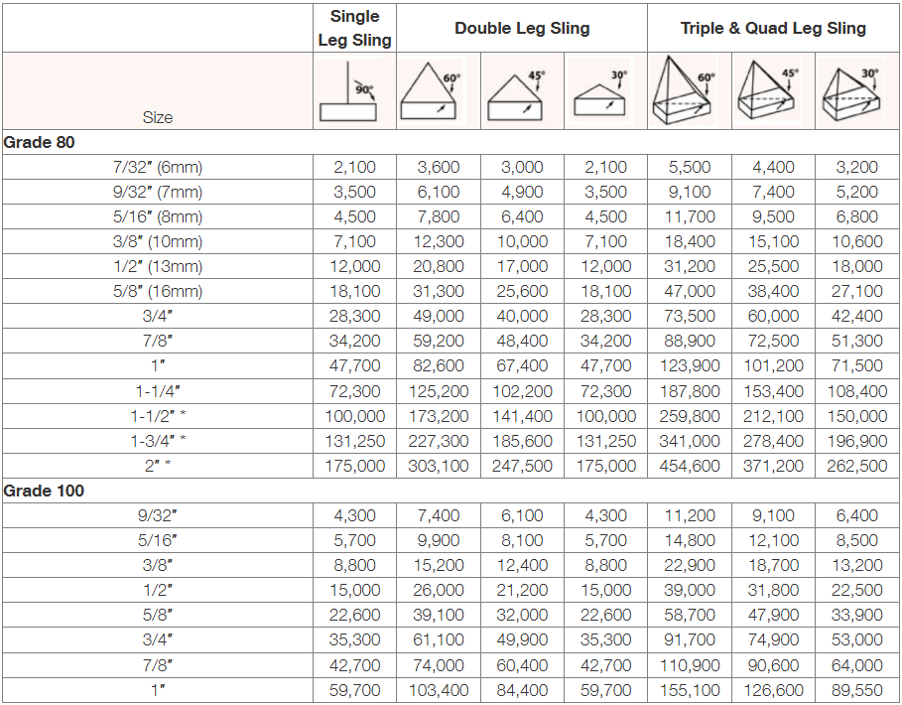

Slide 27
REFERENCES AND RESOURCES
Web Sling Tie Down Association www.wstda.com
Associated Wire Rope Fabricators www.awrf.org
National Association of Chain manufacturers www.nacm.org
Wire Rope Technical Board www.wireropetechnicalboard.org
The Cordage Institute www.ropecord.com
B/A Products Company www.baprod.com
Western Sling – Bishop Co www.westernsling.com
Peerless Chain Co – www.peerlesschain.com
OSHA www.osha.gov
Commercial Vehicle Safety Alliance www.cvsa.org

Slide 28


