Slide 1


THE UNFILTERED TRUTH:
EMPOWERING the YOUTH AGAINST BIG Tobacco
VAPING 101 ​
Presented by:​
Dr. Raymond Chimezie,
President, ​
Health for Schools & Communities Foundation
In collaboration with
Breathe California
&
Kristen Lockhart, MPH from the R.I.C.E Team of ACS CAN
​

Slide 2
Agenda
  1. Who are we?
  2. Tobacco Targeting: Advertising
  3. Vaping devices: hiding in plain sight/contents
  4. Vaping devices: can you name the device
  5. Ingredients of vapes
  5. Health risks from vaping
  6. Resources
  7. Test your knowledge

Slide 3
Dr. Chimezie, PhD, CHES Community Health
Vision
Healthier and safer communities with improved access to preventive health
Mission
Our organization engages in activities that promote health, improves lifestyle, empowers and supports human development in schools and communities adversely impacted by lack of access to basic and preventive care. We will focus our services in California and West Africa.

Slide 4

Kristen Lockhart, MPH ACS CAN
Our Vision:
End cancer as we know it, for everyone.
Our Mission:
To improve the lives of people with cancer and their families through
advocacy, research, and patient support to ensure everyone has an opportunity to prevent, detect, treat, and survive cancer.
The American Cancer Society exists because the burden of cancer is unacceptably high.

Slide 5

BIG TOBACCO’S
DEADLY MISSION:
Make YOU the customers of the future.
Notes:
JUUL pods gave away vapes in the beginning to college students in clubs and at parties. Those same college students came home to their younger siblings who then gained access to vapes. JUUL took out ads focusing on young adults (college students), ran social media campaigns to influence other young adults

Slide 6
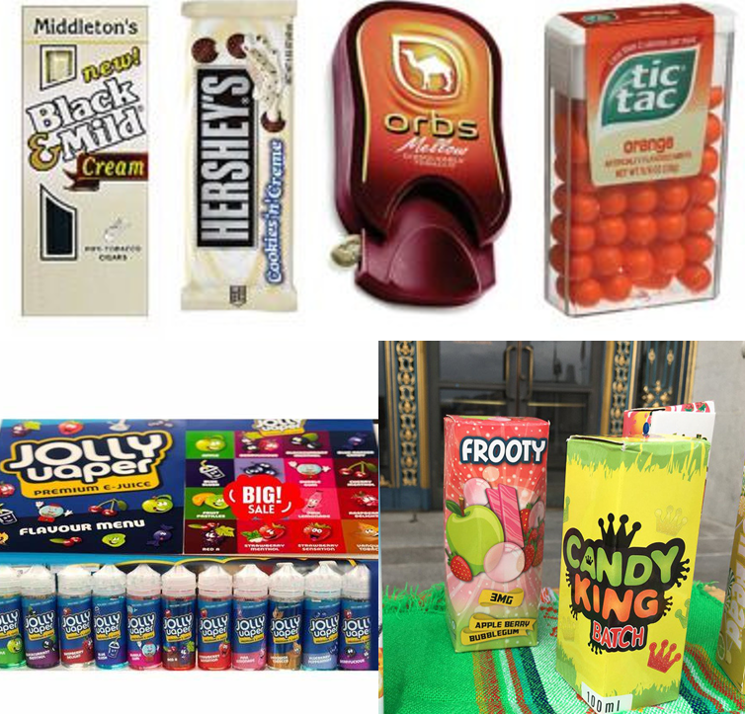
Tobacco Tactics
FLAVORS HOOK KIDS
93% of youth who tried vaping started with a flavored product.
Notes:
Brightly colored packaging, flavors that are comparable to cherry, grapes and cotton candy.
Cartoons with vaping and smoking references
In the store items are positioned in the store eye level for you to see
Utilize social media influencers, celebrities to entice youth to indulge

Slide 7
WHAT ARE E-CIGARETTES?
E-cigarettes (often called vape pens) are battery-operated vaping devices that heat a liquid until it becomes an aerosol (mist), which is inhaled.
Even e-cigarettes that claim to have no nicotine have been found to contain nicotine. Some might contain marijuana, herbs, or oils.
Some e-cigarettes are disposable and designed for one-time use.
Others can be refilled with liquid, recharged, and used over and over.

Slide 8
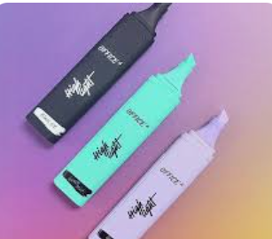

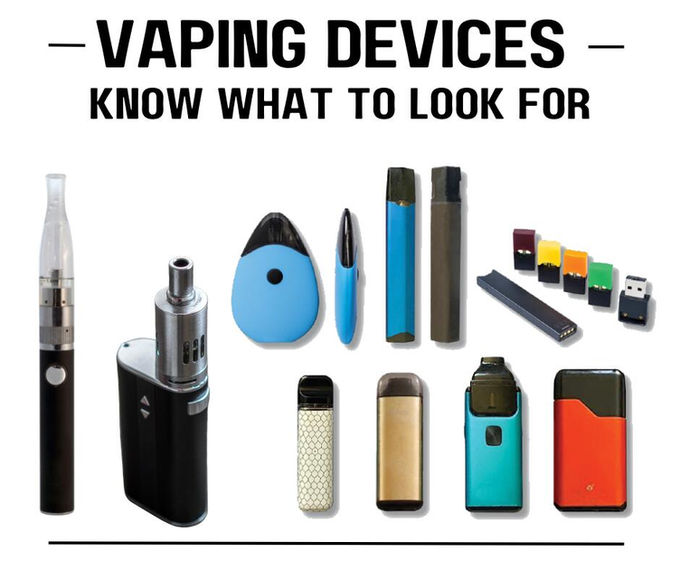
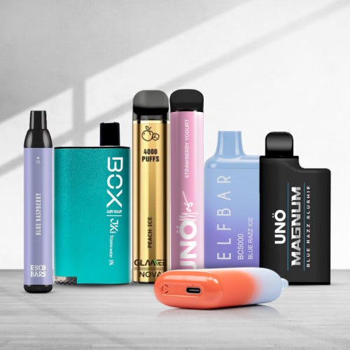

Vaping devices and how they can be concealed
Notes:
At last count, there were more than 15,500 vape flavors available online.
Top left: highlights, resembling a highlighter
Bottom left: Elfbar/flums
Top right: JUUL pods (look like jump drive)

Slide 9
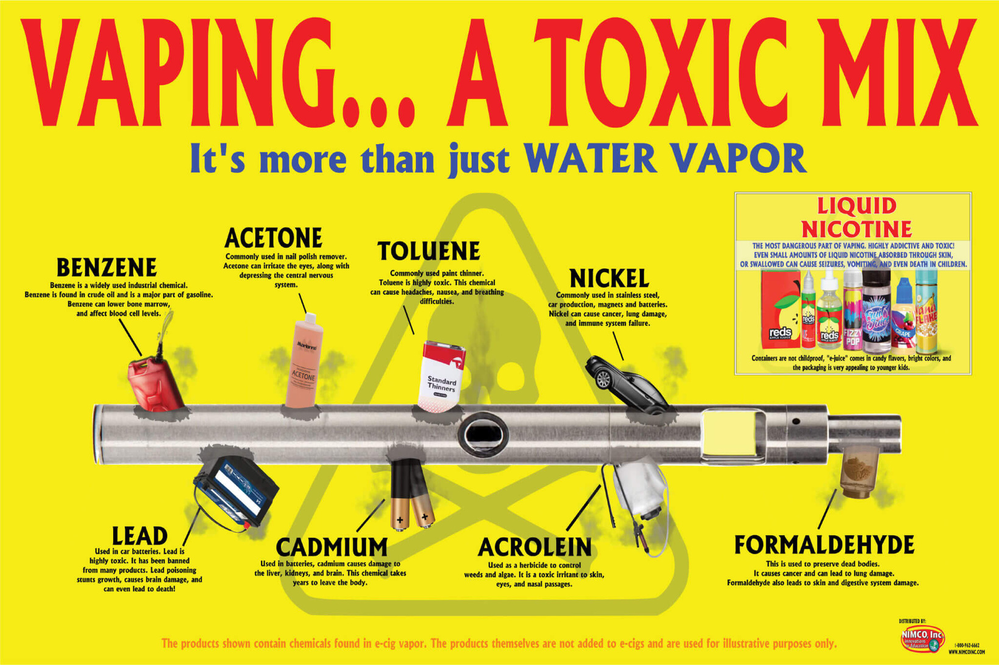
THE TRUTH...
VAPES ARE DANGEROUS.

Slide 10
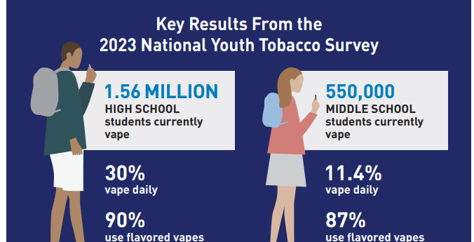
Notes:
Youth stats on smoking

Slide 11
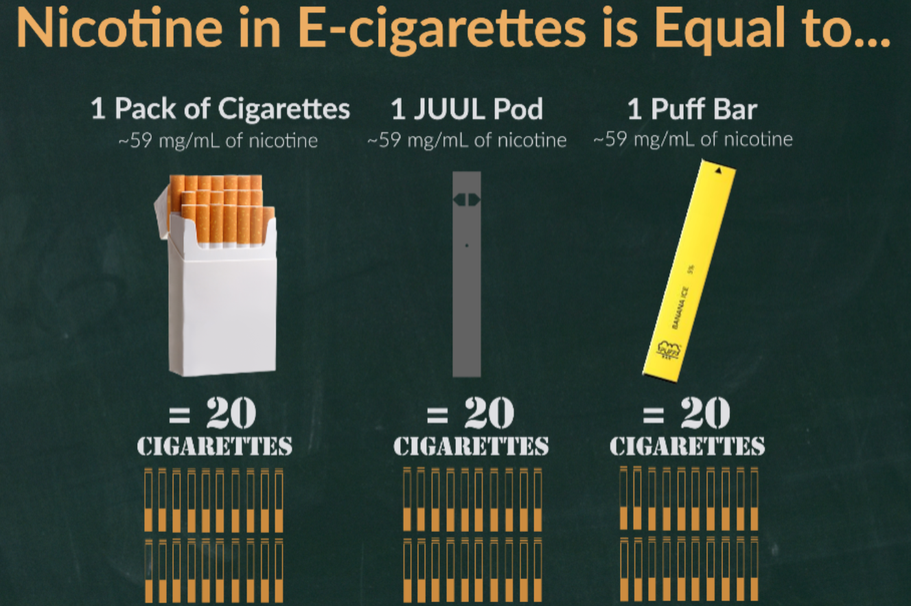
Notes:
Using a JUUL pod or Puff bar is equivalent of smoking a pack of cigarettes

Slide 12

Vaping & Health
Nicotine can rewire a teen’s brain to crave more nicotine and can create addiction.
Changes in the development of memories;
Difficulty focusing and concentrating on tasks;
Extreme mood swings
Vaping can expose users to toxic chemicals and metal particles—such as lead, chromium, and nickel—that can harm the lungs.
E-liquid that contains nicotine may be toxic if swallowed. Accidental exposure to e-liquids in children can lead to nicotine poisoning and even death.
ENDS can explode and cause serious injuries. The cause of explosions is not always clear, but the problem may be related to the batteries in these devices.

Slide 13
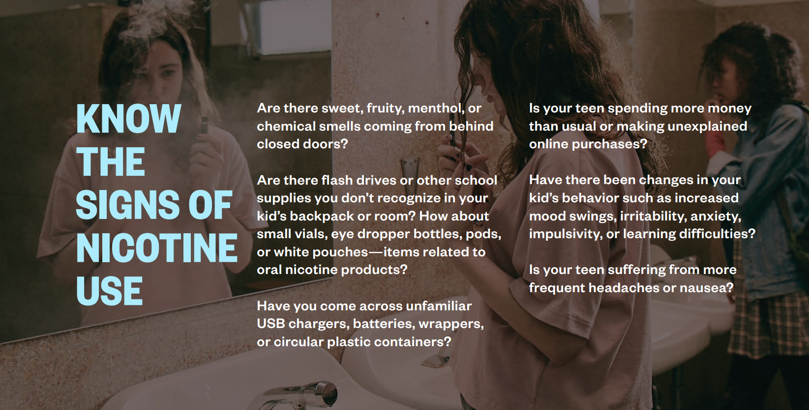
Signs of Vaping:
Undo.org
Notes:
Smells of fruit flavors such as cotton candy

Slide 14

Resources
Text “Quit Vaping” to 66819
visit kickitca.org/text
CDC:
English 1-800-784-8669
Spanish: 1-855-335-3569
My Life My Quit connects: Text “Start My Quit” to 855-891-9989 or call.
SmokeFree Text : QUIT to 47848
DITCHVAPE to 88709

Slide 15
Test your knowledge/Questions
Vaping and Tobacco Prevention Jeopardy Template (jeopardylabs.com)

