Slide 1
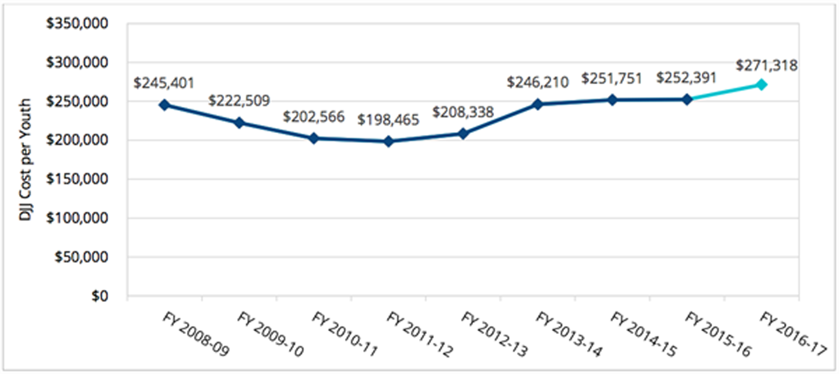

School-based Health Promotion Program: An Approach to Reduced Youth Behavioral Risk Factors
Raymond O. Chimezie, PhD, CHES, FRSPH
President & Founder, Health for Schools & Communities Foundation, Inc.
Abstract
Youths are at risk of unintentional injuries and violence, tobacco use, alcohol and drug use, sexual misbehaviors and sexually transmitted infections (STIs), unhealthy dietary behaviors, and physical inactivity (Morbidity and Mortality Weekly Report, 2016).
Tobacco use, unhealthy eating, and inadequate physical activity lead to chronic disease conditions in adulthood.
The Whole School, Whole Community, Whole Child Model:
-A framework for all schools
Closes the gap to unbalanced education of children
Healthy people are more likely to learn more effectively and accomplish higher goals
Reinforce health promoting behaviors in students, and reduce risks that cause premature mortality and morbidity among young children.
Promote a healthy national labor force and a productive society.
Education focused on immediate and future needs of the child
Engages schools, families, and communities to adopt positive healthy behaviors
Promotes employee health and trains teachers as role models for students.
Background:
Every child should be taught early in life, that, to preserve his own life and his own health and the lives and health of others, is one of the most important and constantly abiding duties,… knowing and avoiding the causes of disease, disease itself will be avoided, and he may enjoy health and live; -(Allensworth, Lawson, Nicholson, et al., 1997).
Early exposure of school children to proper healthy behaviors and awareness of the consequences of making poor choices is of primary importance to the education of the whole child.
Failure to teach children proper health promotion and education habits while in school represents a gap in the education to develop the whole child.
Children represent the future, and ensuring their healthy growth and development ought to be a prime concern of all societies (WHO, 2017).
Problem:
Many school districts do not see the need for health education and promotion (HPE) especially at K-6 levels.
Hypothesis:
Schools that are not incorporating health promotion and education in their curricula could be depriving students opportunities to learn, form, and practice desired healthy behaviors that could prevent life threatening diseases.
Average spending per child in K-12 is lower than national average in California. In 2015, $10.467; $9,595 (2014), $9,220 (2013) –(U.S. Census Bureau, 2018). Cost/juvenile rose from $251,751(2015), $252,391(2016), to $251,318 in 2017.
Investing in health education and promotion could have reduced the number of incarcerated children, rate of mortality and morbidity, and the associated costs.
Figure 1. DJJ cost per youth, actual (FY 2008-09—FY 2015-16), and expected (FY 2016-17
http://www.cjcj.org/news/11350
Click here to insert your Results text. Type it in or copy and paste from your Word document or other source.
Recommendations
School districts to make policies and be supported by key figures in the district including principals
HPE be integrated in the life and culture of every school
K-12 schools adapt and contextualize health education to local needs
Appoint school health coordinator
Teachers trained and supported with resources
Engage parents as partners to reinforce HPE programs at home.
Literature Review
Good health and academic success go hand in hand. Healthy children make better students, and better students become healthy, successful adults who are productive members of their communities (California Department of Education, 2009).
A health promoting school can be characterized as a school constantly strengthening its capacity as a healthy setting for living, learning and working-WHO, 1997
Children’s beliefs and behaviors are shaped during their formative years by the dominant behaviors in their environment and such behaviors tend to persist well into their lives (McEvily, Jaffee, & Tortoriello, 2012).
We must ‘‘strengthen schools as the heart of health.’’ The Institute of Medicine (2012)
Conclusions
Schools occupy a unique position to promote healthy behaviors while educating children
School-based health programs will help children avoid risky health behaviors and reduce the chances of developing chronic diseases
Teaching health promotion and education relentlessly to school children is a preventive measure far more effective and productive than paying for the costs of incarcerating and rehabilitating juveniles.
Reference
1. Allensworth D, Lawson E, Nicholson L, et al., editors. Schools & Health: Our nation's investment. Washington (DC): National Academies Press (US); 1997. 2, Evolution of School Health Programs. Retrieved from: https://www.ncbi.nlm.nih.gov/books/NBK232693
2. Center on Juvenile and Criminal Justice. (2018). California’s Division of Juvenile Justice (DJJ) reports high recidivism despite surging costs. Retrieved from http://www.cjcj.org/news/11350
3. McEvily, B., Jaffee, J., & Tortoriello, M. (2012). Not all bridging ties are equal: Network imprinting and firm growth in the Nashville legal industry, 1933–1978. Organization Science 23(2): 547-563.
4. Mitchel, R. and O’Connell, J. (2009). Health education content standards for California Schools 2015. Retrieved from https://www.cde.ca.gov/be/st/ss/index.asp
5. Morbidity and Mortality Weekly Report (2016). Youth behavior surveillance United States, 2015. Retrieved from https://www.cdc.gov/healthyyouth/data/yrbs/index.htm
6. The Institute of Medicine (2012). Accelerating progress in of obesity prevention: Solving the weight of the nation. Washington, DC: The National Academies Press; 2012
7. United States Census Bureau. (2018). Annual Survey of School System Finances: Per Pupil Amounts for Current Spending of Public Elementary-Secondary School Systems by State: Fiscal Year 2015. Retrieved from https://factfinder.census.gov/faces/tableservices/jsf/pages/productview.xhtml?src=bkmk
8. WHO. (2017). Child health. Retrieved from http://www.who.int/topics/child_health/en/
9. WHO Technical Report Series N°870. Geneva, In St Leger, L., Young, I., Blanchard, C, & Perry, M. (2009). Promoting health in school: from evidence to action. Retrieved from http://hivhealthclearinghouse.unesco.org/library/documents/promoting-health-schools- evidence-action
Contacts: Rchimezie@healthfsc.org. Ph.: 510-703-7798
Poster presentation at the 2018 California School-based Health Alliance Conference, Sacramento, California, May 17, 2018

