Slide 1
Company presentation 2024

Slide 2
Our Mission
To Provide a Complete Suite of Technical & Aircraft Ferry Services for Airlines & Aircraft Leasing Companies

Slide 3
About US
T3Tech, LLC is an Aviation Technical Services group
Founded by Manuel E. Cordero & Cesar Guedez in 2019
Core Group of Consultants that are available to support and help with any questions and or needs the Customer might have
Manuel & Cesar bring over 45 years of combined experience in the Aviation Technical Services Industry

Slide 4
HEadquarters
Miami, Florida, USA
Gig Harbor, Washington State, USA

Slide 5
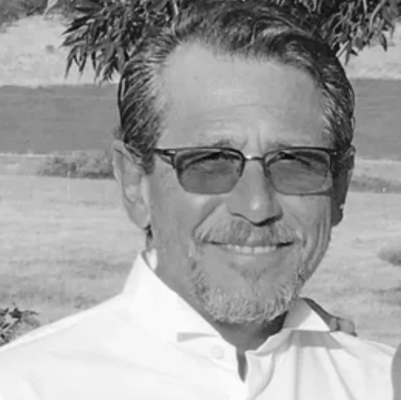
Our Team
Manuel E. Cordero
CEO & President of T3Tech, LLC
Prior to T3Tech, Manuel was responsible for the Technical Group at Jackson Square Aviation as their Senior Vice President of Technical Services
Was part of the team who founded Sky Holding and Jackson Square Aviation
During his various tenures, Manuel has provided expert advice on all technical and commercial aspects of lease, purchase and sale transactions
Led transition efforts related to over 250 aircraft delivery, redeliveries and early terminations
Holds a Bachelor of Science degree in Fluid Dynamics and an FAA Certified Airframe & Powerplant Mechanics license; all obtained at the University of Illinois

Slide 6
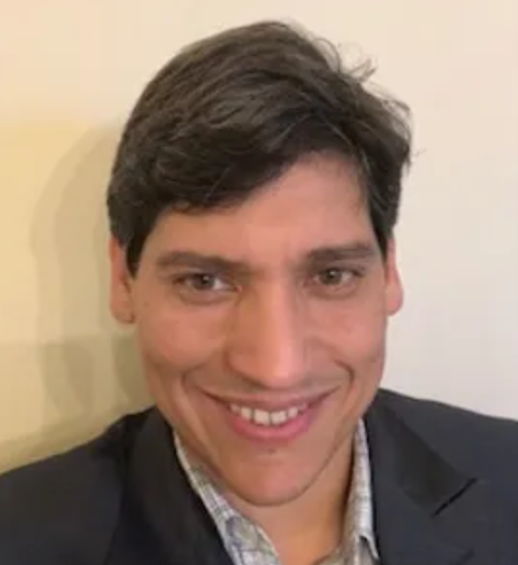
Our TEam
Cesar Guedez
Founder and COO at T3Tech, LLC
25+ years of experience in the Aviation Indiustry
Started his career in Airworthiness Engineering role in Venezuela
Transitioned to the MRO and Airline sector
Had roles as Quality Control, Quality Assurance Director, SVP of Engineering and Maintenance, Corporate VP of Operations
Has an expertise in Aircraft Purchase and Leasing Projects, Aircraft Deliveries & Re-Deliveries, Fleet Transitions and Heavy Maintenance Management

Slide 7
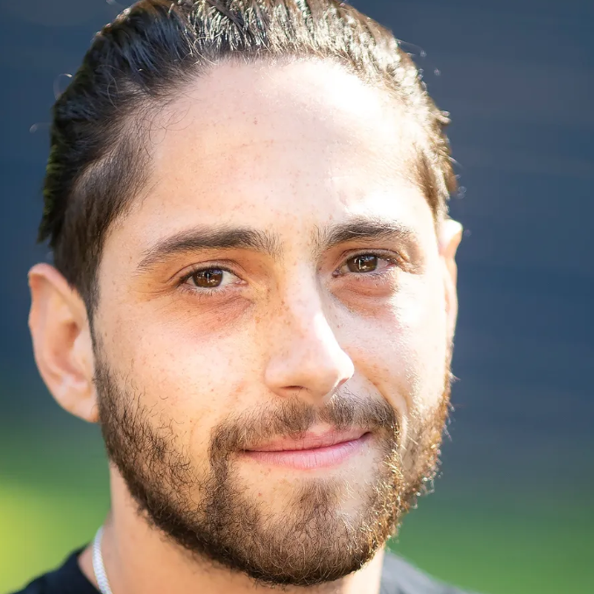
Our Team
Joaquin E. Cordero
Supports T3Tech’s Marketing & Business Development efforts
Currently expanding T3Tech’s Worldwide customer base
Holds a Bachelor of Media Studies & Communications degree from Dominican University of California and a Masters degree from The San Francisco Academy of Art University

Slide 8
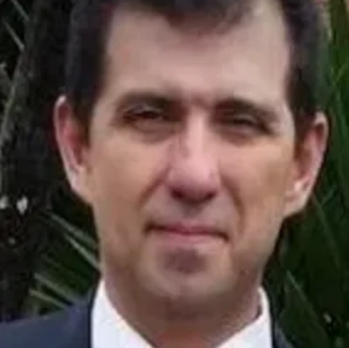
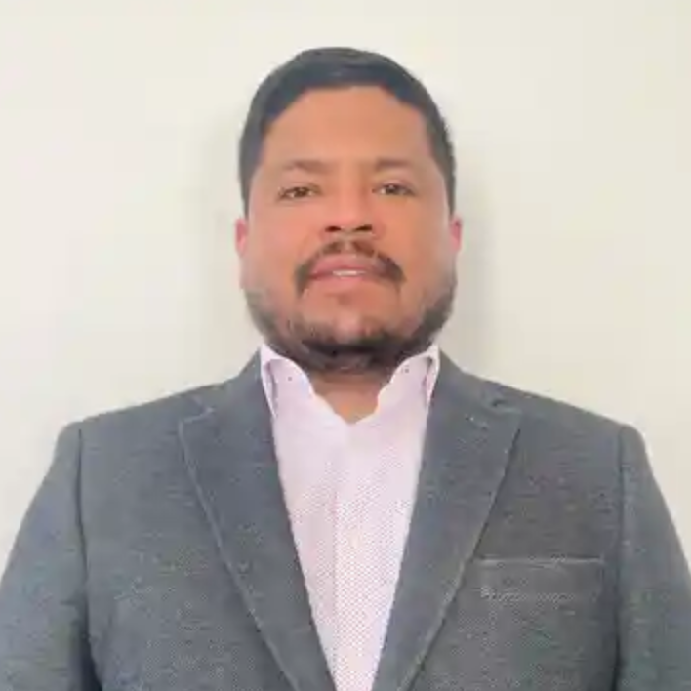
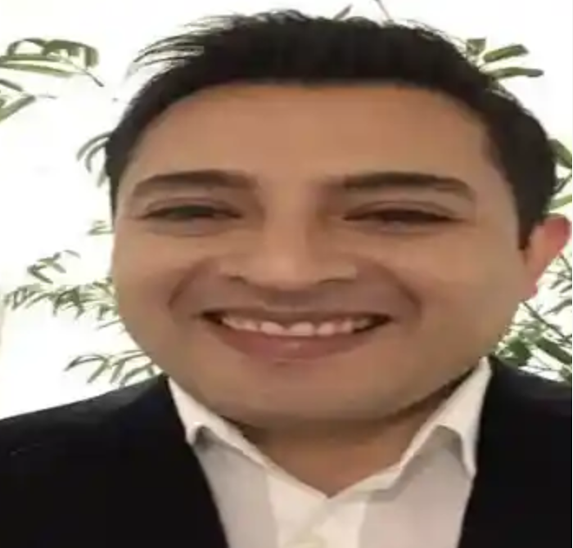
Our Team: Core Consultants
Armando Colmenares
Aeronautical Engineer with 18+ years of experience in maintenance administration, production control and auditing procedures
Armando was in charge of the Reliability Department, Maintenance Production Control, Fleet Maintenance Management
Raul Guillen
15+ years of experience in the Aviation Industry
Vast experience as a technical representative on-site, maintenance inspections, airframe checks, major modifications, technical records, & technical reviews
Oscar Amaya
Mechanical Aerospace Engineer with 25+ years experience in the Aviation Industry
Vast knowledge in Airframe Systems, Structures and Heavy Maintenance Specialist

Slide 9
Our Services
Aircraft Delivery & Redelivery Solutions
Airframe, Engine & Component Records Review
Inspections

Slide 10
Aircraft Delivery & Redelivery Solutions
Complete Aircraft Delivery and Redelivery Solutions for both Airline and Lessors, so that you can focus on your core business

Slide 11
INSPECTIONS
Pre-Purchase Inspections
Surveillance Inspections
Lease Term Inspections
Shop Visit Management

Slide 12
Airframe, Engine & Component Records Review
Complete Airframe, Engine & Component Records Review
Back to Birth (B2B) Engine and Component Review

Slide 13
Worldwide footprint

Slide 14
Our Customers: Airlines

Slide 15
our Customers: Leasing Companies/ Consultant Agencies/ Banks

Slide 16
Contact Us:
Tel/Whatsapp:
Manuel Cordero: +1 (9250 322-9205
Cesar Guedez: +1 (786) 705-9417
Joaquin Cordero: +1 (925) 247-4279
Email:
Manuel Cordero: ceo@tee3tech.com
Cesar Guedez: t3tech@tee3tech.com
Joaquin Cordero: jcordero@tee3tech.com
Website:
tee3tech.com

