Slide 1

RABINDRANATH TAGORE
BIRTH DAY
ARAIDANGA D.B.M ACADEMY
AUTOMOBILE CLASSES
Under
NSQF Cell of DVET, West Bengal

Slide 2
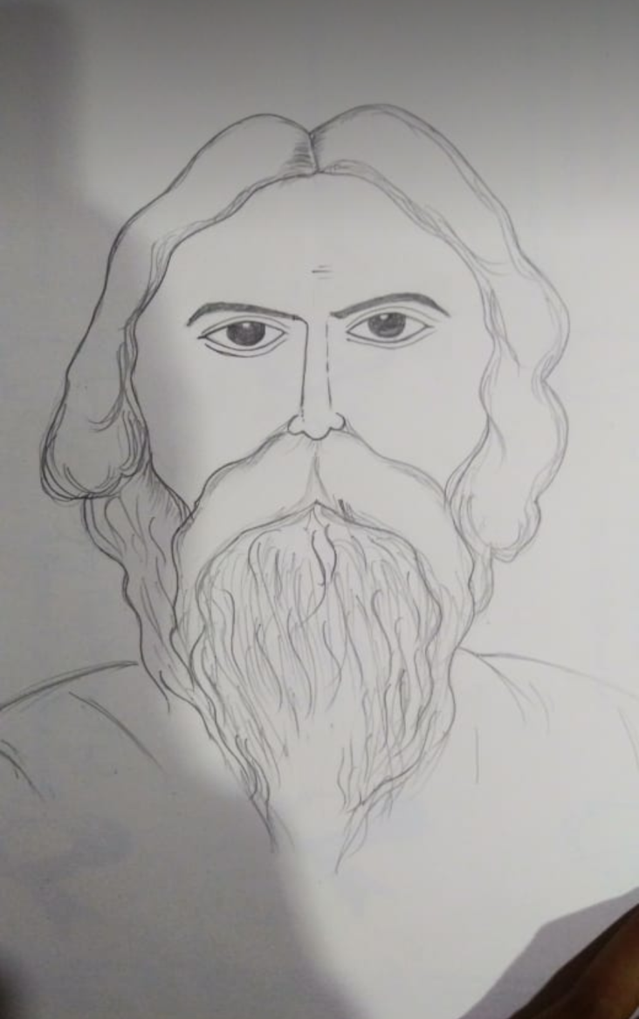
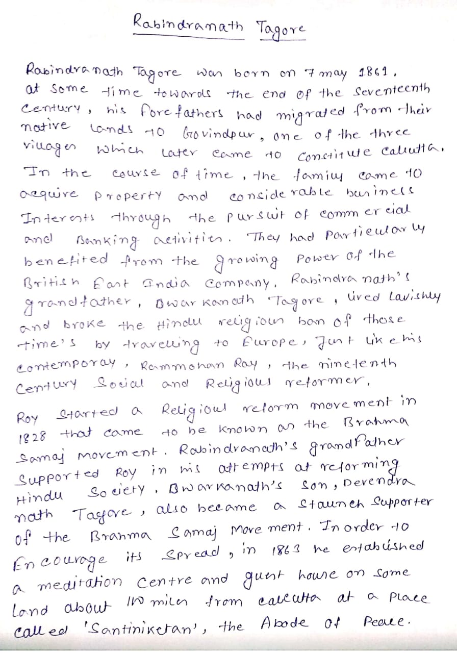
Portrait of R.Tagore & about him by Bishnu Majhi (Class-XI)

Slide 3
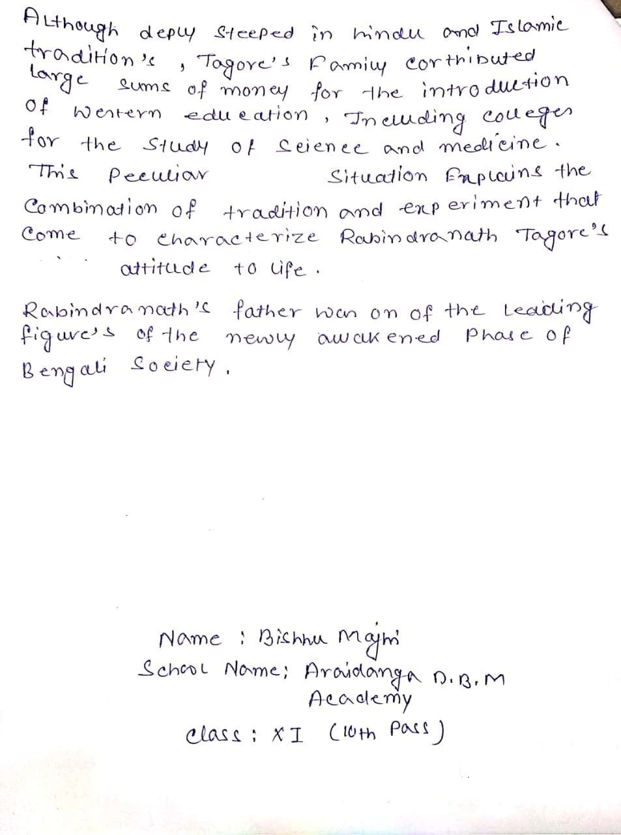
Some Notes about R.Tagore by Bishnu Majhi (XI)

Slide 4
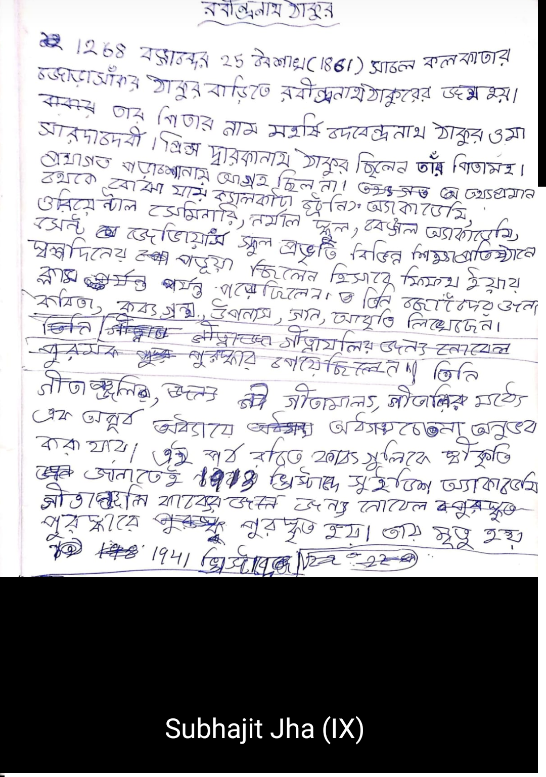
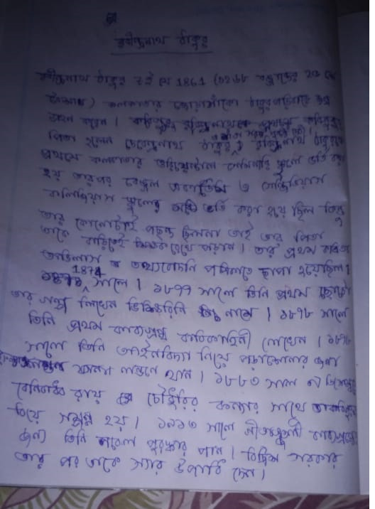
Some Notes about R.Tagore by Subhajit Jha (IX) & Sk Juned Ali (X)

Slide 5
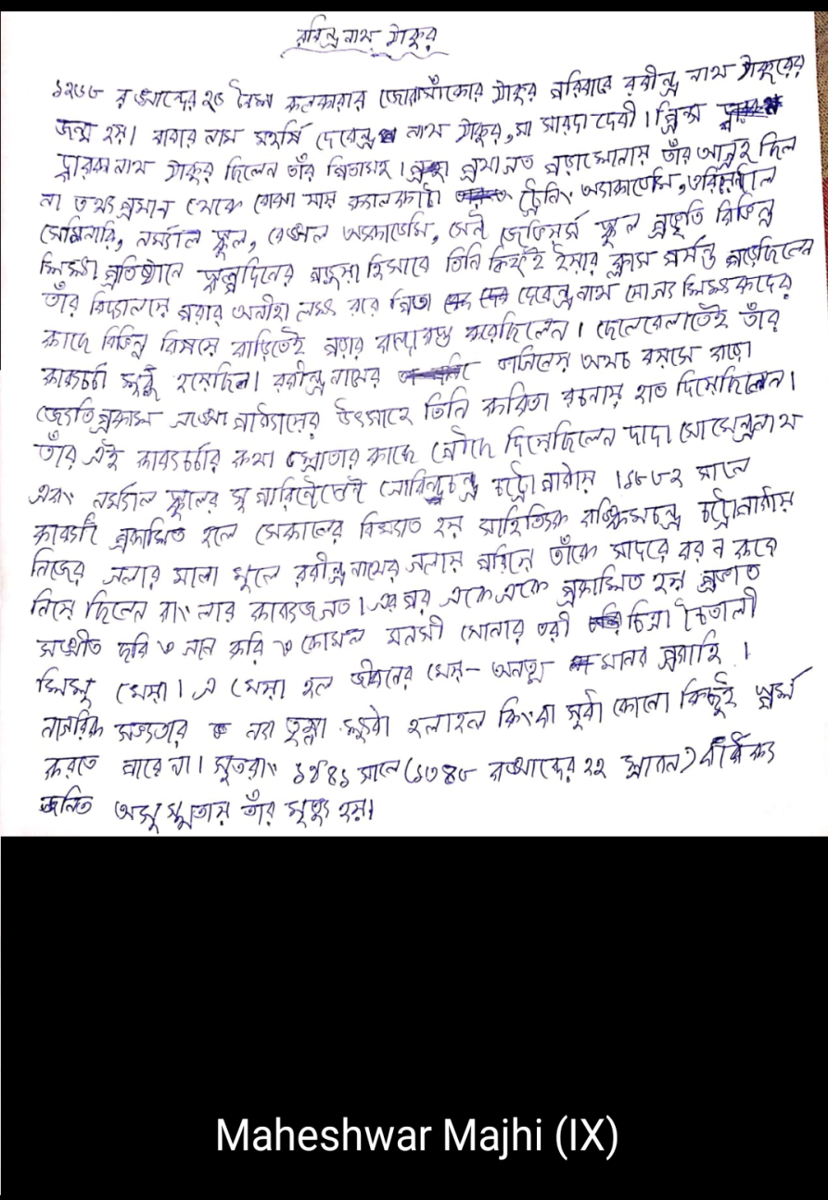
Some Notes about R.Tagore by Maheshwar Majhi (IX)

