Slide 1
Personal Cyber Security
DAVE CHRISTOPHERSON - HUAS TECHS

Slide 2
Topics
What are the bad guys after?
Where are you at risk?
How are you at risk?
How can you protect yourself?
Q and A

Slide 3
What are the bad guys after?
Immediate monetary gain
Ransomware
Support calls
Personal data for later gain or to market to others
Hacking for fun
Access to your home
Cameras
Smart locks
Garage Doors etc.

Slide 4
Where are you at risk?
Home network
Default settings password etc
Cheapest router is not the best router
Is your Wifi identifiable?
In the wild
No network outside you house is a safe network

Slide 5
How are you at Risk?
Weak and common passwords
123456 (Unchanged)
password (Unchanged)
123456789 (Up 3)
12345678 (Down 1)
12345 (Unchanged)
111111 (New)
1234567 (Up 1)
sunshine (New)
qwerty (Down 5)
Iloveyou (Unchanged)
Reusing Passwords

Slide 6
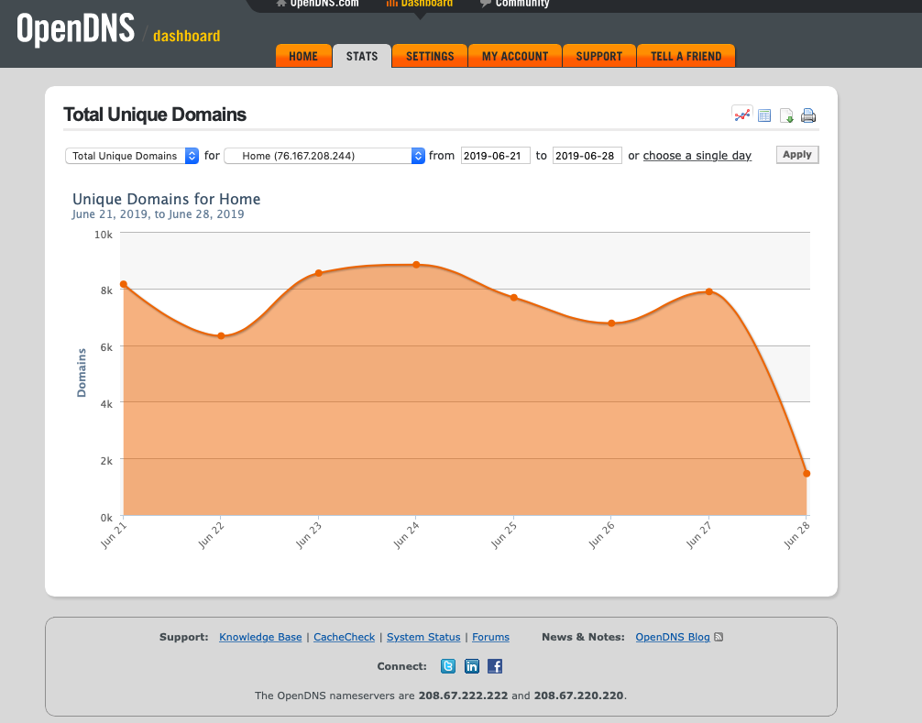
How to protect Yourself?
Home network
Invest in a good router or firewall
Keep it updated
Use OpenDNS or other service

Slide 7
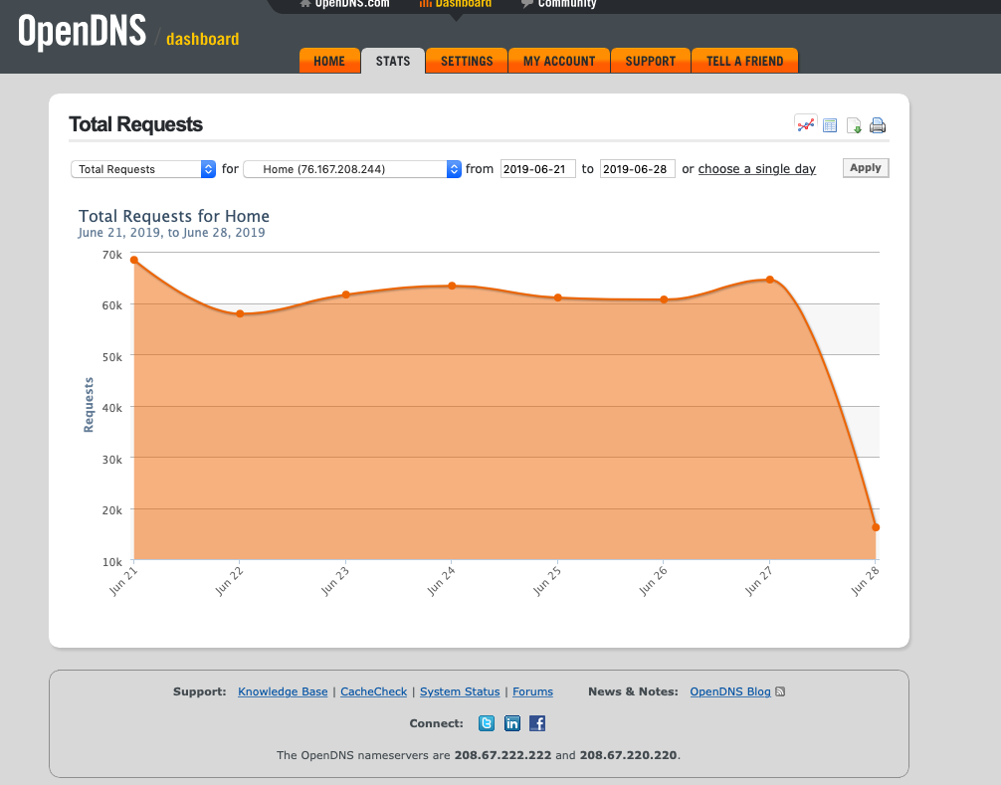
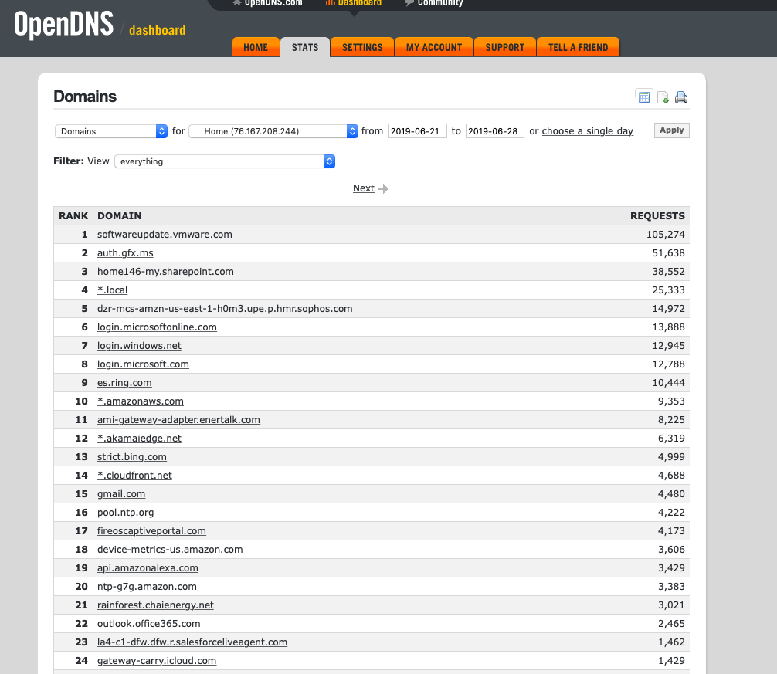

Slide 8
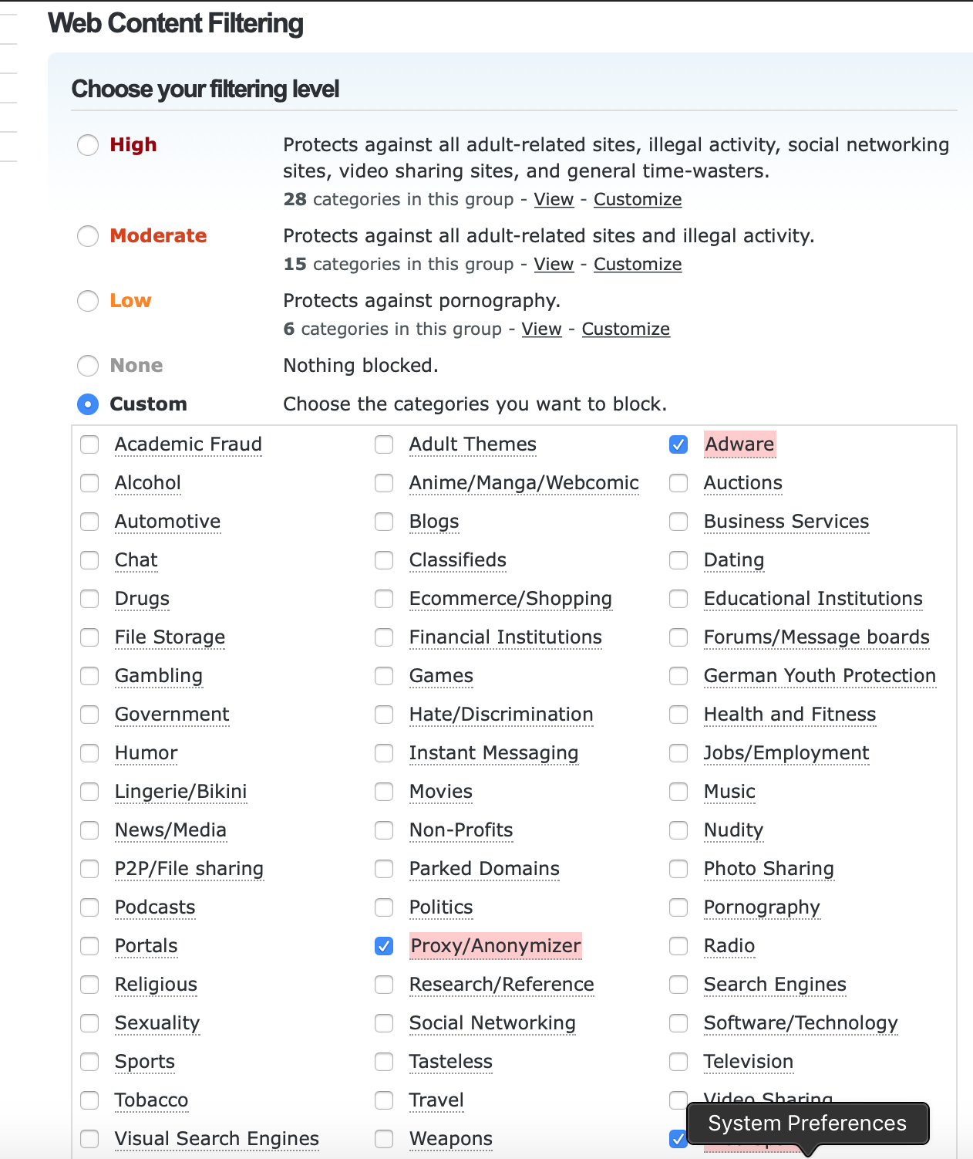

Slide 9
How to protect Yourself?
Text
Keep all computers/phones/tablets/cameras/streaming devices/doorbells etc updated
Change default passwords of all your devices!
Turn on auto update
Backup your data to a local or cloud device
Carbonite, iCloud, OneDrive
Separate your IoT traffic from your computers if possible
Use a good Ransomware/virus software with rollback if possible (Sophos, Microsoft)
Outside your home
Use your smart phone as a hotspot or use a MIFI device.

Slide 10
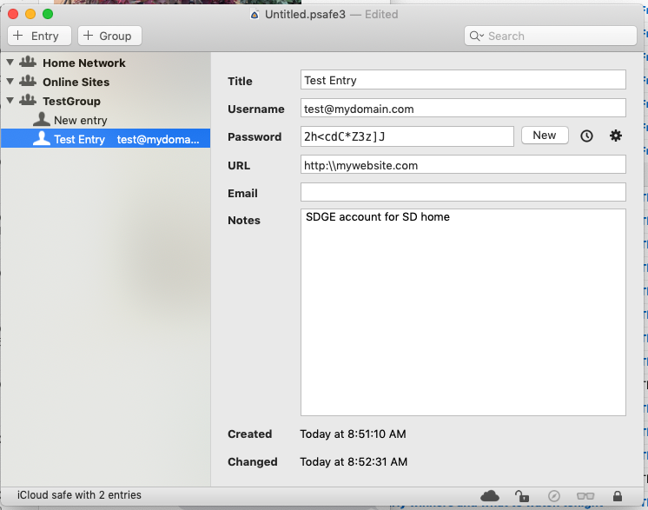
How to protect Yourself?
STOP Reusing Passwords
Switch to Complex passwords
8,lLsb<#dC6v
Password Managers
Pwsafe
1Password
Last Pass
Microsoft, Apple, Google and IRS aren’t going to call you offering help.
Keep yourself informed subscribe to computer security blogs or email lists.

Slide 11
QUESTIONS?

