Slide 1

Marketing Strategy
The Construction Partners
Martin Grobisen grobisen@gmail.com

Slide 2
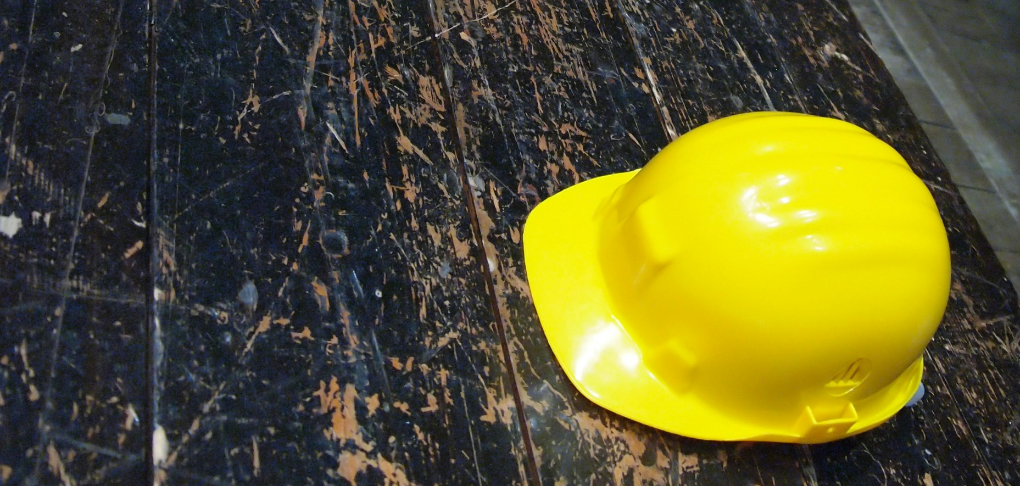
Overview of Social Engineering Strategic Marketing Plan: 30-60-90 Day Roadmap
Positioning The Construction Partners for Growth in Commercial & Institutional Markets

Slide 3

Understanding the Target Market
Primary Segments:
  Commercial developers (office parks, retail centers, mixed-use)
  Institutional clients (hospitals, universities, government)
  Regional REITs and real estate investment groups
Buyer Priorities:
  Cost transparency
  Timely delivery
  Reputation and past performance
  ESG and sustainability alignment

Slide 4
Best-in-Class Marketing Strategies
Thought Leadership: SEO-optimized blog posts and case studies
LinkedIn Engagement: Executive posts, targeted ads, project spotlights
Video Storytelling: Project walkthroughs, client testimonials, time-lapse builds
Email Campaigns: Segmented outreach by industry vertical
Strategic Partnerships: Co-marketing with architecture and engineering firms

Slide 5

30-Day Plan
Foundation & Discovery
  Stakeholder interviews (Klaus, BD team, PMs)
  Audit current marketing assets and channels
  Identify top-performing projects for storytelling
  Launch SEO and keyword strategy
  Draft social media content calendar

Slide 6
60-Day Plan
Activation & Engagement
  Publish 2–3 case studies and blog posts
  Launch LinkedIn Ads targeting developers and REITs
  Produce first video spotlight (e.g., “Inside the build: Tampa Medical Center”)
  Begin segmented email campaigns
  Build CRM tagging for lead tracking

Slide 7
90-Day Plan
Expansion & Optimization
  Host virtual roundtable or webinar for institutional clients
  Launch gated content (whitepaper, ROI calculator)
  Analyze campaign performance and refine targeting
  Begin outreach to strategic partners for co-marketing
  Develop quarterly marketing dashboard

Slide 8
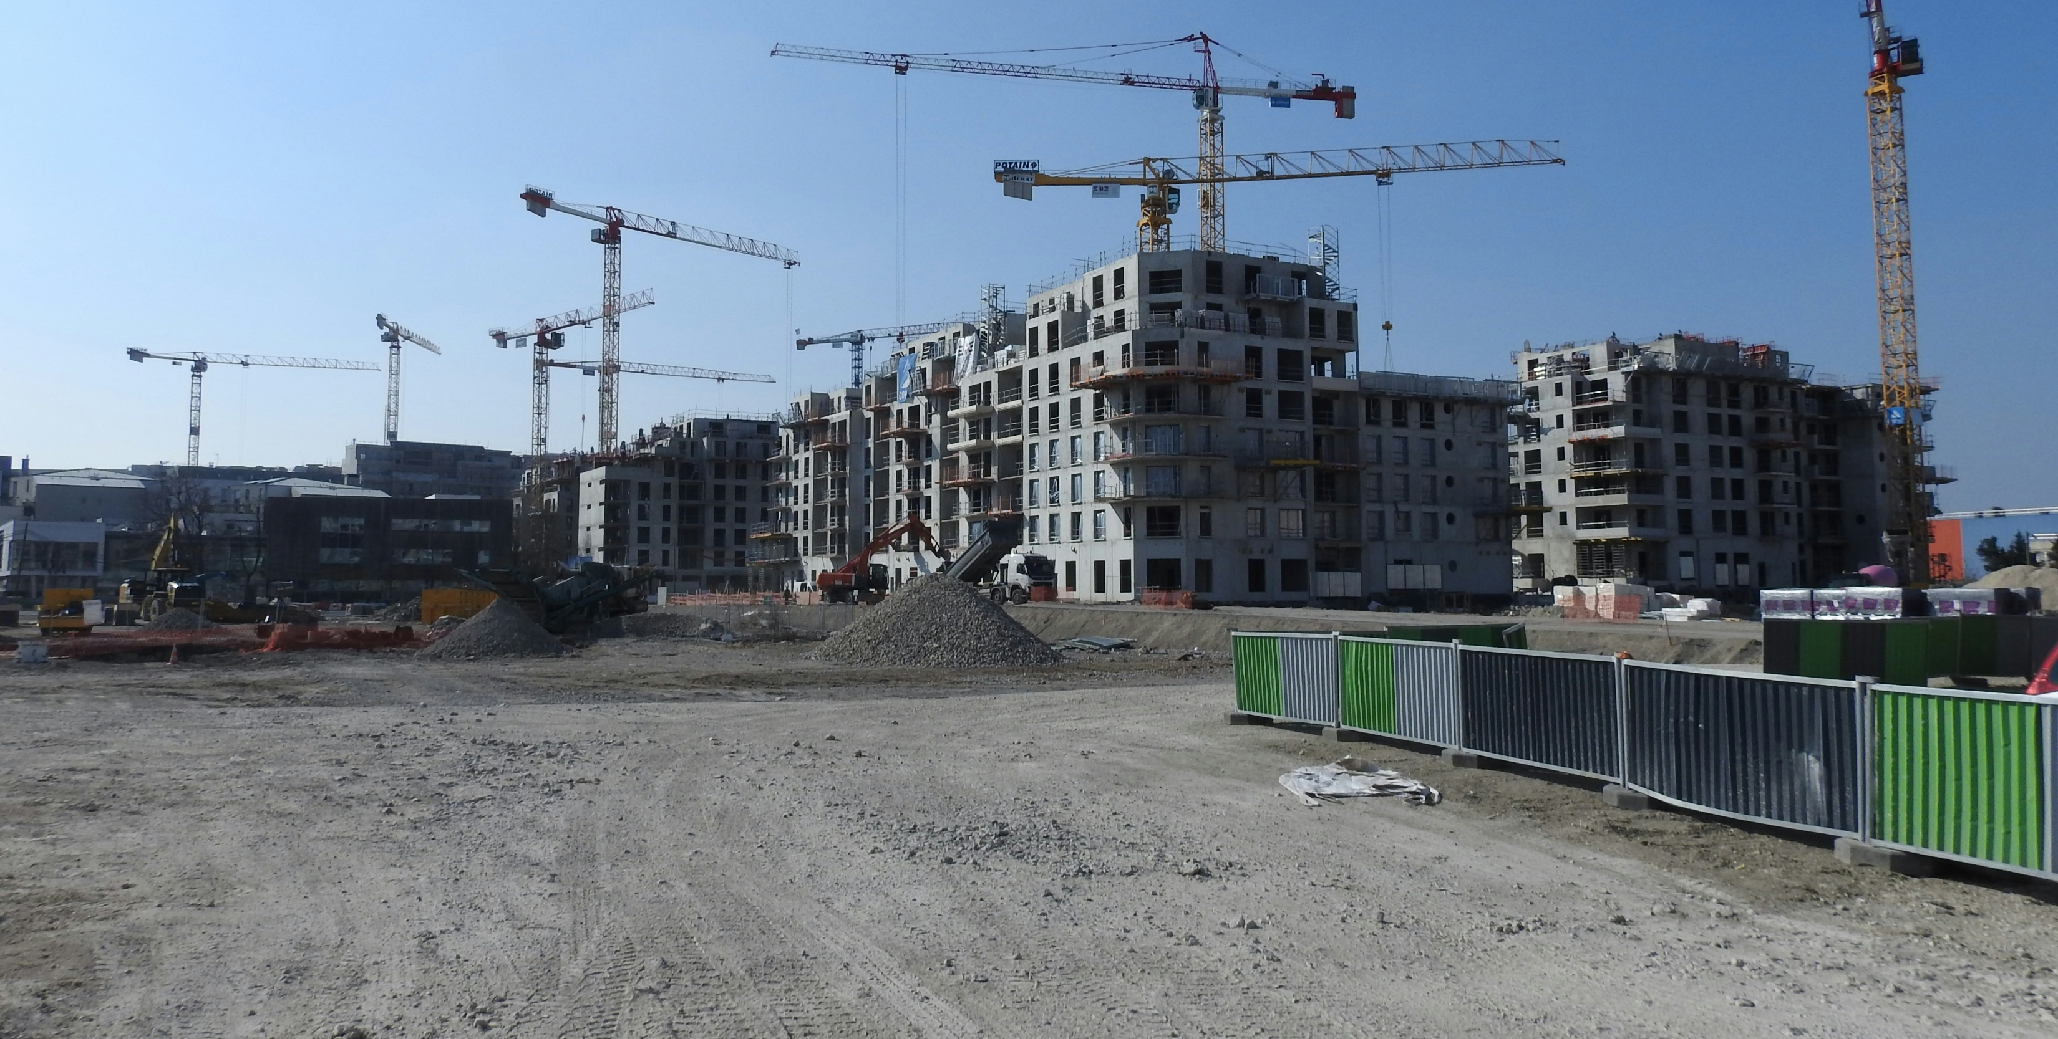
Let’s create marketing that builds trust, drives growth, and reflects the excellence of The Construction Partners.

