Slide 1

Computing-related Organization Presentation

Slide 2
Unit 8 Activity
In this activity, you will research some local options for student involvement in a computing-related organization. This could include clubs, chapters of a professional organization, community groups, etc. Also consider competitions or one-time collaborative events.
Find at least three different opportunities, making sure they are local (within a reasonable distance from your home or school).
Using Microsoft Word or PowerPoint, make a pamphlet that gives basic details about these opportunities. Include details like where and how often it meets, what is discussed/accomplished, how to join, and membership dues (if applicable).
Also in the pamphlet, include an analysis of the merits of the opportunity. In other words, what are the pros/cons of joining? Is this opportunity a good way to sharpen skills or network with other people?
Save your pamphlet and submit it for credit.

Slide 3
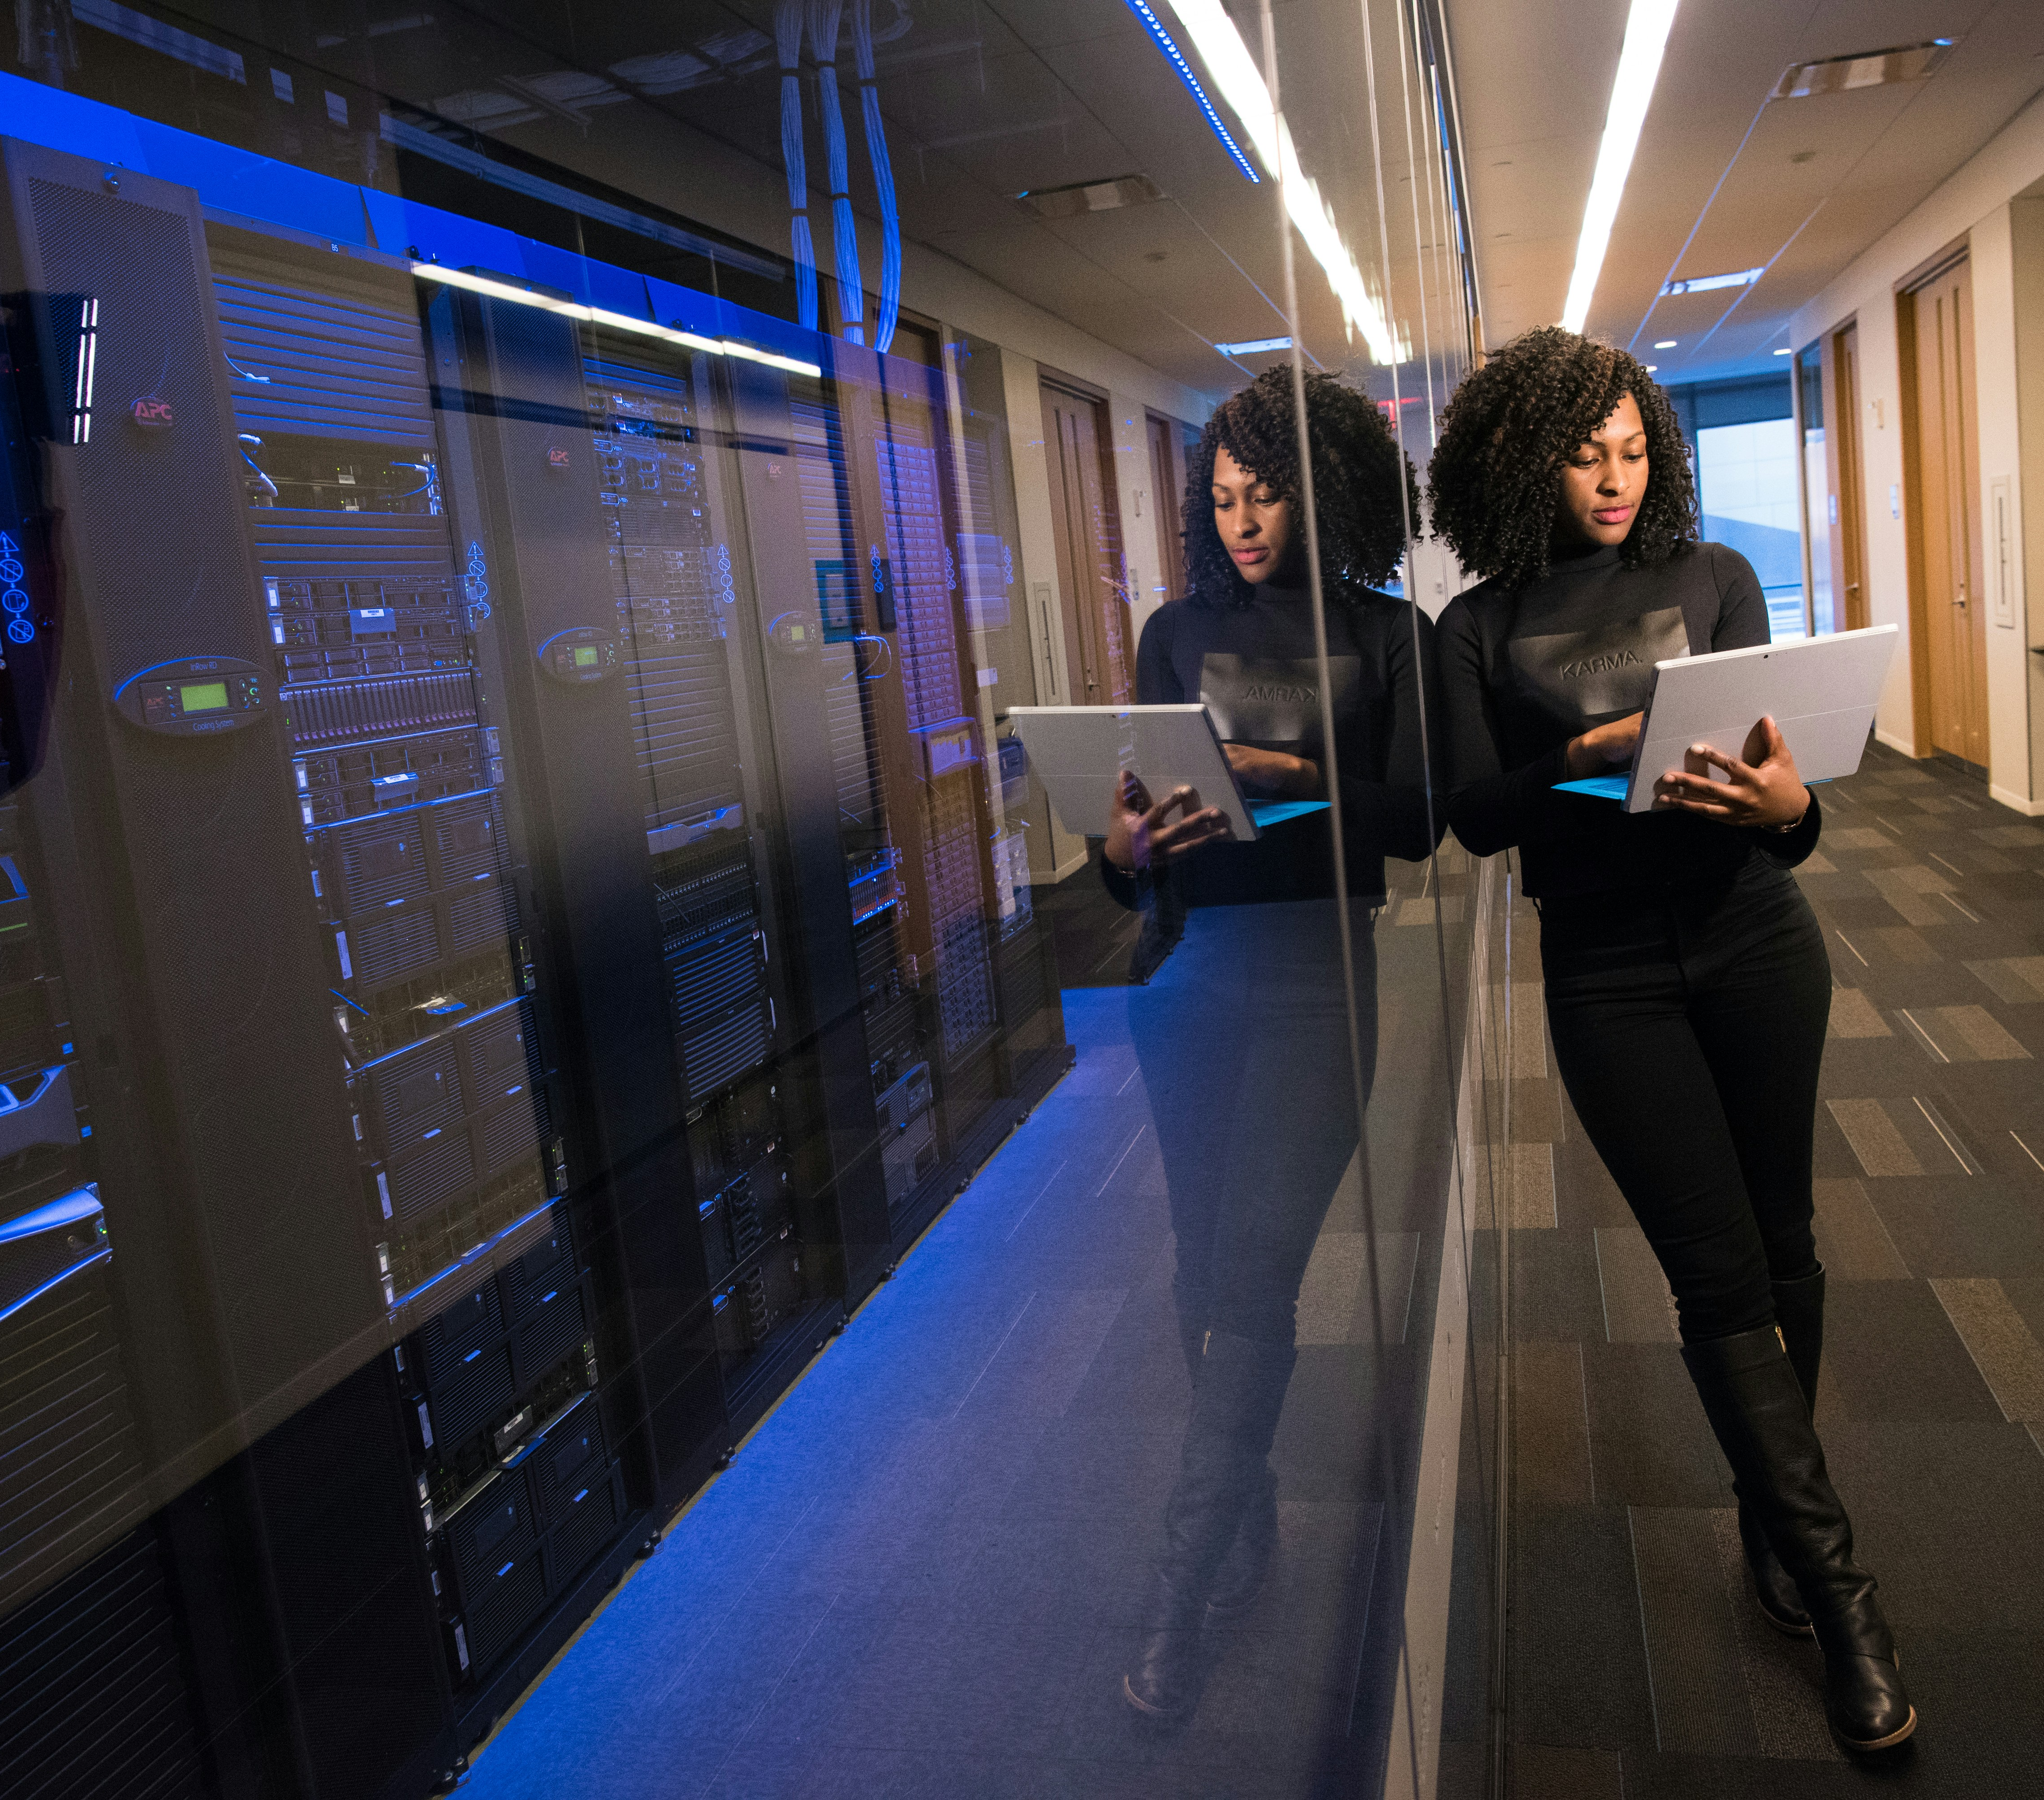
3 Local to Tampa Computing-related Organizations

Slide 4
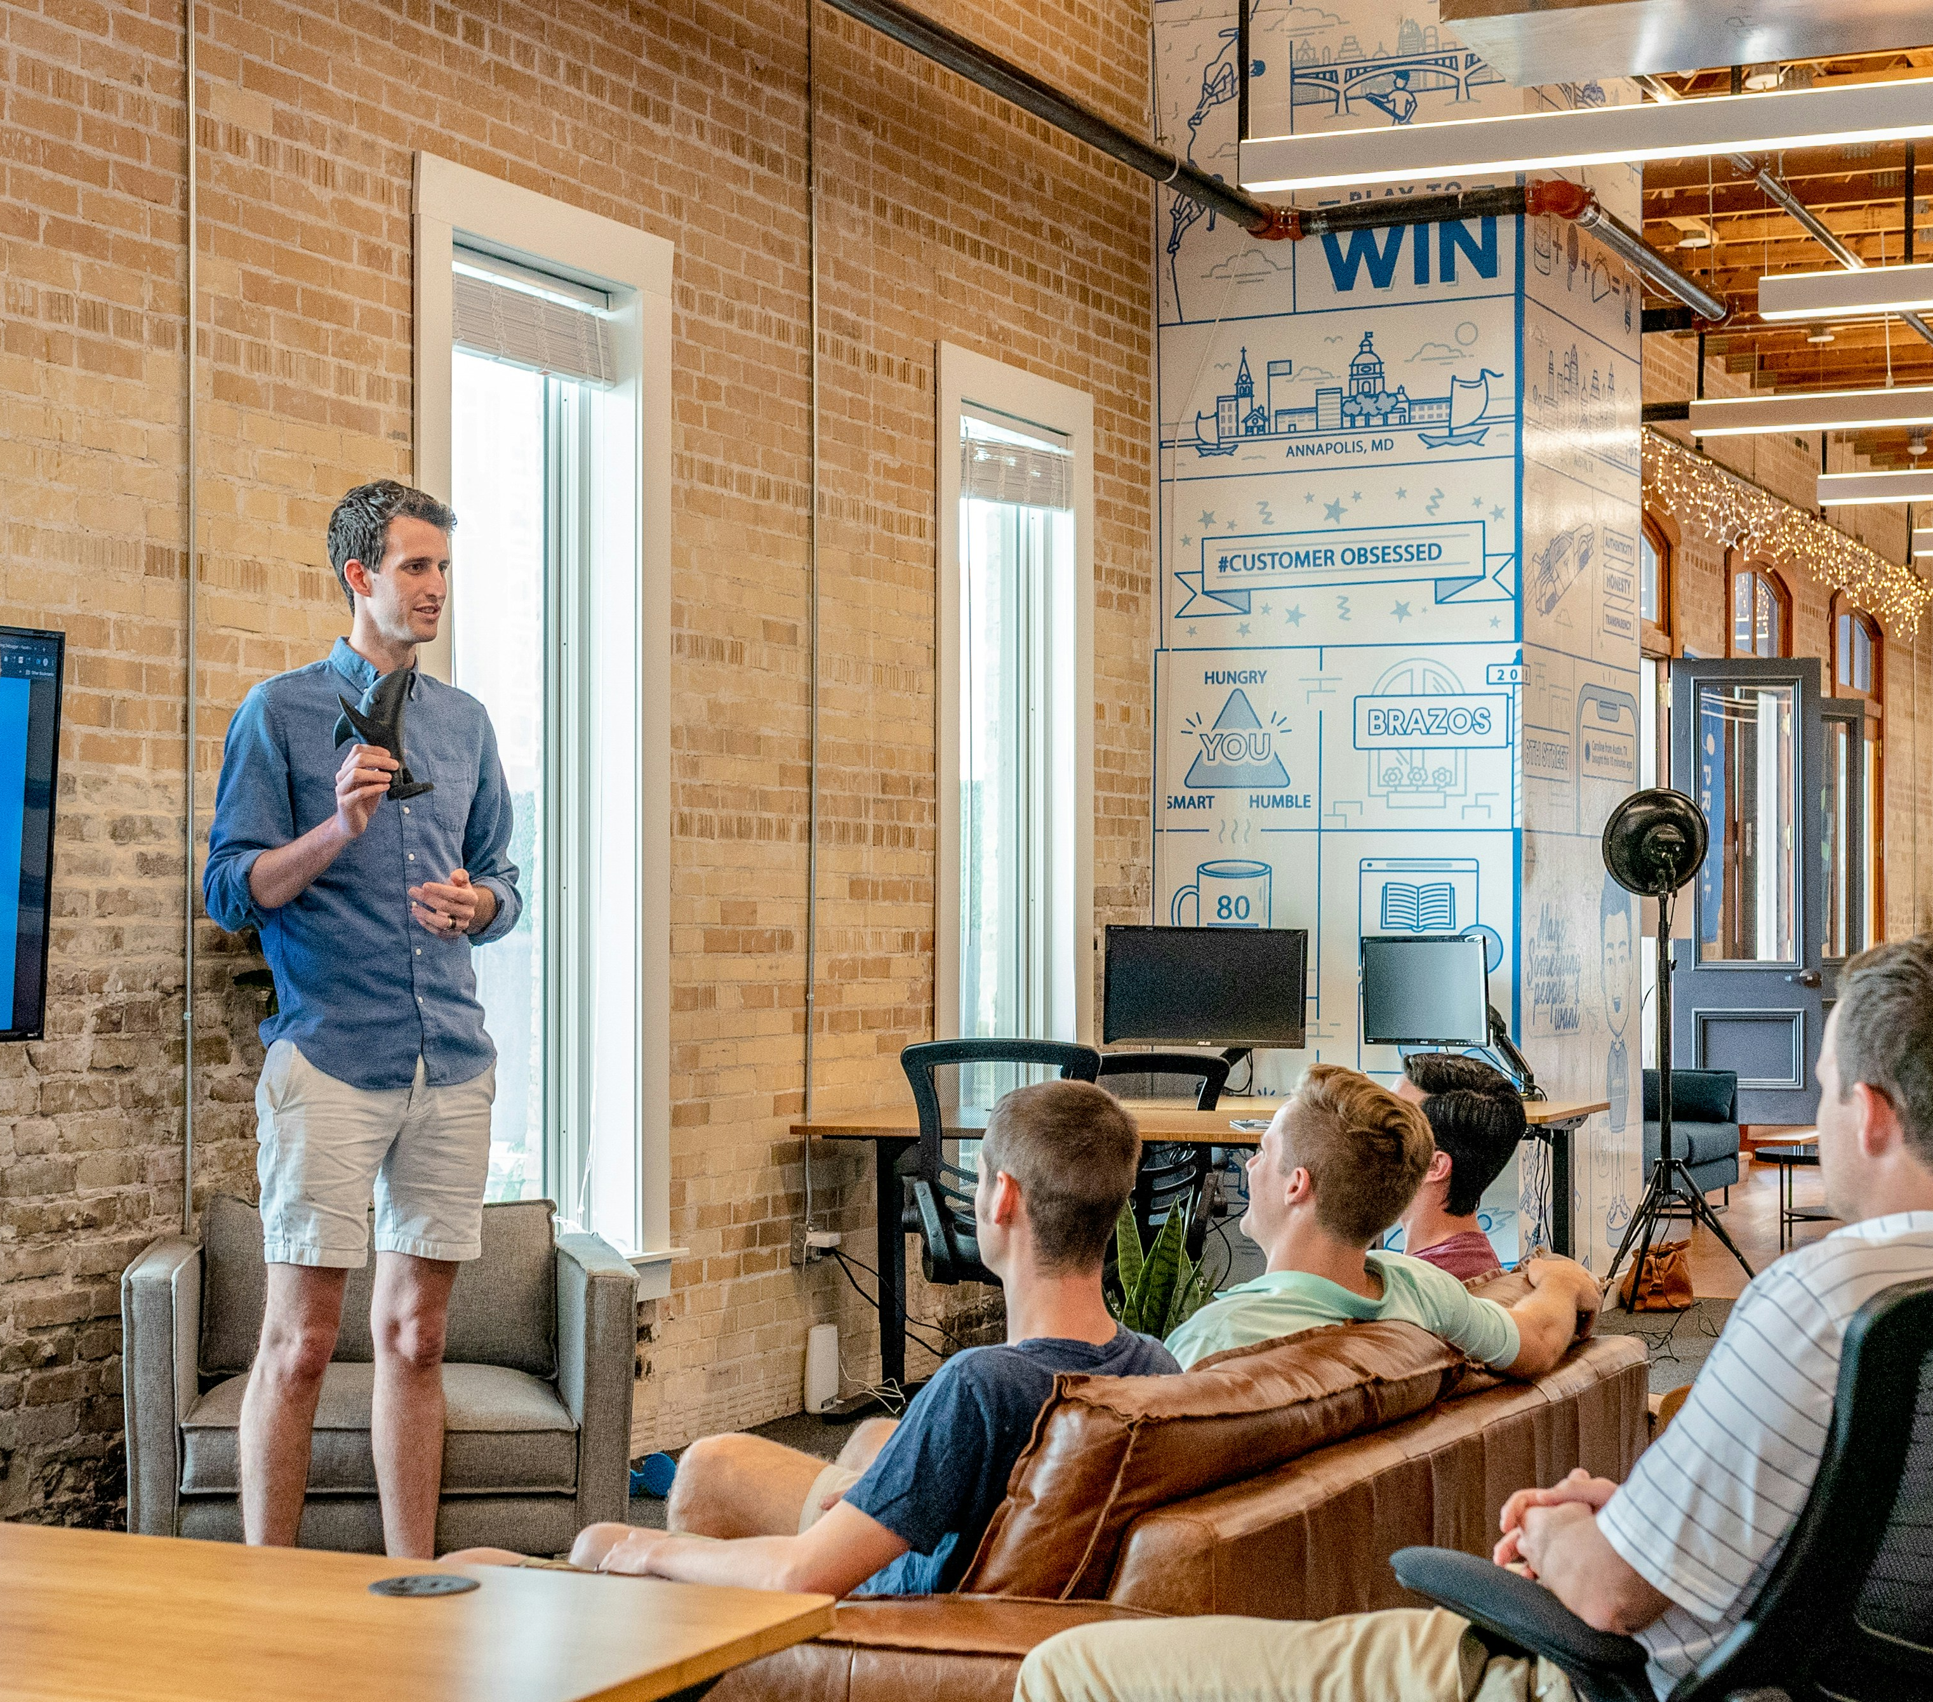
Tampa Devs
Tampa Devs is a nonprofit community for software developers in Tampa Bay.
They host monthly networking events, tech talks, and workshops at various venues around the city.
The meetups are free and open to everyone, providing opportunities to learn new skills, share knowledge, and find career opportunities.
They also have a reverse job board where members can post job openings and connect with potential candidates.
To join, visit their Meetup page and sign up for their events.

Slide 5
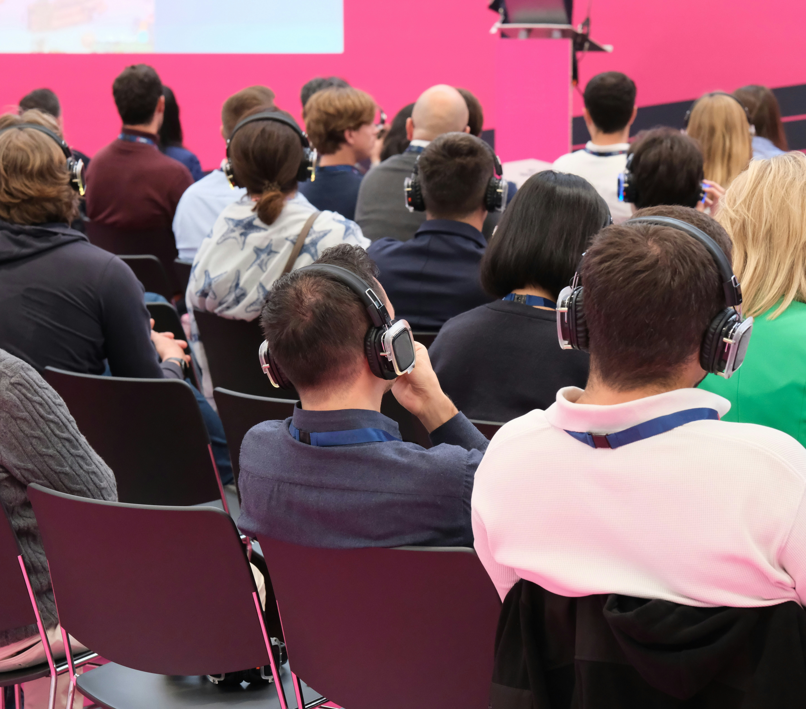
Tampa Bay Techies
Tampa Bay Techies is a 501(c)(3) organization that promotes personal and professional growth for individuals in the technology community.
They host a variety of in-person events, including tech networking happy hours, study groups, and volunteer opportunities.
These events are free to attend and emphasize networking with fellow members and established professionals.
They also offer mentorship programs and training sessions to help individuals develop their skills.
To join, visit their Meetup page and sign up for their events.

Slide 6

Lean Beer
Lean Beer for Software Craftspeople, hosted by Om Patel, is a casual meetup for software developers and tech enthusiasts.
It takes place at local craft breweries around Tampa Bay on the third Thursday of every month.
The format is discussion-driven, with attendees suggesting and voting on topics related to software design, development, and craftsmanship.
It's a great opportunity to network, share ideas, and learn from peers in a relaxed, fun environment.
To join, visit their Meetup page and sign up for their group.

Slide 7
Thank you
Martin Grobisen
813-731-5629
grobisen@gmail.com

