Slide 1

IT Security Presentation
Prevention Is the Best Protection
Martin Grobisen Unit 7 Activity 1

Slide 2

Overview of Social Engineering Attacks
Definition: Social engineering attacks exploit human psychology to manipulate individuals into divulging confidential information or performing actions that compromise security.
Human Element: Unlike technical attacks, social engineering relies on human behavior and trust, making it difficult to prevent with just technical measures.
Common Methods: Attackers use various techniques such as phishing, vishing, smishing, and pretexting to deceive individuals.
Real-World Impact: Social engineering attacks can lead to significant data breaches, financial losses, and damage to an organization's reputation.
Importance of Awareness: Educating employees about social engineering techniques is critical to strengthening the company's defenses and preventing potential attacks.

Slide 3

Phishing
Description: Cybercriminals use deceptive emails and websites to steal sensitive information.
Example: The 2013 Google and Facebook phishing attack where Evaldas Rimasauskas scammed $100 million.
Protection Tip: Always verify the sender's email address and look for suspicious links.

Slide 4

Spear Phishing
Description: Targeted phishing attacks aimed at specific individuals within an organization.
Example: Hackers targeted Sony employees with spear phishing emails, stealing over 100 terabytes of data.
Protection Tip: Double-check the sender's email address and be cautious of unexpected requests.

Slide 5

Whaling
Description: A type of phishing attack targeting high-profile individuals like company executives.
Example: The 2016 Hillary Clinton Presidential Campaign attack where hackers accessed DNC computers.
Protection Tip: Be wary of urgent requests for sensitive information and verify the authenticity of the request.

Slide 6

Smishing
Description: Phishing attacks conducted via SMS or text messages.
Example: In 2020, Bank of Ireland customers lost €800,000 due to a smishing scam.
Protection Tip: Do not click on links in text messages from unknown senders.

Slide 7
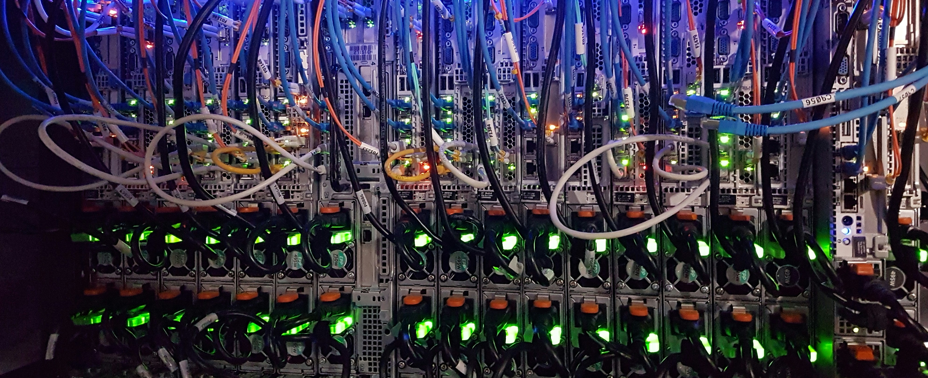
Vishing
Description: Voice phishing attacks using phone calls to steal information.
Example: In 2021, attackers used AI to mimic a company director's voice, convincing a bank manager to transfer $35 million.
Protection Tip: Verify the caller's identity by calling back through official contact numbers.

Slide 8
Spam and SPIM
Description: Unsolicited messages sent in bulk via email (spam) or instant messaging (SPIM).
Example: Email spam campaigns often contain phishing links or malware.
Protection Tip: Use spam filters and be cautious of unsolicited messages.

Slide 9
Typosquatting
Description: Creating fake websites with URLs similar to legitimate ones by using common typos.
Example: Users might accidentally visit "goggle.com" instead of "google.com."
Protection Tip: Double-check URLs before entering sensitive information.

Slide 10
Pharming
Description: Redirecting users to fake websites to steal login credentials.
Example: In 2007, a complex pharming attack targeted at least 50 financial institutions.
Protection Tip: Use trusted bookmarks and verify website security certificates.

Slide 11
Dumpster Diving
Description: Searching through trash for sensitive information.
Example: Sensitive documents discarded without shredding can be retrieved by attackers, and hard drives that have not been properly wiped or destroyed can expose confidential data.
Protection Tip: Shred sensitive documents before disposal, and always destroy hard drive data.

Slide 12
Shoulder Surfing
Description: Observing someone's screen or keypad to gather information.
Example: Attackers might watch over someone's shoulder at an ATM.
Protection Tip: Be aware of your surroundings and shield your screen and keypad.

Slide 13
Tailgating
Description: Unauthorized individuals gaining access to restricted areas by following authorized personnel.
Example: An attacker might follow an employee through a secure door without proper credentials.
Protection Tip: Always ensure doors are securely closed and report suspicious behavior.

Slide 14
Summary of Key Points
Training and Awareness: Emphasize the critical role of employee training and awareness in recognizing and preventing social engineering attacks.
Human Factor: Highlight that social engineering targets human behavior, making it crucial for everyone to be vigilant and cautious.
Common Techniques: Review the various social engineering techniques discussed, such as phishing, smishing, vishing, and pretexting.
Prevention Tips: Reiterate the practical tips and strategies shared for identifying and responding to potential attacks.
Continuous Improvement: Stress the need for ongoing training, regular updates, and staying informed about the latest threats to maintain a strong security posture.

Slide 15
Thank you
Martin Grobisen
813-731-5629
grobisen@gmail.com

