Slide 1

Unit 4 Activity 1
Martin Grobisen

Slide 2
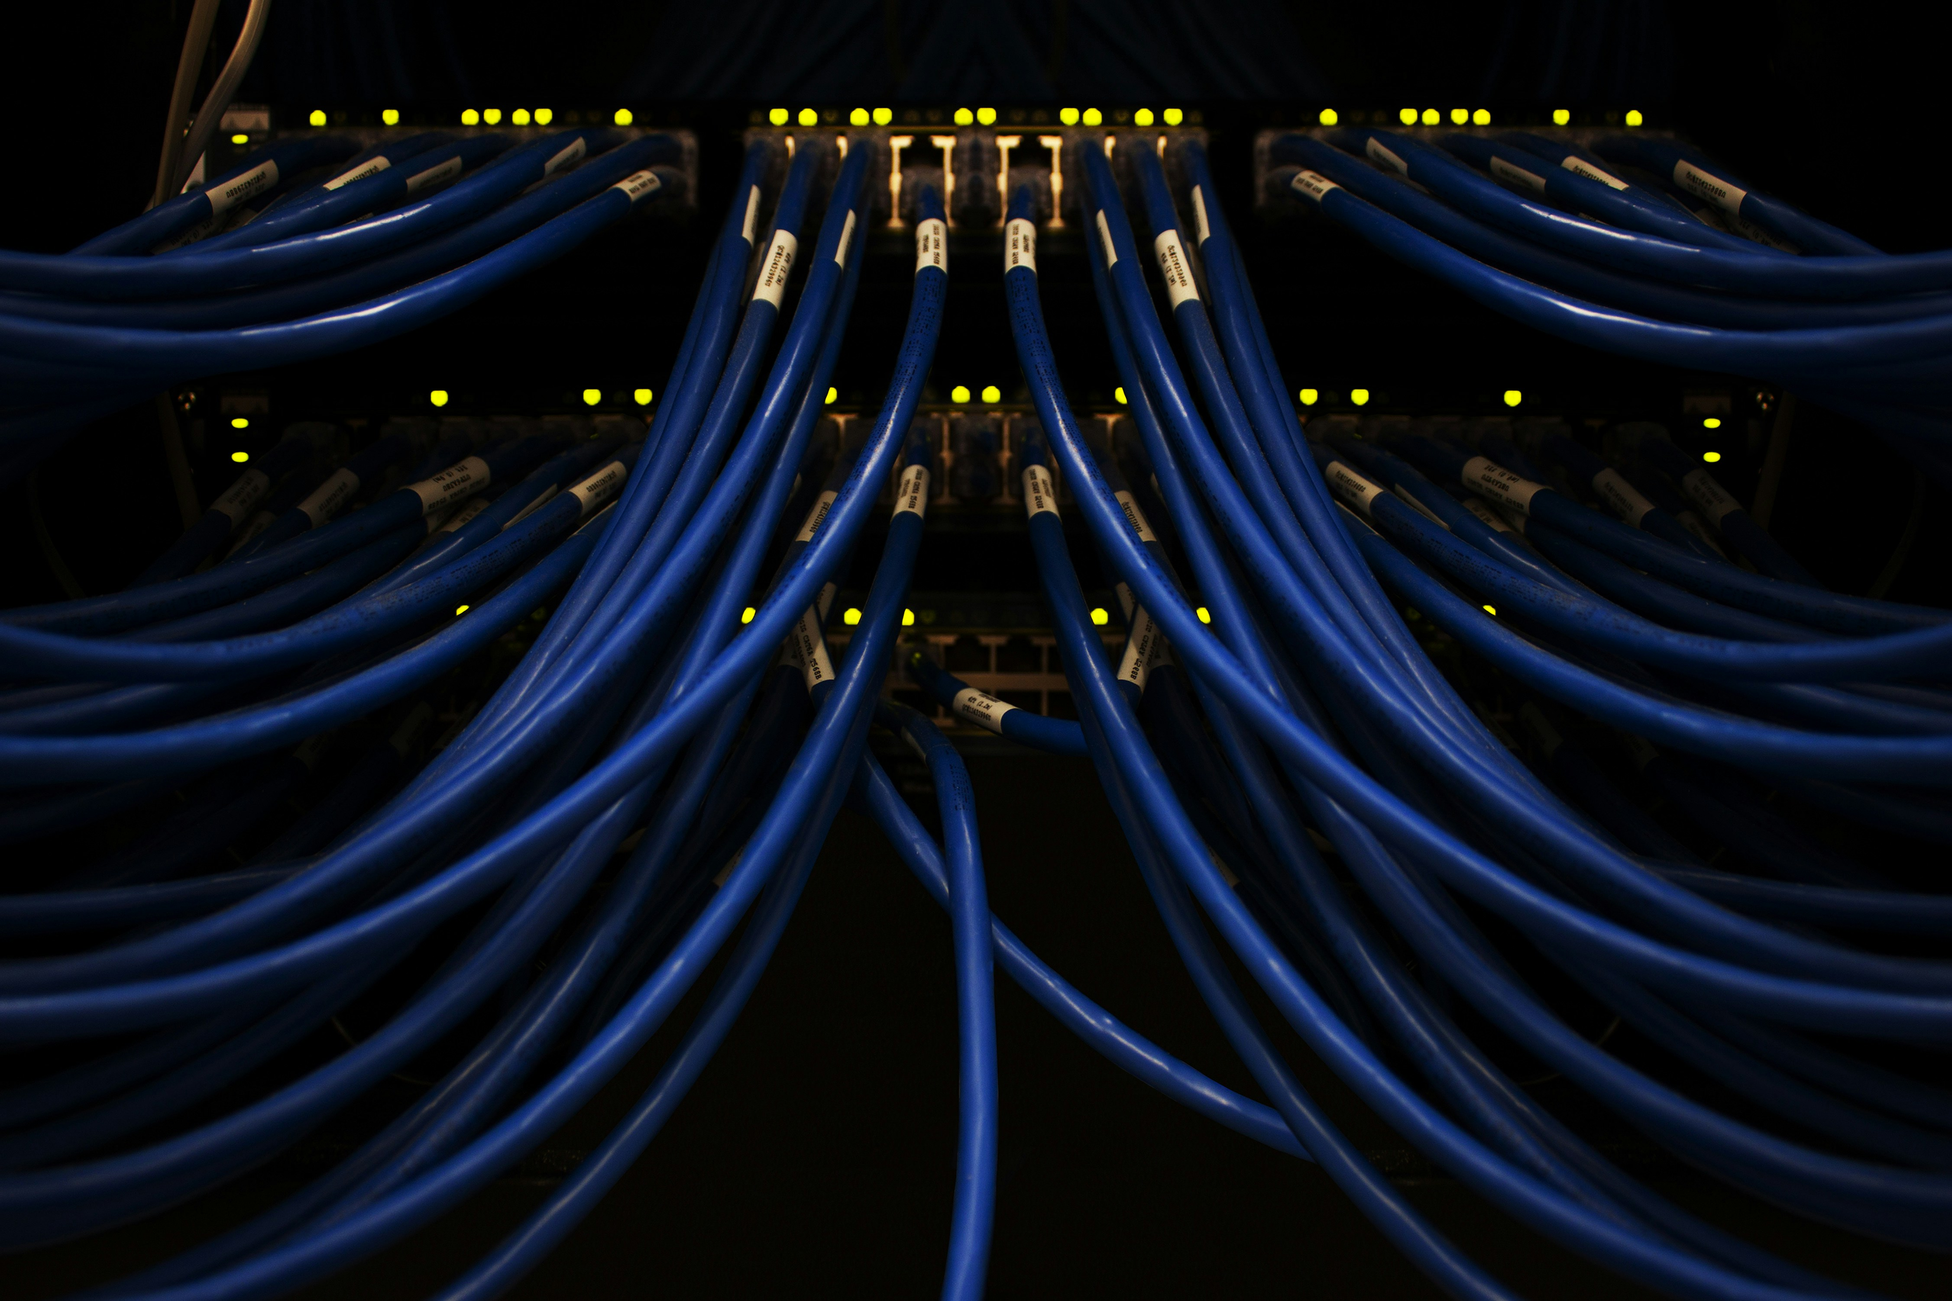
The Weakest Link
While there are certain technical solutions to password security, human behavior remains a vulnerability.
This presentation will explain the logic behind secure password rules.

Slide 3
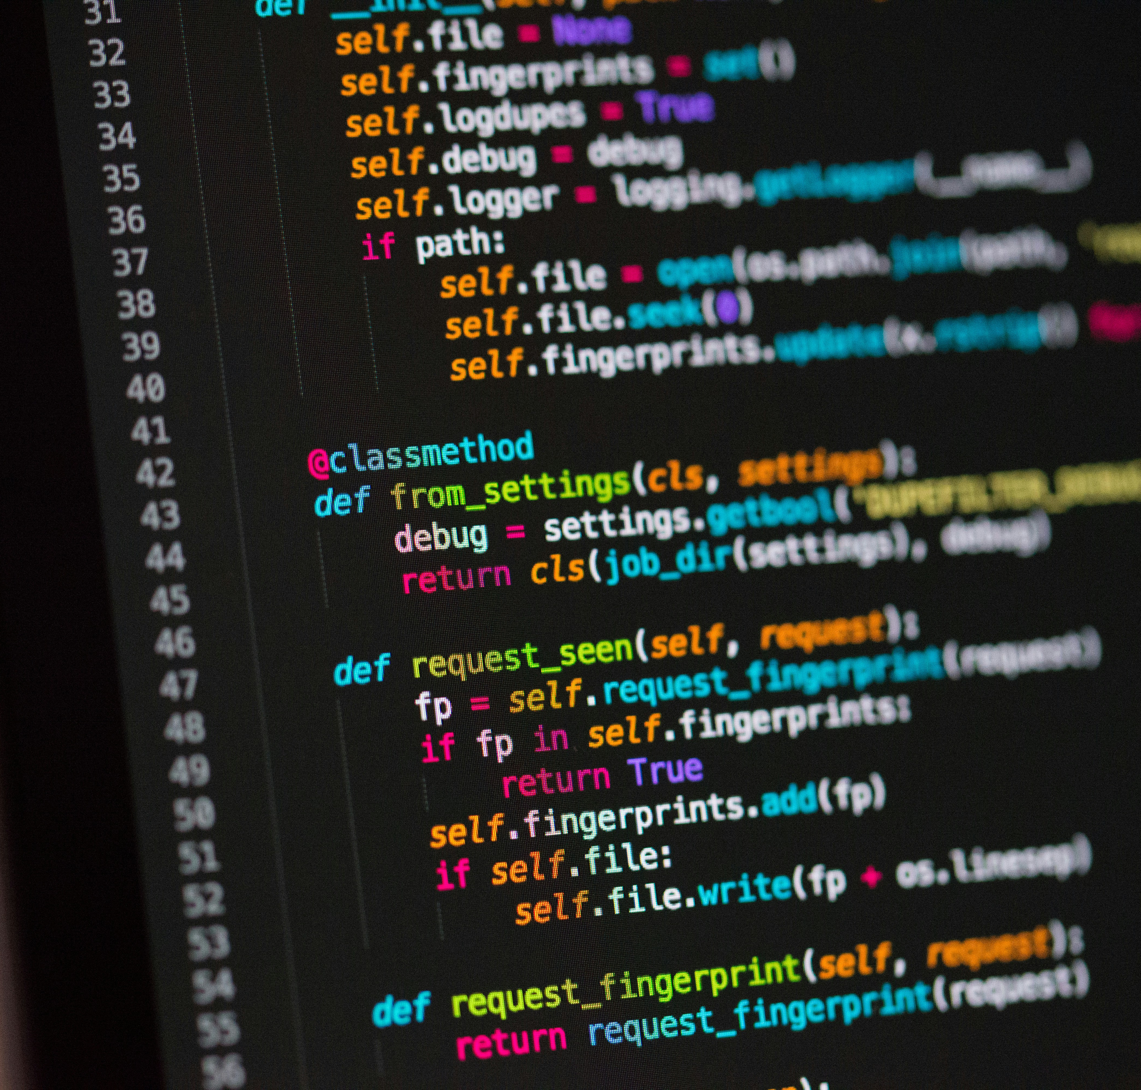
Passwords and AAA
Passwords play a crucial role in the AAA model:
Authentication: Verifies the identity of the user trying to access the system.
Authorization: Determines what an authenticated user is allowed to do.
Access Control: Enforces rules that ensure only authorized users can access certain resources.

Slide 4
Biometric Verification
Biometric verification uses unique physical characteristics to verify identity:
Fingerprint Scanning: Recognizes the unique patterns of an individual's fingerprint.
Facial Recognition: Uses facial features to identify and authenticate users.
Iris Scanning: Analyzes the unique patterns in the colored part of the eye.

Slide 5
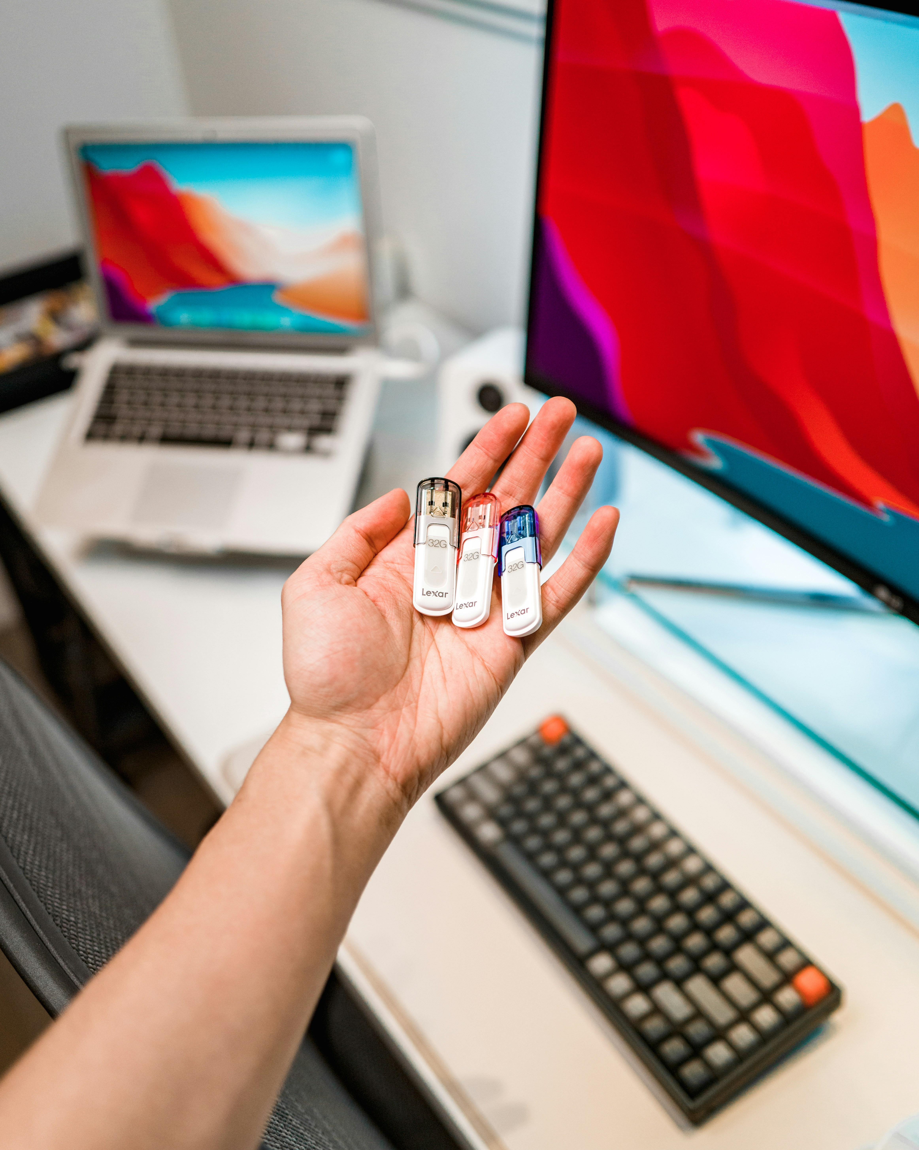
Security Tokens
Security tokens provide a hardware-based method for authentication:
USB Tokens: Physical devices that must be plugged into a computer to gain access.
Smart Cards: Cards with embedded chips that store authentication data.
Key Fobs: Small devices that generate a one-time passcode for login.

Slide 6

Two-Factor Authentication (2FA)
2FA adds an extra layer of security by requiring two forms of verification:
Something You Know: A password or PIN.
Something You Have: A security token or smartphone app.
Something You Are: Biometric verification, such as a fingerprint.

Slide 7
Weak vs. Strong Passwords
Examples of weak vs. strong passwords:
Weak: Password123, qwerty, 123456
Strong: L!nK@2024#, W3sT@side21!, Pa$$w0rD#8!

Slide 8
Corporate Password Policies
Best practices for password policies:
Minimum Length: At least 12 characters to prevent brute-force attacks.
Complexity Requirements: Must include letters, numbers, and special characters to enhance unpredictability.
Regular Changes: Require password changes every 90 days to limit the impact of compromised credentials.
No Reuse: Prohibit using the same password across multiple accounts to reduce risk.
Rationale:
Long, complex passwords are harder to guess or crack.
Regular changes ensure that old, potentially compromised passwords are phased out.
Prohibiting reuse prevents a single compromised password from endangering multiple accounts.

Slide 9

Resources for Creating Robust Passwords
Here are some resources to help create strong passwords:
LastPass Password Generator: Generates strong, random passwords.
1Password Password Generator: Creates complex passwords based on specified criteria.
Norton Password Generator: Offers customizable password creation options.
These resources provide tools to help users generate secure and unique passwords effortlessly.

Slide 10
Thank you
Martin Grobisen
813-731-5629
grobisen@gmail.com

