Slide 1
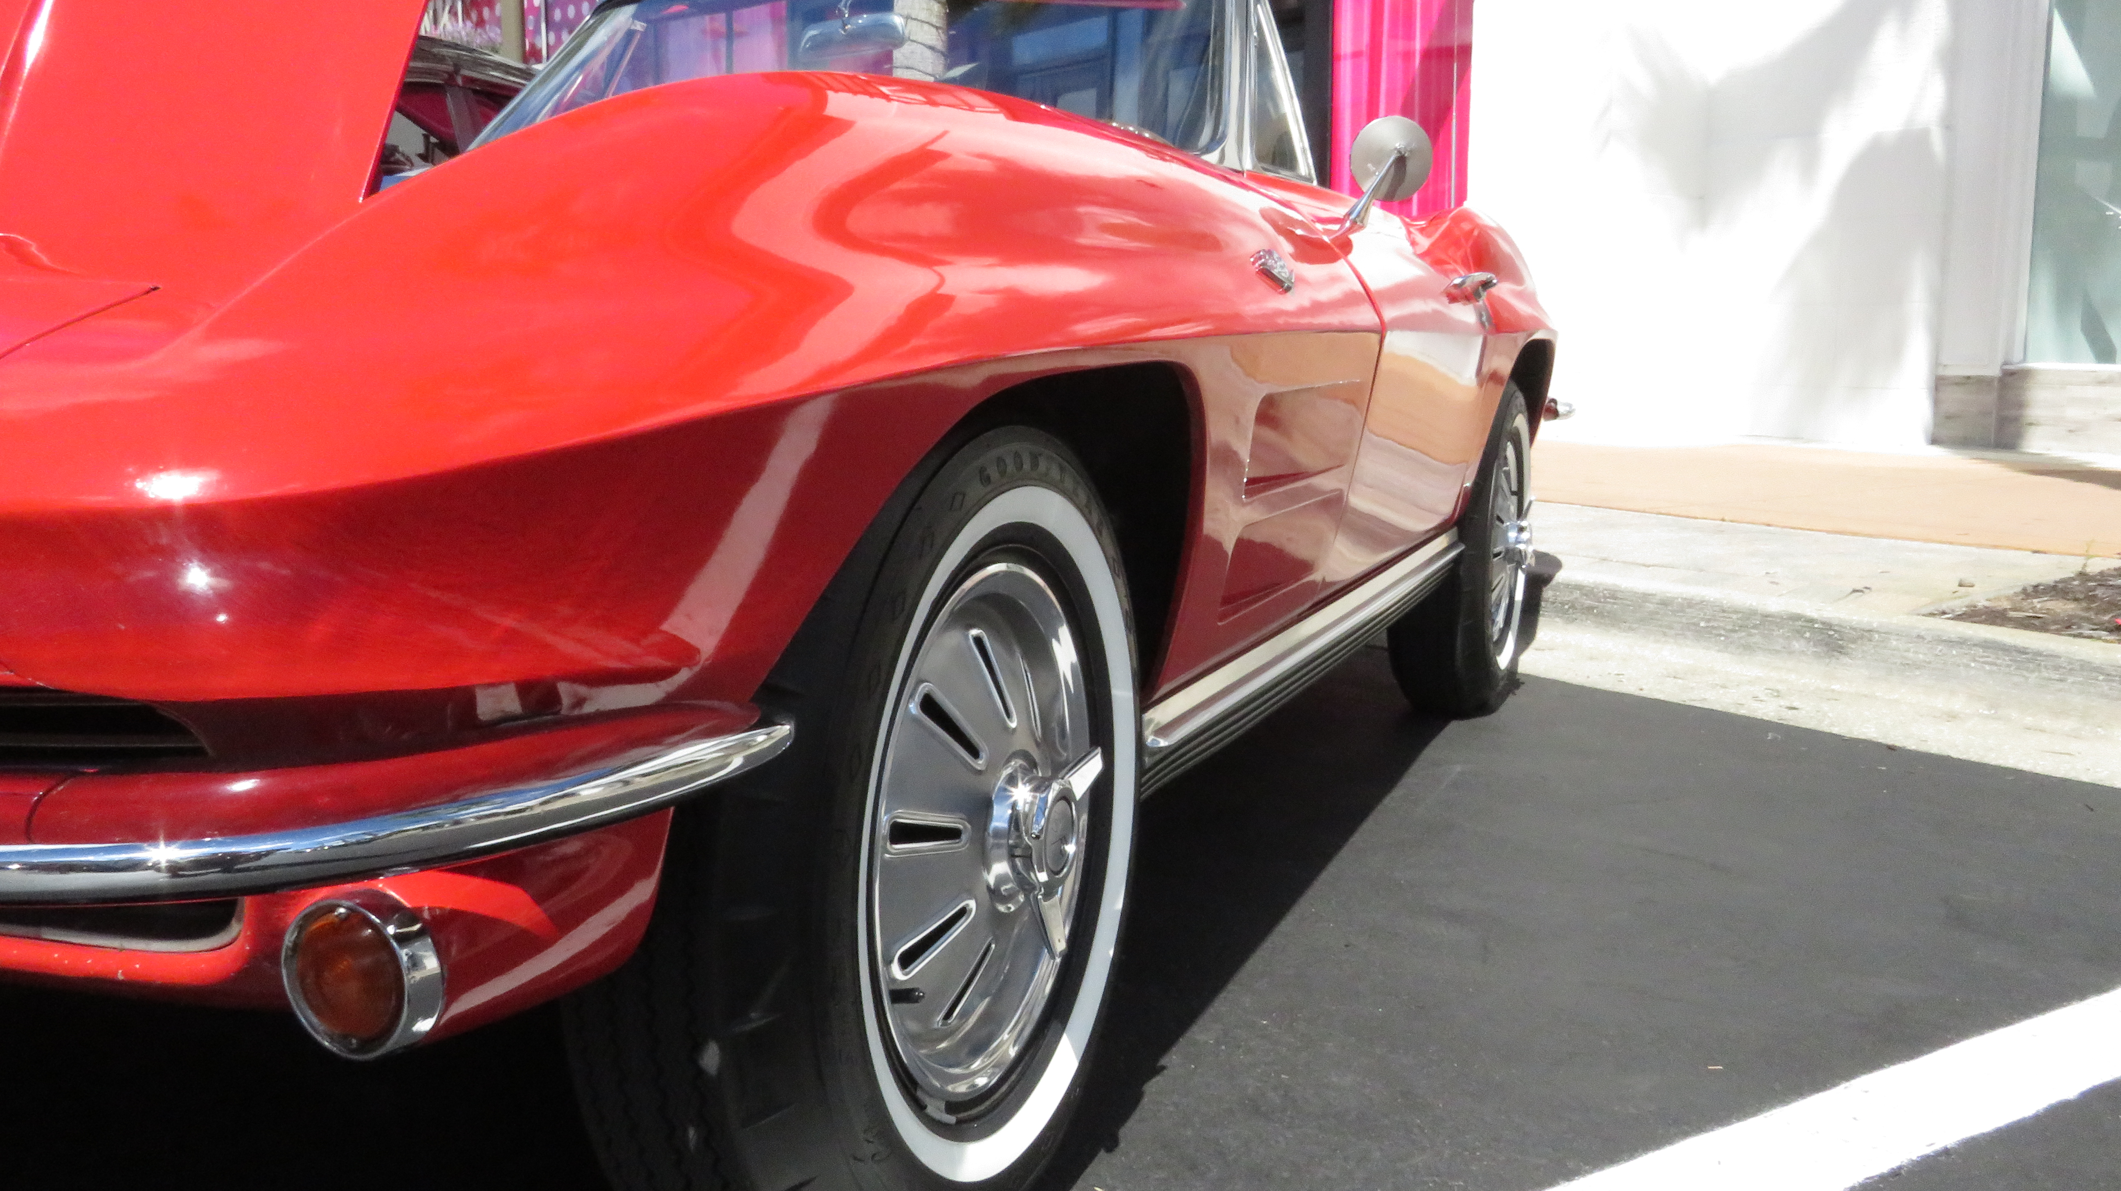
Detailing
By
Martin

Slide 2
About Us
Martin is a car detailing professional who cleans, restores, and enhances the appearance of your vehicle's interior and exterior.
Using specialized tools, equipment, and cleaning products to remove debris, buildup, and stains, he cleans and polishes your vehicle's body. He will also detail your interior.

Slide 3
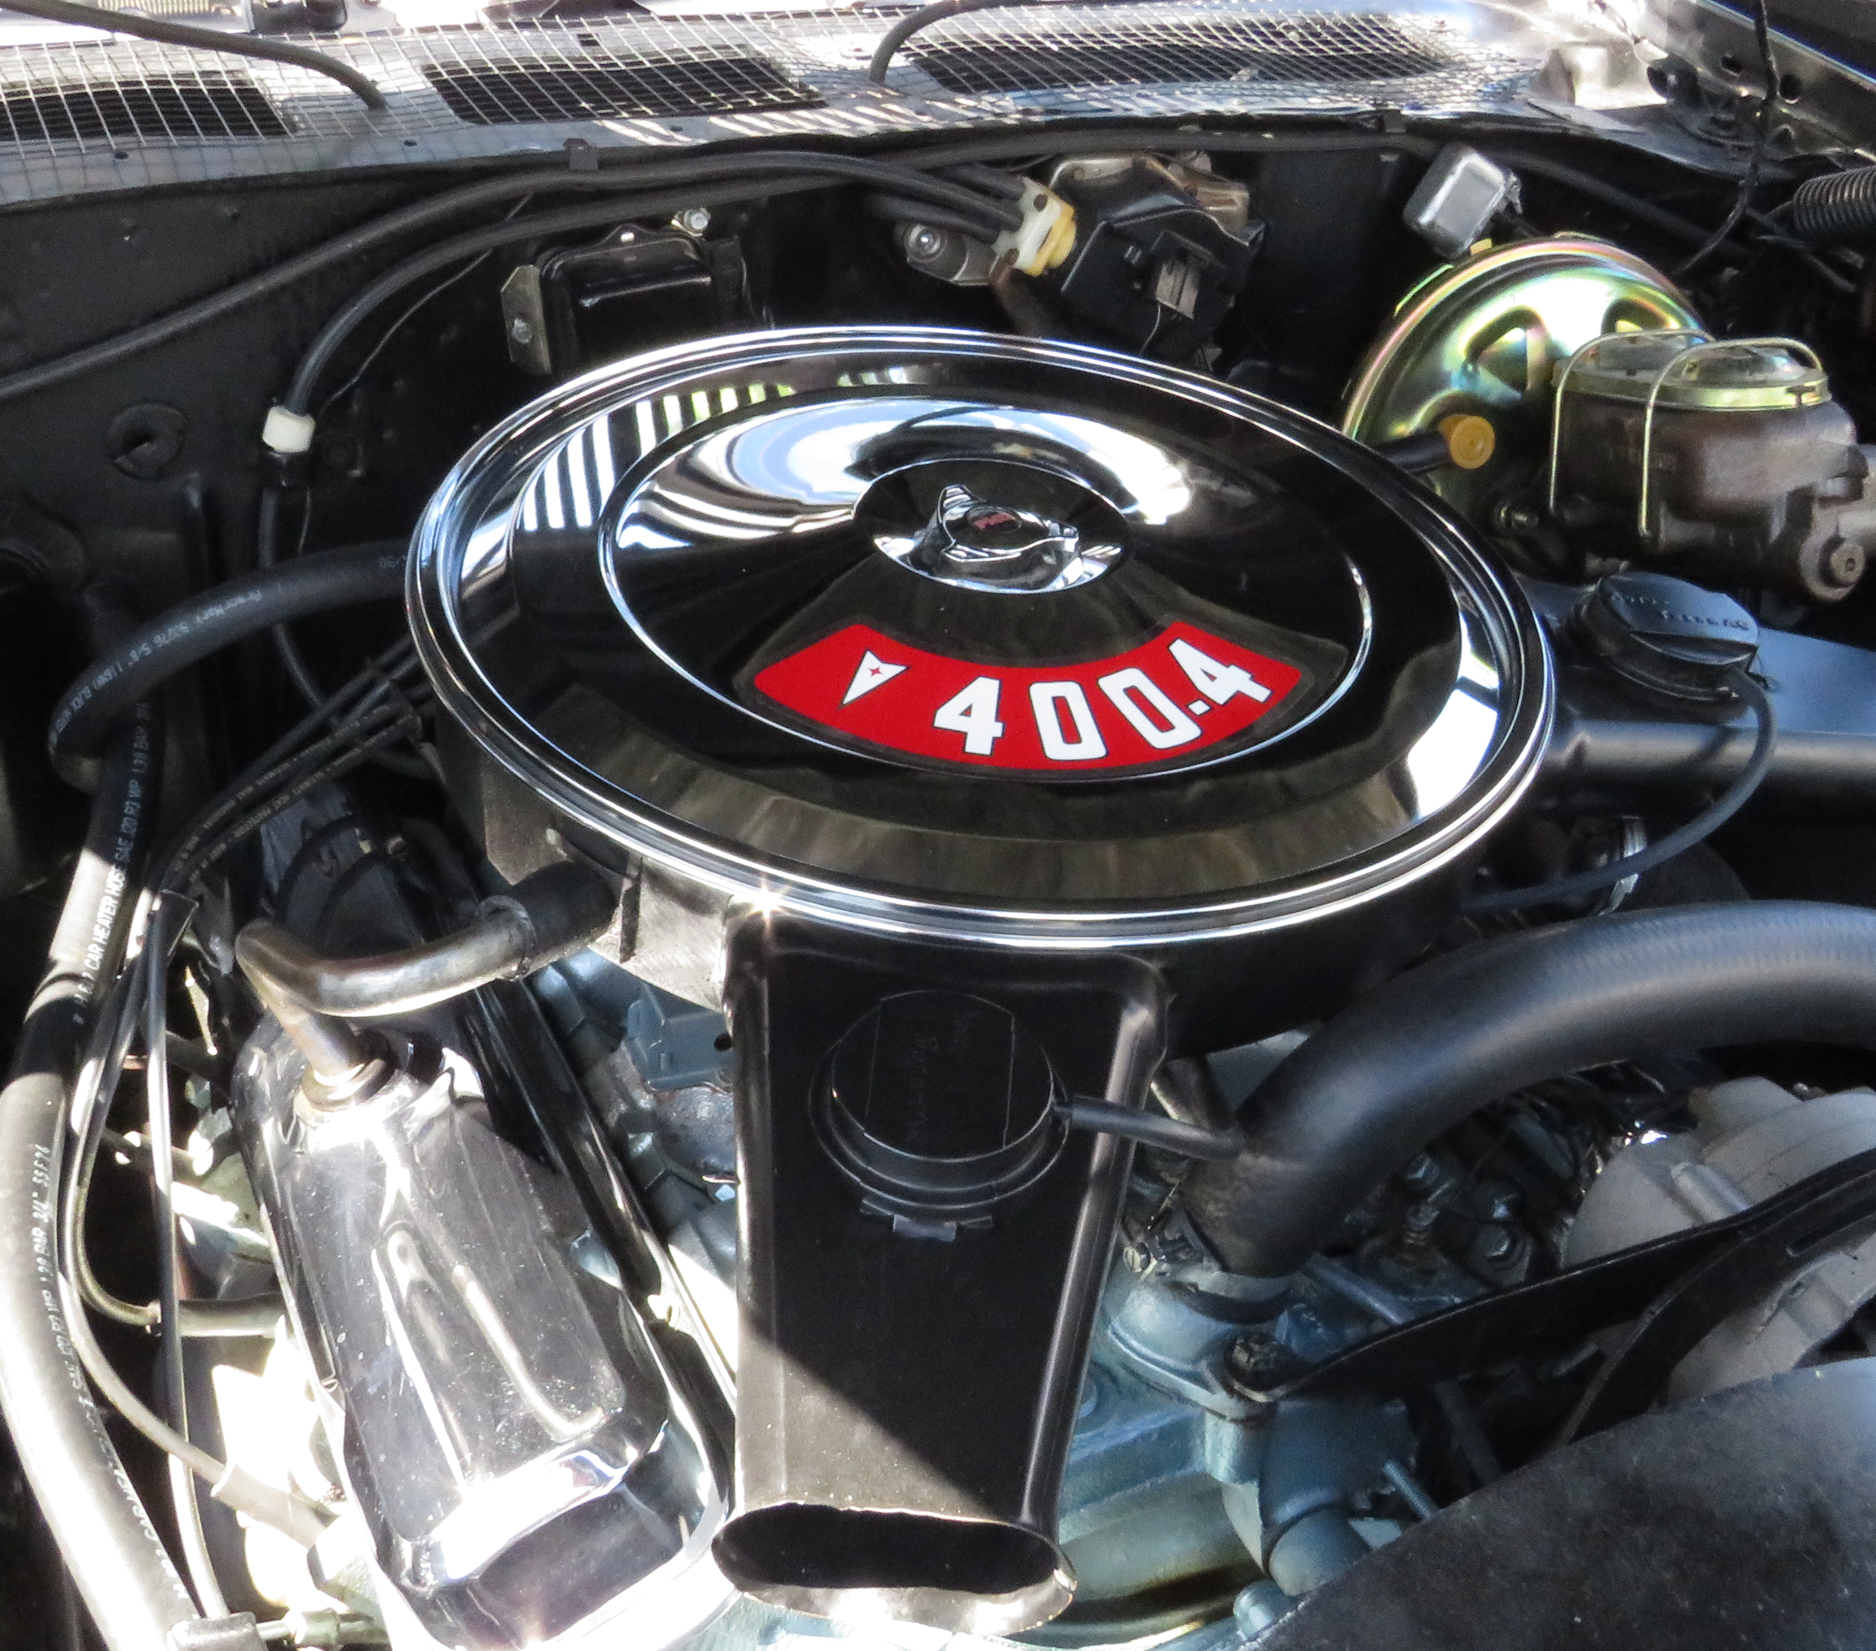
Company Overview

Slide 4
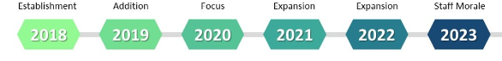
Our Company
Martin
starts
detailing
services
Martin
buys a
detailing
service
Martin
grows
client
base
Martin
buys a
detailing
service
Martin
buys a
detailing
service
Martin
grows
staff

Slide 5
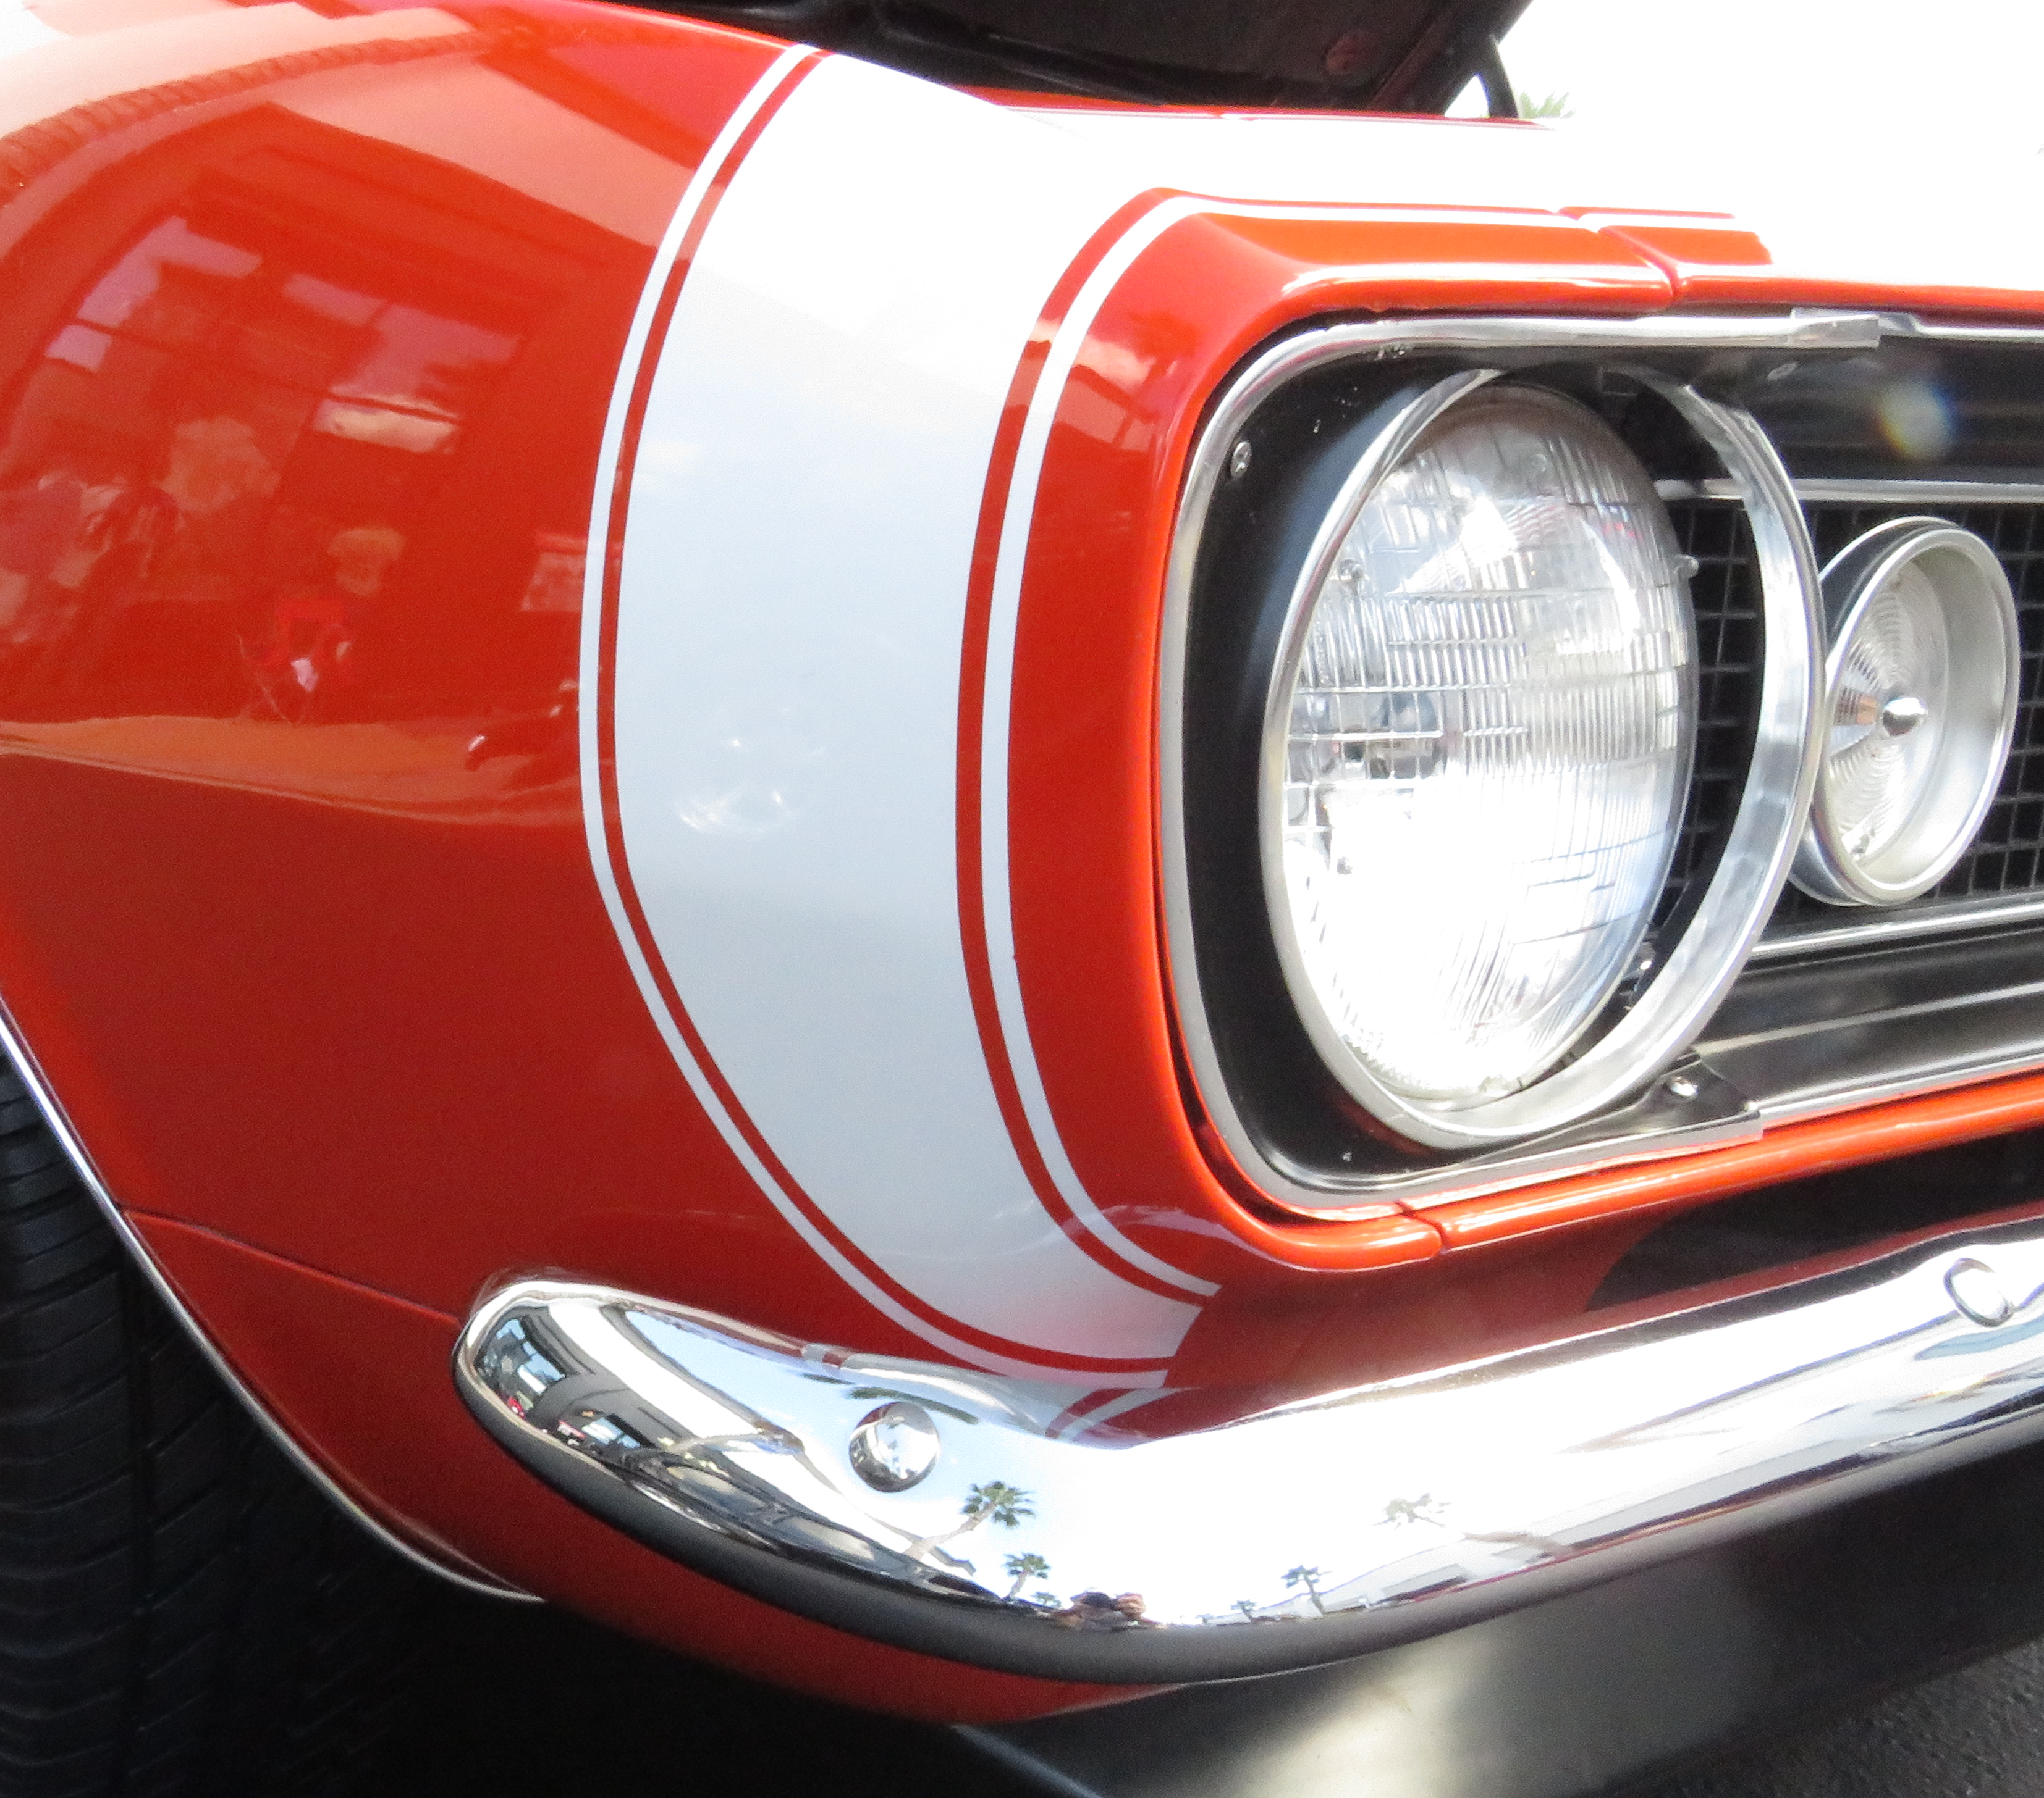
Services Overview
More than just a car wash, we will detail your vehicle to showroom condition!

Slide 6
Rate Card
Services | Silver | Gold | Platinum
Exterior Wash | √ | √ | √
Exterior Clay Bar |  |  | √
Exterior Wax |  | √ | √
Interior Clean | √ | √ | √
Interior Detail |  | √ | √
Engine Detail |  |  | √
Underbody Wash |  |  | √
 | $99 | $149 | $189
Book Now
Book Now
Book Now

Slide 7
Company
Org
Chart
CEO
Martin Grobisen
Office Manager
Jane Doe
COO
Joe Smith
Scheduling
Bee Precise
Marketing Manager
Marty McFly
Supervisor
Harry Carey
Social Media
Jerry Mcguire
Detailer
Thing One
Detailer
Thing Two
Detailer
Hatty Cat

Slide 8
Our Offering
Best
Value!

Slide 9
Thank you
Martin Grobisen
813-731-5629
grobisen@gmail.com

