Slide 1

Memphis Small Business Development Presentation
MG Productions 2024 ©

Slide 2

AGENDA
Introduction
Why Memphis
Current Housing Prices – 5 Cities
Advantage Memphis

Slide 3

Why Memphis
Affordable cost of living
Rich cultural heritage
Thriving food scene
Outdoor recreation opportunities
Strong sense of community
Vibrant arts and cultural scene
Access to healthcare

Slide 4
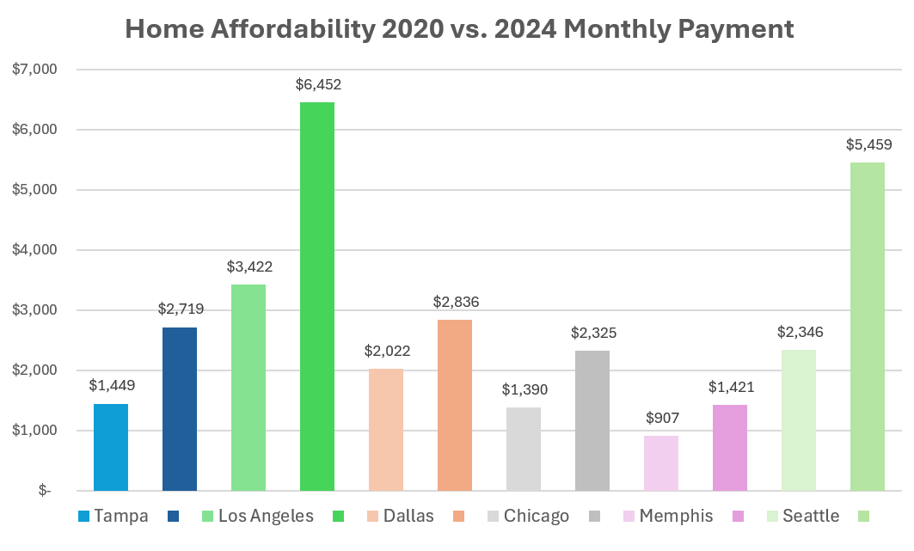

Slide 5
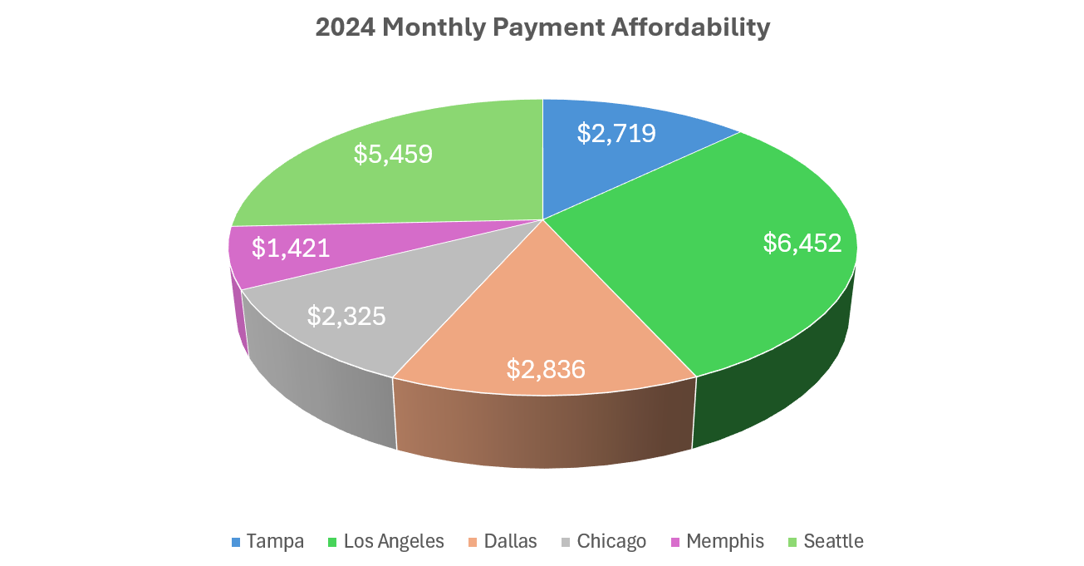

Slide 6
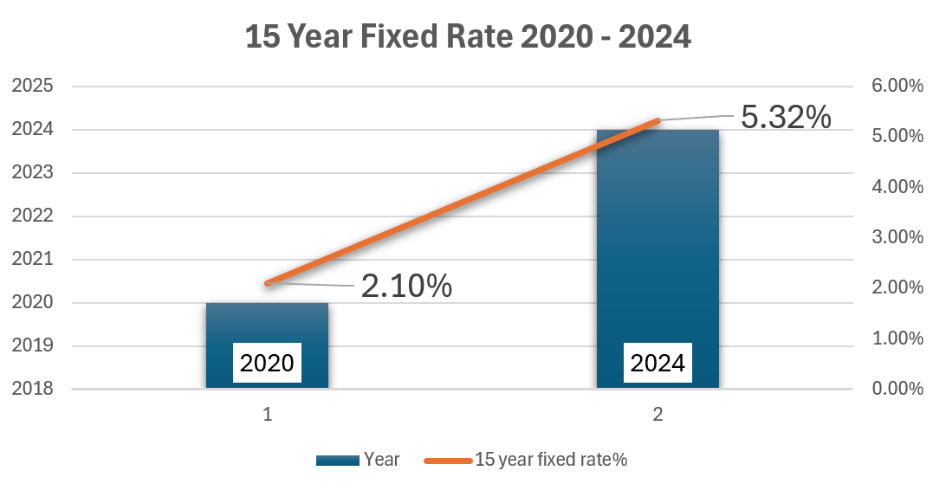

Slide 7

Advantage Memphis
Take Action NOW!

