Slide 1
USF Connect Seminar
Marketing Your Startup to the Next Level
Notes:
I would like to thank:
Matt Lowell, Communications & Marketing Officer
Dr. Rod Casto

Slide 2
Seminar Overview
About Martin
Original State of Ceelox
Marketing Efforts
Successes
Drive for Funding
Q & A

Slide 3

About Martin
Background
  Communications
  Marketing
  Media
  Education

Slide 4
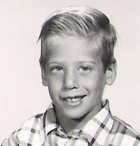

About Martin
Background
  Communications
  Marketing
  Media
  Education
All I Really Need to Know I Learned in Kindergarten
Notes:
These are the things I learned:
Share everything.
Play fair.
Don't hit people.
Put things back where you found them.
Clean up your own mess.
Don't take things that aren't yours.
Say you're sorry when you hurt somebody.
Wash your hands before you eat.
Flush.
Warm cookies and cold milk are good for you.

Slide 5
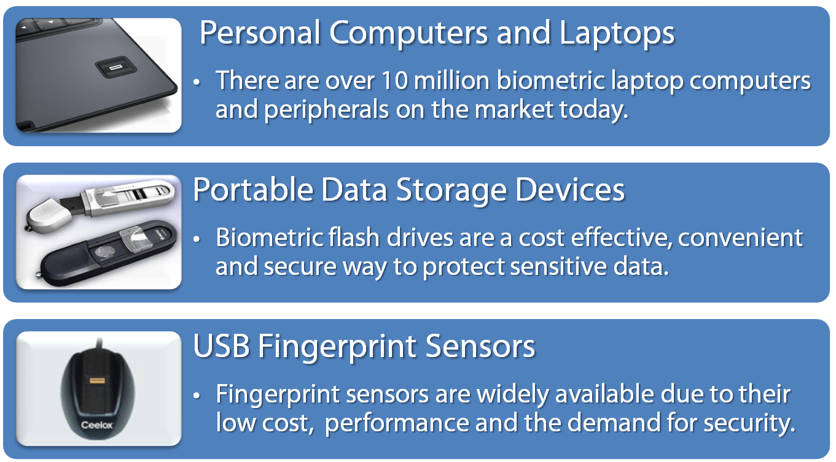
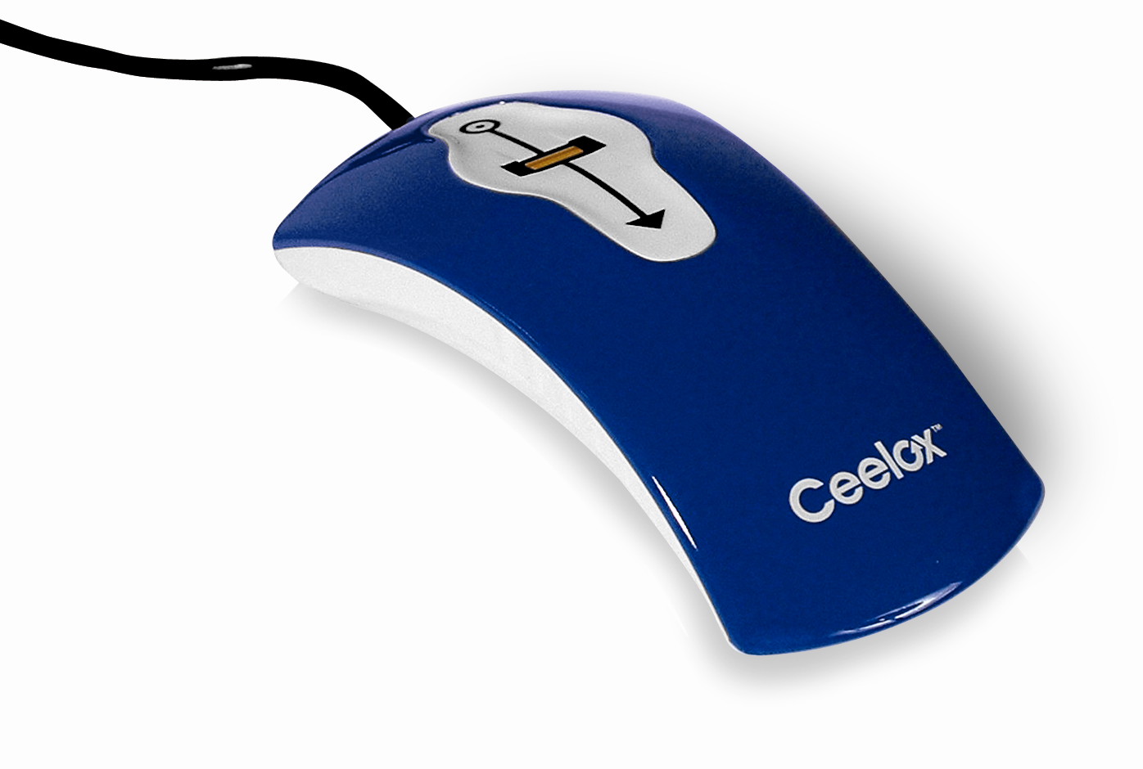
Biometric Devices

Slide 6



Product Segmentation
Identity Access Management
Data and File Encryption
Email and Messaging Security

Slide 7
The Marketing of Ceelox
Marketing Initiatives
PR Initiatives
Sales Team Needs
GSA Initiatives

Slide 8
Marketing Initiatives
Advertising
  Magazine, AdWords, banner ads
Tradeshows
  InfoSec, ICBA, Data Connectors
Collateral
  Sales slicks, website, presentations, CD artwork, pocket folders
Documentation
  User and admin guides, quick starts

Slide 9
PR Initiatives
Press Releases
  Product, Events & Partnerships
Articles
  St Pete Times, TBBJ, Gulf Coast Bus Review
Speaking Engagements
  Association events, webinars, seminars
Interviews
  Newspapers, online portals

Slide 10
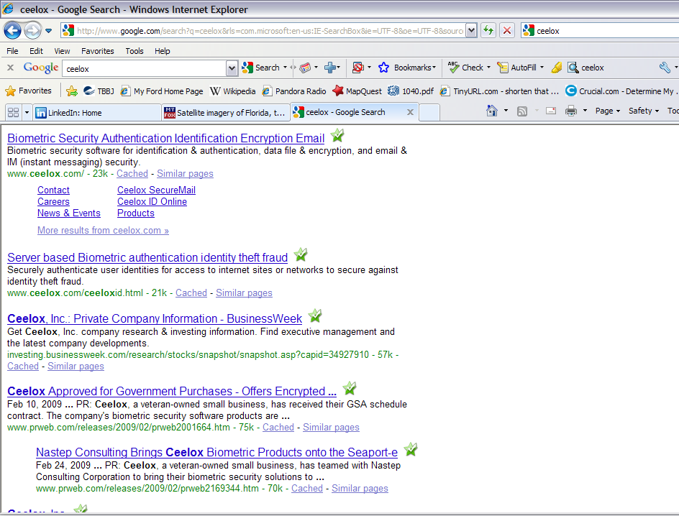
SEO

Slide 11
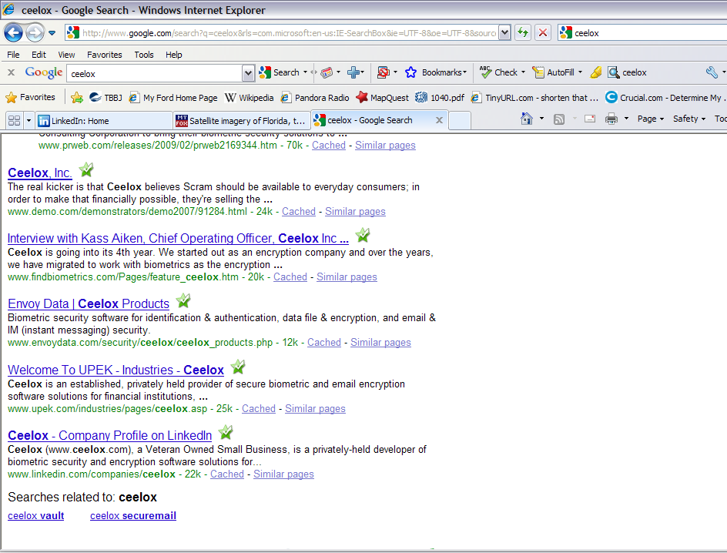
SEO

Slide 12
GSA Initiatives
Getting on the GSA
  Hired marketing firm
Events
  NASA, MacDill AFB
Relationships
  Local Congressman, government agencies

Slide 13
Successes
Aberdeen Interview
  SecureMail analyst interview
findBiometrics.com Interviews
  Year in Review
  CEO interview
SC Magazine Product Reviews
  ID 4 stars
  Vault 5 stars
Frost & Sullivan Award
Notes:
2009 Frost and Sullivan Emerging Biometric Solution of the Year Award.

Slide 14
Funding Basics
Business Plan vs. Executive Summary
Steps to being the “Chosen One”
SWOT Analysis
  Strengths, Weaknesses, Opportunity, Threats
The 4 Ps
  Products, Promotion, Price, Place
Operations and Financial Plan
Generating Cash Flow
Notes:
Step 1: Business Plan Submission
The first step in approaching a VC is to submit a business plan. At minimum, your plan
should include:
1. a description of the opportunity and market size;
2. resumes of your management team;
3. a review of the competitive landscape and solutions;
4. detailed financial projections; and
5. a capitalization table.
You should also include an executive summary of your business proposal along with the
business plan.
Step 2: Introductory Conversation/Meeting
If your firm has the potential to fit with the VC’s investment preferences, you will be
contacted in order to discuss your business in more depth. If, after this phone
conversation, a mutual fit is still seen, you’ll be asked to visit with the VC for a one- totwo
hour meeting to discuss the opportunity in more detail. After this meeting, the VC
will determine whether or not to move forward to the due diligence stage of the process.
Step 3: Due Diligence
The due diligence phase will vary depending upon the nature of your business proposal.
The process may last from three weeks to three months, and you should expect multiple
phone calls, emails, management interviews, customer references, product and business
strategy evaluations and other such exchanges of information during this time period.
Step 4: Term Sheets and Funding
If the due diligence phase is satisfactory, the VC will offer you a term sheet. This is a
non-binding document that spells out the basic terms and conditions of the investment
agreement. The term sheet is generally negotiable and must be agreed upon by all
parties, after which you should expect a wait of roughly three to four weeks for
completion of legal documents and legal due diligence before funds are made available.
Focus on the 4 P’s. They are: Products, Promotions, Price, and Place.

Slide 15
VC Wisdom
Key take away messages
The biggest mistakes
How do you find your opportunities or how do you prefer to be introduced
All things being equal, what makes you choose one investing opportunity vs. another
Notes:
1. Key take away messages
Investing in start-ups is about timing and tenacity. Getting in front of the right people at the right time is critical. Also beware of the investor and make sure you are getting a "fair" deal for your company. One thing I tell entrepreneurs looking for money is to remember that investors are looking for the one red flag as to why NOT to invest, rather than the entrepreneurs viewpoint which is all the reasons why they SHOULD invest.
Go after government grants and contracts right now (SBIR, DOD) as traditional VC funding is tight.
Borrow as much seed money from Friends & Family in order to develop / demonstrate a prototype product / service
1. Know your business and the metrics. Nothing is more frustrating than an entrepreneur who is in love with his idea but knows little of the challenges of monetization.
2. Understand that consideration and due diligence will always take longer than you think so don't assume that any investor will "hurry up" just because you are cash-poor.
3. Make sure you have a sustainable competitive advantage. Investors don't like 'commodity plays' with a low barrier-to-entry. And outside equity investments won't come without expectations of out-sized returns
2. The biggest mistakes
The biggest mistake I see is the entrepreneur really not understanding the market and competitive landscape. The financial projections don't make sense in many cases and have not been thoroughly scrubbed to make sure they are realistic.
Biggest mistake is not getting the story/pitch right. It's got to be extremely compelling.
The quote of "no one else is doing this" sends a dual message to me. First, I will always validate the quote in my due diligence and I find it to be rarely true. Secondly, this is not a positive as it communicates there is not a market that has been vetted. Just look at most of the most successful companies in history and they were not the first to bring the product to market but rather executed their business model the best.
VC presentation mistakes: entire team is inexperienced; hockey stick revenue pro forma; unrealistic assessment of competitors (known & unknown); unrealistic assessment as to how much money is needed for each round; pitching a VC without any form of introduction is pretty useless these days; don't try to pitch the VC that the elephant can be eaten in one bite.
The biggest mistake I see in VC pitches is not adhering to the time allotted. Nothing hacks these guys off more than feeling disrespected, except maybe wasting time getting to the point. They will communicate how much time is given for the pitch and Q&A... it's up to the entrepreneur to adapt accordingly and prepare effectively for each situation.
3. How do you find your opportunities or how do you prefer to be introduced
The best way to get deals through the clutter is to be introduced to us by someone who we trust. Use affinity groups such as alumni of prior jobs, universities, etc. as well as the usual friends and family. It's a long process in raising this type of money so be persistent.
VC prefer be introduced to deals by "friends", just like lots of folks like to meet people through Facebook, VC like to meet deals through referrals.
4. All things being equal, makes you choose one investing opportunity vs. another
Management, management, management. It's all about the people. Have they done this before and are they reasonable about the time and money it will take to get to a viable company from where they are now. We also look for people who understand they are not experts in all areas of management and operations and look to fill those gaps along the way.
What is your unique competitive advantage and how good is your team?
All things being equal, a proposition that has actually managed to extract money from a customer is very attractive over one which has simply generated a lot of interest. It speaks volumes about the product, the market and the ability of the people in the start-up to sell. Some management teams are able to sell consulting or problem solving even when their product is not fully developed. This is a fantastic skill and helps fund cashflow and adapt the product to something that will actually be valuable when fully developed.
All other things being equal, I'll choose people every time. I'd rather have a 'B' idea backed by an 'A' team than the opposite anytime. Choose your partners carefully and with an eye to the future.

Slide 16
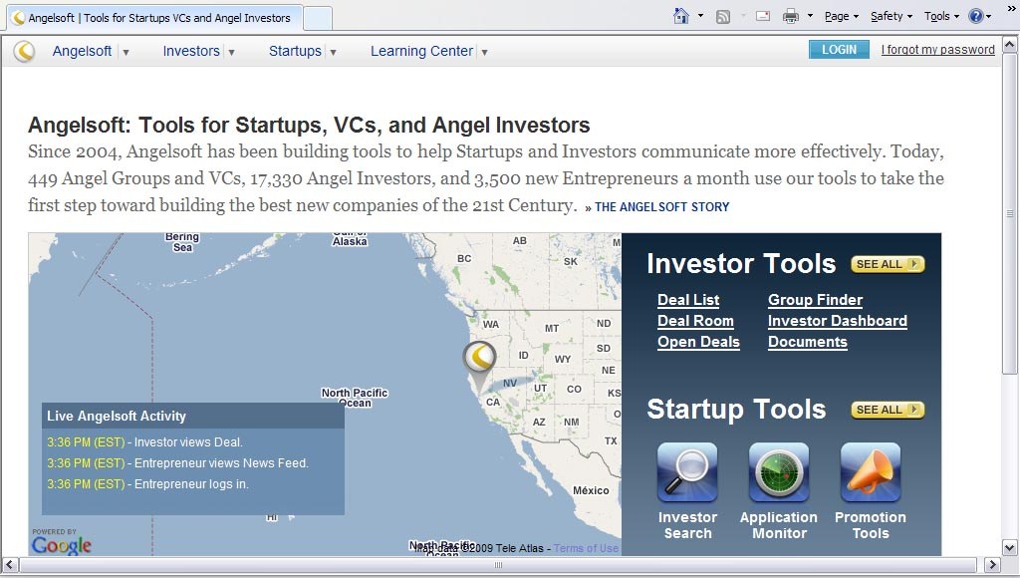
Angelsoft VC software

Slide 17
Conclusion
Presentation Distribution
Questions Please
Marketing Collateral Review

Slide 18
Thank You
Contact Info:
  Martin Grobisen
  mgrobisen@tampabay.rr.com
  813-731-5629

