Slide 1
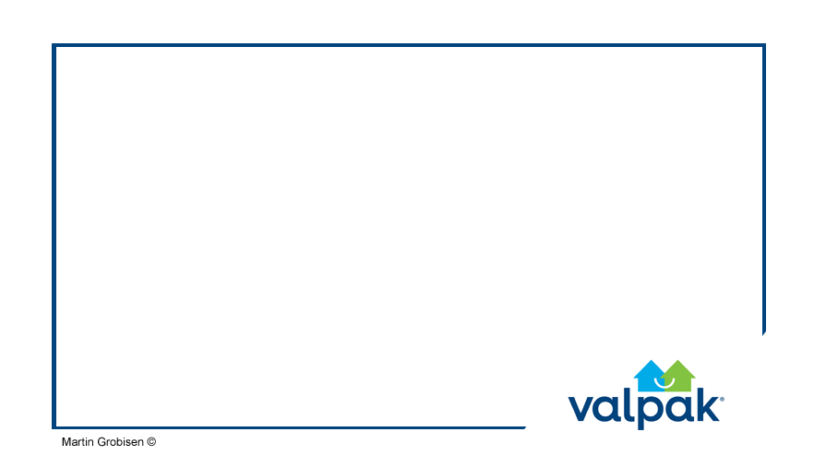
Lead Generation Campaign for the
Restaurant Category
Notes:
Hi, thanks for coming out to hear about our newest marketing campaign proposal.
Today we will be talking about our campaign to drive more leads into the large format printing opportunities within the restaurant industry category.

Slide 2

Overview
Overall strategy
Planned tactics
Budget estimate
Content & messaging strategy
Internal communication timeline
Q & A
Notes:
The focus of our campaign is the to drive more utilization of our large format advertising vehicles.
Fifty-six percent (56%) of postcards are read by recipients.
Thus, we feel that makes large format advertising an excellent vehicle for our clients. In this campaign we are focused on the restaurant industry and feel that the large format is a unique opportunity for our clients to see high ROI.
I would like to start with a quick overview of the strategy.
I will then provide some detail around the planned tactics for each marketing vehicle and the accompanying budget requirements.
Of course, every campaign needs a well-design content and messaging strategy. I will provide a high-level view of both the Pardot tool and the drip program plans.
The internal communications plan and timeline allow for both learning and sales training. The communications plan will help ensure that our campaign is successful and that our franchisees see increased sales.
We can then have a short Q&A session, though if you have any questions during the presentation, please don’t hold them until the end. If it is something that I plan to cover, I will simply let you know.

Slide 3
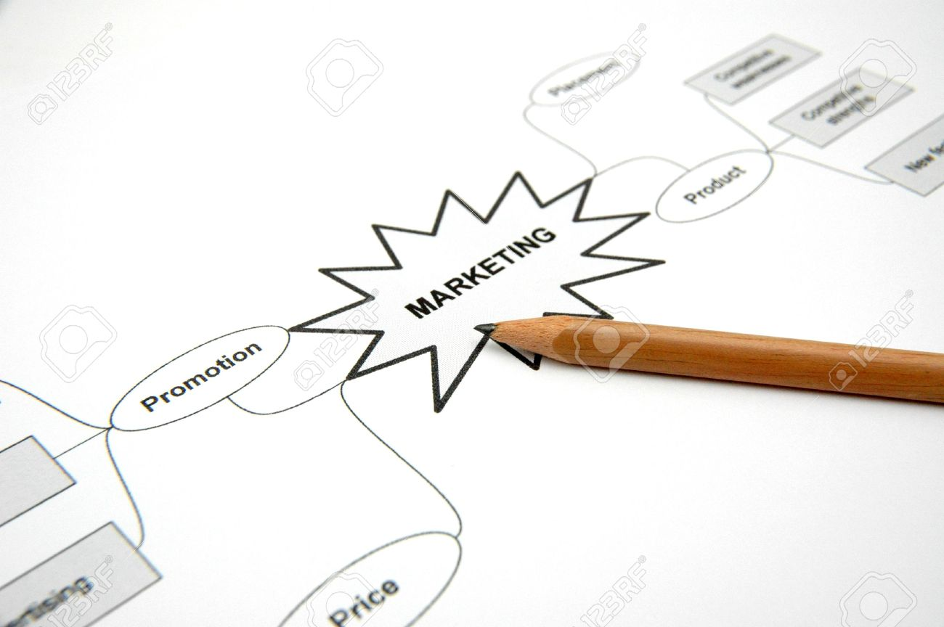
Overall Strategy
Utilization of Pardot
  Email campaign
  Drip logic
Messaging
  Restaurant testimonials & case studies
  Click through rates
Paid ads
  Google AdWords
  Social media
  Restaurant industry portals
Notes:
As we all know, Pardot is a new tool that has yet to be fully implemented to drive increased traffic and sales opportunities.
One of the best uses of Pardot is their drip campaigns and the associated logic for driving email marketing campaigns.
We have numerous industry specific testimonials and case studies, this is a great way to drive prospect interest resulting in improved open and click through rates.
Combining our email marketing efforts with some targeted Google AdWords and social media efforts, we should be able to not only engage our current prospects, but also drive new leads into Pardot, extending our reach.
We will also be syndicating content in specific restaurant industry portals. With the right messaging and imagery, we will be able to drive even more engaged leads into our funnel.

Slide 4
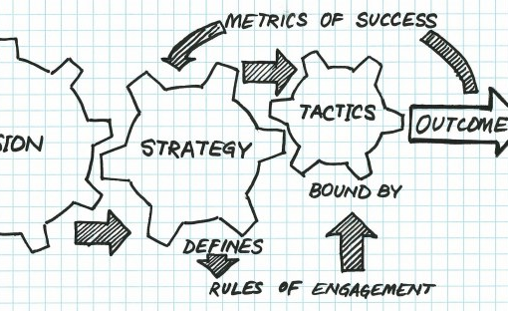
Planned Tactics
Salesforce with current restaurant clients and prospects
Pardot for email marketing automation
Engage Platform for sales reps to send follow-up emails
Google AdWords
Social Platforms - Facebook, Twitter, LinkedIn
Valpak tools
  Direct Mail - Solo (proof in concept)
  Valpak Advertising Website
  Valpak Research Department
Notes:
This campaign will utilize all of our internal marketing tools and team members in order to drive the best results.
The Salesforce CRM has 14,386 current restaurant clients and 23,474 restaurant prospects. By utilizing this extensive database and building specific drip campaigns in the marketing automation tool, Pardot, we will be able to see excellent results, with open rates in the mid-single digits, possibly as high as 6-7%.
The sales reps should continue to use Engage to directly connect with the hot leads, adding the personal touch that only a direct email can do.
A key to driving new leads will be Google keywords and social media messaging. With the right combination of tools, we should be able to substantially increase our database of prospects driving increased sales opportunities for our franchisees.
Of course, being Valpak, we are fully vested in direct mail. For this campaign, we will use every available resource to drive new leads and connect with our current customers and prospects.

Slide 5
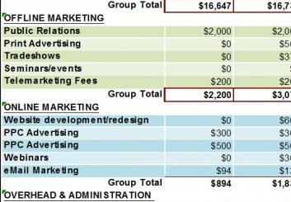
Budget
3-month lead generation campaign
Initial investment:
  $100,000
Initial estimated distribution:
  $35,000 - AdWords
  $30,000 - Remarketing
  $20,000 - Content syndication
  $15,000 – Valpak direct mail expenses
Notes:
This is a 3-month long lead generation campaign designed to utilize several marketing sources for driving new leads, as well as internal resources to deliver more opportunity within our existing database – both existing customers and prospects.
The initial budget estimate is about $100,000 and can be broken down into 4 large buckets.
The largest percentage of the budget, 35% will be used with Google on keyword bidding. By choosing the highest priced keywords, and focusing on click through rates, we can determine success of conversions.
Once a restaurant owner searches for our keywords, we will then be able to remarket to them -30% of the budget . This is an excellent source of leads and has proven to be a great value for the budget spend.
Content marketing is always the best way to drive traffic to our Valpak site. By writing articles and blog posts that can be syndicated, we can get our message out to the sites where our prospect are already doing their research. Although the spend is focused on the 3-month campaign, great content will continue to drive leads long after the campaign is complete.
At Valpak, we believe that direct marketing is the best way to advertise, so all of our campaigns utilize our internal resources to drive success. The estimated hard costs for this campaign are about 15% of the overall budget.
As the campaign moves forward, some of the financial distribution may need to be adjusted in order to drive the most value out of this campaign.

Slide 6
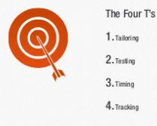
Pardot Marketing Automation Platform
The 4 Ts
  Tailoring the message for your target
  Testing of the emails with A/B testing
  Timing is essential to a good campaign
  Tracking is the “holy grail” of a well developed campaign
Notes:
The Pardot Marketing Automation Platform is a great tool to drive traffic and lead generation. As with all email campaign tools, the 4 Ts should be considered as an essential strategy in targeting our efforts.
By tailoring our message to the target market, we will be able to ensure that the restaurant owner will see a message that will appear to be just for them – because it will be!
It is important that any campaign have some A/B testing during the initial set of drip emails. This will ensure that we can not only reach our intended target, but that the message will have a better chance of being opened and the links clicked on.
With a well-designed drip program, we can control the timing of each email to land at the right time to ensure a better open rate. Building a robust drip program is key to the timing of any email campaign.
One of the key issues with not using a tool like Pardot is that sending out general emails in a campaign do not provide good data to drive continual improvement. Using Pardot means that the next campaign can be even better.
But the tracking in Pardot can do so much more. When a prospect opens an email, they are given a score, the more active they are, the higher their score. This allows the sales team to judge the “hotness” of a lead. And by focusing their efforts on the hottest leads, sales should increase.

Slide 7
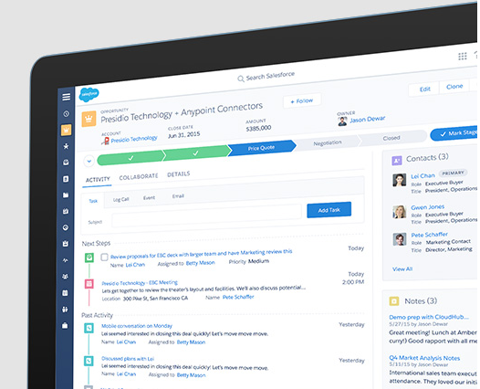
Salesforce Integration
14,386
  Current Restaurant Clients in Salesforce
23,474
  Restaurant Prospects in Salesforce
Notes:
This is where the Salesforce integration is key to our success. With over 14,000 current restaurant clients and 23,000 prospects in our database, we can build an incredible amount of momentum to drive both prospects and clients into our sales funnel.
And as new restaurant leads come in through our integrated marketing efforts, they can be added to our database and incorporated into the ongoing campaigns.

Slide 8
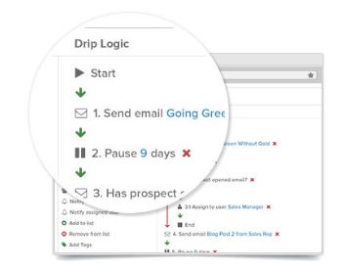
Pardot Marketing Automation
Drip program example
    Send Email #1
      If opened, add 5 points to score
      If link clicked on, add 10 points to score
      Notify Sales (Direct contact via Engage platform)
    If unopened, pause 3 days, send Email #2
      If opened, add 5 points to score
      If link clicked on, add 10 points to score
      Notify Sales (Direct contact via Engage platform)
      If unopened, pause 5 days, send Email #3
    Drip logic continues…
Notes:
The Pardot Marketing Automation Platform allows you to easily build drip campaigns with their drip logic drag-n-drop interface. For example, sending out an email on Thursday between 10-2 you have the best chance of an initial email being opened. Each action on the part of a recipient will drive an increased score that will help the marketing team determine when a prospect should be made into a Sales lead.
For the leads already in Salesforce, any action will add points and the sales rep will be notified that the lead has reactivated. If an email is opened, then the lead receives 5 points, if they click through a link, then 10 points and so on. This is the time for the Sales Rep to continue the conversation with the prospect via the phone, in-person and with the Engage platform.
After the initial email, if there is no action taken, then after a pause, there is a second email sent. This drip can continue until there is action taken or for a specific period of time.

Slide 9
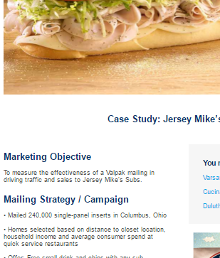
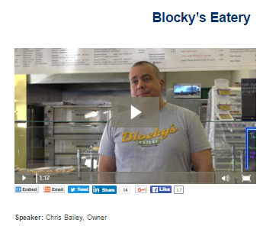
Content & Messaging Strategy
Dear %%Name%%,
We know that getting new customers and retaining current customers in the restaurant industry is a challenge.
Do you want more measurable results from your marketing efforts?
Fifty-six percent (56%) of postcards are read by recipients
Want to See Results Today?
Follow the link to Blocky’s eatery.
Notes:
The emails will have specific content that is relevant to the target market, in this case, the restaurant owner.
With core messaging we can drive increased open rate and click through. In the rough draft example here, I have put together a basic message that will resonate with the restaurant client. By clicking on the Blocky’s Eatery video testimonial, we can ensure that the message to our prospect hits the mark.

Slide 10
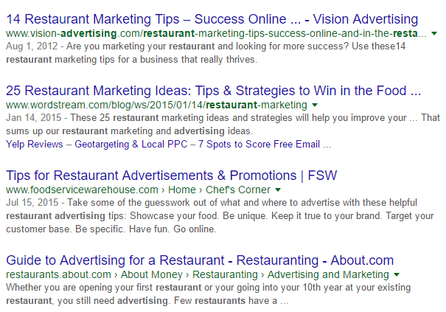
Content Syndication
Notes:
This screen capture is a representation of potential content syndication. If you are a restaurant owner, what would you type into google to find out about the best ways to market your restaurant?
That is exactly what our content needs to address. For example: The top 10 tips to drive new customers to your restaurant. Or, How can direct mail help drive more restaurant customers?
Content syndication is the best way to get your message out to the audience in the places that they are already visiting for information. These restaurant portals are invaluable to reaching our target market and driving lead generation.

Slide 11
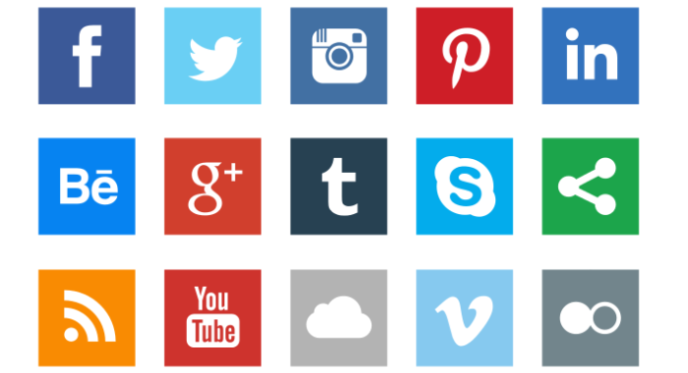
Social Media
Notes:
Engaging our prospects via social media is another valuable component of this campaign.
The campaign messaging can be repurposed to drive social sharing on several platforms. LinkedIn, Facebook and Twitter will be the focus of most of the messaging but YouTube will be a vital source to drive prospects with links to restaurant specific testimonial videos.
There is also a great opportunity to utilize the different social media platforms for paid and sponsored listings and for remarketing. This will account for about 30% of the campaign’s budget.

Slide 12
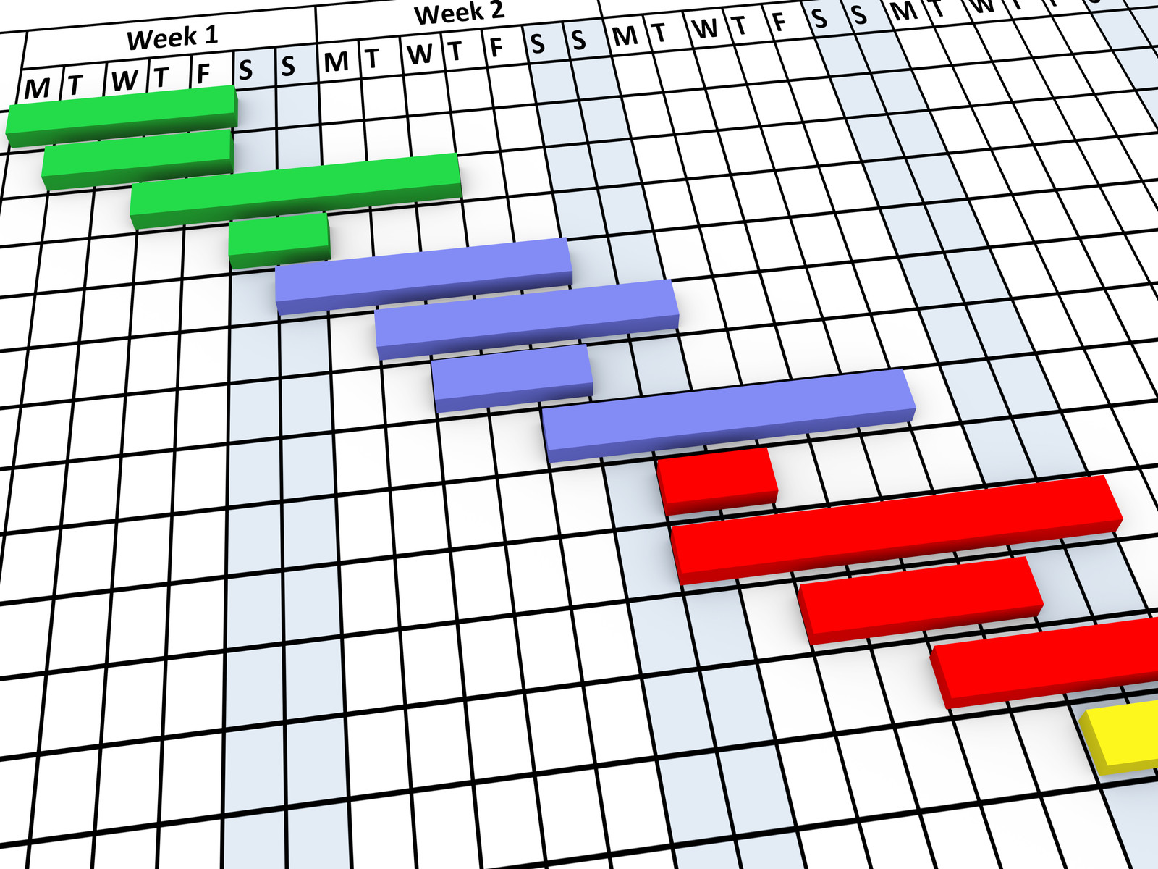
Internal Communication Timeline
Content creators & graphic design
Training for the sales team
Training for the support team
Training for the franchisees
Data-driven results
Evaluate and adjust
Notes:
As with any marketing campaign, the internal communications are the final key to success. There are several important timeline milestones that require multiple teams to participate. The first teams required will be the content creation and graphic design teams. They are critical to all of the messaging that will be used throughout the 3-month long campaign.
As the project moves towards implementation, it is time to deliver internal training to the sales and support teams. This training will include the both the internal sales team and the franchisees. The sales reps will need to know about the offers and the sources of the leads.
As the campaign moves through its life cycle, key metrics will begin to be reviewed and delivered to both the internal clients and the executive team for discussion and evaluation. Throughout the campaign there will be opportunities to adjust not only the messaging but the offer delivery vehicles as well.

Slide 13

Q & A
martin@grobisen.com
Notes:
Thank you for your attention today, you can contact me with any further questions at 813-731-5629 or via email, martin@grobisen.com

