Slide 1
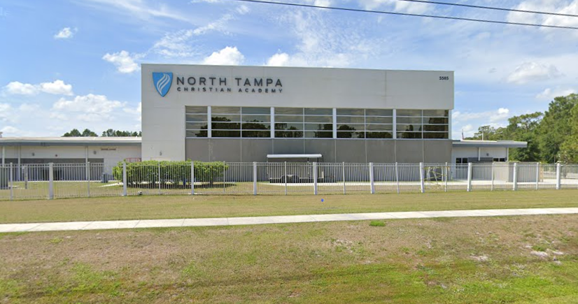
How Vulnerable Is Your School?
Risk Assessment of North Tampa Christian Academy

Slide 2
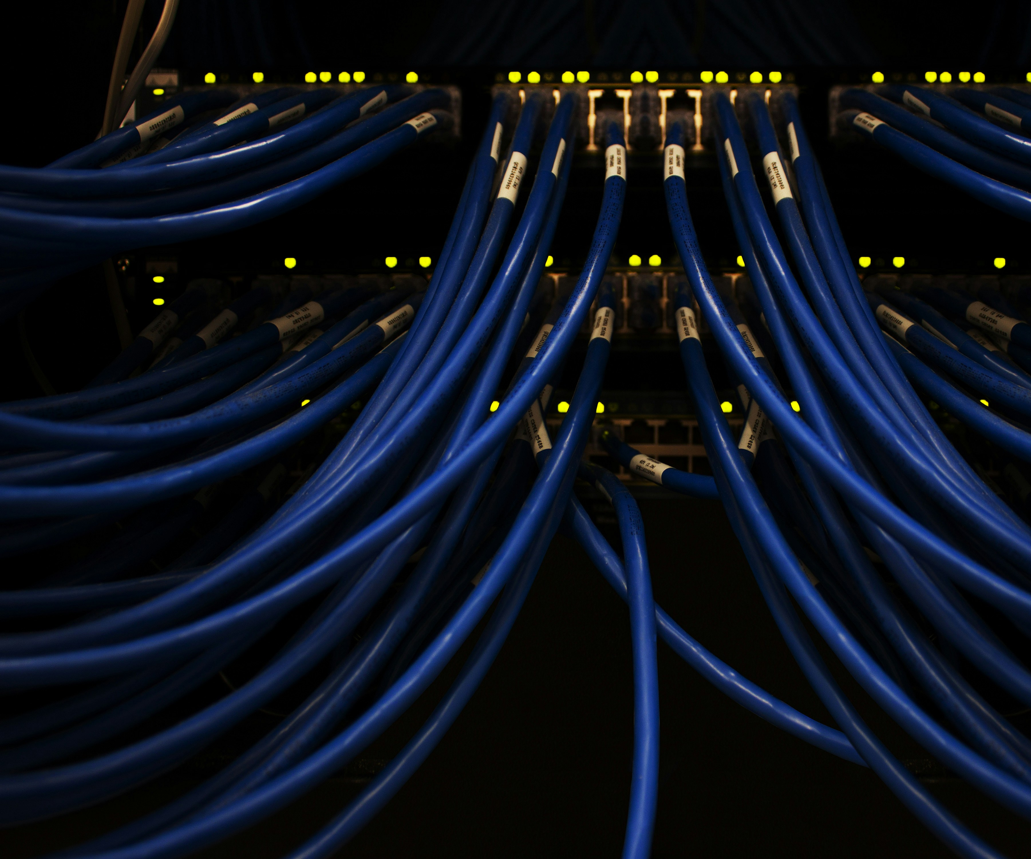
Attack Surface Overview
Definition: The sum of all points through which an unauthorized user can try to enter data or extract data from an environment.
Importance: Understanding the attack surface helps in identifying and mitigating potential vulnerabilities.
Components: Includes hardware, software, network, human, physical, and organizational aspects.

Slide 3

Hardware Vulnerabilities
Definition: Weaknesses in physical devices that can be exploited.
Outdated hardware: Prone to failures and lacks security features.
Unauthorized access: Devices can be easily accessed without proper security measures.
Example: Unsecured laptops and desktops
Warning signs: Frequent hardware malfunctions, missing devices

Slide 4

Software Vulnerabilities
Definition: Weaknesses in software applications that can be exploited.
Outdated software: Susceptible to known exploits and vulnerabilities.
Unpatched systems: Lack of updates leaves systems exposed to threats.
Unpatched operating systems: Can be exploited by malware or hackers.
Warning signs: System crashes or unexplained slow performance.

Slide 5

Network Vulnerabilities
Definition: Weaknesses in network infrastructure that can be exploited.
Weak Wi-Fi passwords: Easily guessed or cracked, providing unauthorized access.
Unsecured network access points: Allow intruders to access the network.
Unsecured Wi-Fi networks: Open to unauthorized access and data theft.
Warning signs: Unusual network traffic or unauthorized devices connected.

Slide 6

Human Vulnerabilities
Definition: Weaknesses due to human actions or inactions.
Lack of security training: Employees unaware of security protocols.
Weak passwords: Easily guessed or reused across multiple accounts.
Phishing email attacks: Deceptive emails trick users into revealing information.
Warning signs: Suspicious emails or unauthorized account access.

Slide 7

Physical Vulnerabilities
Definition: Weaknesses in physical security measures.
Inadequate physical security: Lack of barriers or surveillance.
Easy access to critical areas: Important areas not properly secured.
Unlocked server rooms: Allow unauthorized access to sensitive equipment.
Warning signs: Unexplained physical presence or tampered locks.

Slide 8
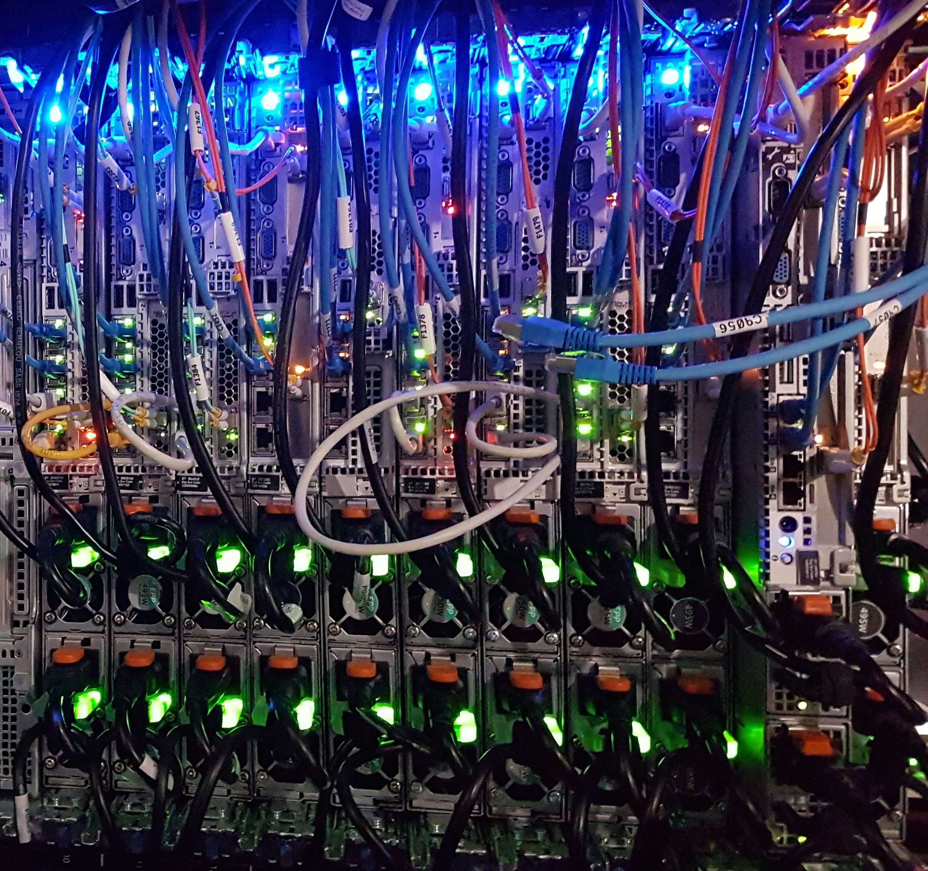
Organizational Vulnerabilities
Definition: Weaknesses in organizational policies or procedures.
Poor security policies: Lack of clear guidelines and protocols.
Lack of incident response plans: Unpreparedness for security breaches.
Lack of a comprehensive security policy: Leads to inconsistent security measures.
Warning signs: Confusion in protocols or delayed response to incidents.

Slide 9
Thank you
Martin Grobisen
813-731-5629
grobisen@gmail.com

