Slide 1
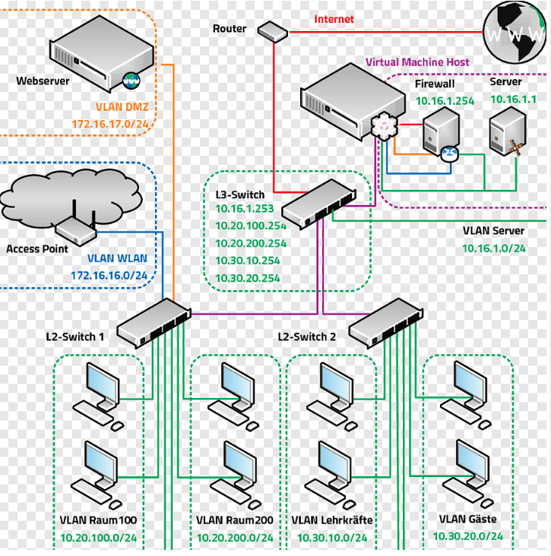
Securing Your Network with Our Managed Switch
Enhancing Security with VLANs
Why Use VLANs?
Virtual Local Area Networks (VLANs) help create separate, isolated networks within your main network. This means that sensitive data and critical devices are kept apart from general network traffic, reducing the risk of unauthorized access. Imagine your network as a house with multiple rooms—VLANs act like locked doors that only certain people can open.
Real-World Use: Improving Efficiency and Security
Why Use a Managed Switch for Your Home Office? A managed switch allows you to create VLANs, which can be especially useful if you’re working from home and need to ensure your work data remains secure. By setting up a separate VLAN for your work devices, you ensure that your personal and work data don’t mix, reducing the risk of data breaches. Unlike unmanaged switches, managed switches offer the flexibility and control to manage your network traffic more effectively.

Slide 2
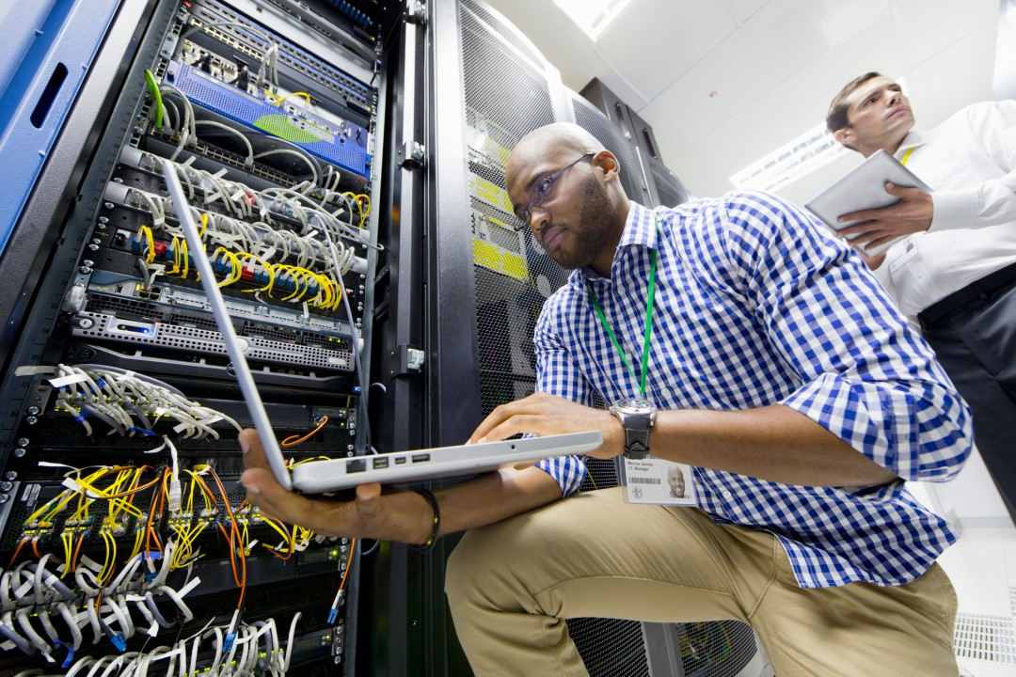
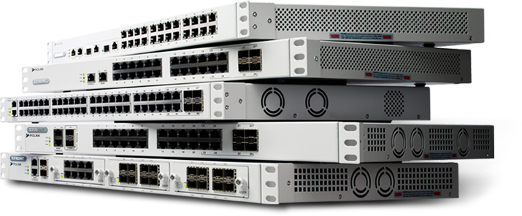
Why Change Default Settings?
It’s crucial to change the default settings on your managed switch. Default settings are often well-known and can be exploited by malicious actors. By customizing settings like passwords and management interfaces, you add an extra layer of security to your network. Think of it as changing the default lock on your front door to a more secure, unique lock that only you have the key to.
Implementing Critical Security Measures
Remember: Secure, Efficient, and Customizable
Our managed switch offers you the tools to create a secure and efficient network environment. By understanding and implementing VLANs, utilizing the features of a managed switch, and changing default settings, you can significantly enhance your network security and performance.
Martin Grobisen Unit 2, Activity 2

