Slide 1

Unit 5 Activity 1
Martin Grobisen

Slide 2

Man-in-the-Middle Attack on Wireless Network
In 2017, Equifax, a credit reporting agency, was the victim of a MITM attack due to an unpatched vulnerability in its web application framework.
This attack exposed the financial information of nearly 150 million people.

Slide 3
Man-in-the-Middle Attack on Wireless Network
Description: Attack intercepted data communication over a wireless network.
Damage: Unauthorized access to sensitive information.
Vulnerability: Unsecured Wi-Fi network.
Prevention: Use WPA3 encryption and VPNs.

Slide 4
What Equifax Could/Should Have Done:
Regularly Update and Patch Systems: Ensuring all software and frameworks are up to date with the latest security patches.
Use Strong Encryption: Implementing strong encryption protocols like WPA3 for wireless communications.
Employ Network Monitoring Tools: Utilizing tools that detect and alert for unusual network activity.

Slide 5

Wiretapping Attack on Wired Network
The National Security Agency (NSA) conducted a wiretapping program without explicit justification since 2001, focusing on metadata collection rather than message content.

Slide 6
Wiretapping Attack on Wired Network
Description: Attack targeted a wired network by wiretapping.
Damage: Eavesdropping on sensitive communications.
Vulnerability: Lack of physical security for network cables.
Prevention: Implement physical security measures and network monitoring.

Slide 7
What Could Have Been Done:
Implement Strict Oversight and Accountability: Ensuring all surveillance activities are justified and approved through proper legal channels.
Encrypt Communications: Using end-to-end encryption to protect data in transit.
Monitor for Unauthorized Access: Continuously monitoring network access and ensuring only authorized personnel can access sensitive data.

Slide 8

Denial of Service (DDoS) Attack
In 2016, the Dyn cyberattack was a major DDoS attack that took down major websites like Twitter, Netflix, and Reddit by overwhelming their servers with traffic.

Slide 9
Denial of Service (DDoS) Attack
Description: Attack overwhelmed the target with traffic, causing service disruption.
Damage: Downtime and loss of service.
Vulnerability: Insufficient network bandwidth and lack of DDoS protection.
Prevention: Use DDoS mitigation services and increase bandwidth.

Slide 10
What Dyn Could/Should Have Done:
DDoS Mitigation Services: Employing services that can detect and mitigate DDoS attacks before they impact services.
Increase Network Bandwidth: Ensuring sufficient bandwidth to handle traffic spikes.
Implement Redundancy: Setting up redundant systems to ensure continued operation even during an attack.

Slide 11

MAC Spoofing Attack
In 2014, Lenovo installed adware called Superfish on their Windows PCs, which used SSL hijacking (a form of MAC spoofing) to inject ads into users' web browsers.

Slide 12
MAC Spoofing Attack
Description: Attack used spoofed MAC addresses to gain network access.
Damage: Unauthorized network access and potential data theft.
Vulnerability: Unsecured network access controls.
Prevention: Implement MAC address filtering and monitor network access.

Slide 13
What Lenovo Could/Should Have Done:
Avoid Pre-installed Software: Not installing potentially harmful adware on devices.
Regular Security Audits: Conducting regular security audits on pre-installed software.
Educate Users: Informing users about the risks of adware and how to remove it.

Slide 14

War Driving Attack
In 2013, information was leaked about the Quantum/FoxAcid MITM system employed by the NSA to intercept TOR connections.

Slide 15
War Driving Attack
Description: Attack involved searching for unsecured wireless networks.
Damage: Unauthorized access to network resources.
Vulnerability: Unsecured wireless networks.
Prevention: Use strong encryption and hide SSIDs.

Slide 16
What NSA Could/Should Have Done:
Secured Network Configurations: Ensuring all wireless networks are properly secured with strong encryption.
Regularly Monitor Network Traffic: Continuously monitoring for unusual or unauthorized access attempts.
Physical Security Measures: Implementing strict physical security to protect network access points.

Slide 17

IoT Malware Attack
In March 2021, Verkada, a cloud-based video surveillance service, was hacked, allowing attackers to access private information and live feeds of over 150,000 cameras.

Slide 18
IoT Malware Attack
Description: Attack spread from IoT devices to other systems.
Damage: Compromised multiple devices and data breaches.
Vulnerability: Unpatched IoT devices.
Prevention: Regularly update firmware and use strong passwords.

Slide 19
What Verkada Could/Should Have Done:
Regular Firmware Updates: Ensuring all IoT devices have the latest firmware updates.
Strong Password Policies: Using strong, unique passwords for all devices.
Network Segmentation: Isolating IoT devices on separate networks to limit the spread of malware.

Slide 20
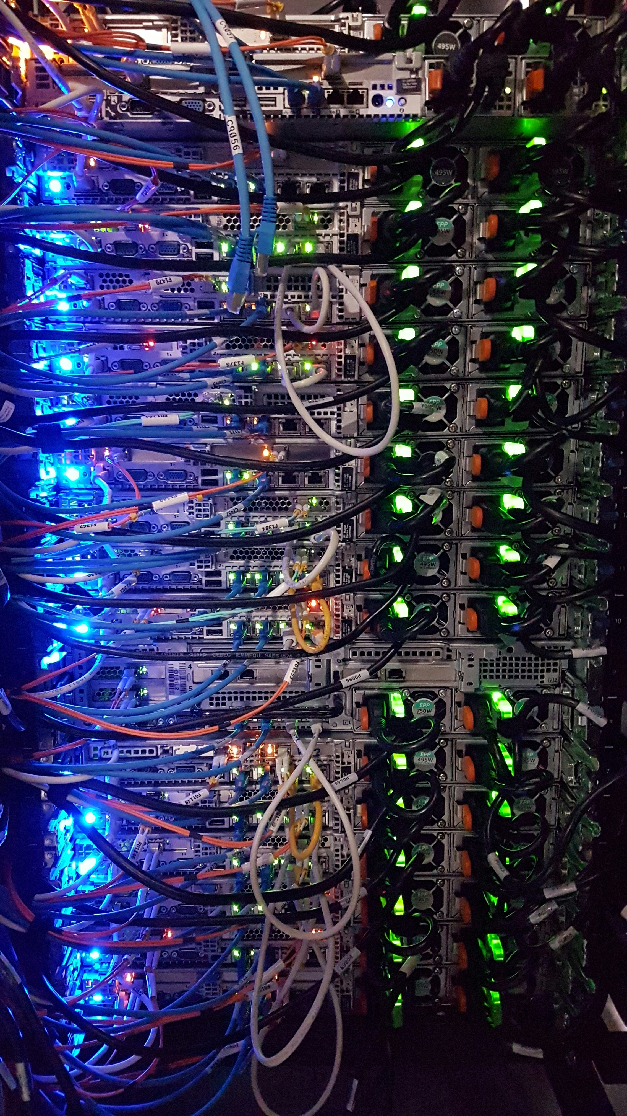
Hardware Targeted Attack
In 2013, researchers demonstrated the BadUSB attack, which involved reprogramming USB devices to act as malicious hardware.

Slide 21
Hardware Targeted Attack
Description: Attack specifically targeted hardware components.
Damage: Physical damage to devices and data loss.
Vulnerability: Lack of physical security and tamper detection.
Prevention: Implement physical security measures and tamper detection.

Slide 22
What Could Have Been Done:
Implement Tamper Detection: Using tamper-evident features on USB devices.
Secure USB Devices: Only using trusted USB devices and avoiding unknown or suspicious devices.
Educate Users: Training users on the risks associated with USB devices and safe usage practices.

Slide 23
Thank you
Martin Grobisen
813-731-5629
grobisen@gmail.com

