Slide 1

IT Security Presentation
Martin Grobisen Unit 6 Activity 1

Slide 2
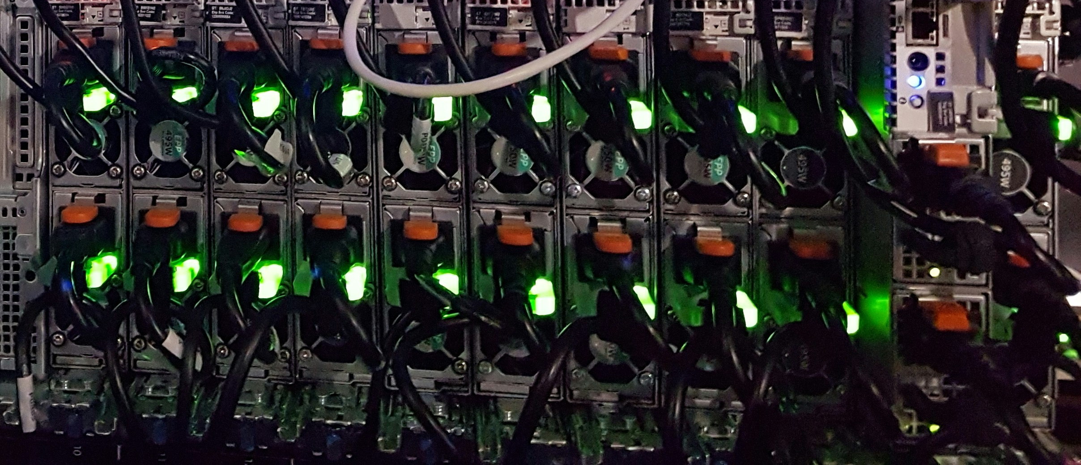
Introduction
Brief introduction to the presentation and its objectives.
Highlight the importance of network security for the company.
Explain the purpose of discussing the key components of the network.

Slide 3
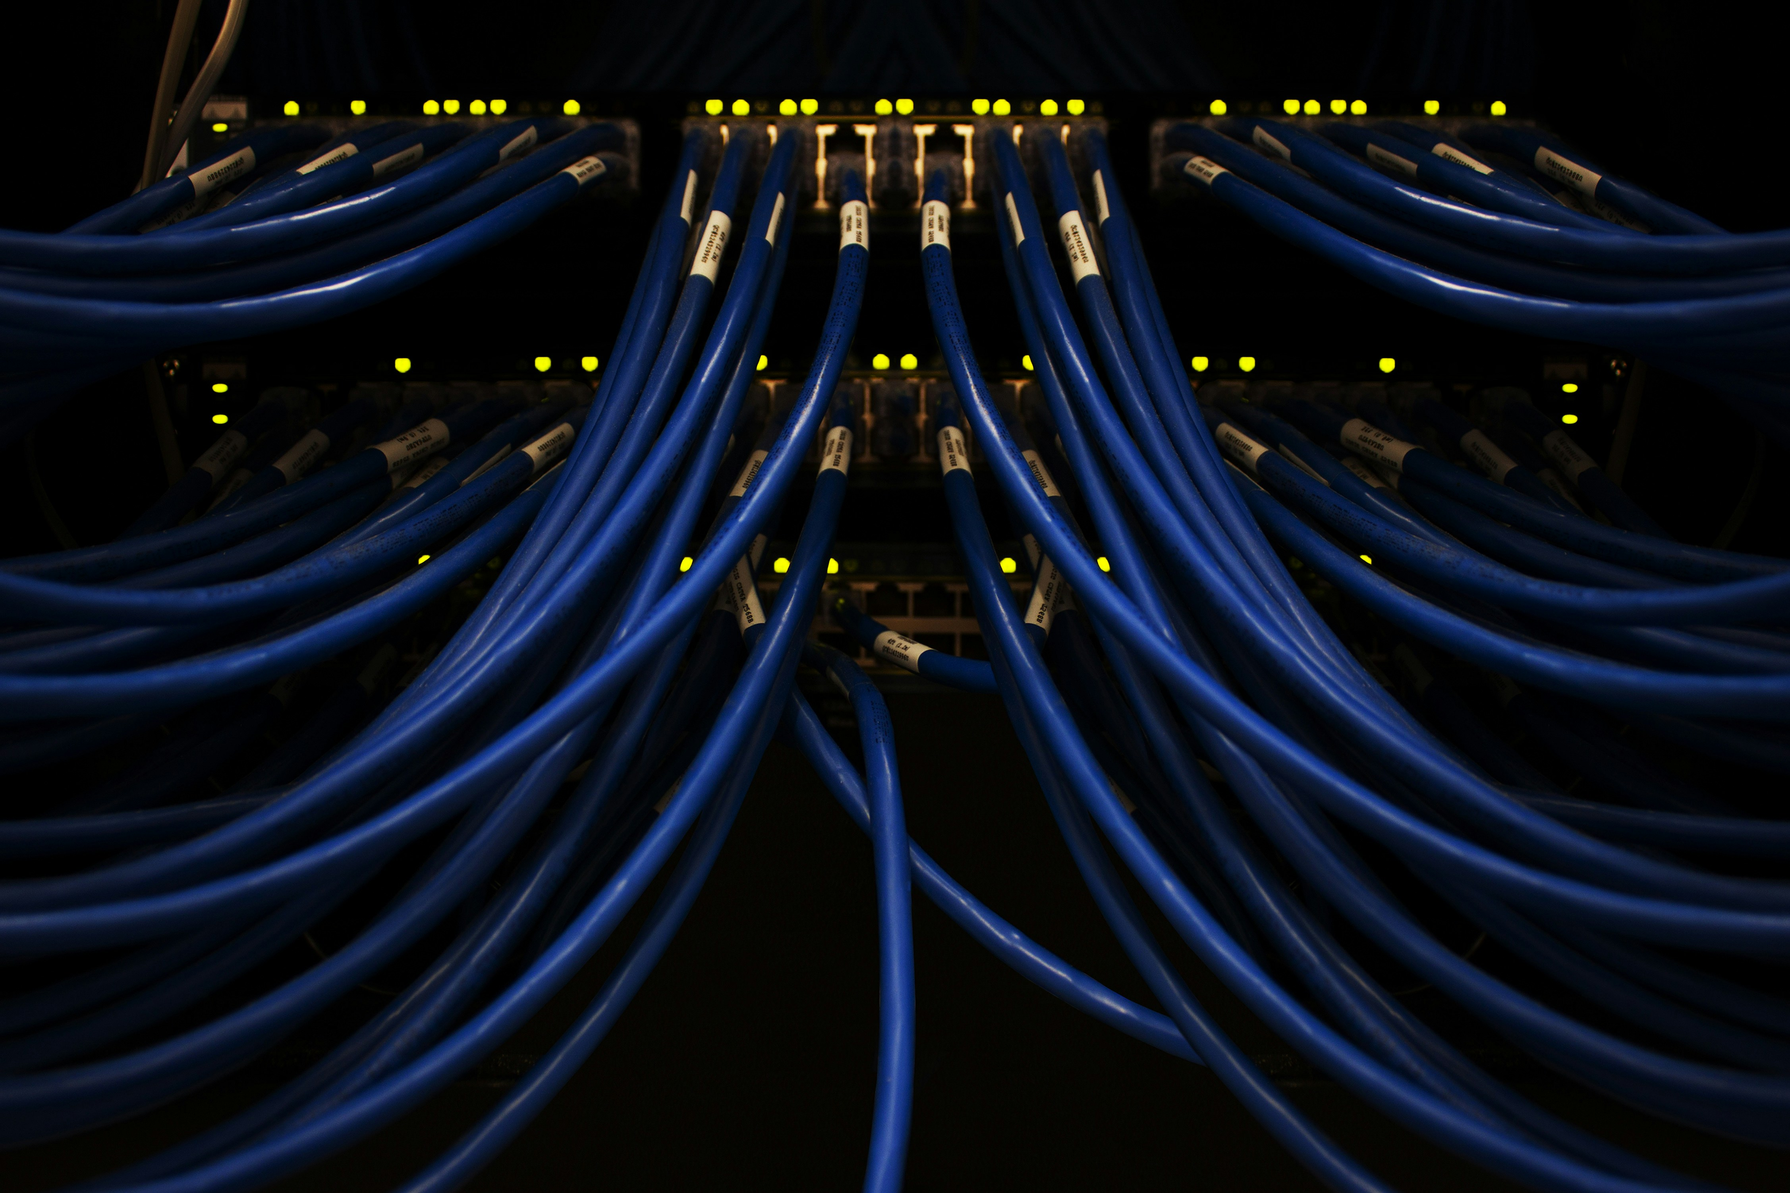
DHCP and Switch Hardware
Explanation:
DHCP (Dynamic Host Configuration Protocol): Automatically assigns IP addresses to devices on the network, simplifying network management.
Switch Hardware: Connects devices within the network, enabling communication between them.

Slide 4
DHCP and Switch Hardware
Threats:
Unauthorized DHCP servers causing IP address conflicts.
Switch vulnerabilities leading to network eavesdropping or data interception.
Target-Hardening Mechanism:
DHCP Snooping: Enables the switch to filter DHCP messages and ensure only legitimate DHCP servers can assign IP addresses.
Access Control Lists (ACLs): Implement ACLs on switches to control traffic flow and enhance security.

Slide 5

DNS
Explanation:
DNS (Domain Name System): Translates domain names into IP addresses, enabling users to access websites and online services.

Slide 6
DNS
Threats:
DNS spoofing or cache poisoning, leading to traffic redirection to malicious sites.
DDoS attacks targeting DNS servers, causing service disruption.
Target-Hardening Mechanism:
DNSSEC (DNS Security Extensions): Adds cryptographic signatures to DNS data, ensuring the authenticity and integrity of responses.
Monitoring and Logging: Continuously monitor DNS traffic and logs to detect and respond to suspicious activities.

Slide 7
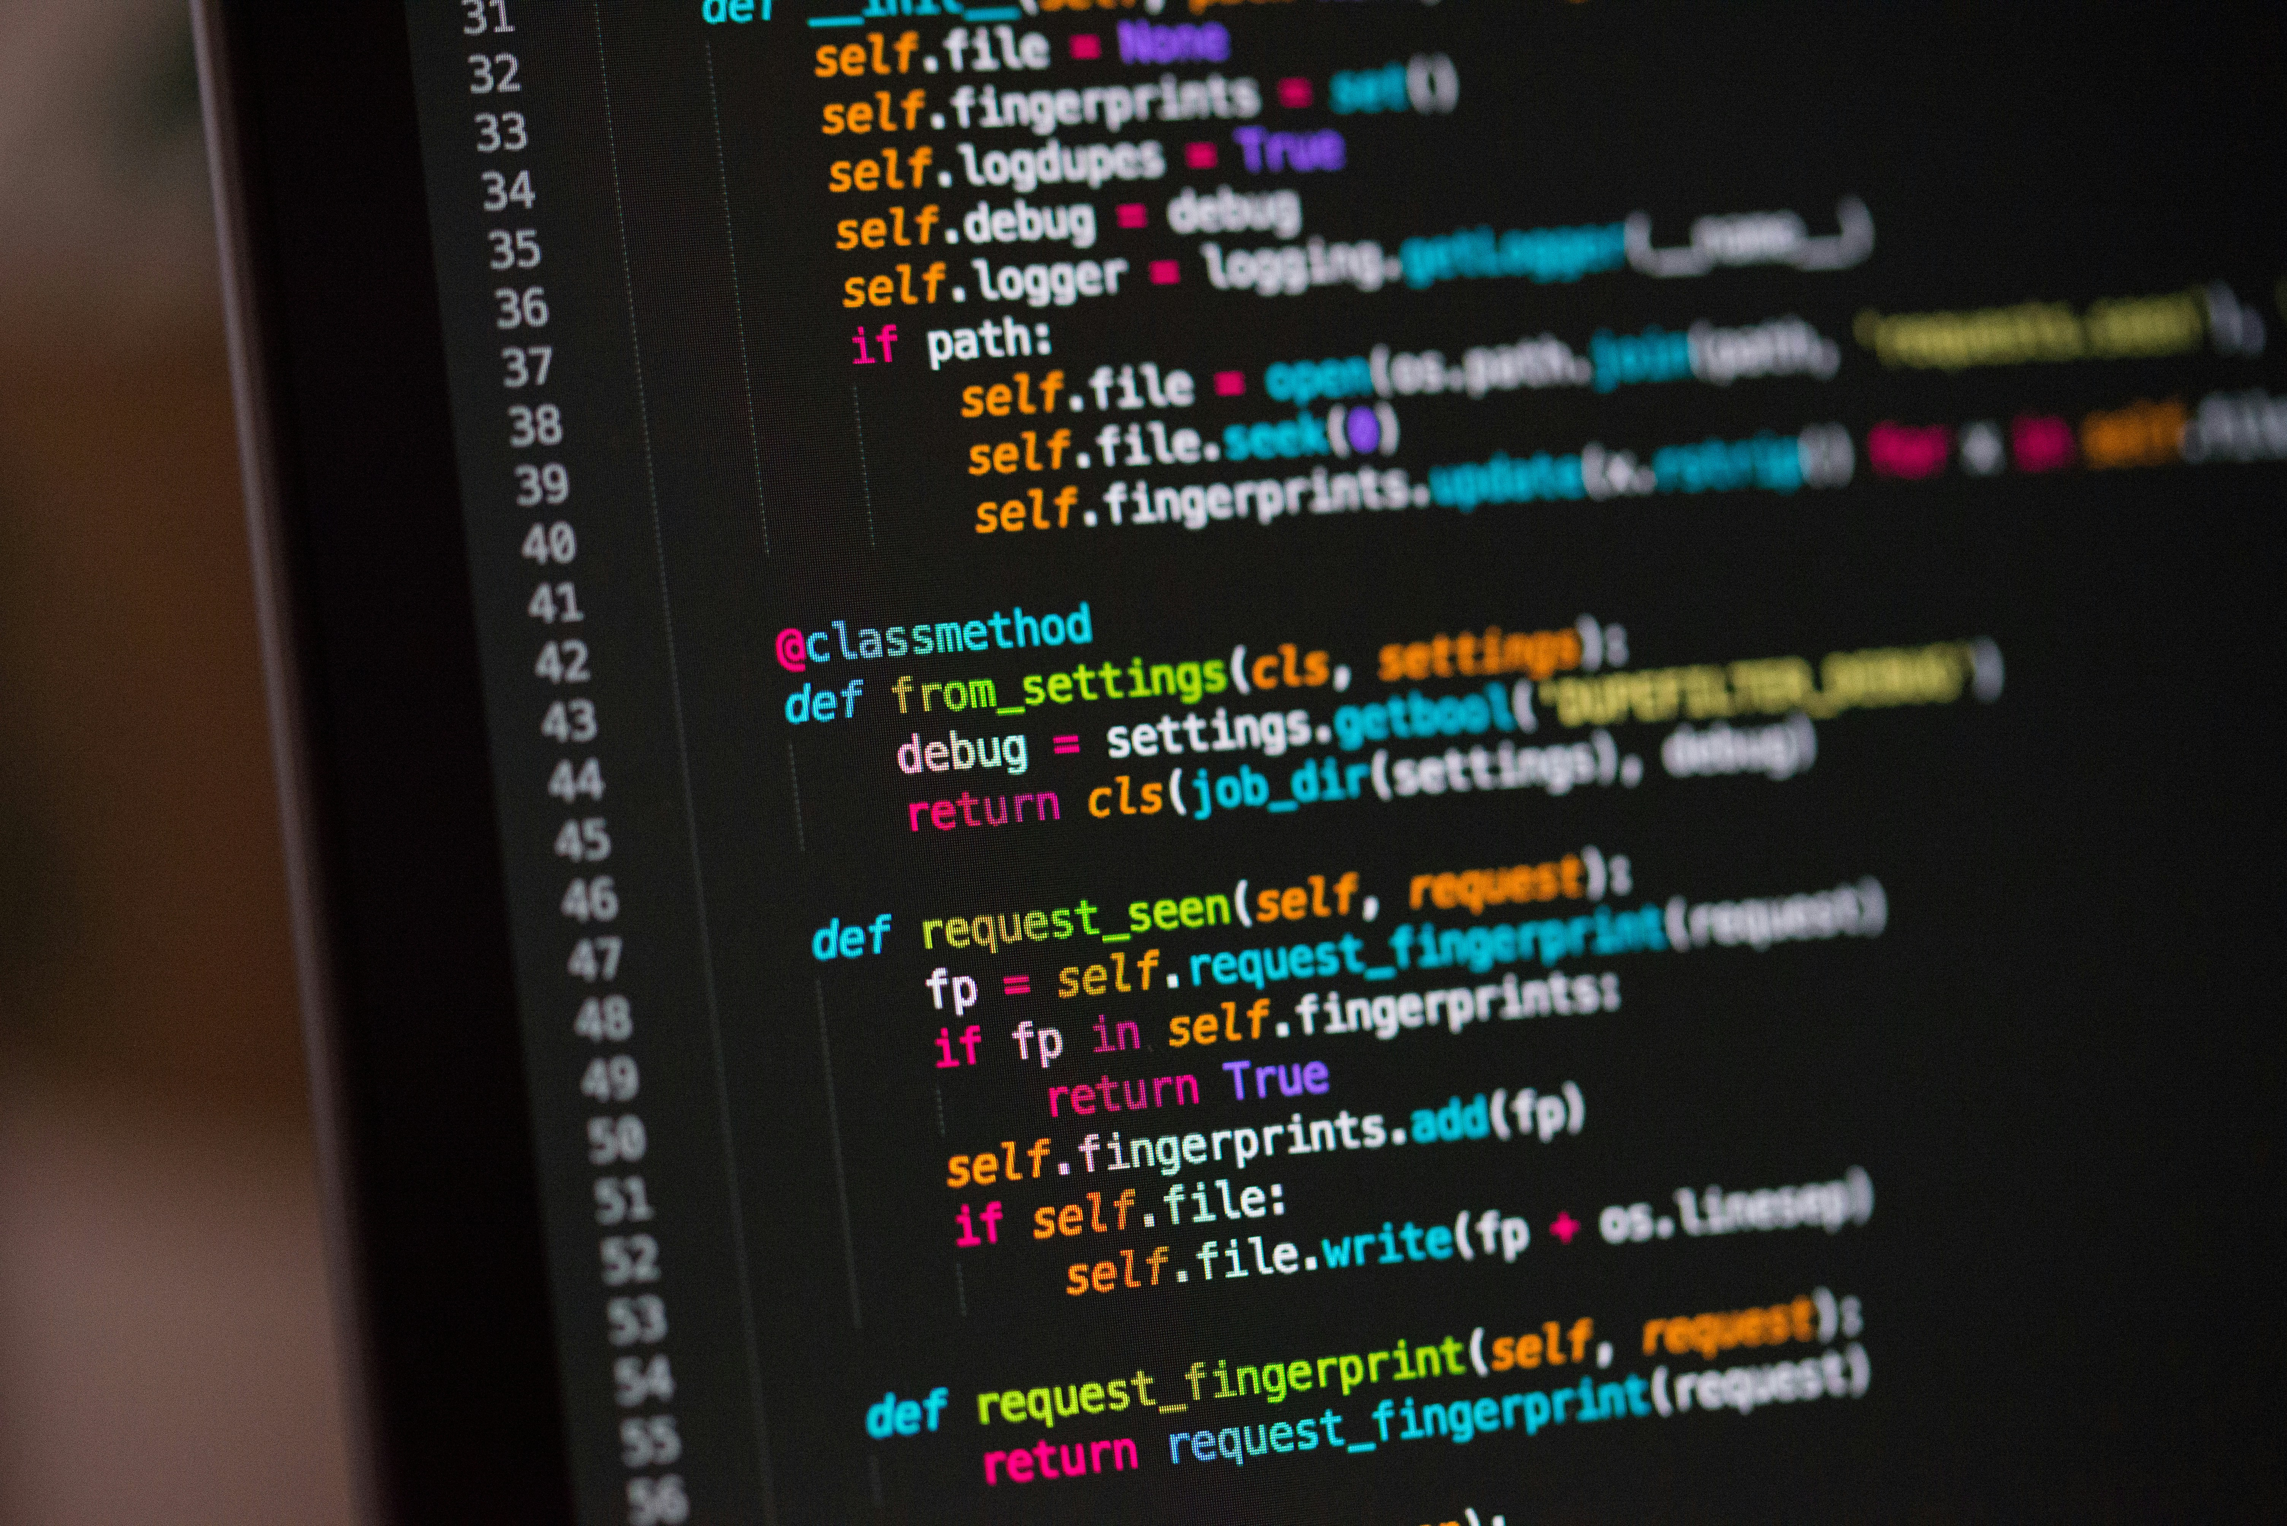
Routers
Explanation:
Routers: Direct traffic between different networks, including internal and external (internet) connections.

Slide 8
Routers
Threats:
Unauthorized access to router settings, leading to network compromise.
Routing attacks such as BGP hijacking.
Target-Hardening Mechanism:
Strong Authentication: Use strong passwords and enable multi-factor authentication for router access.
Regular Firmware Updates: Keep router firmware updated to patch known vulnerabilities.

Slide 9
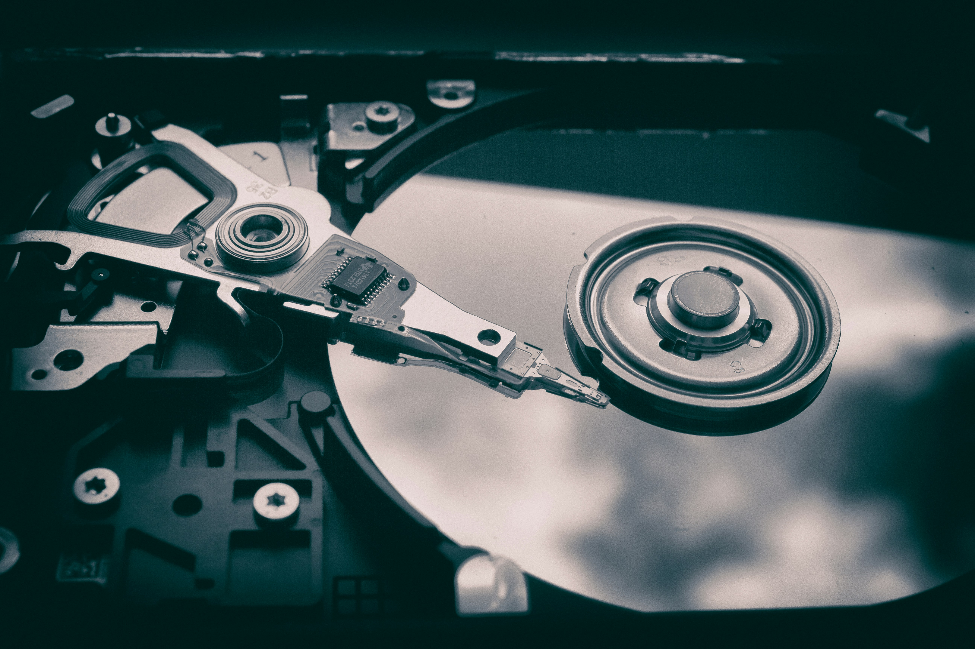
Firewalls and the DMZ
Explanation:
Firewalls: Control incoming and outgoing network traffic based on security rules.
DMZ (Demilitarized Zone): A buffer zone between the internal network and the external internet, hosting public-facing services.

Slide 10
Firewalls and the DMZ
Threats:
Firewall misconfigurations allowing unauthorized access.
DMZ vulnerabilities exposing internal network.
Target-Hardening Mechanism:
Next-Generation Firewalls (NGFW): Provide advanced threat protection, including application-layer filtering and intrusion prevention.
Regular Security Audits: Conduct regular audits to ensure firewall rules and DMZ configurations are up to date and secure.

Slide 11
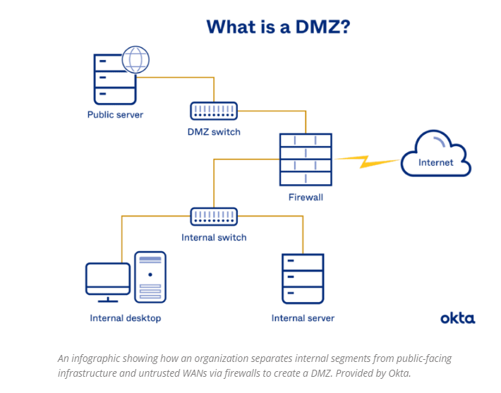
Firewalls and the DMZ
https://www.serverwatch.com/security/dmz-vs-zero-trust/

Slide 12
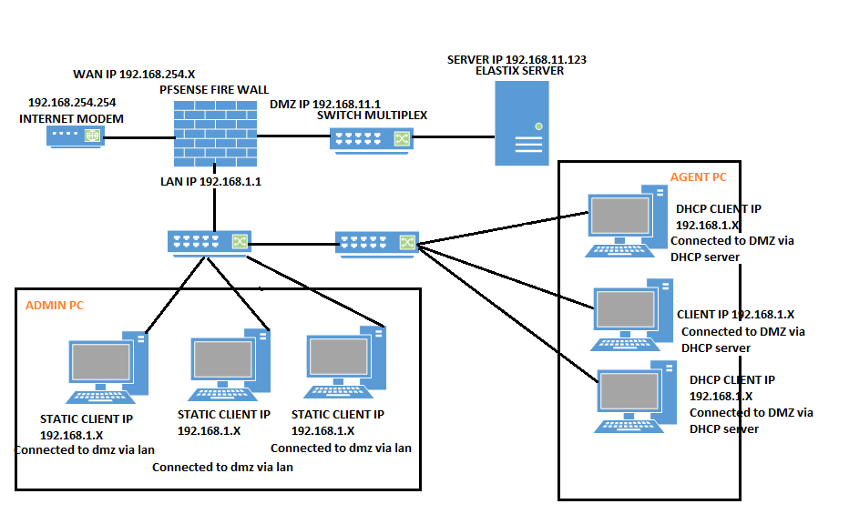
Firewalls and the DMZ
https://forum.netgate.com/topic/142301/how-to-alllow-dmz-to-lan

Slide 13

Conclusion
Recommendations:
Understand how crucial robust network security is for protecting our business operations and customer data.
Implement the key measures for each major network component: DHCP, DNS, routers, and firewalls/DMZ.
Invest in ongoing security tools and training to mitigate evolving threats.
Conduct regular security audits and updates to maintain a strong security posture.
Collaborate as a team to ensure comprehensive security.

Slide 14
Thank you
Martin Grobisen
813-731-5629
grobisen@gmail.com

