Slide 1
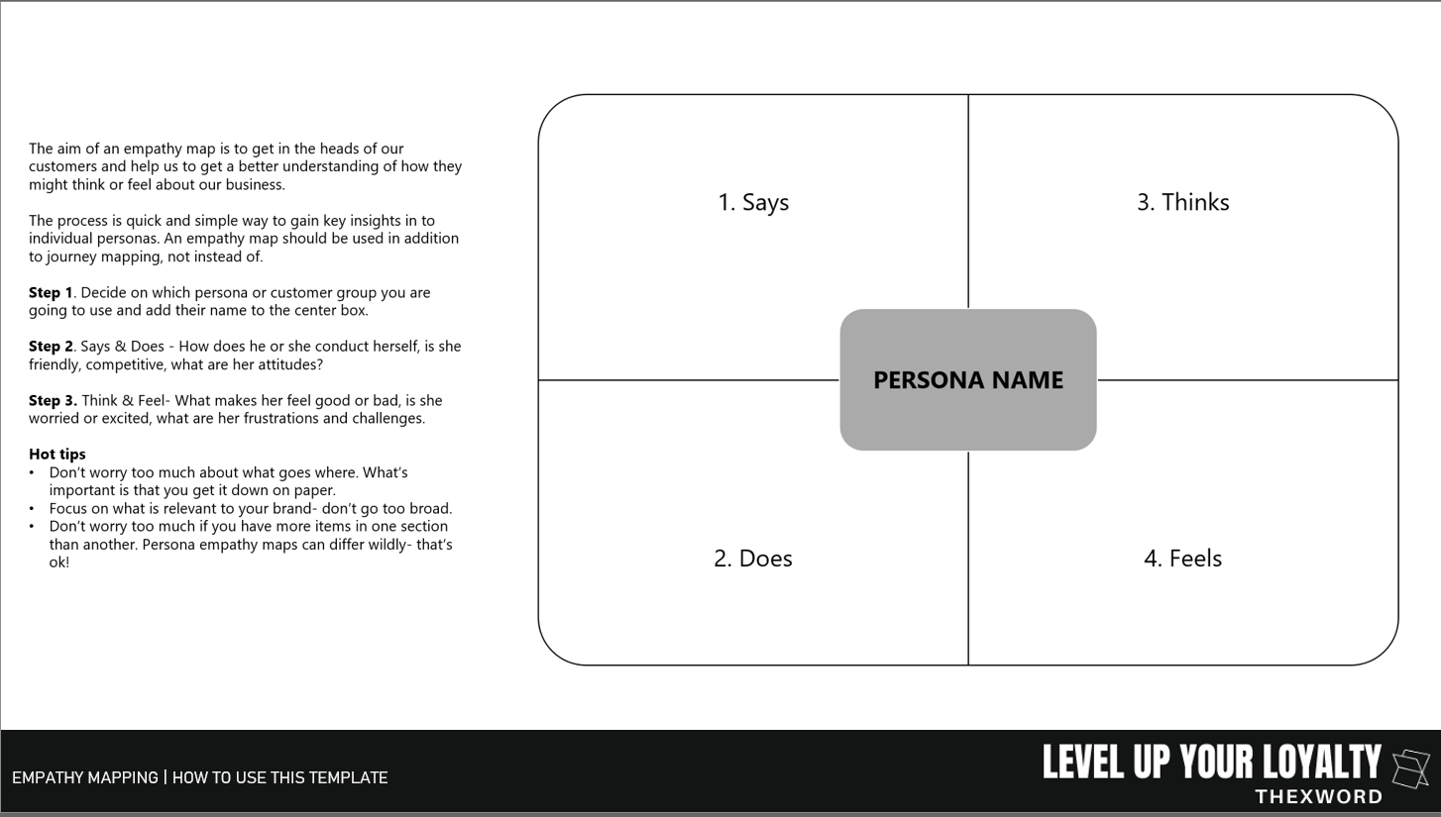

Slide 2

PERSONA NAME
1. Says
3. Thinks
2. Does
4. Feels

