Slide 1
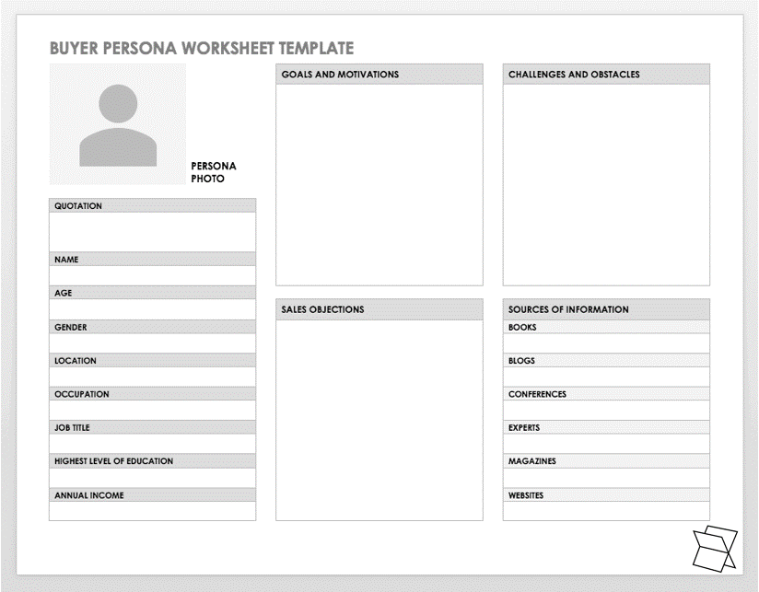
Creating personas is a process used to help more accurately design services and products, ensure more customised marketing and communication and to target more tailored solutions for customer.
Step 1. Make assumptions on a customer group based on past experiences and interactions.
Step 2. Consider items which are of immediate relevancy to your business. EG: Generally male or female, age bracket, education, attitudes, goals & values.
Step 3. Give your persona a fictional name and picture. This will help you and the team to commit it to memory
Top Tips
Use the questionnaire on the next page to help identify key features of your persona.
It’s likely you’ll have more than 1 persona but usually no more than 8. The aim of a persona is to enable accurate segmenting of your customers, acknowledging there will always be outliers.
Each persona will have its own journey map along with specific wants and needs.
This template is an example only, feel free to customize with more specific or relevant information to you and your business.
GETTING STARTED WITH PERSONAS | HOW TO USE THIS TEMPLATE
PERSONA DESIGN | HOW TO USE THIS TEMPLATE

Slide 2
CUSTOMER DEMOGRAPHICS
Age range of this customer group?
Gender or all genders?
Level of education (this will be different for different profiles)?
Career or job? Add a specific occupation or include a category, such as customer service, health care, etc.
Where do they live? City, neighbourhood, type of housing?
Household composition? Single? Married? Children? Pets? How many and how old?
Race or ethnic origin, if pertinent to product, such as certain food brands or dishes?
Other details?
CUSTOMER PSYCHOGRAPHICS
Hobbies and cultural or sports interests?
Favourite movies, websites, TV shows, magazines?
What is the obstacle that your product or service helps them overcome?
Why would a customer hesitate to try your product or business? Lack of familiarity? Travel distance?
What specific concerns would prevent a customer from returning to your business? Rude clerk? Long wait? Dirty floor?
Why would someone recommend your business?
How much do customers spend on products similar to yours? How often do they purchase such products?
Additional observations?
MARKETING DIRECTION
Which communication channels will best reach this customer profile?
Will promotions entice this customer, and, if so, what kind of promotions?
What specific channels and promotions are not suited to this customer?
What new products, services, or updates would attract this customer?
Other details?
PERSONAS

