Slide 1
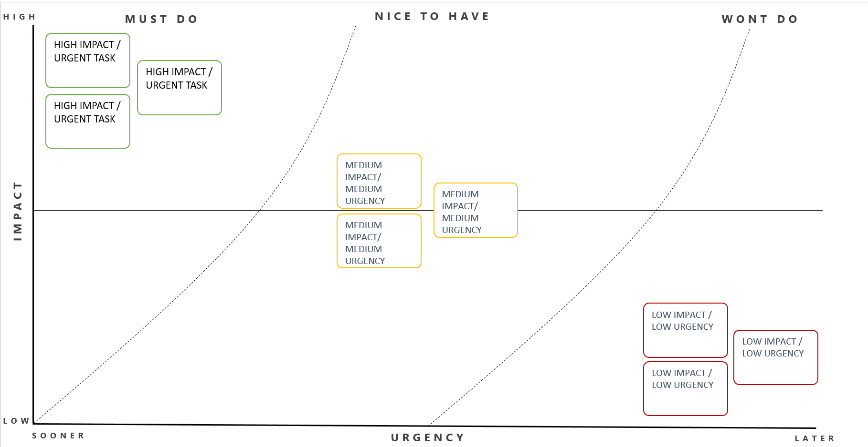
This tool will help you to prioritize the most impactful actions for your customers.
Post completion of your journey mapping consider all of the work that needs to be completed. Group any similar items together so you minimize duplication.
Separate ‘on stage’ items that affect your customers from ‘back stage’ that only affect you.
Step 1. Make that list!
Step 2. Group ‘like’ projects together
Step 3. Place all projects on the page, noting those in the top left hand corner are those to be actioned first.
Top tips
Prioritize work that affects the customer first.
Prioritize pain point resolution or improvements before looking at new opportunities. A customer will forgive one epic fail but they won’t be loyal to a brand that has consistently poor service or problems that don’t seem to be resolved.
Work through the list one project at a time. If you have a team available to you, you may wish to consider running multiple projects of work at one time but be careful not to take on too much.
IMPACT TOOL | HOW TO USE THIS TEMPLATE
IMPACT TOOL| HOW TO USE THIS TEMPLATE

Slide 2
HIGH
MUST DO
NICE TO HAVE
WONT DO
HIGH IMPACT / URGENT TASK
HIGH IMPACT / URGENT TASK
HIGH IMPACT / URGENT TASK
MEDIUM IMPACT/ MEDIUM URGENCY
MEDIUM IMPACT/ MEDIUM URGENCY
IMPACT
MEDIUM IMPACT/ MEDIUM URGENCY
LOW IMPACT / LOW URGENCY
LOW IMPACT / LOW URGENCY
LOW IMPACT / LOW URGENCY
LOW
SOONER
URGENCY
LATER

