Slide 1
Young Guns
2025-2026

Slide 2
MISSION STATEMENT
Young Guns is a non - profit organization dedicated to promoting the western lifestyle in our youth and families. We demand sportsmanship, leadership, and professionalism in our youth as well as adults. We affirmatively promote, preserve, and protect the safety of our participants, volunteers, staff, and livestock. We are dedicated in teaching cultural awareness and diversity, self-worth, and self-esteem while providing wholesome family time and entertainment.
One of our primary goals is to procure sponsorships for operating and awards costs to allow families to enjoy their time together without the burden of excessive expense. Any help with sponsors is greatly accepted.

Slide 3
2024-2025 Season
We completed our 10th year in 2024-2025 and it was a huge success. We had over 280 members for our series. Over $250,000 in prizes given away at our awards banquet, along with 12 scholarships to outgoing seniors. Young Guns was able to help the youth of our community and surrounding areas grow and improve in their horsemanship and leadership skills along with responsibility over the winter months.

Slide 4
What Young Guns brings to Dodge City
Utilize Western States Bank Expo more than any other association
Bring 200 plus families to town for 5 Weekends during “Off” Season
Youth are encouraged to help raise money for event
Give back to the community

Slide 5
What Young Guns Brings to Dodge City
Greater than 225 vehicles that need fuel
$110,000 fuel purchases
200 families that need to eat
$140,000 in meals
70-80 families need a place to stay
$45,000 in Hotel purchases
Families that shop at local business
$185,000 in “other” shopping
40% of families visit the casino during the Rodeo Weekend
Revenue to Expo through 60 RV Hook ups and 120 Stalls
$35,000

Slide 6
2025-2026 Season
4 Event weekends
October 25-26
November 22-23
January 3-4
February 7-18
FINALS 3 Days!!
February 20-22

Slide 7
What will 2025-2026Bring?
1700-1800 Entries per Weekend
250-300 Contestants each weekend
Over 850 attend awards banquet February 22, 2026
38 kids will take home 42 saddles
$250,000 in prizes awarded

Slide 8
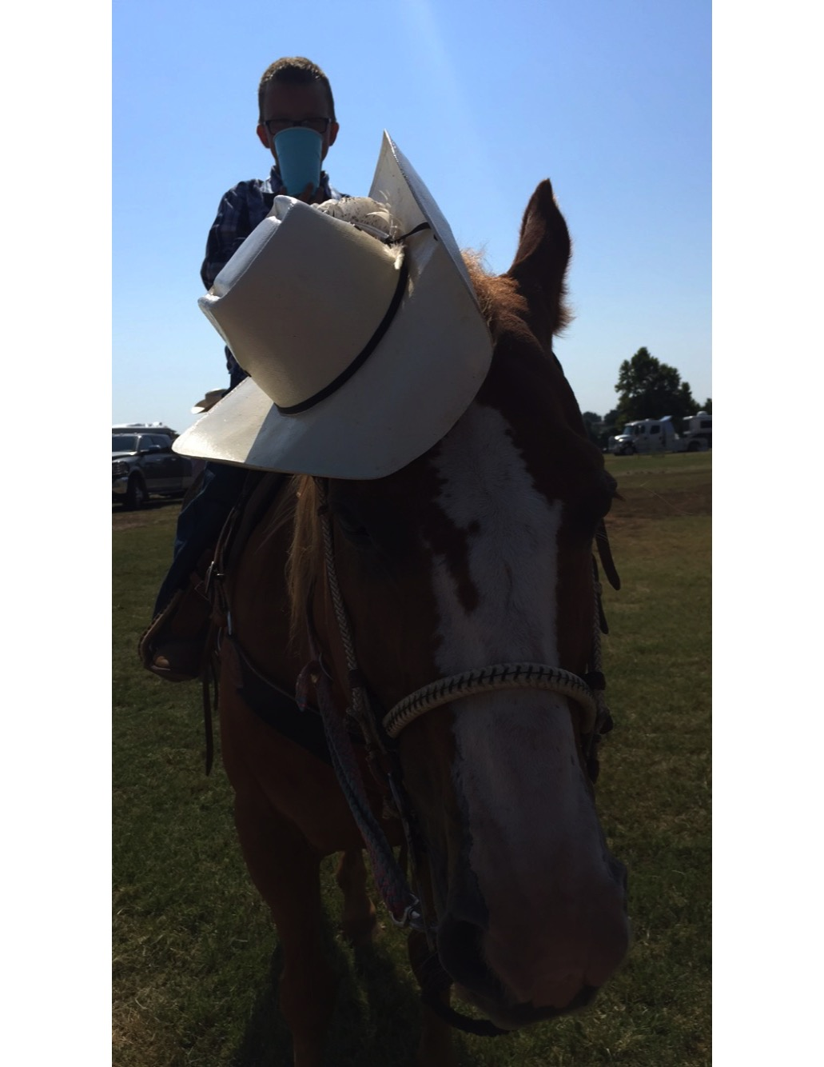
Kids and Age Groups
Young Guns draws kids from Kansas, Colorado, Oklahoma, Nebraska, Missouri, New Mexico and the Texas panhandle.
6 & Under Boys and Girls
7 – 10 Boys and Girls
11 – 14 Boys and Girls
15 – 18 Boys and Girls

Slide 9
Young Guns Events
This Rodeo Series is a Timed Event Extravaganza!
Breakaway Calf Roping
Calf Roping
Dummy Roping (6 and Under)
Steer Breakaway
Steer Wrestling
Team Roping
Goat Tying
Barrel Racing
Pole Bending

Slide 10
Winning “Cool” Awards
Young Guns wants to provide the opportunity for kids to win great awards.
Which include:
Saddles to the All Around and Event Winners
Prizes to the Average Winners and Series Event Winners
Prizes through 8th place in every event, and Finals Average Prizes through 4t^{h} place in every event.

Slide 11
Sponsorship Opportunities
Funding of Scholarship opportunity $1000-$20,000
In 2019-2020 we awarded 4 graduating seniors with a $500 scholarship.
In 2021-2022 we awarded 8 graduating seniors with a $500 scholarship
In 2022-2023 we awarded 10 graduating seniors scholarships totaling over $5500
In 2023-2024 we awarded 10 graduating seniors scholarships totaling over $5500
In 2024-2025 we awarded 13 graduating seniors scholarships totaling $6500
We would like to expand this program.
The opportunity is endless.
All outgoing seniors
All Around Winners
Event winners
Sportsmanship awards

Slide 12
Sponsorship Opportunities
Young Guns All Around Awards Sponsor
Sponsors the Young Guns Series All Around Saddle for Every Age Division.
Sponsorship Cost - $10,000
Benefits include –
Logo on Every All-Around Saddle
Logoed Banners in the Arena
PSA with message of your choice during every rodeo
Social Media recognition thru the series
Prime location for Logo on Contestant Jackets

Slide 13
Sponsorship Opportunities
Young Guns Series Champion Buckle Sponsor
Sponsorship Cost $7500
Benefits include
Logo on 1 age group of saddles
Logoed Banners in the Arena
PSA with message of your choice during every rodeo
Social Media recognition thru the series
Prime location for Logo on Contestant Jackets

Slide 14
Sponsorship Opportunities
Young Guns Age Division Sponsor
Sponsors the Series and Finals Awards for an Age Division.
Sponsorship Cost - $5000
Benefits
Logo on 1 age group of saddles
Logoed Banners in the Arena
PSA with message of your choice during every rodeo
Social Media recognition thru the series
Prime location for Logo on Contestant Jackets

Slide 15
Sponsorship Opportunities
Young Guns Finals Division Awards Sponsor
Sponsorship Cost $2500
Benefits
Logo on contestant Jacket
Banner in the Arena
Social Media Recognition
PSA at each rodeo

Slide 16
Sponsorship Opportunities
Young Guns Gold Saddle Sponsor
Sponsorship Cost $1500
Sponsor Event saddle of your choice
Benefits
Name on contestant Jacket
Banner in the Arena
Social Media Recognition
Announced during rodeo

Slide 17
Sponsorship Opportunities
Young Guns Saddle Finals Event Awards Sponsor
Sponsorship Cost $1000
Benefits
Banner in the Arena
Social Media Recognition
Announced during rodeo

Slide 18
Sponsorship Opportunities
Young Guns Bronze Sponsor
Sponsorship Cost $500
Benefits
Logo displayed in the Arena
Social Media Recognition
Announced during rodeo

Slide 19
Sponsorship Opportunities
Young Guns Community Sponsor
Sponsorship Cost up to $500
Benefits
Name on Community Banner in the Arena
Announced during rodeo

