Slide 1
West Sussex Local Government Reorganisation
19 June 2025

Slide 2
What we’ve done
21 March – initial progress update to MHCLG
All 8 Leaders meeting fortnightly
Collated all options (16)
16 April – Leader evaluation to 4
18 June – workshop on what local looks like

Slide 3
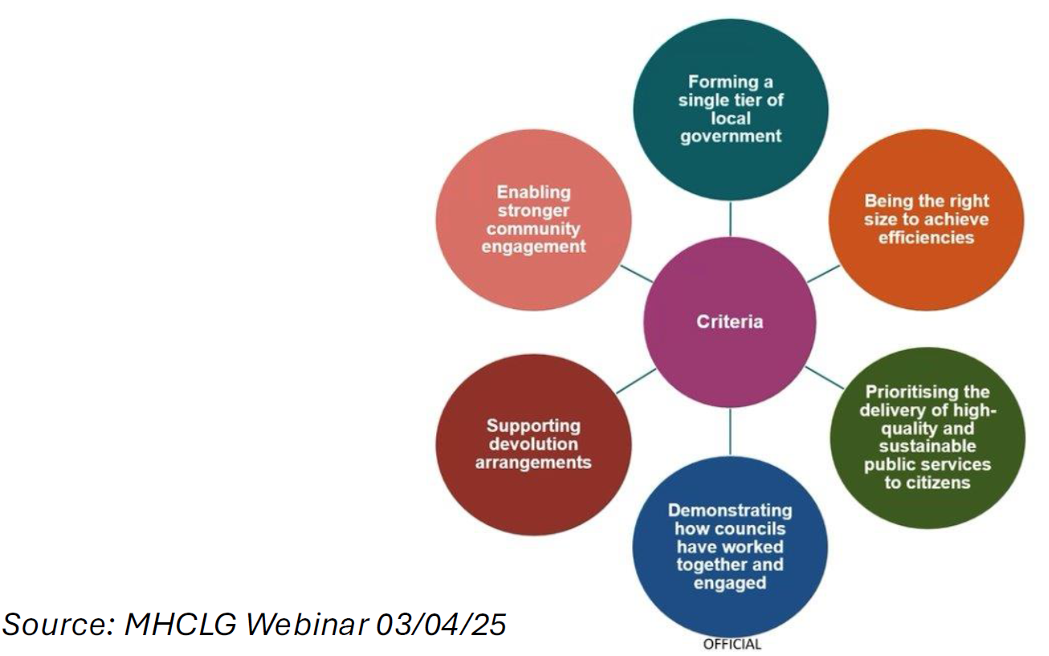
The Government’s Criteria

Slide 4
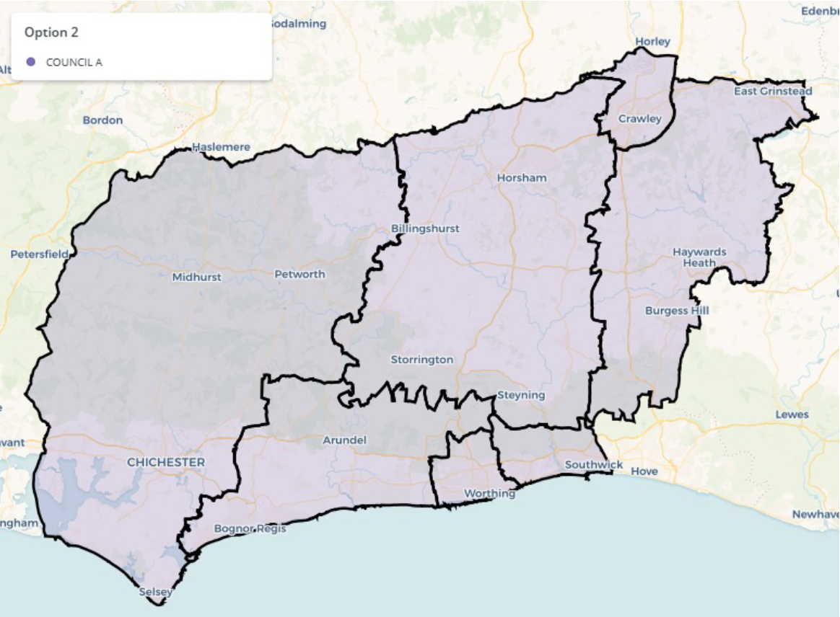
Option A: Single County Option

Slide 5
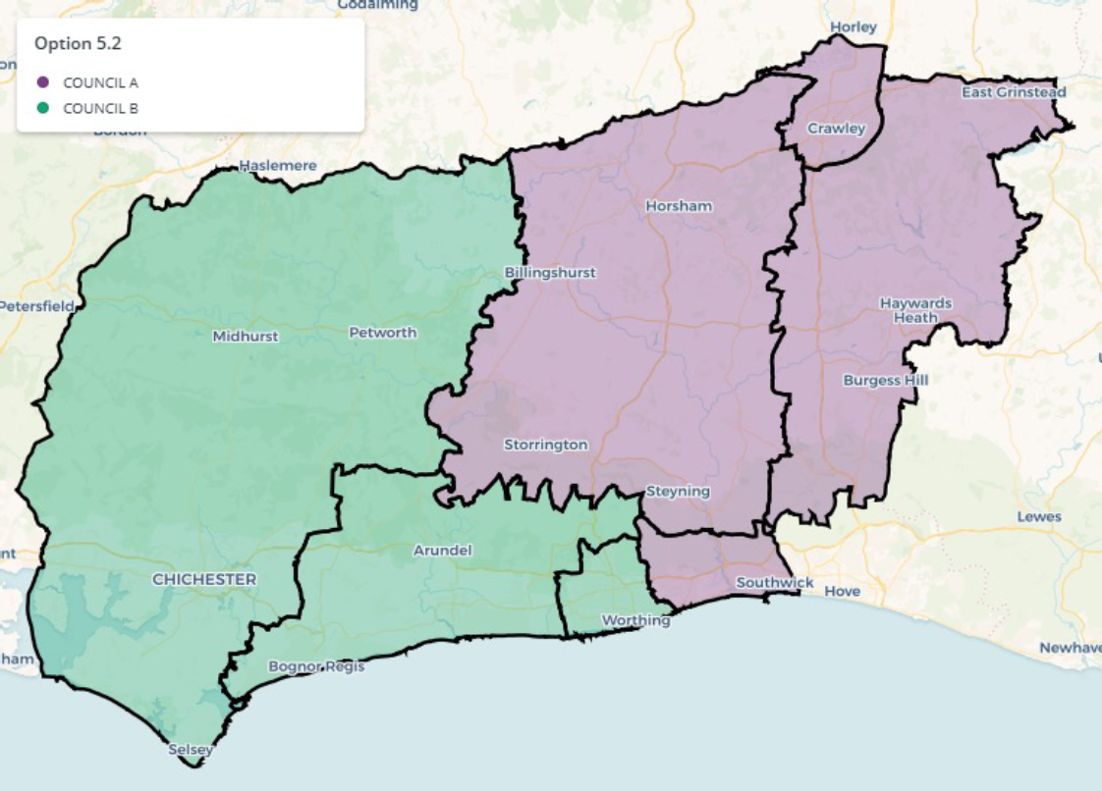
Option B: Two unitaries: east/west split

Slide 6
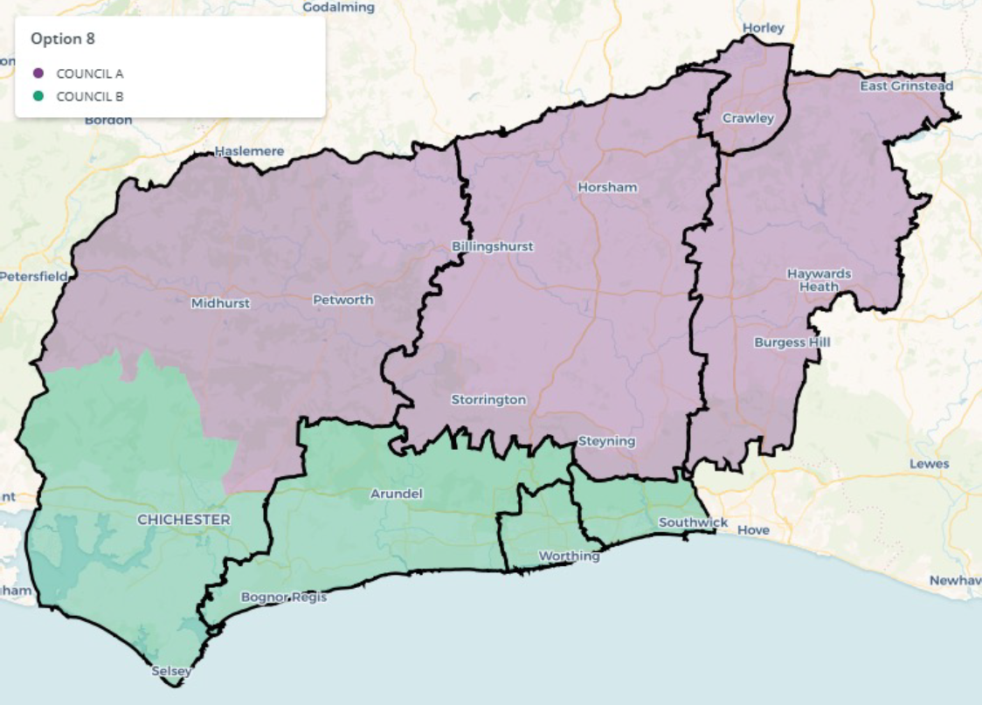
Option C: Two unitaries - north/south split

Slide 7
Option D – Adur/Worthing to Brighton & Hove

Slide 8
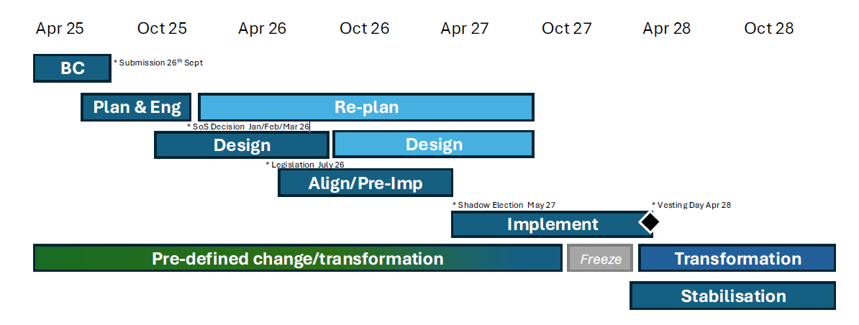
What’s next

Slide 9
Government’s reply to our 21 March update - welcomed
West Sussex councils working together
Data sharing with other councils

Slide 10
Government’s reply to our 21 March - wants
Each Council can submit a proposal for the West Sussex area only.
Proposals will only be assessed against criteria in 5 February letter.
Proposals should increase housing supply.
More information on structures to support the MSA.
If disaggregation information on mitigating impact on social care, children’s services, SEND, homelessness, Public Health.
500,000 a guiding principle not a target, all proposals to show rationale for “proposed approach”.
More information on shared data and evidence with rest of MSA area.
Why your proposal better meets criteria than others.

Slide 11
Government’s reply to our 21 March - wants
Consider efficiency alongside sense of place and local identity.
Stronger community engagement and neighbourhood empowerment.
Local decision making.
High level financial assessment, transition costs and forecast operating costs.
Assumptions.
Getting Worthing out of exceptional financial support.
Invest to save options.
How manage debt locally.

Slide 12
Government’s reply to our 21 March - answers
Brighton and Hove impacts – we should build them in.
Crawley/R&B – we explain disaggregation.
Local Government Finance Reform – spending review June.
Planning changes – don’t delay local plans and regulations in Planning and Infrastructure Bill for transitional arrangements.
English Devolution Bill – introduced when Parliamentary time allows.
Boundary changes – prefer districts as building blocks and review later but can include strong public services and financial justification.
Capacity funding – subsequently notified as £315k.

Slide 13
Role of Parishes - MHCLG
  Towns and parishes do a good job locally and hope they continue to do so
  Government wants to ensure they are part of community engagement processes
  Parishes not an alternative to consulting direct with communities
  will need strong partnership with UA because look after treasured local assets
  Existing legislation for Area Committees so Government prefers this approach
  Unitary Authorities to have good neighbourhood governance structures to be powerful community conveners but doesn’t have to include town and parish councils

Slide 14
Role of Parishes – West Sussex
West Sussex Councils 18 June Workshop on Delivering Local in a Community Context
  Strengths and weaknesses of current model
  Learning from other rural unitary areas
  What does good look like
Horsham District Council independently
  Unparished area of Horsham Town
  Community Asset Transfer Policy

