Slide 1


SSAA
Team Coordinator Meeting
2025

Slide 2

Agenda
Welcome and introductions
Your role
Uniform Pickup
Braves Night
Additional Fundraising Opportunities
Social Media

Slide 3
SSAA Contacts
President
Will Goodwin
goody812@gmail.com
Fundraising
Brian Cole
bmcole1812@gmail.com
Secretary
Carissa Goodwin
cagoodwin3528@gmail.com

Slide 4
Team Coordinator Contacts
Your Contact Info
Go to www.sharonspringsathletics.org
1.Go to Coaches & Coordinator Tab
2.Go down to Team Coordinator Link
3.Click link to complete Google Form
4.Complete for each team you’re coordinating
5.Download Braves Forms

Slide 5
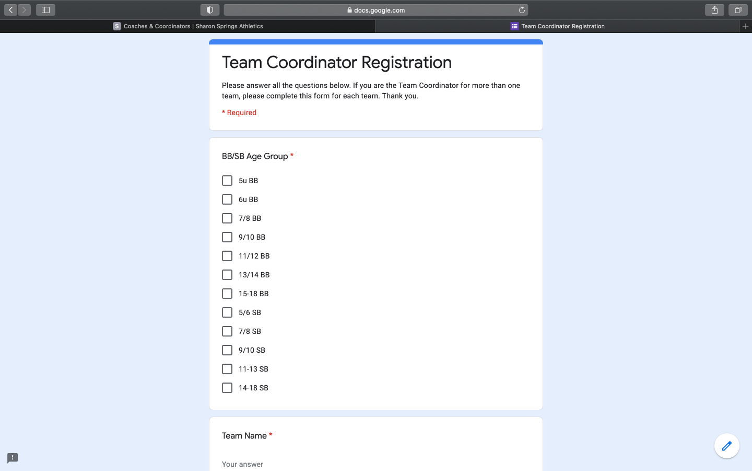
Team Coordinator Contacts

Slide 6
Your Role for the Team
•Collecting funds for the team’s expenses
•Uniform Pickup
•Snack schedules
•Trophies
•Coaches gifts
•Coordinate & Lead Engagement with Team for Fund Raising
–Braves Night
–Community Partners

Slide 7
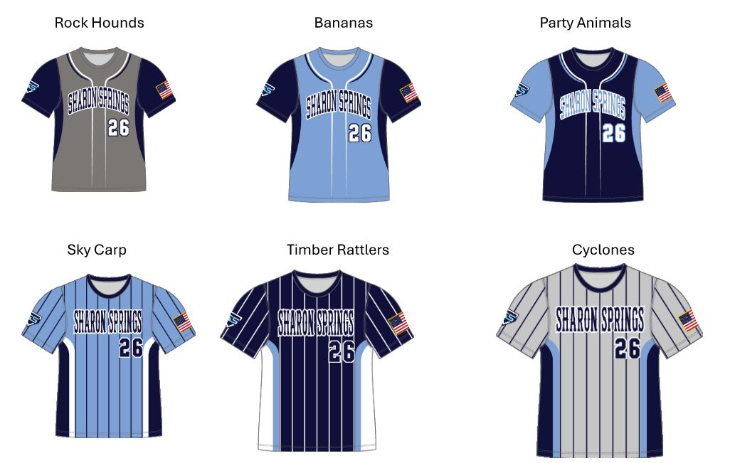
Uniforms - Baseball

Slide 8
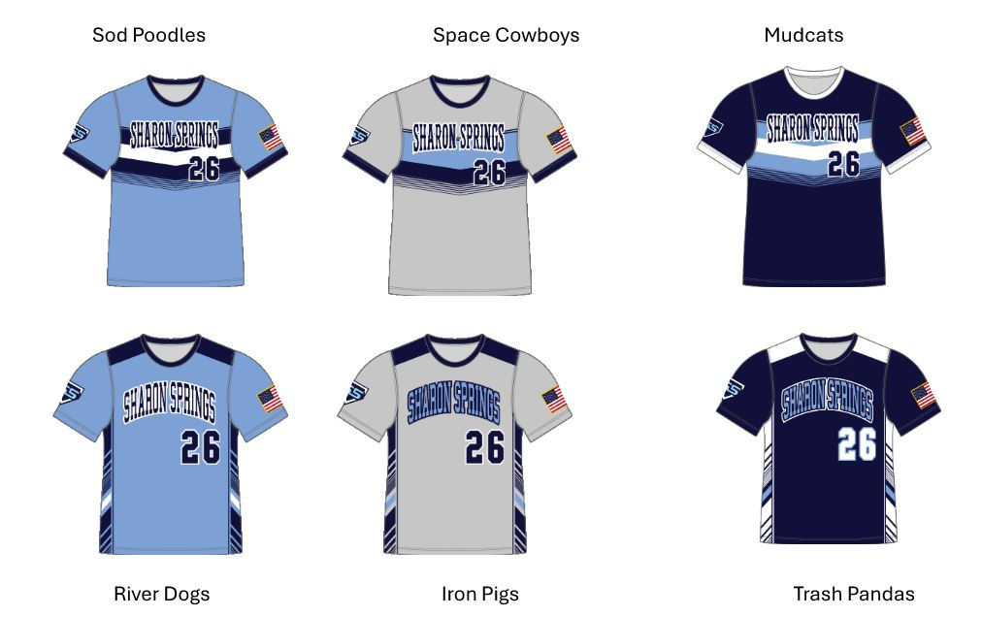
Uniforms - Baseball

Slide 9
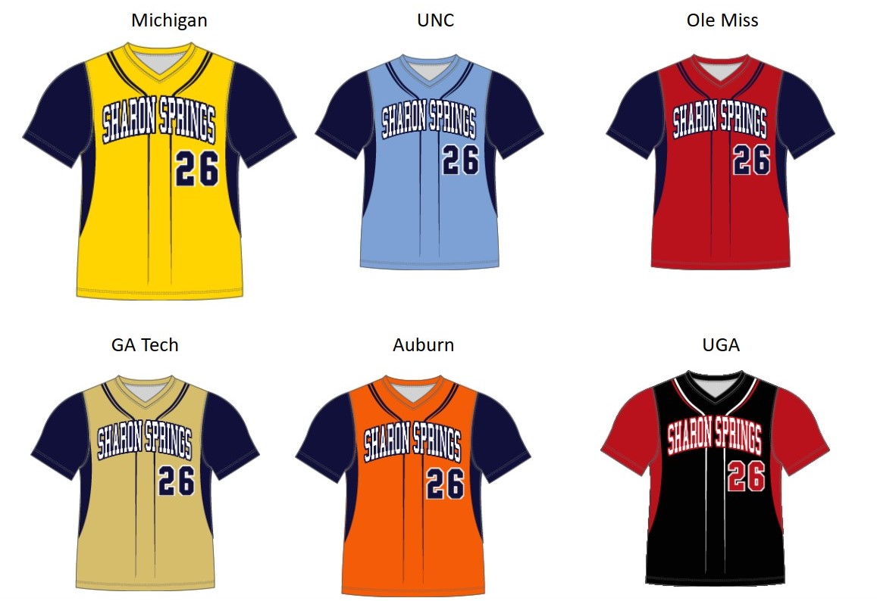
Uniforms - Softball

Slide 10
Uniforms - Key Dates
Uniform Pickup Expected 3/1/25 at Premier Image
Pant Swap Night Expected 3/6/25 at Sharon Springs Community Building

Slide 11

Braves Night
•This is our main fundraising program for field maintenance/equipment and professional services.
Last year: 530 HR porch, 252 Upper reserve and 143 parking pass sold

Slide 12
Braves Night
•Saturday 4/19/24 vs Minnesota Twins
Pregame walk around the warning track
•Ticket Prices
•Homerun Porch $62
•Grandstand Reserve: $28
•Parking (2 options) Premium: $35 Regular: $25
–Everyone needs a ticket (including infants)

Slide 13
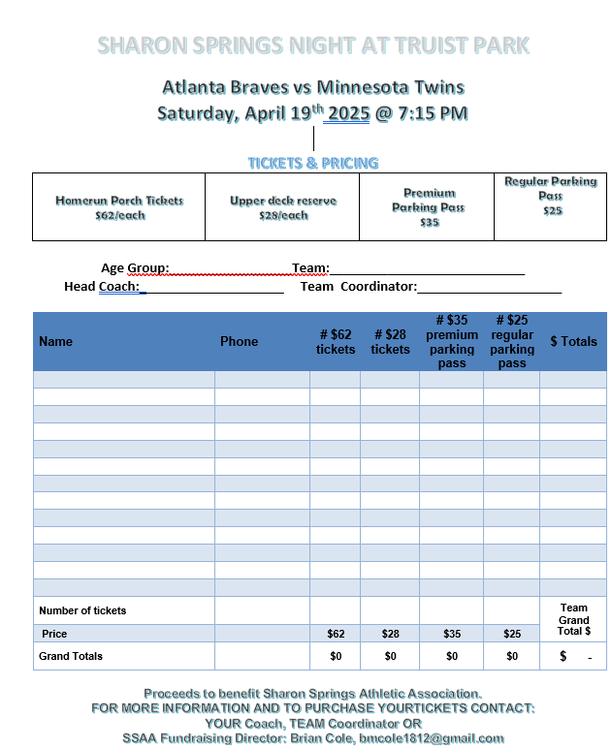
Braves Night

Slide 14
Braves Night
•Timing:
–Turn in ticket orders Tuesday 3/25, Wednesday 3/26 or Thursday 3/27 from 5:30 to 7pm
–Receive tickets - TBD
•Location:
–Upper fields (1-4) at Sharon Springs near the concession stand
•One check per team for total ticket order
–Collect each players order form
–All players ticket order forms will be submitted together
with team combined in a Manila envelope.

Slide 15

Stripers Night
Gwinnett Stripers vs. Charlotte Knights
May 16, 2025 7:05 PM EDT
Coolray Field
2500 Buford Dr, Lawrenceville, GA 30043, US
Fireworks Night
Pregame walk around the warning track
One child will throw out the first pitch (chosen at random from ticket sales)
https://fevo-enterprise.com/event/Sharonsprings5

Slide 16

Poker Night
Saturday April 26, 2025
Registration: 6:00pm
Games Start: 7:00pm
Stars and Strikes in Cumming
$50 initial buy in
Add ons available
Raffles for SS prize bundles
https://forms.gle/FxCTyDLvjuk9j2bQA

Slide 17

Movie Night
Movie Night on the Field
May 2nd (Sandlot)
Tickets $5 per person or $20 per family
Kids under 6 are free
Concessions will be available
Ticket purchase details forthcoming via email

Slide 18
Additional Fundraising
•GearUp Squad Fan Zone
https://sharonspringsbaseballfall2019.itemorder.com/shop/sale/
–SSAA gets portion of proceeds from sales
–Store closes monthly, delivery the following.
–Sales 12 months a year
Field Banners for Sponsors (3’x4’) $500 or in kind trade
Sharon Springs Nights w/ local businesses - TBD

Slide 19
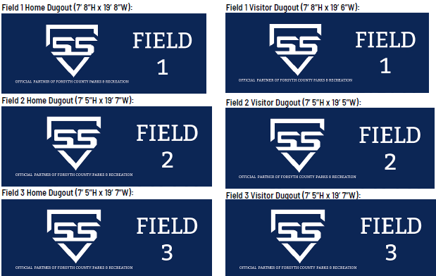
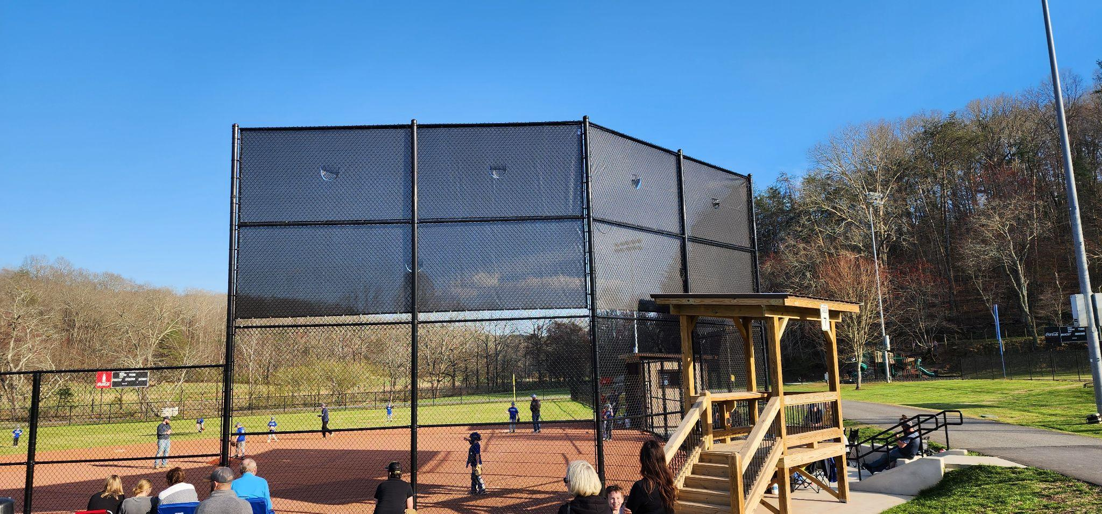
Why do we raise funds?
Ideas and suggestions welcome
bmcole1812@gmail.com
321-517-9250

Slide 20
Social Media
https://sharonspringsathletics.org/
News & Build Community Spirit
Raise Awareness & Grow Program
Thank & Build Relationships with Sponsors
Share Training and Skills Tips
Improve Communication in the Sharon Springs Family
Share Program Successes
sharonspringsathleticssocial@gmail.com
Social Media Coordinator

Slide 21
Team Coordinators
Thank You!!!

