Slide 1

Observe, Listen and Empathize

Slide 2
Map of Our Journey
Observe
Listen/Interview
Empathize
Form Insights
Plan For Action

Slide 3
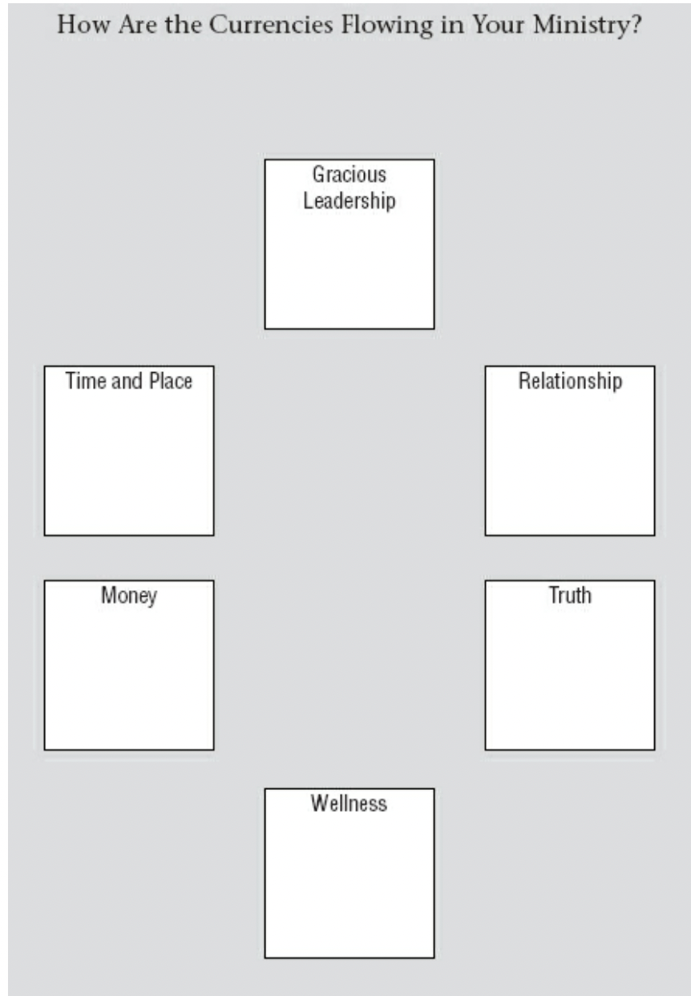
Observe
“Holy Currencies”
Eric Law

Slide 4
Observe
What are the values of this community?
What does this community really care about?
What are the gifts of this community?

Slide 5

Observe
Focus on what is there more than what it isn’t!
Be curious!
Not judgmental!

Slide 6
Observe
What activities are people engaged in?
Look for adaptations.
Look for what people care about.
Look for patterns.
Look at space and environments?
How are they helping or frustrating?
Look for unspoken messages.
Look for the unexpected.

Slide 7
Listen/Interview
Ask open-ended questions
Keep asking “why” until you get the underlying motivation behind behavior and attitudes.
“Show me”
Demonstrating and experiencing what they’re talking about is ideal
Stay broad and finish deep
Get to know them and then dig deeper into the most interesting things
Identify things that don’t match up
Not a time for corrections, challenges or refuting
Ask for clarifications
Be curious and not judgmental!

Slide 8
Empathy
Find ways to get a visceral understanding of your community and the people they serve.
This is how we center ourselves on people lest we get caught up in abstract goals and objectives.
... hence, "Human Centered" Design!

Slide 9
Empathy
Change
Change your perspective
Limit
Limit yourself
Take away some experience that the community takes for granted and observe/consider what it’s like
Engage
Engage in a similar process yourself
Could you do something similar on your own to get a sense of what it would be like to be for you to be on the receiving end of the idea?

Slide 10
Group Task (35 min.)
Break out into your team and apply this together to your project challenge!
1. Take inventory of the currencies in your church according to Eric Law’s ”Holy Currencies”.
2. Answer the “Observe” questions and try and center them according to your project challenge.
3. Choose one of the empathy exercises to better understand the people that you are serving in this project challenge.

Slide 11
Group Task
Share with the whole group:
Share what the two “highest currencies” are in your church and what are the two “lowest currencies”.
Share your top 3 observations.
Share one of your most interesting empathy findings.

Slide 12
Questions and Reflctions

