Slide 1
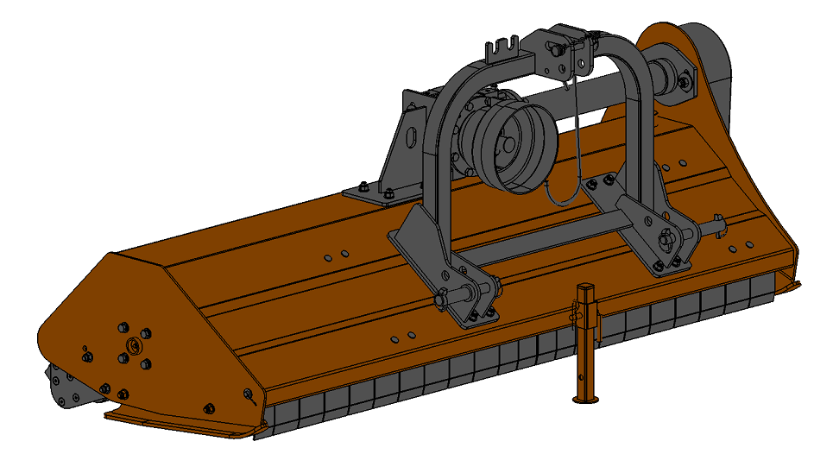
Operator's Manual
Flail Mowers
EF125-155-175-S
EFH155-175-S
3250200703 Rev.1.0
Read the Operator’s Manual entirely. When you
see this symbol, the subsequent instructions
and warnings are serious - follow without
exception your life and the lives of others depend on it!

Slide 2
Table of Contents
Important Safety Information . . . . . . . . . . . . . 1
Safety at All Times . . . . . . . . . . . . . . . . . . . . . . 1
Look For The Safety Alert Symbol . . . . . . . . . .1
Safety labels . . . . . . . . . . . . . . . . . . . . . . . . . . .4
Introduction . . . . . . . . . . . . . . . . . . . . . . . . . . . 7
Application . . . . . . . . . . . . . . . . . . . . . . . . . . . . 7
Using This Manual . . . . . . . . . . . . . . . . . . . . . . 7
Terminology . . . . . . . . . . . . . . . . . . . . . . . . . . . 7
Definitions . . . . . . . . . . . . . . . . . . . . . . . . . . . . .7
Owner Assistance . . . . . . . . . . . . . . . . . . . . . . .7
Serial Number . . . . . . . . . . . . . . . . . . . . . . . . . 7
Further Assistance . . . . . . . . . . . . . . . . . . . . . . 8
Section 1: Assembly & Set-up . . . . . . . . . . . . . 9
Torque Requirements . . . . . . . . . . . . . . . . . . . 9
Hitch Assembly . . . . . . . . . . . . . . . . . . . . . . . . .9
Tractor Requirements . . . . . . . . . . . . . . . . . . 10
Tractor Hook-Up . . . . . . . . . . . . . . . . . . . . . . .10
Driveline Installation . . . . . . . . . . . . . . . . . . . 10
Check Driveline Collapsible Length . . . . . . . .11
Shorten Driveline Length . . . . . . . . . . . . . . . .11
Check Driveline Extended Length . . . . . . . . .12
Check Driveline Interference . . . . . . . . . . . . .12
Section 2: Operating Instructions . . . . . . . . . .13
Pre-Start Checklist . . . . . . . . . . . . . . . . . . . . . 13
Tractor Shut Down Procedure . . . . . . . . . . . .13
Transporting . . . . . . . . . . . . . . . . . . . . . . . . . . 13
Safety Information . . . . . . . . . . . . . . . . . . . . . 13
working Instructions . . . . . . . . . . . . . . . . . . . .14
Operating Instructions . . . . . . . . . . . . . . . . . . 14
General Operating Instructions . . . . . . . . . . . 15
Section 3: Adjustments . . . . . . . . . . . . . . . . . . . . 16
Leveling the Mowers . . . . . . . . . . . . . . . . . . . . . 16
Crushing Height Adjustment . . . . . . . . . . . . . . . .16
Belt Tension Adjustment . . . . . . . . . . . . . . . . . . 16
Rotor Blade Replacement . . . . . . . . . . . . . . . . 17
Section 4: Maintenance & Lubrication . . . . . . . . . . . . 18
Storage. . . . . . . . . . . . . . . . . . . . . . . . . .. . . . . . ..18
Lubrication Points . . . . . . . . . . . . . . . . . . . . . . . .19
Section 5: Features & Benefits. . . . . . . . . . . . . . 21
Section 6 : detailed parameters. . . . . . . . . . . . . . 22
Section 7 ：Part List. . . . . . . . . . . . . . . . . . . . . . . 23
Section 8 ：Wearing parts list. . . . . . . . . . . . . . 41
Section 9 ：Troubleshooting . . . . . . . . . . . . . . . 42
Section 10: Torque Values Chart . . . . . . . . . . . . 43
Section 11: Warranty . . . . . . . . . . . . . . . . . . . . . . 44
© Copyright 2020 All rights Reserved
We provides this publication “as is” without warranty of any kind, either expressed or implied. While every precaution has been taken in the
preparation of this manual, We assumes no responsibility for errors or omissions. Neither is any liability assumed for damages resulting from the use
of the information contained herein. We reserves the right to revise and improve its products as it sees fit. This publication describes the state of this
product at the time of its publication, and may not reflect the product in the future.

Slide 3
Important Safety Information
1

Slide 4
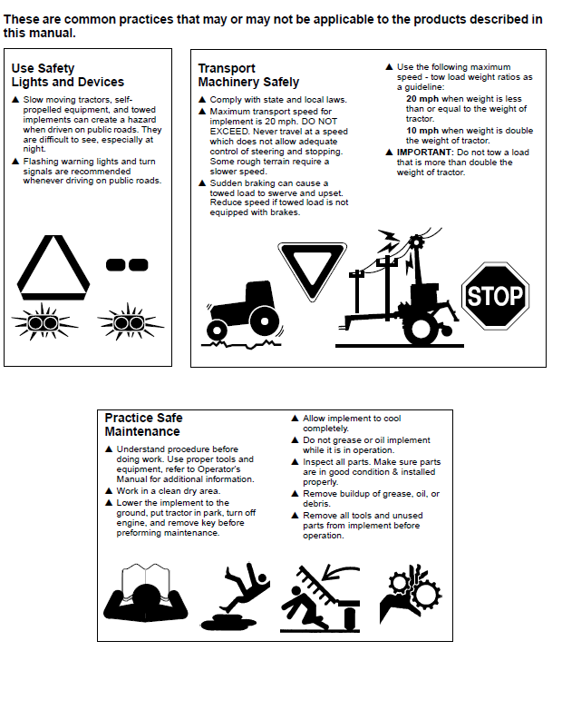
Important Safety Information
2

Slide 5
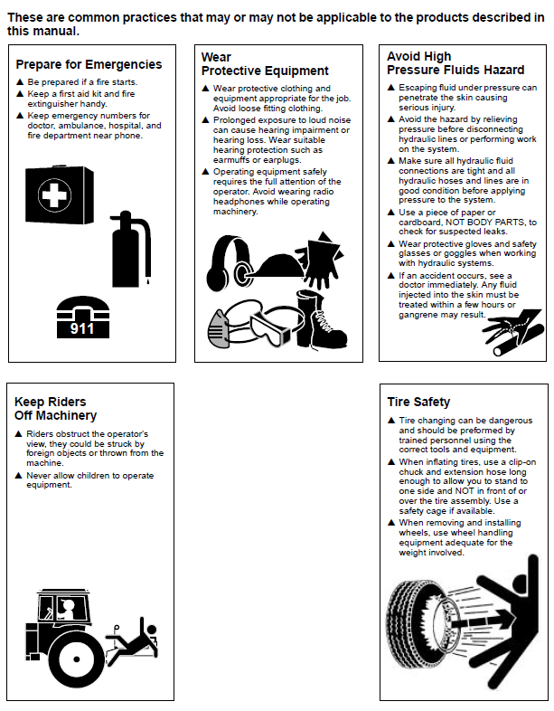
Important Safety Information
3

Slide 6
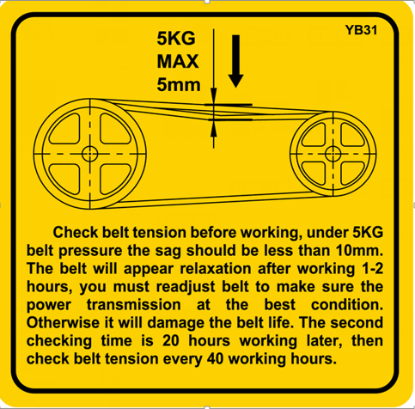
Important Safety Information
Safety labels
Your Flail Mower comes equipped with all safety labels in place. They were designed to help you safety operate your implement. Read and follow the directions.
1. Refer to this section for proper label placement.
Replace all damaged or missing labels. Order new labels
from your nearest dealer.
2. Some new equipment installed during repair requires safety labels to be affixed to the replaced component as specified by Mateng .When ordering new components
make sure the correct safety labels are included in the
request.
3. Refer to this section for proper label placement.
To install new labels:
a. Clean the area the label is to be placed.
b. Spray soapy water on the surface where the label is to
be placed.
c. Peel backing from label. Press firmly onto the surface.
d. Squeeze out air bubbles with the edge of a credit card
or with a similar type straight edge.
4

Slide 7
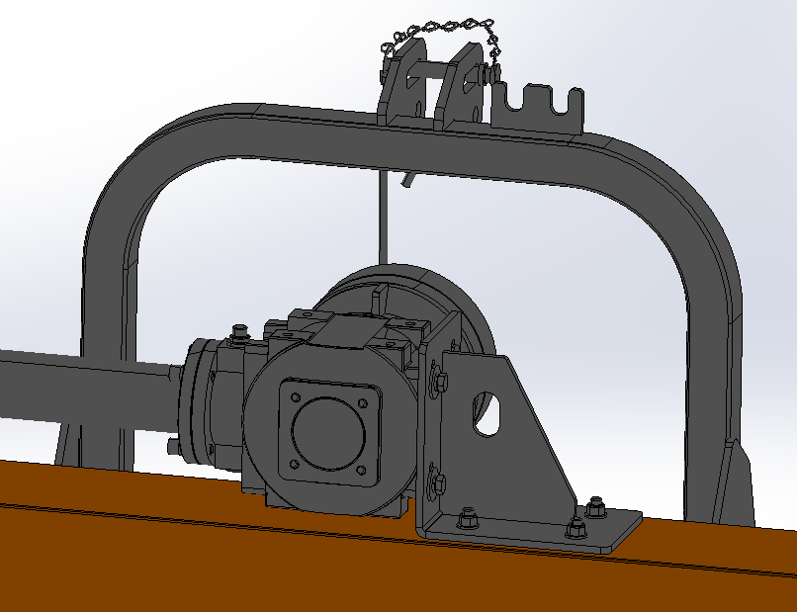
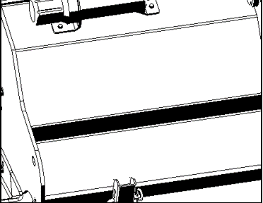
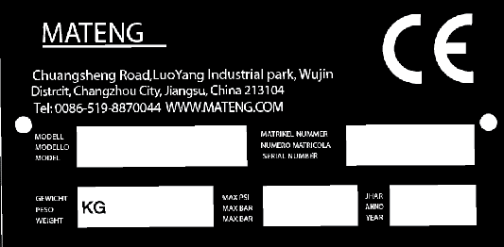
Important Safety Information
The lifting hook
Nameplate
5

Slide 8
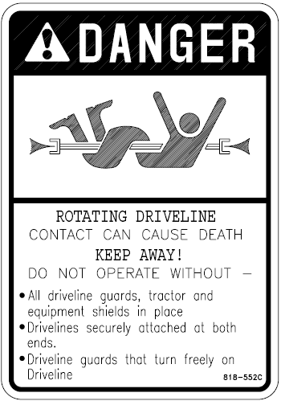
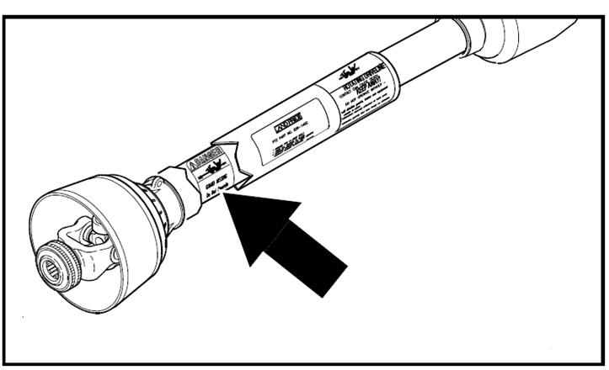
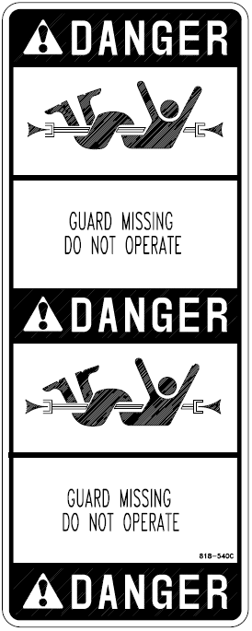
Important Safety Information
Danger: Rotating Driveline
Danger: Guard Missing
6

Slide 9
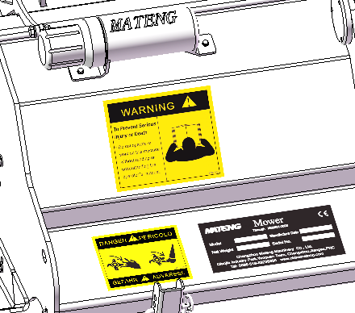
Important Safety Information
Introduction
Terminology
“Right” or “Left” as used in this manual is determined by facing the direction the machine will operate when used unless otherwise stated.
We welcomes you to the growing family of new product owners.
This Flail Mower has been designed with care and built by skilled workers using quality materials. Proper assembly, maintenance, and safe operating practices will help you get years of satisfactory use from this machine.
Application
The Heavy duty L.TRE Series Flail Mowers are
designed and built to provide excellent cutting performance on gently sloping or slightly contoured right-of ways,
roadsides, ditches, pastures, nurseries, and smaller fields of row crop debris, stalks, and residual agricultural growth.
KM series has 5 models available: 1250mm, 1550mm, 1750mm, cutting width, cutting angle, displacement, three point suspension, equipped with a 50HP to 70HP tractor. Specially designed for cutting orchard, on both sides of highway slope, ditch.
Definitions
IMPORTANT: A special point of information related
to the following topic. MATENG’s intention is this
information must be read & noted before continuing.
NOTE: A special point of information that the
operator should be aware of before continuing.
Owner Assistance
The Online Warranty Registration or Warranty
Registration card should be completed by the dealer at the time of purchase. This information is to necessary provide you with quality customer service.
The parts on your Flail Mower have been specially
designed by and should only be replaced with genuine parts. Contact a MATENG dealer if customer service or repair parts are required. Your dealer has trained personnel, repair parts, and equipment needed to service the implement.
All models equipped with fine cutting knives will perform extremely well cutting material up to 1” in diameter or provide a very respectable quality o cut for grooming yards, municipal parks, medians, and right of ways.
All models also can be equipped with forged hammer knives and heavy duty brush rake teeth to make them well suited for nursery and agricultural applications where heavy grass, brush, pruning, saplings, small stumps, corn stocks, and other row crop debris are present. The rake teeth will gather and aggressively force material into the rotor hammer knives for a more complete pulverization.
Serial Number
Model No. ________ Serial No. _________
For quick reference and prompt service, record model
and serial number in the spaces provided above and
again on warranty page 44. Always provide model and
serial number when ordering parts and in all
correspondences with your dealer. Refer to Figure 1 for location of your serial number plate.
Using This Manual
• This Operator’s Manual is designed to help familiarize
you with safety, assembly, operation, adjustments,
troubleshooting, and maintenance. Read this manual
and follow the recommendations to help ensure safe
and efficient operation.
• The information contained within this manual was
current at the time of printing. Some parts may change
slightly to assure you of the best performance.
Serial Number Plate Location
Figure 1
7

Slide 10
Important Safety Information
Further Assistance
Your dealer wants you to be satisfied with your new Mowers.
If for any reason you do not understand any part
of this manual or are not satisfied with the service
received, the following actions are suggested:
1. Discuss the matter with your dealership service
manager making sure that person is aware of any
problems you may have and has had the opportunity
to assist you.
2. If you are still not satisfied, seek out the owner or
general manager of the dealership, explain the
problem, and request assistance.
8

Slide 11
Section 1: Assembly & Set-up
Torque Requirements
Refer to “Torque Values Chart for Common Bolt Sizes”
on page 43 to determine correct torque values when
tightening hardware.
9

Slide 12
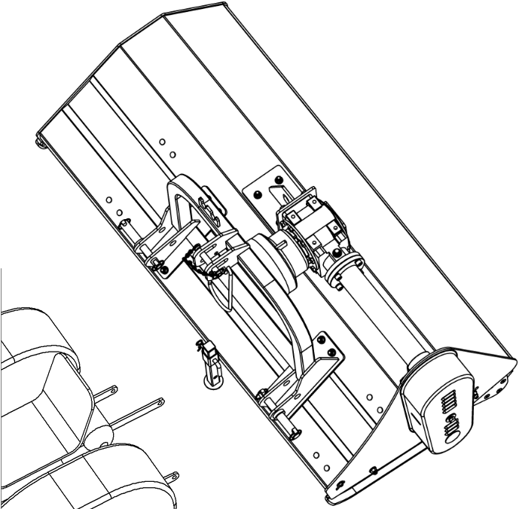
Section 1: Assembly & Set-up
Tractor Requirements
Tractor horsepower and hitch category should be within the range noted below. Tractors outside the horsepower range must not be used. The lower 3-Point arms must be stabilized to prevent side-to-side movement. Most tractors have sway blocks or adjustable chains for this purpose.
Horsepower Rating . . . . . . . . . . . . . . . . . . 50-70HP
Hitch Type . . . . . . . . . . . . . . . . . . . 3-Point Cat. I
Rear PTO Speed . . . . . . . . . . . . . . . . . . . . .540 RPM
Tractor Weight . . . . . . . . . See Important Note Below
3. Align ball swivels in the tractor’s lower 3-Point arms
with pin holes in the lower hitch clevises of the Mowers .
Insert hitch pins and secure with hair pin cotters.
4. Align the top center link with the center hitch
Clevis of the Mowers.
Insert hitch pin and secure with hair pin cotter.
5. With tractor’s 3-Point controls, lift Mowers up 1 to 2 inches and then raise jack stands fully up. Secure
stands with jack pins and hair pin cotters.
6. Level Mowers by adjusting lower 3-Point arms and upper center link. Refer to “Leveling the Mowers ” on page 16.
Driveline Installation
! DANGER
Do not engage tractor PTO while hooking-up and unhooking
driveline or stand near a rotating driveline. A person’s body
and/or clothing can become entangled
Tractor Hook-up
Refer to Figure 1-2:
1. Be certain tractor draw bar does not interfere. Move draw bar ahead or remove if required. Draw bar should also be checked for clearance when unit is raised for the first time.
2. Remove all three clevis hitch pins.
Tractor Hook-Up
Figure 1-2
10

Slide 13
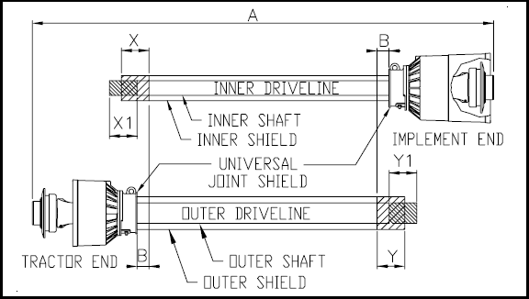
Section 1: Assembly & Set-up
Driveline installation
Refer to Figure 1-3:
1. Park tractor on a level surface. Slowly engage tractor
3-Point lift lever to raise Mowers until gearbox
shaft is in line (level) with tractor PTO shaft.
2. Support Mowers deck at this height with
support jacks or blocks to keep Mowers from
drifting down.
3. Place gear selector in park, set park brake, shut tractor off,
and remove switch key.
4. Slide inner yoke (implement end) of driveline onto the
gearbox. Secure driveline with yoke locking device.
5. Slide outer yoke of driveline over the tractor PTO shaft.
Secure driveline with yoke locking device.
6. If driveline does not fit between tractor and gearbox,
skip to instructions to “Shorten Driveline Length”
on this page.
7. The driveline should now be moved back and forth to
ensure both ends are secured to the tractor and poultry
litter crusher PTO shafts. Reattach any end that is loose.
8. Hook driveline safety chain on the tractor end of driveline to
the tractor. Re-latch safety chain to the driveline shield.
9. Hook driveline safety chain on the Mowers end
of driveline to the Mowers frame. Re-latch
safety chain to the driveline shield.
1. Make sure driveline is properly installed and level
before checking driveline collapsible length. (Refer to
“Driveline Installation” on page 10 if needed.)
Refer to Figure 1-3:
2. With driveline level, measure 1" (“B” dimension)
back from universal joint shield to end of outer
driveline shield. If measurement is 1" or more, skip
“Check Driveline Extended Length” on page 12. If
measurement is less than 1", then continue with
“Shorten Driveline Length” on this page.
Driveline ShorteningFigure 1-3
Shorten Driveline Length
Refer to Figure 1-3:
Check Driveline Collapsible Length
IMPORTANT: Two small chains are supplied with
the driveline. To keep driveline shields from rotating,
these chains must be attached to the outer and inner
driveline shields and to the Mowers and tractor.
1. Un-hook driveline from tractor PTO shaft and pull
outer and inner drivelines apart.
2. Reattach outer driveline to tractor PTO shaft. Pull on
inner and outer drivelines to be sure universal joints
are properly secured.
3. Hold inner and outer drivelines parallel to each other:
a. Measure 1" (“B” dimension) back from outer
driveline universal joint shield and make a mark at
this location on the inner driveline shield.
b. Measure 1" (“B” dimension) back from the inner
driveline universal joint shield and make a mark at
this location on the outer driveline shield.
4. Remove driveline from tractor and gearbox shafts.
5. Measure from end of inner shield to scribed mark
(“X” dimension). Cut off inner shield at the mark. Cut
same amount off the inner shaft (“X1” dimension).
6. Measure from end of outer shield to scribed mark
(“Y” dimension). Cut off outer shield at the mark. Cut
same amount off the outer shaft (“Y1” dimension).
7. Remove all burrs and Crushings.
8. Check drive line extend length next.
IMPORTANT: A driveline that is too long will bottom
out causing structural damage to the tractor and
Mowers . Always check driveline collapsible
Length during initial setup and when connecting to a
different tractor. More than one driveline may be required
to fit all applications.
11

Slide 14
Section 1: Assembly & Set-up
Check Driveline Extended Length
Refer to Figure 1-4:
Make sure driveline collapsible length is acceptable. If
needed, refer to “Check Driveline Collapsible Length”
on page 11 instructions on this page.
The driveline maximum allowable length must, when fully
extended, have a mini mum overlap of the profile tubes by
not less than 1/3 the free length with both inner and outer
profile tubes being of equal length.
1. Apply multi-purpose grease to the inside of the outer
shaft and reassemble the driveline.
2. Assemble driveline profiles together with 1/3
overlapping of inner and outer profile tubes. Once
assembled, measure and record the maximum
allowable length shown below for future reference.
8. Slowly engage tractor hydraulic 3-Point control
lever to lower Mowers . Check for
sufficient drawbar clearance. Move drawbar
ahead, aside or remove if required.
9. Raise and lower implement to find maximum
extended driveline length. Check to make certain
that the driveline overall length does not exceed
the maximum recorded length in step 2.
10. If needed, set tractor 3-Point lift height to keep
driveline from exceeding maximum allowable
length.
Check Driveline Interference
Refer to Figure 1-5:
Driveline Maximum Extended Length
Figure 1-4
3. Attach inner driveline yoke to the Mowers
gearbox shaft. Attach outer driveline yoke to the tractor's
PTO shaft.
4. Move yoke ends of driveline back and forth to ensure
they are secured to the tractor and Mowers
shafts.
Reattach any end that is loose.
Maximum PTO Driveline Movement During Operation
Figure 1-5
IMPORTANT: Small chains are supplied with the
driveline. They must be attached to the inner and
outer driveline shields and to the Mowers and tractor to restrict shield rotation.
1. Slowly engage tractor hydraulic 3-Point control lever
to lower Mowers while checking for
sufficient drawbar clearance. Move drawbar ahead,
aside, or remove if required.
2. Raise and lower implement to find maximum extended
driveline length. Check to make certain the driveline
does not exceed the maximum allowable length and
25°up or down.
3. If needed, set tractor 3-Point lift height to keep
driveline from exceeding the maximum allowable
length and 25° up.
5. Hook driveline safety chain on the tractor end of
driveline to the tractor. Re-latch safety chain to the
driveline shield.
6. Hook driveline safety chain on the Mowers
end of driveline to the Mowers frame. Re-
latch safety chain to the driveline shield.
7. Start tractor and raise Mowers just
enough to remove blocks.
12

Slide 15
Section 2: Operating Instructions
Pre-Start Checklist
Hazard control and accident prevention are dependent
upon the awareness, concern, prudence, and proper
training involved in the operation, transport, storage, and
maintenance of the Mowers . Therefore, it is
absolutely essential that no one operates the poultry litter
Crusher without first having read, fully understood, and
Become totally familiar with the Operator’s Manual. Make
sure the operator has read and paid particular attention to:
• Important Safety Information, page 1
• Section 1: Assembly & Set-up, page 9
• Section 2: Operating Instructions, page 13
• Section 3: Adjustments, page 16
• Section 4: Maintenance & Lubrication, page 18
Make sure the operator has completed the Operating
Checklist below.
1. Park tractor on a level surface.
Don’t work under or around an implement parked on a steep incline.
2. Place tractor in park and set park brake.
3. Disengage PTO if operating.
4. Shut engine off and remove switch key.
5. Wait for PTO to come to a complete stop before
dismounting tractor.
6. Wear safety glasses.
Transporting
! CAUTION
When traveling on public roads whether at night or during the
day, use accessory light and devices for adequate warning to
operators of other vehicles. Comply with all federal, state, and
local laws.
1. When raising Mowers to transport position, be sure
driveline does not contact tractor or Mowers . Adjust
and set tractor’s 3-Point lift height so that the driveline does not
contact Mowers deck in the fully raised position.
2. Be sure to reduce tractor ground speed when turning, leaving
enough clearance so that the Mowers does not
contact obstacles such as buildings, trees, or fences.
3. Select a safe ground travel speed when transporting from one
area to another. When traveling on roadways, transport in such a
way that faster moving vehicles may pass safely.
4. When traveling over rough or hilly terrain, shift tractor to a lower
gear.
Safety Information
! DANGER
Do not engage tractor PTO while hooking-up and unhooking
the driveline or while someone is standing near the driveline.
A person’s body and/or clothing can become entangled in the
driveline resulting in serious injury or death.
! DANGER
Mowers s have the ability to discharge objects at high
speeds if guards and safety shields are not in place and closed.
! DANGER
Gearbox and driveline shields must be secured in place when
operating the Mowers to avoid injury or death from
entanglement in rotating drivelines.
! DANGER
Do not operate a broken or bent driveline. Such a driveline
can brake apart while rotating at high speeds causing serious
injury or death. Always remove Mowers from service until damaged driveline is repaired or replaced.
! DANGER
Never carry a person on the Mowers . A rider can fall or become entangled in the machine causing serious injury or death.
✔ | Check | Page No.
 | Read and follow all Safety Information carefully. Refer to "Important Safety Information". | Page 1
 | Make sure all guards and shields are in place. Refer to "Important Safety Information". | Page 1
 | Read and follow 3-Point hook-up & preparation instructions. Refer to “Assembly & Set-up”. | Page 9
 | Read and made all required adjustments. Refer to "Section 3: Adjustments". | Page 16
 | Read and follow all operating procedures. Refer to "Section 2: Operating Instructions". | Page 13
 | Read and follow all Maintenance Instructions. Refer to "Section 4: Maintenance & Lubrication". | Page 18
 | Read and follow all Lubrication Instructions. Refer to "Lubrication Points". | Page 19
 | Make sure all gearboxes are properly lubricated. Refer to Gearbox Lubrication lubrication. | Page 19
 | Check Mowers initially and periodically for loose bolts and pins. Be sure all lock nut s and bolts are tight. Especially make sure blade bolts are tight. Refer to "Torque Values Chart for Common Bolt Sizes". | Page 43
Tractor Shut Down Procedure
It is essential that the tractor be shut down as noted
below before making any inspections, maintenance
and/or repairs to the tractor and/or Mowers .
13

Slide 16
Section 2: Operating Instructions
! DANGER
Do not operate and/or travel across steep inclines where a
tractor can roll-over resulting in serious injury or death.
Consult your tractor’s manual for acceptable inclines the
tractor is capable of traveling across.
! DANGER
Do not use Mowers to lift or carry objects. Lifting and/or carrying objects can result in damage to the Mowers , serious bodily injury, or death.
! ! DANGER
Do not use Mowers as a working platform. The Mowers is not properly designed or guarded for this. Using the Mowers as a working platform can cause serious injury or death.
! ! WARNING
Always disengage PTO, engage parking brake, shut tractor
engine off, remove switch key, and wait for blades to come a
complete stop before dismounting from tractor.
! ! WARNING
The G.OS is designed to cut grass and brush up to 1"
diameter and yet cut up to 2" diameter brush.
Using this Mowers for another type of work can damage the Crushing components, drive components, Mowers frame, and tractor.
! CAUTION
Do not over speed PTO or machine damage may result. This
Mowers is designed to be used only with a tractor having a 540 RPM rear PTO.
Working Instructions
1. Clear area to be worked of objects and debris that
might be picked up and thrown by the Mowers blades.
Do not use Mowers on stony ground.
2. Make the following machine checks before operating
the Mowers .
• All hook-up pins should be secured.
• All shields should be in place and secured.
• All bolts and lock nut s should be present and tight.
• Make sure the blades are not be broken or loose.
Operating Instructions
Proper servicing and adjustments are the key to the long
life of any machine. With careful and systematic inspection of the Mowers , costly maintenance, time, and
repair can be avoided.
!
Before beginning to work, the following inspection and
checks should be performed:
1. Check oil level in gearbox. Refer to “Gearbox
Lubrication” on page 19.
2. Check that all plugs in gearbox have been replaced
and tightened properly.
3. Be sure all Mowers blades, bolts, and lock nut s are tight.
4. Be certain all guards and shields are in place and
secure.
5. Grease driveline shaft and all other grease fittings.
6. Clear area to be worked of rocks, branches, and
other foreign objects. Do not use Mowers on stony ground.
7. Lower Mowers to ground. Set tractor throttle at
approximately 1/4 open. Engage PTO to start blades
rotating.
8. Operate with 540 rpm PTO tractor. At first begin
working at a slow forward speed and shift up until the
desired speed is achieved maintaining 540 rpm PTO.
The rotor blades will cut better at full blade speed
than at reduced throttle.
9. After working the first 50 feet, stop and check to see
that the Mowers is adjusted properly.
10. Do not make sharp turns or attempt to back up while
Mowers is on the ground.
11. Never work close to or on steep slopes.
12. Do not engage PTO with Mowers in the
fully raised position. Do not engage PTO at full throttle.
Do not lift Mowers with PTO engage.
13. Do not allow anyone including yourself near the
Mowers when it is operating.
14. Periodically check for foreign objects wrapped
around the rotor shaft and remove them after
disengaging PTO, turning off tractor, and removing
ignition key.
14

Slide 17
Section 2: Operating Instructions
General Operating Instructions
Now that you have familiarized yourself with the
Operator’s Manual, completed the Operators Checklist,
properly attached your Mowers to your tractor, made the right offset or center adjustments, and preset your Crushing height, you’re almost ready to begin using your KM Series Flail Mowers
It’s now time to do a running operational safety check. If
at any time during this safety check you detect a
malfunction in either the Mowers or tractor shut the tractor off immediately, remove the key, and make necessary repairs or adjustments before continuing on.
Make sure the tractor’s park brake is engaged, the
tractor’s PTO is disengaged, and the Mowers is resting on the ground. Start the tractor and then back the tractor throttle off till the engine is at low idle. With the tractor’s rear hydraulic lift control lever, raise the Mowers to transport position making sure that the PTO shaft is not in a bind and does not come in contact with the Mowers frame. Lower the unit to Crushing position and, with the tractor still at low idle, engage the PTO. If everything is running smoothly at this point increase the engine rpm until the tractor’s engine reaches full PTO operating speed which will be 540 rpm. Slowly raise the cutter to transport height to make sure the driveline does not bind or chatter. Then return the engine to low idle, disengage PTO, and position the adjustable stops on the tractor’s hydraulic lift lever control console so the cutter can be consistently returned to the same Crushing and transport height.
You should now be ready to move to the Crushing site to
begin working. You should have inspected and should
only be Crushing in an area you are familiar with which is
relatively free of debris and unseen objects. Never
assume an area is clear. In the event you do strike an object, stop the tractor and Mowers immediately to inspect the rotor and make any necessary repairs before resuming operation. It pays to inspect a new area and to develop a plan before you cut.
Normal working speed will be between 2-5 mph and you
will need to maintain tractor PTO speed to produce a
clean cut so make a tractor gear and range selection that
will maintain this combination. Generally the quality of
cut of will be better at
lower ground speeds and Crushing denser ground cover or heavier brush may create the need to slow down. Always cut downward on slopes and avoid crossing the face of steep slopes. Avoid sharp drops and cross diagonally through dips to prevent hanging up the tractor and Mowers . Slow down in turns and avoid sharp turns if at all possible. Remember to look back often.
Now you’re prepared and well briefed so let’s begin
Cutting. Reduce the tractor’s engine rpm, make sure the Mowers is on the ground and in Crushing position, engage the PTO, raise the engine rpm to the appropriate PTO speed, and begin working. Operators must plan ahead and choose a Crushing route that allows safe turns. Try increasing or decreasing ground speed to determine the effect on quality of cut. With a little practice you will be pleased with what you and your Mowers can do.
15

Slide 18
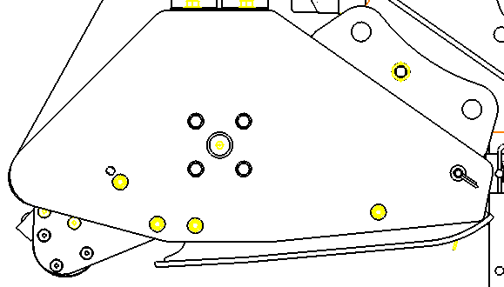
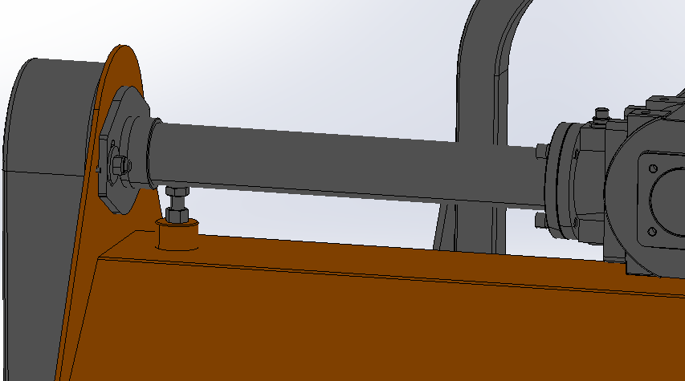
Section 3: Adjustments
! CAUTION
Engage parking brake, shut off tractor, remove key, and
disengage PTO before making any adjustments!
Crushing Height Adjustment
The machines cutting height depends upon the position of Adjustment plate.
! CAUTION
Ensure Mowers with special supports if it is necessary to lift Mowers off the ground to make adjustments! If not supported, the Mowers could fall causing serious injury to those present.
1. Remove bolts that fix the roller height on both sides.
2. Lift or lower both sides of roller in equal measurements.
3. Replace bolts and re-tighten to the proper torque.
4. Inspect blades to make sure they do not touch the
ground. blades that come in contact with the ground
will wear quickly. If necessary, readjust Crushing height
to keep blades from touching the ground.
Leveling the Mowers
Level adjustments are made at the tractor’s 3-Point lower
arms and top center link.
1. Park tractor and Mowers on a flat
level surface.
2. Slowly raise Mowers with the tractor’s
Hydraulic 3-Point lift until the unit is about 1 to 2" above
the ground.
3. Ensure that the lower arms are stabilized to prevent
excessive side movement.
4. Place a spirt level on the top cover running from left
to right and adjust one of the lower 3-Point arms up
or down until the Mowers is level from left
to right.
5. Adjust tractor’s top center link to place the upper
hitch pin vertically above or slightly behind the lower
hitch pins.
6. Slowly operate the tractor's 3-Point hydraulic control
up and down to check for clearance between the
tires, frame, drawbar, etc.
The depth of work adjustment
Belt Tension Adjustment
! ! WARNING
Excessive tension on the belt may lead to premature failure of
belt and drive components. Excessive tension on the belt may
also lead to a safety hazard to the operator or bystanders.
The Belt tension should be checked after the first 20
hours of use and every 40 hours thereafter.
1. Check belt tension by applying approximately 22
pounds of pressure half way between the pulleys.
The belt should deflect approximately 3/8".
2. Belt tension can be adjusted at the belt tension bolt.
Turn belt tension bolt until desired belt tension is
achieved.
3. Loosen gearbox mounting bolts and move gearbox
until Mowers driveline is running straight
(parallel) with the Flail Mo
Belt Tension Bolt
16

Slide 19
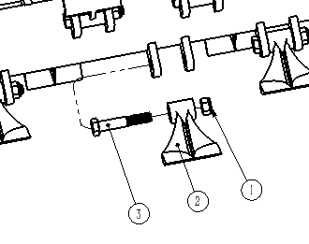
Section 3: Adjustments
Rotor blade Replacement
Frequently check rotor blades to make sure they are in
good working condition and properly secured to the rotor.
Replace worn or damaged parts with new blades.
IMPORTANT:
Make sure that the replacement of blade with other
same weight. This will be a balance of rotor spinning.
IMPORTANT:
The replaced blade must be the original factory accessories
The blade have a Crushing edge on both the leading and trailing edges. When the leading edge wears out, turn existing pair of blade around 180 degrees and reinstall. Replaced blade should be the same length as existing part to maintain rotor balance.
L.TRE Series Blade Replacement
1. Remove locknut (#1), bolt(#3) for forged harmer system.
2. Remove existing blades and spacer (#2) or
turn existing pair of blade around 180 degrees and
reinstall.
3. Install blade with existing bolt, spacer and locknut..
4. Tighten locknut with correct torque.
17

Slide 20
Section 4: Maintenance & Lubrication
Storage
It is good practice to clean off any dirt and grease that
may have accumulated on the Mowers and to inspect and make necessary repairs before parking the unit at the end of the working season and for long periods. This will help ensure that the Mowers will be ready for use the next time you hook-up to it.
! ! DANGER
Always disconnect main driveline from tractor PTO and
secure Mowers in the up position with solid supports before
servicing underside of the Mowers .
1. Remove any dirt and grease that may have
accumulated on the Mowers and moving
parts Scrape off compacted dirt from under the hood and
then wash the surface thoroughly with a garden hose.
2. Check rotor blade and blade bolts for wear and
replace if necessary. See “Rotor blade
Replacement” on page 17.
3. Inspect Mowers for loose, damaged, or
worn parts and adjust or replace as needed.
4. Repaint parts where paint is worn or scratched to
prevent rust. Ask your dealer for MATENG aerosol
touch-up paint It are also available in touch-up bottles
with brush, quarts, and gallon sizes by adding TU, QT,
or GL to the end of the aerosol part number.
5. Replace all damaged or missing labels.
6. A light coat of oil or grease may also be applied to
areas where paint has worn off to minimize oxidation.
7. Lubricate as noted under “Lubrication Points” on
page 19.
8. Store equipment on a level surface in a clean, dry place.
Inside storage will reduce maintenance and make for
a longer mower life. Position the unit on a flat surface
with jack stands lowered to a suitable 3-Point height.
Ensure that the main frame is stable.
9. Store driveline end off the ground.
18

Slide 21
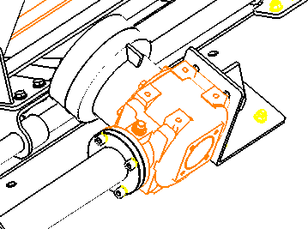
Section 4: Maintenance & Lubrication
Lubrication Points
Driveline Shaft U-Joints
Type of Lubrication: Multi-purpose Grease
Quantity - 4 to 8 Pumps
Driveline Profiles
Type of Lubrication: Multi-purpose Grease
Quantity - Clean & coat inner profile tube
of driveline with
a light film of grease and then reassemble.
Inner Tube Bearings
Type of Lubrication: Multi-purpose Grease
Quantity - As Required
Gearbox Lubrication
Type of Lubrication: SAE EP 90W Gear Lube
Add visual to the center of the gear oil
Reinstall plugs and tighten.
Do not overfill!
Should your gearbox require service, take it to your MATENG dealer.
19

Slide 22
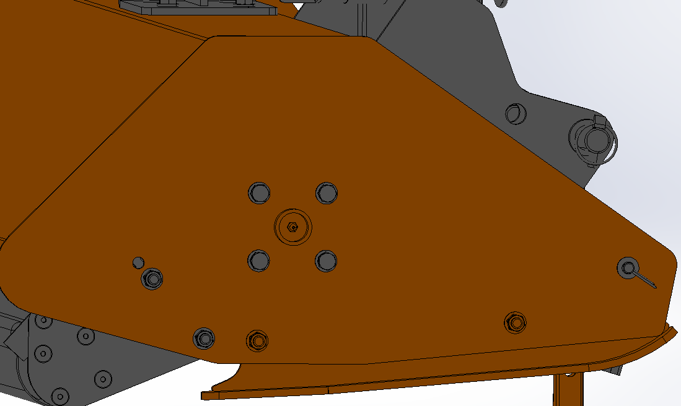
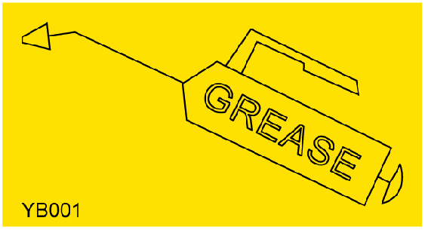
Section 4: Maintenance & Lubrication
The shaft end bearing
Type of Lubrication: Multi-purpose Grease
20

Slide 23
Section 5: Features & Benefits
Features | Benefits
Cutting width | 1250mm-1550mm-1750mm, a good cutting width for many applications.
50-70 HP Gearbox Rating | Fits a large array of consumer, municipality, and landscape of tractors.
3-Point screw type hitch can be | Easily offset the hitch for a closer cut alongside buildings, fences, roadsides, and for getting
The turning angle of the lawn mowers | The vertical 90 degrees to minus 50 degrees
Hydraulic cylinder displacement | Through the hydraulic cylinder convenient swing mower to cut the scope, and effectively avoid obstacles
Two year gearbox warranty | The gearbox is designed tough to withstand the rigors of flail mowing.
540 RPM cast iron gearbox with Reverse running clutch | Enables the rotor to free swing to a stop when the tractor PTO has been turned off.
60mm Cutting height | Variable cutting heights for many uses.Lowest cutting height allows for scalping in grasses such as Bermuda prior to overseeding.
Fine cutting knives | Heavy enough to cut 20mm material, yet fine enough to groom a yard.
Forged hammer knives | Forged hammers are just right for chopping up pruning up to 40mm thick, but will also groom grass in a very acceptable manner.
Reverse rotor rotation | Brings the cut material up and over which allows it to be dispersed more evenly.
High knife tip speed | Knife tip speed of 42 m/s for cleaner cut.
3 - “SPB” Section belts | “SPB” Section belts have more surface to pulley contact and fits deeper in the groove.
4mm Deck thickness | Allows the mower to handle rough conditions.
Height adjusting roller | Rear height adjusting roller with greaseable bearings and tapered ends to prevent gouging during turns.
Standard scrapers on rear height adjusting roller | Keeps roller clean for consistent cutting height.
21

Slide 24
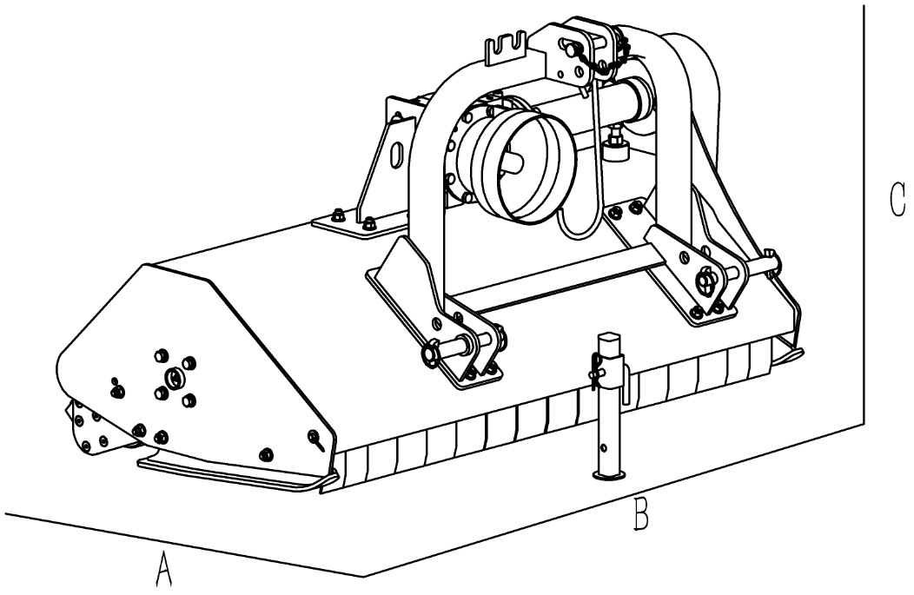
Section 6: Detailed parameters
22

Slide 25
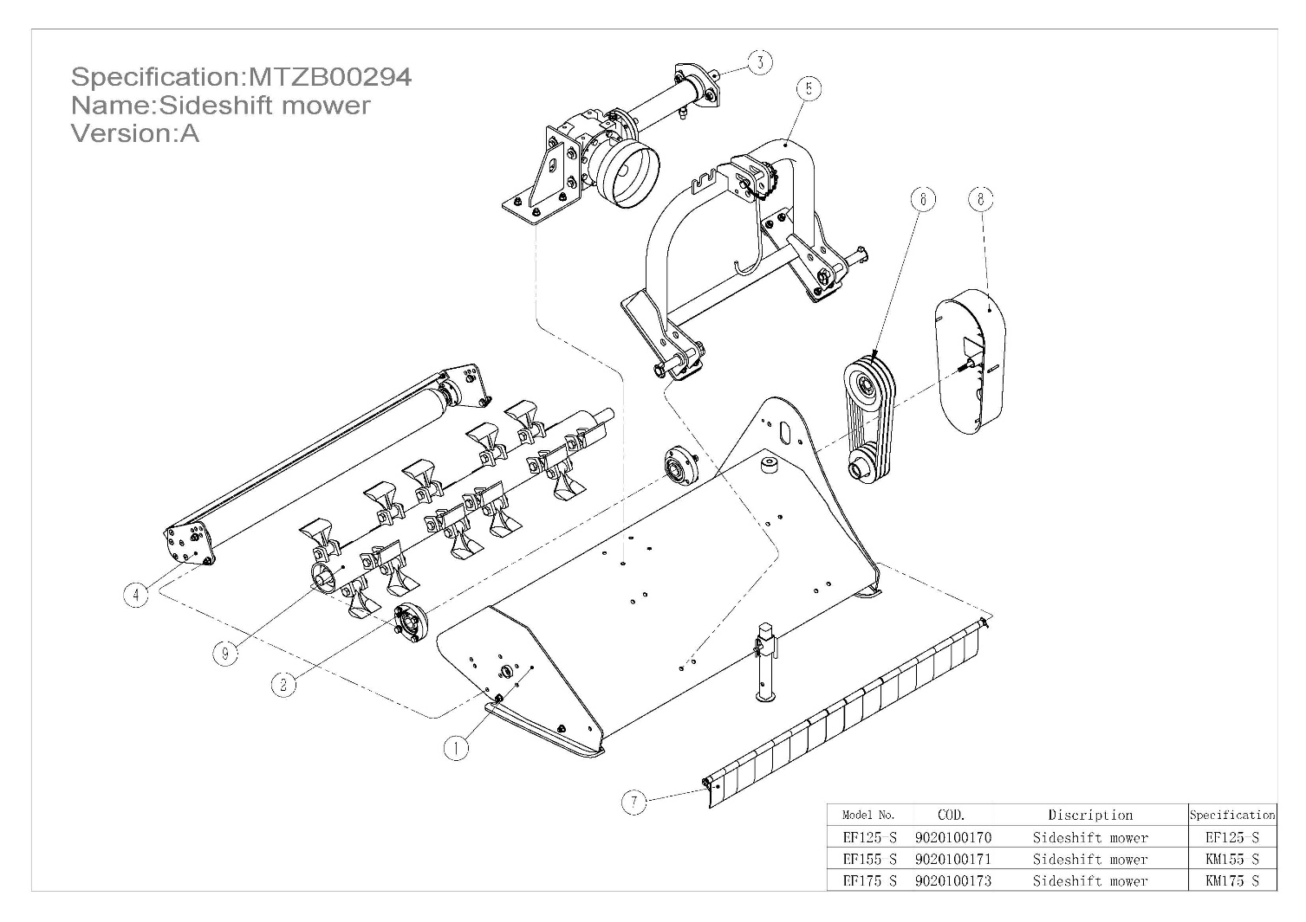
Section 7 ：Part List
Section 7.1 ：main engine (EF125-155-175-S)
POS. | COD. | Specification | Description | EF125-S/Qty | EF155-S/Qty | EF175-S/Qty
1 | 2060105363 | F01059A01000-000 | Panel hood assembly | 1 | - | -
1 | 2060105365 | F01061A01000-000 | Panel hood assembly | - | - | 1
1 | 2060105364 | F01060A01000-000 | Panel hood assembly | - | 1 | -
2 | 2060105366 | F01059A04000-000 | Bearing block assembly | 1 | 1 | 1
3 | 2060105368 | F01059A06000-000 | Transmission assembly | 1 | - | -
3 | 2060105370 | F01061A06000-000 | Transmission assembly | - | - | 1
3 | 2060105369 | F01060A06000-000 | Transmission assembly | - | 1 | -
4 | 2060105371 | F01059A03000-000 | Roller assembly | 1 | - | -
4 | 2060105373 | F01061A03000-000 | Roller assembly | - | - | 1
4 | 2060105372 | F01060A03000-000 | Roller assembly | - | 1 | -
5 | 2060105375 | F01060A09000-000 | Hitch assembly | - | - | -
5 | 2060105374 | F01060B09000-000 | Hitch assembly | - | 1 | 1
5 | 2060105573 | F01059A09000-000 | Hitch assembly | 1 | - | -
6 | 2060105376 | F01059A07000-000 | Side drive assembly | 1 | 1 | 1
7 | 2060105377 | F01059A10000-000 | Protective assembly | 1 | - | -
7 | 2060105379 | F01061A10000-000 | Protective assembly | - | - | 1
7 | 2060105378 | F01060A10000-000 | Protective assembly | - | 1 | -
8 | 2060105381 | F01059A08000-000 | Side shield assembly | 1 | 1 | 1
9 | 2090005104 | F01059A02000-000 | Axle assembly | 1 | - | -
9 | 2090005106 | F01061A02000-000 | Axle assembly | - | - | 1
9 | 2090005105 | F01060A02000-000 | Axle assembly | - | 1 | -
23

Slide 26
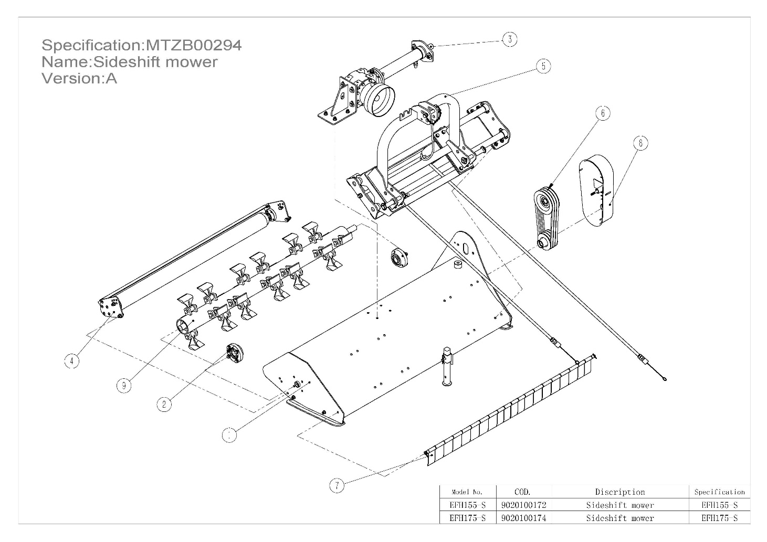
Section 7 ：Part List
Section 7.1 ：main engine (EFH155-175-S)
POS. | COD. | Specification | Description | EFH175-S/Qty | EFH155-S/Qty
1 | 2060105365 | F01061A01000-000 | Panel hood assembly | 1 | -
1 | 2060105364 | F01060A01000-000 | Panel hood assembly | - | 1
2 | 2060105366 | F01059A04000-000 | Bearing block assembly | 1 | -
2 | 2060105366 | F01059A04000-000 | Bearing block assembly | - | 1
3 | 2060105370 | F01061A06000-000 | Transmission assembly | 1 | -
3 | 2060105369 | F01060A06000-000 | Transmission assembly | - | 1
4 | 2060105373 | F01061A03000-000 | Roller assembly | 1 | -
4 | 2060105372 | F01060A03000-000 | Roller assembly | - | 1
5 | 2060105375 | F01060A09000-000 | Hitch assembly | 1 | 1
6 | 2060105376 | F01059A07000-000 | Side drive assembly | 1 | 1
7 | 2060105379 | F01061A10000-000 | Protective assembly | 1 | -
7 | 2060105378 | F01060A10000-000 | Protective assembly | - | 1
8 | 2060105381 | F01059A08000-000 | Side shield assembly | 1 | 1
9 | 2090005106 | F01061A02000-000 | Axle assembly | 1 | -
9 | 2090005105 | F01060A02000-000 | Axle assembly | - | 1
24

Slide 27
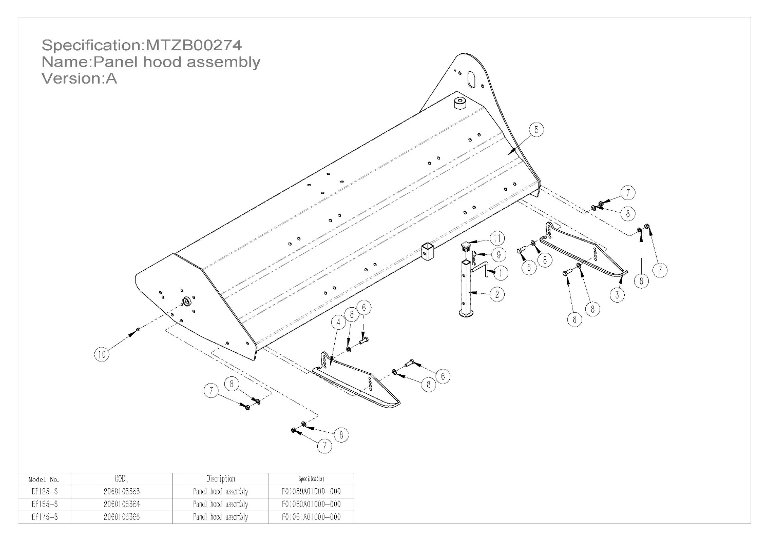
Section 7 ：Part List
Section 7.2 ：Hood components
POS. | COD. | Specification | Description | EF125-S/Qty | EF155-S/Qty | EF175-S/Qty
1 | 2010004983 | F01062A01000-002 | Raker pin | 1 | 1 | 1
2 | 2020002093 | F01062A01400-000 | Leg weldment | 1 | 1 | 1
3 | 2020005204 | F01059A01200-000 | Skateboard Welding | 1 | 1 | 1
4 | 2020005205 | F01059A01300-000 | Skateboard Welding | 1 | 1 | 1
5 | 2020005208 | F01061A01100-000 | Panel hood weldment | - | - | 1
5 | 2020005207 | F01060A01100-000 | Panel hood weldment | - | 1 | -
5 | 2020005206 | F01059A01100-000 | Panel hood weldment | 1 | - | -
6 | 3040100630 | GB/T5783-M12×35-8.8-EP•Zn•C | Full-thread hexagon bolts | 4 | 4 | 4
7 | 3050500612 | GB/T889.1-M12-8-EP•Zn•C | Locknut | 4 | 4 | 4
8 | 3080100610 | GB/T95-12-EP•Zn•C | Plain washer | 8 | 8 | 8
9 | 3120400603 | Din11024-4-EP•Zn•C | Pin | 1 | 1 | 1
10 | 3170400005 | Din71412-G1/8-A | Grease nipple | 1 | 1 | 1
11 | 3210200006 | 31x31 | Pipe Plug | 1 | 1 | 1
25

Slide 28
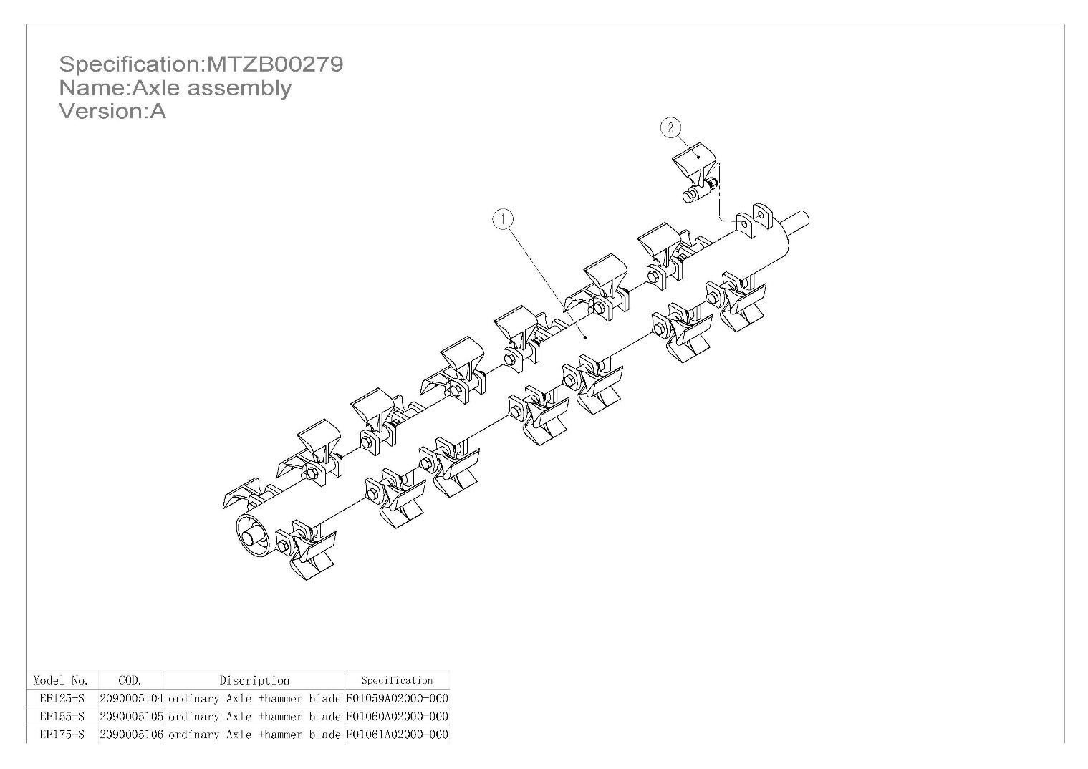
Section 7 ：Part List
Section 7.3 ：Axle assembly
POS. | COD. | Specification | Description | EF125-S/Qty | EF155-S/Qty | EF175-S/Qty
1 | 2020005209 | F01059A02100-000 | Axle weldment | 1 | - | -
1 | 2020005210 | F01060A02100-000 | Axle weldment | - | 1 | -
1 | 2020005211 | F01061A02100-000 | Axle weldment | - | - | 1
2 | 2060204960 | F01059A02200-000 | Blade assembly | 20 | 24 | 28
26

Slide 29
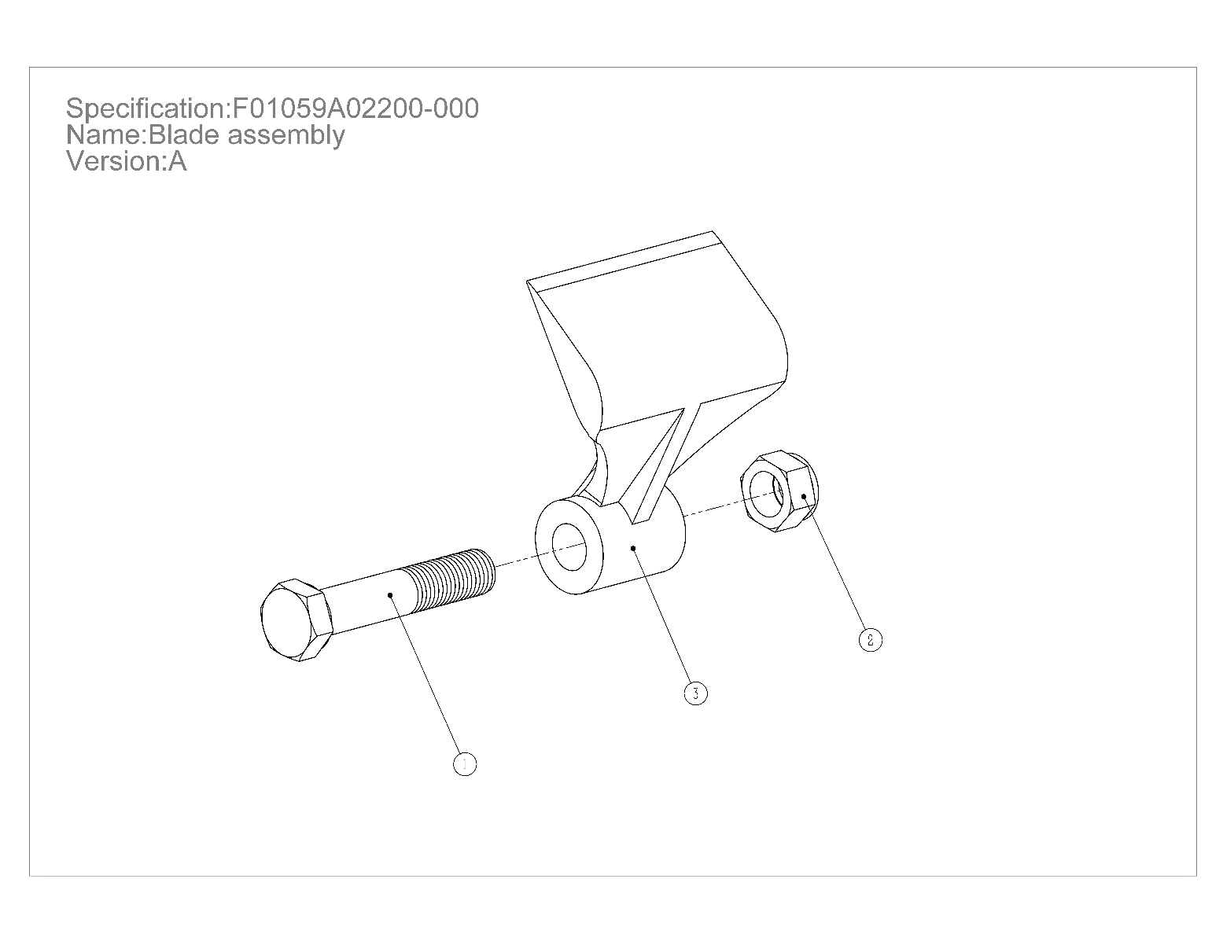
Section 7 ：Part List
Section 7.3.1 ： Hammer components
POS. | COD. | Specification | Description | Qty
1 | 3040300610 | GB/T5782-M16×85-10.9-O | Hexagon head bolts | 1
2 | 3050500610 | GB/T889.1-M16-10-EP•Zn•C | Locknut | 1
3 | 3220100616 | MT01027 | Blade | 1
27

Slide 30
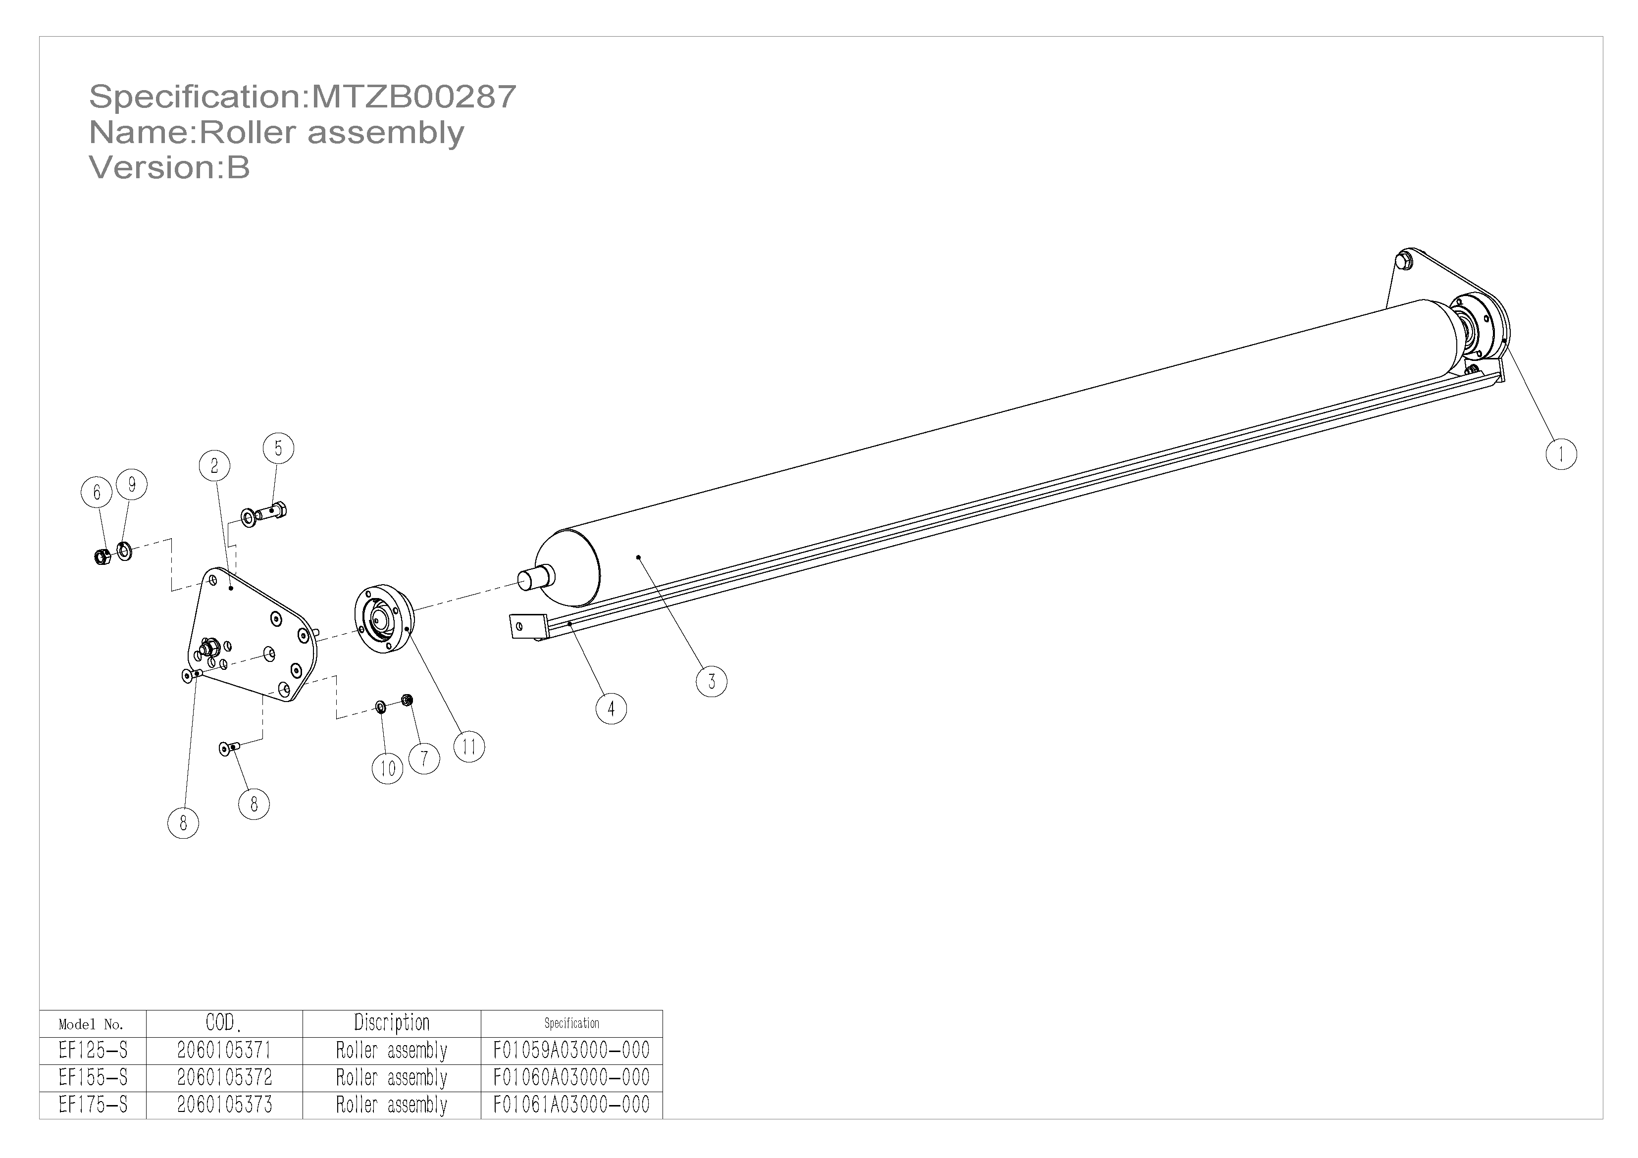
Section 7 ：Part List
Section 7.4 ：Roller assembly
POS. | COD. | Specification | Description | EF175-S/Qty | EF155-S/Qty | EF125-S/Qty
1 | 2000000062 | F01037A03000-001 | Plate | 1 | 1 | 1
2 | 2000000063 | F01037A03000-002 | Plate | 1 | 1 | 1
3 | 2020000113 | F01044A03200-000 | Roller welded parts | 1 | - | -
3 | 2020000111 | F01042A03200-000 | Roller welded parts | - | 1 | -
3 | 2020000108 | G03001A03110-000 | Roller welded parts | - | - | 1
4 | 2020005218 | F01061A03100-000 | Scraper weldment | 1 | - | -
4 | 2020005217 | F01060A03100-000 | Scraper weldment | - | 1 | -
4 | 2020005216 | F01059A03100-000 | Scraper weldment | - | - | 1
5 | 3040100630 | GB/T5783-M12×35-8.8-EP•Zn•C | Full-thread hexagon bolts | 4 | 4 | 4
6 | 3050500612 | GB/T889.1-M12-8-EP•Zn•C | Locknut | 4 | 4 | 4
7 | 3050500616 | GB/T889.1-M8-10-EP•Zn•C | Locknut | 2 | 2 | 2
8 | 3060200604 | GB/T70.3-M8×25-10.9-EP•Zn•C | HSCS-Countersunk | 10 | 10 | 10
9 | 3080100610 | GB/T95-12-EP•Zn•C | Plain washer | 8 | 8 | 8
10 | 3080100614 | GB/T95-8-EP•Zn•C | Plain washer | 2 | 2 | 2
11 | 3100700038 | HRB-UCC205-B | Outer Spherical Ball Bearing with Seat | 2 | 2 | 2
28

Slide 31
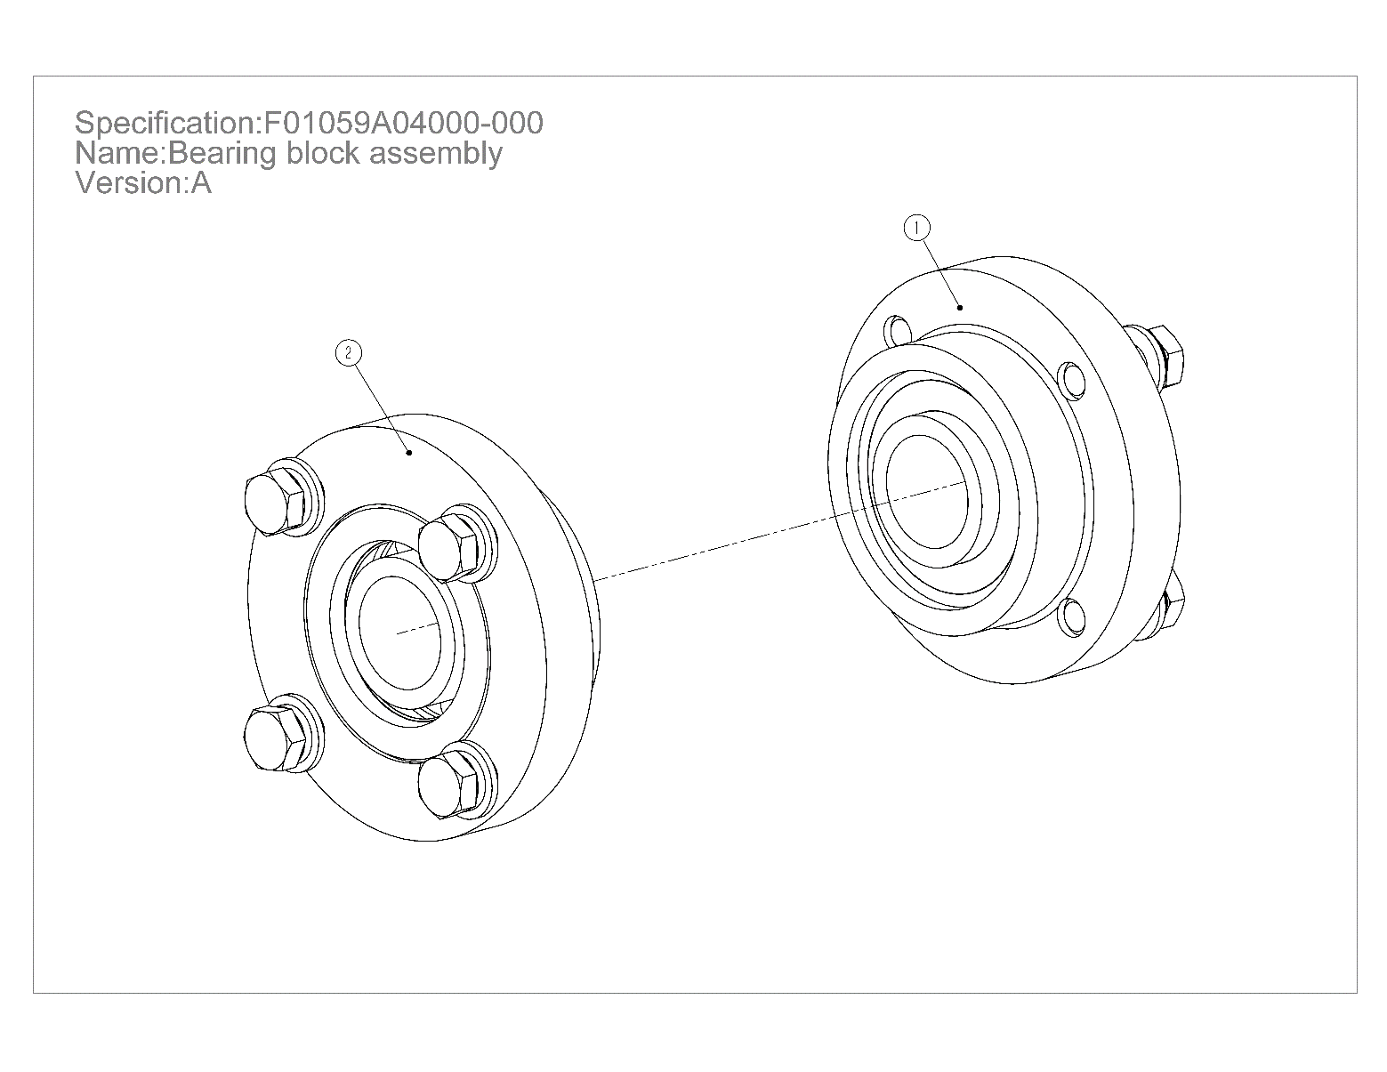
Section 7 ：Part List
Section 7.5 ：Axle bearing assembly
POS. | COD. | Specification | Description | Qty
1 | 2060204940 | F01059A04100-000 | Bearing block assembly | 1
2 | 2060204941 | F01059A04200-000 | Bearing block assembly | 1
29

Slide 32
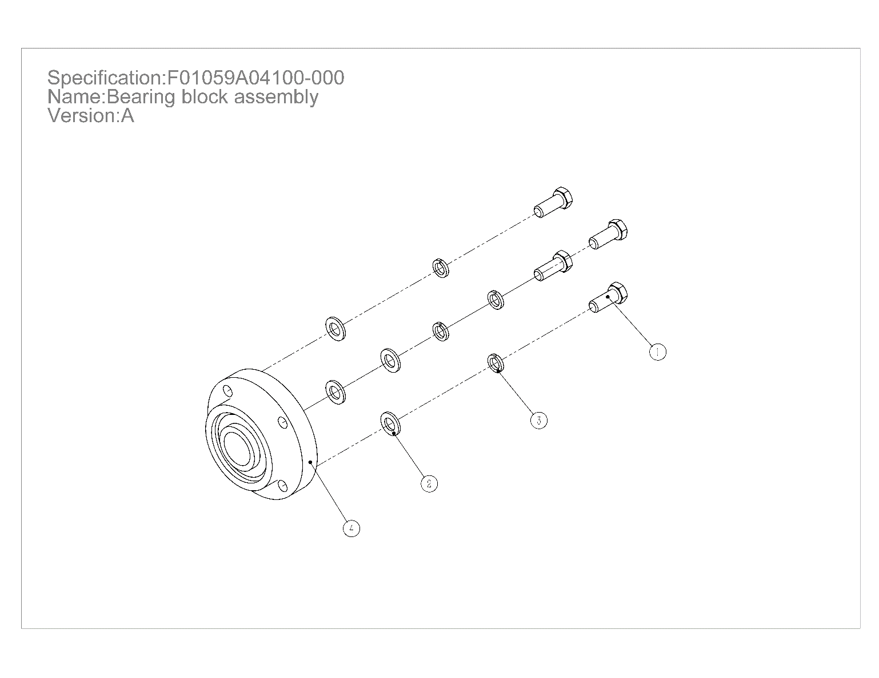
Section 7 ：Part List
Section 7.5.1：Bearing block assembly
POS. | COD. | Specification | Description | Qty
1 | 3040100633 | GB/T5783-M12×30-8.8-EP•Zn•C | Full-thread hexagon bolts | 4
2 | 3080100610 | GB/T95-12-EP•Zn•C | Plain washer | 4
3 | 3080500608 | GB/T93-12-EP•Zn•C | Spring washer | 4
4 | 3100700602 | HRB-UCC207-A | Outer Spherical Ball Bearing with Seat | 1
30

Slide 33
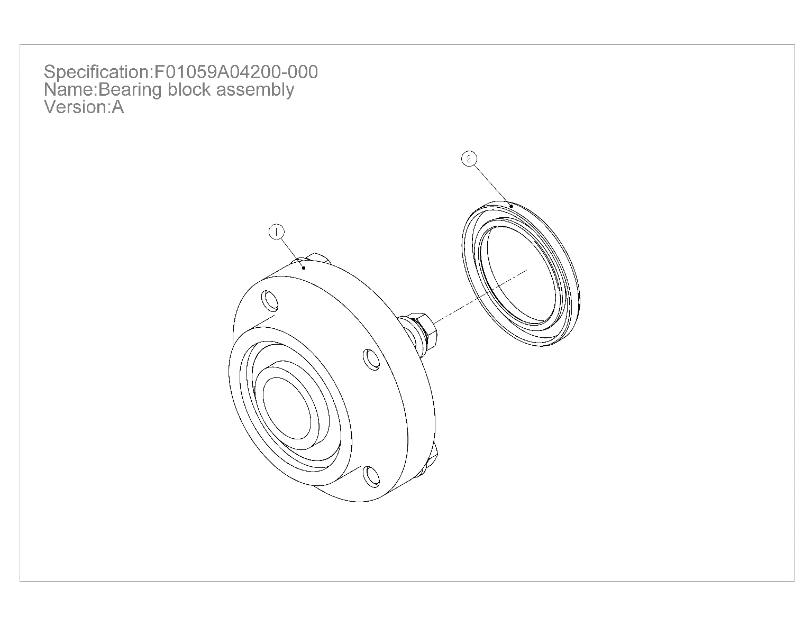
Section 7 ：Part List
Section 7.5.2 ：Bearing block assembly
POS. | COD. | Specification | Description | Qty
1 | 2060204940 | F01059A04100-000 | Bearing block assembly | 1
2 | 3170100046 | GB/T13871.1-FB-55×80×8- NBR | shaft seal | 1
31

Slide 34
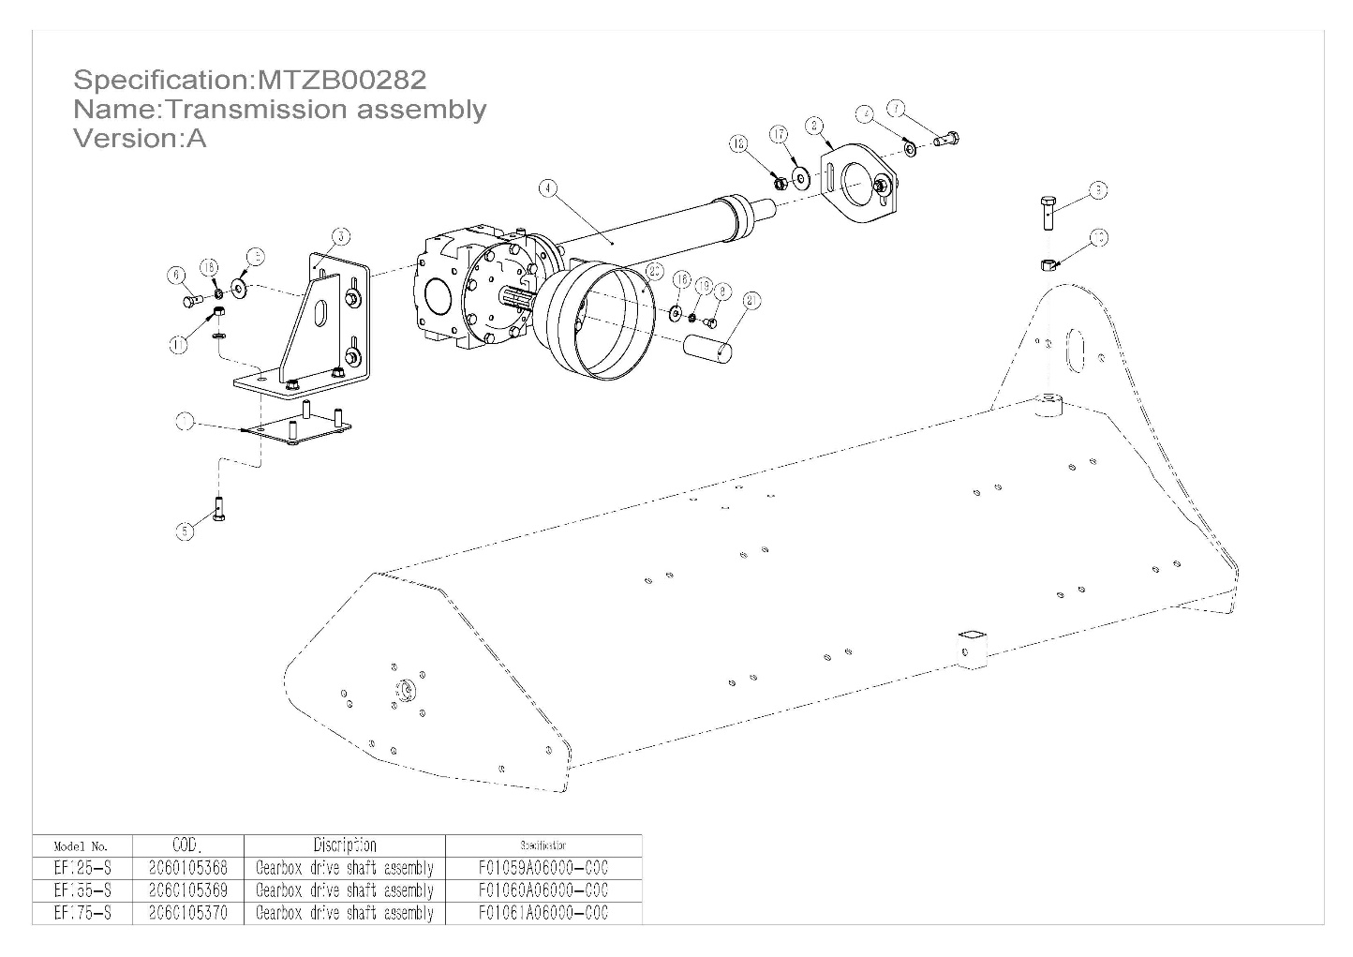
Section 7 ：Part List
Section 7.6 ：Gearbox transmission assembly
POS. | COD. | Specification | Description | EF175-S/Qty | EF155-S/Qty | EF125-S/Qty
1 | 2000005002 | F01059A06000-001 | Plate | 1 | 1 | 1
2 | 2000005003 | F01059A06000-002 | Plate | 1 | 1 | 1
3 | 2020005212 | F01059A06200-000 | Gearbox mounting plate | 1 | 1 | 1
4 | 2060204944 | F01061A06100-000 | Drive assembly | 1 | - | -
4 | 2060204943 | F01060A06100-000 | Drive assembly | - | 1 | -
4 | 2060204942 | F01059A06100-000 | Drive assembly | - | - | 1
5 | 3040100630 | GB/T5783-M12×35-8.8-EP•Zn•C | Full-thread hexagon bolts | 4 | 4 | 4
6 | 3040100633 | GB/T5783-M12×30-8.8-EP•Zn•C | Full-thread hexagon bolts | 4 | 4 | 4
7 | 3040100634 | GB/T5783-M14×40-8.8-EP•Zn•C | Full-thread hexagon bolts | 2 | 2 | 2
8 | 3040100635 | GB/T5783-M10×16-8.8-EP•Zn•C | Full-thread hexagon bolts | 4 | 4 | 4
9 | 3040200601 | GB/T5786-M16×1.5×50-8.8-EP•Zn•C | Full-thread hexagonal bolts（fine pitch） | 1 | 1 | 1
10 | 3050200602 | GB/T6171-M16×1.5-10-EP•Zn•C | Hexagon Nuts (fine pitch) | 1 | 1 | 1
11 | 3050500612 | GB/T889.1-M12-8-EP•Zn•C | Locknut | 4 | 4 | 4
12 | 3050500615 | GB/T889.1-M14-8-EP•Zn•C | Locknut | 2 | 2 | 2
13 | 3080100610 | GB/T95-12-EP•Zn•C | Plain washer | 4 | 4 | 4
14 | 3080100612 | GB/T95-14-EP•Zn•C | Plain washer | 2 | 2 | 2
15 | 3080200605 | GB/T96.2-12-EP•Zn•C | Large plain washer | 4 | 4 | 4
16 | 3080200606 | GB/T96.2-10-EP•Zn•C | Large plain washer | 4 | 4 | 4
17 | 3080200607 | GB/T96.2-14-EP•Zn•C | Large plain washer | 2 | 2 | 2
18 | 3080500608 | GB/T93-12-EP•Zn•C | Spring washer | 4 | 4 | 4
19 | 3080500609 | GB/T93-10-EP•Zn•C | Spring washer | 4 | 4 | 4
20 | 3210300014 | MT50001 | Guard | 1 | 1 | 1
21 | 3210500603 | Φ35×90 | Rubber | 1 | 1 | 1
32

Slide 35
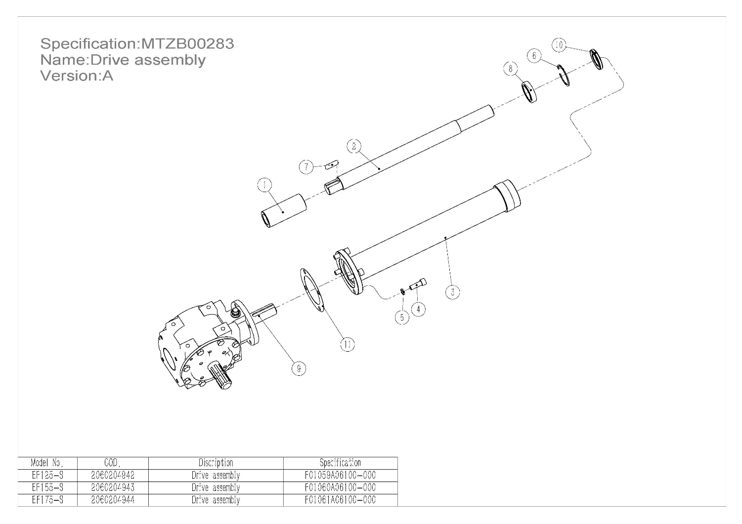
Section 7 ：Part List
Section 7.6.1 ：Gearbox transmission assembly
POS. | COD. | Specification | Description | EF175-S/Qty | EF155-S/Qty | EF125-S/Qty
1 | 2010000016 | G01001A08000-003 | Sleeve | 1 | 1 | 1
2 | 2010004924 | F01061A06100-001 | Transmission shaft | 1 | - | -
2 | 2010004923 | F01060A06100-001 | Transmission shaft | - | 1 | -
2 | 2010004922 | F01059A06100-001 | Transmission shaft | - | - | 1
3 | 2020005215 | F01061A06110-000 | Welding of transmission | 1 | - | -
3 | 2020005214 | F01060A06110-000 | Welding of transmission | - | 1 | -
3 | 2020005213 | F01059A06110-000 | Welding of transmission | - | - | 1
4 | 3060100610 | GB/T70.1-M12×35-8.8-EP•Zn•C | Hexagon socket head cap screws | 4 | 4 | 4
5 | 3080500608 | GB/T93-12-EP•Zn•C | Spring washer | 4 | 4 | 4
6 | 3080600038 | GB/T893-62-A | Retaining rings for borP | 1 | 1 | 1
7 | 3090100009 | GB/T1096-A10×8×40-EP•Zn | Square and rectangular keys | 1 | 1 | 1
8 | 3100100605 | HRB-6007-2Z | Deep groove ball bearing | 1 | 1 | 1
9 | 3160100014 | XH50.300Z.02W | Gear box | 1 | 1 | 1
10 | 3170100010 | GB/T13871.1-FB-35×62×8-NBR | shaft seal | 1 | 1 | 1
11 | 3170500001 | 90×135×0.5 | Sheet gasket | 1 | 1 | 1
33

Slide 36
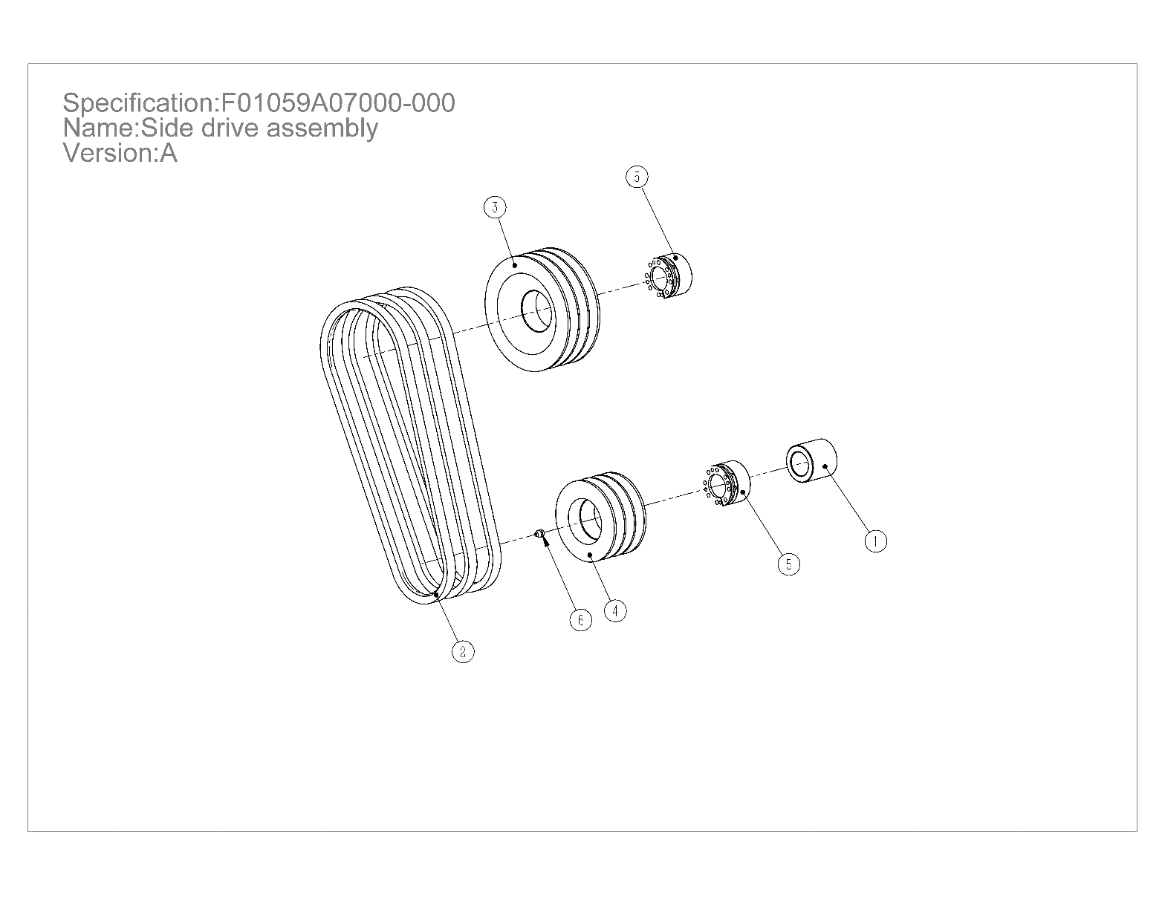
Section 7 ：Part List
Section 7.7 ：Side drive assembly
POS. | COD. | Specification | Description | Qty
1 | 2010004927 | F01059A07000-001 | Spacer sleeve | 1
2 | 3160300016 | GB/T11544-BX1016 | Belt | 3
3 | 3160400034 | SPB163-3-1-60-HT200-O | Pulley | 1
4 | 3160400036 | SPB113-3-1-60-HT200-O | Pulley | 1
5 | 3160500603 | Z3A-35×60-MERRY | Expanding sleeve（MERRY） | 2
6 | 3170400003 | JB/T7940.1-M8×1 | Grease nipple | 1
34

Slide 37
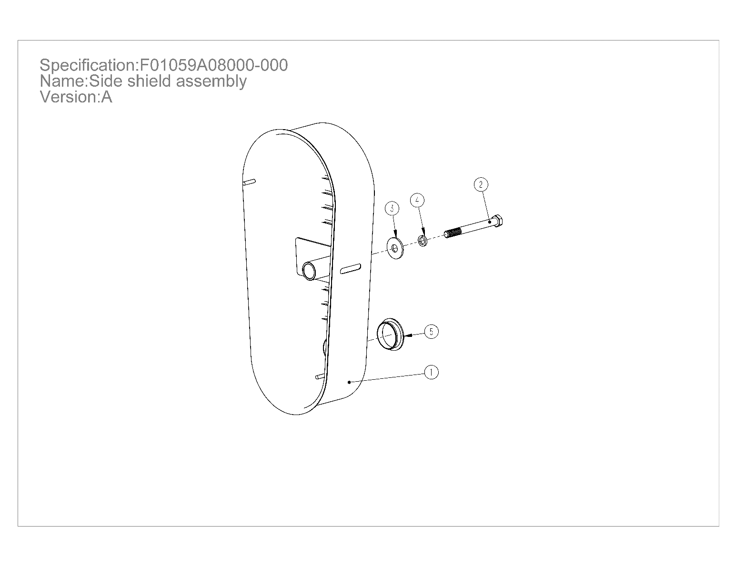
Section 7 ：Part List
Section 7. 8：Belt mask assembly
POS. | COD. | Specification | Description | Qty
1 | 2020002105 | F01059A08100-000 | Welding of pulley cover | 1
2 | 3040300615 | GB/T5782-M12×120-8.8-EP•Zn•C | Hexagon head bolts | 1
3 | 3080200605 | GB/T96.2-12-EP•Zn•C | Large plain washer | 1
4 | 3080500608 | GB/T93-12-EP•Zn•C | Spring washer | 1
5 | 3210200009 | G01009A08000-008 | Pipe Plug | 1
35

Slide 38
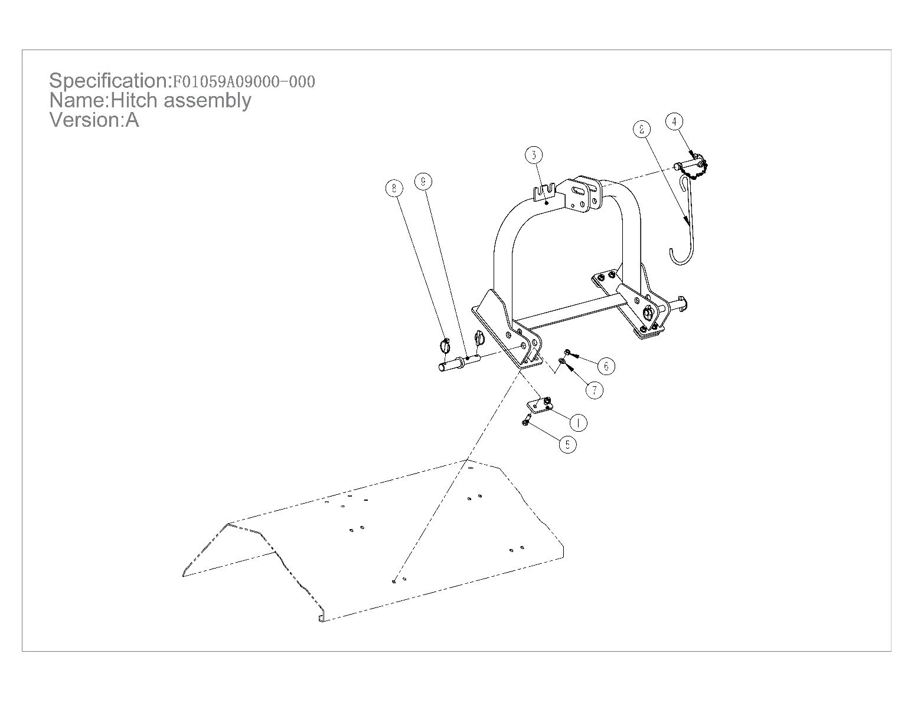
Section 7 ：Part List
Section 7.9 ：Hitch assembly
POS. | COD. | Specification | Description | Qty
1 | 2000005004 | F01059A09000-001 | Plate | 4
2 | 2010004925 | F01059A09000-002 | PTO shaft hook | 1
3 | 2020005219 | F01059A09100-000 | Hitch weldment | 1
4 | 2060204986 | F01062A09400-000 | Assembly | 1
5 | 3040100636 | GB/T5783-M12×40-8.8-EP•Zn•C | Full-thread hexagon bolts | 8
6 | 3050500612 | GB/T889.1-M12-8-EP•Zn•C | Locknut | 8
7 | 3080100610 | GB/T95-12-EP•Zn•C | Plain washer | 16
8 | 3120400601 | GB/T4329-12-EP•Zn•C | Pin | 4
9 | 3120500604 | MT95015 | Pin | 2
36

Slide 39
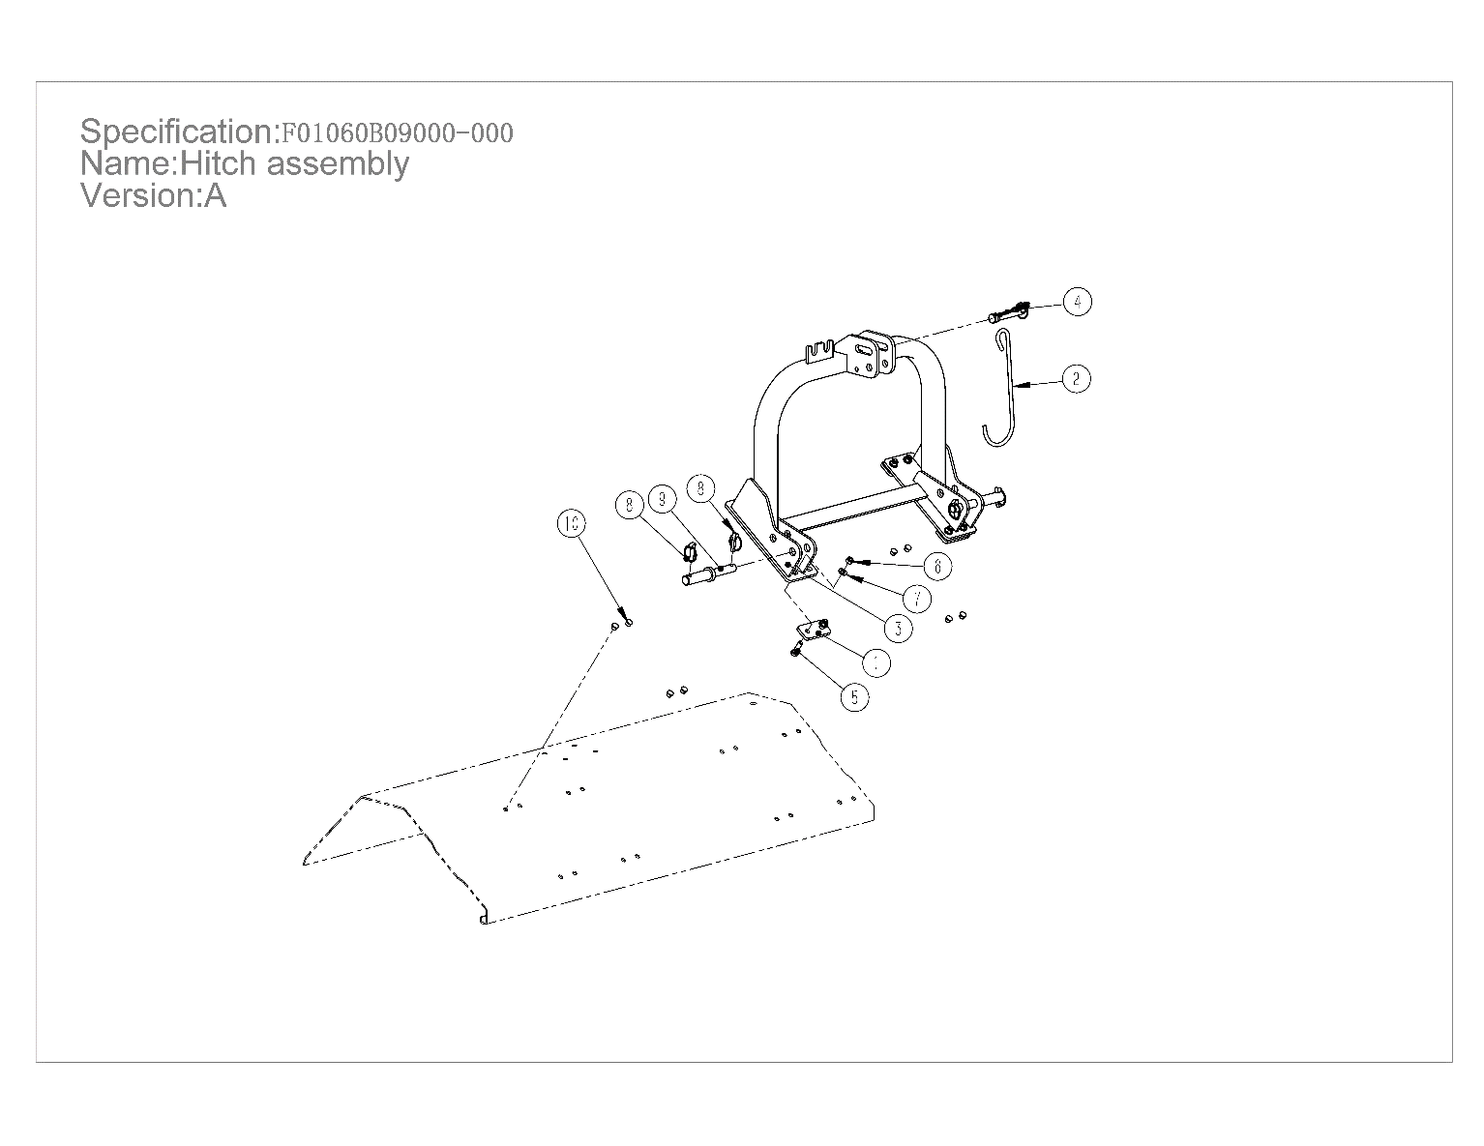
Section 7 ：Part List
Section 7.9 ：Hitch assembly
POS. | COD. | Specification | Description | Qty
1 | 2000005004 | F01059A09000-001 | Plate | 4
2 | 2010004925 | F01059A09000-002 | PTO shaft hook | 1
3 | 2020005219 | F01059A09100-000 | Hitch weldment | 1
4 | 2060204986 | F01062A09400-000 | Assembly | 1
5 | 3040100636 | GB/T5783-M12×40-8.8-EP•Zn•C | Full-thread hexagon bolts | 8
6 | 3050500612 | GB/T889.1-M12-8-EP•Zn•C | Locknut | 8
7 | 3080100610 | GB/T95-12-EP•Zn•C | Plain washer | 16
8 | 3120400601 | GB/T4329-12-EP•Zn•C | Pin | 4
9 | 3120500604 | MT95015 | Pin | 2
10 | 3210200616 | XCD-8041 | Pipe Plug | 8
37

Slide 40
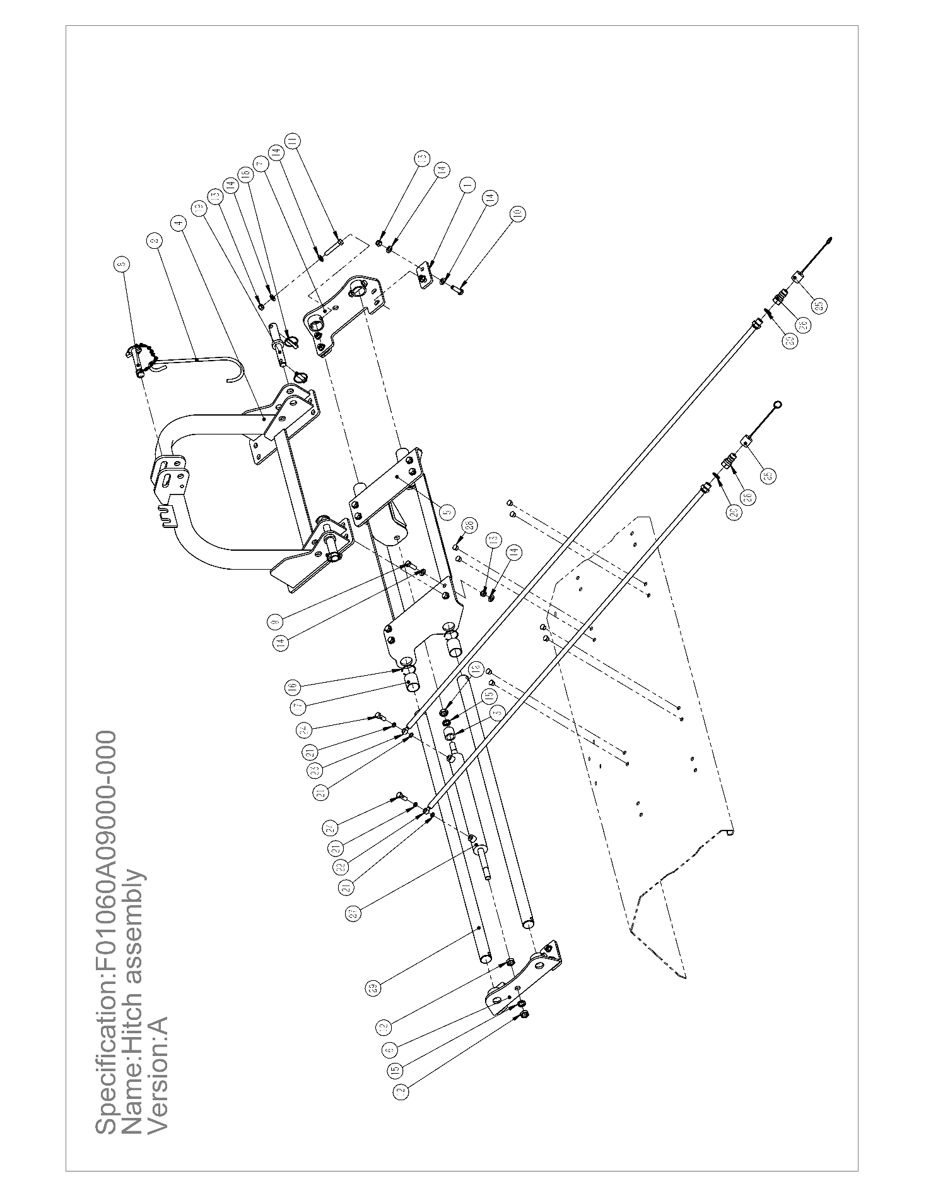
Section 7 ：Part List
Section 7.9：Hitch assembly
38

Slide 41
Section 7 ：Part List
Section 7.9 ：Hitch assembly
POS. | COD. | Specification | Description | Qty
1 | 2000005004 | F01059A09000-001 | Plate | 4
2 | 2010004925 | F01059A09000-002 | PTO shaft hook | 1
3 | 2010004926 | F01060A09000-001 | Spacer sleeve | 1
4 | 2020005219 | F01059A09100-000 | Hitch weldment | 1
5 | 2020005220 | F01060A09100-000 | Weldment | 1
6 | 2020005221 | F01060A09200-000 | Weldment | 1
7 | 2020005222 | F01060A09300-000 | Weldment | 1
8 | 2060204986 | F01062A09400-000 | Assembly | 1
9 | 3040100630 | GB/T5783-M12×35-8.8-EP•Zn•C | Full-thread hexagon bolts | 8
10 | 3040100636 | GB/T5783-M12×40-8.8-EP•Zn•C | Full-thread hexagon bolts | 8
11 | 3040300614 | GB/T5782-M12×70-8.8-EP•Zn•C | Hexagon head bolts | 4
12 | 3050400602 | GB/T6173-M18×1.5-05-EP•Zn•C | Hexagon thin nut (fine pitch) | 3
13 | 3050500612 | GB/T889.1-M12-8-EP•Zn•C | Locknut | 20
14 | 3080100610 | GB/T95-12-EP•Zn•C | Plain washer | 40
15 | 3080500610 | GB/T93-18-EP•Zn•C | Spring washer | 2
16 | 3080900601 | GB/T895.1-45×2.5-EP•Zn•C | Roundwire snap ring for hole | 4
17 | 3100900009 | SF-2-40×44×50 | Bushings | 4
18 | 3120400601 | GB/T4329-12-EP•Zn•C | Pin | 4
19 | 3120500604 | MT95015 | Pin | 2
20 | 3170300006 | BS/A-21.5×28.6×2.5-Q235 | Combined sealing gaskets | 2
21 | 3170300010 | BS-12.4×16×2-Q235 | Combined sealing gaskets | 4
22 | 3180200695 | 2SN06BL×O20910-04-12/M10610-04-08×1500+04 | Hose | 1
23 | 3180200696 | 2SN06BL×O20910-04-12/M10610-04-08×1900+04 | Hose | 1
24 | 3180300601 | M12×1.25-32-5-22-EP•Zn•C | Hollow bolt | 2
25 | 3180400044 | TF12R | Cap | 2
26 | 3180500601 | Q00211041A-08-08-EP▪Zn▪C | Hollow bolt | 2
27 | 3181300028 | CDL1MP5-40/20/348-D-M12×1.25-1CAUM | Hydraulic cylinder | 1
28 | 3210200616 | XCD-8041 | Pipe Plug | 8
29 | 3230100601 | MT90006 | Guide rail | 2
39

Slide 42
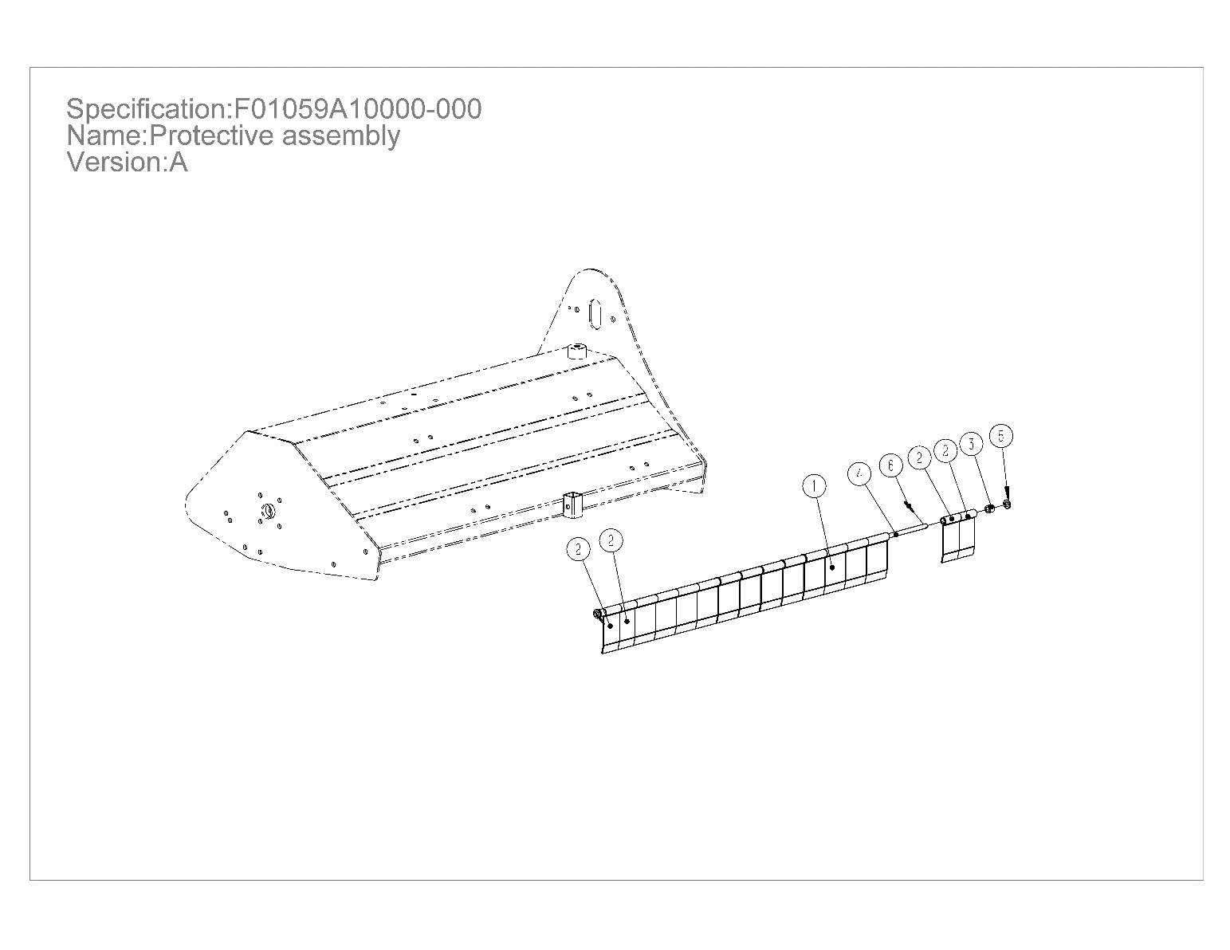
Section 7 ：Part List
Section 7.10 ：Protective components
POS. | COD. | Specification | Description | Qty
1 | 2000004888 | F01059A10000-004 | Plate | 12
2 | 2000004889 | F01059A10000-003 | Plate | 4
3 | 2010004928 | F01059A10000-001 | Spacer sleeve | 2
4 | 2010004929 | F01059A10000-002 | Baffle axle | 1
5 | 3080100610 | GB/T95-12-EP•Zn•C | Plain washer | 6
6 | 3120100602 | GB/T91-4×28-EP•Zn•C | Split pin | 2
40

Slide 43
Section 8: Wearing Part List
Item | Material code | Part No. | Description | Qty | mark
1 | 3050500610 | GB/T889.1-M16-10-EP•Zn•C | Locknut | 20 | Used in 125 Model
2 | 3040300610 | GB/T5782-M16×85-10.9-O | Hexagon bolt | 20
3 | 3220100616 | MT01027 | Blade | 20
4 | 3160300016 | GB/T11544-BX1016 | Belt | 3
1 | 3050500610 | GB/T889.1-M16-10-EP•Zn•C | Locknut | 24 | Used in 155 Model
2 | 3040300610 | GB/T5782-M16×85-10.9-O | Hexagon bolt | 24
3 | 3220100616 | MT01027 | Blade | 24
4 | 3160300016 | GB/T11544-BX1016 | Belt | 3
1 | 3050500610 | GB/T889.1-M16-10-EP•Zn•C | Locknut | 28 | Used in 175 Model
2 | 3040300610 | GB/T5782-M16×85-10.9-O | Hexagon bolt | 28
3 | 3220100616 | MT01027 | Blade | 28
4 | 3160300016 | GB/T11544-BX1016 | Belt | 3
1 | 3050500610 | GB/T889.1-M16-10-EP•Zn•C | Locknut | 24 | Used in 155H Model
2 | 3040300610 | GB/T5782-M16×85-10.9-O | Hexagon bolt | 24
3 | 3220100616 | MT01027 | Blade | 24
4 | 3160300016 | GB/T11544-BX1016 | Belt | 3
1 | 3050500610 | GB/T889.1-M16-10-EP•Zn•C | Locknut | 28 | Used in 175H Model
2 | 3040300610 | GB/T5782-M16×85-10.9-O | Hexagon bolt | 28
3 | 3220100616 | MT01027 | Blade | 28
4 | 3160300016 | GB/T11544-BX1016 | Belt | 3
41

Slide 44
Section 9: Troubleshooting
Problem | Solution
! CAUTION Do not try to clean rear discharge area when Mowers is running. Bodily harm may occur!
Belt slipping | Unplug and clean Mowers deck.
 | Remove belt guard shields and clean sheaves.
 | Replace belt
Patches of uncut to land | Mow at full throttle (540 PTO rpm), check PTO speed, and tractor engine.
 | Shift transmission to a lower gear.
 | Tighten belts.
 | Replace missing blades.
Excessive vibration | Replace blades.
 | Replace drive belt.
 | Replace pulleys or align.
 | Remove belt guard shields & clean debris from belt area & sheaves.
Gearbox noisy | Check lubricant level.
blades scalping grass | Raise Crushing height by adjusting .
 | Change broken pattern.
 | Reduce speed turns.
Uneven cut | Shift to a lower gear.
 | Level Mowers .
 | Replace missing blades or hammers
Tractor loaded down by Mowers | Mow at full throttle (540 PTO rpm).
 | Shift to a lower gear.
 | Clean Mowers .
42

Slide 45
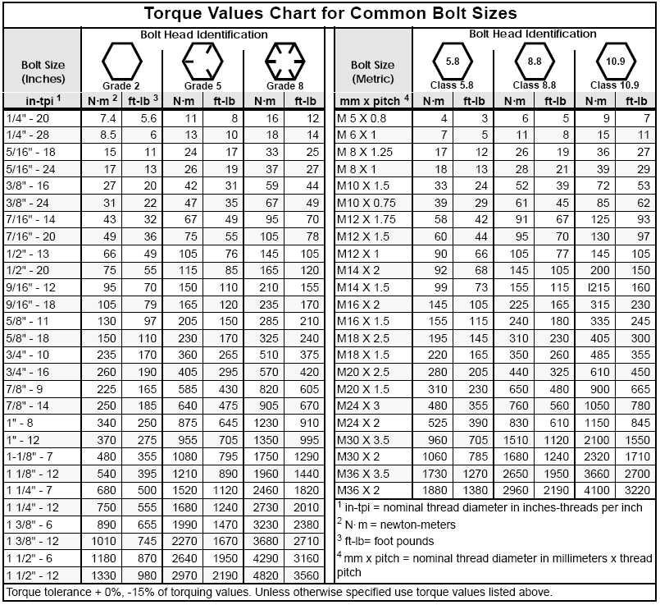
Section 10: Torque Values Chart
43

Slide 46
Section 11: Warranty
Warranty
MATENG warrants to the original purchaser that this MATENG product will
be free from defects in material and workmanship beginning on the date of
purchase by the end user according to the following schedule when used as
intended and under normal service and conditions for personal use.
Overall Unit and Driveline: Eighteen months Parts and Labor
Gearbox: Three years on all components.
Blades and Belts: Considered wear items.
This Warranty is limited to the replacement of any defective part by Mateng and the installation by the dealer of any such replacement part, and does
not cover common wear items. MATENG reserves the right to inspect any
equipment or parts which are claimed to have been defective in material or
workmanship.
This Warranty does not apply to any part or product which in Mateng’s
judgment shall have been misused or damaged by accident or lack of normal
maintenance or care, or which has been repaired or altered in a way which
adversely affects its performance or reliability, or which has been used for a
purpose for which the product is not designed. Misuse also specifically includes
failure to properly maintain oil levels, grease points, and driveline shafts.
Claims under this Warranty should be made to the dealer which originally sold
the product and all warranty adjustments must be made through an authorized
MATENG dealer. MATENG reserves the right to make changes in materials
or design of the product at any time without notice.
This Warranty shall not be interpreted to render MATENG liable for damages
of any kind, direct, consequential, or contingent to property. Furthermore, Mateng shall not be liable for damages resulting from any cause beyond its
reasonable control. This Warranty does not extend to loss of crops, any expense
or loss for labor, supplies, rental machinery or for any other reason.
No other warranty of any kind whatsoever, express or implied, is made
with respect to this sale; and all implied warranties of merchantability and
fitness for a particular purpose which exceed the obligations set forth in
this written warranty are hereby disclaimed and excluded from this sale.
This Warranty is not valid unless registered with MATENG within 30 days
from the date of purchase by the end user.
Model Number ____________________ Serial Number ____________________
44

