Slide 1
2019 Annual Report
KINGSTON & FRONTENAC HOUSING CORPORATION

Slide 2
KFHC 2019 Annual Report
TABLE OF CONTENTS:
ABOUT KFHC…………………………………………………………………...3
MESSAGE FROM THE BOARD CHAIR……………………………………..4
BOARD OF DIRECTORS……………………………………………………...6
MESSAGE FROM THE CEO………………………………………….………7
MANAGER TECHNICAL SERVICES REPORT…….................................9
PROPERTY MANAGER REPORT…………………………………….…….13
MANAGER SUPPORT SERVICE REPORT………………………………..16
MANAGER ADMINISTRATIVE & FINANCIAL SERVICES REPORT…..18
AUDITED FINANCIAL STATEMENTS…………………………………..….22

Slide 3
KFHC 2019 Annual Report
ABOUT KFHC
Mission
We will provide quality affordable
housing, advocate for strong communities and demonstrate respect for all.
Vision
Kingston & Frontenac Housing Corporation will be an active leader in housing by fostering informed, engaged tenants and communities.
Our Board
Our Staff
Our Tenants
Our Community
KFHC’s Board of Directors is comprised of two members of Council, six community leaders and the CAO of the City of Kingston. Our Board of Directors ensures clear mission & purpose, effective strategic planning, evaluation of the CEO, ensures sound financial & legal practices (fiduciary), financial resources, delivers mission and used effectively, engages stakeholders, ensures effective governance.
KFHC staff work within the framework of our Mission Statement and Strategic Plan to provide and maintain our buildings in a safe and supportive environment for our tenants.
Twenty-seven full time office/maintenance staff and ten Building Monitors make up the current staffing compliment.
KFHC works with tenants to develop a Tenant Advisory Group (TAG) to provide leadership and recommendations to staff on tenant concerns, ideas and improvements within the KFHC portfolio.
KFHC serves the community by providing 1082 homes and offering housing programs for the City of Kingston.

Slide 4
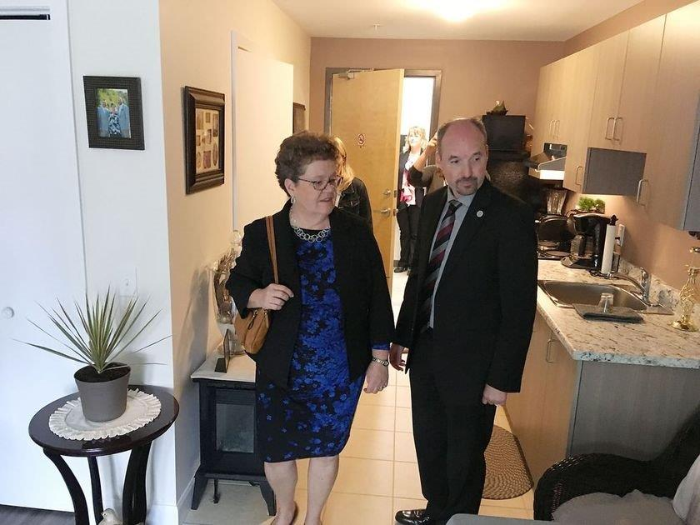
Message from the Board Chair
KFHC 2019 Annual Report
It has been my pleasure to serve as the Chair of the Kingston & Frontenac Housing Corporation Board of Directors for 2019 and to see, first-hand, the dedication, talent and innovative spirit of our employees and board members.
We drafted a new strategic plan early in the year and this document has guided our work as a board and as the largest subsidized housing provider in the region.
An innovative approach to increasing our housing stock led to the construction of “infill” units at our Cliff Crescent and Nickel Curtis sites.
This infill work, which added new apartments to the end of existing townhouse buildings, will continue through to 2020. In total, twelve new residential units opened through our infill projects in 2019 in addition to the twenty nine units completed in early 2019 at 645 Brock Street.
This year, funding was made available to KFHC from all three levels of government for other new housing projects. KFHC is pleased to be
co-developing a new housing complex at 27 Wright Crescent, in collaboration with CJM Property Management Ltd.
Denise Cumming
Board Chair
KFHC Board Chair Denise Cumming and Mayor Paterson tour a new bachelor suite at 645 Brock Street Grand Opening

Slide 5
KFHC 2019 Annual Report
Our three-storey apartment building will share the property with a private-sector market-rent apartment building being built by CJM Property Management Ltd. We are grateful that the City of Kingston has made available the land, which is conveniently located near stores, schools, recreational facilities and public transit. We look forward to the completion of our building on this site, scheduled for fall of 2021.
KFHC has also been asked to take on a leadership role developing a new housing complex at 1316 Princess Street – another well-situated location for rental units. This project will fall later on our project timeline, with the possibility of ninety new apartments constructed by 2023.
Our work with Town Homes Kingston has also progressed through the year. In July, we added administration and finance to the maintenance services that we have been providing to THK since 2018. This fee-for-service arrangement has allowed our joint THK-KFHC task force to identify the best corporate structure to manage both KFHC and THK properties in the years ahead. We hope to have this work completed and the final corporate structure in place by December of this year.
Our board remains grateful to our Management team for their compassionate and capable leadership through some trying circumstances this year. We are grateful for the commitment and support of all of our staff and volunteers, including those who serve on our Tenant Advisory Councils.
We look forward to another productive and rewarding year in 2020.
With thanks
Denise Cumming

Slide 6
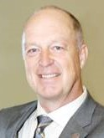
BOARD OF DIRECTORS
KFHC 2019 Annual Report
Catharine Gibson
Vice Chair
Alexandra Ortiz Carlsson Director
Don Amos Director
Denise Cumming
Board Chair
Councillor Gary Oosterhof Director
Kalam Mir Director
Councillor Bridget Doherty Director
Bob Godkin
Director

Slide 7
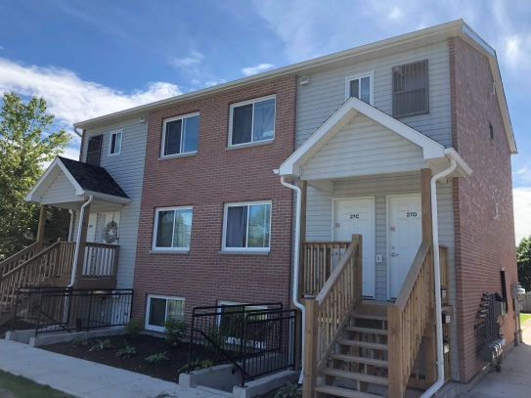
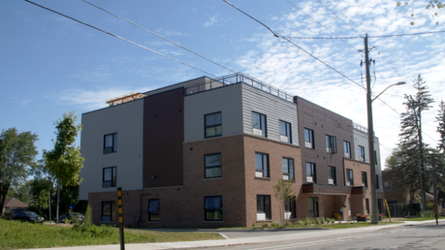
MESSAGE FROM THE CHIEF EXECUTIVE OFFICER
KFHC 2019 Annual Report
It is a privilege to share with you the Annual Report for 2019 which highlights a very busy and successful year. At Kingston & Frontenac Housing Corporation (KFHC) we have focused on the delivery of well-maintained housing units and increasing housing options through the Management Agreement with the Kingston Municipal Non-Profit Housing Corporation, the introduction of the Portable Housing Benefit and the construction of new affordable housing units.
To assist Kingston Municipal Non-Profit Housing Corporation (Town Homes Kingston), the City of Kingston and KFHC signed a service agreement to manage all aspects of the operations which commenced on July 1st, 2019. Due to the well-established processes and systems currently in place at KFHC the implementation of the management agreement was smooth and resulted in efficiencies and reduced contracting costs. The oversight by KFHC was done without any disruptions to the tenants at both organizations.
28 Cliff Crescent “Infill” Project
Mary Lynn Cousins Brame, CEO
645 Brock Street New Build

Slide 8
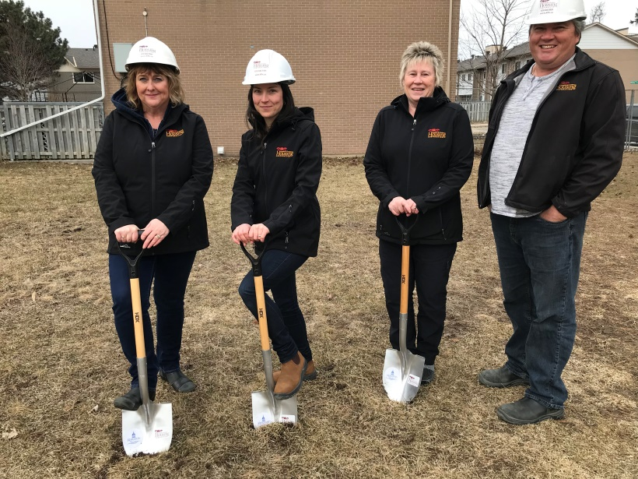
KFHC 2019 Annual Report
To promote affordable housing in the area the Service Manager introduced the Portable Housing Benefit. The Benefit provides applicants a rent subsidy which contributes to their rent with their current landlord or with a new landlord. KFHC manages the program for the City and supports the funding for this program through the conversion of twenty units from RGI to market rent. The reduced subsidy received by KFHC is providing funding for the new program which is increasing the affordability of rents in the community.
KFHC is looking forward to continued partnerships and collaborations with our tenants, the City of Kingston, community organizations and the housing sector to advance the Corporation’s objectives.
I would like to acknowledge and thank the contributions of our tenants, staff, Board of Directors and Stakeholders as we continue on the path to increase quality, affordable homes in our community. Together we can build tenant engagement with the creation of new housing solutions to meet the emerging community needs and to strengthen the organizational resiliency and capacity of the corporation to ensure long-term sustainability.
Ground Breaking at Curtis Crescent

Slide 9
KFHC 2019 Annual Report
Technical Service Department
2019 was a year to refocus on efficiencies, and in many ways, to reinvent ourselves. With the Town Homes Kingston properties now maintained by KFHC for a full twelve months, we were able to combine many operating tenders with both properties portfolios. In addition, the sheer scope of adding three hundred and ninety eight properties allows us to increase our productivity through more robust procedures, property reallocations, and equipment acquisitions.
The spring and summer saw our largest group of summer students ever hired allowing for two groups in two trucks and utilizing three large industrial mowers. The students performed the landscaping for both portfolios in a timely manner resulting in well maintained properties throughout.
SCOTT VANDERSCHOOR, CCCA, CIHCM
MANAGER
The maintenance crew, now consisting of eight full time field staff members, three office staff members, and a Supervisor, has approximately 1,479 units to take care of as well as the common areas of eighteen buildings. Pest control in 2019 was one of the single most expensive line items from our operating budget with plumbing running a very close second.
Four thousand four hundred and fifty four work orders were required to maintain the KFHC properties with 81% of those (3,609) completed internally by our own staff members as shown in Figure 1.1 below, and 19% of those (845) completed by outside contractors. A total of ninety eight KFHC units were renovated for new tenants during 2019 averaging eight per month. All vacant units, which were not held up due to pest infestations or extreme damages, were completed and ready for the new, incoming tenants generally in less than thirty calendar days. Figure 1.2 shows the same work orders done internally by KFHC staff broken out by the priority in which they were categorized by, priority less than seven days, urgent less than four hours, move out, life safety, or general. The vast majority or work orders are categorized as less than seven days, and our overall goal for all work orders is that they are addressed within fourteen days.

Slide 10
KFHC 2019 Annual Report
KFHC Work Orders Completed by Type
Total Completed Work Orders By Priority
Figure 1.1
Figure 1.2
*Based on 3,609 work orders completed by staff in 2019
**“Interior” work orders include cabinets, flooring, drywall repairs, etc.

Slide 11
KFHC 2019 Annual Report
Our newest apartment building located at 645 Brock Street in Kingston opened in early 2019 bringing on twenty nine new mixed income apartments with onsite laundry facilities, a ground floor common area, a full size interior bike storage room, interior garbage and recycling area, and a large roof top amenity space. This new building has eighteen bachelor suites and eleven one bedroom suites.
Some Customer Service initiatives continuing:
Expanded our work wear to t-shirts, ball caps, toques, golf shirts which help to identify us to our tenants.
The distribution of a Maintenance brochure.
“Sorry we missed you” cards.
Comment cards left behind after service calls for tenant feedback.
The 2019 KFHC Capital program included:
All of the in-suite exterior windows and exterior doors were changed at 381 Bagot to a more efficient and warmer E-star rated product benefitting one hundred and four tenants for a cost of $600,005.
Windows were also replaced in forty townhouses at 312 Conacher for a cost of $200,615.
We replaced the kitchens in fifty townhouse units located at 1130 Montreal for a cost of $279,463.
We removed all of our dead or dying ash trees (64 in total) for a cost of $41,174.
We replaced the playground at 1130 Montreal Street for a cost of $40,370.

Slide 12
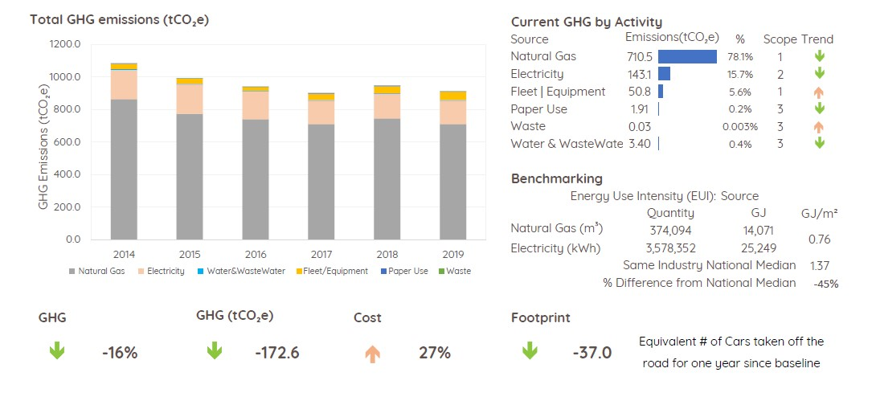
KFHC 2019 Annual Report
In 2019 KFHC continued its membership with Sustainable Kingston and with our goal of an overall reduction in greenhouse gas emissions of 25%. In 2019 we further reduced our GHG by an additional 3.8% from 2018, for a total of 16% reduction since 2014.
Figure 1.3 is a summary chart taken from the 2019 Annual Report produced by Sustainable Kingston for KFHC.
Figure 1.3

Slide 13
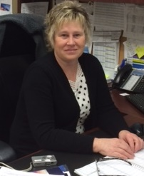
KFHC 2019 Annual Report
Property Management Department
The Property Management Department saw many challenges over the past year. KFHC took over the management of Town Homes Kingston which was supported by seconding staff from the Property Management Department. Arrears continued to increase over the year due to ongoing issues with scheduling at the Landlord and Tenant Board. The vacancy loss rate increased as a number of units had to be held in order to address pest issues. Tenant’s issues escalated due to inappropriate behavior, non-payment of rent and noncompliance in addressing pest problems which required additional support and guidance to resolve the issues. The Property Management department developed many strategies in which to assist in the resolution of these issues.
The Property Management Department took on the responsibility of administering the Portable Housing Benefit, this benefit was introduced under the Province’s Long Term Affordable Housing Strategy as an alternative to existing social housing programs. The program offers more flexibility to households seeking rent-geared-to- income housing. Households who reach the top of the chronological waitlist for RGI assistance are now able to find their own accommodation and receive a monthly housing subsidy. The City of Kingston and KFHC entered into an administration agreement for this pilot program. Fifty households were offered this subsidy, of which thirty are funded by the City of Kingston with KFHC funding the remaining twenty by converting RGI units to Market. We quickly were confronted with the challenges of trying to integrate market tenants into high density townhouse RGI areas. To resolve the issue of high turnover and high rent arrears, a number of the market units we relocated to one of KFHC’s owned apartment building downtown where we were experiencing successful market rentals.
Patricia Price, A.I.H.M
Manager

Slide 14
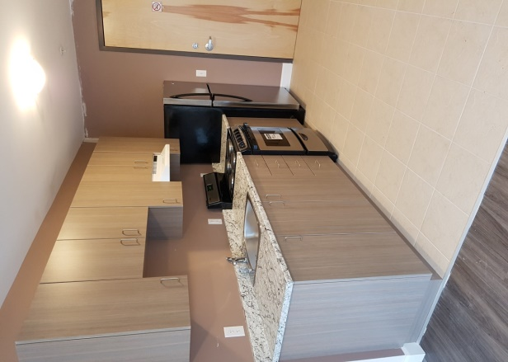
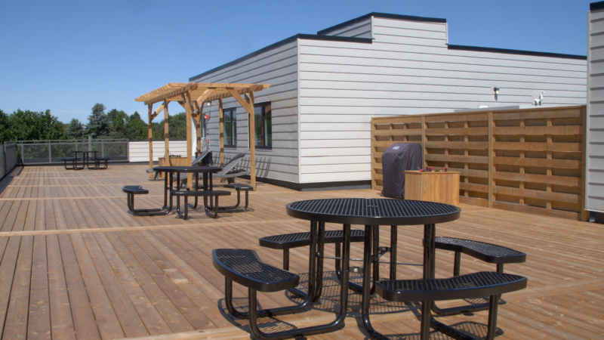
KFHC 2019 Annual Report
Our newest building opened at 645 Brock Street which is our second mixed income building consisting of market, affordable and RGI tenants. The building is fully occupied and our grand opening was held on May 29th, 2019.
Looking to the future, the property management department is excited about the merging of Town Homes Kingston and Kingston & Frontenac Housing Corporation, the roll out of the new directives of simplified rent calculations, and new developments.
645 Brock Street Bachelor Unit
645 Brock Street Rooftop Terrace

Slide 15
KFHC 2019 Annual Report
KFHC Food Rescue Program
Kingston & Frontenac Housing Corporation has rescued 10,832 lbs of food in 2019 through FoodRescue.ca. In this year, they worked with fifteen business in the community by recovering fresh surplus food for a total of 249 rescues. These rescues helped provide 10,832 meals, divert 27,255 lbs of greenhouse gas emissions and save $28,163.
Pickup Location | Food (lbs) | Count of Rescues
Tim Horton's #1308 | 8,328 | 127
James’ Valumart | 1,280 | 52
St. Lawrence College Culinary Program | 197 | 26
Arlington Park Tim Horton's | 167 | 12
Balzac’s Coffee – Kingston | 32 | 7
Tim Horton's #177 – 1166 Division St. Kingston, ON | 275 | 6
Aqua Terra | 39 | 4
The Elm Cafe | 17 | 4
Mary Brown’s – Kingston West | 110 | 3
Tim Horton's #1552 – 4037 Bath Road Kingston, ON | 100 | 2
Tim Horton's #3702 – 640 Dalton Ave Kingston, ON | 16 | 2
Copper Branch Kingston | 100 | 1
Juniper Cafe | 11 | 1
Tim Horton's #3015 | 10 | 1
Tony Deodato & Sons | 150 | 1
Grand Total | 10,832 | 249
10,832
Meals provided
“Thank you for your partnership with Second Harvest Food Rescue. Your engagement is helping provide food to people who need it, saving valuable surplus food from going to waste and reducing negative environmental emissions. "
$28,163
Donated food value
27,255 lbs of GHGs
Emissions averted

Slide 16
KFHC 2019 Annual Report
Support Services
The unmet needs of tenants and lack of supports available to meet them continue to be a concern for KFHC. With the assistance of seventeen students made available through our partnerships with Queen’s University Nursing, Queen’s University Occupational Therapy, and St. Lawrence College/ Laurentian University Nursing, individual and group interventions were available to approximately 15% of the portfolio. We acknowledge their commitment to support the tenants.
Fiona Drake, B.A, M.Ed.
Manager
Mental Health First Aid continues to be a useful training to support our ability to respond to people with mental health issues living in social housing. Support Services had the opportunity to assist other housing corporations with training and 2019 saw us delivering this program to both Peterborough and Cornwall Housing corporations. We are proud to be part of a network committed to giving people a framework to be able to better understand and offer assistance to individuals experiencing mental health problems or crises.

Slide 17
KFHC 2019 Annual Report
We were very excited to be chosen to be part of an initiative with Queen’s University in the development and implementation of the Oasis program. Oasis is designed to support seniors living independently so they can remain in their homes longer, by providing them a space to be social, get active and connect. The program has been very much appreciated and we thank everyone who participated in and supported this program.
The CP@Clinic, launched in May of 2018 at 129 Van Order Dr., continued to run this year. Tenants received free health checkups, personalized health advice and links to other resources from our favourite paramedic, Jason Kervin. As 2019 came to an end, with good health stabilization having been achieved, the plan is to launch this program at Rideaucrest Towers in 2020. Thank you, Frontenac Paramedics, for supporting our tenants!

Slide 18
KFHC 2019 Annual Report
FINANCE DEPARTMENT
The annual report is my opportunity in which to highlight the financial success of the corporation. Kingston & Frontenac Housing Corporation’s strategic plan guides the work of the corporation. Three critical areas of focus have been established, that of healthy financial performance to sustain all housing programs under the KFHC portfolio, well maintained housing for our residents and building new housing solutions to meet the Kingston community need. Under each focus there are established goals which specifically address how KFHC aims to expand its portfolio and increase the financial sustainability of the corporation.
Our goals are long-term with expected accomplishments extending beyond the one fiscal year (January to December). The corporation establishes the activities for the fiscal year and monitors them monthly with the 4th quarter providing direction for the next fiscal year and financial cycle. The actual progression and work is reviewed monthly at the Finance, Audit and Administration subcommittee meeting with the Committee Chair updating the Board of Directors. The monthly financial results and annual audited financial statements are submitted to the Service Manager and the City of Kingston. This cycle of reporting on what we are planning to accomplish and what has been achieved is essential for accountability to the Board and the Shareholders.
Dan Song, AIHM,CPA,CGA
Manager

Slide 19
KFHC 2019 Annual Report
In 2019, we built and successfully rented 41 new apartments with different affordable level rents at 645 Brock Street and 28 Cliff Crescent. This accomplishment marked new additional assets of $6,790,440 into KFHC’s housing stock.
Up to 2019, we have built 146 new apartments valued at $24 million under the affordable housing program. The corporation is still enthusiastically continuing with the goal to increase additional mixed-income rental units and building more self-sustainable buildings in Kingston. In addition to our new construction, we continue to operate the RGI program managing 956 families under the program, which has an accumulated equity of $1,262,585 meanwhile, over the past three year’s (2017 to 2019) KFHC has returned the contributions of $262,457 back to City of Kingston.
The financial information contained in the charts reveals that KFHC spent over $13 million in operating funding in 2019 to sustain our portfolio, support our tenants and offer a variety of housing programs to the community.
KFHC’s financial success is fundamentally tied to having strong internal controls, a dedicated staffing group and good governance at the Committee and Board level. The Executive Management Team has outstanding leadership through the development of business plans, the evaluation of performance and the continual monitoring and adjusting of financial expenditures, revenue generation and investments. As the financial controller of a fast growing corporation I am grateful for the dedication, competence and commitment of the staff, managers and board.

Slide 20
KFHC 2019 Annual Report

Slide 21
KFHC 2019 Annual Report

