Slide 1
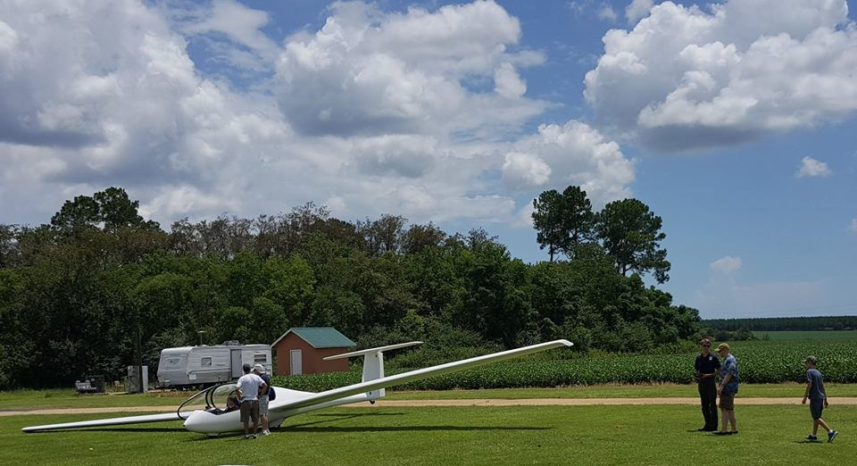
Coastal Soaring Association Membership Packages

Slide 2
Six Pack ($595)
One (1) Six-Pack membership (lasts for 90 days)
Six (6) dual-instructional flights to 3000 ft with an FAA-qualified Glider Flight Instructor (flights must be completed within 90 days)
Package includes
Soaring Society of America membership (lasts for 90 days)
Three (3) months’ club dues
Oct 2024

Slide 3
Snowbird ($200-$500)
Members of SSA-affiliated soaring clubs may join Coastal Soaring Association as Snowbirds for a minimum of one (1) month and a maximum of six (6) months yearly. Snowbirds are non-voting members with flight privileges.
$140 annual Snowbird fee
$60 per month dues
Must be a current member in good standing with an SSA-affiliated club or possess private insurance through SSA Group Plan.
Must meet CSA currency and proficiency requirements.
Oct 2024

Slide 4
Armchair Dream-to-Solo ($2795)
Coastal Soaring Association membership
Soaring Society of America membership
Thirty (30) dual-instructional glider flights with FAA-qualified Flight Instructor
First solo flight
Six (6) months’ club dues
1. Should first solo occur prior to flight number 30, remaining flights may be flown dual or solo at the discretion of the duty CFI-G.
2. Should student not be ready to solo at flight number 30, up to five (5) additional flights will be provided. Students requiring more than thirty-five (35) flights to solo will be charged on a per-flight basis at regular club rates.
3. After six (6) months, regular club dues rates apply.
Oct 2024

Slide 5
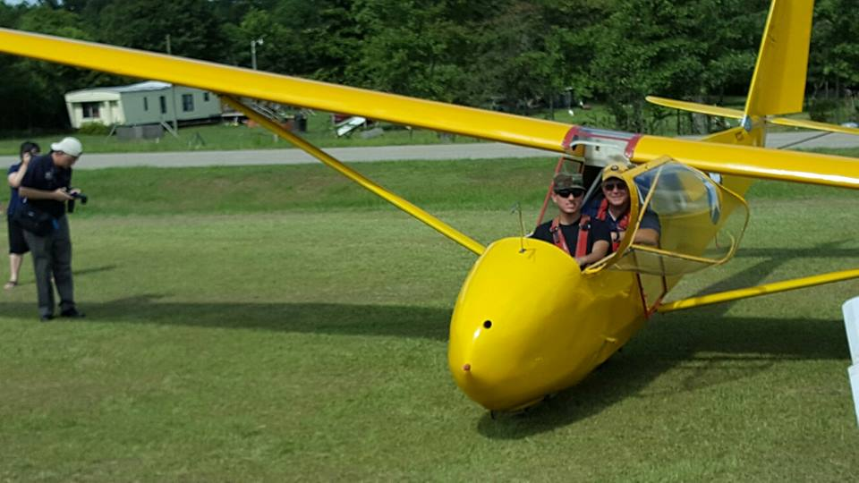
Solo-to-Certificate ($2395)
Six (6) months’ club dues
Thirty (30) flights to facilitate completion of Private Certificate
Written Test preparation
Flight Test preparation
Oct 2024

Slide 6
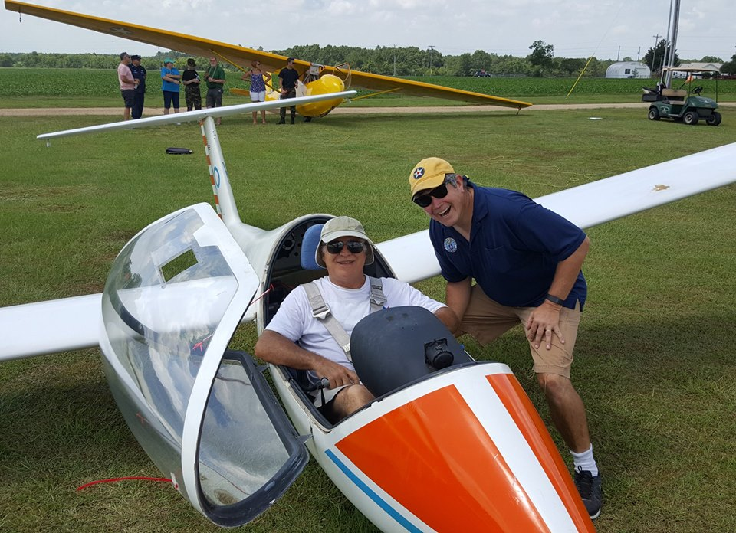
Add-On-Rating – Private ($2795)
Coastal Soaring Association initiation
Six (6) months’ club dues
Thirty (30) flights
Oral preparation for checkride
Oct 2024

Slide 7
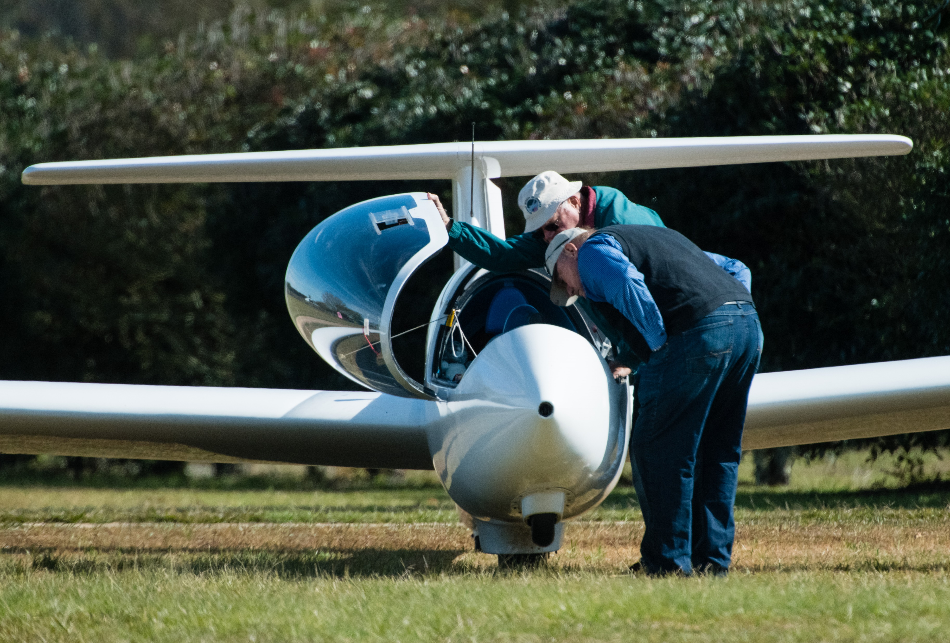
Add-On-Rating – Commercial ($3495)
Coastal Soaring Association initiation fee
Six (6) months’ club dues
Thirty (35) flights
Oral preparation for checkride
Oct 2024

