Slide 1

AUTOMOTIVE TOOL IDENTIFICATION

Slide 2
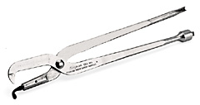
Brake Spring Pliers
2

Slide 3

Brake Adjuster
1

Slide 4
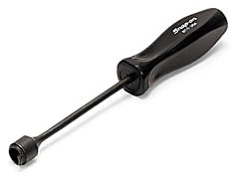
Brake Spring Tool
3

Slide 5

Brake Pedal Jack
4

Slide 6
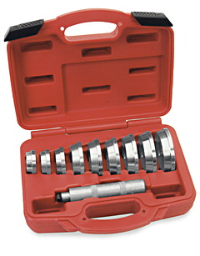
Bearing Seal and Race Driver Set
5

Slide 7
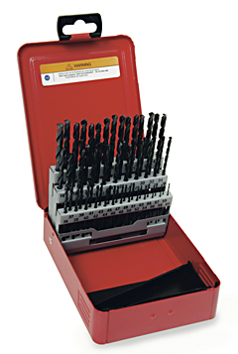
Twist Drill Set
6

Slide 8

Trouble / Work Light
7

Slide 9
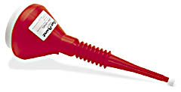
Funnel
8

Slide 10
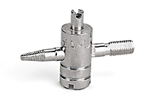
Valve Core Removing Tool
9

Slide 11
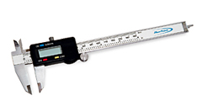
Calipers
10

Slide 12
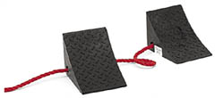
Wheel Chocks
11

Slide 13
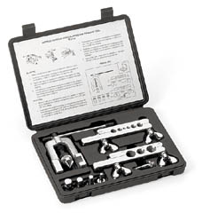
Flaring Tool Set
12

Slide 14
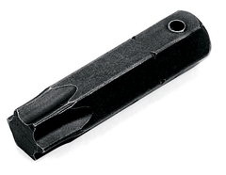
Torx Bit
13

Slide 15

Tap & Die Set
14

Slide 16
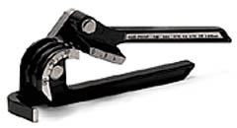
Tubing Bender
15

Slide 17
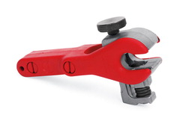
Tubing Cutter
16

Slide 18

Diagonal Cutter Pliers
17

Slide 19

Combination Slip-Joint Pliers
18

Slide 20
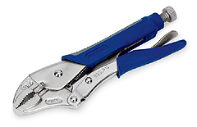
Locking Pliers
19

Slide 21
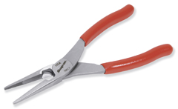
Needle Nose Pliers
20

Slide 22
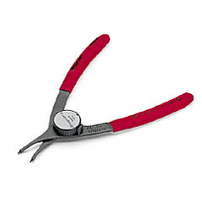
Retaining Ring Pliers
21

Slide 23
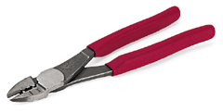
Terminal Crimping Pliers
22

Slide 24
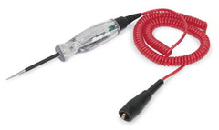
Test Light
23

Slide 25

Digital Brake Drum Gauge
24

Slide 26
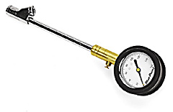
Tire Pressure Gauge
25

Slide 27
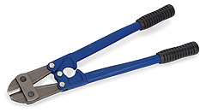
Bolt Cutters
26

Slide 28
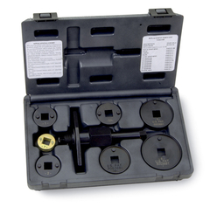
Brake Caliper Tool Set
27

Slide 29
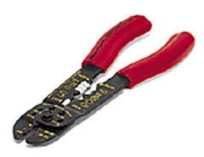
Wire Stripper
28

Slide 30
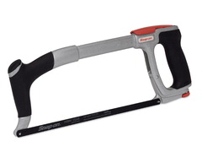
Hacksaw
29

Slide 31

Utility Knife
30

Slide 32
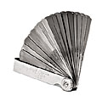
Feeler Gauge
31

Slide 33
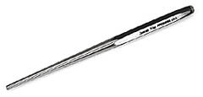
Drift Pin Punch
32

Slide 34

Flat Chisel
33

Slide 35
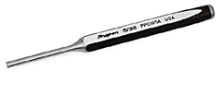
Pin Punch
34

Slide 36

Sliding T-Handle
35

Slide 37
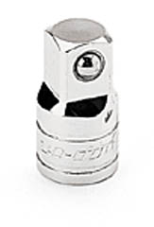
Adaptor
36

Slide 38

Universal Joint
37

Slide 39
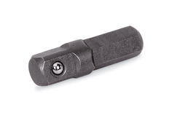
Hex-to-Square Adaptor
38

Slide 40
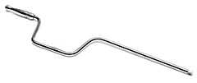
Speeder
39

Slide 41
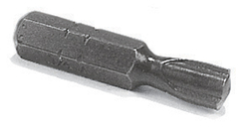
Clutch Bit
40

Slide 42
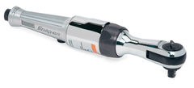
Air Ratchet
41

Slide 43
Hex-to-Square Adaptor
42

Slide 44

Flathead Screwdriver
43

Slide 45
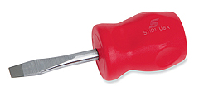
Stubby Flathead Screwdriver
44

Slide 46
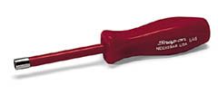
Nut Driver
45

Slide 47

Phillips Screwdriver
46

Slide 48
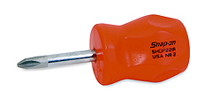
Stubby Phillips Screwdriver
47

Slide 49

Putty Knife
48

Slide 50
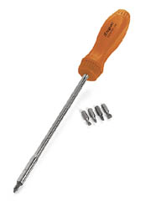
Ratcheting Screwdriver
49

Slide 51

TORX Screwdriver
50

Slide 52
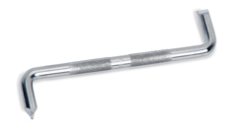
Offset Flat Tip Screwdriver
51

Slide 53
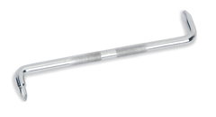
Offset Phillips Screwdriver
52

Slide 54
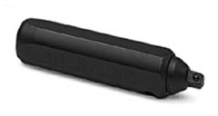
Impact Driver
53

Slide 55
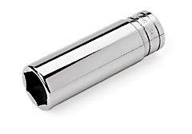
6-Point Deep Socket
54

Slide 56
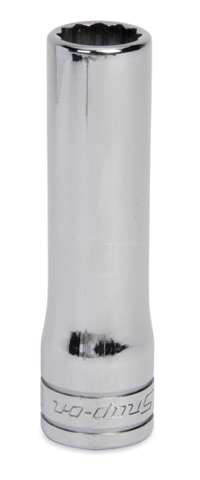
12-Point Deep Socket
55

Slide 57

12-Point Socket
56

Slide 58
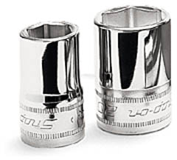
6-Point Socket
57

Slide 59
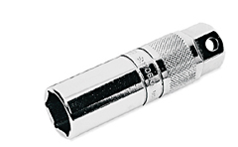
Spark Plug Socket
58

Slide 60
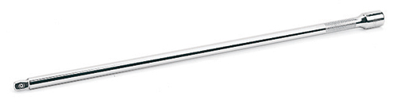
Socket Extension
59

Slide 61
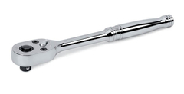
Ratchet
60

Slide 62

Breaker Bar
61

Slide 63

Flex Head Ratchet
62

Slide 64
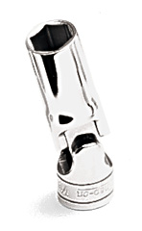
Flexible Socket
63

Slide 65
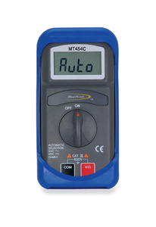
Digital Multimeter
64

Slide 66
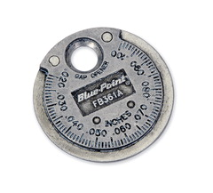
Spark Plug Gap Tool
65

Slide 67
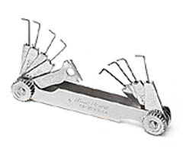
Spark Plug Feeler Gauge
66

Slide 68

Torque Wrench
67

Slide 69
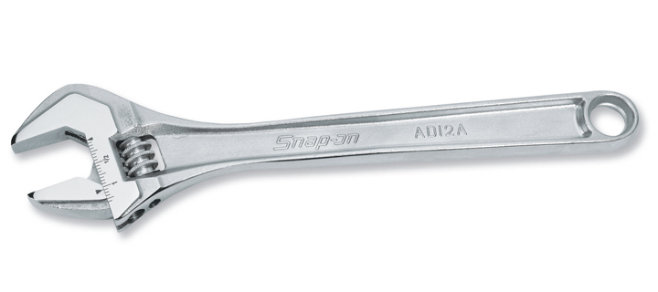
Adjustable Wrench
68

Slide 70

Boxed End Offset Wrench
69

Slide 71

Chain Wrench
70

Slide 72

Flare Nut Wrench
71

Slide 73
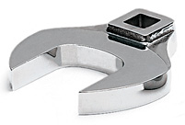
Crowfoot Wrench
72

Slide 74

Rolling Head Pry Bar
73

Slide 75

Straight Pry Bar
74

Slide 76

Center Punch
75

Slide 77
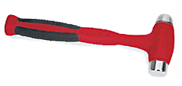
Dead Blow Hammer
76

Slide 78

Ball Peen Hammer
77

Slide 79

Claw Hammer
78

Slide 80

Sledge Hammer
79

Slide 81

Brass Drift Punch
80

Slide 82

Taper Punch
81

Slide 83

Carbon Scraper
82

Slide 84

Gasket Scraper
83

Slide 85

Tape Measure
84

Slide 86

Tread Depth Gauge
85

Slide 87

Wire Brush
86

Slide 88

Allen Wrench
87

Slide 89

Battery Post Cleaner
88

Slide 90

Battery Terminal Puller
89

Slide 91

Battery Cable Pliers
90

Slide 92

Cape Chisel
91

Slide 93

Air Chisel Set
92

Slide 94

Air Compressor
93

Slide 95

Air Pressure Regulator
94

Slide 96

Air Ratchet
95

Slide 97

Brake Bleeder Wrench
96

Slide 98

Jack Stands
97

Slide 99

Parking Brake Cable Tool
98

Slide 100

Battery Charger
99

Slide 101

Rotor Micrometer
100

Slide 102

Coolant System Tester
101

Slide 103

Creeper
102

Slide 104

Dial Indicator
103

Slide 105

Heat Gun
104

Slide 106

Bearing Packer
105

Slide 107

Face Shield
106

Slide 108

Fender Cover
107

Slide 109

Floor Jack
108

Slide 110

Handheld Vacuum Pump
109

Slide 111

Quick Coupler
110

Slide 112

Hydraulic Press
111

Slide 113

Impact Socket
112

Slide 114

Impact Wrench
113

Slide 115

Puller Set
114

Slide 116

Depth Micrometer
115

Slide 117

Outside Micrometer
116

Slide 118

Oil Filter Wrench
117

Slide 119

Oxy-acetylene Torch Wrench
118

Slide 120

Parts Washer
119

Slide 121

Blow Gun
120

Slide 122

Solas Scan Tool
121

Slide 123

Screw Extractor
122

Slide 124

Serpentine Belt Tensioner Tool
123

Slide 125

Snap Ring Pliers
124

Slide 126

Soldering Iron
125

Slide 127

Open End Wrench
126

Slide 128

Tap
127

Slide 129

Die
128

Slide 130

Air Chuck
129

Slide 131

Inspection Mirror
130

Slide 132

Blow Torch
131

Slide 133

Tread Depth Gauge
132

Slide 134

Soldering Gun
133

Slide 135

Adjustable Joint Pliers
134

Slide 136

Cordless Drill
135

Slide 137

Hole Saw
136

Slide 138

Lineman’s Pliers
137

Slide 139

Valve Stem Inserter
138

Slide 140

Grease Gun
139

Slide 141

Timing Light
140

Slide 142

Spark Plug Boot Pliers
141

Slide 143

Wheel Balancer
142

Slide 144

Ear Protection
143

Slide 145

Full Face Respirator
144

Slide 146

Coil Spring Compressor
145

Slide 147

Tail Pipe Cutter
146

Slide 148

Tailpipe / Exhaust Stretcher
147

Slide 149

Dust and Grease Cap Tool
148

Slide 150

Torque Wheel Extension
149

Slide 151
x

Slide 152
x

Slide 153
x

Slide 154
x

Slide 155
x

