Slide 1
CONSTRUCTION TOOL IDENTIFICATION

Slide 2
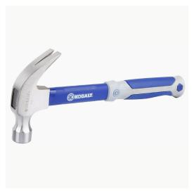
Curved Claw Hammer
1

Slide 3
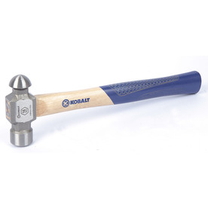
Ball Peen Hammer
2

Slide 4
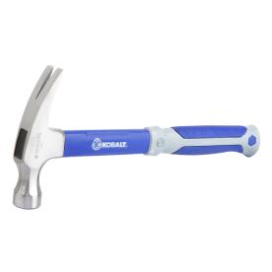
Ripping Hammer
3

Slide 5
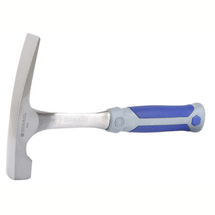
Brick Hammer
4

Slide 6
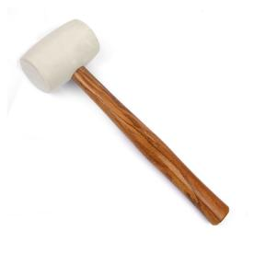
Rubber Mallet
5

Slide 7
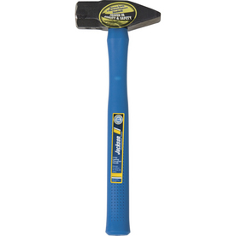
Cross Peen Hammer
6

Slide 8
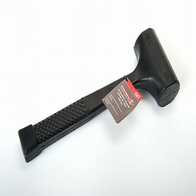
Dead Blow Hammer
7

Slide 9
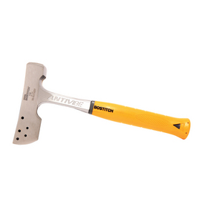
Shingler’s Hatchet
8

Slide 10
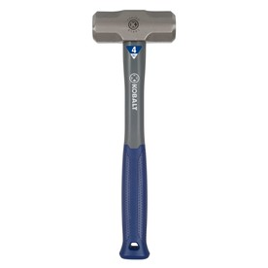
Sledge Hammer
9

Slide 11
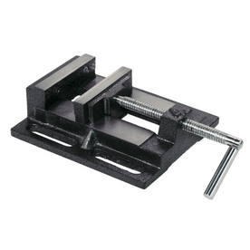
Drill Press Vise
10

Slide 12
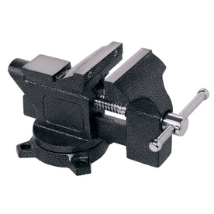
Machinist’s Vise
11

Slide 13
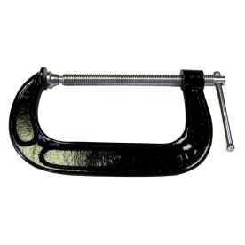
C Clamp
12

Slide 14
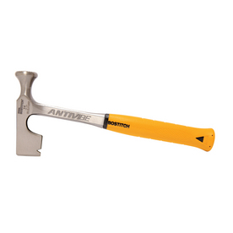
Dry Wall Hammer
13

Slide 15
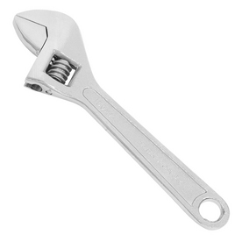
Adjustable Wrench
14

Slide 16
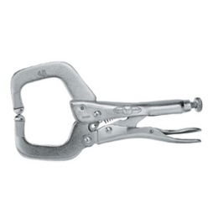
Locking C Clamp
15

Slide 17
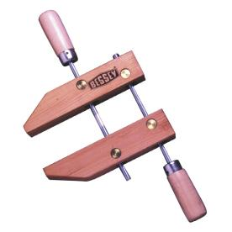
Hand Screw Clamp
16

Slide 18
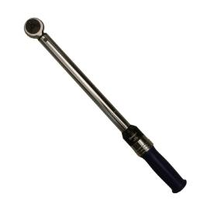
Torque Wrench
17

Slide 19
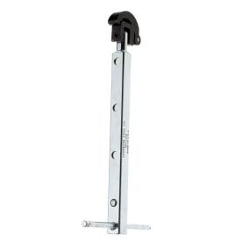
Telescoping Basin Wrench
18

Slide 20
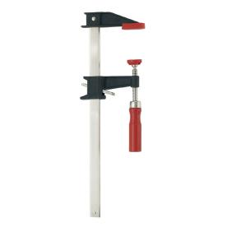
Bar Clamp
19

Slide 21
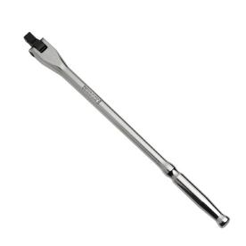
Breaker Bar
20

Slide 22
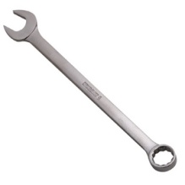
Combination Wrench
21

Slide 23
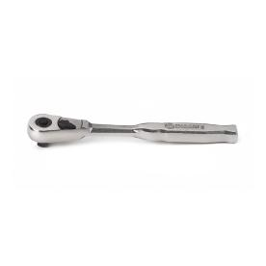
Ratchet
22

Slide 24
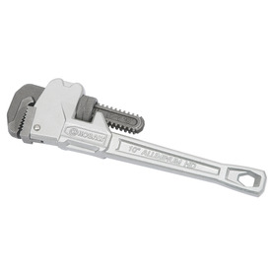
Pipe Wrench
23

Slide 25
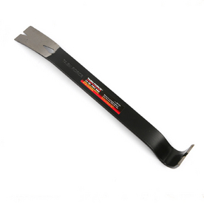
Steel Pry Bar
24

Slide 26
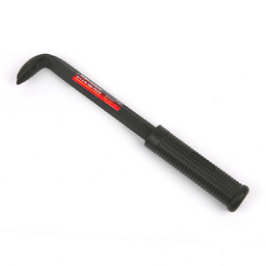
Nail Pry Bar
25

Slide 27
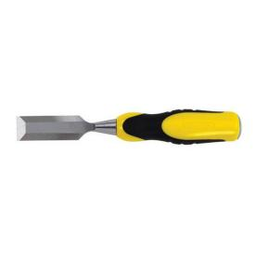
Wood Chisel
26

Slide 28
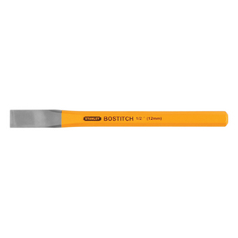
Cold Chisel
27

Slide 29
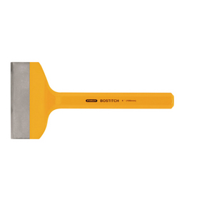
Mason’s Chisel
28

Slide 30
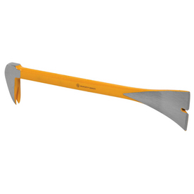
Molding Bar
29

Slide 31
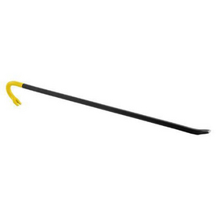
Wrecking Bar
30

Slide 32
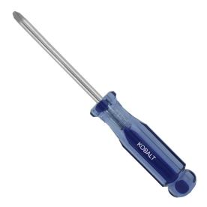
Phillips Screwdriver
31

Slide 33
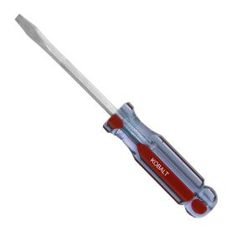
Flat Head Screwdriver
32

Slide 34
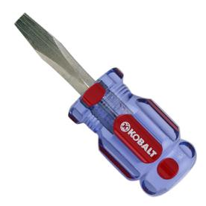
Stubby Flat Head Screwdriver
33

Slide 35
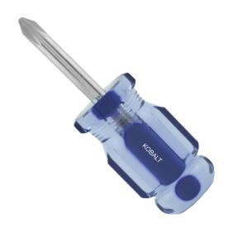
Stubby Phillips Screwdriver
34

Slide 36
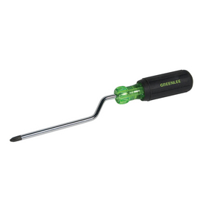
Crank Action Screwdriver
35

Slide 37
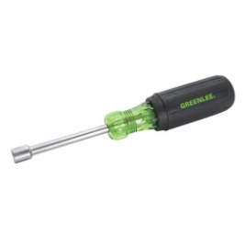
Nut Driver
36

Slide 38
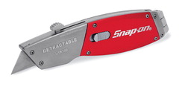
Utility Knife
37

Slide 39
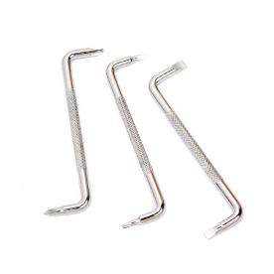
Offset Screwdrivers
38

Slide 40
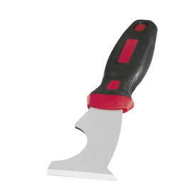
5-in-1 Glazing Knife
39

Slide 41
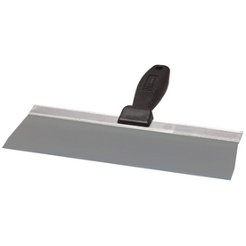
Taping Knife
40

Slide 42
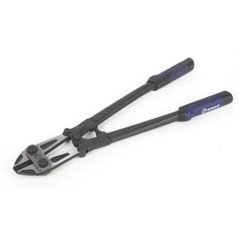
Bolt Cutter
41

Slide 43
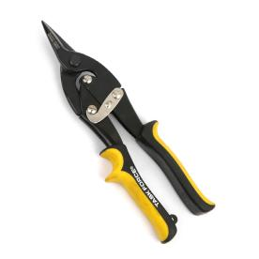
Aviation Tin Snips - Straight Cut
42

Slide 44
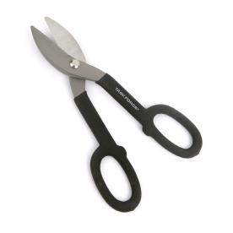
Tin Snips
43

Slide 45
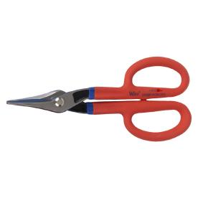
Steel Snips
44

Slide 46
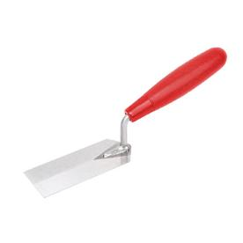
Margin Trowel
45

Slide 47
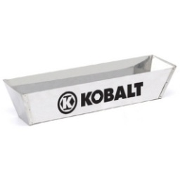
Stainless Steel Mud Pan
46

Slide 48
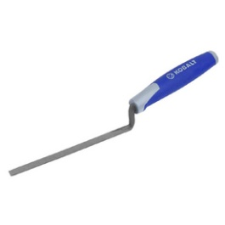
½-inch Brick Jointer
47

Slide 49
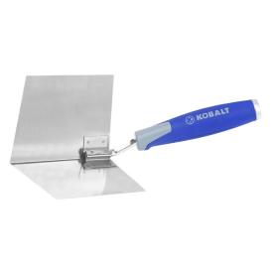
Corner Trowel
48

Slide 50
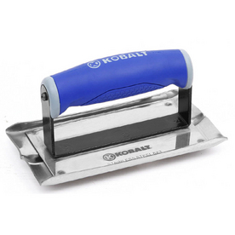
Concrete Groover
49

Slide 51
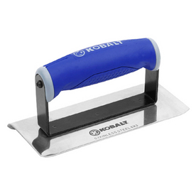
Concrete Edger
50

Slide 52
Finishing Trowel
51

Slide 53
Concrete Float
52

Slide 54
Hand Concrete Float
53

Slide 55
Rubber Float
54

Slide 56
Brick Trowel
55

Slide 57
Pointing Trowel
56

Slide 58
Putty Knife
57

Slide 59
Pole Sander
58

Slide 60
Bastard File
59

Slide 61
Half Round File
60

Slide 62
Dry Wall Saw
61

Slide 63
Miter Box and Saw
62

Slide 64
Carbide Circular Saw Blade
63

Slide 65
Steel Circular Saw Blade
64

Slide 66
Masonry Saw Blade
65

Slide 67
Coping Saw
66

Slide 68
Dovetail Saw
67

Slide 69
Hacksaw
68

Slide 70
Hand Saw
69

Slide 71
Laminate Saw
70

Slide 72
Back Saw
71

Slide 73
Compass Saw
72

Slide 74
Dado Set
73

Slide 75
Hook Blade
74

Slide 76
Razor Blade
75

Slide 77
Needle Nose Pliers
76

Slide 78
Diagonal Cutting Pliers
77

Slide 79
Tongue and Groove Pliers
78

Slide 80
Locking Pliers
79

Slide 81
Slip Joint Pliers
80

Slide 82
Lineman’s Pliers
81

Slide 83
Cable Cutters
82

Slide 84
Fencing Pliers
83

Slide 85
Concrete Nippers
84

Slide 86
Wire Strippers
85

Slide 87
Center Punch
86

Slide 88
Drive Pin Long Punch
87

Slide 89
Pin Punch
88

Slide 90
12-pt Deep Well Socket
89

Slide 91
6-pt Deep Well Socket
90

Slide 92
Socket Extension
91

Slide 93
Socket Adaptor
92

Slide 94
Universal Joint
93

Slide 95
Glass Cutter
94

Slide 96
Auger Bit
95

Slide 97
Hole Saw Bit
96

Slide 98
Twist Drill Bit
97

Slide 99
Spade Bit
98

Slide 100
Glass Drill Bit
99

Slide 101
Forstner Bit
100

Slide 102
Electric Circular Saw
101

Slide 103
Electric Reciprocating Saw
102

Slide 104
Miter Saw
103

Slide 105
Belt Sander
104

Slide 106
Finishing Sander
105

Slide 107
Electric Jig Saw
106

Slide 108
Electric Router
107

Slide 109
Tape Measure
108

Slide 110
Carpenter’s Pencil
109

Slide 111
Level
110

Slide 112
Framing Square
111

Slide 113
Line Level
112

Slide 114
Combination Square
113

Slide 115
Post Level
114

Slide 116
Speed Square
115

Slide 117
Contour Gauge
116

Slide 118
Drywall Square
117

Slide 119
Sliding T Bevel
118

Slide 120
Compass
119

Slide 121
Protractor
120

Slide 122
Long Tape
121

Slide 123
Stair Gauge
122

Slide 124
Tripod
123

Slide 125
Transit
124

Slide 126
Leveling Rod
125

Slide 127
Mason’s Rule
126

Slide 128
Laser Detector
127

Slide 129
Rotary Laser Level
128

Slide 130
Mason Line
129

Slide 131
Brick Tongs
130

Slide 132
Line Block
131

Slide 133
Chipping Hammer
132

Slide 134
Bench Grinder
133

Slide 135
Scratch Awl
134

Slide 136
Chalk Line Reel
135

Slide 137
Extension Wood Rule
136

Slide 138
Round File
137

Slide 139
x

Slide 140
x

Slide 141
x

Slide 142
x

