Slide 1

CONSTRUCTION TOOL IDENTIFICATION

Slide 2
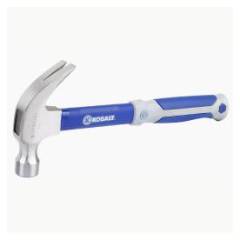
Curved Claw Hammer
1

Slide 3
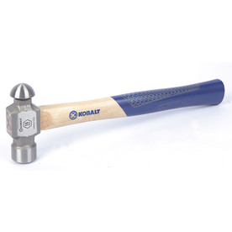
Ball Peen Hammer
2

Slide 4
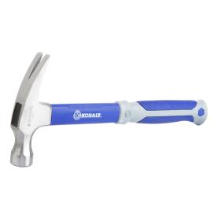
Ripping Hammer
3

Slide 5
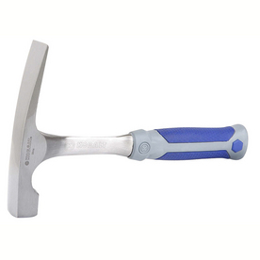
Brick Hammer
4

Slide 6
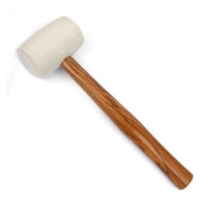
Rubber Mallet
5

Slide 7
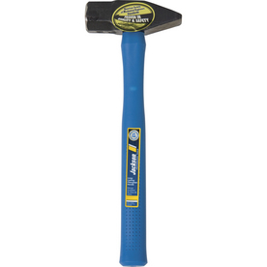
Cross Peen Hammer
6

Slide 8
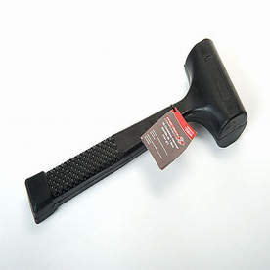
Dead Blow Hammer
7

Slide 9
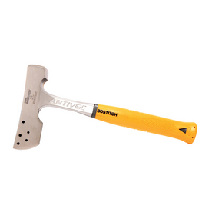
Shingler’s Hatchet
8

Slide 10
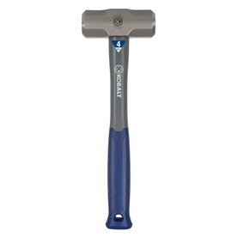
Sledge Hammer
9

Slide 11
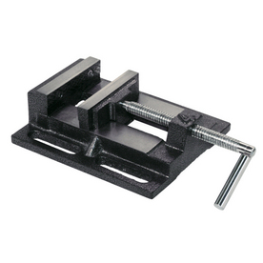
Drill Press Vise
10

Slide 12
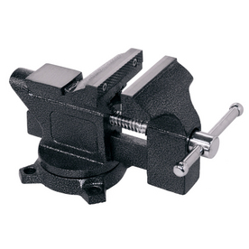
Machinist’s Vise
11

Slide 13
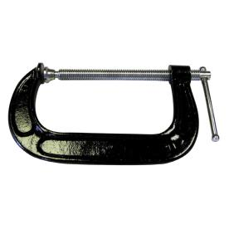
C Clamp
12

Slide 14
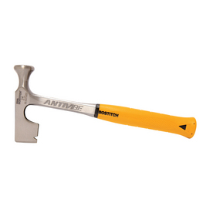
Dry Wall Hammer
13

Slide 15
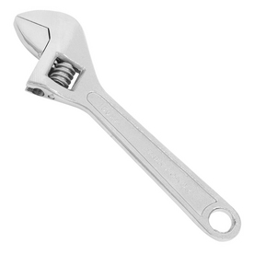
Adjustable Wrench
14

Slide 16
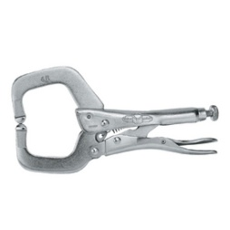
Locking C Clamp
15

Slide 17
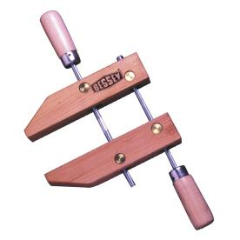
Hand Screw Clamp
16

Slide 18
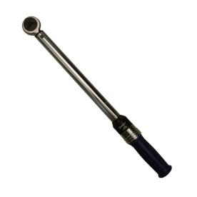
Torque Wrench
17

Slide 19
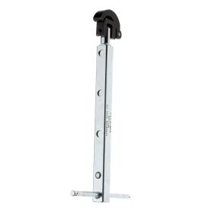
Telescoping Basin Wrench
18

Slide 20
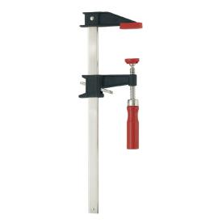
Bar Clamp
19

Slide 21
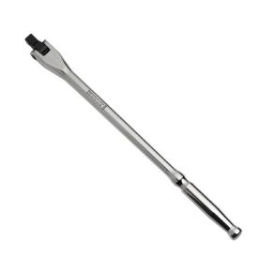
Breaker Bar
20

Slide 22
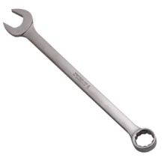
Combination Wrench
21

Slide 23
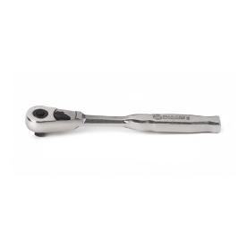
Ratchet
22

Slide 24
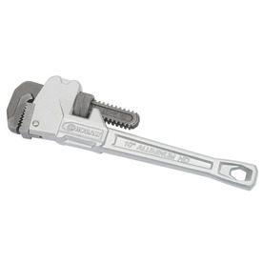
Pipe Wrench
23

Slide 25
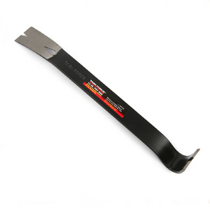
Steel Pry Bar
24

Slide 26
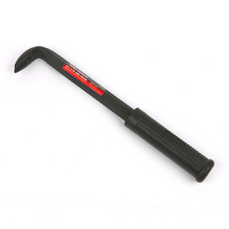
Nail Pry Bar
25

Slide 27
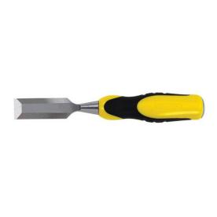
Wood Chisel
26

Slide 28
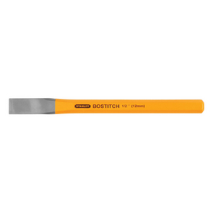
Cold Chisel
27

Slide 29
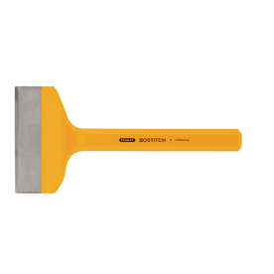
Mason’s Chisel
28

Slide 30
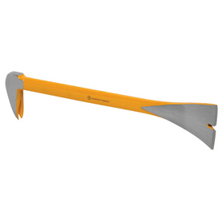
Molding Bar
29

Slide 31
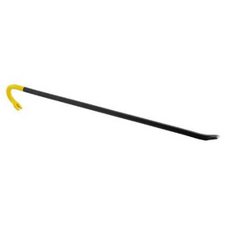
Wrecking Bar
30

Slide 32
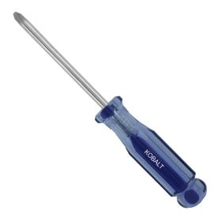
Phillips Screwdriver
31

Slide 33
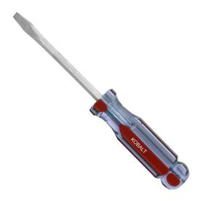
Flat Head Screwdriver
32

Slide 34
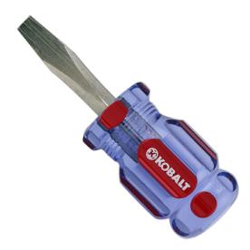
Stubby Flat Head Screwdriver
33

Slide 35
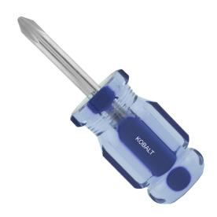
Stubby Phillips Screwdriver
34

Slide 36
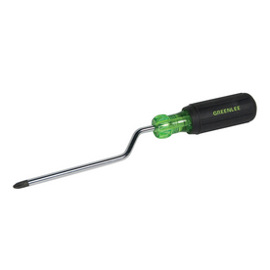
Crank Action Screwdriver
35

Slide 37
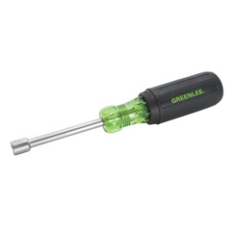
Nut Driver
36

Slide 38
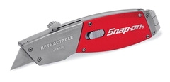
Utility Knife
37

Slide 39
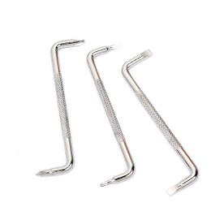
Offset Screwdrivers
38

Slide 40
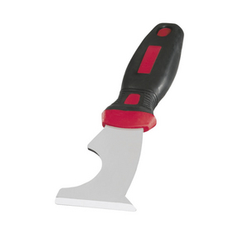
5-in-1 Glazing Knife
39

Slide 41
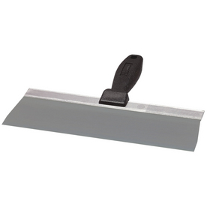
Taping Knife
40

Slide 42
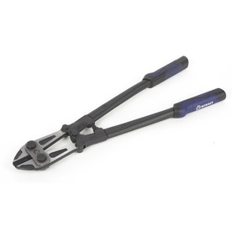
Bolt Cutter
41

Slide 43
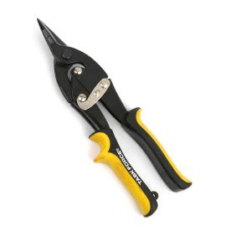
Aviation Tin Snips - Straight Cut
42

Slide 44
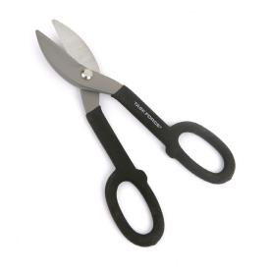
Tin Snips
43

Slide 45
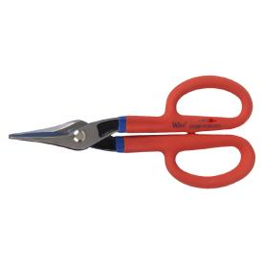
Steel Snips
44

Slide 46
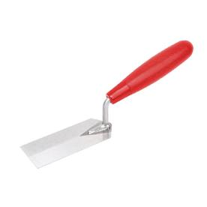
Margin Trowel
45

Slide 47
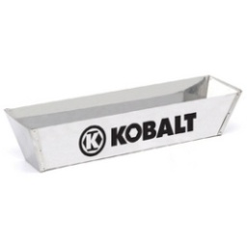
Stainless Steel Mud Pan
46

Slide 48
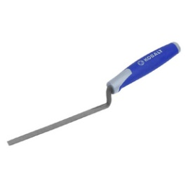
½-inch Brick Jointer
47

Slide 49
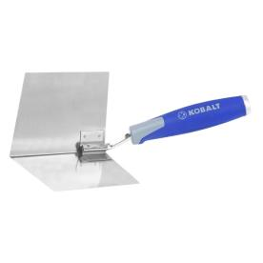
Corner Trowel
48

Slide 50
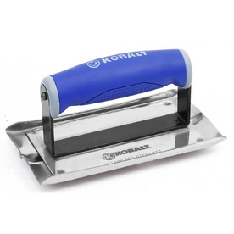
Concrete Groover
49

Slide 51
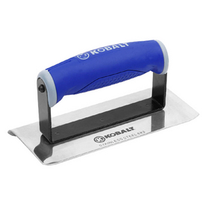
Concrete Edger
50

Slide 52

Finishing Trowel
51

Slide 53

Concrete Float
52

Slide 54

Hand Concrete Float
53

Slide 55

Rubber Float
54

Slide 56

Brick Trowel
55

Slide 57

Pointing Trowel
56

Slide 58

Putty Knife
57

Slide 59

Pole Sander
58

Slide 60

Bastard File
59

Slide 61

Half Round File
60

Slide 62

Dry Wall Saw
61

Slide 63

Miter Box and Saw
62

Slide 64

Carbide Circular Saw Blade
63

Slide 65

Steel Circular Saw Blade
64

Slide 66

Masonry Saw Blade
65

Slide 67

Coping Saw
66

Slide 68

Dovetail Saw
67

Slide 69

Hacksaw
68

Slide 70

Hand Saw
69

Slide 71

Laminate Saw
70

Slide 72

Back Saw
71

Slide 73

Compass Saw
72

Slide 74

Dado Set
73

Slide 75

Hook Blade
74

Slide 76

Razor Blade
75

Slide 77

Needle Nose Pliers
76

Slide 78

Diagonal Cutting Pliers
77

Slide 79

Tongue and Groove Pliers
78

Slide 80

Locking Pliers
79

Slide 81

Slip Joint Pliers
80

Slide 82

Lineman’s Pliers
81

Slide 83

Cable Cutters
82

Slide 84

Fencing Pliers
83

Slide 85

Concrete Nippers
84

Slide 86

Wire Strippers
85

Slide 87

Center Punch
86

Slide 88

Drive Pin Long Punch
87

Slide 89

Pin Punch
88

Slide 90

12-pt Deep Well Socket
89

Slide 91

6-pt Deep Well Socket
90

Slide 92

Socket Extension
91

Slide 93

Socket Adaptor
92

Slide 94

Universal Joint
93

Slide 95


Glass Cutter
94

Slide 96

Auger Bit
95

Slide 97

Hole Saw Bit
96

Slide 98

Twist Drill Bit
97

Slide 99

Spade Bit
98

Slide 100

Glass Drill Bit
99

Slide 101

Forstner Bit
100

Slide 102

Electric Circular Saw
101

Slide 103

Electric Reciprocating Saw
102

Slide 104

Miter Saw
103

Slide 105

Belt Sander
104

Slide 106

Finishing Sander
105

Slide 107

Electric Jig Saw
106

Slide 108

Electric Router
107

Slide 109

Tape Measure
108

Slide 110

Carpenter’s Pencil
109

Slide 111

Level
110

Slide 112

Framing Square
111

Slide 113

Line Level
112

Slide 114

Combination Square
113

Slide 115

Post Level
114

Slide 116

Speed Square
115

Slide 117

Contour Gauge
116

Slide 118

Drywall Square
117

Slide 119

Sliding T Bevel
118

Slide 120

Compass
119

Slide 121

Protractor
120

Slide 122

Long Tape
121

Slide 123

Stair Gauge
122

Slide 124

Tripod
123

Slide 125

Transit
124

Slide 126

Leveling Rod
125

Slide 127

Mason’s Rule
126

Slide 128

Laser Detector
127

Slide 129

Rotary Laser Level
128

Slide 130

Mason Line
129

Slide 131

Brick Tongs
130

Slide 132

Line Block
131

Slide 133

Chipping Hammer
132

Slide 134

Bench Grinder
133

Slide 135

Scratch Awl
134

Slide 136

Chalk Line Reel
135

Slide 137

Extension Wood Rule
136

Slide 138

Round File
137

Slide 139
x

Slide 140
x

Slide 141
x

Slide 142
x

