Slide 1


Putting Health First
A Section 125 Preventive Care Management Program

Slide 2


What is Employer’s Choice
Preventive Health Plan?
01
An all-inclusive preventative healthcare management program that supplements group health insurance plans.
02
A HIPAA-compliant participatory Medical Expense Reimbursement Wellness plan, compliant with IRS codes 125, 213, and 105, and backed by a Legal Protection Plan.
03
With no out-of-pocket cost, Employer’s Choice prioritizes and incentivizes preventative health care for employees and at the same time benefits employees & employers through tax savings.
Notes:
Our plan is all-inclusive.
It doesn’t replace any aspect of your existing healthcare program – our program enhances the benefits you offer your employees.
Our program is compliant both with HIPAA and with the IRS!
Our program prioritizes wellness (or preventive health care) at no out-of-pocket cost for you or your employees.
<click> Before we do anything else, let me explain our New Client Onboarding process

Slide 3

Validated
Why Employer’s Choice Preventive Health Plan?
It’s all about Employee Health!
Using validated and award- winning AI and Care Navigation, Employer’s Choice Preventive Care Puts Health First By:
Predicting future medical issues
Predicting cost of these issues
Engaging EEs to prevent disease
Rewarding EEs for engaging
Improving your bottom line
At no out-of-pocket cost to you or your employees

Slide 4
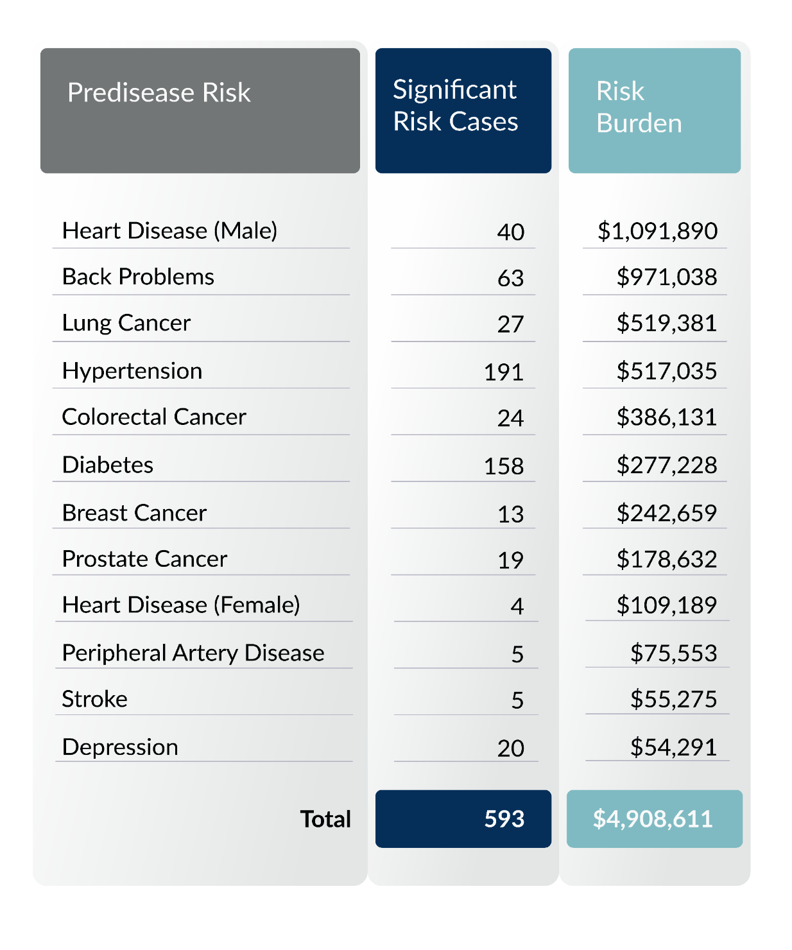
Predict and Prevent Future Conditions
Significant Risk = Ticking Time Bombs
Total Predisease Risk Burden Per HRA Participant [595] = $8,250
Facts:
15% of individuals drive 85% of the cost
59% of next year’s high-cost population comes from this year’s low-cost population (50% of all claims)
Source: United Healthcare

Slide 5
Validated Algorithms Save Lives
Diseases averted reflected in a 5-year case study
Diseases Averted

Slide 6

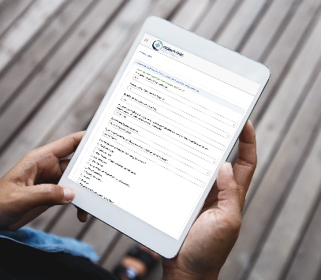



How it Works for Employees
Employees perform ONE activity per month of their choice.
The 15-minute Health Profile is the only requirement.
Required Activity:
Health Profile
Other
Health Activities
(any month)
(1 per month)
We recommend employees start by completing the online
Health Profile, however, they can complete it any month of their program year. The Health Profile will personalize the Personal Health DashboardTM to the employee and predict future risk burden.
Wholeistic™ Health Coaching
24/7 no cost TeleMed
Health Videos
Behavioral Health Modules
HealtheMail, HealtheDigest
Surveys
And much more…

Slide 7

Personal Health DashboardTM
The PHD™ can be translated into over 60 languages and offers numerous features. It allows you to oversee your tasks and benefits, including an individual risk profile, a risk resolution center, and health reminders.
Begin by activating your account and watching the intro video on your effective date. Other activities include:
View your Personal Health Profile
Complete Health Risk Assessment (HRA)
Complete behavior modification modules
Watch over 250 multimedia videos
Connect your wearable directly to the fitness tracker
Use “My Beneﬁts” tab to learn more about additional free beneﬁts
After you activate your account, you can access your Personal Health DashboardTM (PHD) on the mobile app.

Slide 8


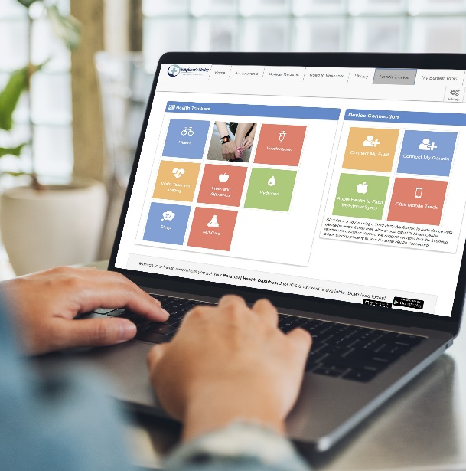
Employee Benefits Include:
RN Wholeistic™ Health Coaching
Virtual Medical Care for the Whole Family
Personal Health DashboardTM
Telephonic Coaching
Nutrition Education
Disease Management
S.M.A.R.T. Goals
Behavior Change Counseling
Smoking Cessation
$0 copay or cost
Primary Care with same doctor
24/7 Urgent Care
Mental Health Therapy
Prescription and Pharmacy Care
70+ urgent care medications at no cost
Personal Health Profile
Stress & Sleep Programs
Medical & Video Library
DNA Testing
Health Tracker
Online Behavior Change Modules
Notes:
The BIGGEST BENEFIT: Enjoying good health.
Did you know that studies have shown Telemedicine could reduce visits to ER or Urgent Care by 70% ?
Our Preventive Healthcare program offers 24/7/365 Telemedicine for the Whole Family and a $0 Copay encourages your employees to seek early treatment.
Your employees are not left to fend for themselves – they have access to holistic coaching reinforced by our award-winning app we call the Personal Health Dashboard.
<click> let’s take a moment to explore our App …

Slide 9

A Dual Approach
1
SECTION 125 CAFETERIA PLAN
This provides you the opportunity to receive certain benefits on a pre-tax basis and has the potential to generate healthcare savings while also utilizing tax advantages under Section 125 integrated with your Group Health Plan.
WELL-BEING SERVICES AND SOLUTIONS
2
This offers state-of-the-art health tracking software, 24/7 telemedicine with a $0 co-pay, online learning modules, WholeisticTM Coaching, and more.
Benefits provided at no out-of-pocket cost to the employee.
Notes:
While this might seem repetitive … it’s worth repeating!
Section 125 has been around since 1978 and allows your employee to pay for certain benefits on a pre-tax basis
Obama Care (ACA) expanded this law to encourage preventive or wellness programs …
I have a question – do you think installing solar on your home would be a good thing for you and the environment?
Why don’t more people install solar? Yes – it’s expensive! Has a Long Payback
So the government encourages behavior by reducing or eliminating the COST barrier and now we’re seeing more and more solar systems being installed.
<click> It’s the same concept with Wellness …

Slide 10
Employee Paycheck Example #1
Example of employee pay making $31,200.00 annual salary. (~$15/hr.)
with and without the Employer’s Choice program using 2020 W4 federal filing rules:
 | WITHOUT Employer’s Choice | WITH Employer’s Choice | DIFFERENCE
MONTHLY GROSS INCOME | $2,600.00 | $2,600.00 | $0.00
Employer’s Choice Pre-Tax Deduction | $0.00 | $1,200.00 | $1,200.00
Taxable Income | $2,600.00 | $1,400.00 | $1,200.00
Tax Withholding | $435.50 | $159.43 | $275.07
Employer’s Choice Post-Tax Reimbursement | $0.00 | $1,000.00 | $1,000.00
Net Take Home Pay | $2,165.50 | $2,240.57 | $75.07
PRE-TAX
Preventive Health Care Programs such as Telemedicine, Coaching, and more
DEDUCTION
 | Tax Withholding without Employer’s Choice | Tax Withholding with Employer’s Choice
Federal Tax | $146.67 | $18.33
Social Security | $161.20 | $86.80
Medicare | $37.70 | $20.30
State Tax | $39.15 | $2.81
Total Tax Withholding | $434.50 | $159.43
Increase in take-home pay using Employer’s Choice program
$75.07
PER MONTH INCREASE
$900.84
PER YEAR INCREASE
Employer’s Choice cannot guarantee the same favorable tax outcome in all situations as federal and state tax laws are continuously changing.

Slide 11
Employee Paycheck Example #2
Example of employee pay making $100,000.00 annual salary. (~$48/hr.)
with and without the Employer’s Choice program using 2020 W4 federal filing rules:
 | WITHOUT Employer’s Choice | WITH Employer’s Choice | DIFFERENCE
MONTHLY GROSS INCOME | $8,333.33 | $8,333.33 | $0.00
Employer’s Choice Pre-Tax Deduction | $0.00 | $1,200.00 | $1,200.00
Taxable Income | $8,333.33 | $7,133.33 | $1,200.00
Tax Withholding | $2,223.42 | $1,794.42 | $429.00
Employer’s Choice Post-Tax Reimbursement | $0.00 | $1,000.00 | $1,000.00
Net Take Home Pay | $6,109.91 | $6,338.91 | $229.00
PRE-TAX
Preventive Health Care Programs such as Telemedicine, Coaching, and more
DEDUCTION
 | Tax Withholding without Employer’s Choice | Tax Withholding with Employer’s Choice
Federal Tax | $1,153.42 | $889.42
Social Security | $516.67 | $442.27
Medicare | $120.83 | $103.43
State Tax | $432.50 | $359.30
Total Tax Withholding | $2,223.42 | $1,794.42
Increase in take-home pay using Employer’s Choice program
$229.00
PER MONTH INCREASE
$2,748.00
PER YEAR INCREASE
Employer’s Choice cannot guarantee the same favorable tax outcome in all situations as federal and state tax laws are continuously changing.

Slide 12
Employer Payroll Savings Example
 | WITHOUT Employer’s Choice | WITH Employer’s Choice | DIFFERENCE
GROSS INCOME | $2,600.00 | $2,600.00 | $0.00
Employer’s Choice Pre-tax Payment | $0.00 | $1,200.00 | $1,200.00
Employee’s Monthly Gross Taxable Income | $2,600.00 | $1,400.00 | $1,200.00
Employer’s Monthly FICA Contributions | $198.90 | $107.09 | $91.80
Employer’s Annual FICA Contribution | $2,386.80 | $1,285.20 | $1,101.60
Gross Annual Employer’s Savings | $0.00 | $1,101.60 | $1,101.60
NET ANNUAL EMPLOYER’S SAVINGS PER EMPLOYEE | $0.00 | $0.00 | $681.60
Employer’s Choice
Cost Per Employee
Per Month: $35
Per Year: $420
Savings Per Employee
Per Month: $91.80
Per Year: $1,101.60
NET SAVINGS PER EMPLOYEE
AFTER Employer’s Choice FEE
Per Month: $56.80
Per Year: $681.60
Employer’s Choice cannot guarantee the same favorable tax outcome in all situations as federal and state tax laws are continuously changing.

Slide 13

Additional Employer Benefits
Insurable
Health Plan Options
Legal protection up to $500,000 for the employer and $10,000 for each employee.
Add an America’s Choice Group Plan to round out your Program.

Slide 14
Implementation Timeline
TASK
Wk. 1 | Wk. 2 | Wk. 3 | Wk. 4 | Wk. 5 | Wk. 6 | Wk. 7 | Wk. 8 |
USHC
Task
Group Task
Initial Payroll Analysis
Proposal
Contracting: BAA, Employer Agreement, New Client Setup Form
Detailed Payroll Analysis
Banking Ach Form
Cafeteria Agreement
Payroll Setup, Codes & Dry Run
Member Communications, Planning & Strategy
Go Live (First Payroll)
Invoicing
Note: Underlined tasks above are clickable links.

Slide 15

Bottom Line:
Better Employee Health
Improved Employee Benefits
Enhanced Employee Pay
Increased Profits
All While REDUCING COST

Slide 16


THANK YOU
FOR CHOOSING
Putting Health First
Employers Choice Employer Presentation v8 08-22-2024

