Slide 1

NORCAL PREMIER SOCCER
INTRODUCTION TO COLLEGE RECRUITING
October 29, 2025
CONFIDENTIAL
www.norcalpremier.com

Slide 2
TOPICS
What do the Divisions mean?
How do you choose the right school?
Recruiting rules
How do College Programs recruit?
How can you get recruited?

Slide 3
WHAT DO THE DIVISIONS MEAN?
NCAA
  D1
  D2
  D3
NAIA
Junior/Community College

Slide 4
WHAT DO THE DIVISIONS MEAN?
NCAA D1
Highest level of Competition
Maximum of 28 athletic scholarships for both Men and Women (Power Conferences)
Can stack aide, in both Men’s and Women’s soccer (academic and athletic aide)
Roster limit of 28
SEASON
Fall (Competitive Season)
  Beginning of August- Beginning of December
  Max 4 hrs daily, 20 hrs weekly; have to have one day off every week
  Allowed to play 20 matches total (Exhibitions included)
Spring Season (Non-Competitive Season)
  6-8 weeks in 20 hour segment
  Max. 4 hrs daily, 20 hrs weekly
Off Season
  Max 8 hrs weekly, no more than 4 with a ball
Summer Break - Vacation/Time Off

Slide 5
WHAT DO THE DIVISIONS MEAN?
NCAA D2
Often next highest level of Competition
Full rides - up to 9.9 for men, 9.9 for women
SEASON
Fall
  Mid-August- End of November
  Max. 4 hrs daily, 20 hrs weekly
Spring Season
  6-8 weeks
  Max. 4 hrs daily, 15 hrs weekly
Off Season
  Max 8 hrs weekly, no more than 4 with a ball
Vacation

Slide 6
WHAT DO THE DIVISIONS MEAN?
NCAA D3
Variable level of Competition
NO athletic scholarships | a lot of other aid available
SEASON
Fall
  Late-August- End of November
  Max. 4 hrs daily, 20 hrs weekly
  1 day off in 7
Spring Season
  24 days
  No more than 4 in a week
  1 date of competition (2 games)
Off Season
  None
Vacation

Slide 7
WHAT DO THE DIVISIONS MEAN?
NAIA
Variable level of Competition
Up to 12 Full Rides
SEASON
Fall
  Mid-August- Early December
  Hourly rules per institution/conference
Spring Season
  3 games
Off Season/Vacation
  per institution/conference

Slide 8
WHAT DO THE DIVISIONS MEAN?
NJCAA (JuCo)
Variable level of Competition
Many options in Northern California (38 Men’s Programs & 44 Women’s Programs)
SEASON
Fall
  Pre-Season + Summer Class - Early December
  Matches (mid-Aug through mid-Novr; playoffs through mid-Dec)
Spring
  175 total hours, max 12 weekly
  3/1-5/31 - 4 game dates
Off Season/Vacation
  Classes

Slide 9
HOW DO YOU CHOOSE A SCHOOL?
Choose the right School for YOU
CONSIDERATIONS - ATHLETIC
Level: D1 not the only or best option! All divisions should be considered….
Playing time: just being on the roster good enough?
Playing style: programs play differently; do your research, watch them play
Coach relationship: Important, good communicator, trust/respect
Time commitment / load management: soccer + academics + social = a lot

Slide 10
HOW DO YOU CHOOSE A SCHOOL?
Choose the right School for YOU
CONSIDERATIONS - ACADEMIC
Major: earning your degree is everything!
Class size: Student to teacher ratio
Academic rigor/reputation: the standard has gone up at all universities
Academic support: advisors, tutors, teammates, other athletes

Slide 11
HOW DO YOU CHOOSE A SCHOOL?
Choose the right School for YOU
CONSIDERATIONS - SOCIAL/PERSONAL
Location, Distance: close or far from home, warm or cold weather
Size: big or small, go back to class size as well
Football: not every University or College has a football program
City/Campus: older or modern, resources, amenities
**COST**: take into strong consideration; think things through & DO NOT make a decision solely based on the level of the program (D1). Make sure your parents, family, and/or support system are a part of the discussion. There are pathways you can take initially that are much more cost effective that will help you pursue your ultimate goals (JuCo).

Slide 12
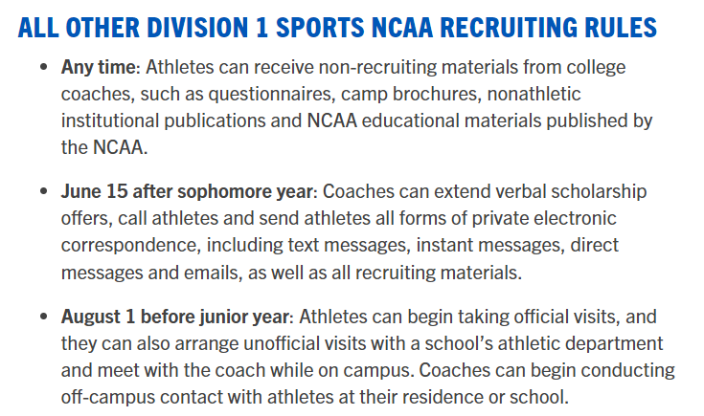
RECRUITING RULES - NCAA D1
RESOURCE: https://www.ncsasports.org/recruiting

Slide 13
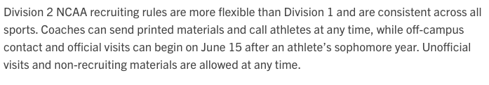
RECRUITING RULES - NCAA D2
RESOURCE: https://www.ncsasports.org/recruiting

Slide 14
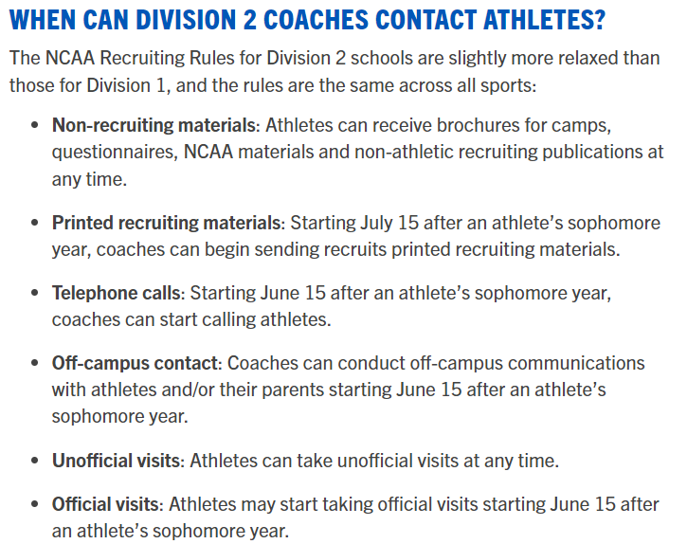
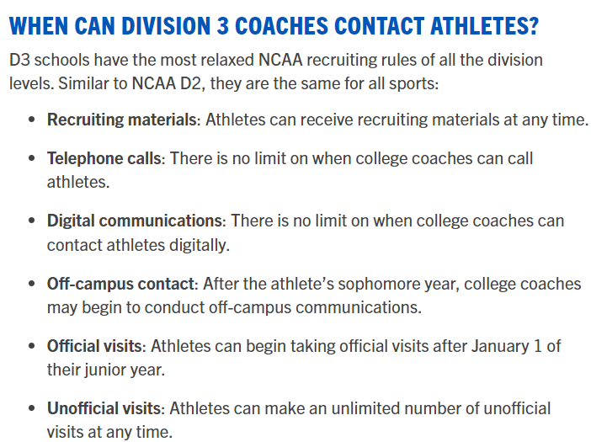
RECRUITING RULES - NCAA D3
RESOURCE: https://www.ncsasports.org/recruiting

Slide 15
RECRUITING RULES - NAIA
No recruiting calendar restrictions of any kind….

Slide 16
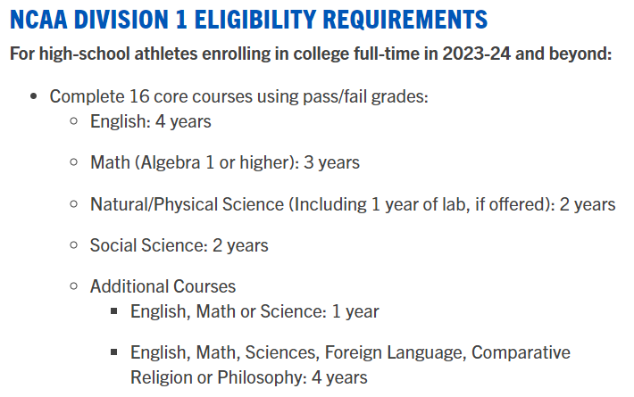
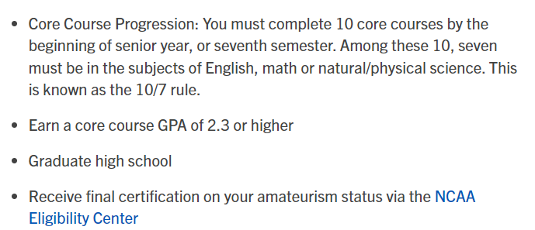
ELIGIBILITY REQUIREMENTS - NCAA D1
RESOURCE: https://www.ncsasports.org/recruiting

Slide 17
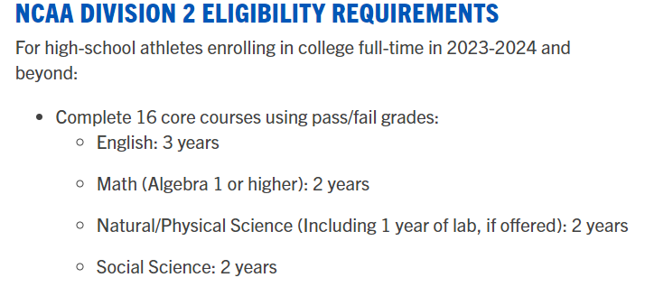
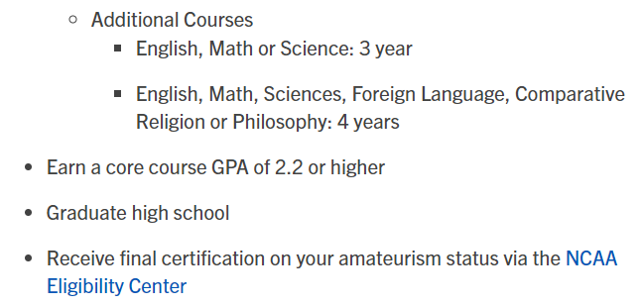
ELIGIBILITY REQUIREMENTS - NCAA D2
RESOURCE: https://www.ncsasports.org/recruiting

Slide 18
ELIGIBILITY REQUIREMENTS - NCAA D3
Determined by each individual institution…

Slide 19
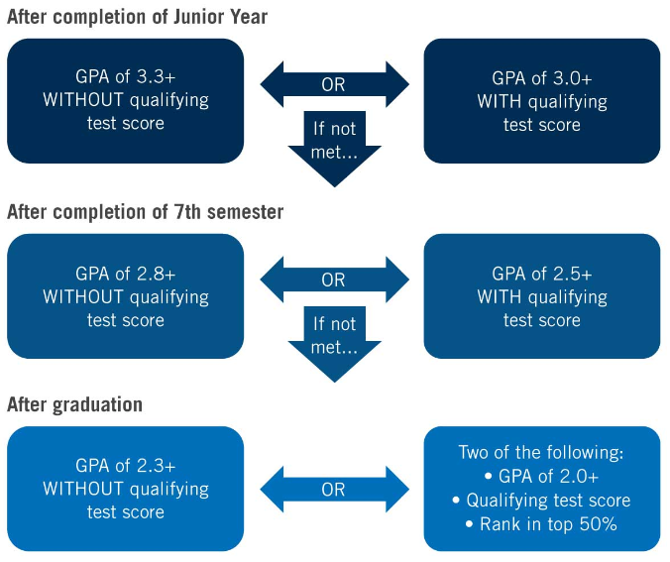
ELIGIBILITY REQUIREMENTS - NAIA
RESOURCE:
playnaia.org

Slide 20
HOW DO COLLEGES RECRUIT?
Every School/Coach is different
  Resources matter (recruiting budget, size of coaching staff)
Showcases (youth, international)
ID Camps (youth, international)
Video (youth, international)
Relationships (club, overseas, contacts/colleagues)
League matches
Training sessions
Tryouts (rare at D1 level)

Slide 21
HOW DO COLLEGES RECRUIT?
THE BIG PICTURE: TRANSFERS IN COLLEGE SOCCER
College soccer boasts around 88,305 players—split nearly evenly between men (44,259) and women (44,046)—across NCAA Divisions I, II, III, NAIA, and NJCAA. Each year, thousands of these athletes don’t stay put. Thanks to the NCAA’s Transfer Portal (launched in 2018) and the one-time transfer rule (post-2021), players can move without sitting out, making transfers a hot trend. Across all college sports, 15,000–20,000 athletes hit the portal annually, and soccer likely accounts for 1,500–3,000 of them—about 10–15% of the total. That’s a lot of cleats on the move!

Slide 22
HOW DO COLLEGES RECRUIT?
NJCAA (JUCO): THE TWO-YEAR LAUNCHPAD
Junior colleges are the unsung heroes of the transfer world. With 9,740 soccer players (4,840 men, 4,900 women) across 242 men’s and 245 women’s teams, JUCO offers a fresh start for high school grads who didn’t land a four-year spot. About 30% of these players—roughly 2,922 (1,452 men, 1,470 women)—transfer to a four-year school within two years.
ODDS IN FOCUS
JUCO to 4-Year: 1 in 3.3 chance (30% of 9,740)
WHERE DO THEY GO?
NCAA D2: 60% (1,753 players), the biggest landing spot
NCAA D1: 20% (584), for the standout talents
NAIA: 15% (438), a solid alternative
NCAA D3: 5% (147), often for academics over athletics

Slide 23
HOW DO COLLEGES RECRUIT?
INTERNATIONAL STUDENTS = 21,000
In college soccer, over 21,000 foreign-born players currently play, with over 30% of all Division I male players being from abroad. Additionally, nearly 25,000 international student-athletes compete in NCAA sports, indicating a significant presence of international students in college soccer.

Slide 24
HOW DO YOU GET RECRUITED?
EXPOSURE
Club Team (events, showcases, league matches)
Video
Camps
Relationships (Club Directors, Club Coaches)
Individual Player (you get out of it what you put into it, it’s YOUR journey)

Slide 25
HOW DO YOU GET RECRUITED?
AWARENESS (YOUR JOURNEY)
Emails
Phone calls
Video
Profiles
Recruiting Services
Visits (go onto campus to see for yourself)

Slide 26
THANK YOU
www.norcalpremier.com

