Slide 1
Renewing Memberships
Members

Slide 2
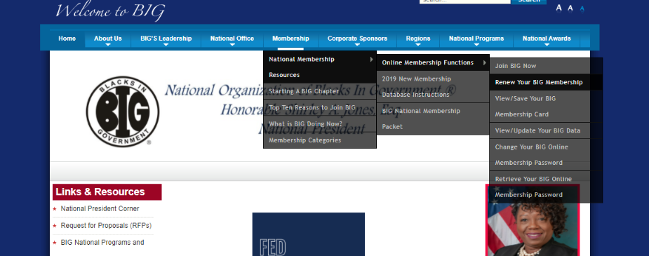
From the BIG home page - Select National Membership Resources; then Online Membership Functions; then Renew your BIG Membership
OR
Navigate to https://members.bignet.site/ and log in using your email address and password. Your password is case sensitive. This new system will not recognize your old password so you will need to reset it if you don’t remember it.

Slide 3
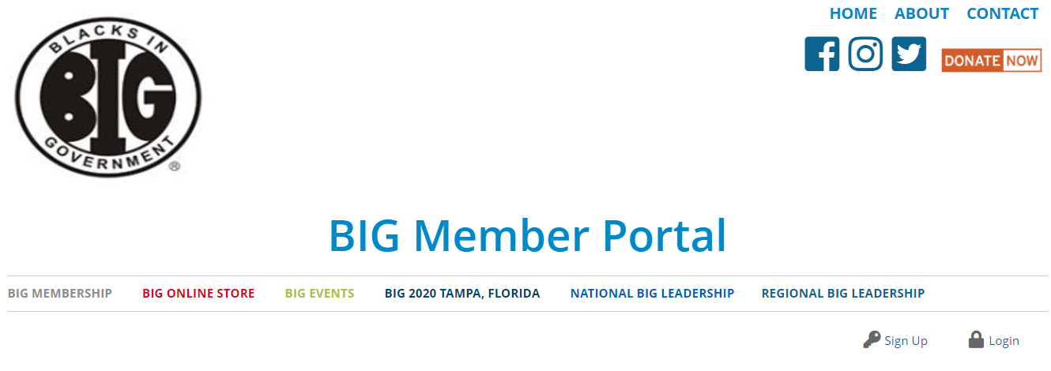
Members
You will need to enter the portal to make purchases (renew/upgrade memberships or NTI Registrations)

Slide 4
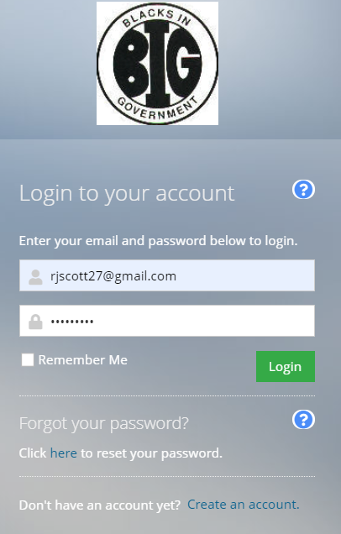
If you have forgotten your password, click reset password, it will send a link to the email address you have on file.

Slide 5
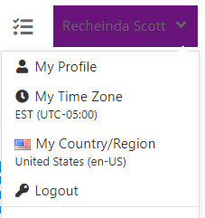
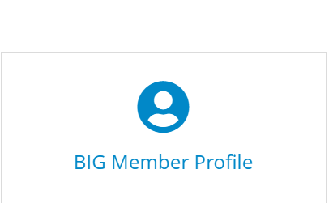
Once you are logged in select my profile from the dropdown box or scroll down and click on BIG MEMBER PROFILE

Slide 6
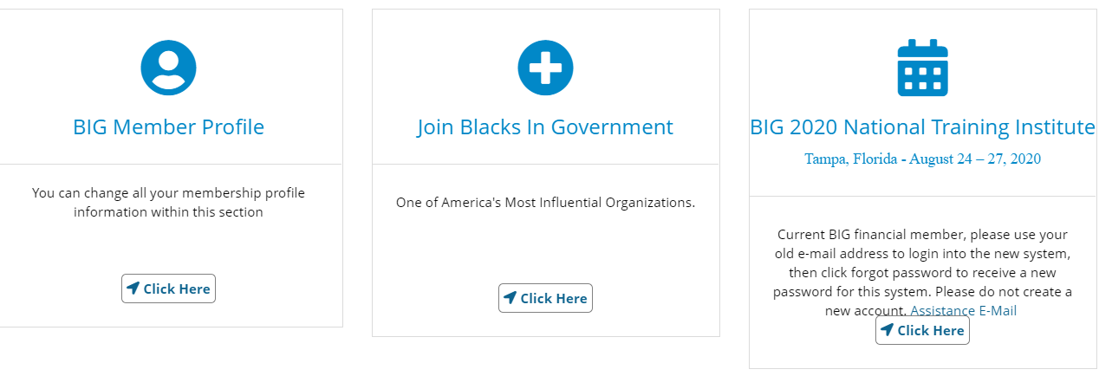

Slide 7
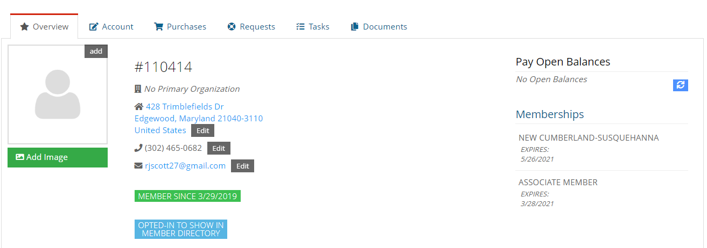
Current Members
Current member profiles have been uploaded. You will be able to add additional or edit information. Customer profiles hold all the data on an individual. Most often you will use Overview, Account and Purchases.
Overview Tab: Displays an overview of information about the customer, including an image, membership number, primary contact information chapter and membership status.

Slide 8
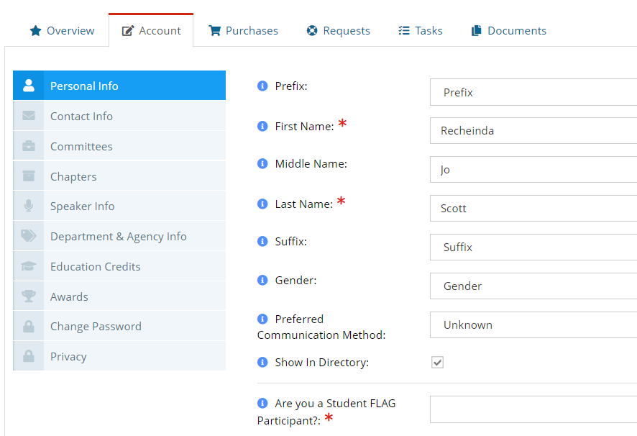
Account Tab:
Manages the member’s information
You can edit name and contact information
You can also change your password.

Slide 9
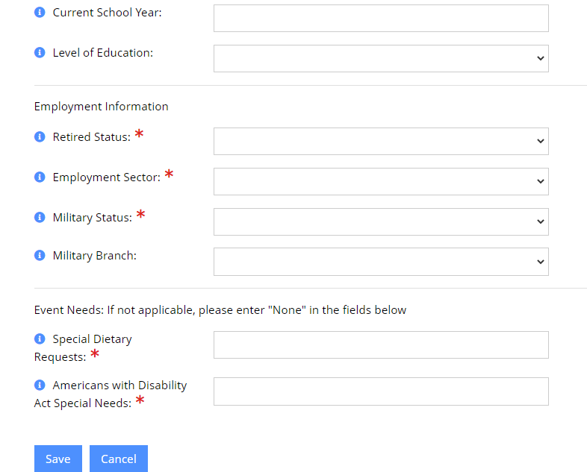
All asterisked fields are required.
The employment Information is required.

Slide 10
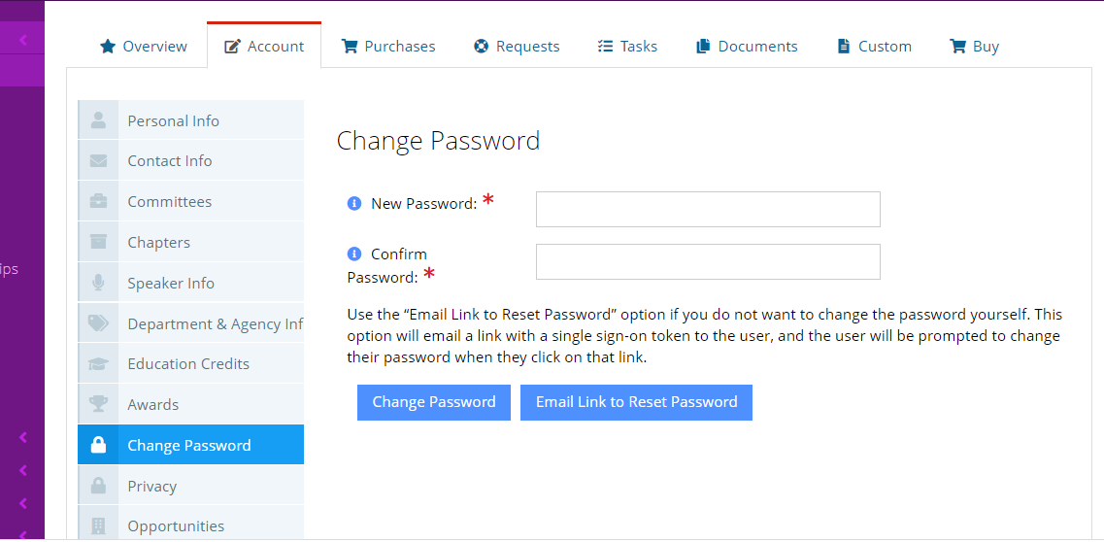
You can change your password yourself or request an email link to reset password

Slide 11
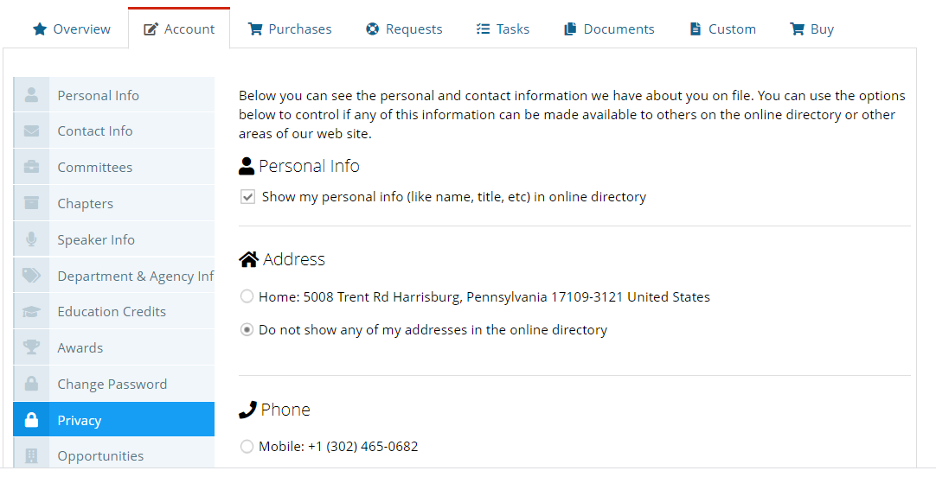
You can also select privacy options.

Slide 12
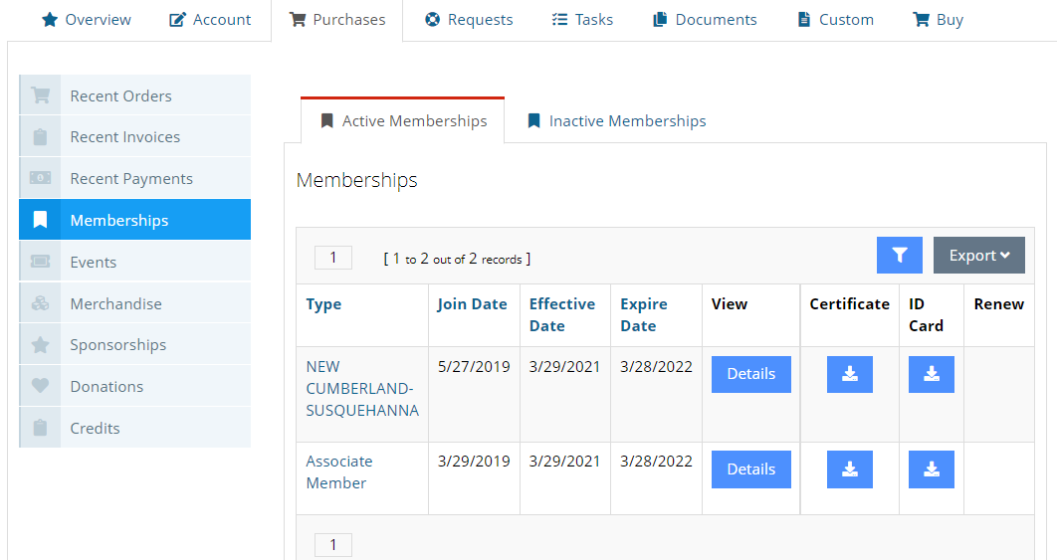
Purchases Tab: This shows a members’ current, or active, National and chapter membership. It lists the membership expiration date.
This also shows Inactive Memberships. A purchase history; Sponsorships and donations are accessible under this tab. You can access order and invoice information.

Slide 13
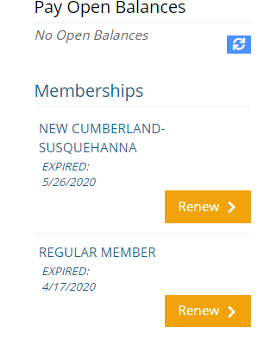
Membership Renewal Instructions:
You can renew from the Overview screen. Click on regular member “Renew”.

Slide 14
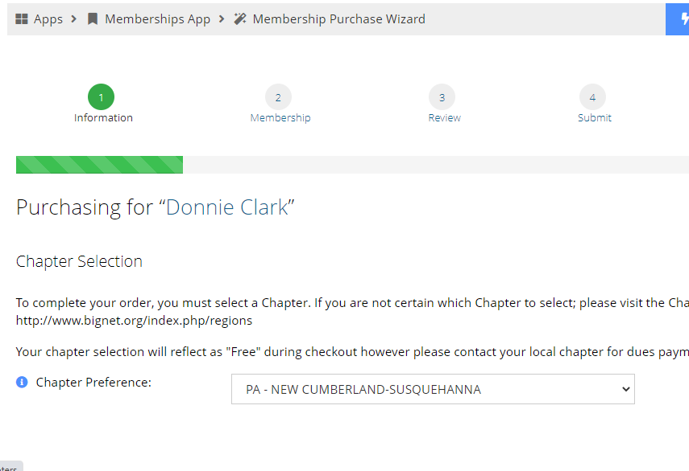
You will then be taken to a page where you will be required to select the chapter from the drop-down box that you are renewing in. You are renewing so the chapter that you are currently in will show.
Click Next

Slide 15
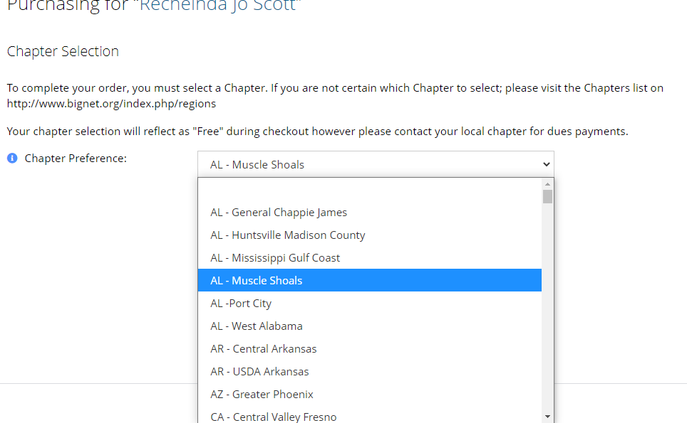
Chapters are listed by state
Select chapter and hit next

Slide 16
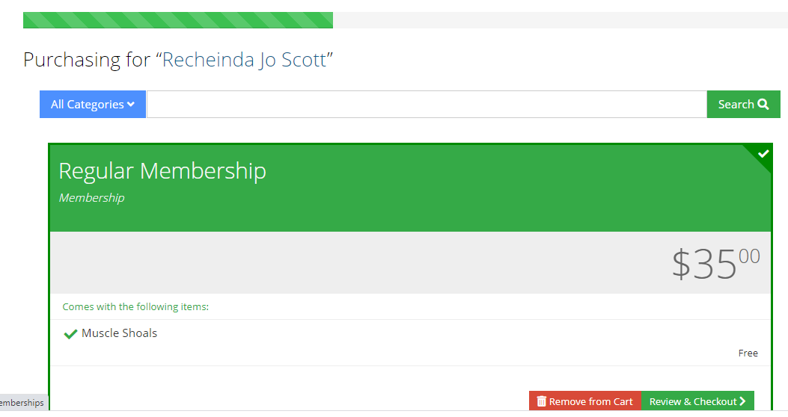
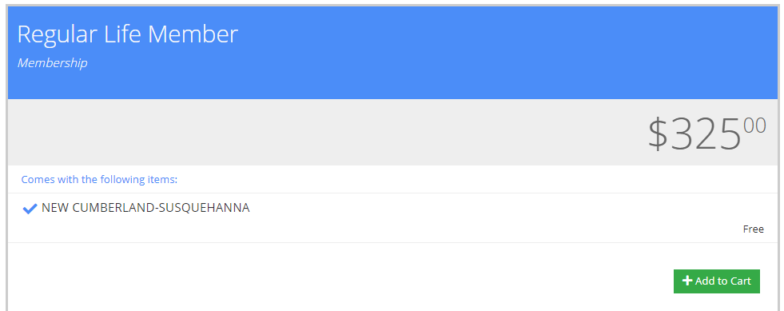
Select the membership type that fits your specific membership choice. Click Next

Slide 17
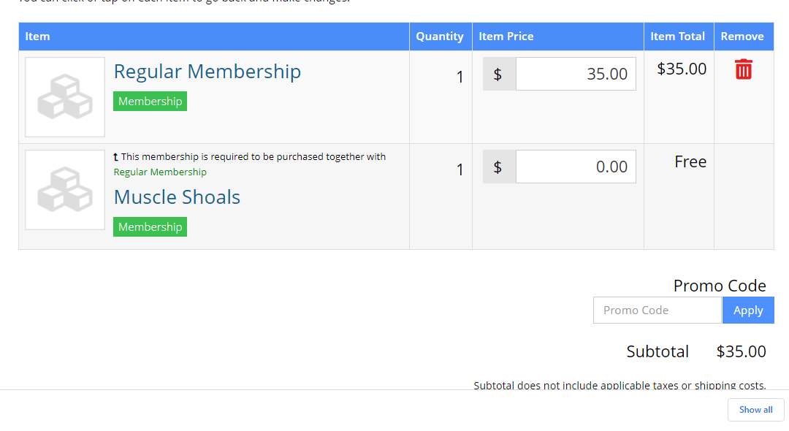
Review make sure there is a chapter – (Free) listed.
Checkout.

Slide 18
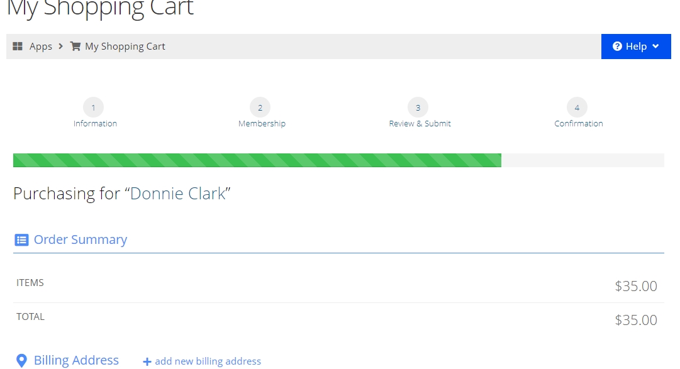
Choose your payment option, view your cart and make payment.
You will receive an email confirmation of your payment.

Slide 19
Membership Renewal Instructions:
You can also click on “Membership”. Click on “Renew” and follow above instructions.

Slide 20
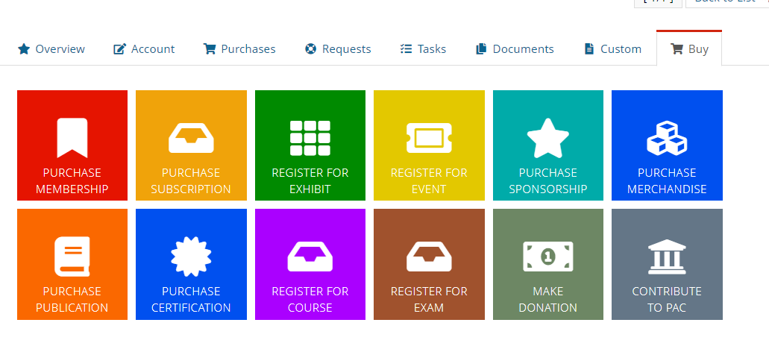
If you are renewing before it is due:
Click on BUY
Select Purchase Membership

Slide 21
You will then be taken to the Purchase Wizard
Click Next and finish the membership selection.

Slide 22
Questions??

Slide 23
New Member Directions

Slide 24
Member Enrollment Instructions:
1. Go to the website – https://member.bignet.site/
2. Place your cursor over the “Membership” tab at the top
of portal, a drop-down list will appear, select “Become a
member.

Slide 25
From the BIG home page - Select National Membership Resources; then Online Membership Functions; then Renew your BIG Membership

Slide 26
New Customers/Members
When you enter the portal to make purchases or to join the organization you will need to create an account/profile first.
Creating an account/profile: 1. Click on “Sign up” in the upper right-hand corner of the screen

Slide 27
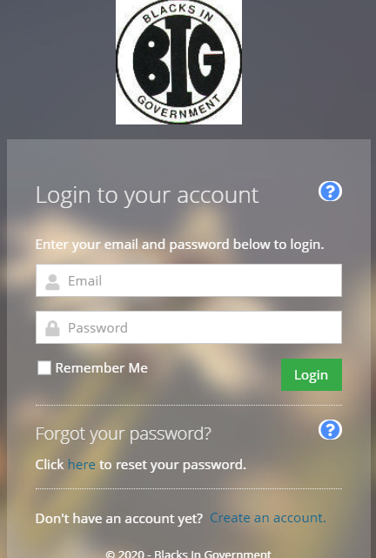
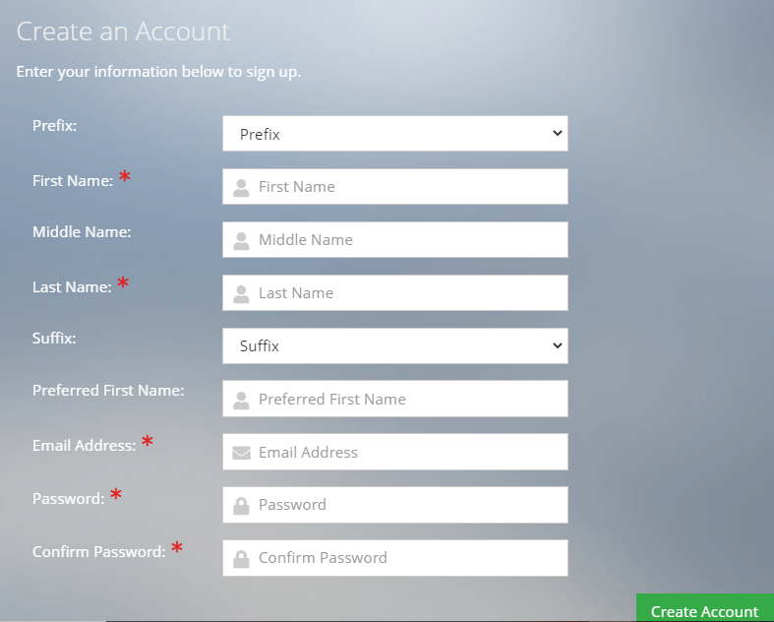
Click on “Create an account.”
Here you will create your account. Please be sure to add a personal email address that is active and that you check on a regular basis this is where information and confirmations will be sent.

Slide 28
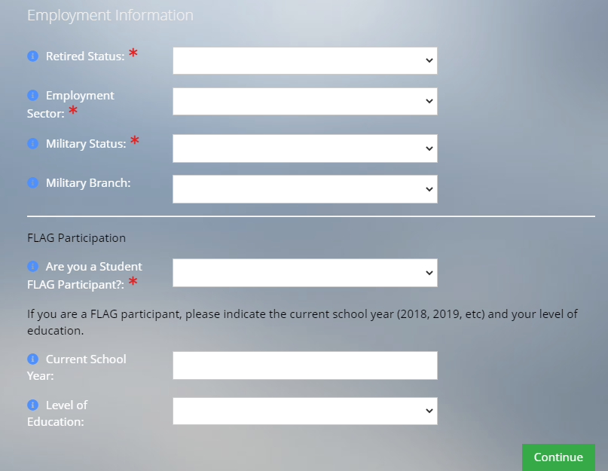
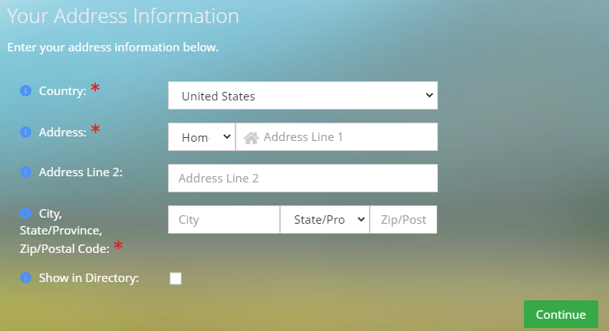
Fill in all employment information, FLAG info, click continue. Fill in address info, click continue.

Slide 29
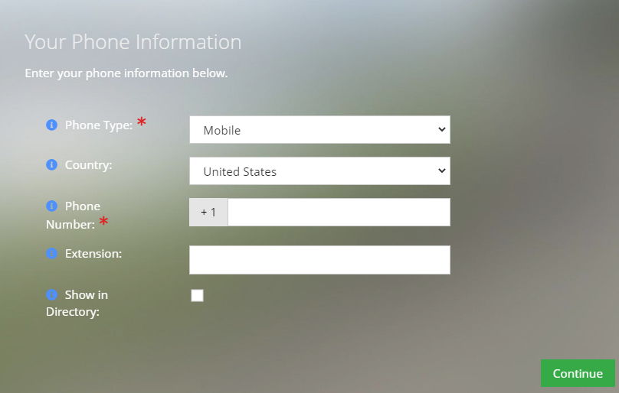
Fill in phone information, click continue. Fill in address info, click continue.

Slide 30
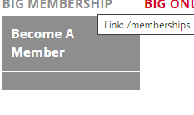
This brings you back to the BIG Member Portal. Click on BIG Membership drop-down “Become A Member” at the top left.

Slide 31
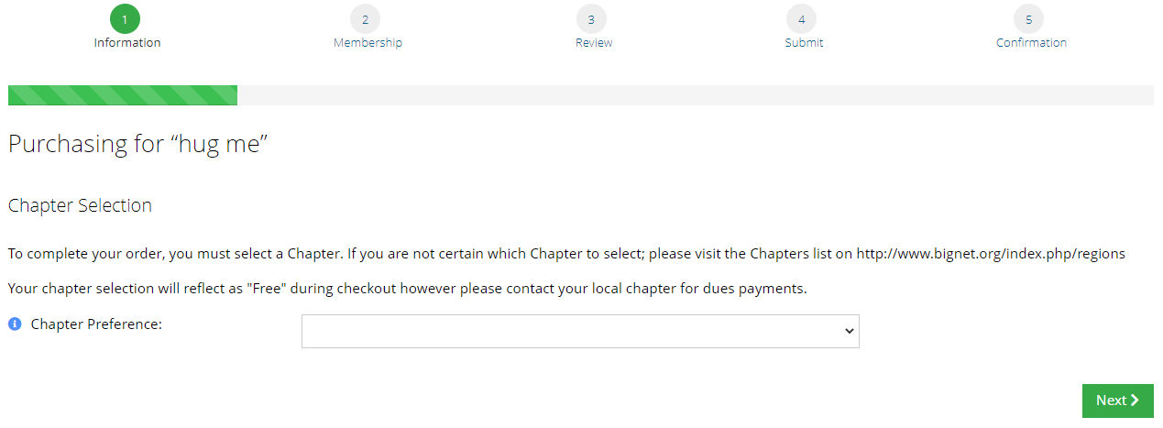
You will then be taken to a page where you will be required to select the chapter that you would like to join. Chapters are listed within each state. After choosing a chapter click next.

Slide 32
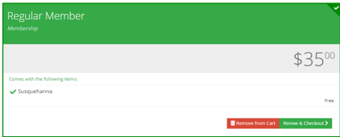
Select the membership type that fits your specific membership choice. Click Next

Slide 33
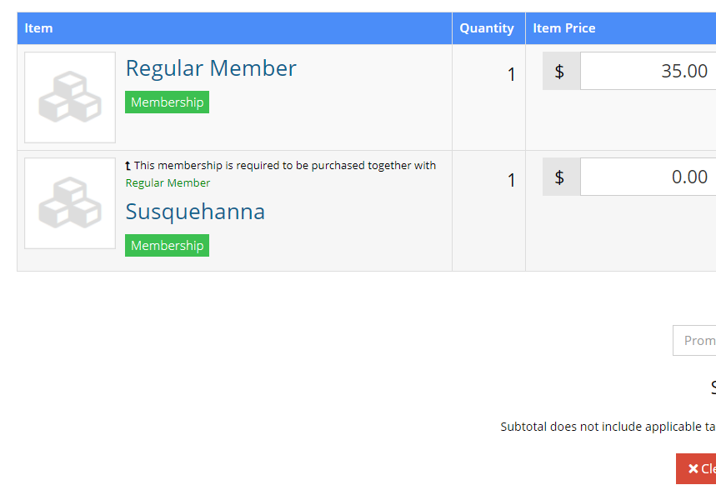
Review and checkout.

Slide 34
Choose your payment option, view your cart
and make payment
You will receive an email confirmation of your payment

Slide 35
Questions??

Slide 36
Running A Chapter Roster
Presidents & Membership Chairs

Slide 37
Presidents & Membership Chairs:
Navigate to https://members.bignet.site/ and log in using your email address and password. Your password is case sensitive. This new system will not recognize your old password so you will need to reset it if you don’t remember it.

Slide 38
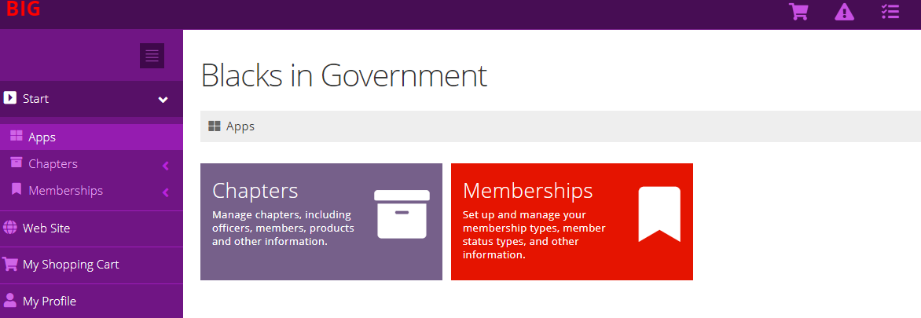
Click on chapters app

Slide 39
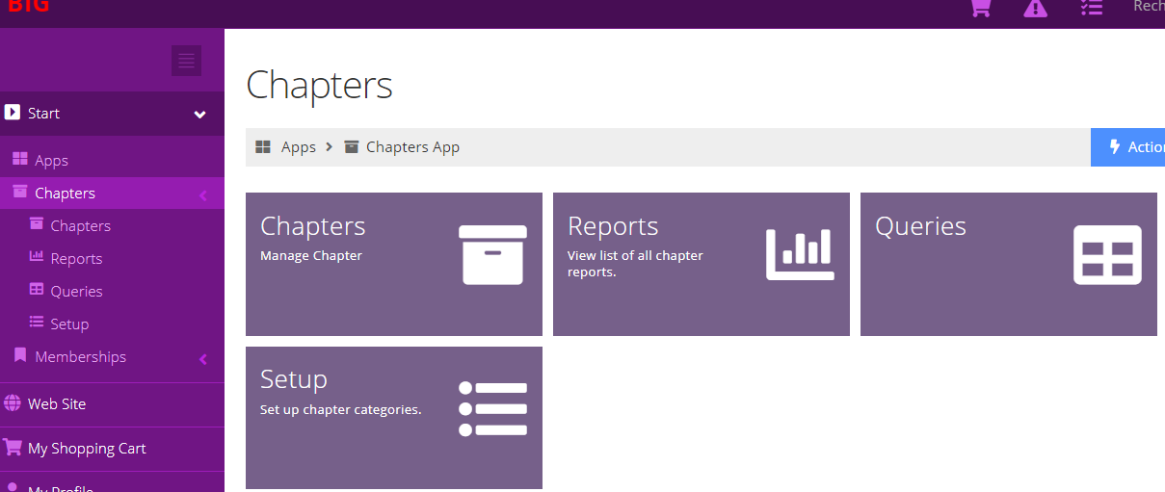
Then click on the reports app.

Slide 40
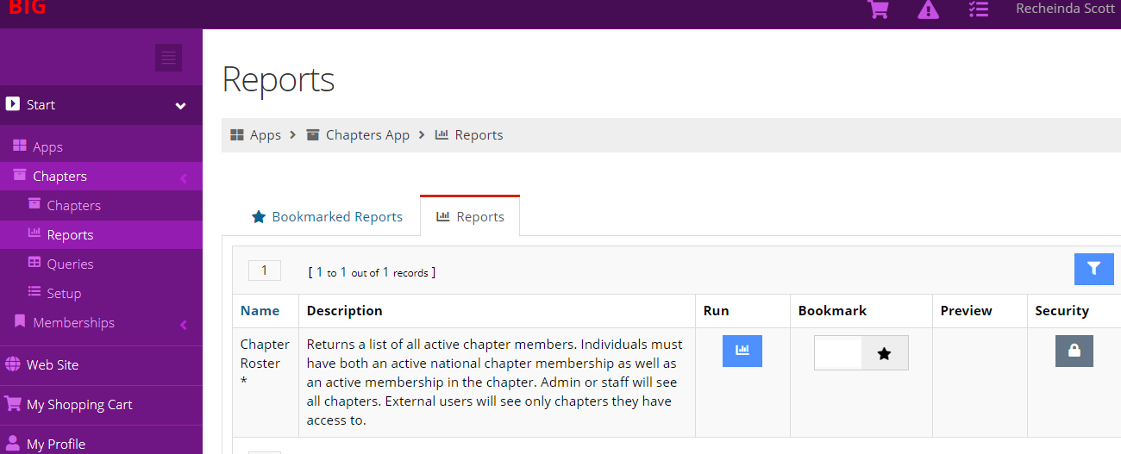
Click Run.
Run Report

Slide 41
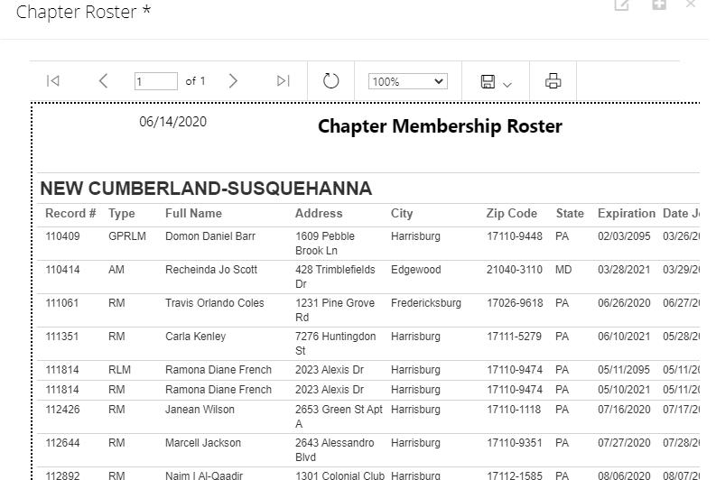
This produces your chapter roster.

Slide 42
Membership issues contact:
National Membership Chair - Jerry Jackson
Email: bigmembershipchair@gmail.com
To Join or Renew via check or money order, please use the BIG Membership Application and make payable
to:
Blacks In Government
Attn: BIG National Membership Chair Jerry Jackson
3005 Georgia Avenue, NW
Washington, D.C. 20001-5015

Slide 43
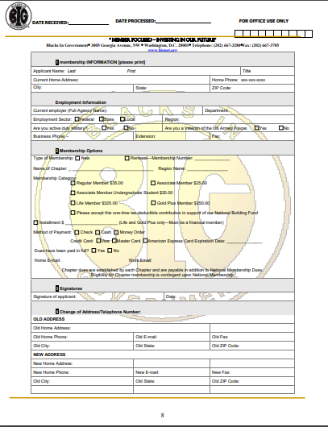

Slide 44
