Slide 1
Our Re-opening Story
SBC
Our Reopening Story

Slide 2

The world is healing.
Less people are getting sick. Things are slowly opening up again.

Slide 3

Soon, we will be re-opening.
Slowly, we will start inviting individuals and staff back to the Day Program.

Slide 4

And we are so excited to see you!
SO exited!

Slide 5

But things are going to be a little different.
You might have questions about how we are going to stay safe.

Slide 6

There will be new guidelines to follow.
These guidelines and rules will help everyone stay healthy while interacting with each other.

Slide 7
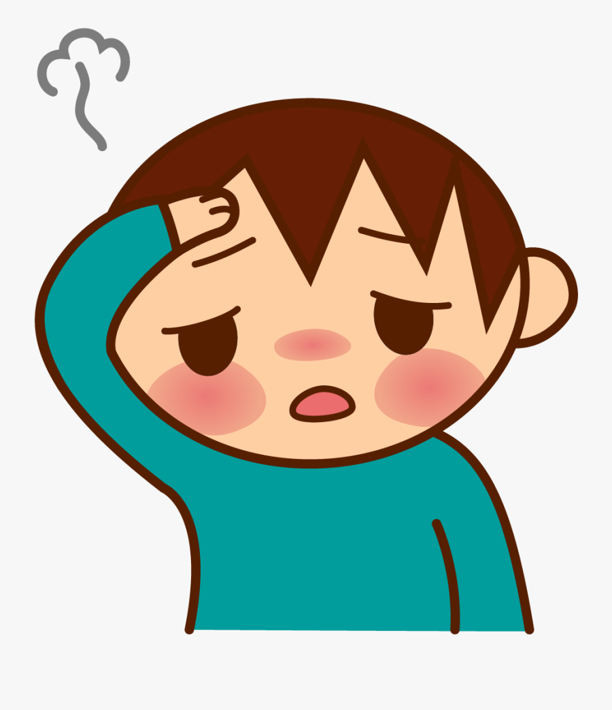
If you are sick, or have a fever…
Stay home. We do not want to get other people sick. It is safer for everyone. If you get sick while at the Day Program you will need to go home.

Slide 8
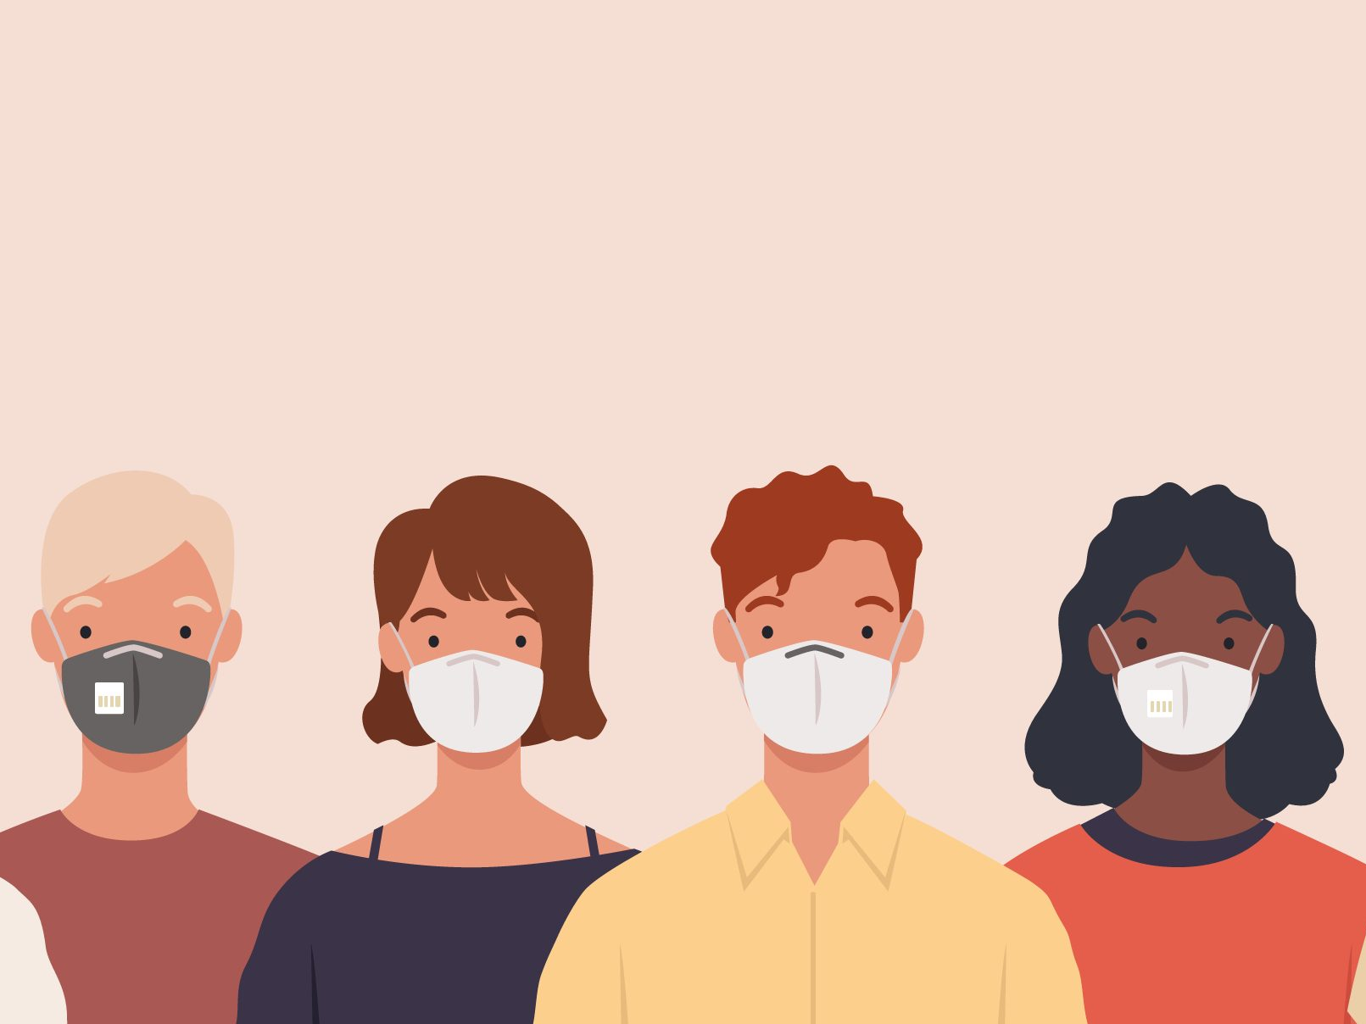
We have to be careful.
We will be wearing masks to protect each other. You will wear one as well if you are able to.

Slide 9
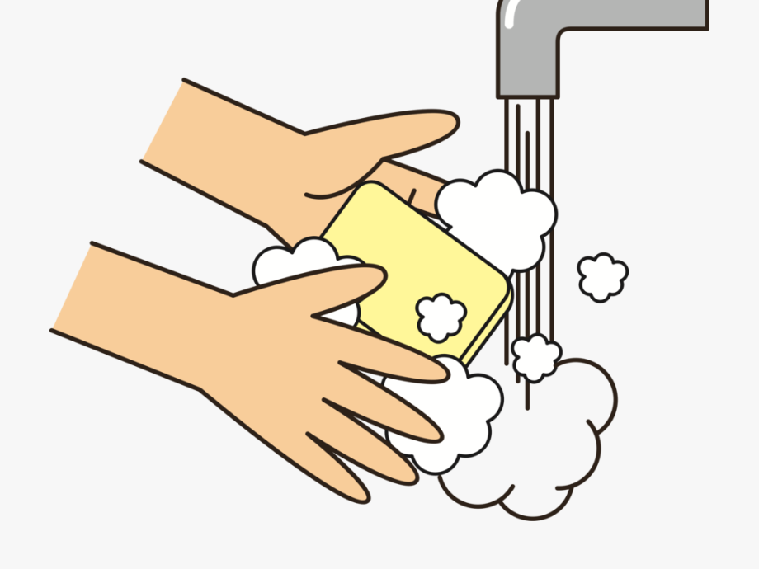
We will be washing our hands, a lot.
Throughout the day we will all be washing our hands many, many times.

Slide 10
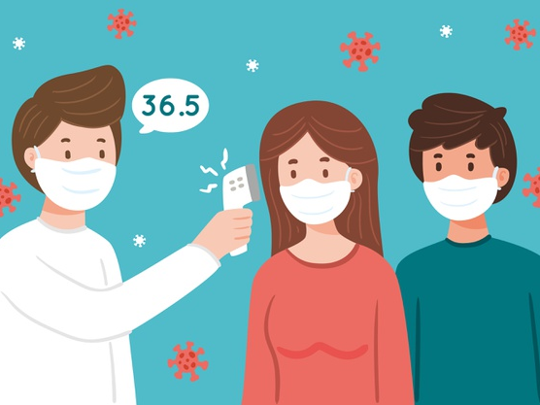
We will check our temperatures.
When we arrive at the Day Program, we will check everyone’s temperatures. This will happen a few times throughout the day.

Slide 11
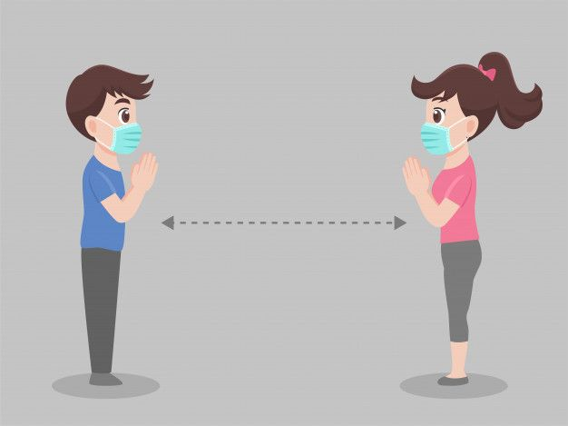
We will practice social distancing.
We will need to keep space between each other. Both staff and individuals will socialize, sit and do activities with a safe distance between them.

Slide 12
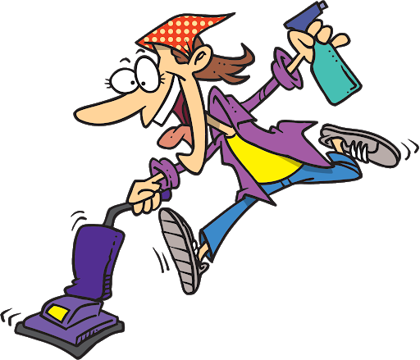
Lots of cleaning.
Staff will be cleaning throughout the day to make sure everything is sanitized and safe for use. (With all the running around, they may end up looking like this cartoon!)

Slide 13
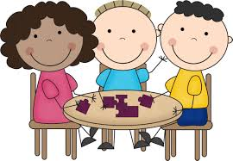
Small groups.
At the Day Program we can only have a small number of staff and individuals in at a time. We may have shorter days to allow more people to come in.

Slide 14
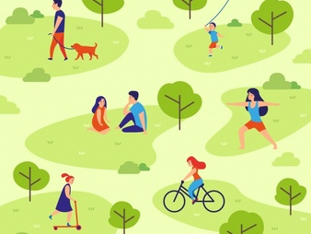
Outside activities.
With the beautiful summer weather, we are going to try to stay outside as much as possible.

Slide 15
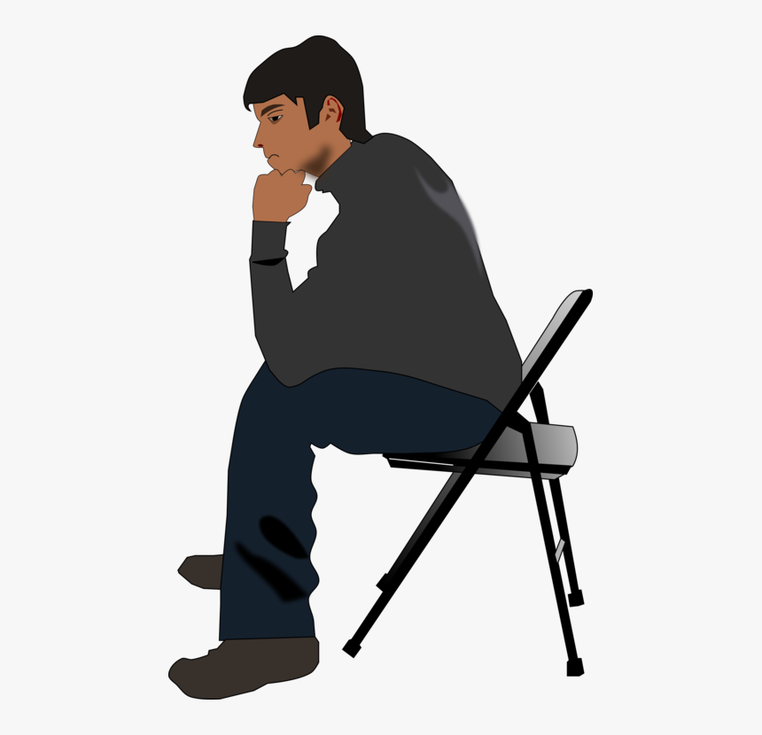
Not everyone will be able to come back.
At least not right away. We need time to make sure everything is safe for everyone.

Slide 16

It is going to be different.
But if we all work together, we can help keep the world happy, healthy and safe.

Slide 17
We can’t wait to see you all!

