Slide 1
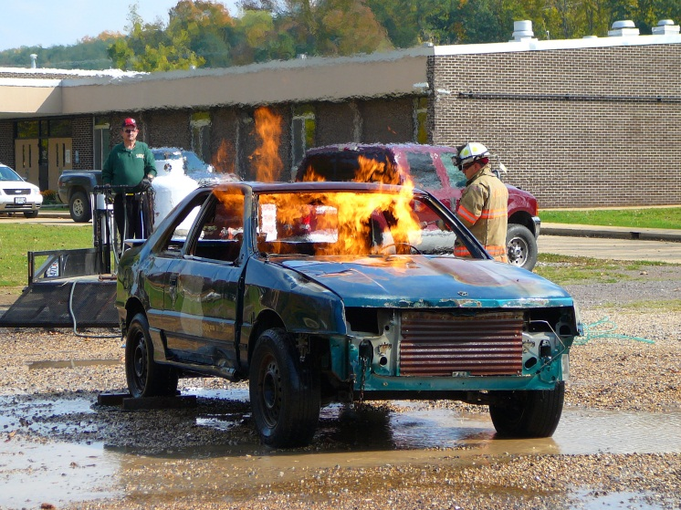
Free Training Opportunity
Vehicle Firefighting
Funded though the Missouri Division of Fire Safety
Fire Education Commission
COURSE DESCRIPTION:
This course pertains to NFPA 1001 Standard on Fire Fighter Professional Qualification.
Vehicle fires/accidents result in one of the most frequent responses by fire departments in Missouri. While firefighters may have a general understanding of the basic response to extinguish a fire in a burning vehicle, the same does not hold true with features in some of today’s high tech automobiles. The proper angle of approach, components used in safety devices, to the materials used to build the vehicles are constantly changing and becoming even more dangerous to unaware responders.
FULL PERSONAL PROTECTIVE
EQUIPMENT IS REQUIRED TO
PARTICIPATE IN EVOLUTIONS AND
RECEIVE A CERTIFICATE.
Full PPE (fire fighting turn out gear)
includes: helmet, hood, coat, bunker
pants, gloves, and boots. It is
recommended that PPE meet current
NFPA standards for firefighting
protective equipment.
Where:
Meta FD
110 E. 3rd St.
Meta, MO
Contact:
Kenny Helton
573-680-0802
heltonkenny@yahoo.com
Date:
Dec. 8th , 2018
Start Time: 8:00 AM
Local Emergency Training Specialists, LLC
P.O. Box 74
Cadet, Mo. 63630
573-438-7760 573-330-0211
letstrain@hotmail.com www.letstrain.org

