Slide 1
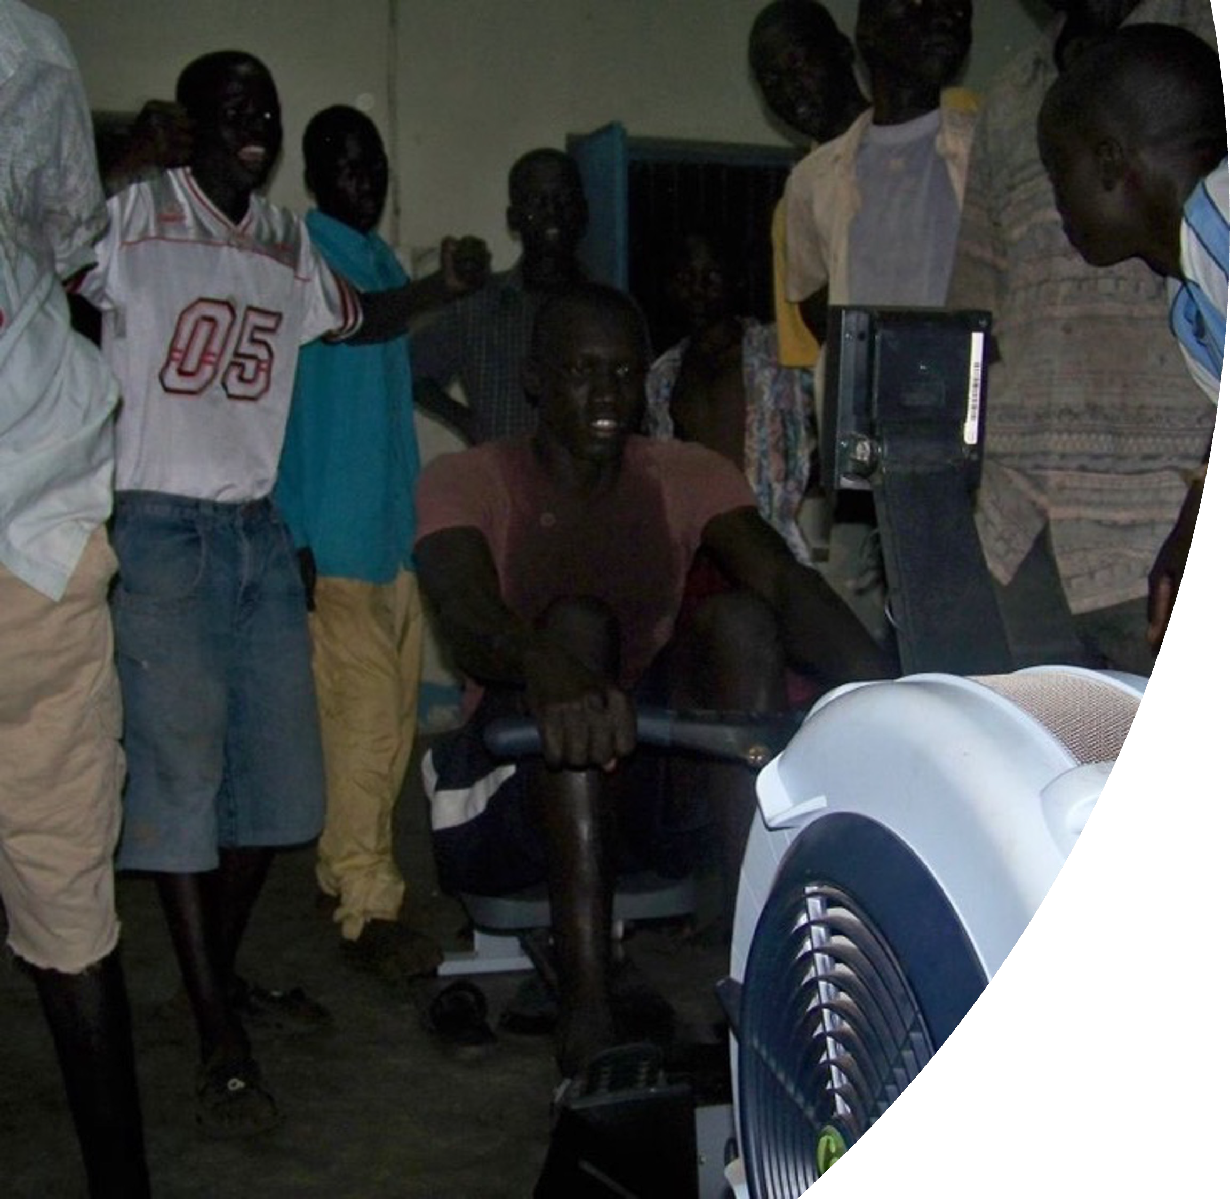




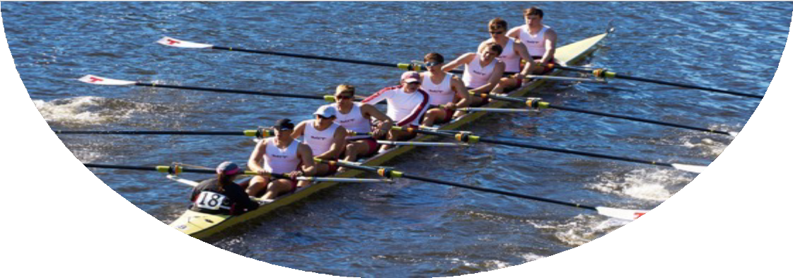
South Sudan Olympic Rowing Scholarships
South Sudan School Erg Competitions
https://KCC-T1D.org
Row4Life
Nurturing Exceptional Leadership from Rowing
https://Row4Life.org
Cover Pix: Orphans rowing at Juba Orphanage circa 2010
11-30-2025
1

Slide 2
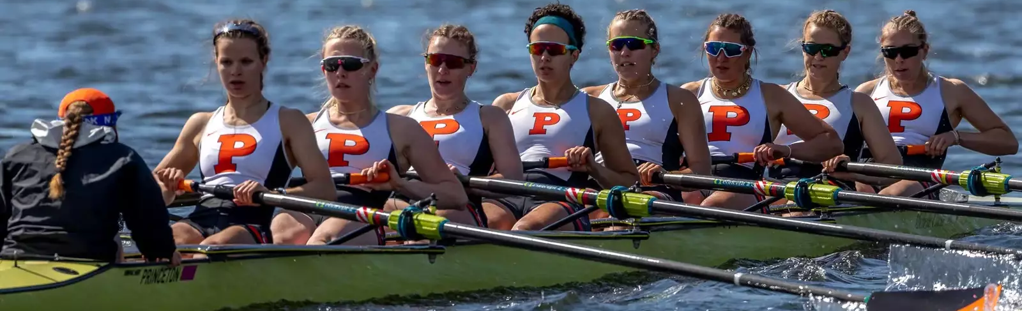
Row4Life’s Goal
Nurture exceptional leadership among South Sudan young men and women by two programs:
  Identify, groom, and nurture young South Sudanese boys and girls to win a scholarship to university for the sport of “rowing”, and from there to compete in the Olympics
  Support inter-school, inter-city, and inter-state competitions; Identify the “best athlete” in South Sudan
Amazing young men and women, all from different ethnicities, and from across South Sudan (all States) is a powerful & unifying message.

Slide 3
So.... Do you want to experience the excitement of competing against the best athletes in the world? They all deal with extreme pain and push for excellence on the erg . . . and then the Olympics!
See the following video... and turn up the volume!

Slide 4
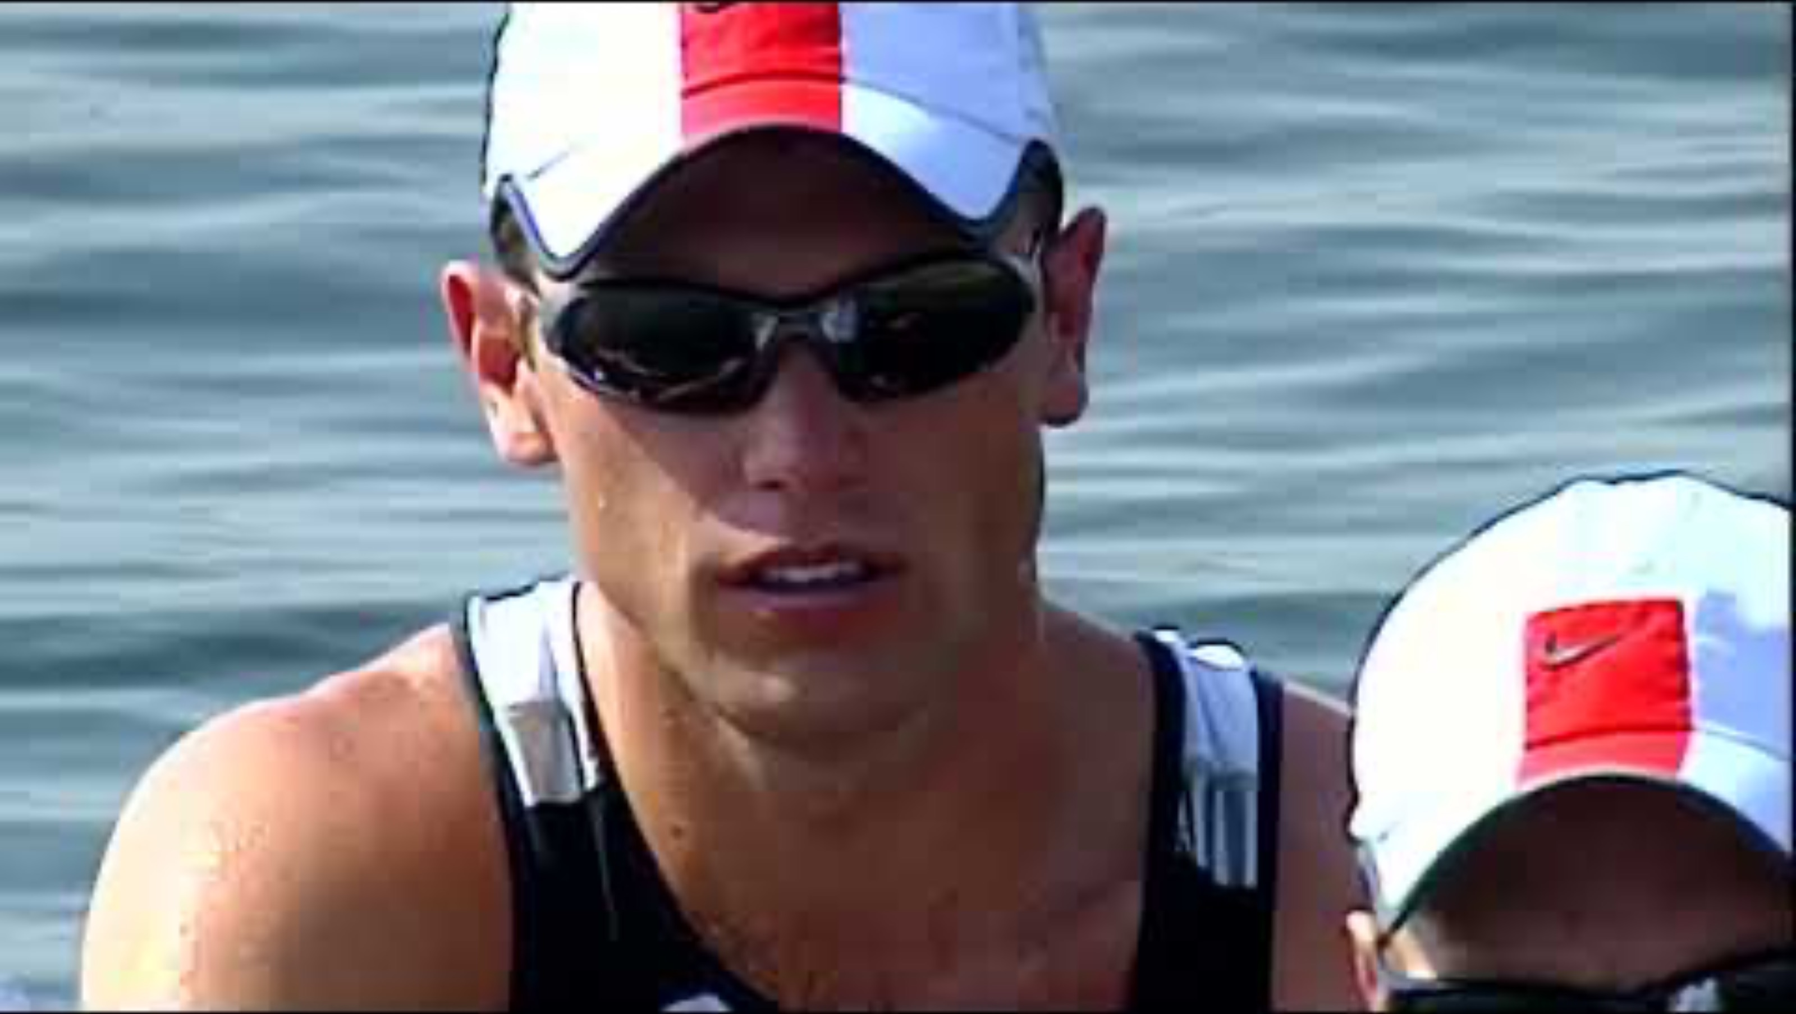
Olympic Rowing Regatta (Athens, 2004)
Click below if movie does not start automatically

Slide 5
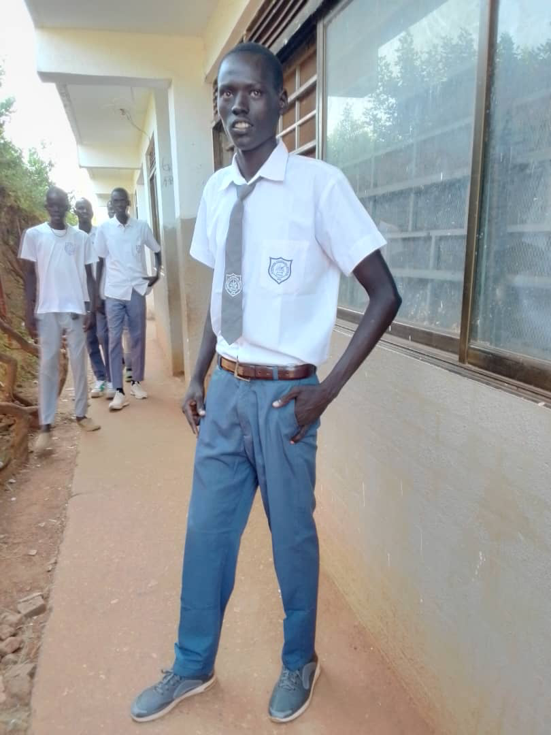
Future Olympic Gold Medalist?
Future leader of South Sudan?
Samuel is a Sophomore in Wau, South Sudan
Samuel is very poor but wants to help his family and his country
Samuel wants to attend University in the U.S. on a rowing scholarship
Samuel is going to be a world class rowing athlete and is going to win Olympic Gold for his country, someday
Samuel and other young men and women are the future leaders of South Sudan
Row4Life is going to help Samuel and others help themselves and in turn, help South Sudan!

Slide 6
Meet Samuel Aru
Sophomore (S2) at Standard Secondary School; Wau, South Sudan
6’8” tall
150 pounds; Yes, he needs to gain muscle and weight through more food
Time using the erg: Since November 1, 2024
Average workout each day (no more than 10 minutes; Wau only has one operational erg and other students share
  Aside: Row4Life is bringing 4 more ergs to Wau in March 2025
Best 2k to date: 7:10 at average SR of 33
Samuel is entered in the World Indoor Rowing Championships in Feb 2025. He will be competing on-line

Slide 7
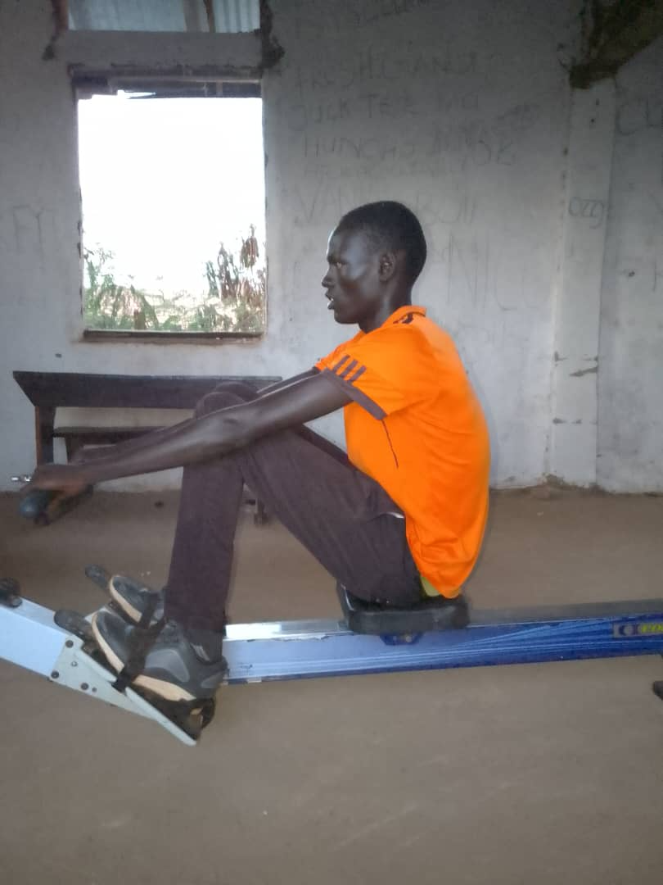
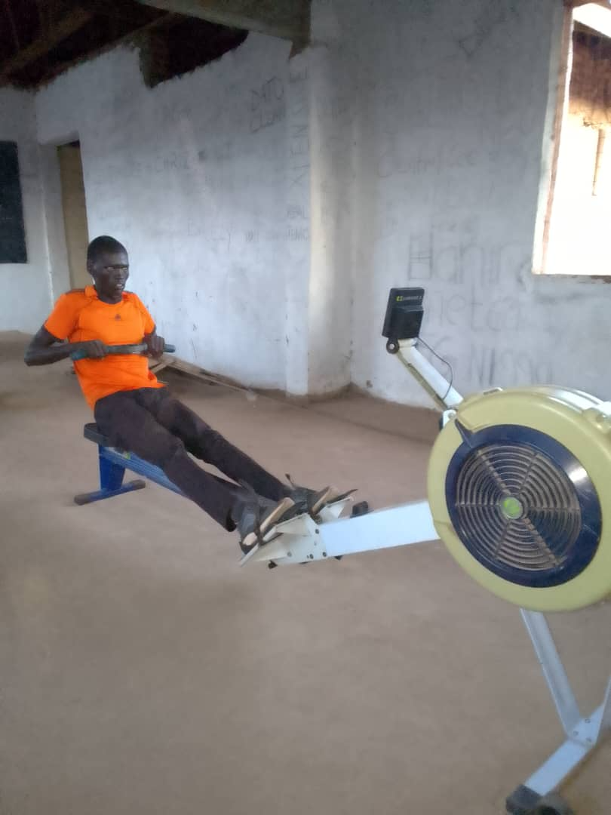
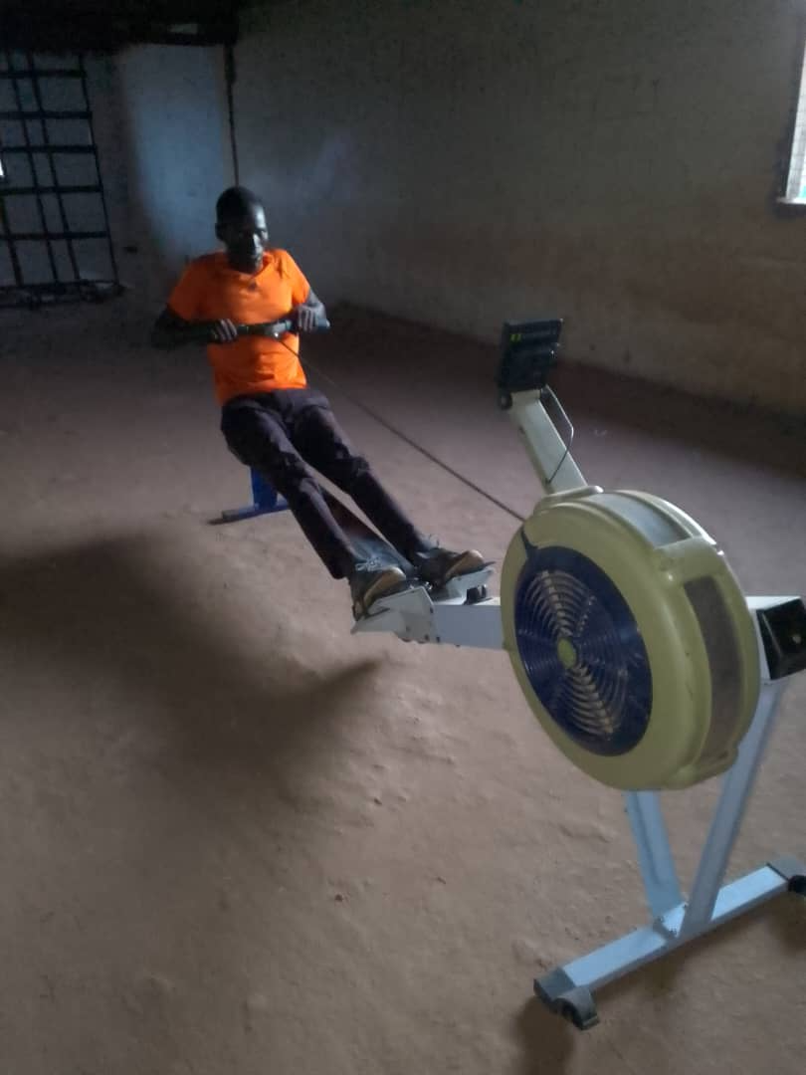
Samuel Aru
Future Olympian and Leader; Wau, South Sudan

Slide 8
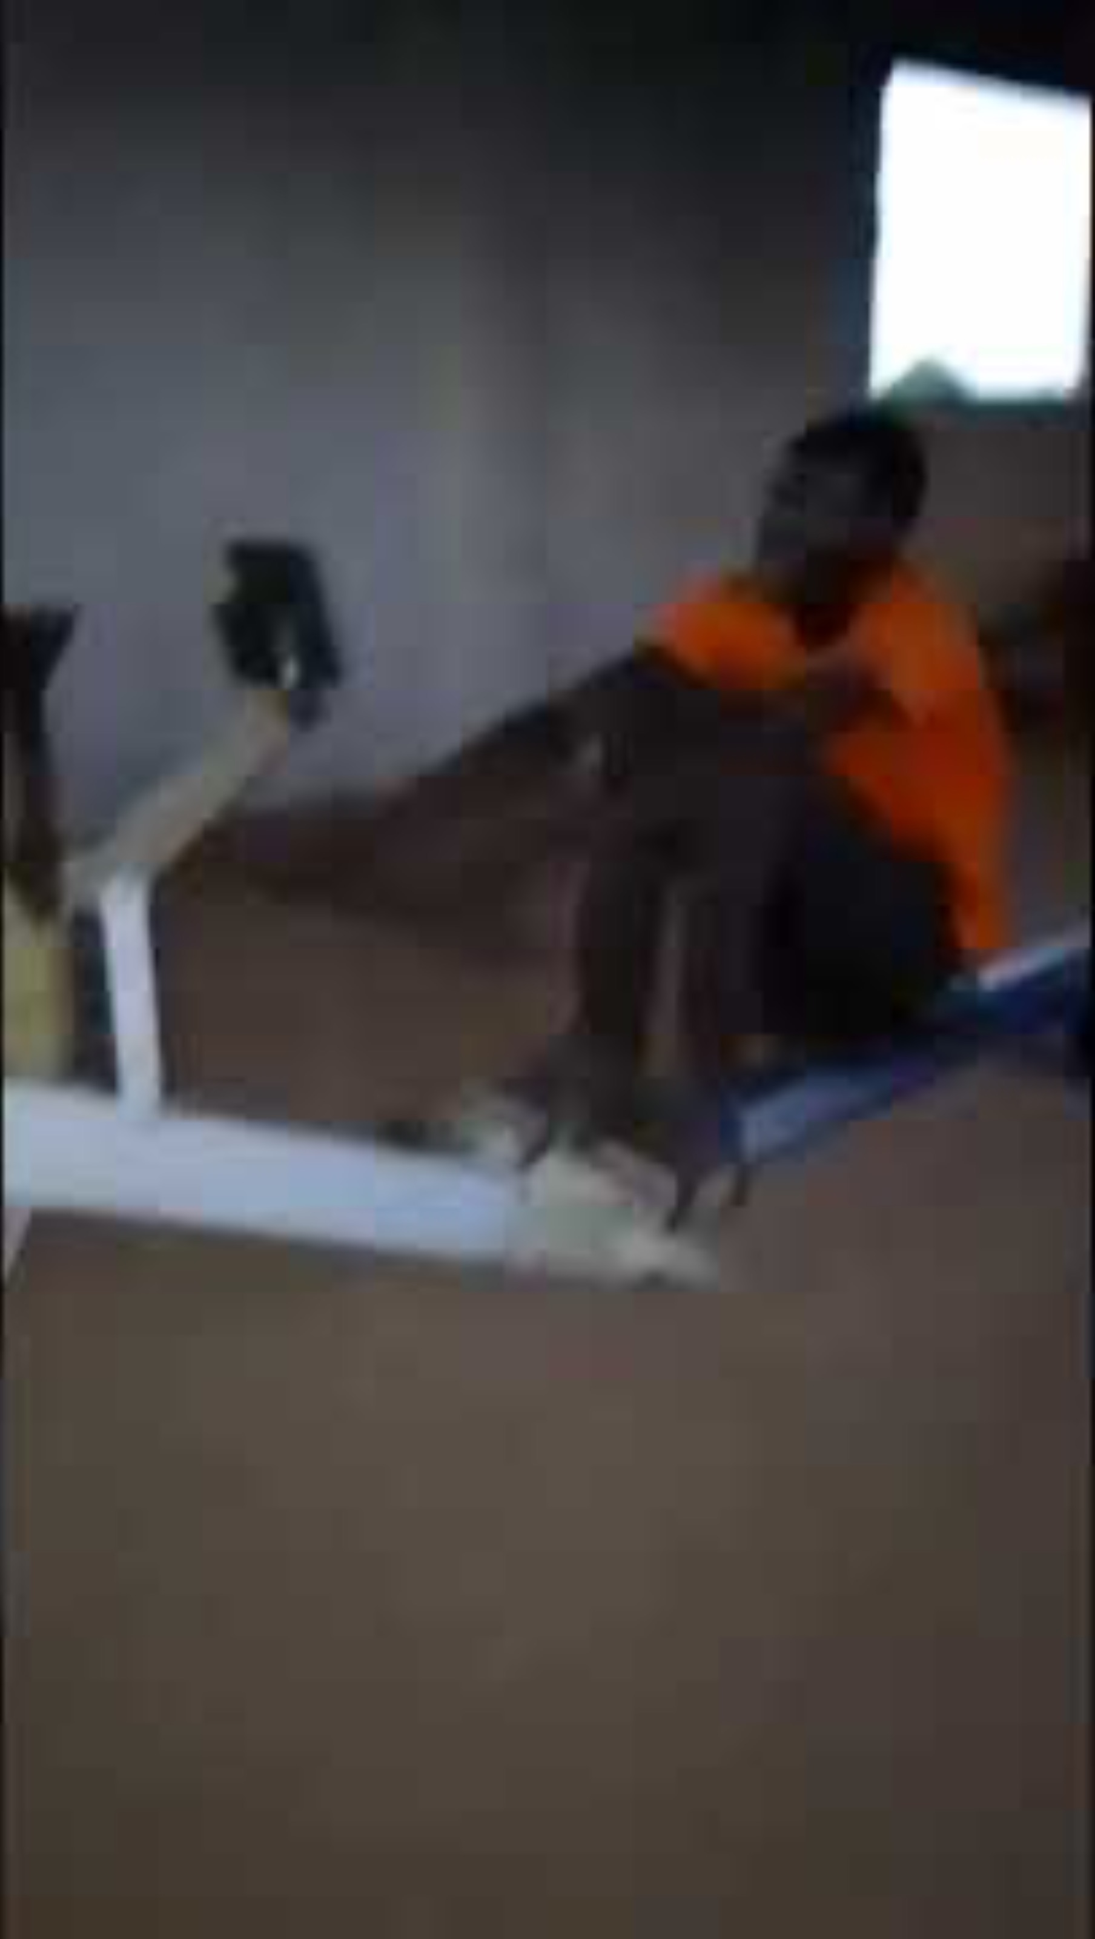
Samuel Aru
Future Olympian & Leader; Wau, South Sudan
Click on image if video does not start automatically

Slide 9
Ethnic-Based Killing in South Sudan Continues;
Civil War and conflict have been ongoing for 70 years
Primary basis for conflict are long-term, passed on from generation to generation having originated from the differences between farming culture and pastoral (cattle-based) cultures
Lethal violence is unfortunately still very common, occurring singularly as well as on a large scale
Row4Life success will require students of different ethnic background to work and competing alongside each other. This will instill national pride and show strength in diversity and mitigate ethnic-based violence.

Slide 10
R4L Program #1:
Attending University and then the Olympics
Exclusive (insert school name) Olympic Training Rowing Club
The ONLY way to learn to row at an international level is to compete within the colleges & universities
Scholarships are given to top athletes and are NOT solely based upon past experience with rowing. Instead, they are primarily based upon:
  Speaking/writing/reading English; This is required and without exception
  Height (South Sudan is home to tallest people in world)
  Attitude (the athlete must be humble but also fiercely competitive)
  Most importantly, a fast 2k time on the erg.
  Girl scholarships are equal to boys; this is U.S. Law, which is an advantage for girls.
T-shirts, posters, other motivational tools
These boys and girls, together, are the basis of a national team.... But they all need to get scholarships, first

Slide 11
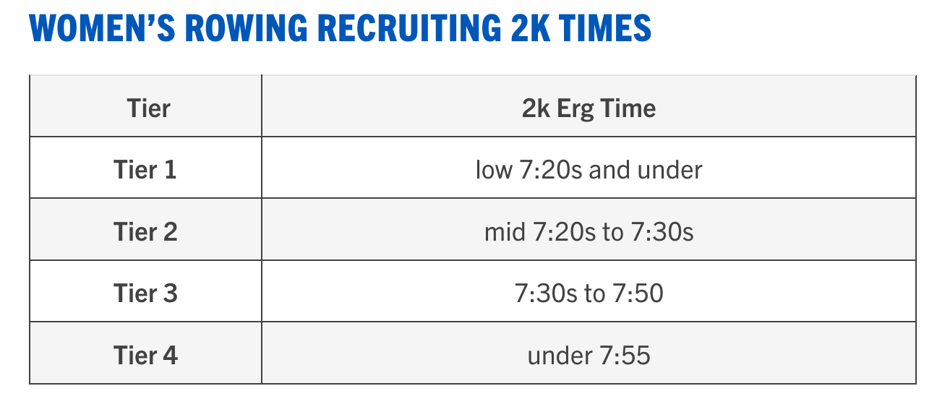
Women’s Erg Times
Tier 1: Top Division 1 teams (Harvard, Yale, Princeton, many others)
Tier 2: Top Division 3 teams (Bates, Oberlin, Bowdoin, many others)
Tier 3: Division 2 teams, middle Division 3 teams and lower Division 1 teams (Washington State, Duke, many others)
Tier 4: Lower Division 3 teams and top club teams (UVA, Rice, Notre Dame, many others)

Slide 12
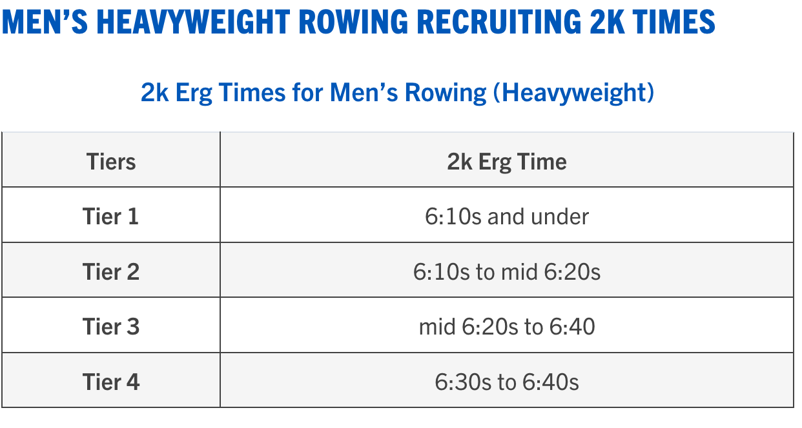
Men’s Erg Times
Tier 1: Top Division 1 teams (Harvard, Yale, Princeton, many others)
Tier 2: Top Division 3 teams (Bates, Oberlin, Bowdoin, many others)
Tier 3: Division 2 teams, middle Division 3 teams and lower Division 1 teams (Washington State, Duke, many others)
Tier 4: Lower Division 3 teams and top club teams (UVA, Rice, Notre Dame, many others)

Slide 13
R4L Program #2:
Inter-School, National, and Int’l Erg Competitions
Exclusive (insert school name) Erg Rowing Club
All students will be encouraged to participate and represent their school, state, or country for erg-competitions.
  College not involved; Olympics not involved
  Because college is not involved, English not required
  Age groups
  Athletes represent their school, city, state, and country. There are international erg competitions, too
  Competitions can be virtual, or on-line in real-time
  The erg determines the school’s, State’s, or country’s best athlete; Period.
Trophies and modest prizes (t-shirts, pencils, soap, etc.) to be considered
Members of this club can be S1, S2, S3, or S4 (freshman to senior); All members MUST be enrolled in school.

Slide 14
How to Find Amazing Athletes?
16 erg Concept2 machines currently in Secondary Schools in: Wau (6), Warrap Town(1), Torit(1), Bor(1), Malakal(1), and Juba(6)
Each school has events and training for their own students as well as a time/day set-aside for students from outside their school to try out
(insert school name) Olympic Training Rowing Club is exclusive with special times set aside each day for training
(insert school name) Erg Rowing Club is exclusive with special times set aside each day for training
It’s entirely possible for some students to be members of both clubs
Two of Six sites in South Sudan are on-line capable; Others soon.
Interschool competition planned for Wau and Juba in Winter 2025

Slide 15
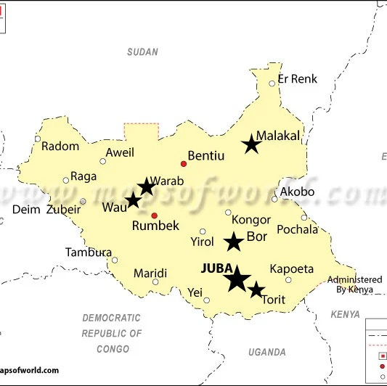
Where Can We Find Amazing Athletes and Future Leaders?
Currently, Row4Life has placed erg Concept2 rowing machines in the following states and cities in South Sudan:
  Central Equatoria; Juba; 6; Row4Life National Erg Rowing Center
  Eastern Equatoria; Torit; 1 erg
  Jonglei; Bor; 1 erg
  Upper Nile; Malakal; 1 erg
  Western Bahr el Ghazal; Wau; 6 ergs
  Warrap; Warrap Town; 1 erg

Slide 16
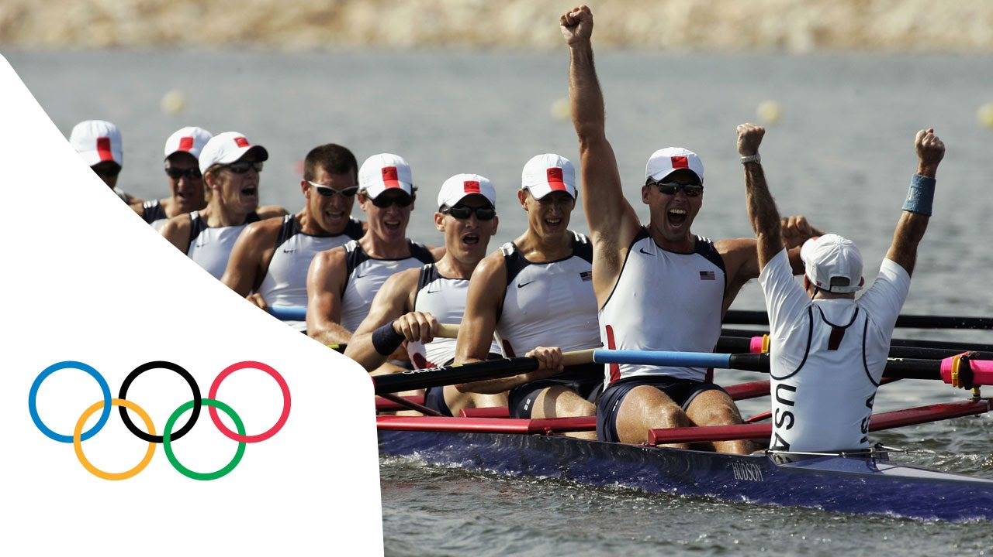
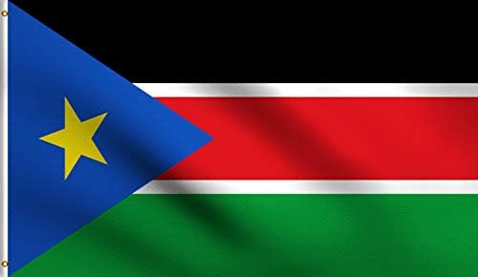
The South Sudan National Olympic erg Rowing Team
There are future Olympians and World Erg champions in South Sudan; Samuel will hopefully be our first!
Row4Life will provide training, introduce athletes to to universities for rowing scholarships, and coordinate inter-school erg competitions
This idea is not just “possible”; It’s inevitable. South Sudan athletes will eventually win at the Olympics as well as at the World Erg championships.

Slide 17
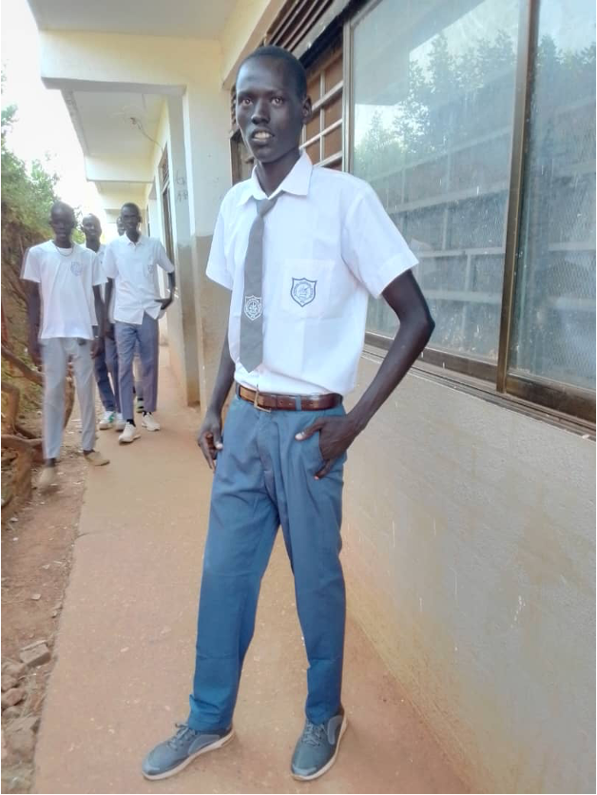
Samuel Aru
6’8” Sophomore on Row4Life.org Team
Future leader and Olympic Champion?
https://KCC-T1D.org
Row4Life
Nurturing Exceptional Leadership from Rowing
https://row4life.org
2-1-2025
1

