Slide 1


CASE STUDIES

Slide 2

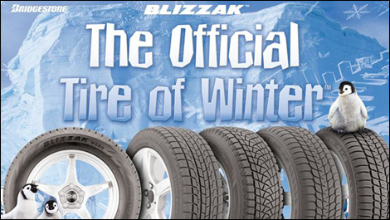
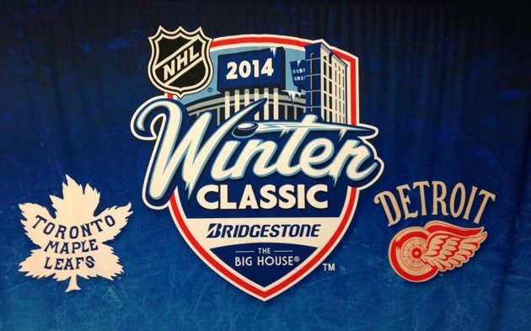
BRIDGESTONE
2014 Winter Classic
Weather Insurance
OBJECTIVES
Leverage NHL Winter Classic to increase sales of Bridgestone Blizzak Winter Tires
HOW IT WORKED
All customers who purchased Bridgestone Blizzak Winter Tires had the opportunity to guess the temperature at puck drop.
Customers who participated in the promotion were rebated 100% of the cost of the tires if their guess was correct.
Any brands / case studies mentioned here do not imply a material relationship with ICSB / IC Group.

Slide 3
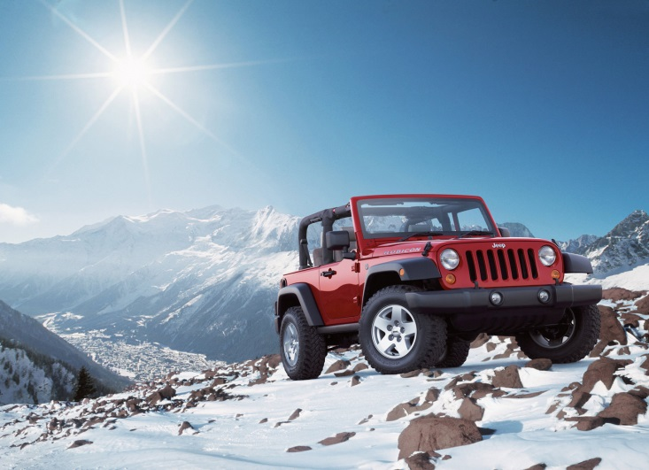

CHRYSLER
JEEP PROMOTION
Weather Promotion
OBJECTIVES
Jeep needed to blow out inventory for a New Year of vehicle models, they turned to a unique Weather Promotion to help spur sales
HOW IT WORKED
Any consumer who purchased a JEEP between December 8th and January 24th were eligible to receive a FULL REFUND on the purchase price of their vehicle if it snowed more than 12cm on January 31st
Any brands / case studies mentioned here do not imply a material relationship with ICSB / IC Group.

Slide 4

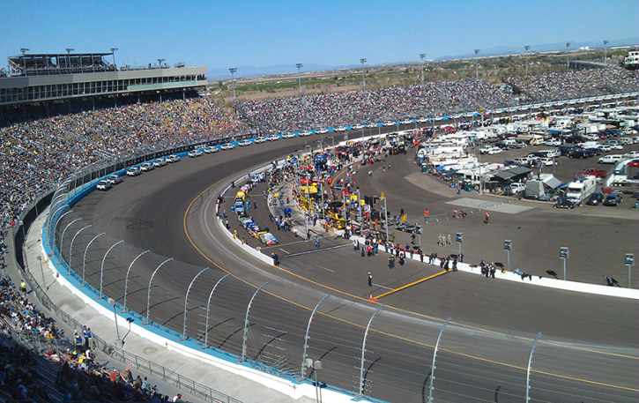
DeWALT
$1 Million Challenge
OBJECTIVES
Skill Based Event
Create excitement surrounding a DeWALT PR event
Increase DeWALT product awareness and brand affinity
HOW IT WORKED
Power tool enthusiasts from 460 events in 50 cities were invited to clock-in as the fastest to drive 5 screws into a pine board using a DeWALT cordless drill
Winners from each event played for a new van filled with DeWALT tools and a trip to the Phoenix International Raceway for the final championship
16 finalists competed for the title and a chance to beat the clock for the $1 Million grand prize.
Any brands / case studies mentioned here do not imply a material relationship with ICSB / IC Group.
Notes:
Background
DEWALT felt strongly if the company could get its new drill into the hands of its target audience, sales would increase. That was the idea behind the DEWALT Million Dollar Challenge. So DEWALT set up challenges at Home Depot stores all over the country to see who could drive a set of screws into a block of wood fastest using the new XRP cordless drill. Local winners went on to compete in regional challenges. Sixteen regional winners competed in Phoenix for $1 million. If you completed the challenge within the time limit, you earned that big payday. One guy beat the clock and cashed in.
Campaign Scope
The goal was to generate excitement and press coverage for DEWALT and help Home Depot, DEWALT’s biggest customer, boost sales and traffic. We leveraged the excitement of the contests into media coverage. National radio advertising publicized local challenge events at Home Depot. Eye-catching, in-store materials generated buzz. Ad tactics were coordinated with public relations to promote the events.
Return On Objective
It was a huge success on all fronts. Sales for the XRP drill rose. Home Depot reported a rise in store traffic with DEWALT tools selling briskly. The event garnered national media exposure from CNN, CNN International, the Today Show, USA Today and ESPN.

Slide 5


Promote Gillette sponsorship and brand awareness to drive product sales among NASCAR fans
Gillette
Young Guns
“Million Dollar
Race to Finish”
OBJECTIVES
Leveraged Sweepstakes
Participants entered PIN from product at the promotion website.
Each PIN was linked to one of the Young Guns.
For each major race a unique PIN was randomly selected.
If the PIN had been entered, the consumer who entered the PIN instantly won $100,000.
If the Young Gun who was tied to the PIN won that specific race the consumer won $1,000,000.
HOW IT WORKED
#97 Kurt Busch
#8 Dale Earnhardt, Jr.
#29 Kevin Harvick
#48 Jimmie Johnson
#17 Matt Kenseth
#12 Ryan Newman
Any brands / case studies mentioned here do not imply a material relationship with ICSB / IC Group.

Slide 6
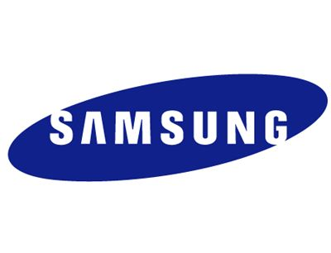
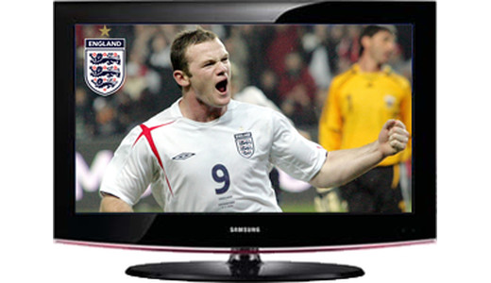

SAMSUNG
FIFA World Cup 2010
Conditional Rebate
OBJECTIVES
Leverage the FIFA World Cup to increase Samsung’s sales of Flat Screen TVs and new “Smart TV’s”
HOW IT WORKED
All customers that purchased a Flat Screen TV (Plasma or LCD) of 32” or larger would be refunded 100% of the purchase price in the event their country of origin won the 2010 FIFA World Cup
Customers who participated in the promotion were refunded with gift tokens or vouchers in the amount of the Flat Screen TV purchase price
Any brands / case studies mentioned here do not imply a material relationship with ICSB / IC Group.

Slide 7
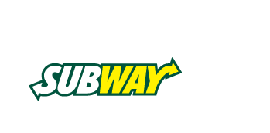
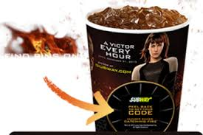

SUBWAY
Hunger Games Catching Fire Promotion
Instant Win & Leveraged Sweepstakes
OBJECTIVES
Engage Subway and Hunger Games fans with great prizes
Increase sales of Subway products
HOW IT WORKED
Consumers would receive peel to reveal game pieces on 32-44oz drink cups that would unveil an instant win prize and a sweepstakes entry
PIN codes entered online to redeem instant win prizes as well as a sweepstakes ballot for a $1 Million Grand Prize.
Any brands / case studies mentioned here do not imply a material relationship with ICSB / IC Group.
Notes:
New Registrations – 217,396
Returning User Logins – 136,021
Unique User Logins – 63,509
Sweeps Entries – 666,358
PIN Entries – 438,285
Facebook Shares – 409
Twitter Shares – 117
Footer Link to Subway.ca – 3,004
Opt-Ins – 56,938

Slide 8
THANK YOU
Dylan MacTavish
Account Executive
905-608-1999 x34
Dylan.Mactavish@icgroupLP.com

