Slide 1
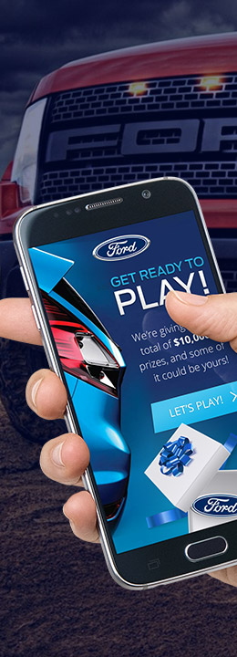
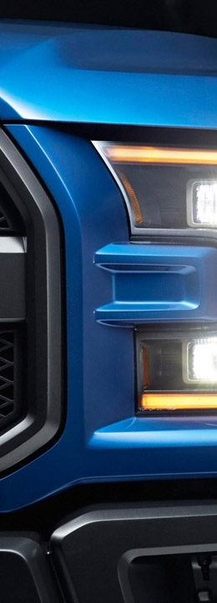
PRIZE
MACHINE
CONNECT | DISTRIBUTE | DRIVE
Reward Instantly
1

Slide 2
Today’s Agenda
Overview of IC Group
Our approach to Loyalty & Incentives
Case Studies
Our goal
Is to show you best-in-class programs and concepts that will help you achieve your business and marketing objectives
2

Slide 3
IC Group
Quick Overview

Slide 4
Preferred Partner
IC Group is the global partner of choice for brands looking to stimulate sales, increase engagement and drive loyalty with their members.
4
Copyright and Proprietary © 2017 IC Group LP. Not for distribution.

Slide 5
Global Services
We are experts across various disciplines that allow brands to insert IC Group
into their Agency mix to execute programs with ease.
Program Design & Strategy
Data Measurement & Analytics
Prize Redemption Insurance
Creative Design, UX & Copywriting
Digital Technology & Hosting
Prize/Reward Procurement & Fulfillment Management
Legal & Risk Management
5
Copyright and Proprietary © 2017 IC Group LP. Not for distribution.

Slide 6
Multi-Year Loyalty Award Winner
An industry-leading partner in various category verticals
6
Copyright and Proprietary © 2017 IC Group LP. Not for distribution.

Slide 7
The Value We Bring
Helping brands achieve measured success
with their customers
BUILD RECRUITMENT
INCREASE SALES
DRIVE LOYALTY
BUILD AWARENESS
30-50% average opt-in rate to future communication
By rewarding consumers for their purchase – 6X sales increase potential
Building a two-way relationship and helping to strengthen retention
Over 1 billion members worldwide driven to our programs
Through social integration and core marketing efforts
7
Copyright and Proprietary © 2017 IC Group LP. Not for distribution.

Slide 8
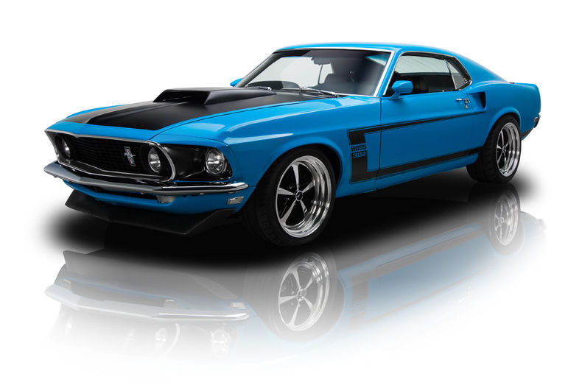
dealers need.
Incenting potential customers to visit a Ford Dealership is the first step in a POWERFUL and LOYAL partnership
Low cost incentives to drive visits
An Affordable tool to deliver incentives
Local Dealership promotions and offers
Administrative control or full support
8
Copyright and Proprietary © 2018 IC Group LP. Not for distribution.

Slide 9
introducing.
9
Copyright and Proprietary © 2018 IC Group LP. Not for distribution.

Slide 10
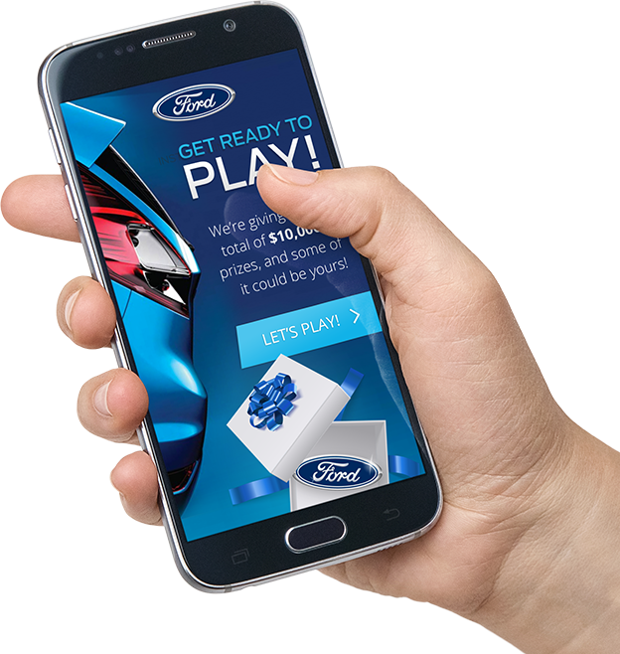
what is Prize Machine?
A two part incentive platform, that puts the power in the hands of dealers
INSTANT WIN GAME
Always-on Instant Win Game engine and Sweepstakes solution loaded with a minimum $10,000+ in guaranteed prizes.
PLATINUM OFFERS
Powerful local offers system for dealerships to provide localized offers to reward customers with greater value
10
Copyright and Proprietary © 2018 IC Group LP. Not for distribution.

Slide 11
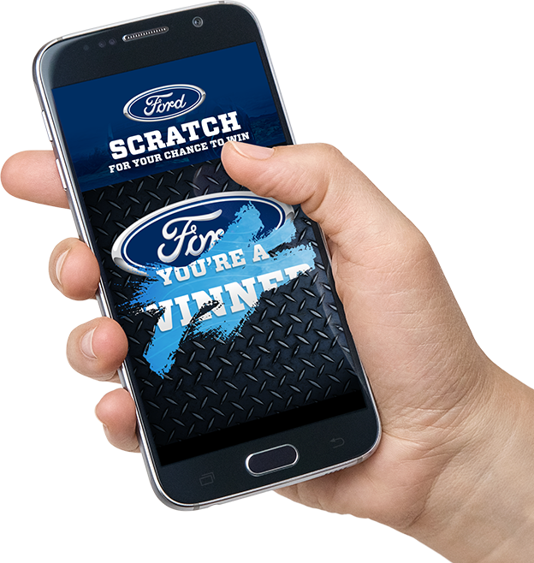
instant win game.
Rewarding your potential customers every second
Loaded with $10,000 in guaranteed Instant Win prizes every month
Two $500 guaranteed Sweepstakes Gas Cash prizes every month
High-valued digital gift cards fulfilled instantly via email
Custom Branding for each Dealership
Fun game to reveal prizes your customers have instantly won!
11
Copyright and Proprietary © 2018 IC Group LP. Not for distribution.
Notes:
Accessed by API for Live connection or Unique PIN code and Token Links for inclusion in all of your marketing materials.

Slide 12
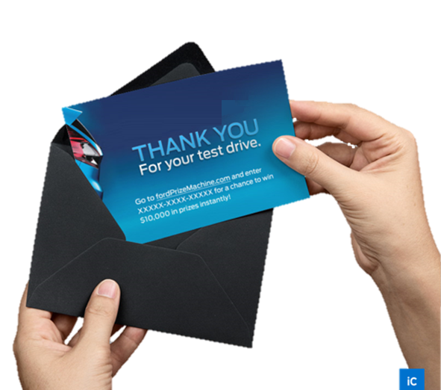
a flexible marketing tool.
Pick the behaviors you want to reward:
Test drives
Signing up for emails
Opening emails
Completing surveys
Social posts or likes
Attending your event
Sharing with friends
Requesting price
Trade in
Direct mail responses
Use the API for live rewarding or Tokens to issue to customers.
12
Copyright and Proprietary © 2018 IC Group LP. Not for distribution.
Notes:
AA: WHY USE PRIZE MACHINE?

Slide 13
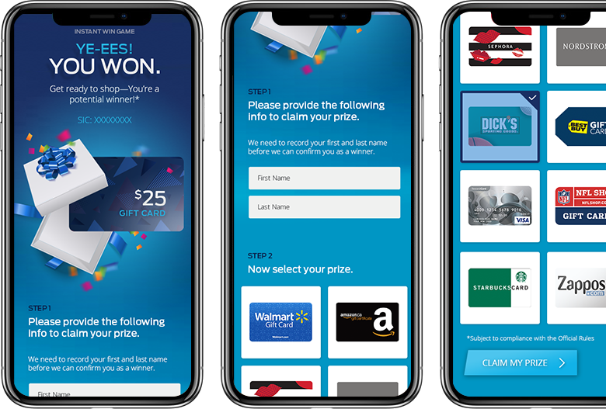
win screen flow.
Players are shown they have won instantly and claiming their prize has never been easier
Winner Enter first/last name
Select which gift card they want
An email is sent with claim code
Its that simple…….
13
Copyright and Proprietary © 2018 IC Group LP. Not for distribution.

Slide 14
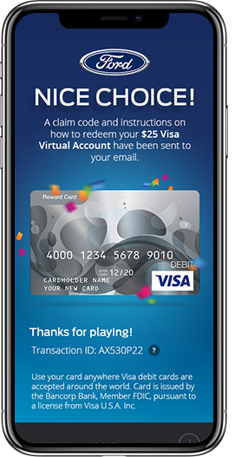
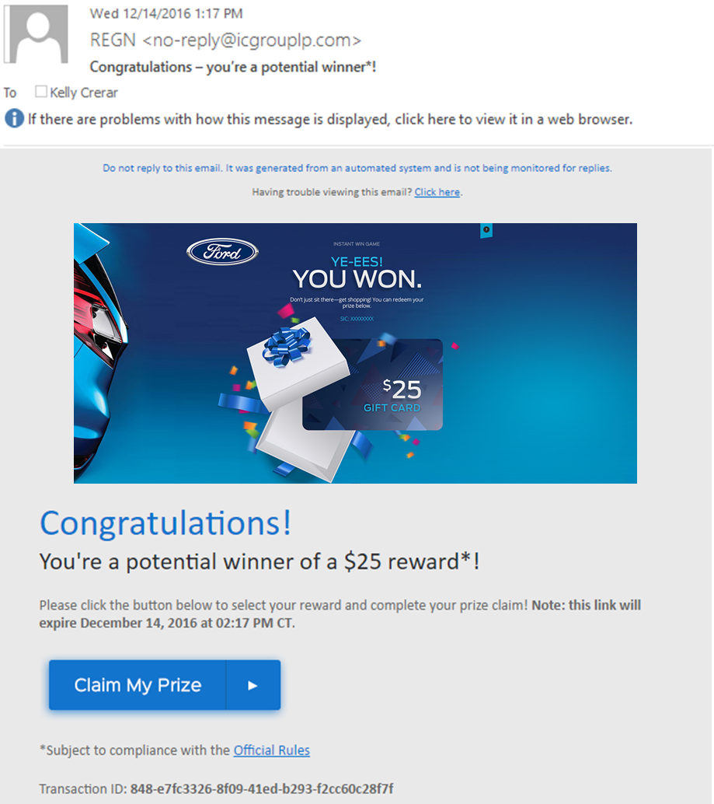
prize delivered.
Prizes in the hands of winners instantly!
Game screen shows choice
Email sent with claim instruction
One more click and your spending your reward
Unclaimed rewards are emailed over a 14 day period with a reminder to claim prize
14
Copyright and Proprietary © 2018 IC Group LP. Not for distribution.

Slide 15
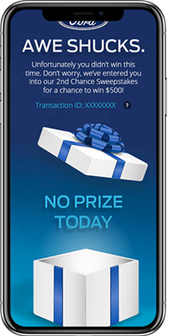
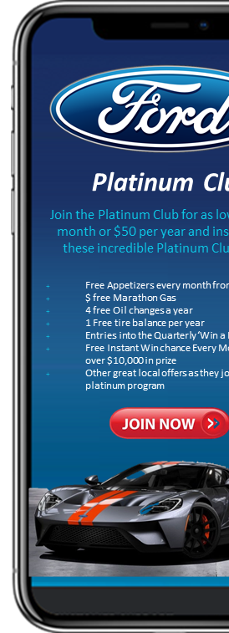
driving to platinum.
Non-winners are immediately taken to a platinum club opportunity
They are still entered into $500 Gas Cash Sweepstakes
Player is taken to Platinum club explore screen where they can see the incredible value for $5 month
Easy Join/sign-up and pay flow.
15
Copyright and Proprietary © 2018 IC Group LP. Not for distribution.

Slide 16
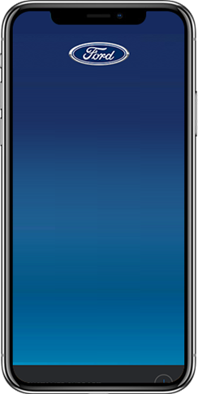
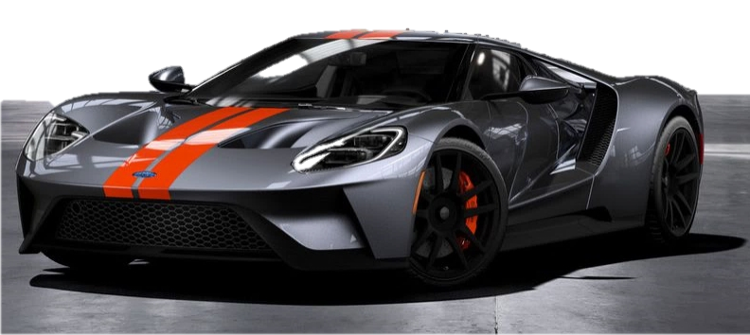
platinum club offers platform.
Platinum Club
Membership based program
Dealers can launch their own sweepstakes in minutes for ONLY their dealership customers whenever they need
Dealers can add their own offers for products, services or partnership deals to move lagged inventory or fill slow service dates.
The Prize Machine team will add national and local offers that all dealerships can use to engage their Platinum members
Join the Platinum Club for as low as $5 per month or $50 per year and instantly get these incredible Platinum Club offers:
Free Appetizers every month from Applebee’s
$ free Marathon Gas
4 free Oil changes a year
1 Free tire balance per year
Entries into the Quarterly ‘Win a Ford” Draw
Free Instant Win chance Every Month in the over $10,000 in prize
Other great local offers as they join the platinum program
16
Copyright and Proprietary © 2018 IC Group LP. Not for distribution.

Slide 17
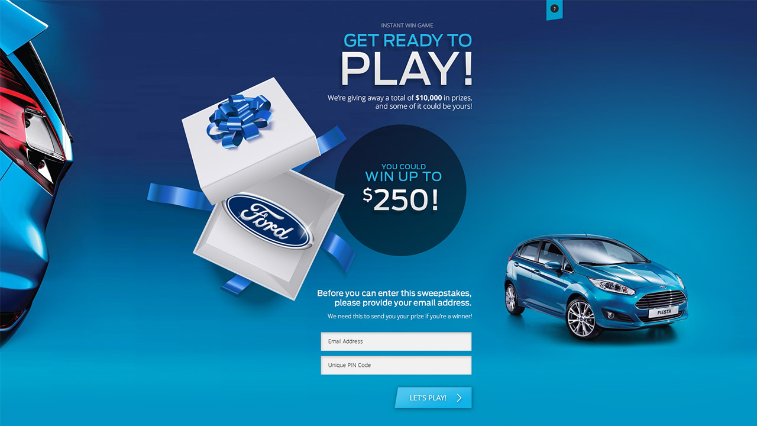
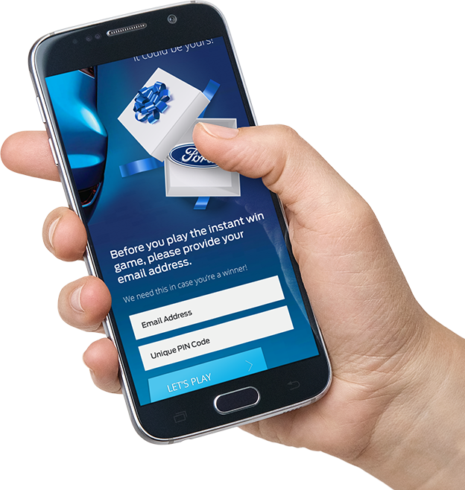
17
Copyright and Proprietary © 2018 IC Group LP. Not for distribution.

Slide 18
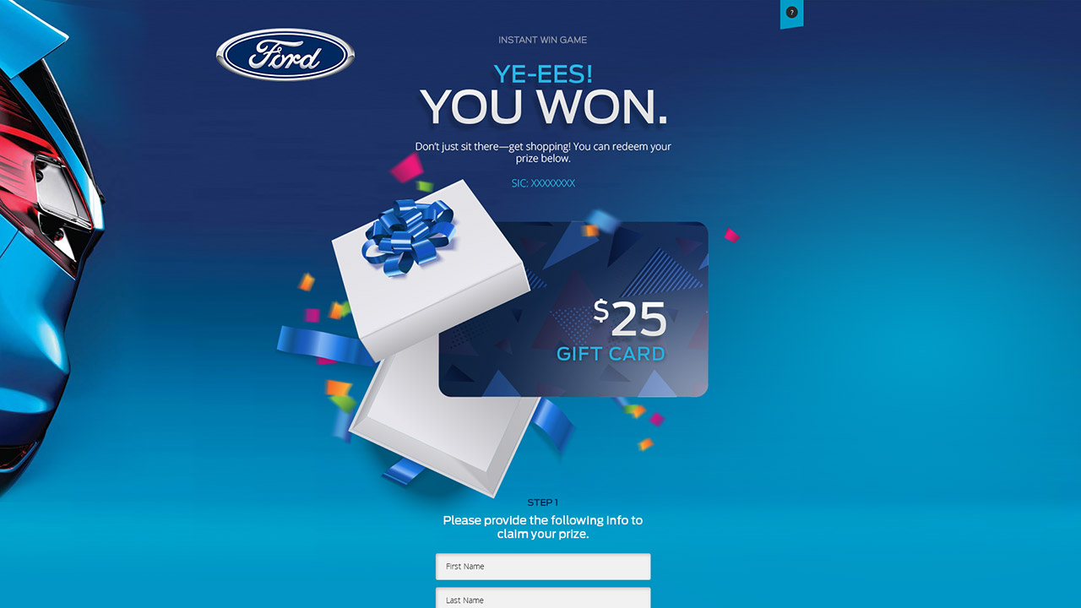
18
Copyright and Proprietary © 2018 IC Group LP. Not for distribution.

Slide 19
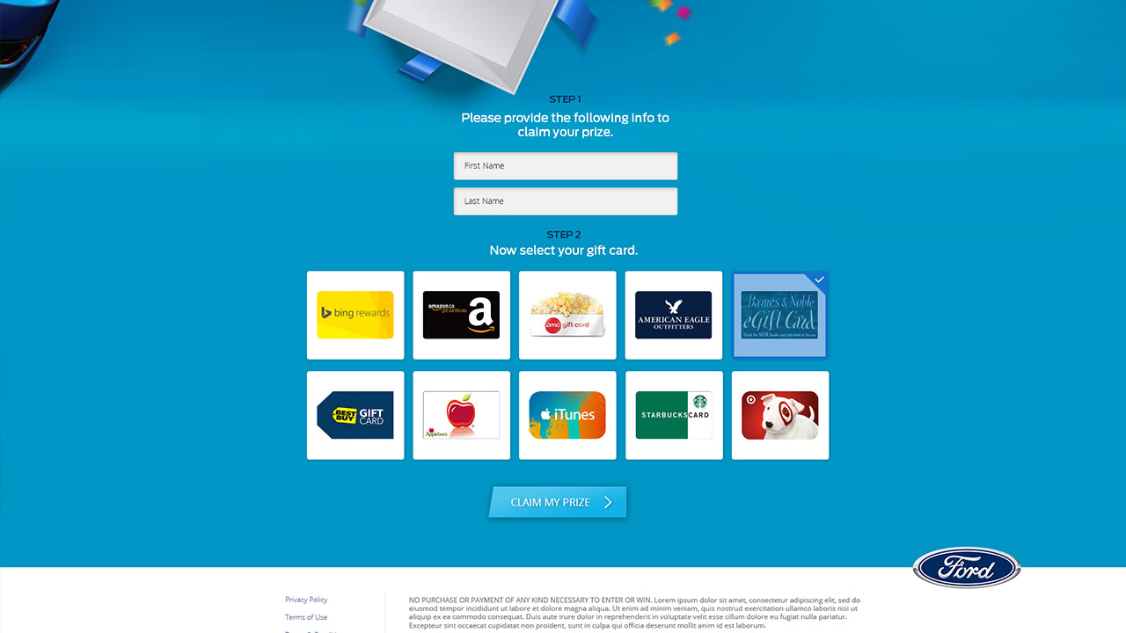
19
Copyright and Proprietary © 2018 IC Group LP. Not for distribution.

Slide 20
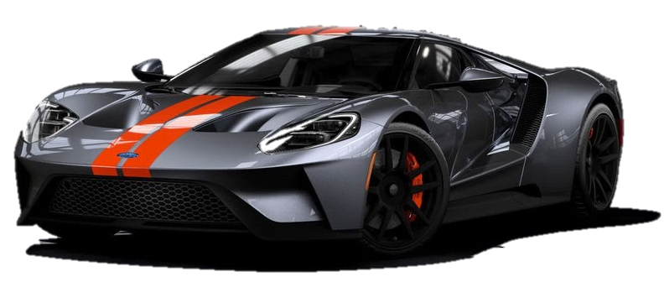
Platinum Club
Join the Platinum Club for as low as $5 per month or $50 per year and instantly get these incredible Platinum Club offers:
Free appetizers every month from Applebee’s
$ free Marathon Gas
4 free oil changes a year
1 free tire balance per year
Entries into the quarterly ‘Win a Mustang ” draw
Sweepstakes offers from dealership
Dealership partner offers
Other great local offers as they join the platinum program
20
Copyright and Proprietary © 2018 IC Group LP. Not for distribution.

Slide 21
Thank you
Kelly Crerar – Partner IC Group
Email: Kelly@icgrouplp.com
Number: 204-487-5014
Skype: kellycrerar1
Website: www.icgrouplp.com
Steve Schroeder - CEO, Smart Community Technologies
Email: steve@smartcommunitytech.com
Number: 562-201-2580
Skype: steve.schroeder72
Website: www.smartcommunitytech.com
Copyright and Proprietary © 2017 IC Group LP. Not for distribution.
21

